Slide 1
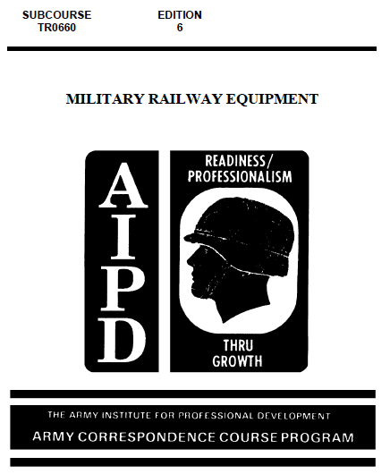

Slide 3
Many old-time railroaders sigh with nostalgia when a steam
locomotive is mentioned. But the hissing of steam has long since
given way to the efficient whir of the diesel electric. The first
American diesel locomotive was introduced in 1925 when a 300-
horsepower one was used, rather inconspicuously, as a switch engine
in a freight yard.
On class I railroads, steam locomotion still dominated 20 years
later--39,000 steamers compared to just 3,800 diesels. Within
another 7 years, the diesels outnumbered the steam locomotives 30,500
to 16,000. By 1960, steam locomotives were no longer being used on
the main line--their number had dropped to 261 while the diesel fleet
had grown to 28,278.

Slide 4
Who knows what the future will bring? A sigh of nostalgia for
the diesel-electric locomotive? Perhaps. The diesel-electric as
well as its only surviving competitor, the all-electric, may be made
obsolete by the turbine engine or the linear induction engine--or
maybe some power system yet to be created.
Over the years, commercial rolling stock has changed; it's
bigger, better, and, in some instances, highly specialized. But the
basic house cars, gondolas, and flats are still in use and will long
continue. The bigger cars have increased the fleet's capacity while
the total number of cars has decreased. The many different kinds of
specialized cars are designed to meet the particular needs of certain
shippers, military and civilian

Slide 5
The Army also owns, operates, and maintains diesel-electric
locomotives and various types of rolling stock. Suppose you received
an assignment to plan a rail operation for providing logistical
support to combat troops in a theater of operations. You would need
to know what rail equipment you had to move troops and supplies
to the frontlines, and who would maintain it. This text, consisting
of three chapters, introduces you to some of the rail equipment the
1
Army has to provide rail support for a tactical mission, the type
best suited for specific jobs, and the men who maintain it. Chapter
1 describes the Army's diesel-electric locomotives and how they are
classified. Chapter 2, divided into two sections, discusses railway
rolling stock with emphasis in section I on the fleet specially
designed and built for use in any theater of operations. Section II
discusses some other types of rolling stock including piggyback and
container equipment. Finally, chapter 3 outlines briefly the Army
maintenance system and explains who is responsible for maintaining
military railway equipment.

Slide 7
1.1. GENERAL
Fast, powerful, reliable, and economical, the modern, highly
developed diesel-electric locomotive has undoubtedly found a
permanent niche for itself as a prime mover. It requires a minimum
of maintenance, low-cost fuel oil, a small supply of water, and a
short warmup period. The diesel engine of the locomotive can produce
more heat units of work more efficiently than any other engine and is
used as a source of motive power for locomotives throughout the
world. The efficiency of diesel engines from 100 to 2400 indicated
horsepower, as the source of energy to turn electrical generators,
has been adequately proven.
The U.S. Army owns diesel-electric locomotives for training
transportation railway service personnel in their operation, for use
in utility railroad service, and for combat logistical support. This
chapter describes the Army's locomotives and explains the system used
to classify them.

Slide 8
1.2. DIESEL-ELECTRIC LOCOMOTIVES
A diesel-electric locomotive is an efficient, self-contained
unit with all parts properly coordinated for providing motive power
for railway equipment. The major parts are the diesel engine to
furnish primary power, a generator, electrical equipment to transmit
power from the generator to wheels, trucks to keep driving wheels on
rails, and an under frame and a cab to hold the trucks in line and to
support the diesel engine, generator, control equipment, air
compressor, and other necessary equipment

Slide 9
The diesel engine in the locomotive is an internal combustion
engine similar to that used in the automobile. The diesel engine
uses compression ignition, a process whereby air is compressed to
extremely high pressure resulting in high temperature within the
cylinder. Then fuel oil, injected into the cylinder, is ignited by
the high temperature of the compressed air. On the other hand, an
automobile engine uses a mixture of gasoline and air which is ignited
by a spark from a spark plug. The mechanical energy output of
the diesel engine is converted by a generator into electrical energy
which powers the traction motors that drive the axles and turn the
locomotive's wheels.

Slide 10
Three representative diesel-electric locomotives that the Army
owns and operates are described briefly in subparagraphs a through c.
The classification 0-6-6-0, etc., is explained in paragraph 1.3.
a. The 0-6-6-0, 120-ton road switcher locomotive, shown in
figure 1.1, is designed for use in heavy-duty road and yard service.
It may be used in single or multiple units on standard and broad gage
railways, This 120-ton, 1600-horsepower locomotive is highly
versatile, suitable for operation under extremes of climate, and
adaptable for both foreign and domestic coupling arrangements. This
locomotive is often referred to as MRS-l--the MRS stands for military
road switcher.

Slide 11
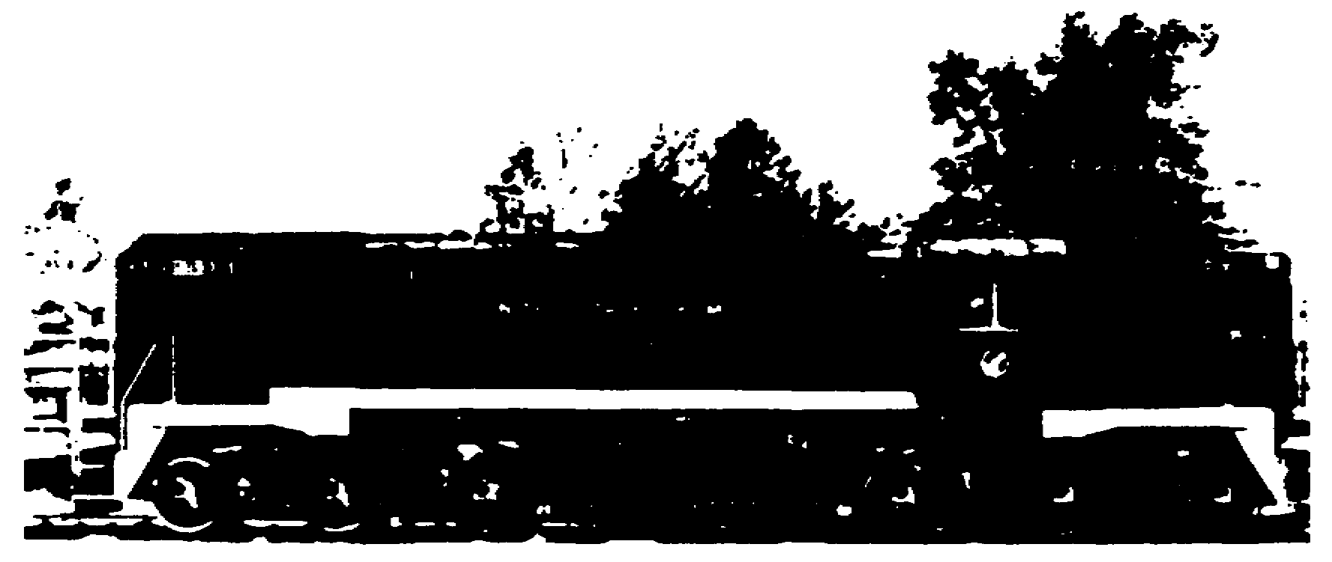

Slide 12
b. The 0-4-4-0, 100-ton, SW-8 locomotive, shown in figure 1.2,
is designed for heavy-duty road and switching service on standardgage
railroads both in the continental United States and foreign
countries. It has an 800-horsepower engine and has multiple-unit
capability.
c. The 0-4-4-0, 60-ton locomotive, shown in figure 1.3, can
be used for both road and switching service. It may be used in
single or multiple units on broad gage railroads. This locomotive
has a 500-horsepower diesel engine and can be used on both

Slide 13
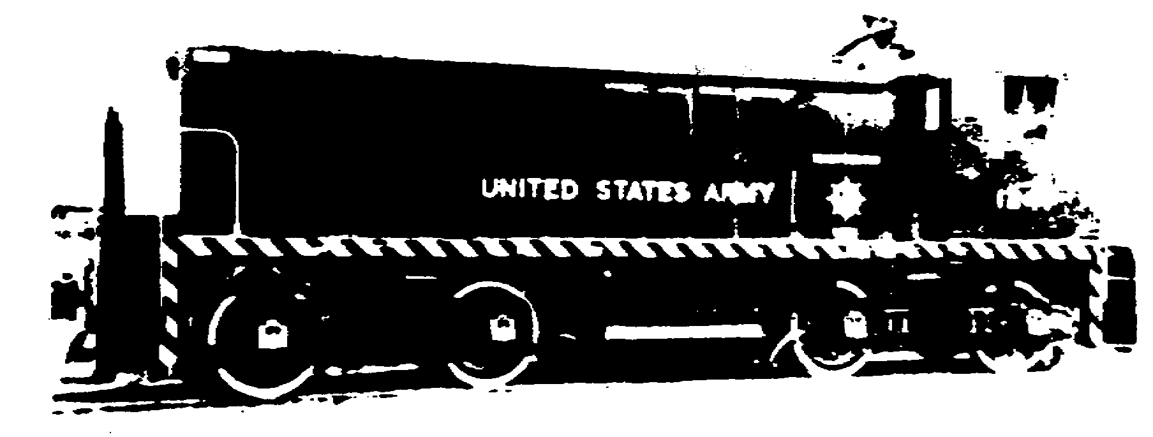

Slide 14
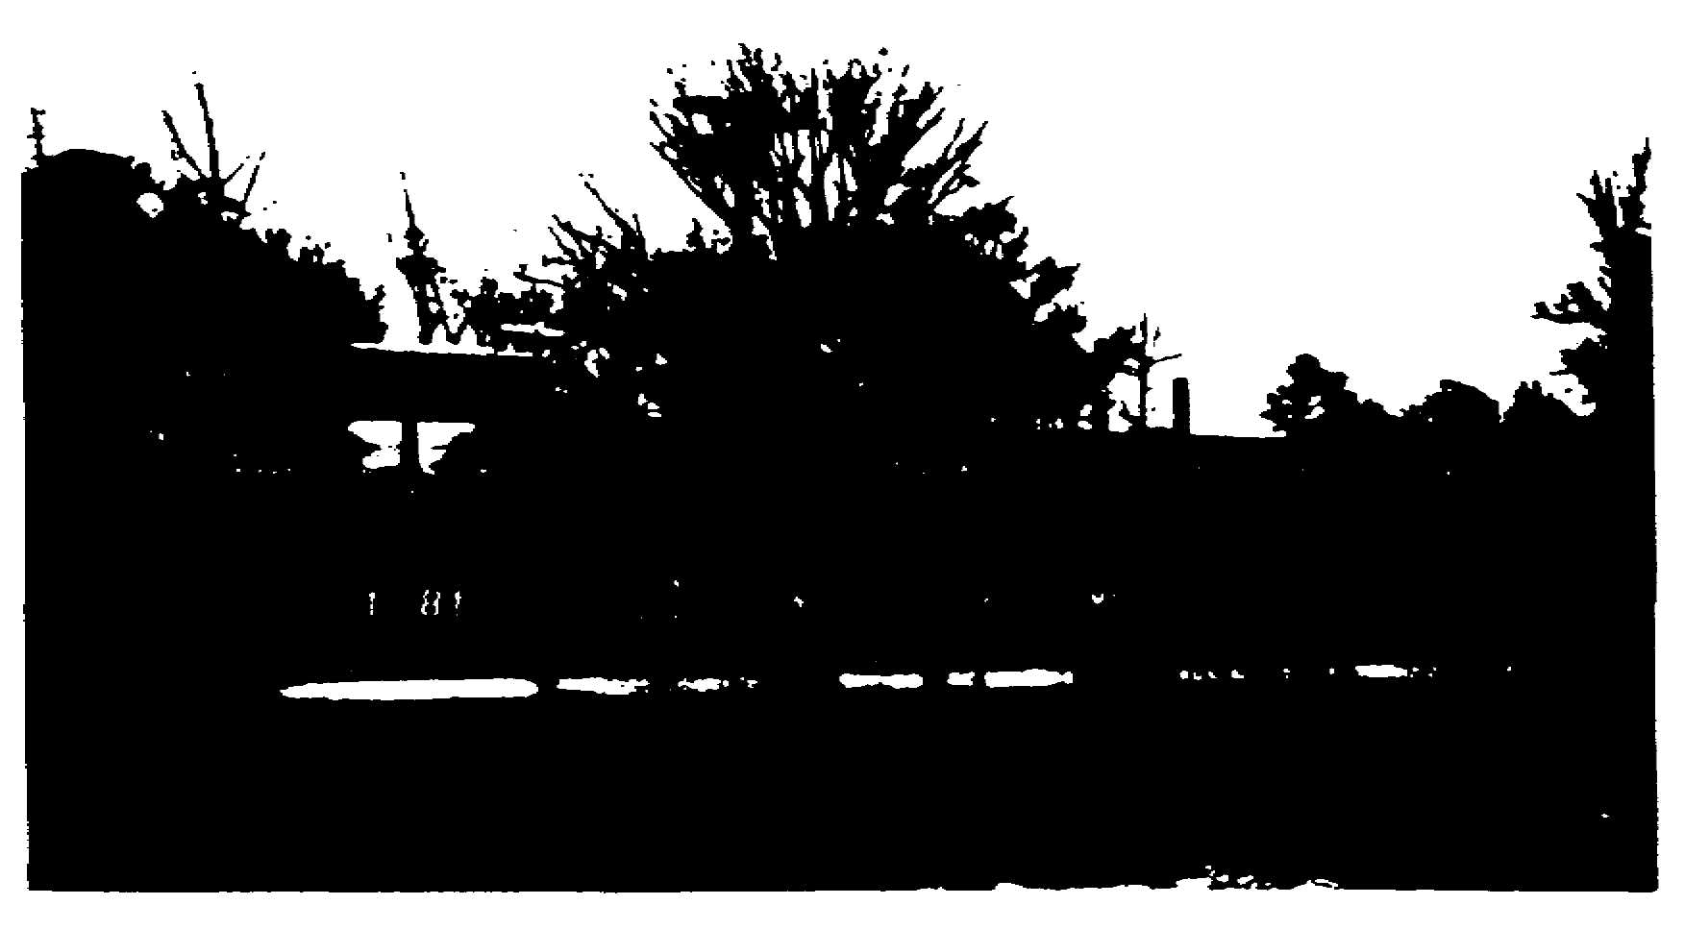

Slide 15
1.3. CLASSIFICATION
Locomotives have been classified in various ways--by size,
by horsepower, and by tractive effort. However, none of these is
5
completely descriptive or adequate for all purposes. The most widely
used and accepted system of classification is the Whyte
Classification System. It was developed about 1900 by F. M. Whyte, a
mechanical engineer on the New York Central and Hudson Railroad. The
system is generally accepted in Great Britain and the British
Commonwealth and in North and South America.

Slide 16
The Whyte classification is based on the number of locomotive
wheels on the axles of each type of truck. Wheels or trucks are of
three types--leading (front), driving, and trailing (rear). Truck is
the term used to designate a wheeled assembly that supports a
locomotive or a car body. The Whyte system uses a series of digits
or numerals separated by hyphens to specify the number of wheels in
each type of locomotive truck. The first numeral denotes the number
of wheels in the leading truck, the next one or two represent the
number in the driving group, and the last specifies the number in the
trailing truck. The numerals always refer to the wheels from front
to rear. Digits are never omitted; if there are no leading or
trailing wheels, a zero is used.

Slide 17
All wheels on Army diesel-electric locomotives are drivers;
there are no leading or trailing wheels. The diesels have either two
sets of six-wheel trucks or two sets of four-wheel trucks.
Therefore, the digits 0-6-6-0 denote no leading or trailing wheels
and 2 sets of 3 driving axles with 2 wheels on each, or a total of 12
driving wheels. Likewise, an 0-4-4-0 locomotive would have no
leading or trailing wheels and two sets of two driving axles each, or
a total of eight driving wheels. Figure 1.4 illustrates the Whyte
system of classifying diesel-electric locomotives.

Slide 18
Another system, commonly used in Europe and other parts of the
world, uses letters and figures to identify a diesel or electric
locomotive by its axles. Letters are used for driving axles and
numbers for nondriving axles. In this system, "A" stands for one
driving axle, "B" for two, "C" for three, and "D" for four. A small
"o" placed after the initial letter shows that each axle is
individually powered. Thus, a single unit locomotive with two
individually powered two-axle trucks would be classified as a Bo-Bo.
One with three axle trucks in which the center axle is an idler would
be designated as an A1A-AlA.

Slide 19
1.4. SUMMARY
Diesel-electric locomotives have internal combustion engines
to furnish primary power and electrical equipment to transmit
the power from the engines to the driving wheels. In the engine's
6
Figure 1.4. Whyte Classification of Diesel-Electric Locomotives.
cylinder, highly compressed air reaches a high temperature and
provides the spark that ignites the fuel oil as it is injected into
the cylinder.
Army locomotives are classified under the Whyte Classification
System, according to their wheel arrangement from front to rear. A
series of digits separated by hyphens specify the total number of
wheels on the axles of each type of truck beginning with the leading
truck, next the driving wheels, and then the trailing truck. Army
diesel-electric locomotives have neither leading nor trailing trucks;
all wheels are drivers. These locomotives generally have two sets of
either four-wheel or six-wheel trucks.

Slide 20
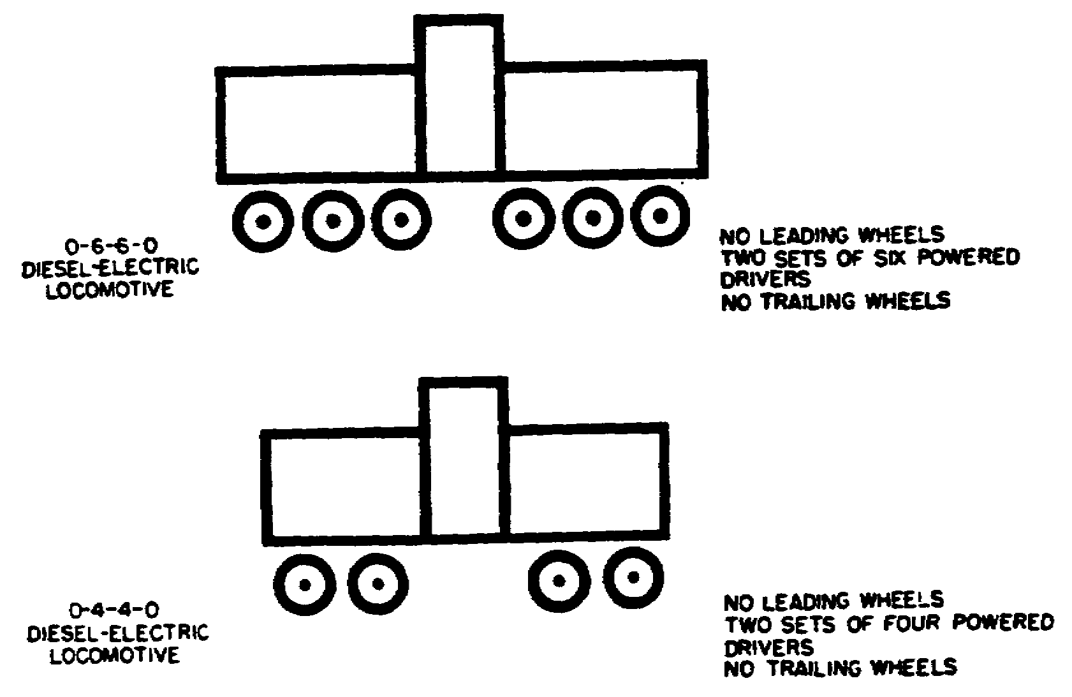

Slide 22
2.1. GENERAL
The first railway cars were merely horse-drawn wagons. They
were introduced in England in 1602 to transport loads of coal from
English mines to navigable streams where the coal was transferred to
vessels. The wagons were equipped with handbrakes to reduce their
speed when they started rolling faster than the gait of the horses
that pulled them. They had wooden wheels and rolled on wooden wagon
ways or rails, called tramways. Experience soon proved that the
wooden wheels and rails wore out quickly and had to be replaced
frequently. This led to the use of metal wheels and rails. But, as
time passed and industries grew, the limited capabilities of the
horses and wagons could not meet the demands of transporting the
ever-increasing tonnages. Some method of transportation was needed
that could both carry heavier loads and withstand long use.

Slide 23
When the steam locomotive was built to replace the horses of
the wagon roadways, iron rails and later steel ones were developed.
Railway cars were designed and built to replace the horse-drawn
wagons. The original railway cars were constructed to handle minimum
loads as were locomotives, roadbeds, and track structures. Through
the years, roads and structures have been improved and the equipment
made more efficient, larger, heavier, stronger, and safer. Railroads
and private-car owners, including the Army, now own and operate a
vast heavy-duty railway fleet.

Slide 24
Today's piggyback and Flexi-Van cars provide a high degree of
flexibility which minimizes empty-car movements on return trips.
Containerization is expanding continually and is being used
increasingly. With containers, the flatcar becomes an all-purpose
car with the advantage of fast loading and unloading. Freighthandling
labor is reduced, and damage to the lading is decreased.

Slide 25
This chapter describes some of the railway equipment the
Army owns. Emphasis is placed on the foreign service or knockdown
fleet that can be used in a theater of operations anywhere in the
8
world. The chapter also discusses other freight cars, passenger and
special equipment, and a recently developed rail car which may prove
to be very desirable in the transportation of nuclear weapons.

Slide 26
2.2. TYPES OF ROLLING STOCK
Railway rolling stock is classified into four general types:
house cars, open-top cars, flatcars, and tank cars. All railway cars
except flatcars have six general components: trucks, brake gear,
draft gear, couplers, underframe, and superstructure. Since flatcars
have no superstructure, they have only five general components. The
following subparagraphs discuss each of the four types of cars in the
order mentioned.

Slide 27
a. House cars have an enclosed superstructure with sides,
ends, and roof and usually doors, vents, ladders, and rooftop running
boards. Boxcars, refrigerator cars, and cabooses are examples.
Since boxcars and refrigerator cars are discussed in paragraphs 2.13
and 2.19, only the caboose is described here. A caboose is a car
attached to the rear of a freight train. It accommodates the
conductor and flagman and serves as their office and quarters while
in transit. The caboose also carries supplies, tools, and car parts
that might be required en route.

Slide 28
b. Open-top cars, such as gondolas, ballast cars, and hoppers,
normally have sides and ends. However, both types of hopper cars,
covered and open-top, are included in the open-top car category. The
following subparagraphs describe the two types of hoppers and the
ballast car. The gondola car is discussed in paragraph 2.12.
(1) Covered hoppers are permanently enclosed, weather-tight
cars with fixed sides, ends, and roofs. Openings with weather-tight
covers or doors are provided in the roof or sides through which the
cars are loaded. For unloading, the cars may have openings in the
bottom with tight-fitting covers, doors, ports, or valves, or roof
and side openings through which freight may be discharged. Covered
hoppers may be partitioned into compartment

Slide 29
(2) Open-top hoppers are similar to gondolas except that
they have higher sides and ends, and generally interiors with selfclearing
features. For example, a sloping construction of the car
bottom and compartments that end at openings equipped with doors
provide for discharge of the car's contents. Open-top hopper cars
are of many types that vary according to the size and class of
commodities they carry. Some have twin hopper pockets while others
have quadruple ones; each has a door for discharging lading.

Slide 30
(3) Ballast cars are similar to low-side gondolas except
that the load may be discharged from the sides. Sometimes referred
to as side-dumping gondolas, these cars are used for hauling ballast,
sand, gravel, or small loads of coal.
c. Flatcars have no housing or body; they simply have a floor
laid over the underframe sills. The load capacities of flatcars
range from 50 to 250 tons. Examples are the basic flatcar and the
depressed-center one; they are described further in paragraphs 2.11
and 2.18.

Slide 31
d. Tank cars are those with tanks mounted on special
underframes. They carry many kinds of liquid and semiliquid
commodities ranging from milk to TNT. The Interstate Commerce
Commission (ICC) issues regulations and specifications governing tank
cars used in the United States. These specifications are combined
with those of the Association of American Railroads (AAR) to make one
set of specifications covering car construction that the ICC
publishes. For oversea use, the specifications are modified because
of emergency austerity demands.

Slide 32
2.3. FREIGHT EQUIPMENT FOR MILITARY USE
The first instance of rail cars being used for military
purposes probably occurred during the Civil War when mortars were
permanently mounted on railroad flatcars and moved into an area to
support troops. In 1917, five naval railway batteries were built and
shipped to France for use in World War I campaigns. Each battery
consisted of a gun car carrying a 14-inch gun, and ammunition,
workshop, kitchen, and berthing cars. The 14 cars of each battery
were probably the first rail cars used entirely for military purposes.

Slide 33
Army railway motive power and rolling stock built for use in
domestic service differ little in design from standard U.S.
commercial rail equipment. In comparison to foreign equipment,
however, it is generally larger and heavier. When World War II
began, European rolling stock had a small carrying capacity and was
scarce in all theaters of operations. Many cars were hurriedly
designed and built in the United States and shipped overseas knocked
down to save shipping space, and a few American cars were modified
for use on European railroads. This experience led to the
development of a railway fleet capable of operating on railroads of
various gages which could be sent quickly to areas of conflict. Some
of the equipment can be shipped knocked down to conserve shipping
space. Section I describes the knockdown equipment.

Slide 34
Section I. Knockdown Fleet
2.4. GENERAL
Experience in World Wars I and II showed that foreign railway
systems were incapable of sustaining combat operations because the
capacity and the amount of foreign rail equipment were not enough for
military purposes. The U.S. Army realized it had to be prepared to
produce its own motive power and rolling stock should it again engage
an enemy on foreign soil.

Slide 35
Soon after World War II, the Army began to develop a railway
fleet suitable for use in any future theater of operations. The
objective for railway cars was a modified American car design capable
of operating in any foreign country in a train with local equipment.
Starting with a basic flatcar that could be converted to a gondola or
boxcar by addition of the proper superstructure, these cars were to
be designed to work with the coupling and braking systems on
equipment used on principal railroads of foreign countries, and to be
capable of operating on railroads of various gages. Keeping in mind
these requirements, American designers developed a basic flatcar.

Slide 36
In addition to the domestic service equipment, the Army
inventory contains a knockdown fleet of 40-ton equipment designed and
built primarily for emergency oversea service. Another one for use
on narrow-gage track in foreign theaters was proposed but not
procured; it was to consist of 76-ton diesel-electric locomotives,
30-ton gondolas, 30-ton flatcars, and 55-ton depressed center cars.
The 40-ton fleet consists of more than 11,000 items of motive power
and rolling stock in storage at various Army depots and
installations. Paragraphs 2.5 through 2.10 discuss generally the
construction and major components of the cars in the foreign service
fleet and the basic procedure of assembling knockdown cars. The
remainder of the section and accompanying figures describe cars of
the fleet that can be assembled or partially assembled in a theater,
and explain their assembly and conversion.

Slide 37
2.5. CONSTRUCTION
Because of the expected shorter life of emergency equipment
used in a theater of operations as compared with standard equipment,
the fleet is constructed as simply and economically as military
standards permit. Designers of the equipment found that physical
characteristics of foreign railroads would limit capacity and
dimensions. For example, track and bridge load limits would
determine the equipment's axleload while clearances would affect its
dimensions.

Slide 38
The designers decided that a capacity of 40 tons was best for
transporting military supplies and equipment on standard- to broadgage
railroads--56 1/2, 60, 63, and 66 inches. Design modifications
were based on the equipment's shorter life expectancy and on
regulations expected to govern rail operations in a theater. The
emergency oversea equipment is designed and built to meet clearance
limitations of foreign railroads. The major assemblies and
components of the different types of knockdown cars are
interchangeable. Paragraphs 2.6 through 2.9 discuss four of the
basic components of railway cars of the knockdown fleet with the
exception of tank. cars; paragraph 2.10 discusses their assembly

Slide 39
2.6. TRUCKS
Multigage trucks enable the knockdown fleet to operate on
railroads of various widths--those with standard to broad gages. The
trucks can be adapted to the different gages, or an entire truck may
be removed and another substituted. Changing the gage of the wheels
when once set on multigage trucks can be accomplished only by a
general support maintenance unit. Wheels cannot be pushed in or out
at will; a heavy-duty wheel press is required.
The multigage trucks can be applied to locomotives, wrecker and
locomotive cranes, snowplows, and other rail equipment. Trucks and
wheels used on equipment of the fleet conform to the standards of the
Association of American Railroads and are completely interchangeable
among cars of the same capacity. Only the major assemblies, however,
are interchangeable among the trucks themselves. A diagram of a
typical railway truck is shown in figure 2.1.

Slide 40
2.7. COUPLERS
Because the fleet is
designed primarily for service
in an oversea area, it is
equipped with the hook and link
coupler used predominantly in
Europe, Russia, and other
parts of Asia. The inserted
sketch shows the hook and
link of the coupler as well
as the bumpers for absorbing
jolts. Figure 2.2 is a model
of a car equipped with a hook

Slide 41
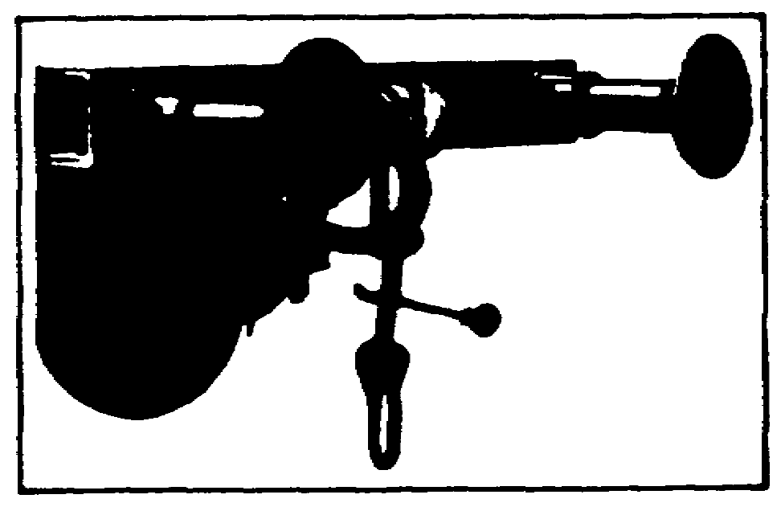
and link coupler and end bumpers. The equipment of the fleet is
designed so that it can also use the standard automatic U.S. coupler

Slide 42
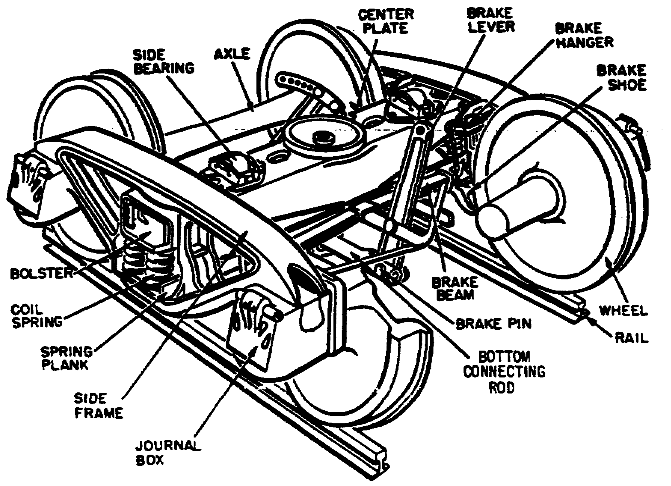

Slide 43
2.8. UNDERFRAMES
Equipment of the fleet uses steel underframes completely
fabricated and drilled at carbuilders' shops in the United States.
All underframes for flatcars, gondolas, and boxcars are assembled in
the same way. Wooden plank flooring is laid over the underframe.

Slide 44
2.9. SUPERSTRUCTURE
Made generally of wood with metal reinforcement bars, the
superstructure units provide only rigidity. They are not designed to
support any appreciable amount of the weight of the lading. The
superstructure units are prefabricated, punched, and drilled for
rapid assembly.

Slide 45
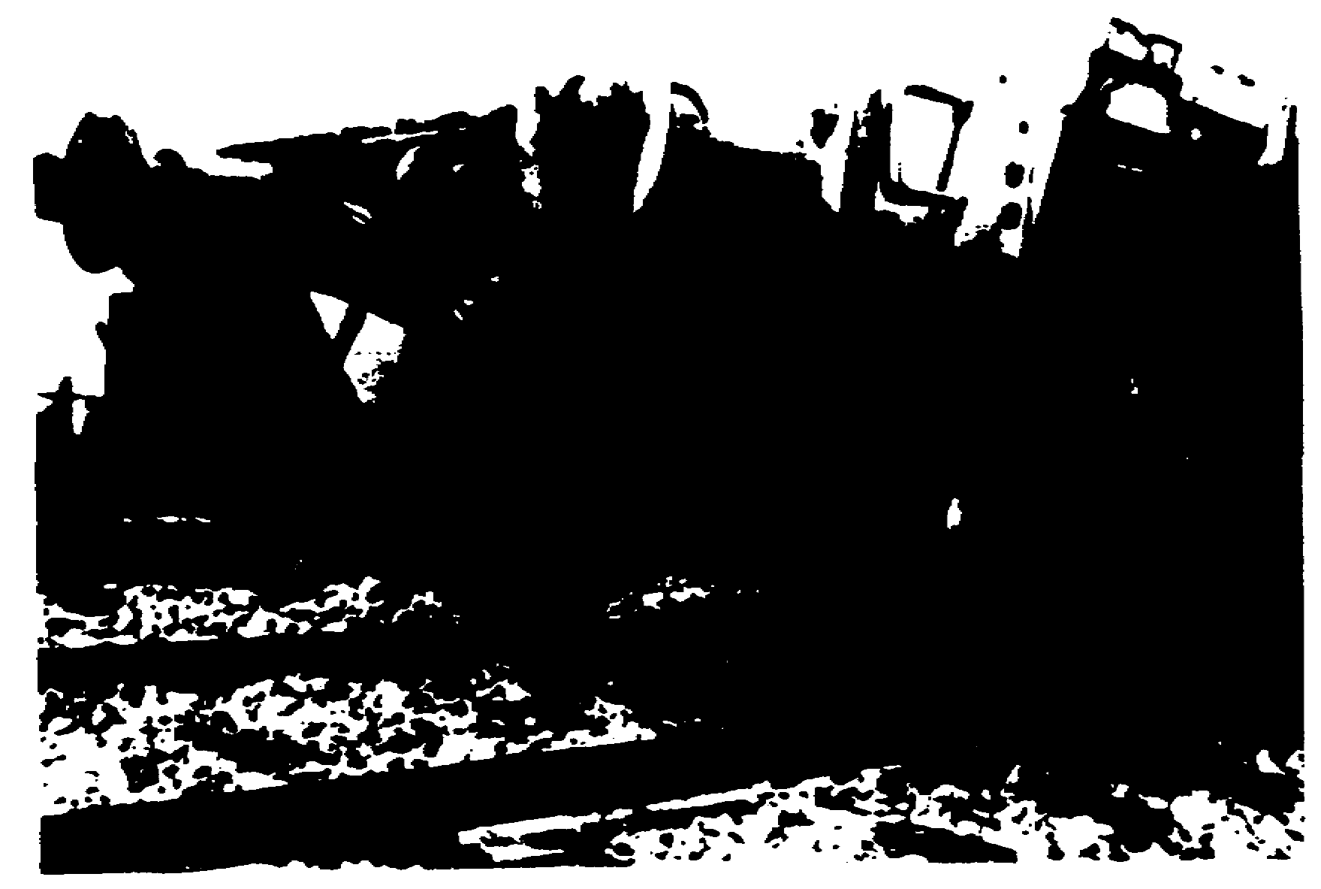

Slide 46
2.10. ASSEMBLY
The general method of assembling a car of the knockdown fleet,
with the exception of tank cars, follows. First, assemble the trucks
and the underframe. Then, install miscellaneous items to underframe,
including airbrake equipment, and apply to the underframe's end sill
such parts as coupling, draft gear, buffers, and blocks. Next, mount
the underframe assembly to the trucks. Lastly, attach body side
bearings, shims, and wear plate to body bolster. When required, add
the proper superstructure. The components of unassembled cars are
packaged in quantities that permit issue of cars in multiples of 10;
components common to all cars are packaged separately from those
peculiar to one type of car.

Slide 47
2.11. FLATCAR
Known as the workhorse of rail service, a flatcar is used to
transport very large and very heavy items. The basic unit of the
knockdown fleet is the flatcar. It is simply a floor laid over the
underframe sills and placed on trucks; it has no housing or body.
Figure 2.3 shows the major components of the flatcar, and figure
Figure 2.3. Components for Assembling Flatcar.
2.4 shows the car after assembly. Flatcars of the knockdown fleet
are structurally designed with load capacities of 40 tons. In
addition to serving as regular flatcars, the 40-ton cars also provide
the foundation to which superstructure units can be added to convert
them to gondolas and boxcars.
Figure 2.4. Assembled Flatcar.
Underframes for flatcars of the 40-ton fleet are shipped with
the wooden floor already laid. Flatcar underframes are completely
interchangeable with any other car of the fleet. The side and end
sills of the flatcar are prefabricated, punched, and drilled.

Slide 49
In a theater, the flatcar is generally used for very early rail
operations. When theater activities stabilize and requirements
increase for transportation of supplies that need protection from
weather or pilferage, the flatcar can be converted to a closed car.
After conversion, the weight of the lading is still carried by the
car bed. The superstructure provides rigidity, not support. Because
of its versatility, the flatcar is the backbone of the fleet.

Slide 50
2.12. GONDOLA
By the addition of the sides and ends, the basic flatcar
becomes a gondola. Either high-side, 48-inch, or low-side, 18-inch,
gondolas may be assembled depending on the height desired; the only
difference in the two cars is the height of the superstructure.
Figure 2.5 shows a flatcar being converted to a high-side gondola, and
figure 2.6 shows it after assembly. The sides and ends of gondolas
in the knockdown fleet, made of 1 1/2-inch tongue-and-groove wood
sheathing with metal reinforcement bars, may be used on the 40-ton
flatcar underframes with minor adjustments to the corner bands and
ends.

Slide 52
Conversion of the flatcar to a gondola consists generally of
positioning sides to underframe side sills and securing them in
place, fastening handholds, and positioning end assemblies and
securing to corner posts on all corners of the car. Gondolas can
transport a variety of heavy and bulky items. They are used
primarily for carrying such materials as coal, ore, stone, lumber,
iron and steel products, and machinery. If necessary, they can be
used to transport troops

Slide 53
2.13. BOXCAR
Enclosed with sides and ends and having a roof, the boxcar is
designed to carry commodities that must be protected against
breakage, pilferage, or weather damage. Like the gondola, the boxcar
of the knockdown fleet can be assembled by adding the proper
superstructure to the flatcar underframe.

Slide 54
Made of a light frame with plywood lining, the superstructure
consists mainly of sides, ends, doors, and a roof. The sides are
constructed in four separate sections, two for each side; the ends
are single units; and the roof is one unit. The door assembly
consists of a door track, threshold plate, and door. Figure 2.7
shows the flatcar underframe with boxcar superstructure unassembled,
and figure 2.8 shows the assembled boxcar with the door open.

Slide 55
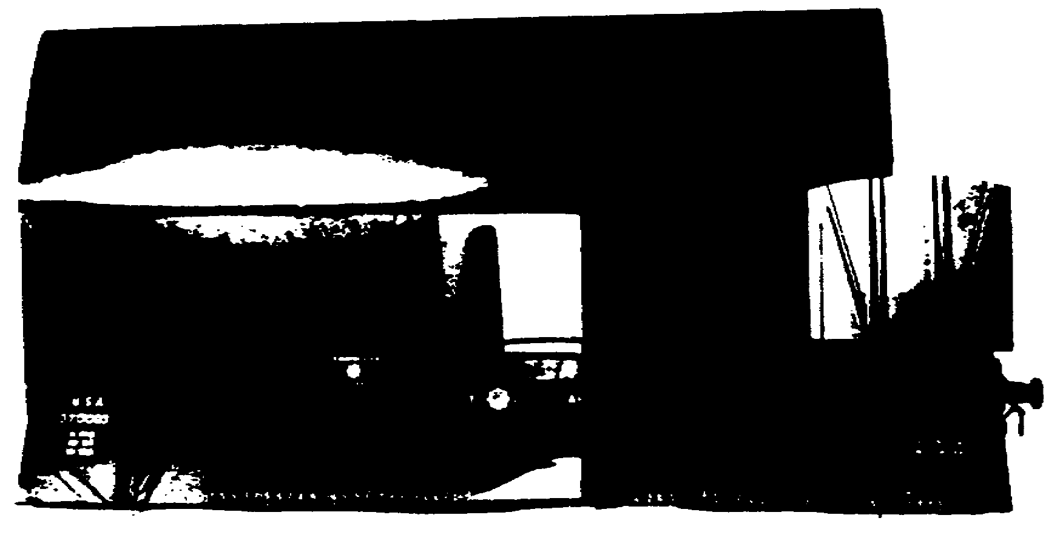

Slide 57
To assemble the car, the underframe is assembled the same as
for the flatcar with the exception of camber adjustment, corner
connection angles, sill steps, and handholds. The two side sections
adjacent to one end of the car are first attached to the underframe;
then the end unit connecting those two side sections is attached to
them and the end sill of the underframe. The same procedure is
followed for the other end of the car. When the side sections and
end units are erected and the door tracks and doors are in their
proper place, the roof is positioned and secured to the corners and
sides.

Slide 58
2.14. TANK CAR
A tank car consists of a tank, usually made of steel, mounted
on a car with a special underframe. Except for its superstructure
and a modified underframe, the tank car has components similar to
other cars. The underframe is floored and steel running boards are
built on each side at a height even with the flooring. Made of a
corrosion-resistant material, tank shells may have either a single
compartment or multiple ones. The ordinary tank car has a single
compartment equipped with dome safety valves and bottom outlets.

Slide 59
To prevent corrosion, linings are required in steel tanks when
acids are shipped in them. Some may be insulated to provide the even
temperature required by certain commodities. In addition, some cars
may have steam coils installed inside the tank shell to provide heat
for lading. Tank cars are used for transporting liquid and
semiliquid commodities such as oils, gasoline, alcohols, acids, coaltar
products, compressed gases, fruit juices, and milk. Tank
capacities usually range from 5,000 to 10,000 gallons. A typical
U.S. Army tank car is shown in figure 2.9.
Figure

Slide 60
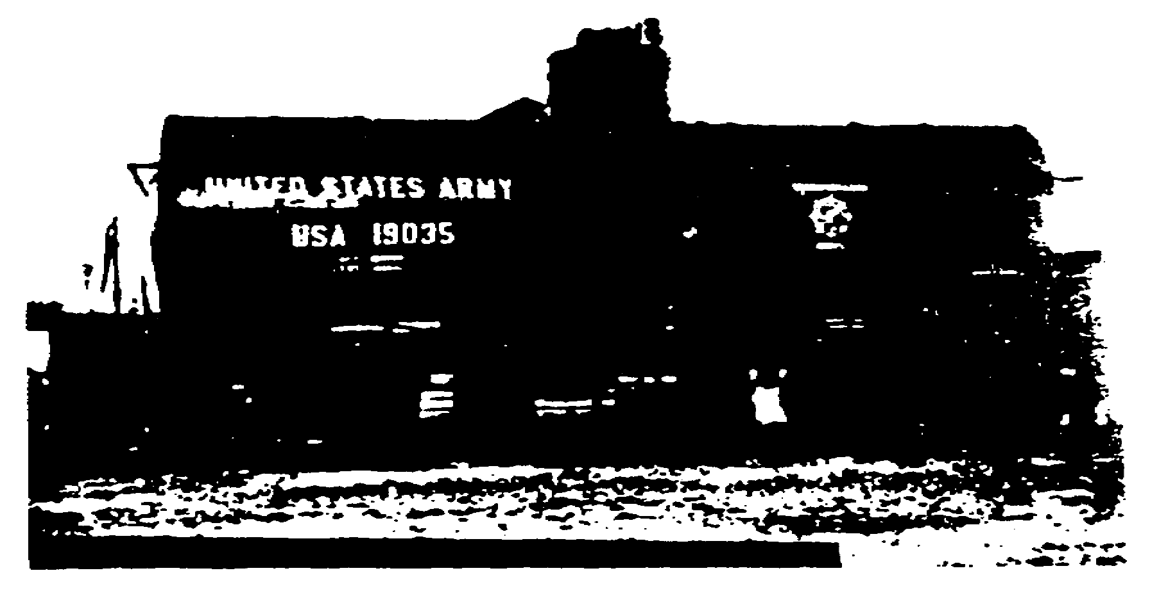

Slide 61
Tank cars in the foreign service fleet have single
compartments and would normally carry petroleum products. The 5,000-
18
gallon car operates on narrow-gage railroads, while the 10,000-gallon
one runs on standard- to broad-gage tracks. The car manufacturer
assembles the tank unit to the car underframe along with the outlet
and safety valve assemblies and dome cover. The remaining work can
be done in the field. It consists of assembling and applying the
following: subcenter sill and center plate to the tank and underframe
assembly; tank and underframe assembly to the trucks; miscellaneous
items such as brake equipment supports to underframe; parts to end
sill; airbrake to underframe; body side bearings, shims, and wear
plate to body bolster; and such miscellaneous items as tank ladder
and braces to tank car body and tank.

Slide 62
2.15. SUMMARY
Experience in World War II proved that the Army must be
prepared to supply its own locomotives and rail cars in a theater of
operations since many foreign countries have just enough rail
equipment to support their own needs. Military tonnage requirements
placed on these rail systems would not only exceed the capabilities
of their equipment and facilities but also create near chaos in their
operations. Therefore, to meet emergencies, the U.S. Army inventory
contains a fleet of railway equipment specially designed and built
for use in theaters of operations where standard- to broad-gage
railroads are operated.

Slide 63
In developing the foreign service equipment, designers found
that physical characteristics of foreign railroads would influence
size and capacity. They decided that a capacity of 30 tons was best
for equipment that would operate on narrow-gage railroads and 40 tons
for equipment operating on standard to broad gages; however, only the
40-ton fleet was procured. The cars were fabricated, punched, and
drilled at carbuilders' shops to provide for easy assembly in a
theater. They can be shipped knocked down to conserve shipping
space. Major components and assemblies are interchangeable. With
minimum modification to the coupling arrangement and by substituting
trucks or altering trucks to fit different gages, the 40-ton
equipment can operate on from standard- to broad-gage track ranging
from 56 1/2 to 66 inches.

Slide 64
The flatcar is the basic unit of the knockdown fleet. It can
serve as a regular flatcar during early theater operations. When
theater activities stabilize and other types of cars are needed, the
flatcar can be converted in the field to a gondola or boxcar.
Gondolas can be assembled by adding sides and ends to the flatcar.
Depending on the height desired, either the high- or low-side gondola

Slide 65
may be erected. When cars are needed to carry commodities requiring
protection from the weather or pilferers, the flatcar can be
converted to a boxcar by the addition of sides, ends, doors, and
roof. After the flatcar has been converted to either a gondola or a
boxcar, the weight of the lading is still carried by the bed of the
car. Superstructure units provide rigidity but do not support any
appreciable amount of weight.

Slide 66
Tank cars of the fleet are partially assembled by the car
manufacturer who attaches the tank unit to the car underframe along
with the outlet and safety valve assemblies and dome cover. The
remaining assembly can be done in the field.

Slide 67
Section II. Other Equipment
2.16. GENERAL
In addition to the knockdown cars described in paragraphs 2.11
through 2.14, some heavier freight cars, some passenger cars, and
some equipment built for special purposes are included in the foreign
service fleet. This section discusses this rolling stock and, in
addition, some of today's newer developments in rail equipment.

Slide 68
2.17. EIGHTY-TON FLATCAR
Some 80-ton flatcars are included in the oversea fleet for
carrying ordnance and engineer equipment weighing more than 40 tons.
An example is seen in figure 2.10. Similar to the 40-ton flatcars,
only larger, these cars are designed to meet most railway operating
restrictions in a theater. They are shipped knocked down and are
packed for easy assembly; however, converting them to a gondola or a
boxcar is not planned for at present. Because of their greater load
capacity, each car is mounted on two 6-wheel trucks, three axles per
truck, to avoid exceeding the low axleload limit on foreign railway
track, bridges, and other rail structures which are designed to
support a certain amount of weight per axle. With the 6-wheel truck,
weight is distributed evenly over a greater area than with a 4-wheel
truck, and more weight can be supported. The 80-ton flatcar is
designed to operate on standard- to broad-gage railroads.

Slide 70
2.18. DEPRESSED-CENTER FLATCAR
Flatcars with lowered or depressed centers have been designed
and built for transporting ordnance and engineer material and
equipment that would exceed permissible heights if loaded on regular
flatcars. Their usefulness is measured mainly by the added headroom
they afford for clearances. The 70-ton depressed-center flatcar
designed for foreign service has two 6-wheel trucks, as shown in
figure 2.11, and operates on from standard- to broad-gage track, 56
1/2 to 66 inches.

Slide 71
2.19. REFRIGERATOR CAR
Refrigeration is important in moving perishable items, and
controlling the temperature is essential to protect such foods as
fresh fruits and vegetables from freezing in transit. Refrigerator
cars can be used for both purposes: to keep commodities cool and to
protect them from too much cold. A car can be cooled with ice or by
mechanical means. Standard refrigerator cars resemble boxcars in
general outward appearance. The framework, sheathing, ends, and roof
are similar to that used in standard boxcar construction except that
insulation has been added and, in ice-cooled refrigerator cars, the
roof has hatch openings through which ice is loaded. Figure 2.12
shows a refrigerator car with hatches visible.

Slide 72
Refrigerator cars developed for the foreign service fleet are
40-ton, eight-wheel, ice-cooled cars. They have the same type of
underframe, trucks, and brake and coupler arrangement as the other
cars in the foreign service fleet. The superstructure's outside
sheathing is plywood. Two ice bunkers are installed, one at each end
of the car, to receive ice from the hatch openings, and hinged metal
racks are placed over the floor. The sides, ends, roof, and floor
are insulated with fiberglass.

Slide 73
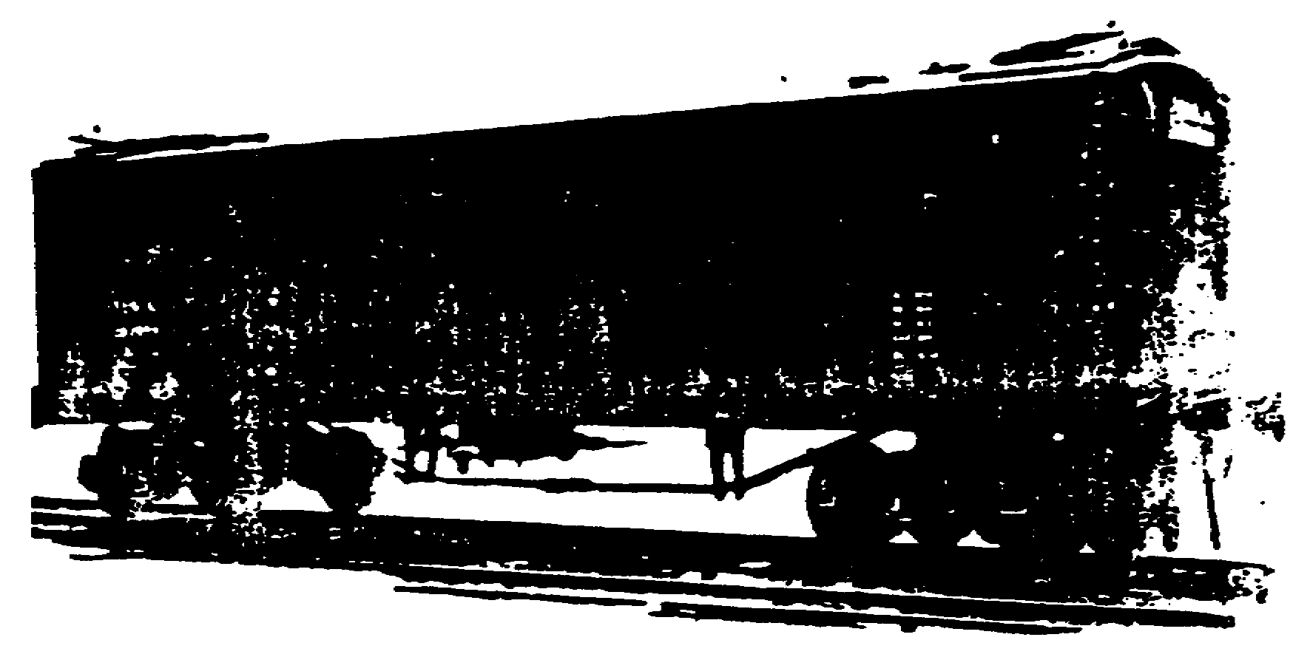

Slide 74
2.20. PASSENGER EQUIPMENT
Ambulance train cars are the only passenger equipment included
in the foreign service fleet. Because of the experience of the Army
Medical Service during the Korean and Vietnam wars, the rapid
development of air transportation, and the quick evacuation of
wounded from combat, the requirement for rail hospital cars in a
theater is not as great as years ago. However, ambulance trains
provide temporary facilities to care for sick and wounded patients
while transporting them to central points where they can be evacuated
by air to base hospitals.

Slide 75
After World War II, the Surgeon General requested that an
ambulance train consisting of three types of cars, a ward, a medical
personnel, and a kitchen-dining-storage car, be designed and
developed for use on foreign railroads with standard to broad gages.
The cars were to have a common underframe and superstructure design
with interior arrangements and fixtures appropriate to each type.
The 3-car prototype train was designed and constructed and has been
placed in storage.

Slide 76
The cars of the ambulance train are constructed of steel
and have interchangeable underframe and superstructure components;
they are built to resist great impact forces and provide maximum
safety and comfort. They have multigage four-wheel, passenger-type
trucks, and the coupler arrangement is designed to permit rapid
conversion to another coupling arrangement of the standard– to
broad-gage trains. Each car is insulated, ventilated, and equipped
with its own heating and power-generating plants and water supply
system; only the ward car is air-conditioned. Car windows are
designed for complete blackout. The three cars of the train are
designed to operate as a unit to furnish complete railway ambulance
facilities. Each type of car is discussed in the following
subparagraphs.

Slide 77
a. Ward car. Located midway on both sides of the center aisle
of the ward car are tier-type bunks to accommodate 30 litter patients
or 12 litter and 24 ambulatory patients. Six bunks are stationary;
24 can be converted to seats. Other facilities necessary for the
patients' comfort and care are included: sterilizing equipment, a
lavatory, and an air-conditioning system. A receiving room is
located at the platform, and sliding side doors provide for receiving
patients into the car.

Slide 78
b. Medical personnel car. Personnel of the Army Medical
Service are provided with sleeping quarters, dressing rooms, and
toilet facilities in the medical personnel car. It is equipped with
two air-circulating blower units, and it contains staterooms for 4
officers, 2 nurses, and 15 enlisted men.

Slide 79
c. Kitchen-dining-storage car. Space for storing medical and
food supplies and for preparing and serving food is contained in the
kitchen-dining-storage car. The car is divided into three sections:
a kitchen with such cooking facilities as stove, refrigerator,
steamtables, and bins to prepare complete meals; a dining area with
tables to seat 24; and a cleaning area containing a service sink and
storage space for medical, food, and cleaning supplies. This car
also has an emergency water supply.

Slide 80
2.21. SPECIAL EQUIPMENT
To reduce the time required for various types of rail
operations and to speed up repairs, laborsaving machinery and tools
are provided. Special equipment designed for specific purposes has
been built for use in railway operations. Two types of such
equipment included in the foreign service fleet are cranes and
snowplows.

Slide 81
a. Cranes. In loading and unloading cars and moving supplies
and materiel, cranes help to speed up many railway operations.
Clearing rail lines when traffic has been interrupted by washouts,
landslides, wrecks, or other causes is one of the many tasks for
which cranes can be used. The cranes in the foreign service fleet
can be especially useful in handling heavy truck assemblies and bulky
superstructure units in erecting cars of the knockdown fleet. Figure
2.13 shows a crane in use.

Slide 82
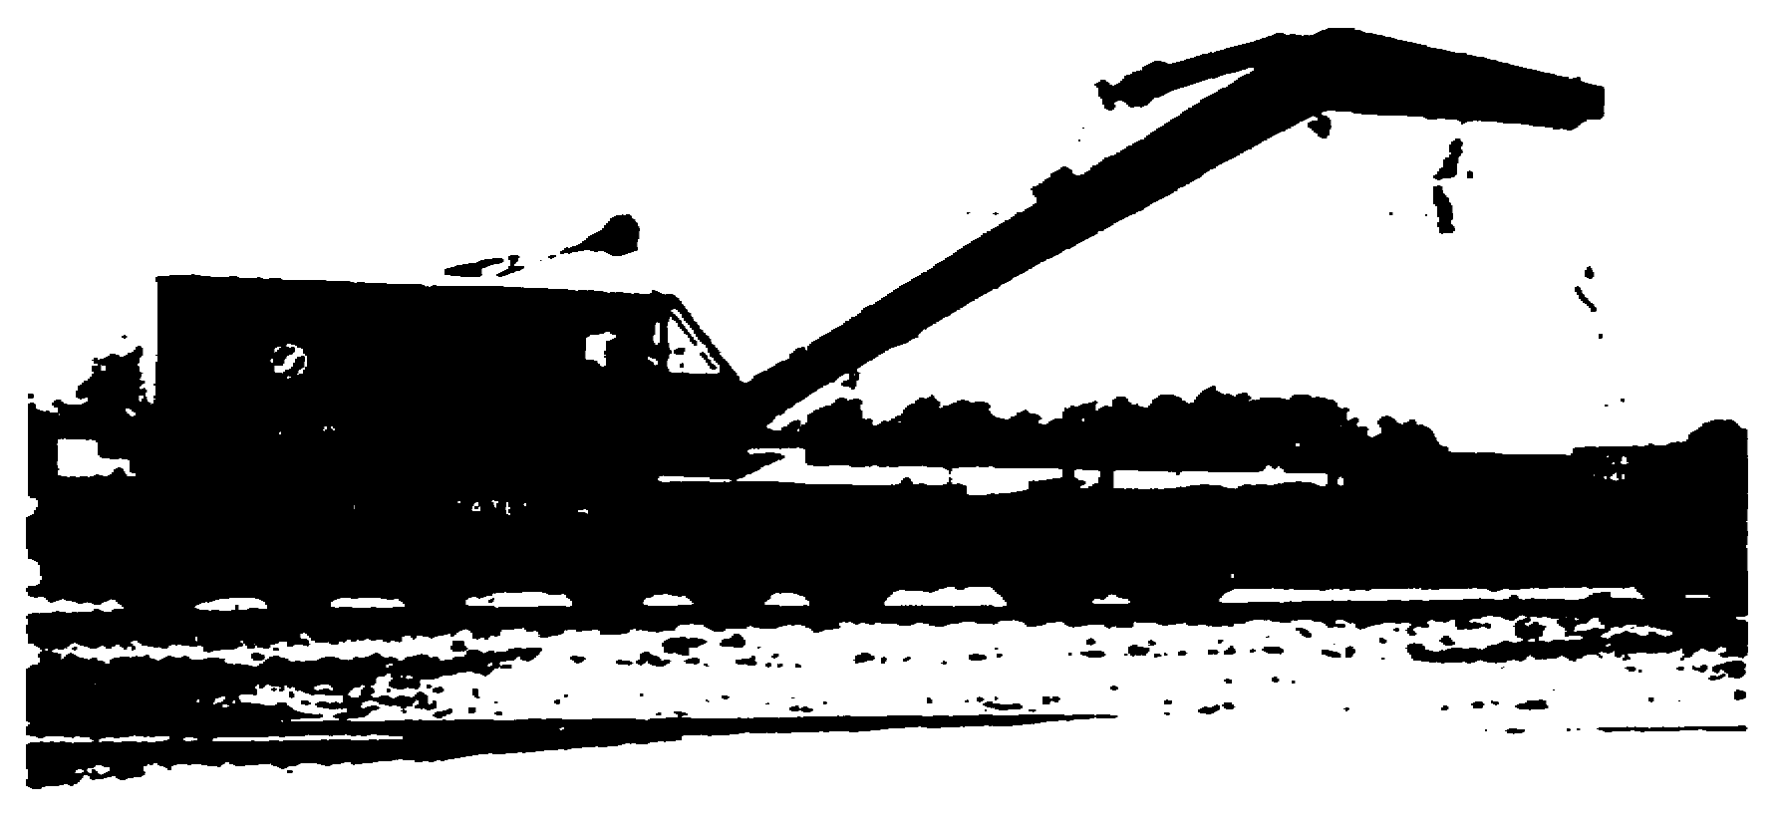

Slide 84
b. Snow-handling equipment. Clearing snow and ice from
railway tracks is important in keeping railroads operational in
severe weather. The snow-handling equipment in the foreign service
fleet is a year-round, multipurpose track maintenance machine. In
addition to clearing ice and snow from tracks during the winter, this
snowplow, also called a spreader-ditcher car, can be used during
other seasons of the year to do a variety of jobs. Some of these
include: spreading and leveling ballast, ditching, forming slopes and
banks, moving dirt and fill material, widening roadbeds and cuts,
building up and reinforcing roadbeds, and removing foul ballast from
the ends of ties. A sketch of the spreader-ditcher is inserted below.

Slide 85
2.22. SPECIAL RAIL CARS
Some of the Army's highly refined weapons systems, such as
missiles, rockets, and nuclear warheads, pose special transportation
problems because of their size and sensitivity. While in transit,
these weapons may be damaged by handling, environment, and the
conveyance itself; therefore, special care must be taken in moving
and protecting them. One of the more recently developed railway
cars, designed for both piggyback and container service, is equipped
with a shock-absorbing mechanism that provides a high degree of
protection for the equipment and lading. Shown in figure 2.14, it
has three basic elements: a container, a trailer chassis, and the
piggyback rail car itself. The following subparagraphs discuss this
equipment.

Slide 87
a. Container. Specifically designed and built to operate
interchangeably between road, rail, and ship, the container is the
key item in containerization transportation. It can be used in lifton-
lift-off or roll-on-roll-off service. The container is built with
lifting eyes and stacking castings on all four corners and is
engineered to withstand the stresses of lift-on-lift-off operations
at ports, rail terminals, or loading docks. The corner post
construction permits stacking of fully loaded containers. These
features of design and construction are particularly desirable in
ship operation where a crane is the one practical means of loading
and unloading containers. Some containers have fork pockets that
enable them to be loaded or unloaded by forklift trucks. Pulling a
container on or off the rail car is done with a power-operated winch
that provides the power to draw the container on or off the car. The
container is locked to the rail car by the same kind of tiedown
clamps used to secure ordinary truck trailers.

Slide 88
b. Trailer chassis. Designed and built to accommodate the
container, the trailer chassis has devices that lock and unlock the
container easily and quickly. The chassis is moved by a truck
tractor that operates dependably on either rough country roads or
smooth city streets. The chassis is equipped with piggyback adapter
equipment so that it can be driven on or off the piggyback rail car.
From front to rear, it is engineered and built for container service.

Slide 89
c. Piggyback rail car. Designed exclusively for container and
piggyback service, the piggyback rail car is equipped with a shock
absorber that absorbs 75 percent of the shock the car receives. A
center guide automatically alines containers and trailers so that
loading and unloading is a smooth, continuous, hands-off operation.
An automatic tiedown hitch, operated from the truck tractor which is
backed onto the rail car, secures trailers and containers to the
shock-absorbing mechanism. Because the load is carried lower than on
ordinary rail cars, this piggyback car provides railroad clearance
for the largest trailers now normally in use. Provision is also made
for possible future changes in the width of the trailers because
there are no side rails to interfere.

Slide 90
Mixed loads of containers and conventional trailers can be
hauled on the piggyback rail car. Without modification, it can
transport containers, chassis--with or without containers, tank
containers, tank trailers, semitrailers, furniture vans, and
automobile carriers. The car is fully compatible with ordinary
flatcars in both main-line and yard service. At present, the
Military Traffic Management Command (MTMC) leases a limited quantity
of this equipment when needed for use in domestic interchange. The
equipment is not now a part of the Army's foreign service fleet.

Slide 91
2.23. SUMMARY
The foreign service fleet contains special freight cars, such
as the 80-ton and the depressed-center flatcars, for carrying very
large and very heavy ordnance and engineer equipment. Included in
the fleet are ice-cooled, fiberglass-insulated refrigerator cars to
carry perishable items, and the cranes and snow-handling equipment to
speed up various jobs and keep railroads operational.

Slide 92
The only passenger equipment included in the fleet is the
foreign service ambulance train which consists of three types of cars:
a ward, a medical personnel, and a kitchen-dining-storage car. A
prototype of each of these three cars has been designed and built for
standard- to broad-gage rails; they are now in storage. The ward car
contains facilities for patient care and comfort including an airconditioning
system. Sleeping quarters, dressing rooms, and toilet

Slide 93
facilities are included in the medical personnel car. The kitchendining-
storage car contains a kitchen with facilities to prepare
complete meals, a dining area where meals can be served, and a
cleaning-storage area containing service sink and space for storing
supplies.

Slide 94
Special equipment in the foreign service fleet are cranes and
snowplows. Cranes help in handling heavy equipment, and the snowhandling
equipment cleans ice and snow from tracks. In addition to
its use during the winter months, this machine (also called a
spreader-ditcher car) can be used during other seasons of the year
for various track maintenance jobs.

Slide 95
Finally, MTMC leases a limited quantity of rail equipment
designed for both container and piggyback service for use within the
United States. Because of its great shock-absorbing capability, this
equipment may be very effective for transporting highly sensitive
weaponry. This equipment, however, is not presently a part of the
foreign service fleet.

Slide 97
3.1. GENERAL
Maintenance is the work that every man in a unit must do to
keep his equipment in first-class shape. In its simplest form,
maintenance consists of cleaning, lubrication, repair, and
preservation. It is important to safety; the failure of one small
part in a locomotive or railway car may cause the loss of hundreds of
lives because of an accident or the lack of delivery of material
vital to combat forces.

Slide 98
Rail equipment used for the logistical support of combat forces
must have proper maintenance. Having the best equipment money can
buy is little better than having none if it is not taken care of.
The foundation of any efficient rail operation is to have high
standards of inspection and maintenance. In peacetime, high
maintenance standards are the rule; in wartime in a theater of
operations, however, some of these standards may have to be
sacrificed to accomplish the main objective of the military
railroads--getting troops and supplies to the front to support
fighting armies.

Slide 99
This chapter discusses the Army maintenance system, how it
relates to railway equipment, and the units responsible for
maintaining this equipment

Slide 100
3.2. CATEGORIES OF MAINTENANCE
The Army maintenance system, based on experience and practical
operation, is divided into four categories: organizational, direct
support, general support, and depot maintenance. The categories
assign responsibility for specific maintenance tasks for specific
items of materiel to specific levels of command. They are defined in
the following subparagraphs. Paragraphs 3.3 through 3.5 explain how
rail maintenance fits into these categories and who is responsible
for each.

Slide 101
a. Organizational maintenance is normally authorized to,
performed by, and the responsibility of a using organization on the
equipment in its possession. This maintenance consists of functions
and repairs within the capabilities of men, skills, tools, and test
equipment authorized to a unit by a table of organization and
equipment (TOE) or by a table of distribution (TD).
b. Direct support maintenance is normally authorized to and
performed by a designated maintenance activity in direct support of a
using organization on a return-to-user basis.

Slide 102
c. General support maintenance is authorized to and performed
by designated TOE and TD organizations in support of the Army supply
system. Repairs and overhauls bring materiel up to required
maintenance standards and ready-to-issue condition based upon
applicable supported Army area supply requirements.
d. Depot maintenance is performed by activities with a
capability of overhauling, rebuilding, and repairing equipment beyond
that of general support maintenance organizations. Depot maintenance
augments the procurement program in satisfying overall Army
requirements

Slide 103
In the continental United States, depot maintenance of
railway equipment is a responsibility of the Army Materiel Command.
The maintenance is performed in selected commercial rail repair shops
under contract. In a theater of operations, depot maintenance is not
normally performed. If it were, for example in a large sophisticated
theater, it would be a responsibility of the supply and maintenance
command, theater army support command (TASCOM).

Slide 104
3.3. ORGANIZATIONAL MAINTENANCE
Men in the operating units of the transportation railway
service perform organizational maintenance on equipment they use.
Engineers, running the locomotives, and car inspectors check and
service equipment each time it is used. On locomotives, the
maintenance includes inspecting, cleaning, lubricating, adjusting,
and replacing such minor parts as fuel injectors and subassemblies.
On rolling stock, it includes inspection of airbrakes, running gear,
and other parts, and examination and lubrication of journal boxes.

Slide 105
Organizational maintenance may be separated into three parts:
before-, during-, and after-operation service.
a. Before-operation service is performed by the equipment
operators and users to find out if the locomotive and rail cars are
ready for use and if there have been any changes since the last
after-operation service. This may include no more than an inspection
to insure that the equipment is ready to do its job; however, it
should never be neglected.
b. During-operation service consists of noting any unusual or
unsatisfactory performance of equipment or components during their
use. If any deficiencies are detected in a locomotive, they should
be investigated, corrected if authorized, and then reported to the
proper mechanics upon return from the road.
c. After-operation service prepares the equipment to do its
next job without unnecessary delay. Most of this service consists of
inspecting a locomotive and rail cars to detect deficiencies that may
be corrected before they develop into more serious problems.

Slide 106
3.4. DIRECT SUPPORT MAINTENANCE
The transportation railway equipment maintenance company of the
transportation battalion has two platoons that are responsible for
the direct support maintenance of locomotives and cars. The car
repair platoon is responsible for maintenance, repair, and inspection
of cars. It performs light car repairs and inspects cars passing
over the division for defects. On rolling stock, direct support
maintenance includes replacing brakeshoes, installing airhose,
repairing trucks, and changing defective wheels. The diesel-electric
locomotive repair platoon is responsible for maintenance and running
repairs to locomotives, cranes, and similar equipment. Such
maintenance includes repairing end items and replacing unserviceable
parts, subassemblies, and assemblies--wheels and journals, for
example.

Slide 107
Four railway service teams may be attached to the battalion to
perform direct support maintenance on locomotives and rolling stock.
They are the ambulance train maintenance detachment, the dieselelectric
locomotive maintenance crew, the railway car repair crew,
and the railway workshop mobile detachment. The ambulance train
maintenance detachment augments the railway car repair crew when
required to perform direct support maintenance on ambulance trains.
This team provides refrigeration and supply specialists necessary for
this support. The diesel-electric locomotive maintenance crew may
be assigned to a railway battalion to perform direct support
maintenance on locomotives and cars at a small terminal or

Slide 108
to augment the battalion's capabilities. The railway car repair crew
may be assigned to a railway battalion to inspect and perform direct
support maintenance on railway cars at points distant from fixed
facilities. As mentioned earlier, this team works with the ambulance
train maintenance detachment in maintaining ambulance trains. The
railway workshop mobile detachment provides direct support
maintenance on diesel-electric locomotives and rolling stock in areas
where static facilities are inadequate or nonexistent. The team's
mobile shop can be mounted on rail cars.

Slide 109
3.5. GENERAL SUPPORT MAINTENANCE
In a theater of operations, general support maintenance is the
responsibility of the diesel-electric locomotive repair company and
the transportation railway car repair company. Both companies are
normally assigned to the maintenance battalion of a supply and
maintenance command field depot. They may be attached to a
transportation railway group of TASCOM's transportation command since
no one else but the railway service requires their support.

Slide 110
For locomotives, some examples of general support maintenance
are repairing undercarriages, removing and installing traction
motors, rewinding armatures, repairing electrical control equipment,
and assembling and testing new diesel-electric locomotive units. All
heavy repairs on railway cars, such as stripping and erecting, are
made by the railway car repair company. It also assembles and
inspects knocked-down equipment brought into the theater.

Slide 111
3.6. SUMMARY
The four categories of Army maintenance are organizational,
direct support, general support, and depot. The four categories as
they relate to railway maintenance are the responsibility of various
units. For example, organizational maintenance is done by equipment
users in the operating units. Direct support maintenance is provided
by two platoons of the transportation railway equipment maintenance
company. Four railway service teams may be attached to the
battalion: the ambulance train maintenance detachment, the diesel electric
locomotive maintenance crew, the railway car repair crew,
and the railway workshop mobile detachment. General support
maintenance is performed by the diesel-electric locomotive repair
company and the railway car repair company. In a theater, there is
normally no depot maintenance capability.

