Slide 1
SUPERVISE THE LAND TRANSPORT OF HAZARDOUS MATERIAL
Subcourse Number TR1030
EDITION 8
US Army Transportation School
Fort Eustis, Virginia 23604-5400
8 Credit Hours
Edition Date: December 1988

Slide 2
INTRODUCTION
When your unit is tasked with loading hazardous cargo for overland
transport, it is your responsibility as a transportation officer to
ensure that the hazardous cargo is loaded correctly. The nature of
hazardous cargo requires extra supervision on your part to ensure
that the cargo is handled safely and loaded securely.

Slide 3
PART A - DOCUMENT, LABEL, AND INSPECT FOR DAMAGE
When dealing with hazardous cargo, you must use strict accountability
and careful handling procedures. As a supervisor, you do not have to
personally inspect, account for, and handle each piece of cargo; but
you should make sure that your unit personnel know how to perform
these tasks properly.
Cargo Documentation on Transportation Control and Movement Document
or Government Bill of Lading

Slide 4
This part of the lesson describes the process of checking cargo and
documentation to ensure the shipment matches the paperwork. As an
officer, you must be able to instruct unit personnel on how to
perform this task.

Slide 5
The task starts with cargo documentation. All cargo transported
overland has some sort of documentation that describes the cargo and
identifies the consignor and consignee. The general name for this
documentation is "bill of lading" or "waybill." You will commonly
encounter two types of waybills: the Transportation Control and
Movement Document (TCMD) and the Government Bill of Lading (GBL).
Use the TCMD (DD Form 1384) when transporting cargo by government
units in government vehicles. Use the GBL (Standard Form 1103) when
transporting cargo by a commercial carrier. For this subcourse, you
must become familiar with specific blocks of information on these
documents that identify cargo types, status, and configuration

Slide 6
Transportation Control and Movement Document
The TCMD uses codes from DOD Regulation 4500.32-R, Volume I, Military
Standard Transportation and Movement Procedures (commonly known as
MILSTAMP) to describe cargo. Five blocks of information are used on
the TCMD to identify hazardous cargo. Those blocks are keyed by
circled numbers in Figure 1-1 and are discussed below.

Slide 7
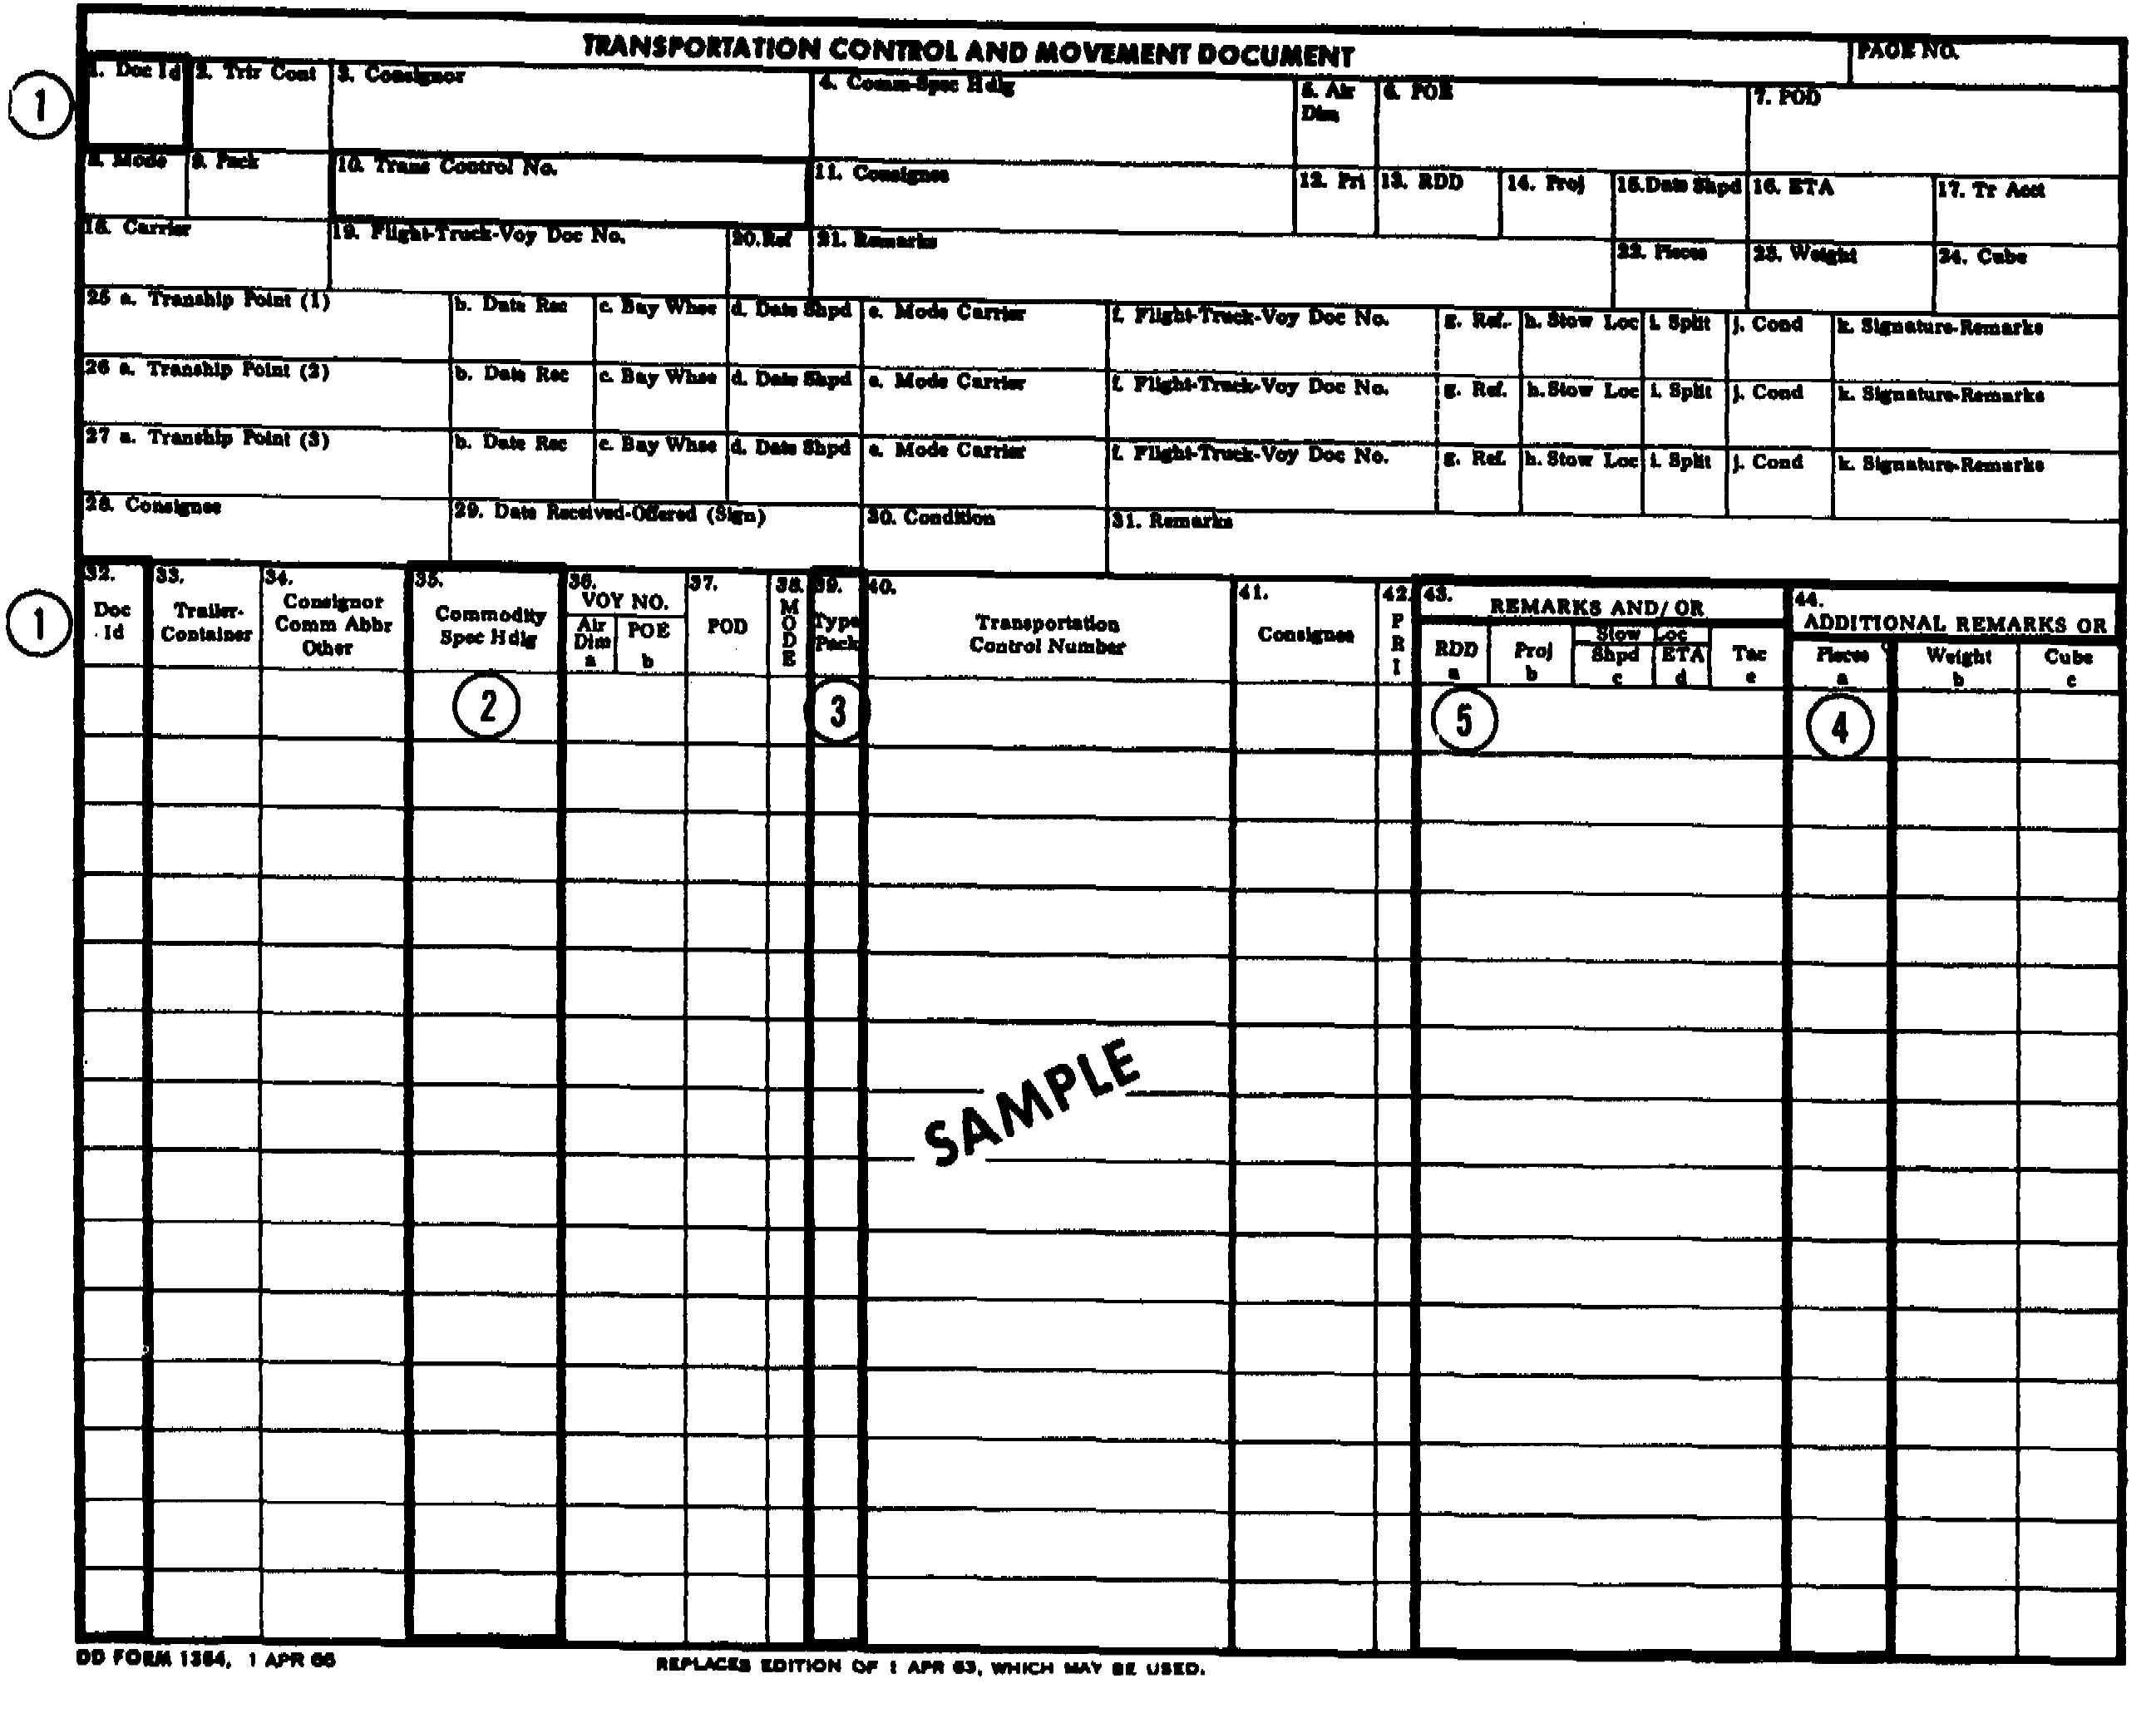

Slide 8
Item 1: The "Doc ID," or Document Identifier block (block numbers 1
and 32). The Document Identifier code is a three-position
alphanumeric field in which the first position is always "T." The
letter "E" in the second position indicates a shipment of ammunition
and explosives; the letter "J" in the second position indicates a
shipment of hazardous materials other than ammunition and explosives.
For example, if the Document Identifier shows "TJ," the shipment
consists of hazardous material other than ammunition and explosives.

Slide 9
Item 2: The "Commodity Spec Hdlg," or Commodity/Special Handling
block (block number 35). The Commodity/Special Handling Code is a
five-position alphanumeric field that identifies a particular cargo
and provides special information pertaining to a particular shipment.
The format of this alphanumeric field is explained in Paragraph 12 of
Appendix B of MILSTAMP. MILSTAMP contains a number of codes
corresponding to the commodities shipped through the military
transportation system. The first three positions of the
Commodity/Special Handling Code indicate the general type of
commodity being shipped and are shown at Figure 1-2. The fourth
position of the code indicates the type of cargo and also shows if
the commodity is a hazardous material.

Slide 10
• Hazardous cargo. Nearly all classes of hazardous material
fall within certain ranges on the first three positions of the
code. Ammunition, explosives, most oxidizers, most acids, and
radioactive substances have codes ranging from 400 to 499.
Petroleum products, other than bulk, have codes ranging from
600 to 609. Chemicals and compressed gases have codes ranging
from 630 to 639. These ranges of codes include most types of
hazardous material your unit is likely to transport. The
commodity code categories are summarized in alphabetical order
with a cross reference to specific commodity codes listed in
numerical sequence.

Slide 11
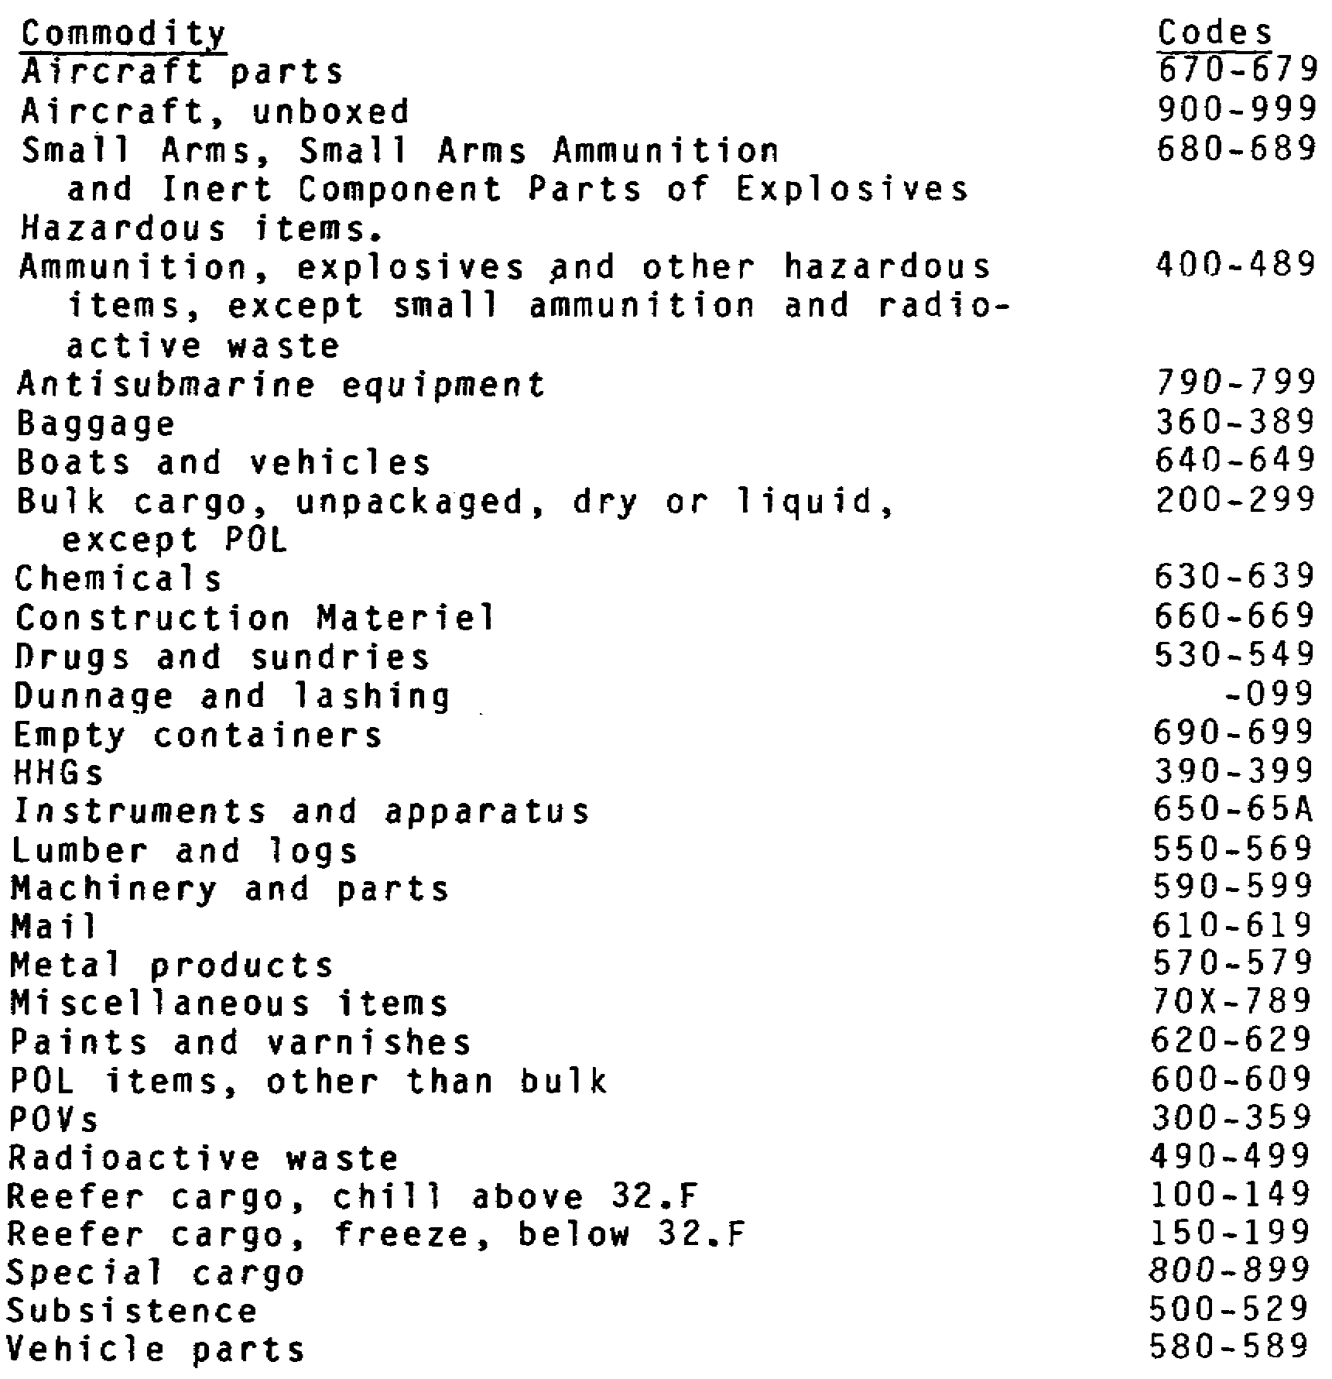

Slide 12
The fourth position of the Commodity/Special Handling Code is keyed
to Paragraph 14 of Appendix B of MILSTAMP and is shown at Figure 1-3.
This figure lists general characteristics of cargoes, including the
general types of hazardous cargoes. These characteristics are keyed
to an alphanumeric character that is in the fourth position of the
Commodity/Special Handling Code. In Figure 1-3, six codes--the
characters H, M, Q, Z, 1 and 2--are associated with nonhazardous
cargo. Any character other than these in the fourth position of the
code indicates hazardous material.

Slide 13
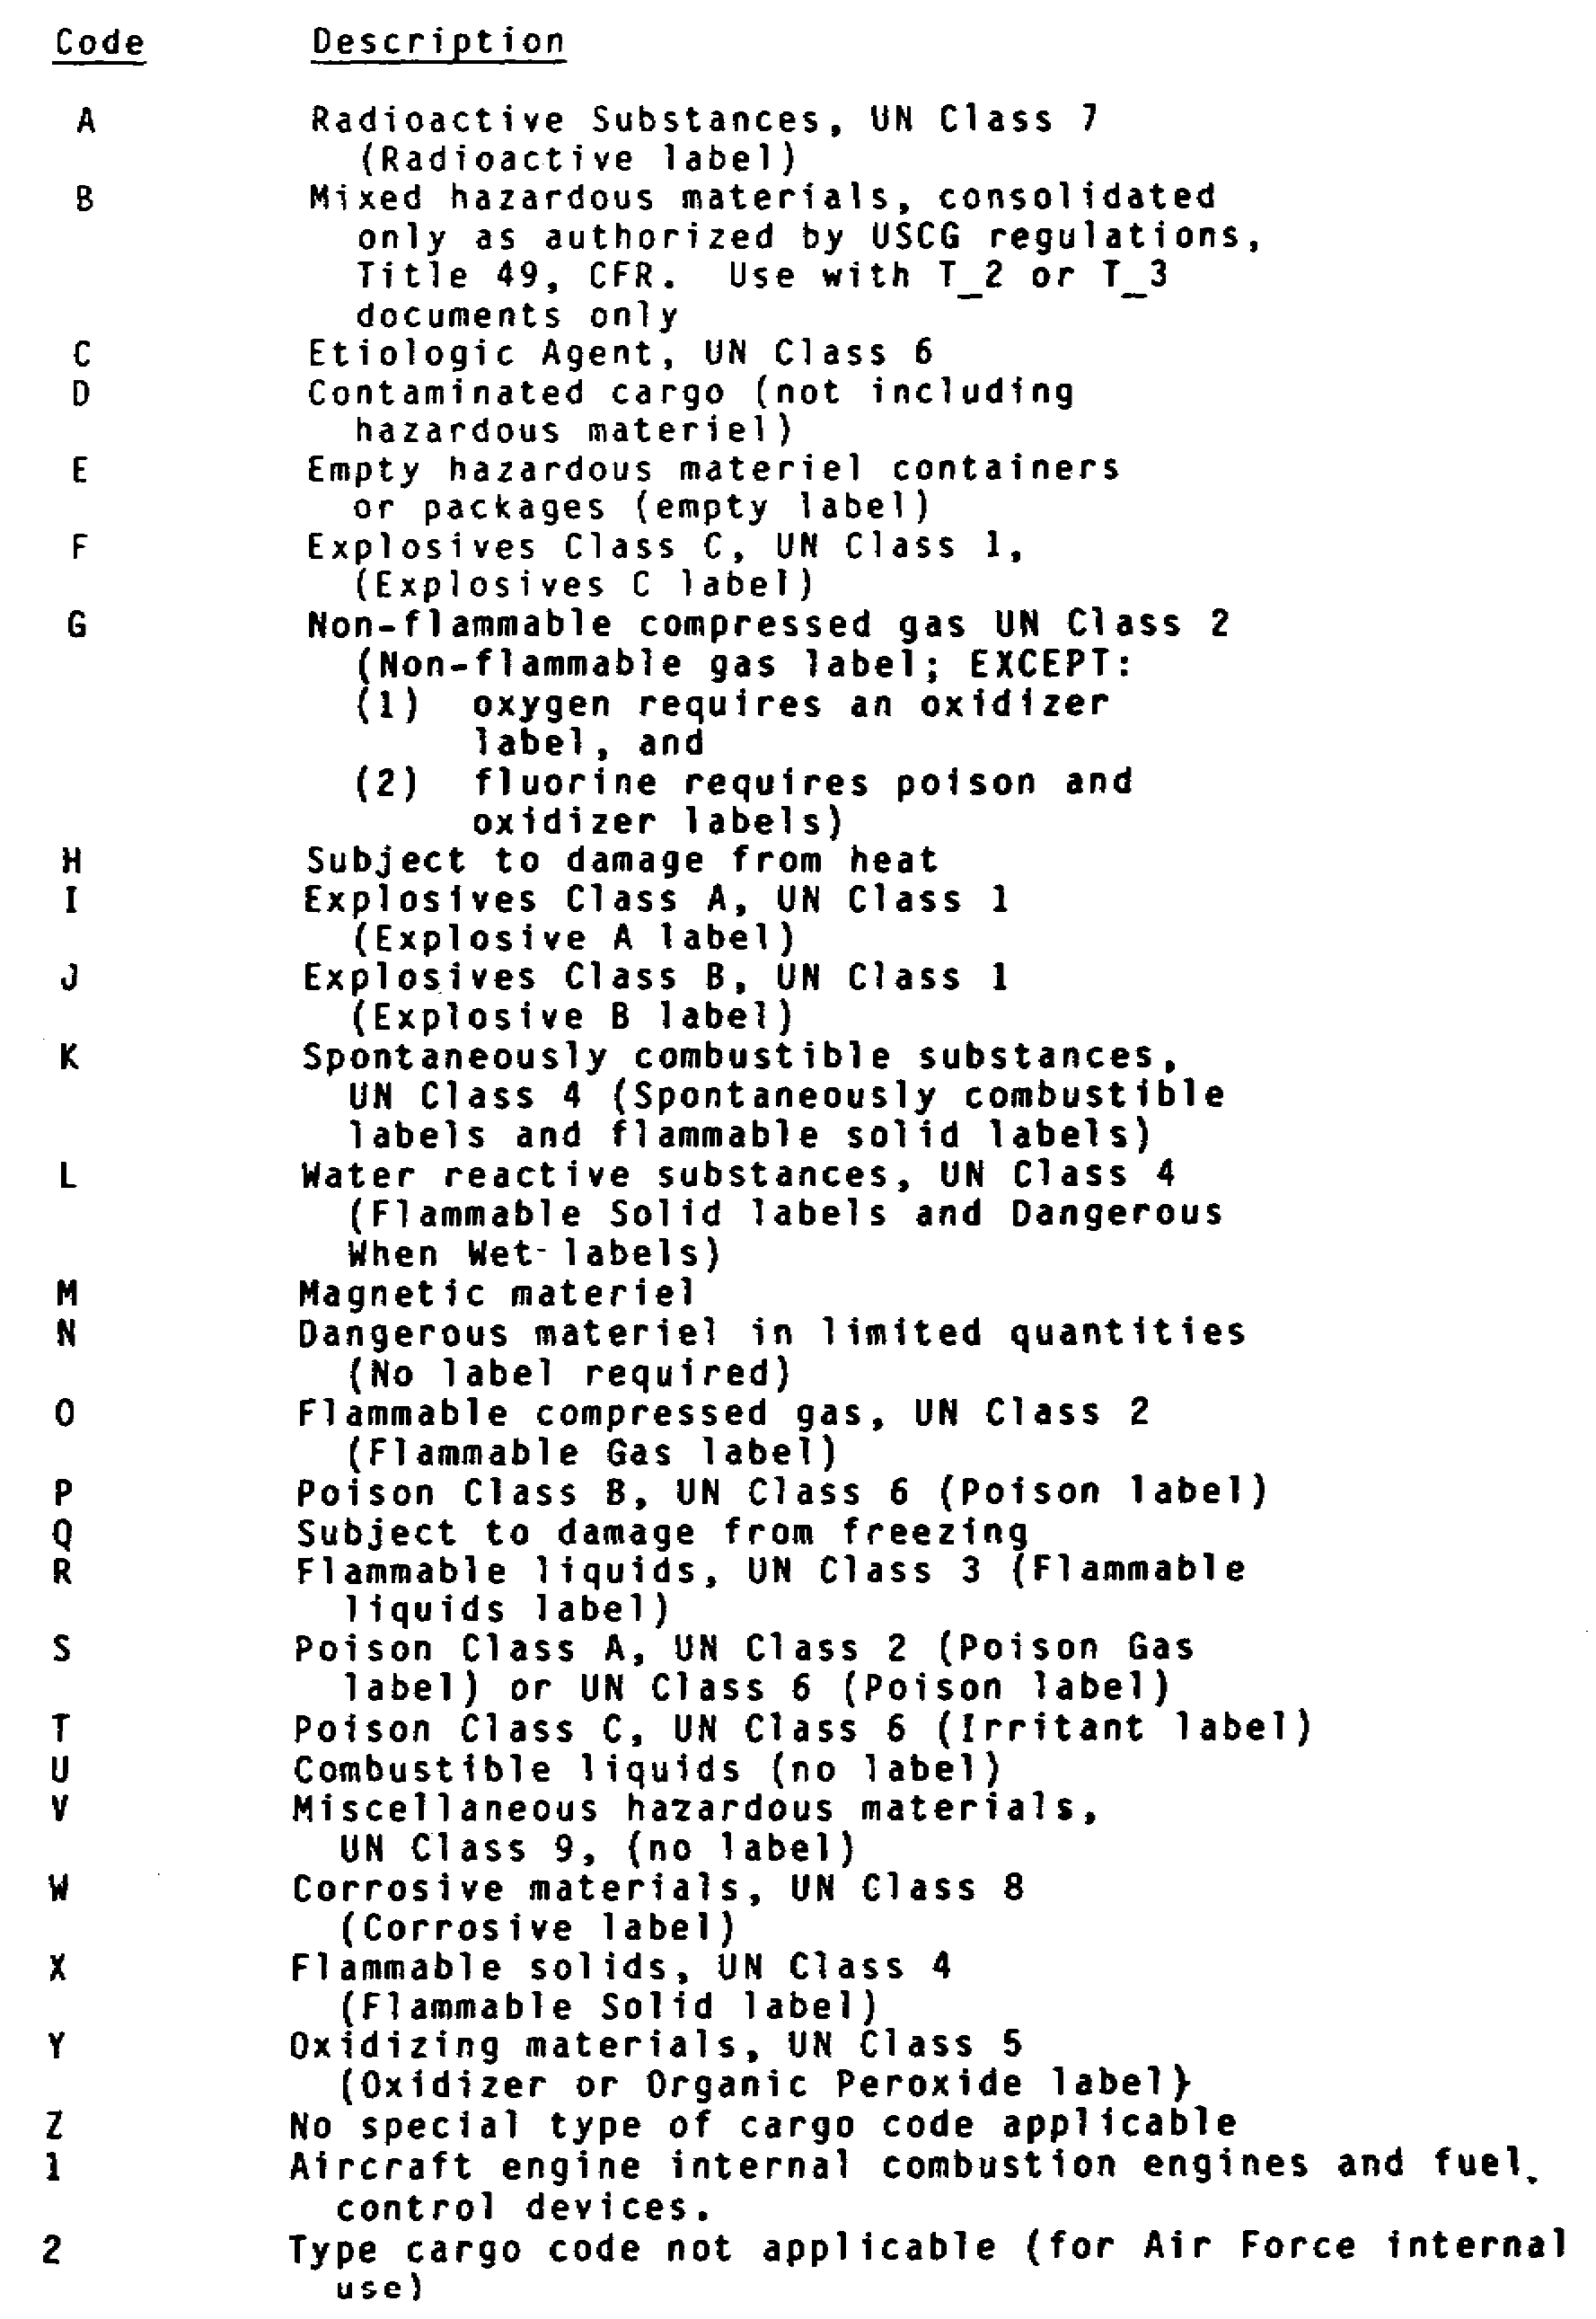

Slide 14
Sensitive Cargo. Sensitive cargo is a special MILSTAMP cargo
category. Sensitive cargo includes small arms, ammunition,
and explosives which are a definite threat to public safety
and can be used by militant, revolutionary, criminal or other
elements for civil disturbances, domestic unrest, or criminal
actions. Sensitive cargo is identified in the fifth position
of the Commodity/Special Handling Code. If a commodity is
sensitive, the fifth position of the Commodity Special
Handling Code is either 4, D, M, or U.

Slide 15
Item 3: The "Type Pack" block (block number 39). The Type Pack
Block is a two-position alphanumeric field that describes the way a
commodity is packaged. Codes for this field are found in Paragraphs
87 through 90 of Appendix B of MILSTAMP and are shown in Figure 1-4.
The Type Pack Code is useful for determining what a particular
hazardous commodity looks like especially when the commodity may come
in a variety of packages. The first position shows the type of
container in which the shipment is loaded; the second position
identifies who loaded the vans and to what capacity.

Slide 16
Item 4: The "Pieces" column (column a) of the "ADDITIONAL REMARKS
OR" block (block 44). The Pieces Column is a numeric field
indicating the number of pieces a particular shipment of cargo
includes. This information is important in keeping track of a
shipment that includes many pieces of hazardous cargo

Slide 17
Item 5: The "REMARKS AND/OR" Column (block 43). Classified cargo is
never identified as such on a TCMD. If cargo is classified, its
nature may be inferred from the type of security services required.
Any security requirement for a piece of cargo will normally be listed
in this block.
Items 3 and 4 of Figure 1-1 can apply to classified and sensitive
cargo as well as hazardous cargo

Slide 18
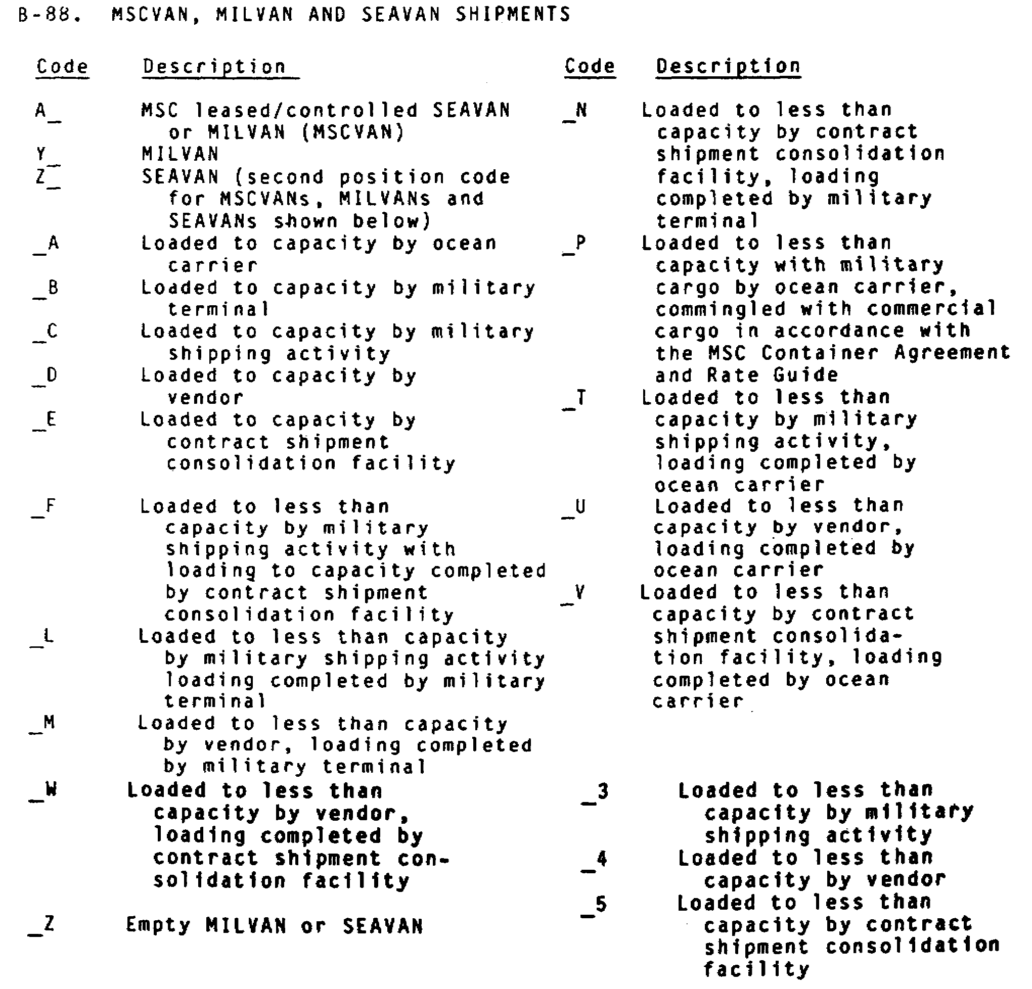

Slide 19
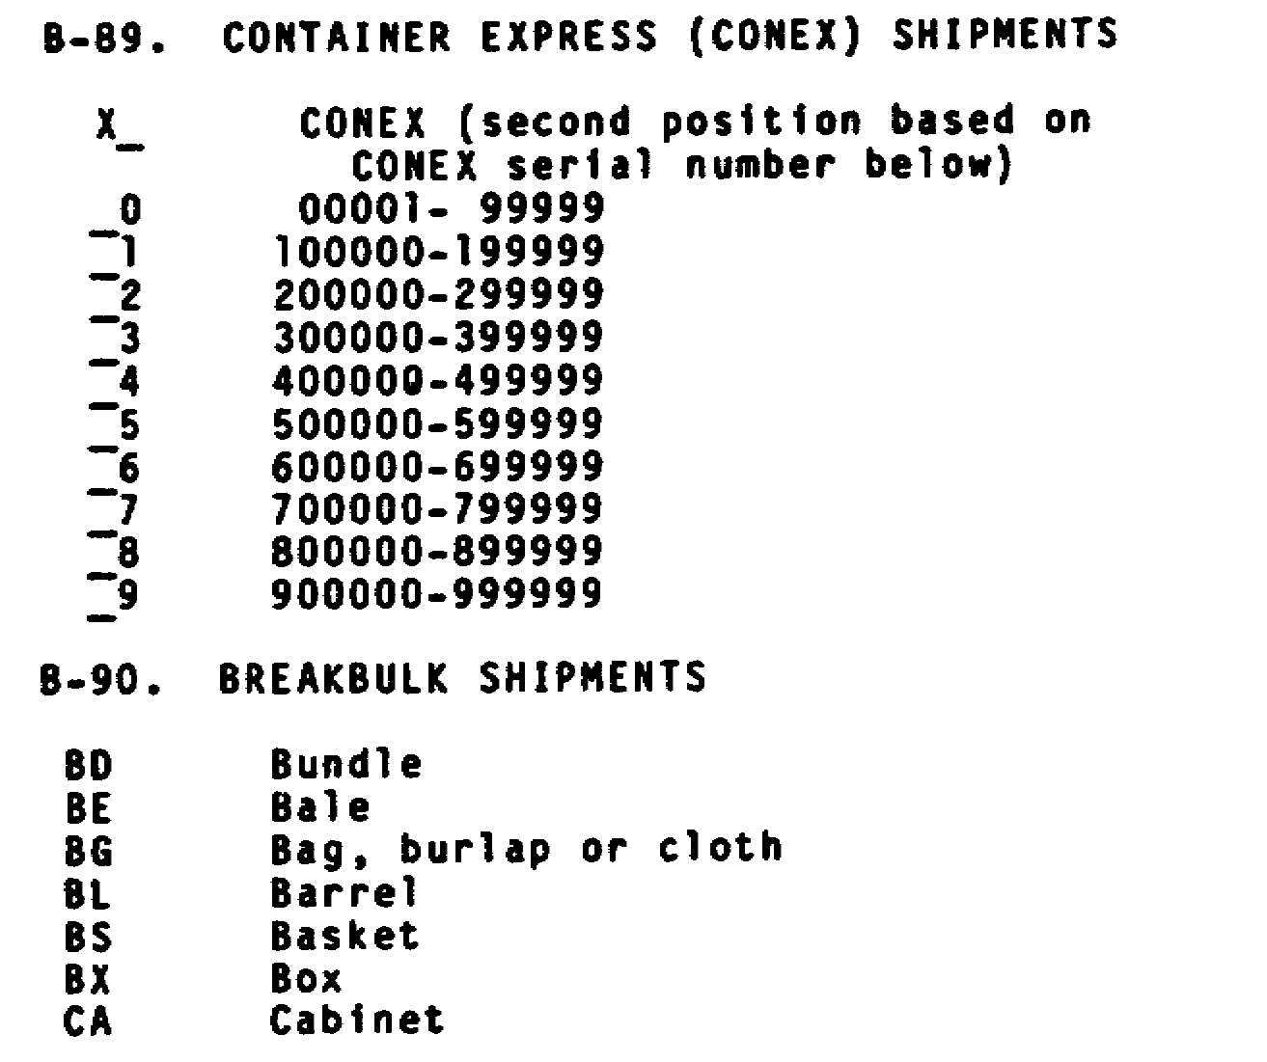

Slide 20
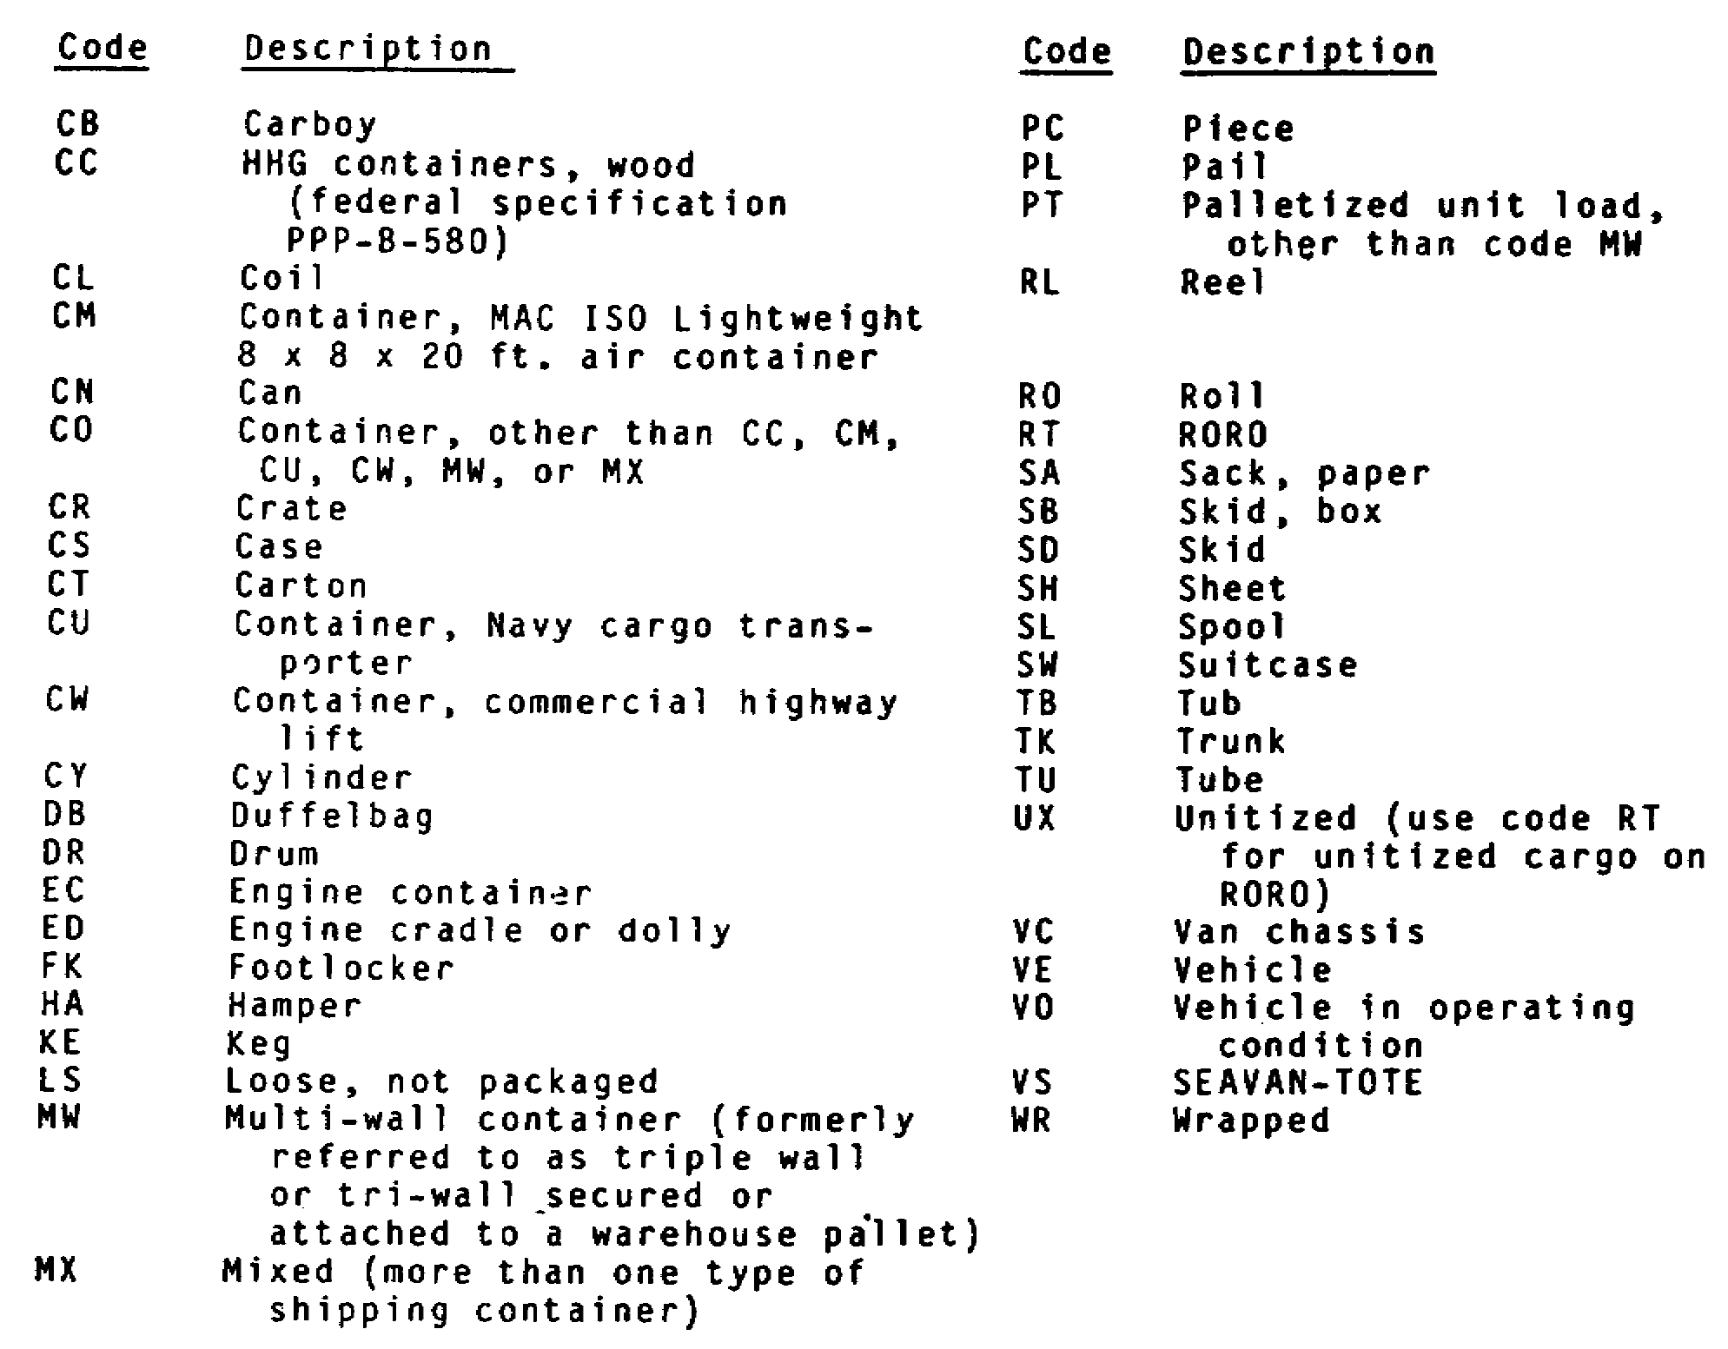

Slide 21
US Government Bill of Lading
The US Government Bill of Lading (Standard Form 1103), unlike the
TCMD, does not put information about hazardous or sensitive cargo in
code. Instead, that information, with the exception of a detailed
description of the cargo, appears in a group of blocks in the middle
of the form. Figure 1-5 shows a sample GBL keyed with circled
numbers.

Slide 22
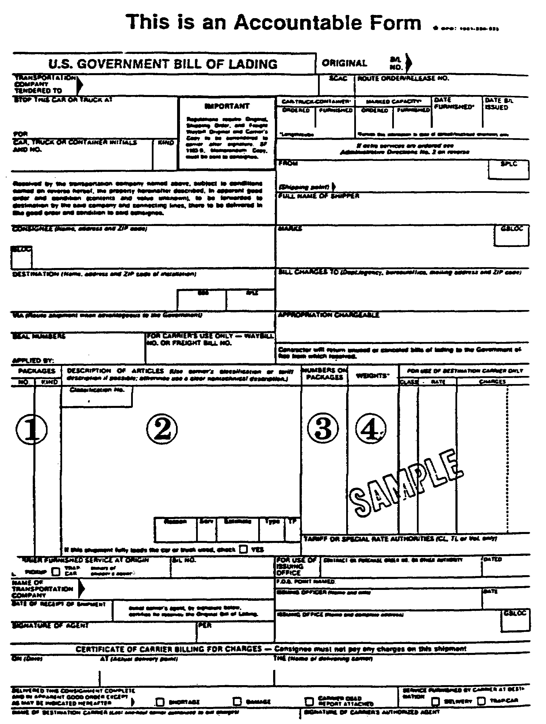

Slide 23
Key 1, the "PACKAGES" block, lists the number and kinds of packages
in the cargo. Key 2, the "DESCRIPTION OF ARTICLES" block, lists
standard, in-the-clear descriptions of the cargo. Key 3, the
"NUMBERS ON PACKAGES" block, lists the numbers appearing on each
piece of cargo if there is more than one piece in a shipment. Key 4,
the "WEIGHTS" block, lists the weight of each package and the cubic
measurements of each package where required.

Slide 24
Hazardous cargo may be identified in the "DESCRIPTION OF ARTICLES"
block (Key 2) by an in-the-clear description or by a United Nations
North American hazardous materials identification number. The United
Nations North American hazardous identification number is a
universally accepted standard of identifying hazardous materials by
the type of hazards they represent to property and personnel. The
identification numbers are matched to descriptions of the hazards in
Section 172.101 of CFR 49. Section 172.101 cross-references United
Nations identification numbers with other parts of Section 172 that
describe the different hazards. Pages from Section 172.101 appear in
Appendix B. To find a description of an item you must--

Slide 25
• locate the Identification Number symbol in column 1.
• note the part of Section 172 that describes the hazardous
material involved. This information appears in column 2.
• turn to the appropriate part of Section 172 for a description
of the hazards involved with that material

Slide 26
The hazards description usually appears on the GBL; however, if only
the UN identification number appears, consult Section 172.102 in
Appendix B.

Slide 27
Hazardous materials should be readily identifiable. Each piece of
hazardous material must display a standard hazardous materials label
in accordance with CFR 49. Figure 1-6 shows standard hazardous
materials labels. The TCMD often tells you in the REMARKS AND/OR
block what type Of hazardous materials label a commodity requires.
The fourth position of the Commodity/Special Handling Code also
indicates whether a. hazardous material label is required. The
description of the code in MILSTAMP Appendix B, Paragraph 14,
includes the type of hazardous materials label that a commodity
requires. See Figure 1-3.

Slide 28
The GBL usually indicates the type of hazardous materials label
required in the "DESCRIPTION OF ARTICLES" block (Key 2 of Figure
1-5). If it does not, look up the referenced United Nations
Identification Number and check the commodity description in CFR 49,
Hazardous Materials Table 172-102. Column 2 identifies the item;
Column 4 identifies the required labels. It is very important to
ensure each piece of hazardous cargo carries the appropriate material
label.

Slide 43
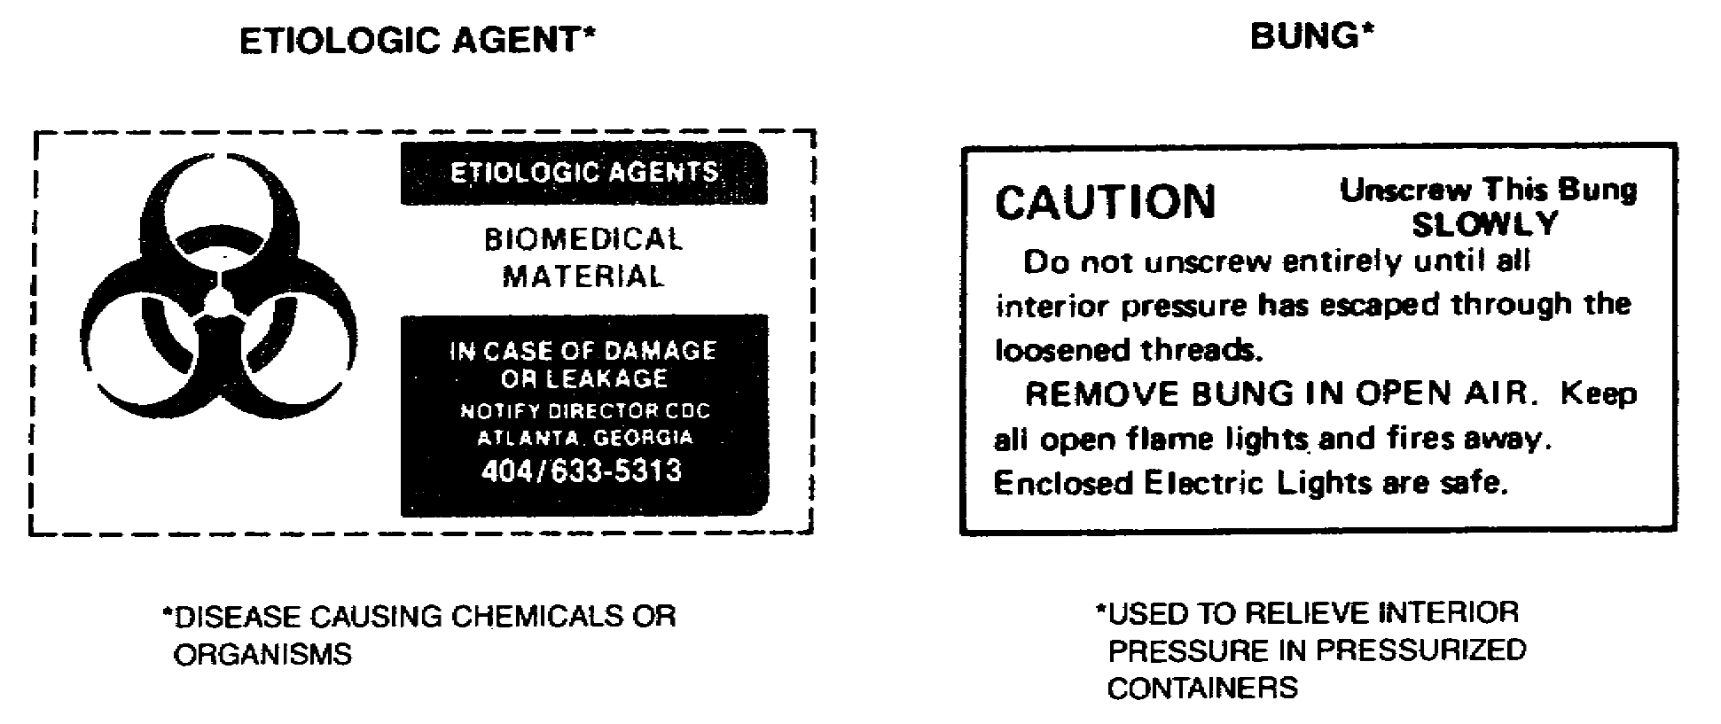

Slide 44
INSPECTING CARGO ITEMS FOR DAMAGE
When unit personnel are tallying cargo, instruct them to inspect each
piece of cargo for evidence of damage. Evidence of damage includes
the following:
• Stains.
• Leakage or spillage.
• Torn, cut, crushed, or mutilated packaging.
• Wetness.
• Loose or rattling contents.

Slide 45
If evidence of damage is found, personnel should immediately notify
you or appropriate safety personnel so the damaged cargo can be
inspected and repacked or removed from the loading area

Slide 46
PART B - INSPECT AND PLACARD VEHICLES
Army Regulation 55-355, Military Traffic Management Regulation,
requires that motor vehicles carrying hazardous cargo be inspected
prior to loading and unloading, and that they display appropriate
hazardous materials placards. The regulation also requires a
preloading inspection and placarding of all railcars carrying
hazardous cargo.

Slide 47
MOTOR VEHICLE AND TRAILER INSPECTION USING
DD FORM 626
AR 55-355 requires that motor vehicles and trailers used to transport
hazardous materials use DD Form 626 as the inspection document.
Personnel will inspect the vehicle and correct any deficiencies noted
on the DD Form 626 before the vehicle enters the loading/unloading
area.
A sample DD Form 626, Motor Vehicle Inspection (Transportation
Hazardous Materials) appears in Figure 1-7. Instructions for
completing DD Form 626 appear on the back of the form.

Slide 48
RAILCAR INSPECTION USING CAR CERTIFICATES
If you are shipping hazardous material by railcar, you must conduct
two preloading inspections before loading hazardous cargo. These
preloading inspections are recorded on a Car Certificate (see Figure
1-8). The Car Certificate is a three-part form. The carrier files
the original copy and attaches one copy to each outer side of the
fixed placard board of the railcar.

Slide 49
The carrier representative makes the initial inspection, and approves
the car for service by signing certification number one on the car
certificate. You, as the shipper, or someone authorized by you, must
conduct a second preloading inspection. After loading, the shipper
must inspect the car again, and sign certification number two on the
Car Certificate to indicate that the cargo is properly loaded and is
ready for transport. In addition, if the shipment of hazardous cargo
is in containers or on trailers, the carrier representative or you,
as the shipper, must ensure that these containers are properly
secured on the flatcar. The carrier representative or the shipper
signs certification number three on the Car Certificate when the
containers or trailers holding hazardous cargo are properly secured.

Slide 50
The carrier representative and shipper should consider the following
criteria when making preloading or loaded car inspections

Slide 52
• Preloading Car Inspection Criteria. This includes but is not
limited to, the following:
- Air and hand brakes must be serviceable.
- Brake shoes must be at least 3/8-inch thick, and in safe
and suitable condition for service.
- Journal boxes must be properly packed, oiled, and
covered. Trucks and springs must be in good condition.
Bearing wedges must not be bent, cracked, or broken.
Boxcars must be equipped with journal roller bearings.
Friction bearings are no longer allowed in interchange railroad
service.
http://www.amstedrail.com/aar/C7490.htm

Slide 53
- Coupling and hoses must be in good condition.
- Spark shields must meet safety requirements which include
no holes or decayed metal; and no accumulation of oil,
grease, or other debris which could support combustion.
- Door runners and channels must be inspected for damage.
If door gaps cannot be sealed by stripping, the car will
be rejected.
- Placard holders and doorkeepers must be installed in the
proper places.
- Cargo space in cars must be swept clean before loading,
- Roofs with holes or decay will be rejected.

Slide 54
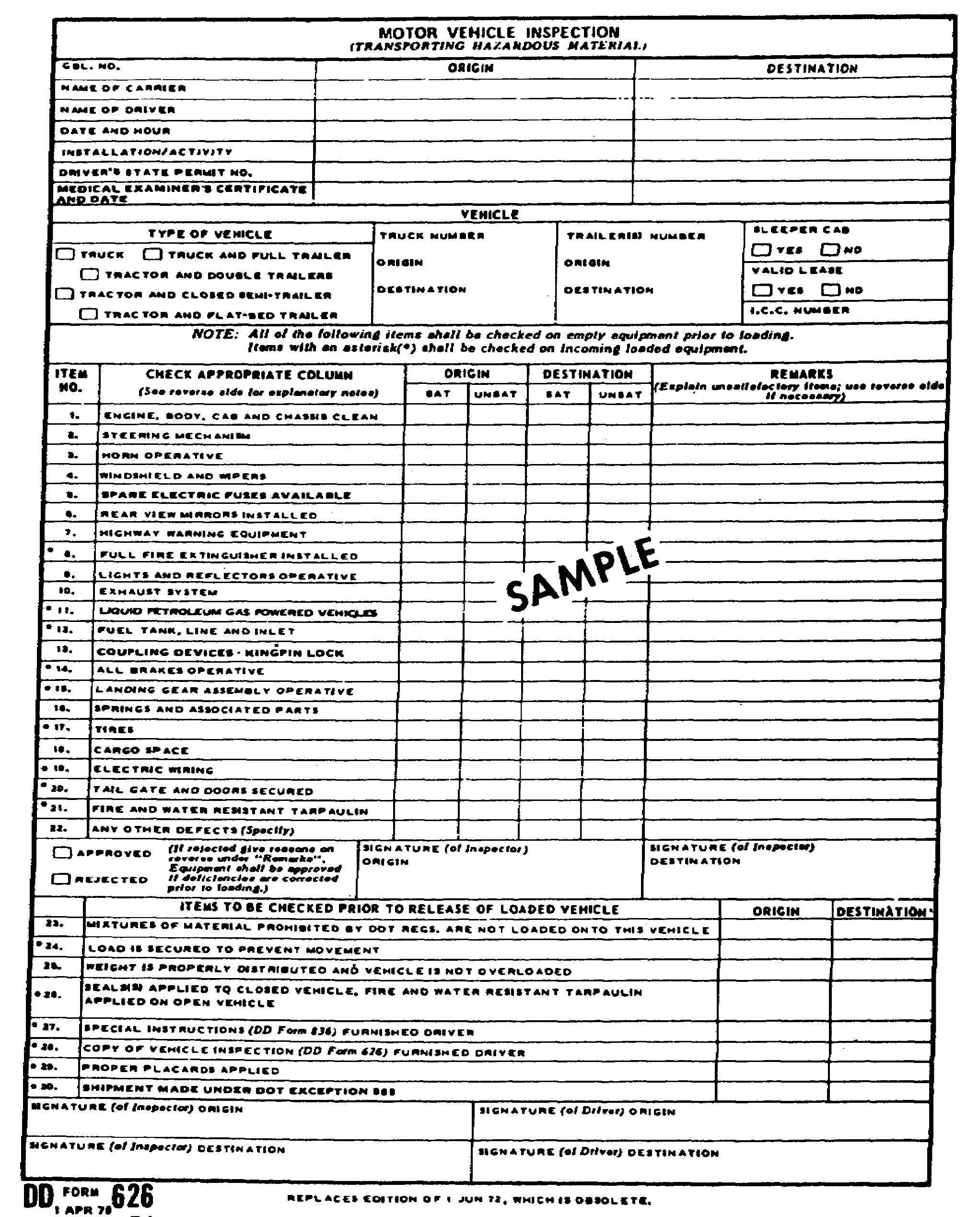

Slide 55
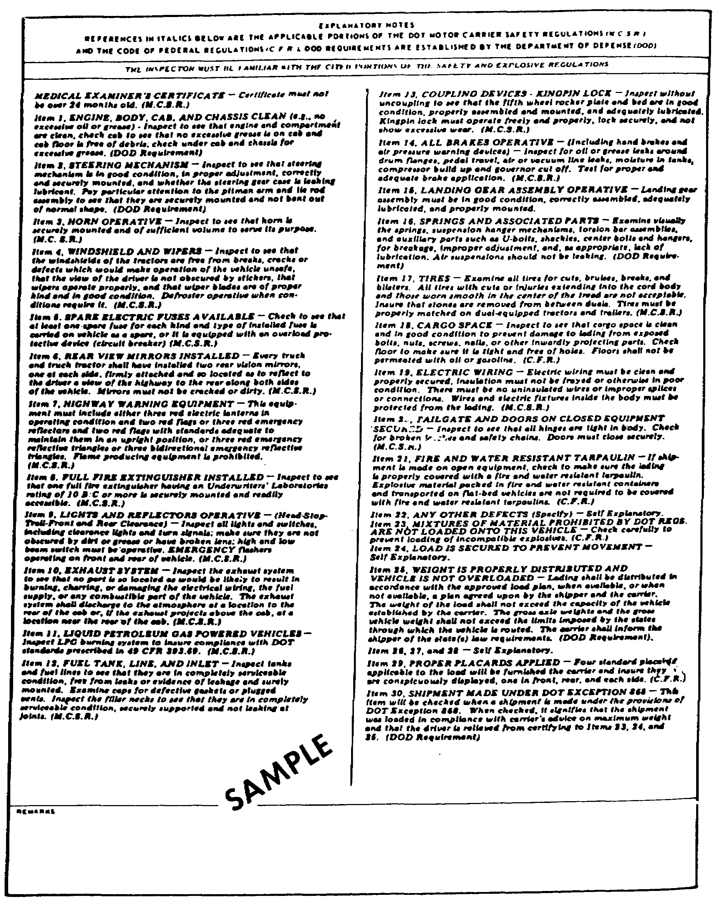

Slide 56
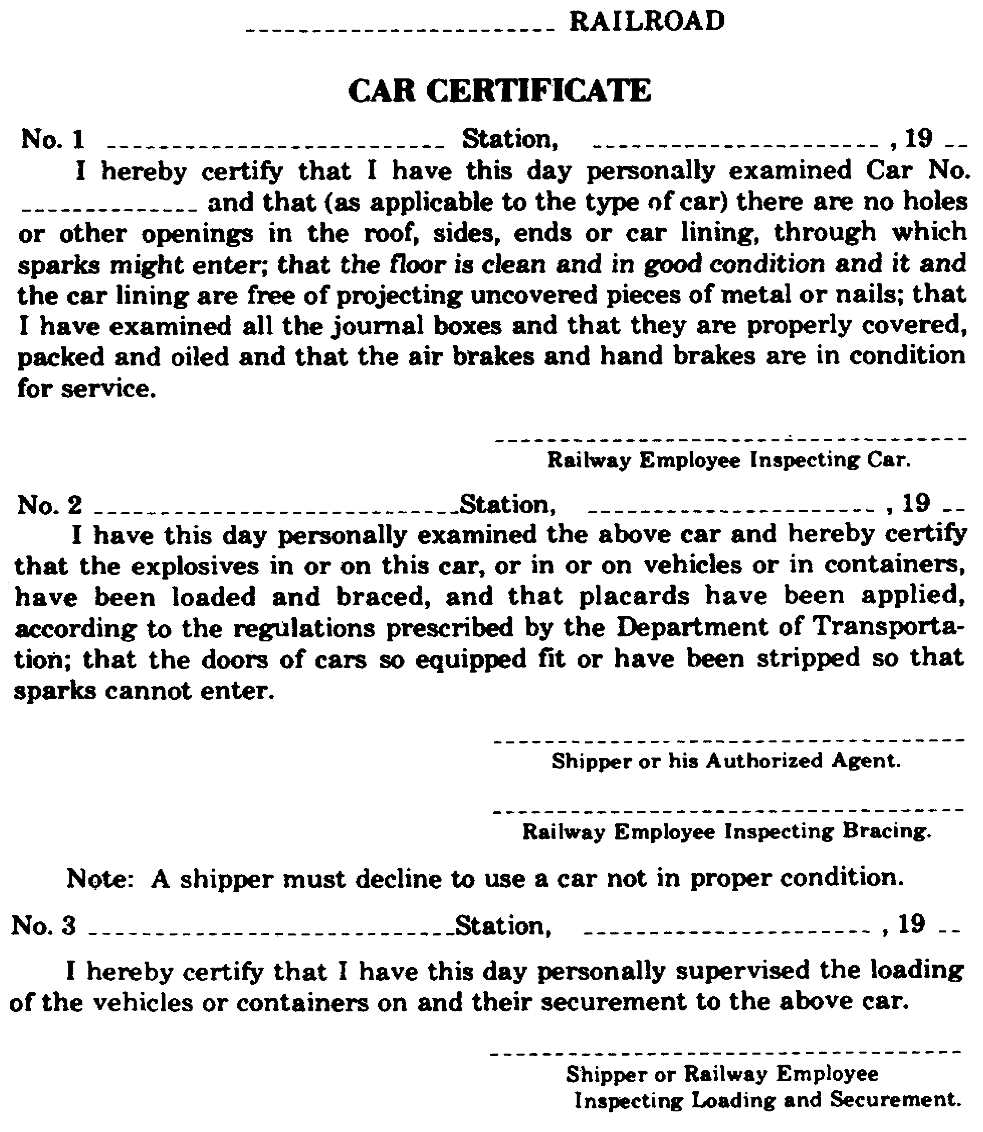

Slide 57
• Loaded Car Inspection Criteria. This includes, but is not
limited to, the following:
- Load must be properly blocked, braced, and shored in
accordance with Military Standard Transportation and
Movement Procedures (MILSTD) or other military service
drawings.
- Shipment must not contain any combination of explosives
or dangerous articles prohibited by Department of
Transportation (DOT) regulations from being loaded,
transported, or stored together.
- All items must be in good condition and marked in
accordance with DOT and other applicable regulations.
- Placards must be properly placed.

Slide 58
PLACARD VEHICLES/RAILCARS IN ACCORDANCE WITH CFR 49 AND AR 55-355
Department of Transportation hazardous materials transportation
regulations in CFR 49 and Army Regulation 55-355 require that all
vehicles/railcars transporting hazardous materials must have placards
indicating the nature of their cargo. Every vehicle/railcar with any
quantity of a hazardous material must be placarded on each end and on
each side with the type of placards specified in the CFR 49 tables
reproduced in Figure 1-9. The various hazardous materials placards
look like larger versions of the hazardous materials labels.

Slide 59
A vehicle/railcar carrying two or more classes of hazardous materials
requiring different placards specified in Figure 1-9, Table 2 may be
placarded DANGEROUS in place of the different placards. However,
when 5,000 pounds or more of one class of hazardous material is
loaded in a vehicle/railcar, the vehicle/railcar must display the
appropriate placard for that hazardous material in addition to the
DANGEROUS placard. This regulation does not apply to a portable
tank, cargo tank, or tank car. No placard is required on a vehicle
if it contains less than 1,000 pounds total of any of the materials
listed in Figure 1-9, Table 2.

Slide 60
If your unit is responsible for shipping hazardous materials, you
must provide the carrier with the appropriate hazardous materials
placards. If your unit is a motor or rail transportation unit, you
must obtain appropriate hazardous materials placards from the shipper
at the time the cargo is loaded. If hazardous material is shipped in
freight containers having a capacity of 640 cubic feet or greater,
each freight container must display the appropriate placard.

Slide 61
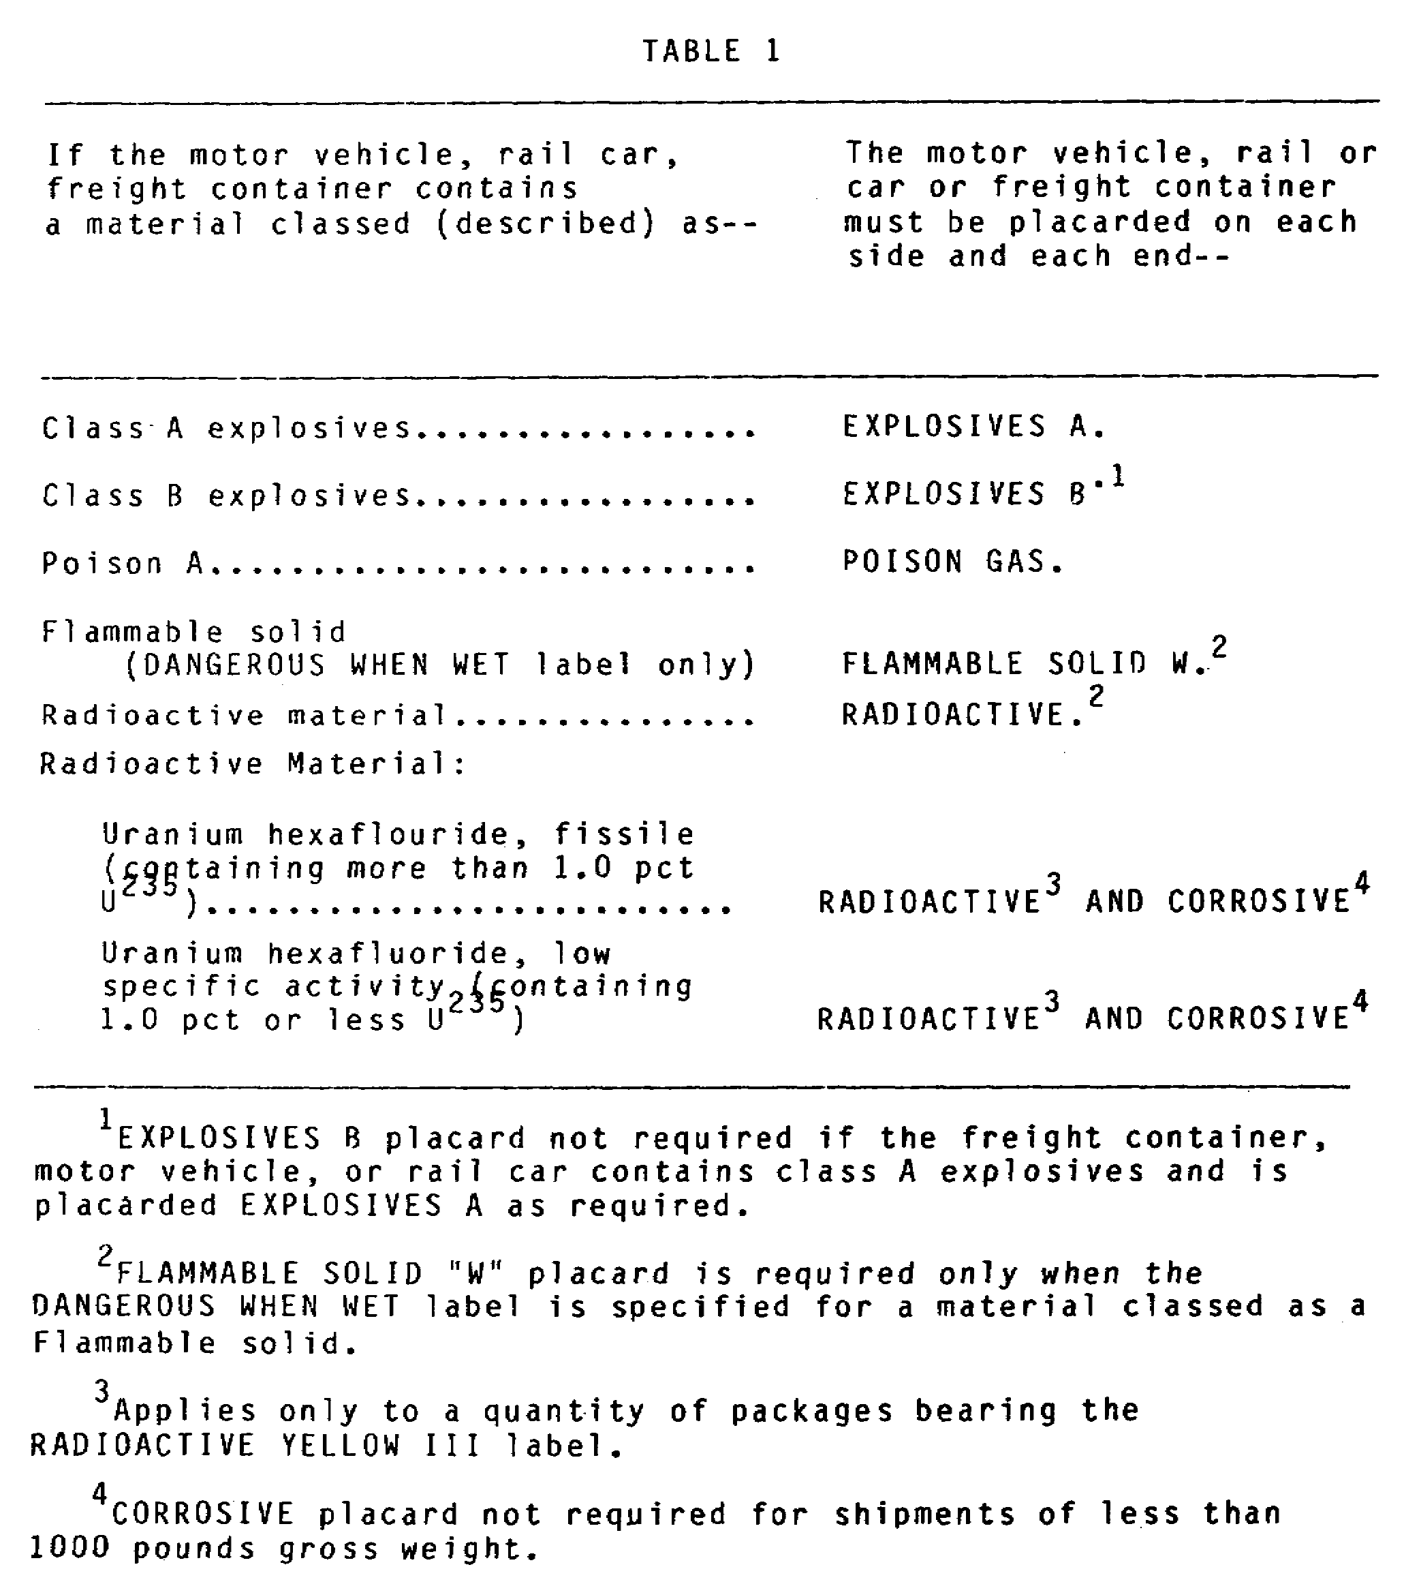

Slide 62
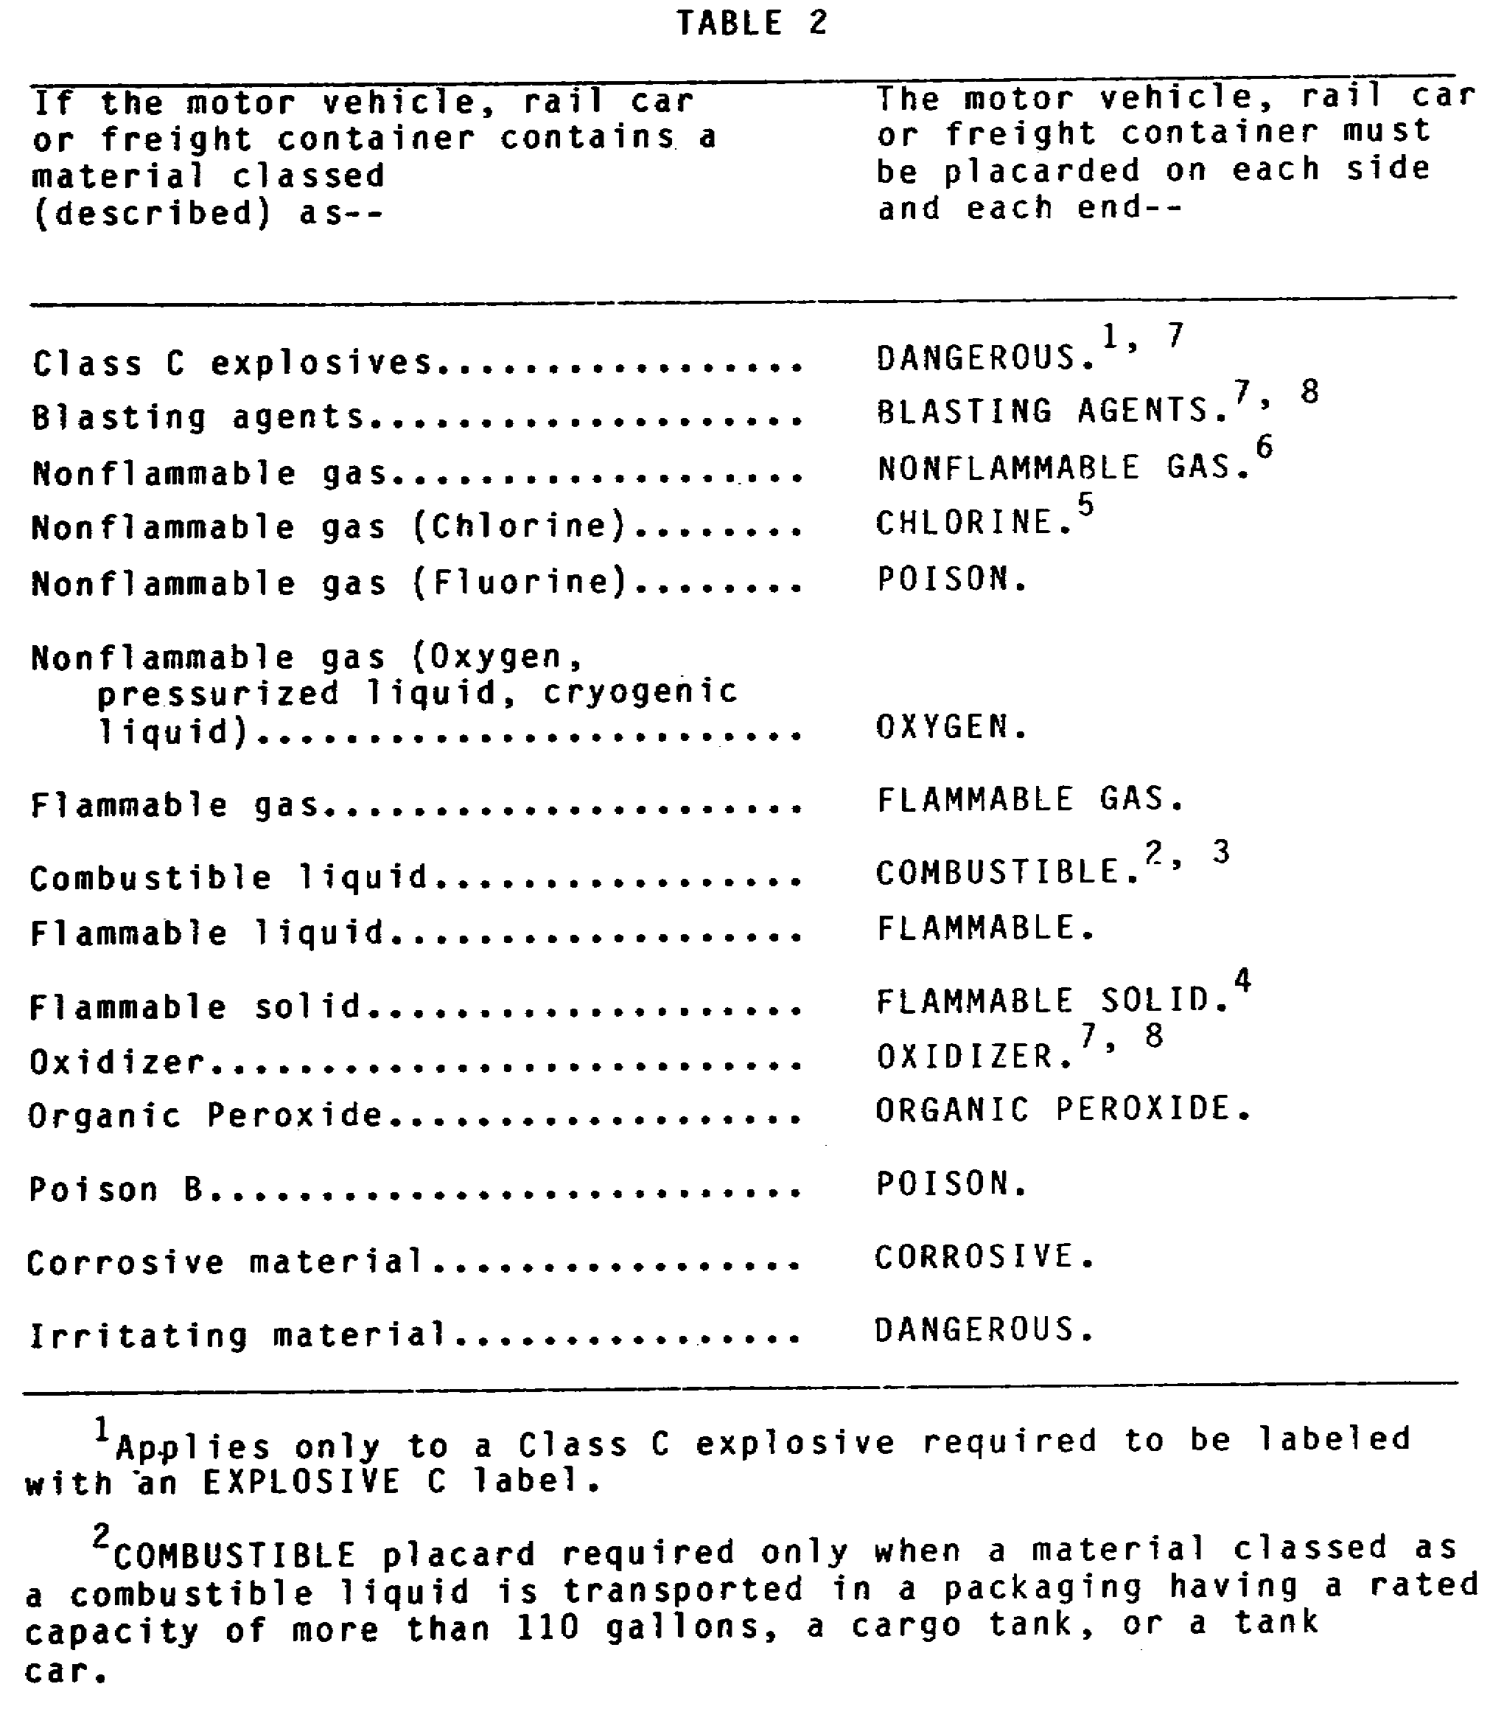

Slide 63
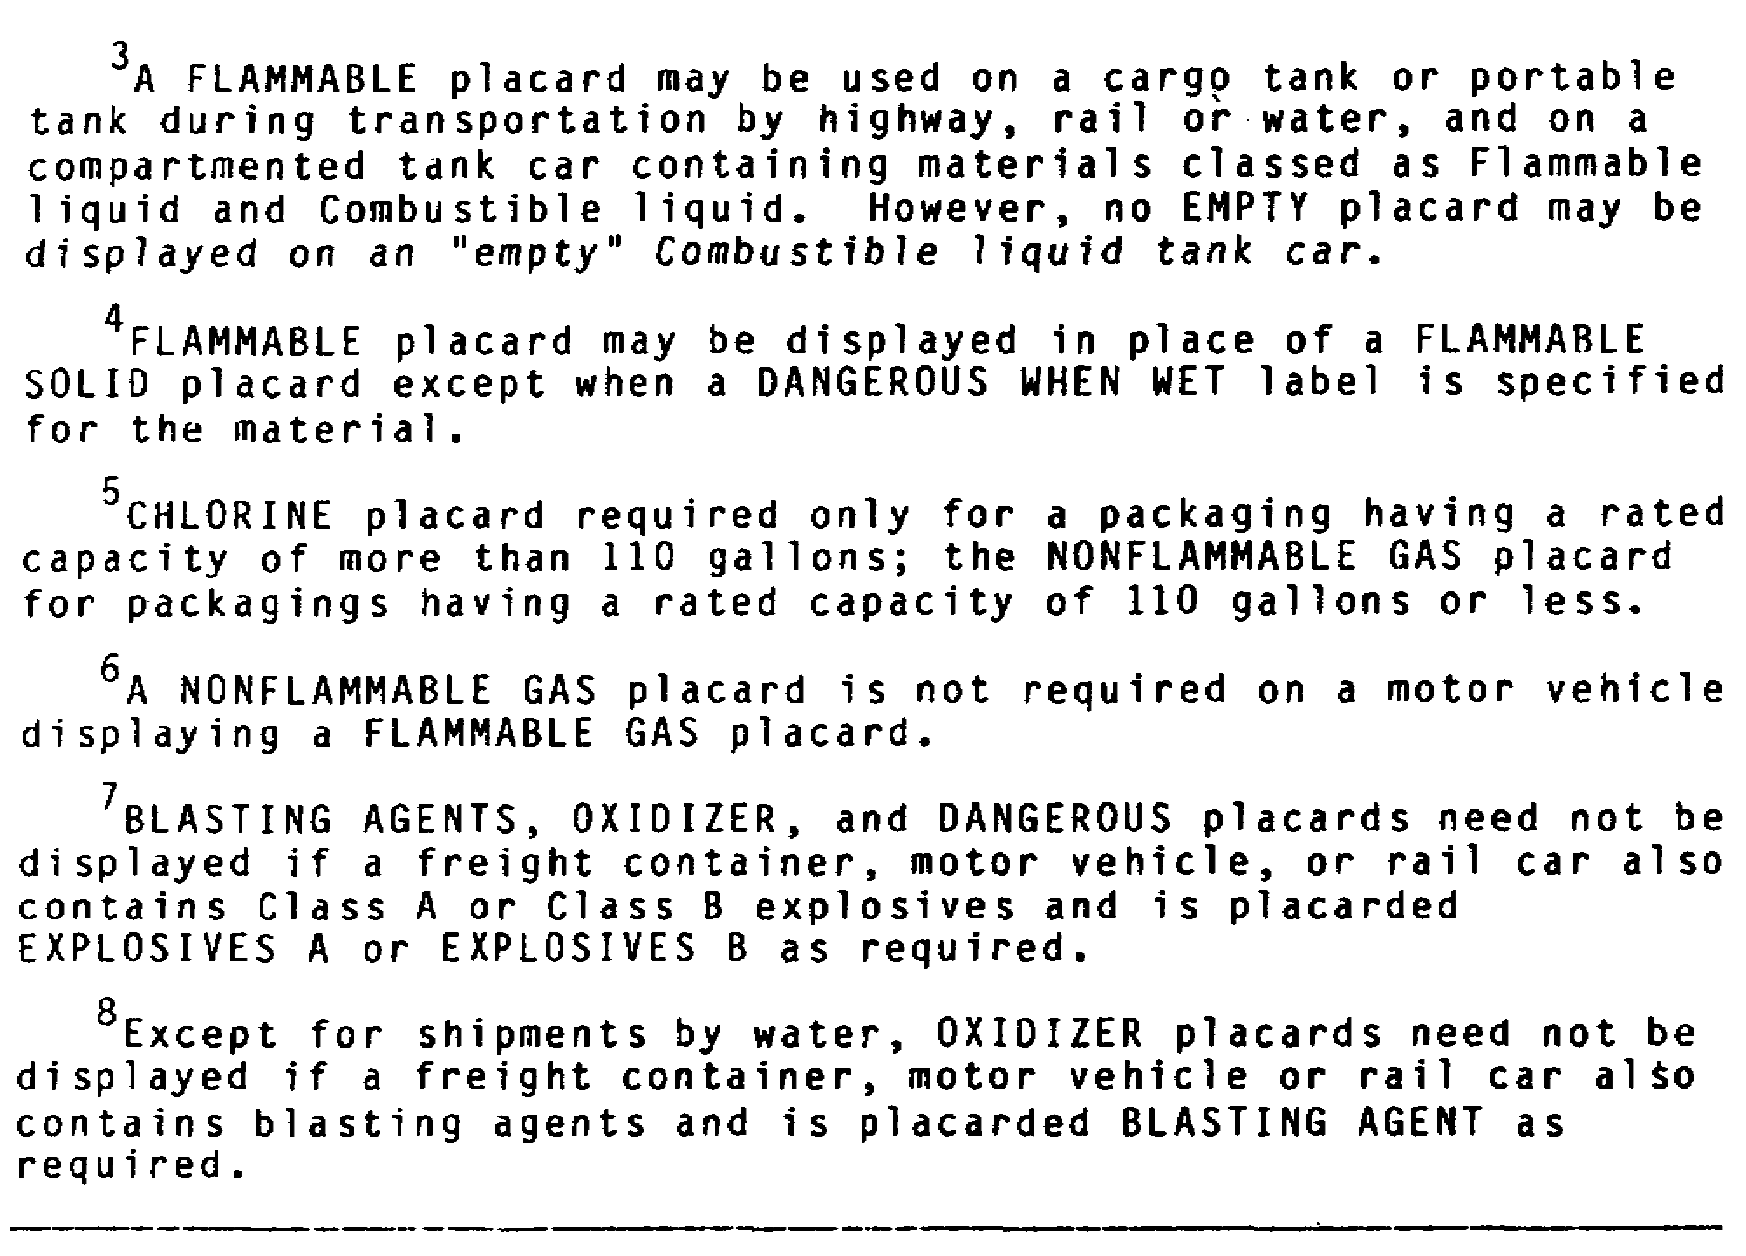

Slide 64
PART C - INSPECT LOADED CARGO
You should always ensure that cargo is properly loaded to prevent
damage to cargo, damage to equipment, and injury to personnel. This
part will discuss the procedures and regulations to follow when
loading hazardous cargo.

Slide 65
CARGO COMPATIBILITY RULES OF CFR 49
Many types of hazardous materials are incompatible with one another.
Transporting incompatible hazardous materials together is prohibited
by CFR 49.

Slide 66
Section 174.81 of CFR 49 contains a Segregation and Separation Chart
of Hazardous Materials in railcars. The table shows which hazardous
materials (principally ammunition and explosives) must not be loaded
or stored together and is located in Appendix B of this subcourse.
The table is a matrix listing hazardous materials in horizontal row
and vertical column. The articles listed here must not be loaded or
stored together. For example, detonating fuzes Class A, with or
without radioactive components (g in the column) must not be loaded
or stored with high explosives or propellent explosives Class A (b in
the row). If a dotted line appears at an intersection of a row and
column, the articles listed may be loaded or stored together.
Exceptions and limitations are indicated by footnotes

Slide 67
Section 177.848 of CFR 49 contains the Segregation and Separation
Chart of Hazardous Materials for determining compatibility when
shipping by motor vehicle. The table, which is reproduced in the
extract of CFR 49 (see Appendix B) is read in the same manner as the
table in Section 174.81.

Slide 68
In general, hazardous materials that are not specified as
incompatible in these tables may be shipped together. Hazardous
materials may generally be transported with nonhazardous materials.
There is one major exception to this rule: A carrier may not
transport any package of material bearing a poison label with food
stuffs, feed, or any edible material intended for consumption by
humans or animals.

Slide 69
MOTOR VEHICLE TRANSPORT
The following measures are required in the loading and securing of
hazardous materials when transport is by motor vehicle.
General Handling Requirements
• Secure and brace packages to prevent movement in the vehicle.
• Do not permit smoking or open flame while loading or
unloading.
• Set vehicle handbrake while loading and unloading.
• Do not use tools which may damage packages for loading or
unloading.

Slide 70
• Do not permit extremes of temperature during transport.
• Load flammable solids, oxidizing materials, or corrosive
liquids with compatible cargo, so they are easily accessible.
• Severely restrict use of cargo heaters when hazardous material
is being transported.

Slide 71
Explosives Handling Requirements
• Do not load or unload explosives from any motor vehicle with
the engine running.
• Do not use bale hooks and other metal tools for loading,
unloading, or handling.
• Do not roll packages except for barrels and kegs.
• Keep all packages away from hot vehicle tailpipes and sources
of sparks.
• Equally distribute the weight of the cargo over the load bed
as much as possible.
• Secure tarpaulins by means of rope, wire, or other tiedowns.
• Do not load or carry Class A explosives on any vehicle or
combination of vehicles if--

Slide 72
• Do not load or carry Class A explosives on any vehicle or
combination of vehicles if--
- more than two cargo-carrying vehicles are in the
combination.
- any full trailer in the combination has a wheel base of
less than 184 inches.
- any vehicle in the combination is a tank motor vehicle.
- the other vehicle in the combination contains any
initiating explosive, packages of radioactive materials
with "Yellow III" labels, Class A or B poisons, or
hazardous materials in a portable tank.

Slide 73
• Ensure transport vehicles have tight floors with no
projections that may damage packages.
• Do not transport detonating primer on the same motor vehicle
with any Class A or Class B explosive.
• Contain explosives entirely within the body of the motor
vehicle.
• Close the vehicle tailgate and secure it during transport.
• Transport explosives in a closed vehicle or in an open vehicle
cargo bed covered with a tarpaulin.
• Secure and separate packages or containers which may damage
explosives.

Slide 74
• Do not transfer explosives on any public highway, street, or
road, except in an emergency.
• Do not load liquid nitroglycerin, desensitized liquid
nitroglycerin, or diethylene glycol dinitrate directly above
any other explosive, or in any quantity in excess of 900
quarts on one motor vehicle or 10 quarts in any one individual
container. The net load should not exceed 7,500 pounds

Slide 75
• No handling or transportation restrictions are necessary for
practice ammunition containing no explosive or other dangerous
articles. This includes cartridge cases, dummy or drill
cartridges, sandloaded projectiles, sandloaded bombs, empty
projectiles, empty mines, empty bombs, solid projectiles, or
empty torpedoes. Rotating bands should be appropriately
protected against deformation.

Slide 76
Flammable Liquids Handling Requirements
• Stop vehicle engine unless it is operating a pump.
• Bond and ground cargo containers prior to and during transfer
of cargo. For containers which are not in metallic contact
with each other, provide either metallic bonds or ground
conductors for the neutralization of possible static charges
prior to and during transfers of flammable liquids between
such containers. Connect an electric conductor to the
container to be filled and

Slide 77
subsequently connect the conductor to the container from which
the liquid is to come, in that order. To provide against
ignition of vapors by discharge of static electricity, make
the latter connection at a point well removed from the opening
from which the flammable liquid is to be discharged.
• Bond and ground cargo tanks before and during transfer of
cargo. When a cargo tank is loaded through an open filling
hole, one end of a bond wire should be connected to the
stationary system piping and the other end to the shell of the
cargo tank to provide a continuous electrical connector.

Slide 78
Handling Requirements for Flammable Solids and Oxidizers
• Close and secure vehicle tailgate during transport.
• Transport cargo in a closed vehicle, an open vehicle cargo bed
covered with a tarpaulin, or in watertight containers.
• Keep cargo dry during handling and transport.
• Load material subject to spontaneous combustion or heating to
afford adequate ventilation so the cargo does not overheat and
catch fire. Unload vehicle as soon as practicable after
reaching its destination.

Slide 79
Corrosive Liquids Handling Requirements
• Handle carboys and other containers individually when loaded
or unloaded by hand.
• Load carboys only one tier high unless they are boxed or
crated, or are in barrels or kegs.
• Cargo should be stacked, blocked, and braced to prevent damage
during transport.
• Load storage batteries so they are insulated against short
circuit.

Slide 80
Compressed Gases Handling Requirements
• Ensure the floors of the vehicle cargo bed are as flat as
possible.
• Load cylinders onto any motor vehicle not having a floor or
platform only if the vehicle is equipped with suitable racks

Slide 81
Poisons Handling Requirements
• Use all practicable means to minimize the spread of poisons
into the atmosphere during loading or unloading.
• Load and unload away from public places and allow only
necessary personnel to be present.
• Do not permit the transportation of a Class A poison or an
irritating material if there is any interconnection between
packagings.

Slide 82
Radioactive Material Handling Requirements
• Limit the number of packages of radioactive materials in a
vehicle so that the total transport index number, as
determined by adding together the transport index numbers on
the labels of the individual packages, does not exceed 50.
The transport index of a package is the highest radiation dose
rate, in millirem per hour, at three feet from any accessible
external surface of the package.

Slide 83
• Packages of radioactive material bearing RADIOACTIVE YELLOW II
or RADIOACTIVE YELLOW III labels must not be placed in a motor
vehicle or in any other place closer than the distances shown
in Figure 1-10, to any area which may be continuously occupied
by passengers, employees, animals or undeveloped film. If
more than one of these packages is present, compute the
distance from Figure 1-11 based on the total transport index
number (determined by adding together the transport index
numbers on the labels of the individual packages). Where more
than one group of packages is present in any single location,
a single group may not have a total transport index greater
than 50. Each group of packages must be handled and stowed
not closer than 6 meters (20 feet), measured edge to edge, to
any other group.

Slide 84
• Load shipments of low-specific activity materials to avoid
spilling and scattering loose materials.
• Block and brace packages so that they cannot charge position
during transportation.
• Survey each vehicle used for transporting radioactive
materials under exclusive-use conditions with radiation
detection instruments after each use. Fixed and nonfixed
radiation should not exceed the standards listed in Section
173.443 and 177.843 of CFR 49 (these standards are not
provided).

Slide 85
RAIL TRANSPORT
The following measures are required in loading and securing hazardous
materials when transport is by rail

Slide 86
Explosives Forbidden for Transport
• Explosives which ignite spontaneously or undergo marked
decomposition when subjected to high temperatures (167°F or
greater) for 48 consecutive hours.
• Explosives containing an ammonium salt and a chlorate, or an
acidic metal salt and a chlorate.
• Leaking or damaged packages of explosives.
• Nitroglycerin or diethylene glycol dinitrate

Slide 87
• Loaded firearms.
• Fireworks that combine an explosive and a detonator or
blasting cap.
• Fireworks that contain yellow or white phosphorous.
• Toy torpedoes with maximum outside dimension exceeding 7/8
inch, or toy torpedoes containing a mixture of potassium
chlorate, black antimony, and sulfur with average torpedo
weight exceeding four grains

Slide 88
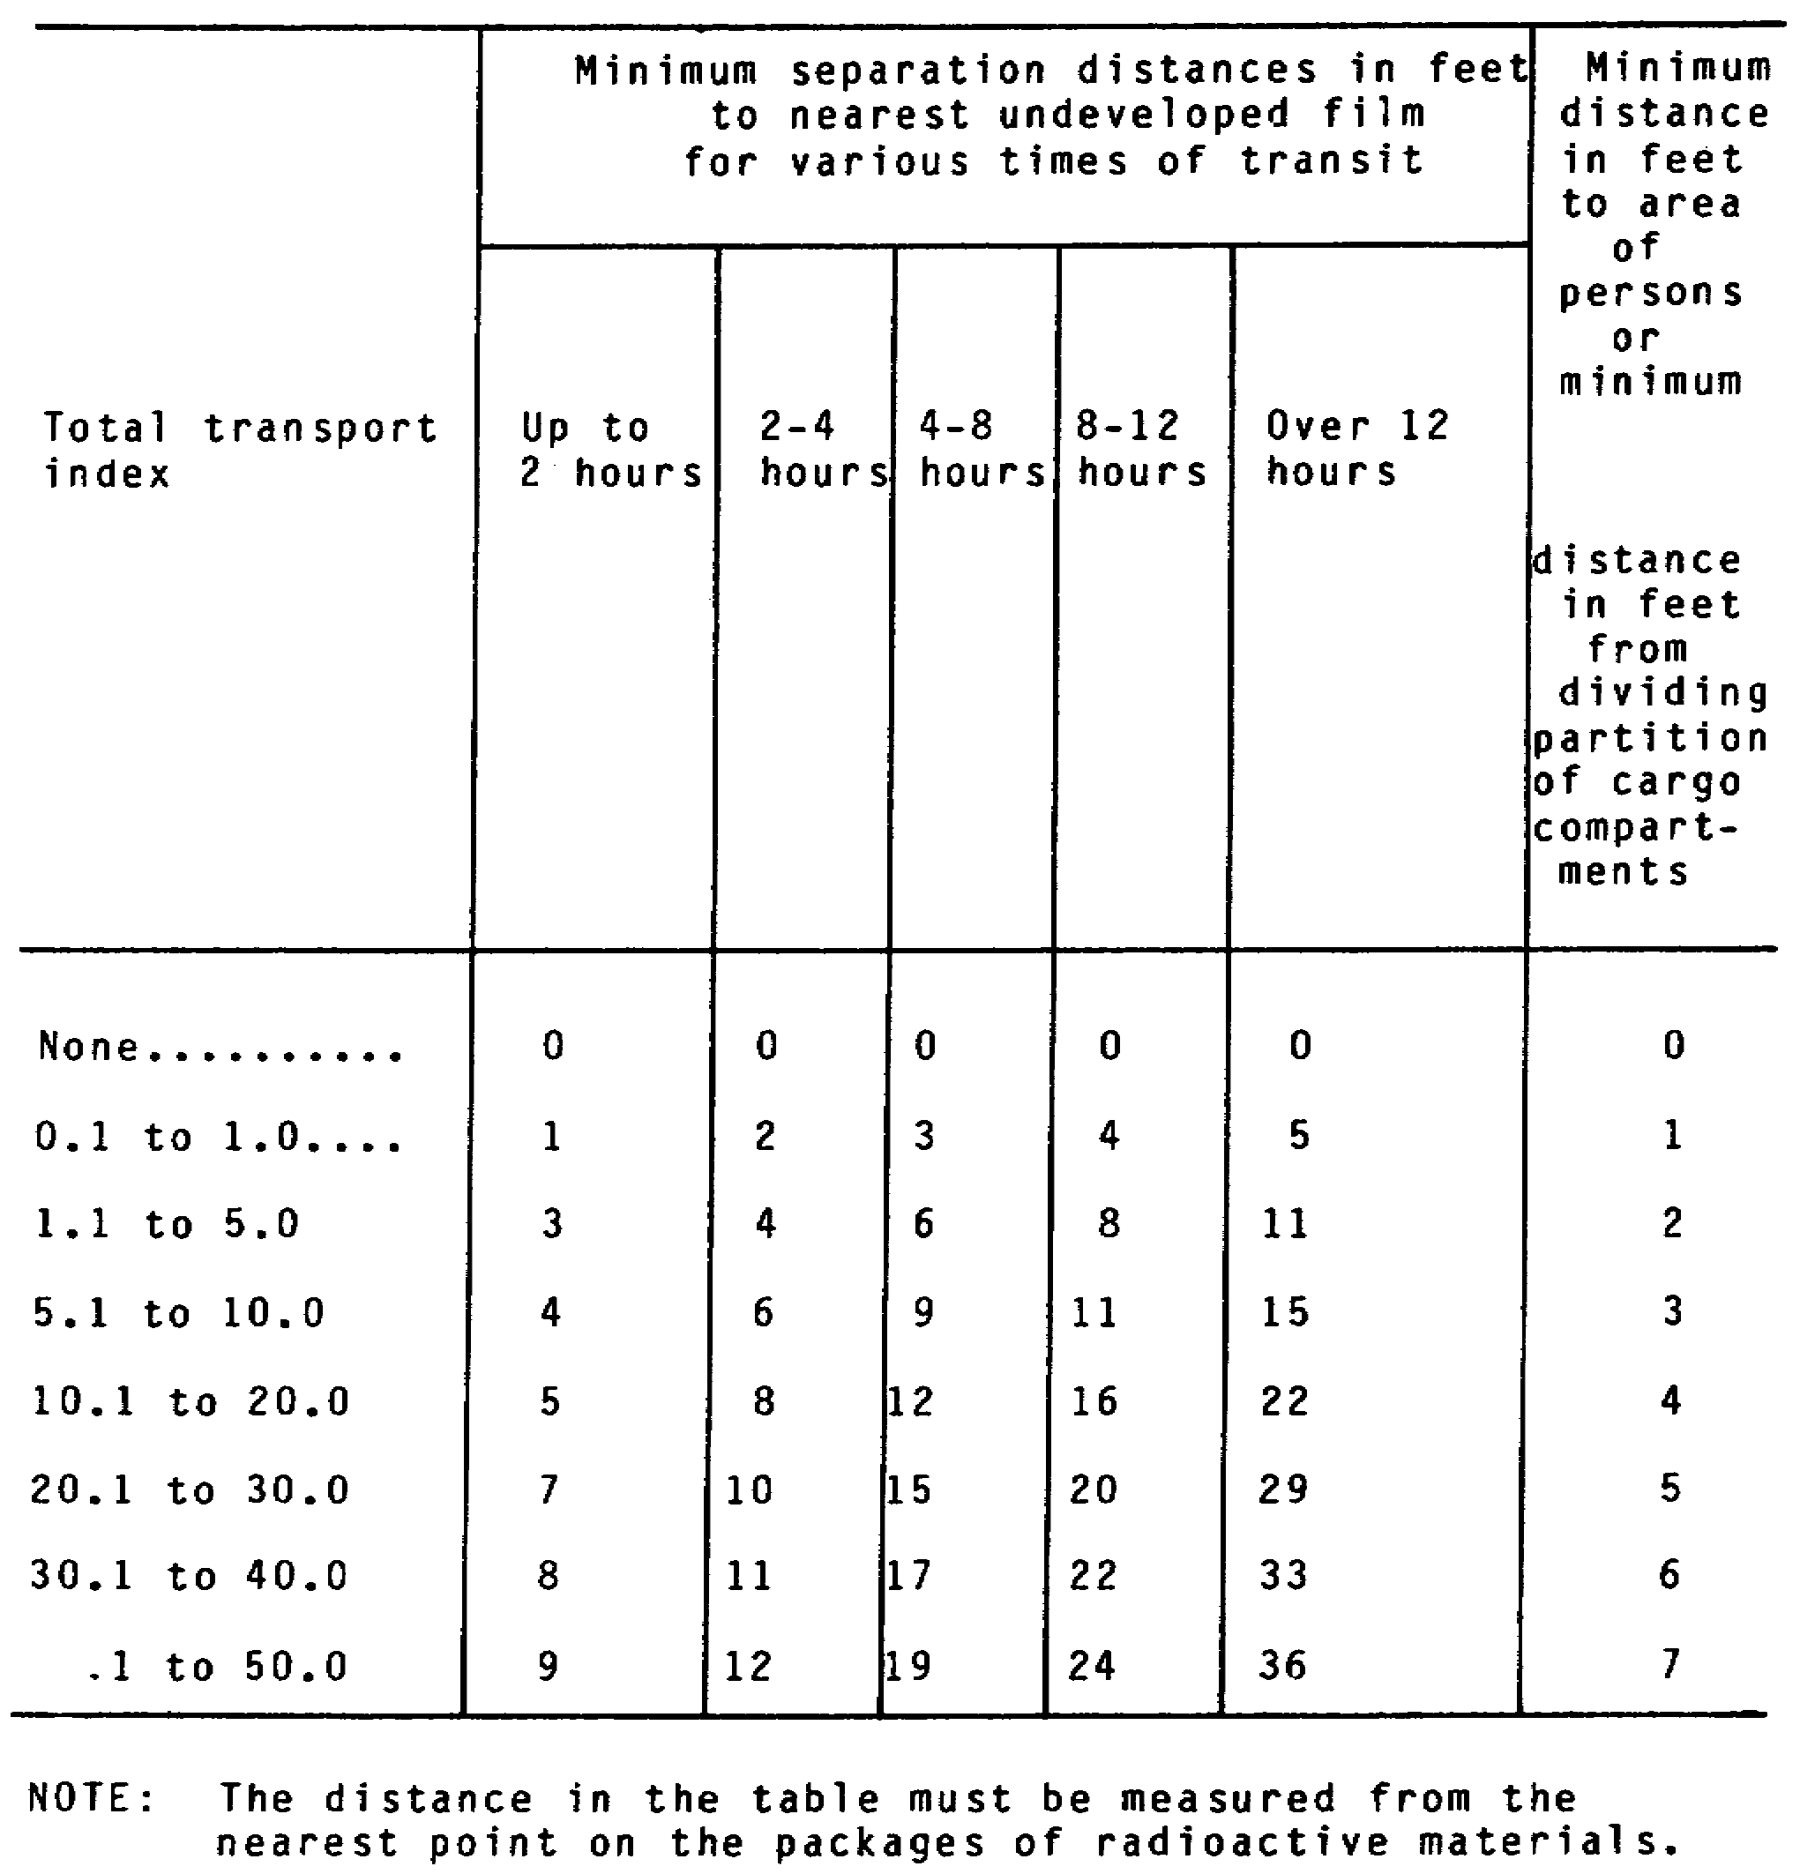

Slide 89
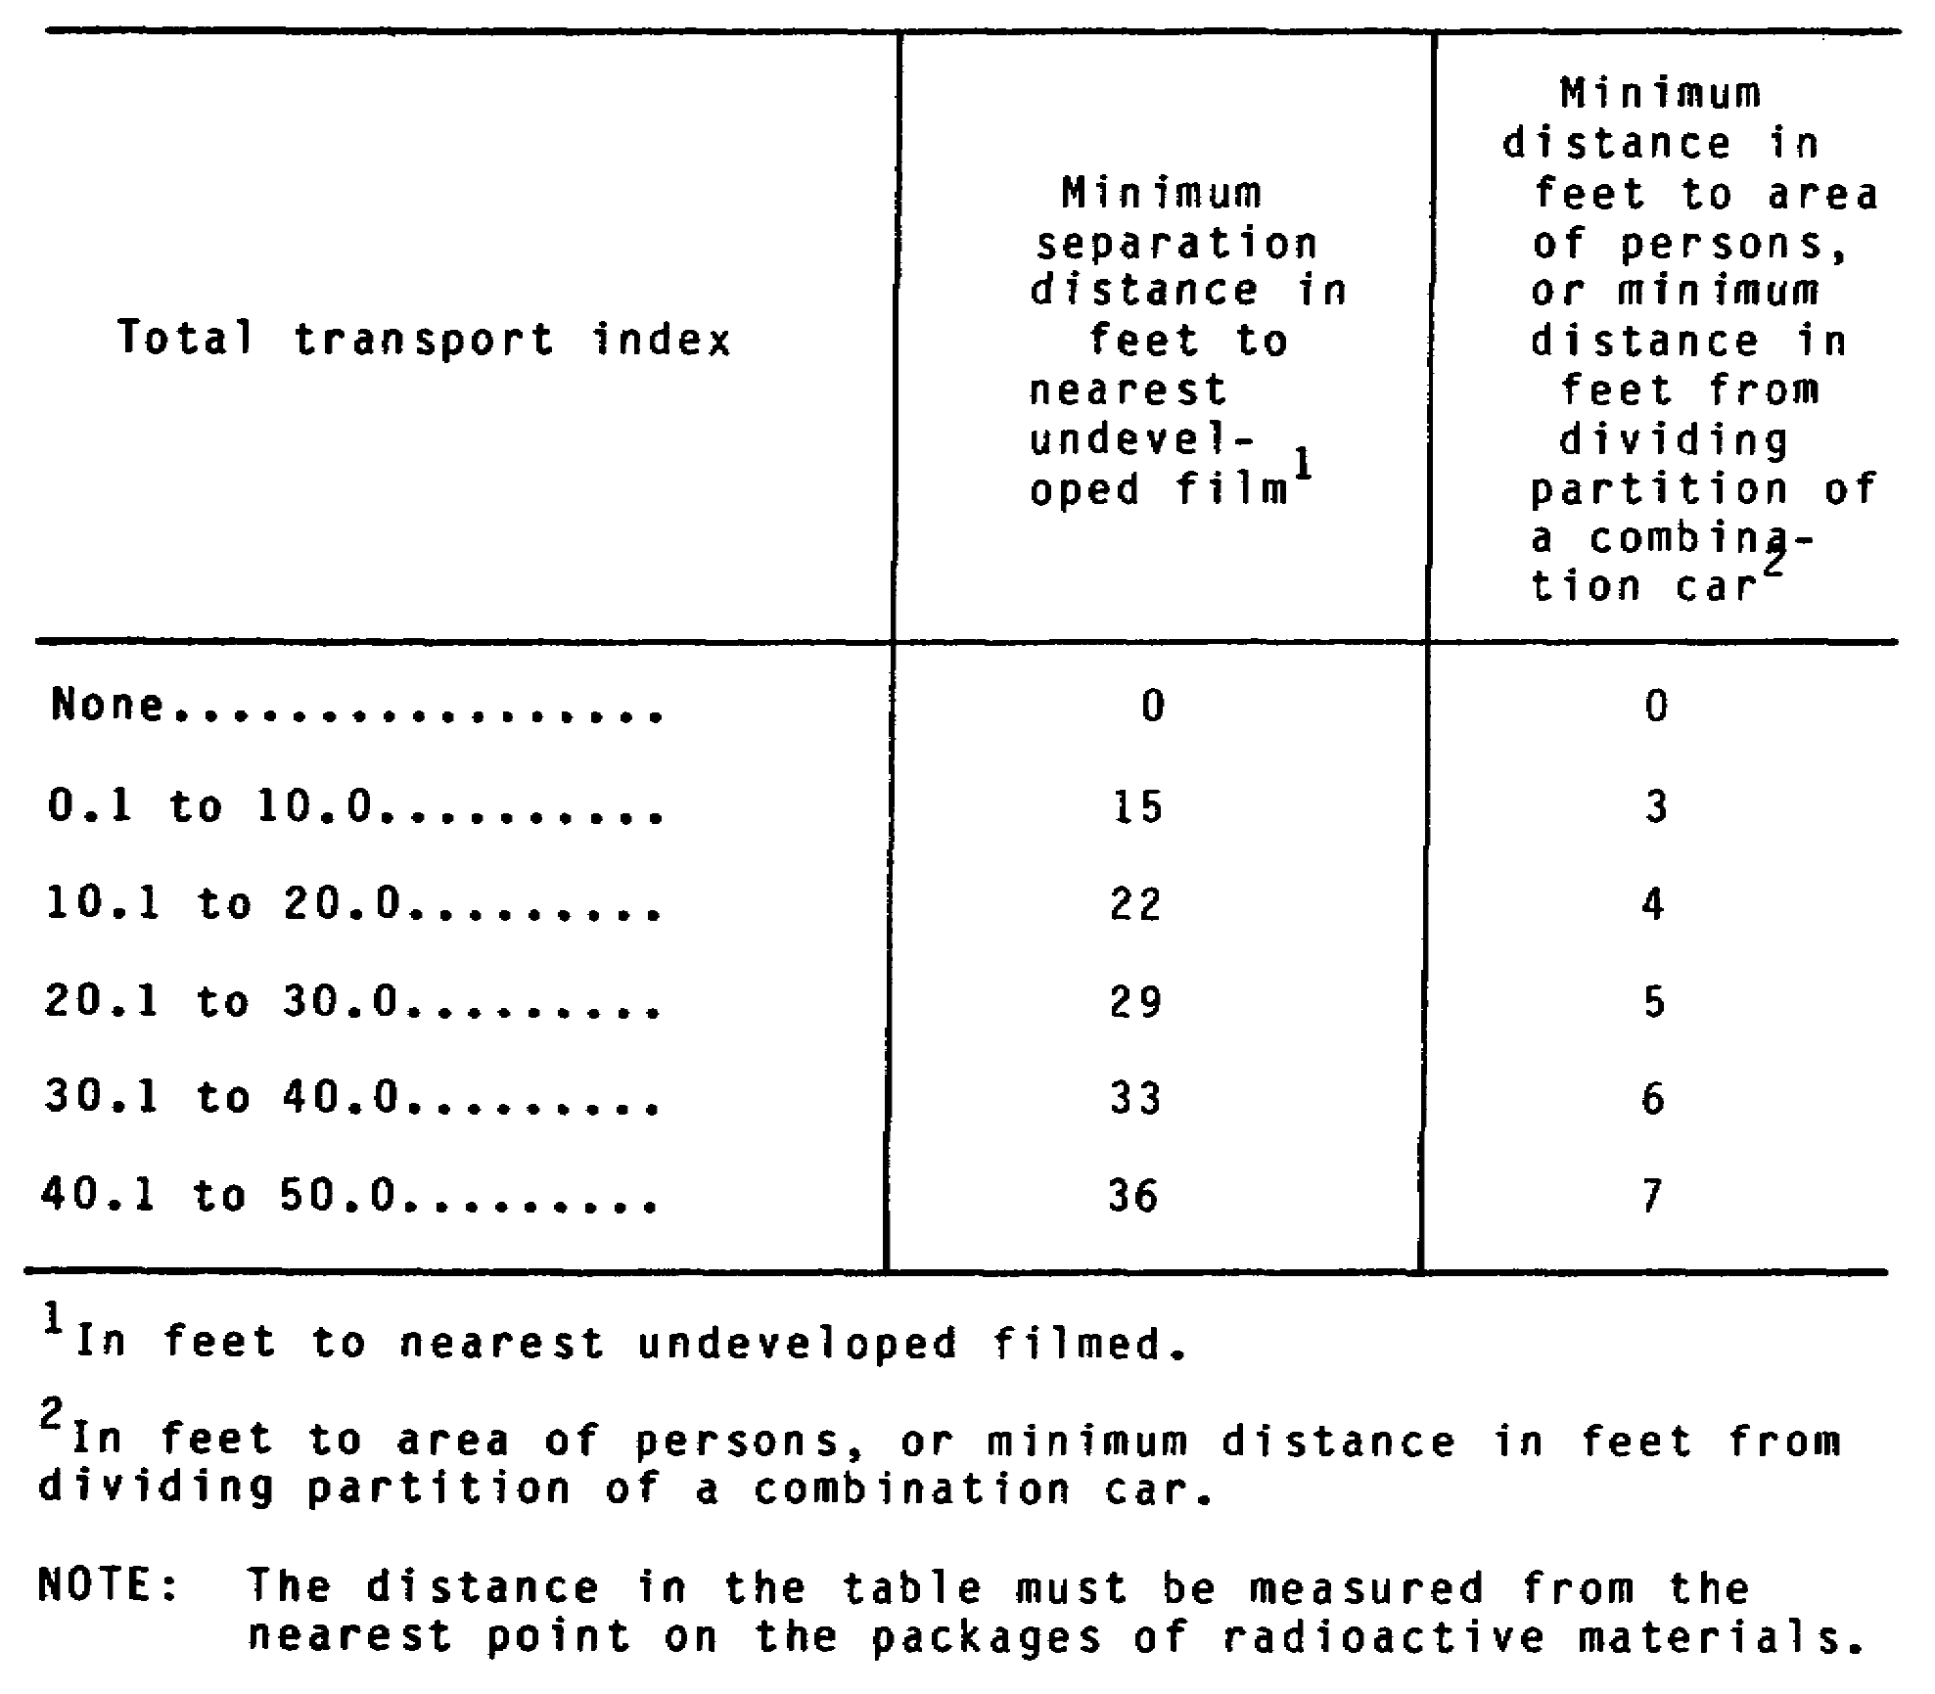

Slide 90
Loading Requirements for Explosives
• Load and secure Class A explosives so that the ends of the
wooden boxes do not bear against sides of fiberboard boxes and
there are no pressure points on the boxes.
• Load large (500 lbs or more) explosive bombs, unfuzed
projectiles, rocket ammunition, rocket motors, and other Class
A and Class B explosives, which are not packed in boxes, in
stock cars or in flat-bottom gondola cars only if they are
adequately braced.

Slide 91
• Load Class A and Class B explosives, which cannot be loaded in
closed cars due to their size, in open-top cars or on
flatcars, provided they are protected from the weather and
accidental ignition.
• Load boxes of high explosives; low explosives; or black powder
packed in long cartridges, bags, or sift-proof liners and
containing no liquid explosive ingredient, on their sides or
ends.

Slide 92
• Do not load Class A explosives higher than the car lining
unless additional lining is provided as high as the load.
• When the cargo of a car includes any explosives, distribute
the weight of the cargo to equalize the weight on each side of
the car and over the trucks.
• Load wooden kegs, fiber kegs, barrels, and drums on their
sides or ends.

Slide 93
• Do not place packages of explosives in the space opposite the
doors unless the doorways are boarded on the inside as high as
the cargo. This does not apply to palletized packages if they
are properly braced.
• Securely block packages and brace them to prevent the packages
from changing position, falling to the floor, or sliding into
Each other.
• Do not drop packages during handling.
• Ensure planks for rolling trucks from platforms to cars have
beveled ends.

Slide 94
• Ensure loading platforms and the workmens's shoes are free
from grit.
• Take all possible precautions against fire.
• The shipper is responsible for furnishing all materials needed
to stow and secure explosives on or in a railcar.
• Do not load explosives into a railcar equipped with any type
of lighted heater or open-flame device, or electric devices
having exposed heating coils.
• Use properly loaded, blocked, and braced container cars;
freight containers on flatcars; and gondola cars to transport
Class A explosives, except black powder in metal containers.

Slide 95
• Ensure that all freight containers used for transporting Class
A explosives are weatherproof, allow for secure blocking and
bracing of cargo inside, and can maintain structural integrity
of itself and cargo under an 8 mph impact.
• Do not use drop-bottom railcars to transport freight
containers of Class A explosives.
• You may transport Class A and B explosives in trucks or
trailers on flatcars if cargo is protected from the weather.
• Class A explosives and initiating or priming explosives may
not be together in the same railcar.
• Car certificates are not required for Class C explosives

Slide 96
Loading Requirements for Flammable Gases
• Do not transport flammable gases in a railcar equipped with
any type of open-flame device, or an internal combustion
engine.
• Secure cylinders containing compressed gases in an upright
position to prevent their overturning, or load them in a
horizontal position.
• Do not transport cylinders containing compressed gases in
hopper-bottom cars

Slide 97
Loading Requirements for Poisons
• Do not transport poison gas in the same car with any edible
material intended for consumption by humans or animals.
• Transport Class A poisons in DOT approved containers or tanks,
and securely block and brace them.
• Transport Class A Poisons in carload lots; however, gas-filled
projectiles may be transported in less-than-carload lots.
• Ensure each shipment of Class A Poisons is accompanied at all
times by a qualified escort supplied with equipment to handle
leaks and other packaging failures which could result in
escape of the gas.
• When transporting Class A Poisons in a tank, securely mount on
a railcar especially provided for it or on a gondola car
prepared with substantial wooden frames and blocks

Slide 98
• Transport drums of Class A Poisons with the filling holes up,
and securely block and brace them against any movement.
• When transporting Class A Poisons in drums in a boxcar, load
drums from ends of the car toward the space between the car
doors, and there brace them with center gates and wedges

Slide 99
Loading Requirements For Flammable Liquids
• Do not load flammable liquids in a railcar equipped with any
type of lighted heater open-flame device or internal
combustion engine.
• You may transport metal barrels or drums containing flammable
liquids in a steel gondola, flatcar, or stock car. However,
do not transport them in a hopper bottom car.
• Do not transport flammable liquids bearing a POISON label in
the same car with edible material intended for consumption by
humans or animals.

Slide 100
Loading Requirements For Flammable Solids
• Do not transport poisonous, flammable solid material bearing a
POISON label with foodstuffs, feed, or any other edible
material intended for consumption by humans or animals

Slide 101
Loading Requirements for Oxidizers
• Do not transport oxidizer material bearing a POISON label in
the same car with foodstuffs, feed, or any other edible
material intended for consumption by humans or animals.

Slide 102
Loading Requirements for Radioactive Materials
• Limit the number of packages of radioactive material
transported in a railcar to a number making a total transport
index of 50. The transport index and total transport index
are determined in the same manner as for transport by motor
vehicle. This provision does not apply to exclusive-use
shipments

Slide 103
• Do not place packages of radioactive material bearing
RADIOACTIVE YELLOW-II or RADIOACTIVE YELLOW-III labels closer
than three feet to an area which may be continuously occupied
by any passenger, rail employee, or shipment of animals; nor
closer than 15 feet to any package containing undeveloped film
(if so marked). If more than one package of radioactive
materials is present, the distance must be computed from
Figure 1-11 on the basis of the total transport index number
(determined by adding together the transport index numbers on
the labels of the individual packages) of packages in the car.

Slide 104
• Ensure adequate transport controls to assure that no Class III
shipment is transported in the same railcar with any other
radioactive material shipment. In loading and storage areas,
segregate each fissionable (fissile) Class III shipment by a
distance of at least 20 feet from other packages required to
bear a RADIOACTIVE label.
• Ensure personnel do not remain unnecessarily in a railcar
containing radioactive materials.

Slide 105
• Securely block and brace all packages of radioactive material
to prevent movement during transport.
• In the case of packages shipped under the exclusive-use
provision, ensure the radiation level does not exceed 2
millirem per hour in any normally occupied position in the
transport vehicle or adjacent railcar

Slide 106
• Survey each exclusive-use railcar used for transporting
radioactive materials with appropriate radiation detection
instruments after each use. A vehicle may not be returned to
service until the radiation dose rate at any accessible
surface is 0.5 millirem per hour or less, and all significant
removable radioactive surface contamination has been removed.
• Stencil any exclusive-use car with the words FOR RADIOACTIVE
MATERIALS USE ONLY in letters at least 3 inches high in a
conspicuous place on both sides of the exterior of the car.
Keep the car closed at all times other than during loading and
unloading

Slide 107
Loading Requirements for Corrosive Materials
• Do not transport carboys of corrosive liquids by rail in a
container car.
• Load, block, and brace packages of corrosive liquids being
transported so that they cannot change position during
transport.
• Place less-than-carload shipments of corrosive liquids in
carboys near the doorway of the car and nail wooden strips to
the car floor so that the liquid from a broken carboy will
drain toward the doorway and outside the car.

Slide 108
• When carrying a less-than-carload shipment of corrosives in
carboys, cover the floor around carboy boxes with clean, dry
sand or earth.
• Handle carboys with the necks up.
• Protect electric storage batteries to prevent short circuits;
do not load or store them with explosives.
• Do not use wet electric storage batteries in refrigerator or
plug-door type cars unless the car: have vents which prevent
an accumulation of gas within the car

Slide 109
• When transporting nitric acid with other corrosive liquids in
carboys, separate it from the other carboys. Nail a 2-x 6-
inch plank, set on edge, across the car floor at least 12
inches from the nitric acid carboy.

Slide 110
PROPERLY SECURED CARGO
Secure all cargo to prevent damage. Secure hazardous cargo not only
to prevent damage to the cargo, but also to prevent damage to
equipment and injury to personnel. Secure by bracing, blocking,
tying down, and covering. FM 55-30, Army Motor Transport Units and
Operations, describes techniques used to secure cargo on motor
vehicles. TM 55-2200-001-12, Application of Blocking, Bracing, and
Tiedown Materials for Rail Transport, describes techniques used to
secure cargo on railcars. CFR 49 includes securing requirements for
hazardous cargo such as detonators, flammable cryogenic liquids, and
flammable gases. Consult each of these sources to determine the
proper measures for securing a particular hazardous cargo.

Slide 111
The following are general criteria for determining if cargo is
properly secured.
• Block, brace, or lash cargo so that no movement can occur
during transport.
• Load boxes and crates so that the stronger sides are parallel
with the direction of vehicle movement.
• Load drums, kegs, carboys, and cylinders so that their
openings (bungs, valves, necks) are face up.
• Adequately protect materials that are sensitive to shock,
puncturing, denting, or crushing by using crates, crib
blocking, or other appropriate methods.
• Secure materials that may emit poisonous or flammable gases
while allowing ventilation for the gases.

Slide 112
• Secure materials that may emit poisonous or flammable gases
while allowing ventilation for the gases.
• Protect materials against moisture with closed containers,
closed vehicles, or tarpaulins as appropriate.
• Protect flammable, combustible, and explosive materials from
all sources of heat, flame, and sparks.
• Never load cargo higher than the top edge of the sides of the
transporting vehicle.
• Load cargo so that the weight is evenly distributed over the
load bed.

Slide 113
PROPER DOCUMENTATION OF CARGO
Every shipment of hazardous materials must be appropriately
documented by some form of waybill. The forms usually used are the
TCMD (DD Form 1384) and the GBL (Standard Form 1103 and accompanying
forms).
If you are a transportation officer in a shipping activity, you are
responsible for making sure that the carrier receives cargo
documentation before starting the haul. If your unit acts as a
carrier of hazardous cargo, be sure that unit personnel are in
possession of the appropriate waybill before they start a haul

Slide 114
If a GBL is used, the carrier DOES NOT receive a copy of Standard
Form 1103. The carrier receives a document called the Freight
Waybill, Standard Form 1106. The carrier will also often carry the
consignee's documentation for the shipment. The consignee's
documentation is Standard Form 1103b, Memorandum-Property Received.
Both Standard Form 1106 and Standard Form 1103b are part of a GBL
set, of which Standard Form 1103 serves as the original.

Slide 115
LESSON TWO
SUPERVISE OVERLAND TRANSPORT OF HAZARDOUS CARGO
MQS Manual Tasks: 01-7381.00-0010
01-7381.00-0020

Slide 116
INTRODUCTION
This lesson discusses the special tasks involved in planning and
monitoring the transport and unloading of hazardous cargo.
To properly supervise the transport and unloading of hazardous cargo,
you must be able to--
• plan transport of cargo.
• inform carrier of security precautions.
• observe safety and security precautions during loading and
unloading.

Slide 117
PART A - PLAN TRANSPORT OF CARGO
The safety of individuals and the environment are prime
considerations in the shipment of hazardous materials. Some of these
materials require special security precautions. Careful planning is
imperative before undertaking shipment of hazardous materials

Slide 118
SECURITY REQUIREMENTS
The security service requirements for arms, ammunition, and
explosives (AA&E) are determined by a categorization defined by DOD
Manual 5100.76. There are four major categories of AA&E. Examples
of each category are described in extracts of the Transportation
Security Guide in Appendix B. The minimum security service
requirements for various shipments of the categories of arms,
ammunition, and explosives appear below.

Slide 119
Category I
For truckload shipments of Category I AA&E the following requirements
apply:
• Security Escort Vehicle Service (SEVS).
• Exclusive use of vehicle.
• Vehicle must be locked and sealed by the shipper.
• Trip lease may not be used.
• Single-line haul is required.
• When two or more vehicles are in convoy, drivers must be in
sight of other vehicles at all times. Convoy will require
only a single escort vehicle.
• Stop off in transit authorized.

Slide 120
For less-than-truckload shipments of Category I AA&E, the following
requirements apply:
• Armed Guard Surveillance (AGS).
• SEVS.
• Exclusive use of vehicle.
• Vehicle must be locked and sealed by the shipper unless
shipment requires open equipment.

Slide 121
• CONEX or similar container may be used.
• Trip lease may not be used.
• Single-line haul is required.
For rail shipments, the following requirements apply:
• AGS.
• Military Traffic Expediting (MTX) Service.
• Railcars must be locked and sealed by the shipper.
• Use Category I motor regulations for associated motor movement

Slide 122
Category II
The minimum security service requirements for truckload shipments of
Category II arms, ammunition, and explosives appear below:
• AGS.
• Exclusive use of vehicle.
• Vehicle must be locked and sealed by the shipper.
• Trip lease not authorized.
• Single-line haul is required.
• Stop off intransit authorized.

Slide 123
For less than truckload shipments, these requirements apply:
• AGS.
• CONEX or similar container may be used.
• Cargo must be packaged to a weight of at least 200 pounds,
banded and sealed (if practicable), or container must be
locked and sealed by the shipper.
• Single-line haul is required.
• Trip-lease may not be used by carrier

Slide 124
For rail shipments, these requirements apply:
• Rail surveillance service (RSS) with load divider doors used
when available.
• MTX.
• Railcars must be locked and sealed by the shipper.
• Consignee must be notified of impending delivery immediately
upon dispatch of shipment.
• Category II motor regulations apply to associated motor
movement.

Slide 125
Categories III and IV
The minimum security service requirements for truckload shipments of
Categories III and IV arms, ammunition, and explosives appear below.
• Dual Driver Protective Service (DDPS).
• Trip lease may not be used.
• Single-line haul is preferred.
• Locked and sealed by shipper unless open equipment is
required.

Slide 126
For less than truckload shipments, these requirements apply:
• DDPS.
• CONEX or similar container may be used.
• Cargo must be packaged to a weight of at least 200 pounds,
banded and sealed (if practicable), or container must be
locked and sealed by the shipper.
• Trip lease may not be used.
• Single-line haul is preferred.
• Locked and sealed by shipper unless shipment requires open
equipment

Slide 127
For rail shipments, these requirements apply:
• Railcar must be locked and sealed by the shipper.
• RSS.
• MTX
• Consignee must be immediately notified of impending delivery
upon dispatch of shipment.
• Category III motor minimum security standards apply to
associated motor movement.

Slide 128
ROUTING FOR CARGO
Routing is defined as an order issued by a routing officer specifying
the mode of transportation and the means within that mode by which
shipment will move.
Responsibility for determining transport routing for cargo depends on
the nature of the cargo and the transportation environment. You are
responsible for routing shipments of Class C explosives that weigh
less than 10,000 pounds. The MTMC Area Command routes Class A and B
explosives and all shipments weighing more than 10,000 pounds.

Slide 129
In situations where MTMC is responsible for routing the shipment, you
must call the MTMC Area Command and inform them you need a route
order. To issue a route order, MTMC must know the preferred mode of
transport and the level of security service required by the shipment.
The MTMC Area Command will process your request and issue a route
order. A route order contains the following information:
• Name(s) of the carrier(s) to be used and contact information
for the carrier(s).
• Junction points required by the shipment.
• Miscellaneous instructions required for the proper forwarding
of the shipment.
• The period for which the route order is valid

Slide 131
If your unit routinely ships cargo requiring security services, the
MTMC Area command may issue a standing route order that is valid for
all shipments to a particular consignee for a specified period.

Slide 132
CARRIER PROVIDING REQUIRED SECURITY SERVICE
Whether you or MTMC determine routing for a shipment, you are
responsible (assuming you are the shipper) for contacting the
carrier(s) and arranging shipment. If MTMC determines the routing,
the carrier it selects will have the capability of providing the
required security service. If you are determining the routing, be
sure to consult the MTMC Area Command for names of carriers who can
provide the required security service. Before you select the
carrier, check the carrier's tender/tariff to confirm the
availability of the appropriate protective service.

Slide 133
PART B - INFORM CARRIER OF SECURITY PRECAUTIONS
ROUTE AND SCHEDULE FOR HIGHWAY TRANSPORT
If you are using a commercial carrier for the shipment, the route and
schedule should have been established at the time you contracted with
the carrier. You should confirm route and schedule with the
driver(s).
If you are using Army Transportation elements for the shipment, you
or someone authorized by you should brief each driver on the
transport route and schedule.

Slide 134
ENSURE CARRIER UNDERSTANDS PROTECTIVE SERVICE REQUIREMENTS
Commercial carriers should normally be aware of and understand the
safety and security measures required during transport. Army
transportation elements may have to be briefed unless they routinely
handle transport of hazardous cargo.
You should ensure that the carrier understands the sensitivity of the
material being shipped under protective services and the
responsibilities and requirements for the type of protective service
specified. A commercial carrier should not be informed as to the
shipment’s classification. If transport is by commercial motor
vehicle, ensure that the driver knows how to obtain information on
Refuge or Safe Haven (see glossary), if required. Ensure every
carrier is instructed on the procedures to follow in case of
emergency. These instructions should include the appropriate toll
free telephone number to call in case of emergency

Slide 135
In all cases, emphasize to the carrier representative that, until the
consignee accepts delivery, the carrier has custody of the shipment
and is responsible for using all appropriate protective measures

Slide 136
There are two specific responsibilities under this task.
• If transport is via highway, ensure driver receives DD Form
836, Special Instructions for Motor Vehicles Drivers, which is
illustrated in Figure 2-1. DD Form 836 is used when hazardous
materials are being transported by motor vehicle. The form
instructs the driver in general precautions, breakdown
procedures, accident procedures, fire procedures, and whatever
other measures are necessary. Every driver of the vehicle
must acknowledge receipt of the DD Form 836 by signing the
appropriate block at the bottom. You or someone authorized by
you must complete each driver's DD Form 836. Most of the
information required for completing the form should be readily
available from the waybill and CFR 49. Fire procedures should
be available from your installation's Safety Officer.

Slide 137
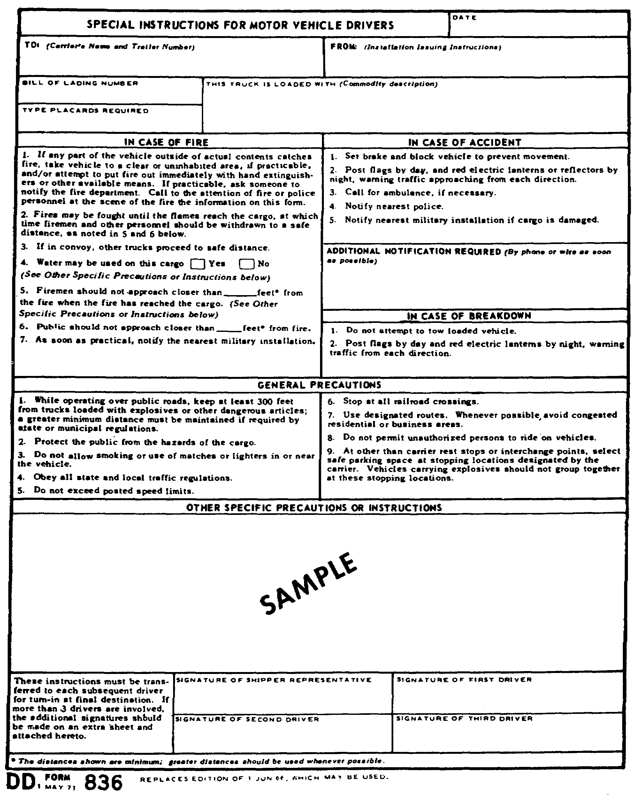

Slide 138
• Ensure carrier uses DD Form 1907 where Appropriate. DD Form
1907, Signature and Tally Record is used whenever required as
part of a security service for a shipment. The form is
illustrated in Figure 2-2. Each carrier representative
(commercial or Army) accepting custody of the shipment must
acknowledge receipt of the cargo by completing a row of
Section B on the form. Section A of the form must be
completed by the shipper. If your unit is the shipper, make
sure a DD Form 1907 is initiated if the security service
requires use of a signature and tally record. Information for
Section A should be available from the shipment waybill and
route order. If your unit is the carrier, make sure Section B
of each DD Form 1907 is completed where and when appropriate
(refer to Figure 2-2).

Slide 139
DELAYED OR OVERDUE SHIPMENT OF HAZARDOUS CARGO
If your unit is the shipper, you must notify the consignee and the
local security office if a shipment of arms, ammunition, or
explosives will be delayed in its arrival. If your unit is the
consignee, you must notify the shipping unit Transportation Officer
and the local security office if a shipment of arms, ammunition, or
explosives is not received within 48 hours of its estimated time of
arrival. The MTMC Area Command should also be notified if a shipment
of hazardous cargo will be delayed or becomes overdue

Slide 140
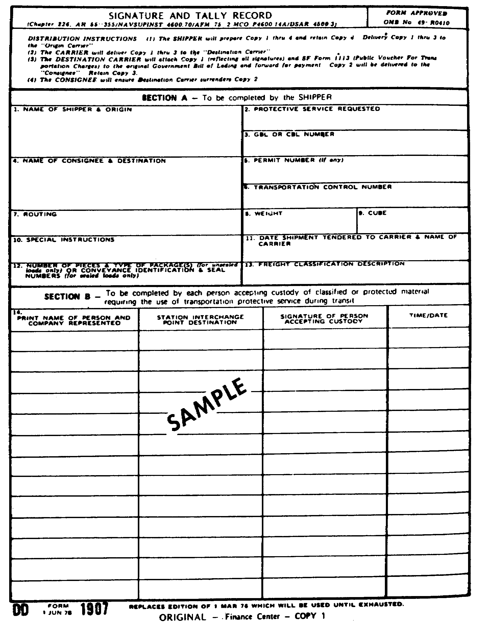

Slide 141
PART C - OBSERVE SAFETY AND SECURITY PRECAUTIONS
EQUIPMENT AND PROCEDURES
Correct equipment and procedures for unloading hazardous cargo are
the same as for loading. You learned these procedures in Part C of
Lesson 1.

Slide 142
INSPECT CARGO FOR DAMAGE
Inspect cargo for damage during transfer and unloading. Note any
evidence of damage on the waybill. If there is evidence of damage to
hazardous cargo, especially ammunition and explosives, personnel
should immediately inform you of the damage so you can contact
appropriate safety personnel. Do not move or disturb the damaged
cargo except at the direction of safety personnel.

Slide 143
TALLYING AND REPORTING CARGO DISCREPANCIES
Tally cargo on the TCMD or GBL during every loading, unloading, or
transfer operation to prevent shortages. It is especially important
to tally arms, ammunition, and explosives. Make sure you can account
for every piece of cargo. If cargo discrepancies (lost, damaged, or
incomplete) are found follow the appropriate discrepancy reporting
procedures. The Transportation Officer at the destination should
initiate a Transportation Discrepancy Report (TDR). The initial
message should be on the form illustrated in Figure 2-3. Backup
documentation, the Standard Form 361, TDR, should be prepared at the
same time the Discrepancy Message is prepared. An example of
Standard Form 361 is shown in Figure 2-4. Detailed instructions for
completing these forms appear in AR 55-38.

Slide 144
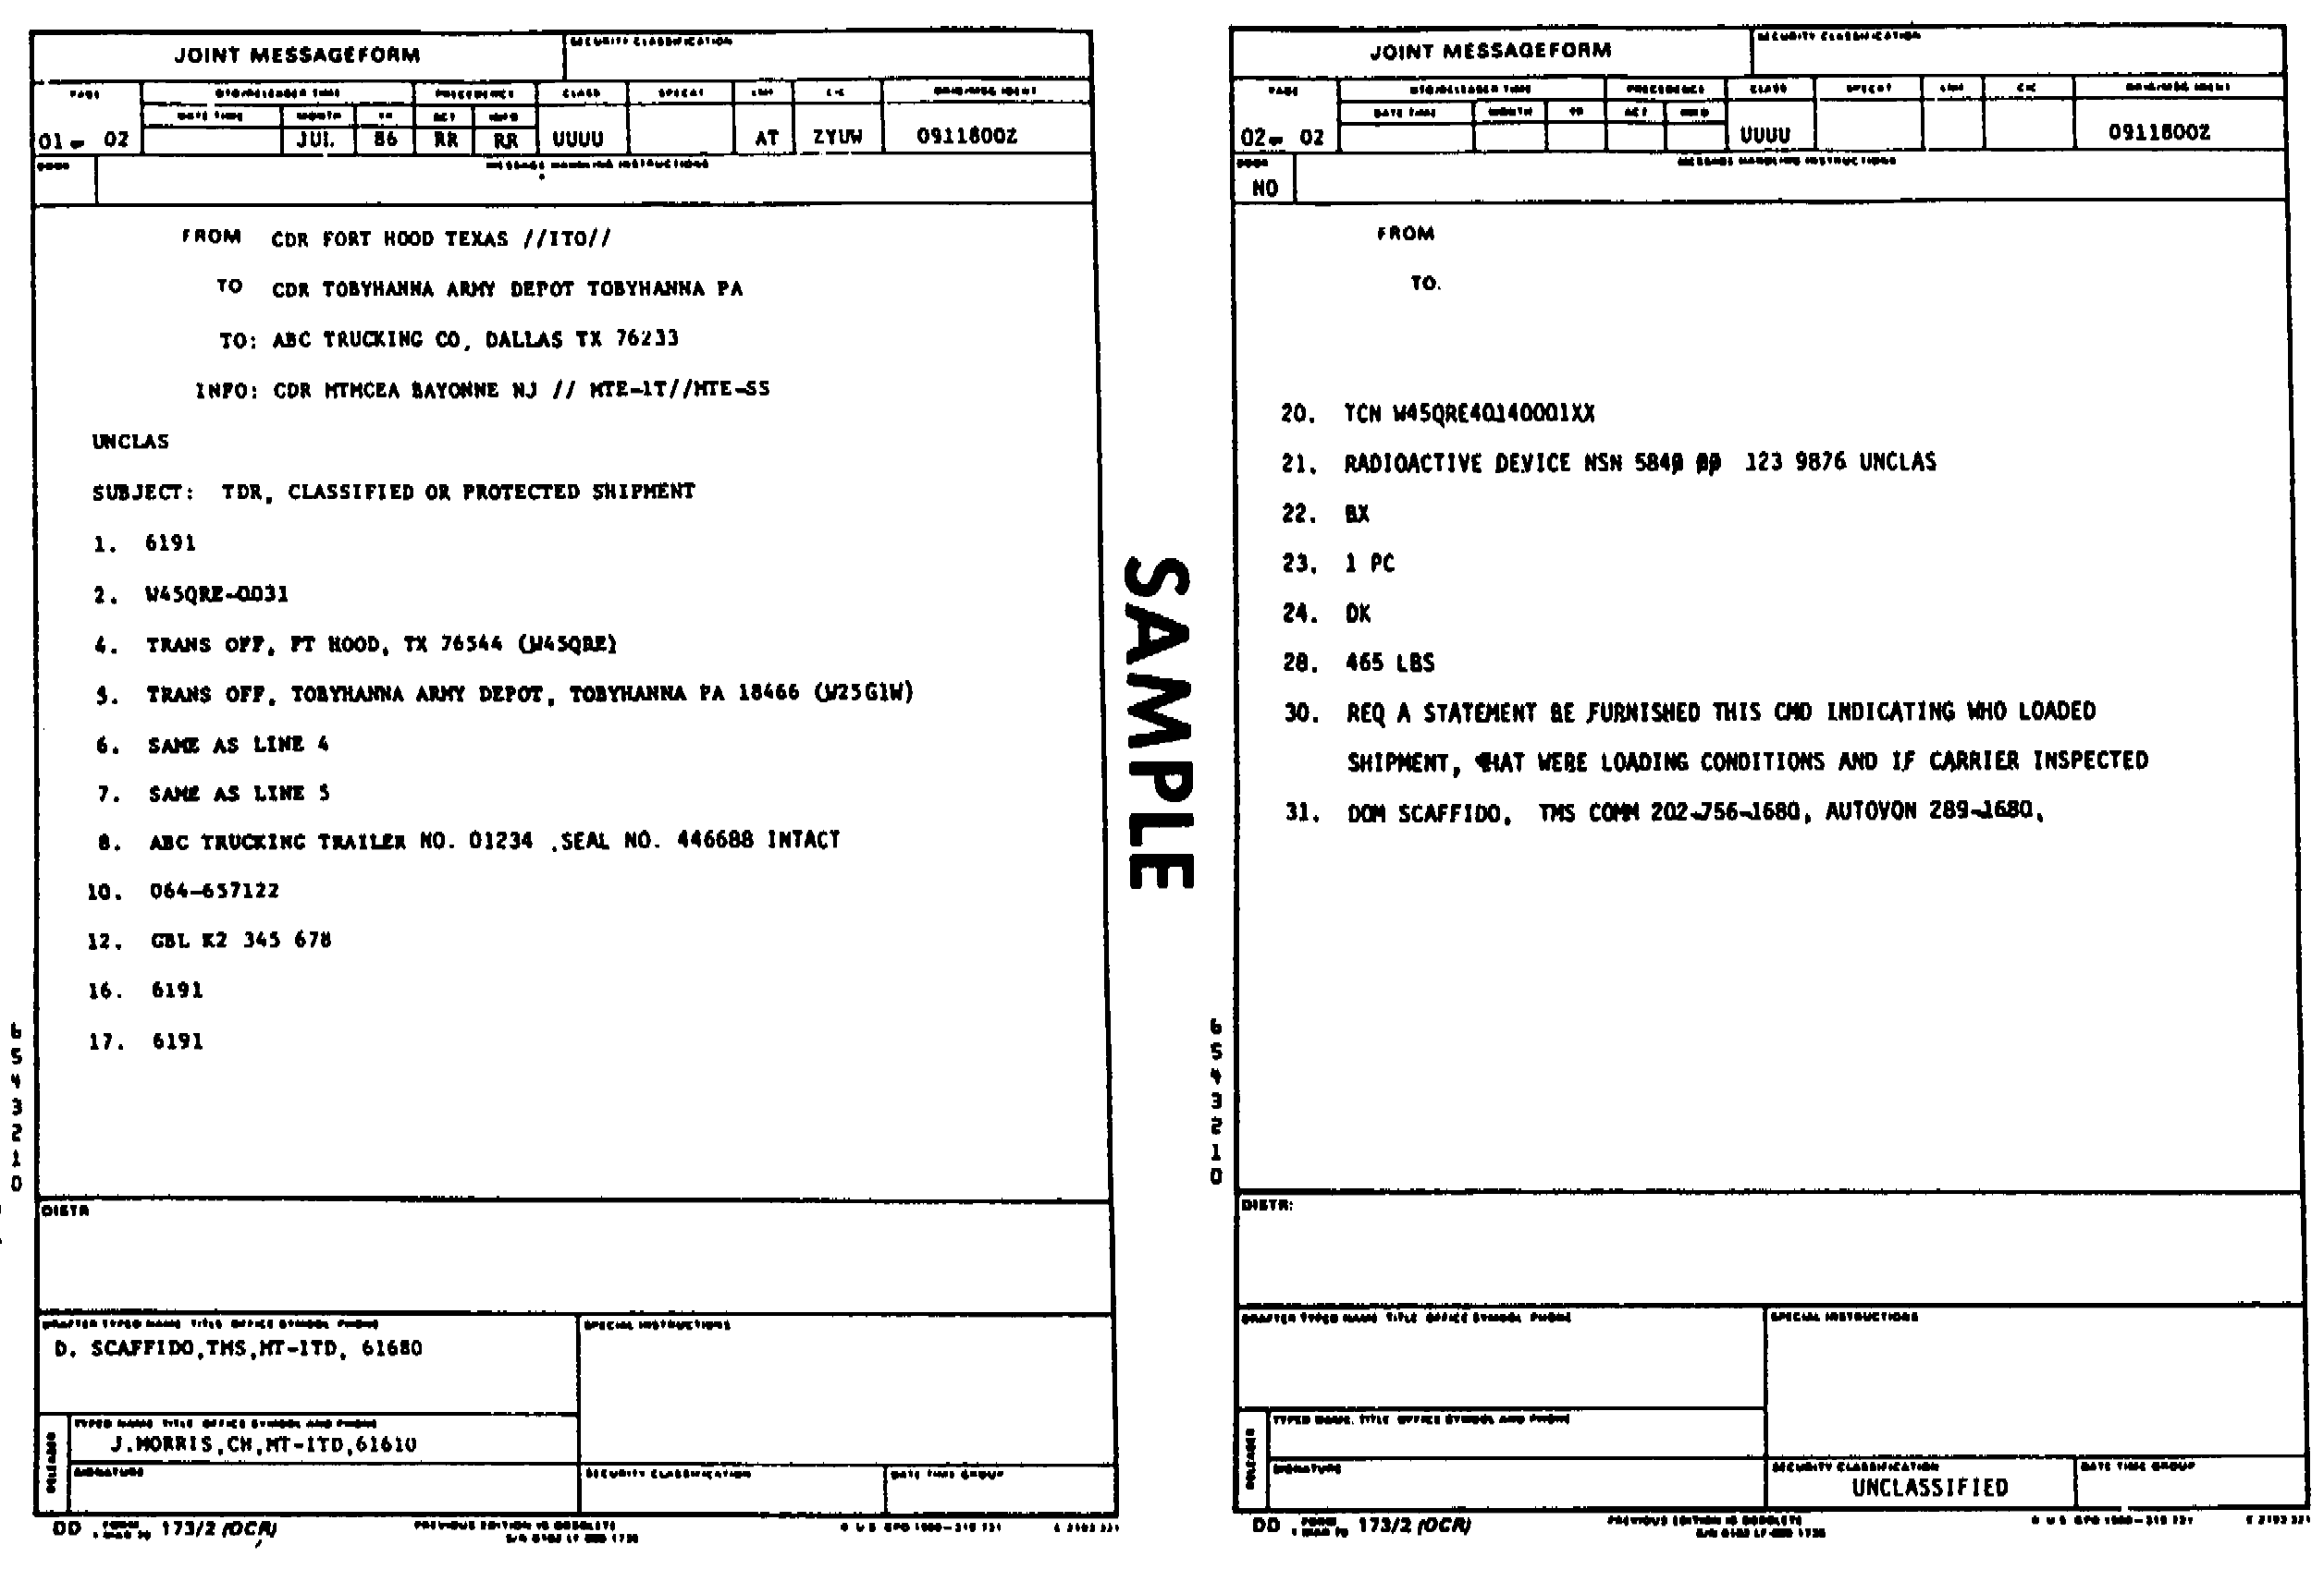

Slide 145
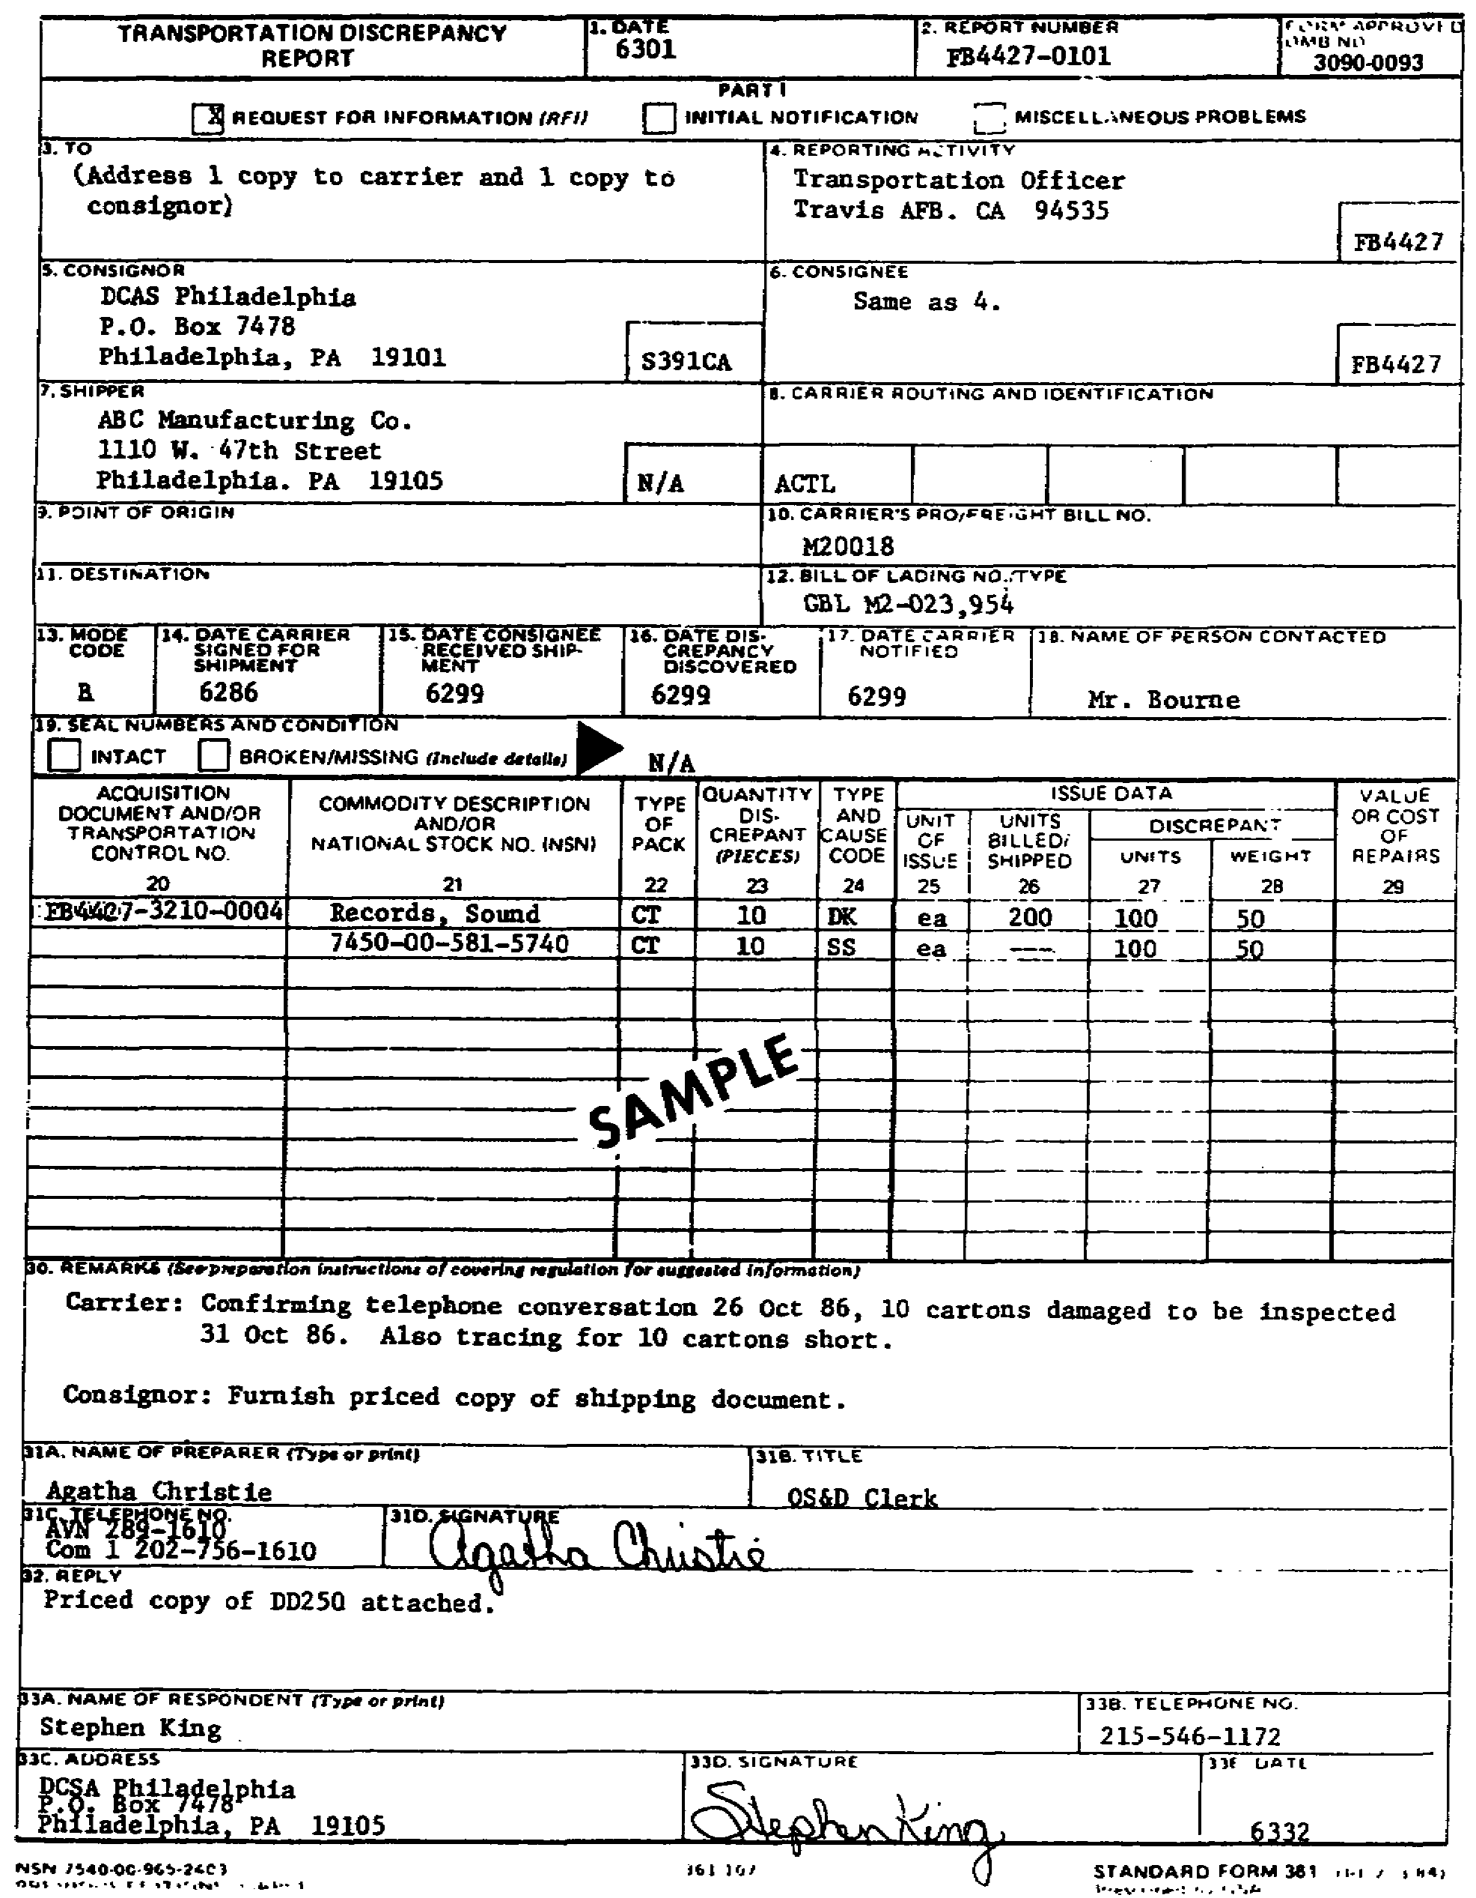

Slide 146
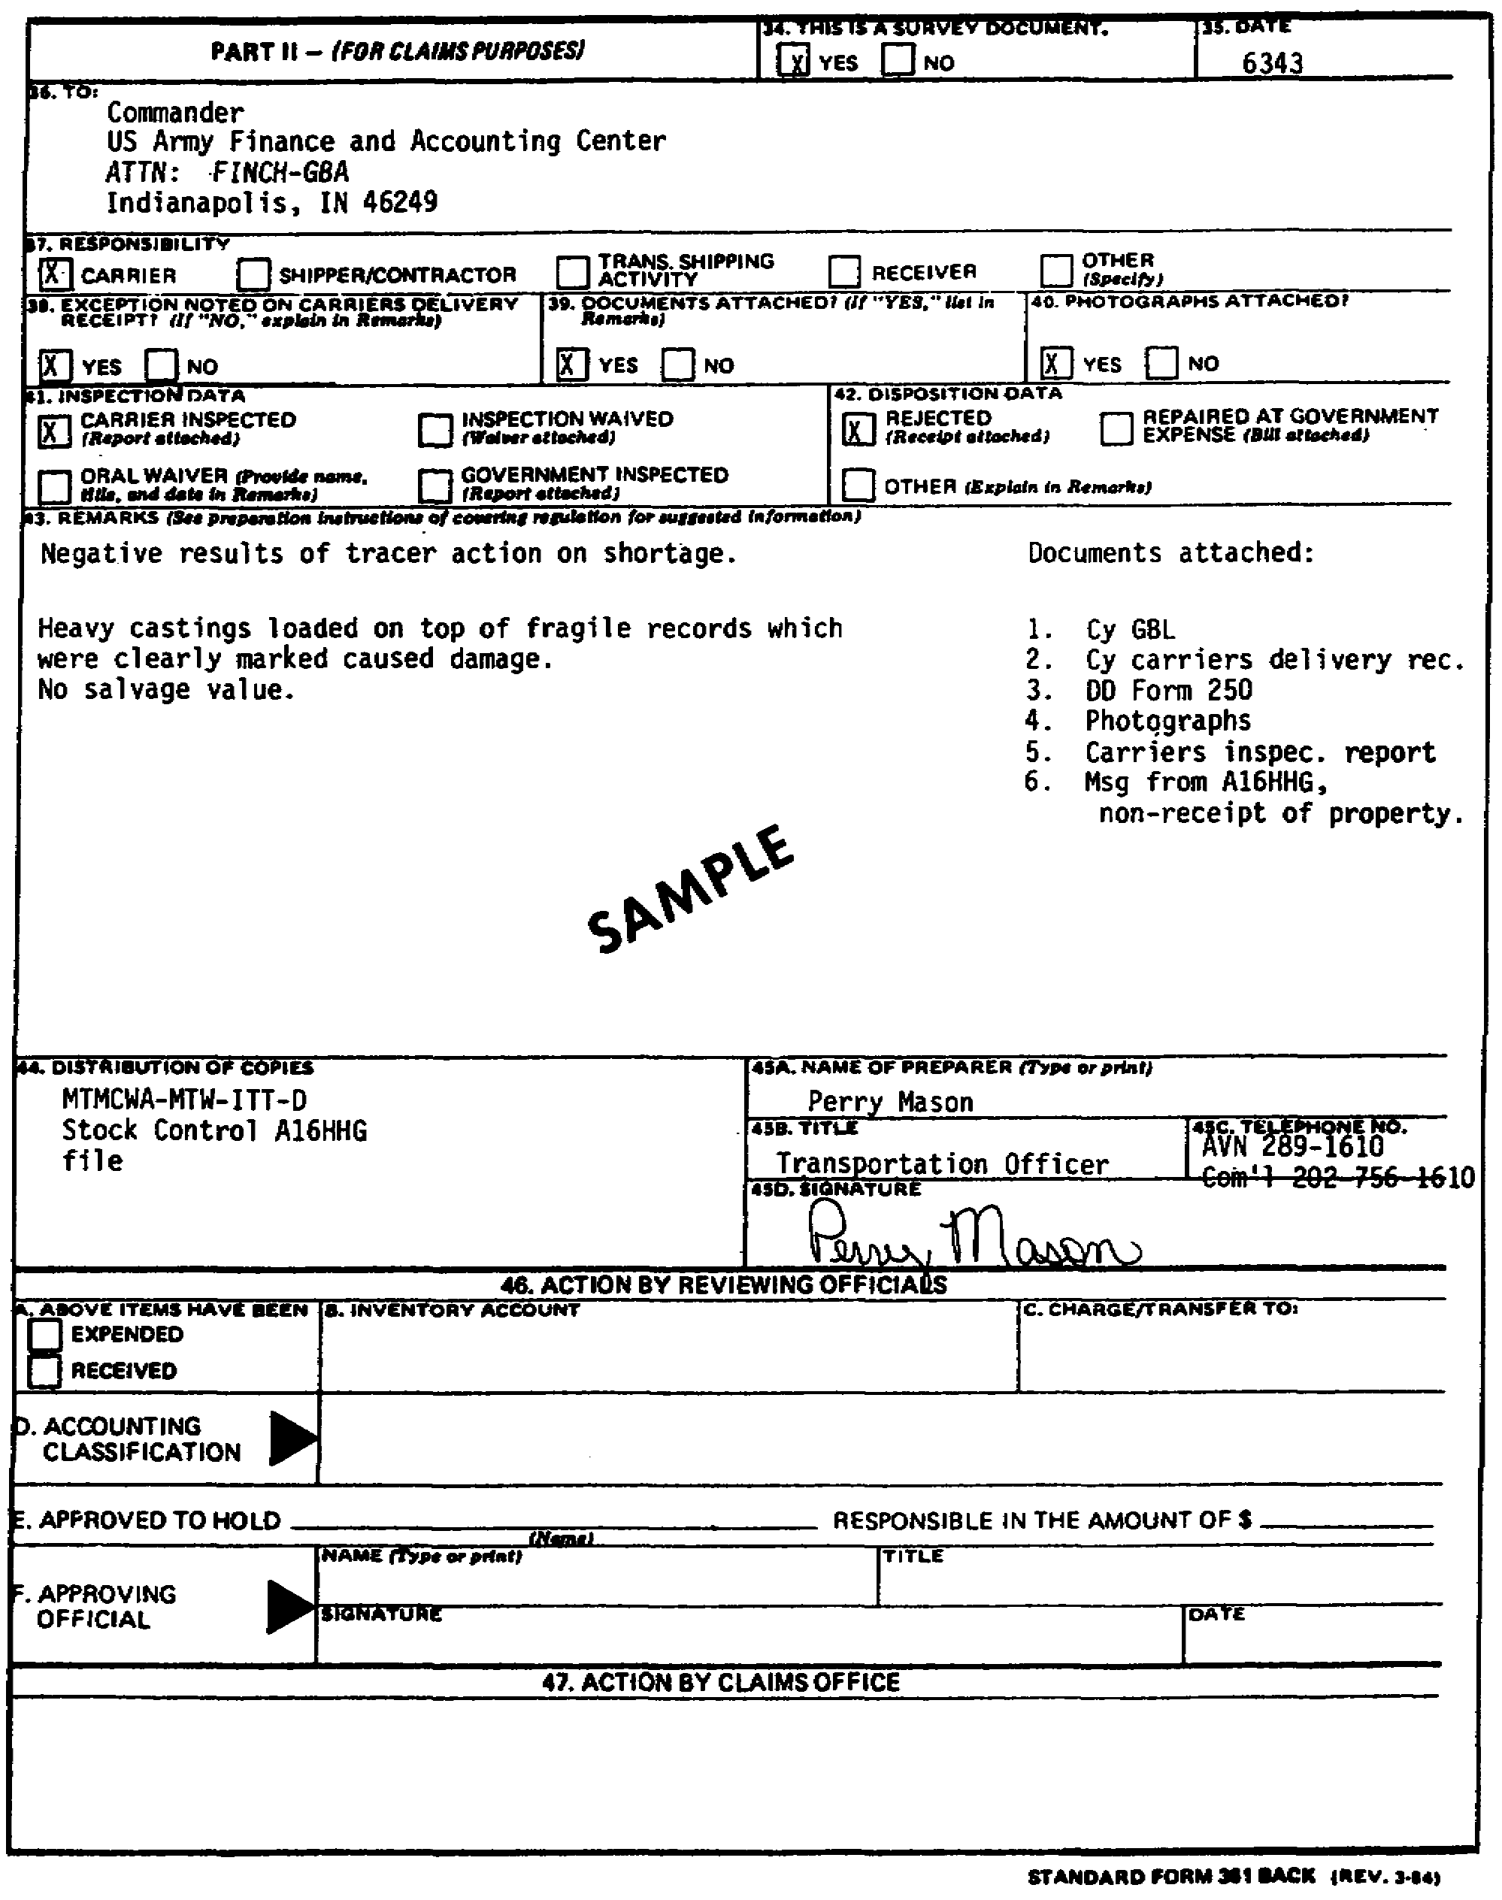

Slide 147
COMPATIBILITY RULES OF CFR 49
A compatibility chart for ammunition and explosives appears in
Sections 174.81 and 177.848 of CFR 49. A number of these
compatibility rules are required and summarized in Lesson 1. Make
sure unit personnel understand the compatibility rules and follow
them.

