Slide 1
Filed Inspection Data
USA, USAX,USNX,DODX
RAIL CARS
Created by Adam Nugent Rosenberger
DOD FORM 1335

Slide 2
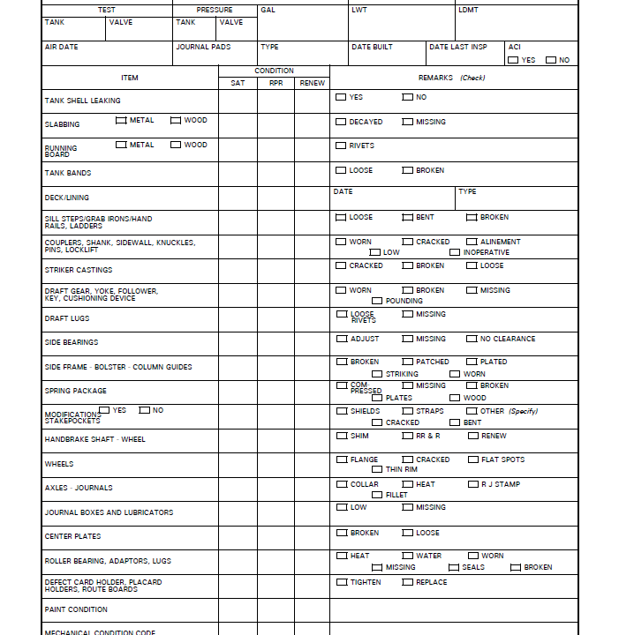
FIELD INSPECTION RAIL CARS FORM

Slide 3
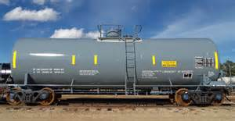
ITEM TANK SHELL LEAKING
Satisfactory, Repair, or Renew
Remarks Check, Yes or Know

Slide 4
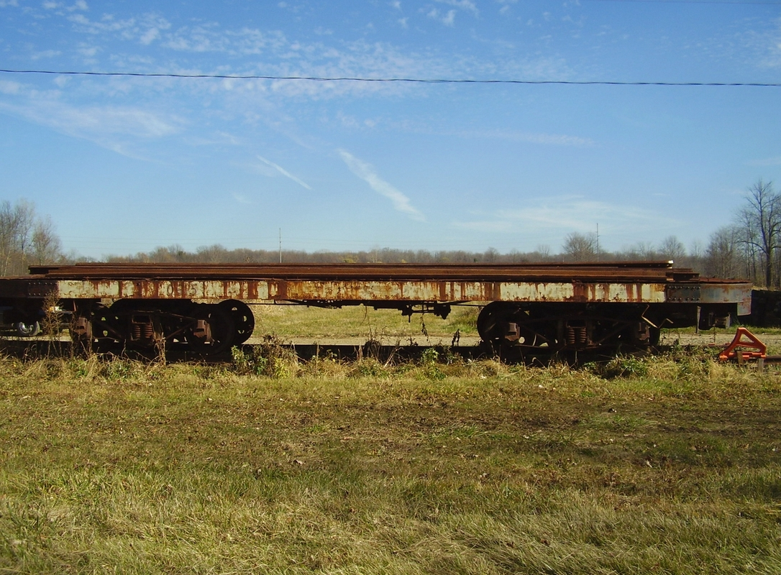
SLABBING
Satisfactory, Repair, or Renew
Check, Metal or WOOD
Check Decayed or Missing

Slide 5
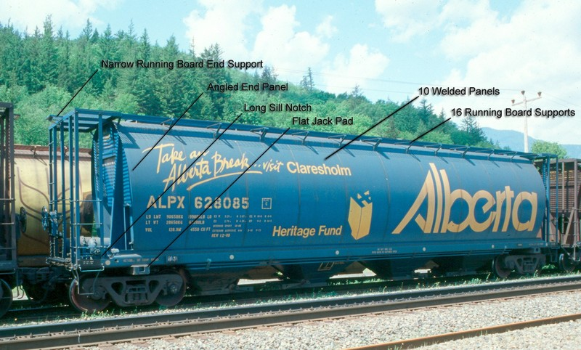
Running Board
Satisfactory, Repair, or Renew
Check Metal or Wood
Check Rivets

Slide 6
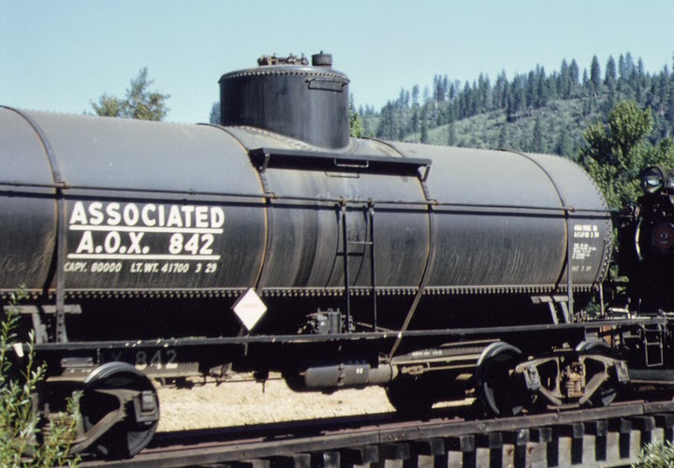
TANK BANDS
Satisfactory, Repair, or Renew
Check Loose or Broken

Slide 7
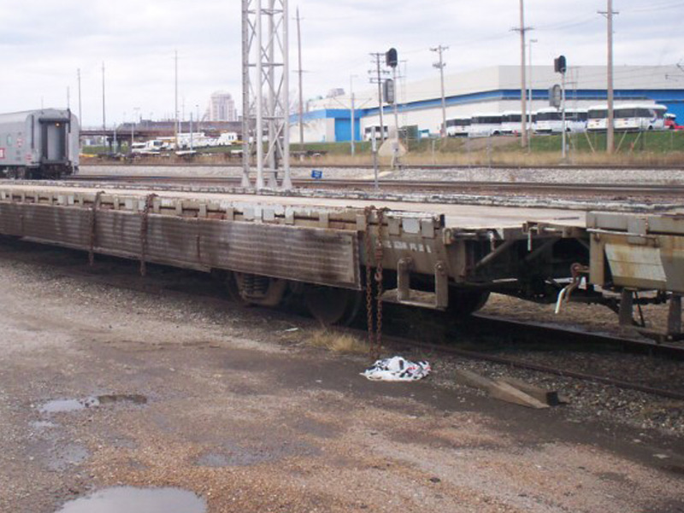
DECK/LINING
Satisfactory, Repair, or Renew
DATE, and TYPE

Slide 8
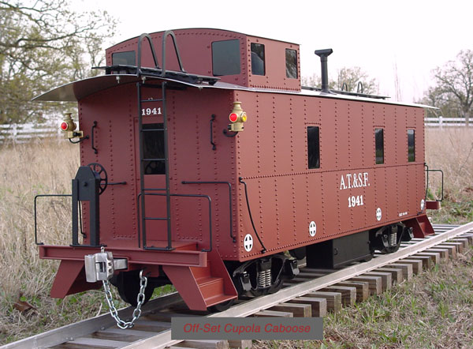
SILL STEPS/GRAB IRONS HAND RAILS, LADDERs
Satisfactory, Repair, or Renew
Check Loose, Bent, or Broken

Slide 9
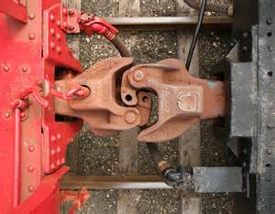
COUPLERS, SHANK, SIDEWALL, KNUCKLES, PINS, LOCKLIFT
Satisfactory, Repair, or Renew
Check Worn, Cracked, Alinement, Low, Inoperative

Slide 10
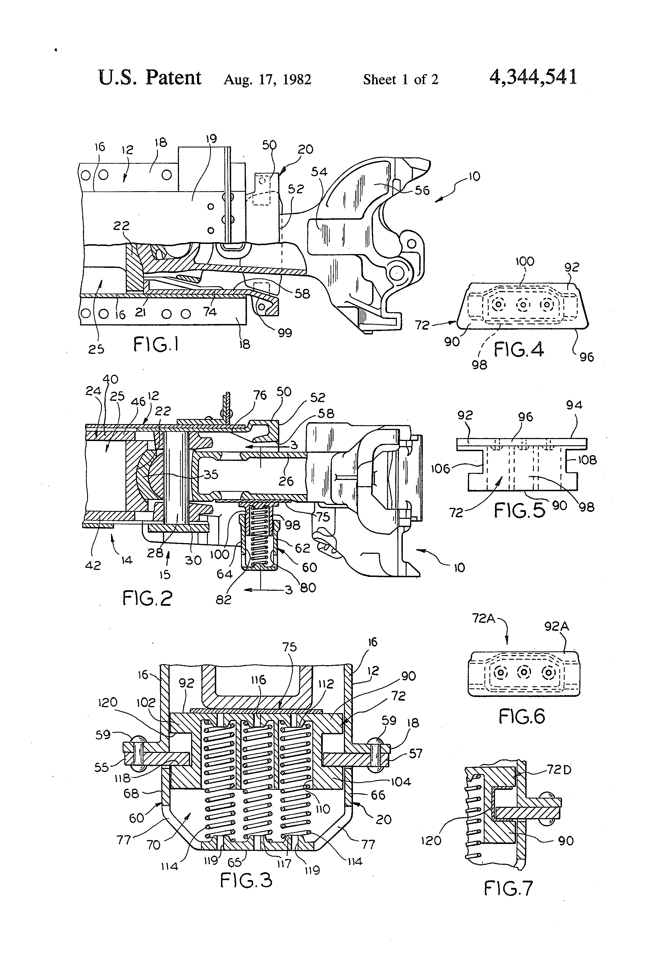
STRIKER CASTING
Satisfactory, Repair, or Renew
Check Cracked, Broken, Missing
Satisfactory, Repair, or Renew

Slide 11
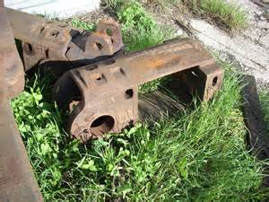
DRAFT GEAR, YOKE, FOLLOWER,KEY, CUSHION DEVICE
Satisfactory, Repair, or Renew
Check Worn, Broken, Missing, Pounding

Slide 12
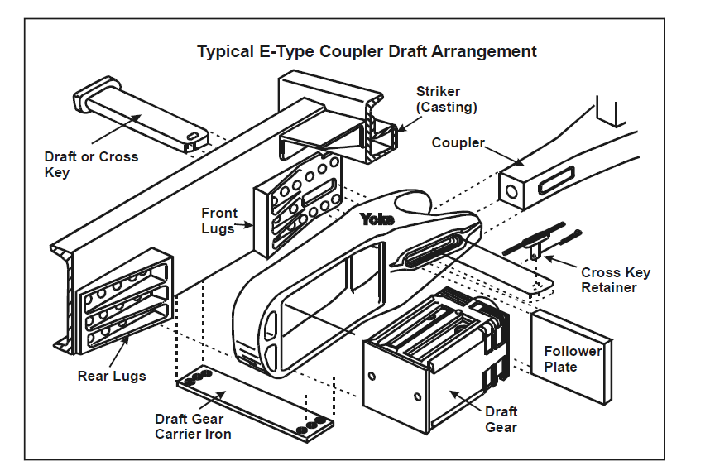
DRAFT LUGS
Satisfactory, Repair, or Renew
Check Loose Rivets, Missing

Slide 13
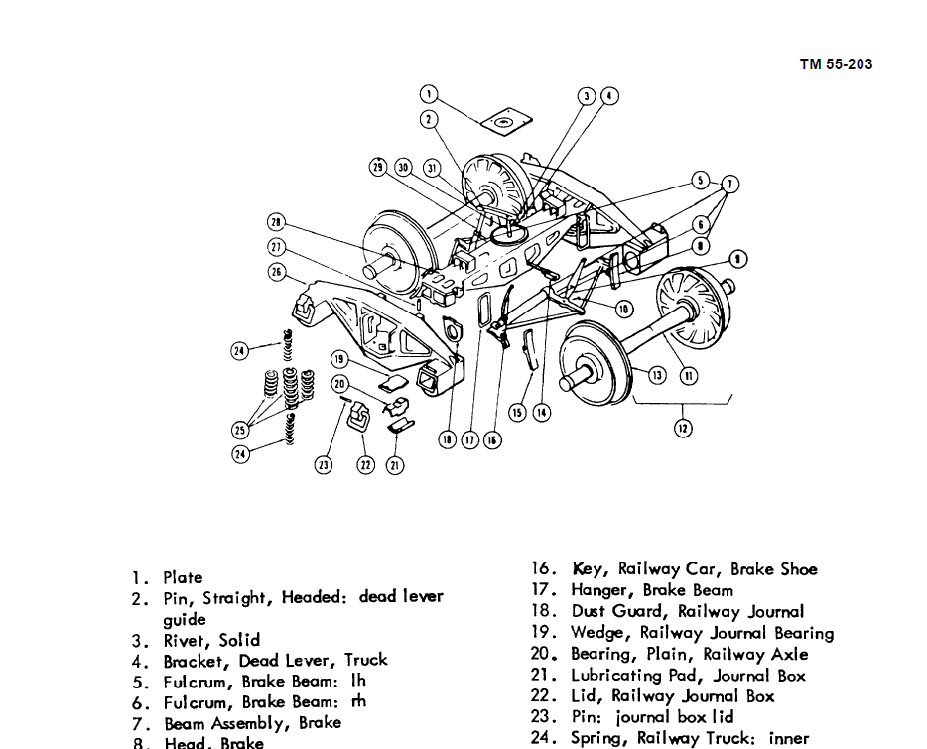
SIDE BEARINGS
Satisfactory. Repair, or Renew
Check Adjust, Missing, No Clearance

Slide 14
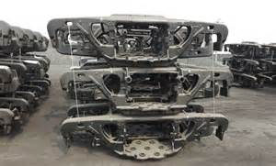
SIDE FRAME-BOLSTER-COLUMN GUIDES
Satisfactory, Repair or Renew
Check Broken, Patched, Plated, Striking, Worn

Slide 15
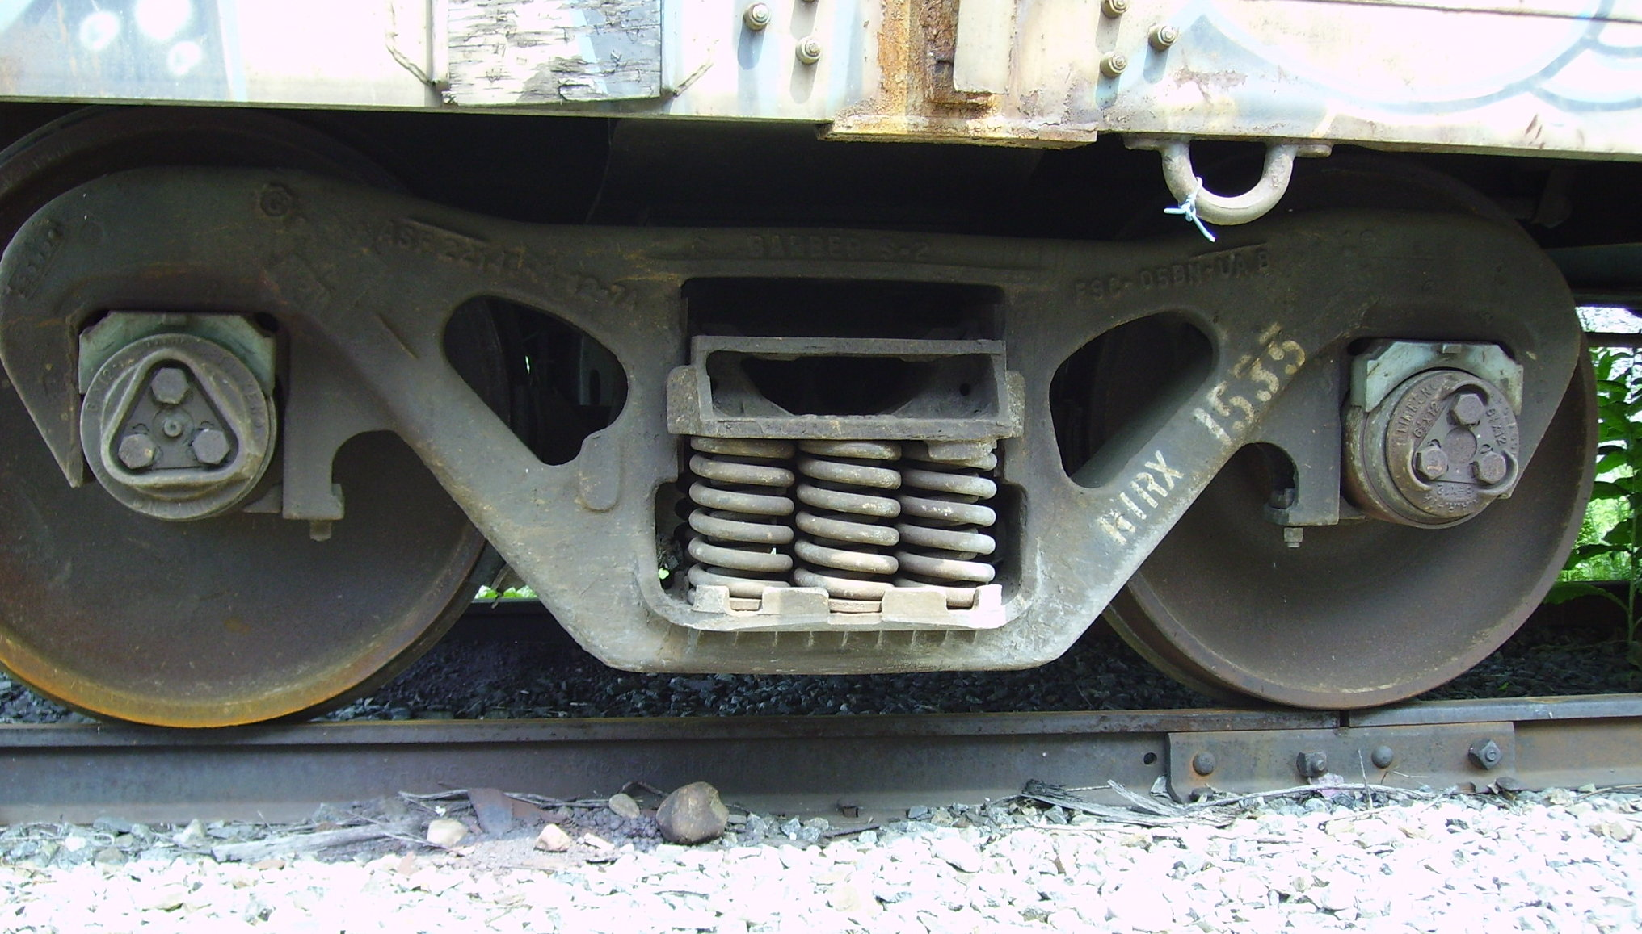
SPRING PACKAGE
Satisfactory, Repair, Renew
Check Compressed, Missing, Broken, Plates, Wood

Slide 16
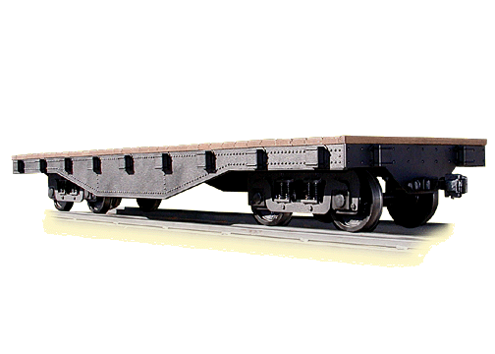
MODIFCATIONS STAKEPOCKETS
YES OR NO
Satisfactory, Repair, or Renew
Check Shields, Straps, Other (specify),
Cracked, Bent

Slide 17
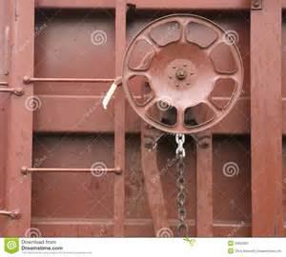
HANDBRAKE SHAFT –WHEEL
Satisfactory, Repair, Or Broken
Check Shim, RR & R, RENEW

Slide 18
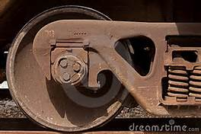
WHEELS
Satisfactory, Repair, or Renew
Check Flange, Cracked, Flat Spots, Thin Rim

Slide 19
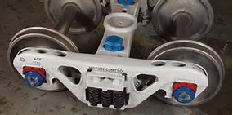
AXLES – JOURNALS
Satisfactory, Repair, or Renew
Check Collar, Heat, RJ STAMP, Fillet

Slide 20
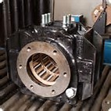
JOURNAL BOX AND LUBRICATORS
Satisfactory, Repair, or Renew
Check Low, Missing

Slide 21
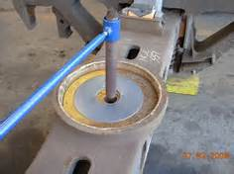
CENTER PLATES
Satisfactory, Repair, Or Renew
Check Broken, Loose

Slide 22
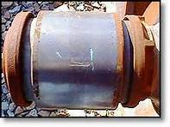
ROLLER BEARING, ADAPTERS,LUGS
Satisfactory, Repair, Renew
Check Heat, Water, Worn, Missing, Seals, Broken

Slide 23
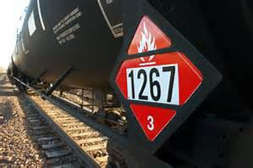
DEFECT CARD HOLDER, PLACARD HOLDERS, ROUTE BOARDS
Satisfactory, Repair, Renew
Check Tighten, Replace

Slide 24
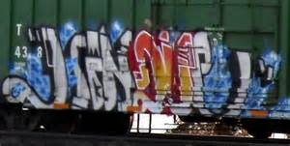
PAINT CONDITION
Satisfactory, Repair, Renew,

Slide 25
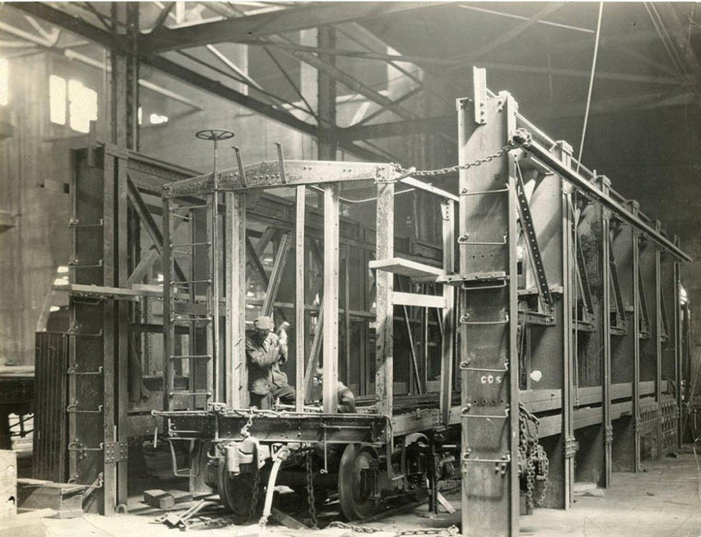
MECHANICAL CONDITION CODE
Satisfactory, Repair, or Renew

