Slide 2
LESSON TEXT
CLEANING AND MAINTAINING STORAGE TANKS
1. PURPOSE OF CLEANING. Many types of bulk petroleum storage tanks are found in
military petroleum storage terminals. Cleaning this type of equipment is the responsibility of the
using organization or unit. There are many hazards involved in tank cleaning and repair, and
great care should be used before, during, and after the cleaning to avoid injury to personnel. It
may be necessary to vapor free or clean storage tanks for three principal reasons: inspection,
maintenance, and repair of equipment; removal of sediment, sludge, and corrosion from
equipment; and change of the type of product to be stored. A change of the type of product
may require tank cleaning because the presence of another petroleum product may
contaminate the product to be stored.

Slide 3
2. PREPARATION FOR CLEANING. Preparations for the cleaning operations depend on
the construction of the tank and the amount of sludge to be removed. Bolted steel tanks used
by the military are provided with floor-level cleanout doors. A lined sump... should be prepared
near the cleanout door to receive the flow of sludge and water when this type of tank is cleaned.
Large permanently installed riveted or welded tanks are provided with manholes. The amount
of sludge in the tank should be estimated then plans made for its disposal. A disposal area
must be designated by competent authority; if (in wartime only) the sludge is to be buried, a pit
or pits should be dug before removing sludge from the tank. If it is necessary to transport the
sludge to a designated disposal area, suitable vehicles should be available. Prior to beginning
any cleaning operations, you must coordinate with the local environmental engineer to obtain a
safety permit.

Slide 4
3. HEALTH HAZARDS. Health hazards present in petroleum products should be pointed
out to the cleaning detail before operation begins in order to avoid injuries, errors, and misuses
of equipment and to increase efficiency. Two or more members of the cleaning detail should be
trained and tested in artificial respiration and first aid and retrained periodically..

Slide 5
a. Dusts.. One of the most toxic dusts that results from cleaning and repairing tanks is
tetraethyllead. Lead dust and fumes also result from removing paint by burning or sanding and
from burning sludge from tanks contaminated by leaded fuel. Fibrosis-producing dust injures
the lungs and may be generated when operating sanding and sandblasting equipment.
b. Gases and Vapors. The most poisonous gas or vapor found by cleaning personnel
is hydrogen sulfide. Hydrocarbon vapors from gasolines and jet fuels are very narcotic and
could result in respiratory failure. Tanks that have been unused for some time may be deficient
in oxygen because of oxidation or rusting.

Slide 6
4. REMOVING SOURCES OF IGNITION. Rich combustible petroleum vapor is heavier
than air and is capable of traveling for some distance when released. Depending upon ground
and atmospheric conditions, the vapor may travel 100 yards or more; it tends to hug the ground,
linger in low spots and diffuse slowly into the atmosphere. If such vapor is ignited, the flame
could travel back to the tank. Flashback is usually fatal to anyone caught in it. If vapors from
petroleum products are mixed with proper amounts of air, they form explosive mixtures within a
limited range. If the vapor ignites in an open space where hot gases have plenty of room to
expand, there is no explosion; if the mixture ignites in a confined space, an explosion takes
place. All fires connected with petroleum products result from ignition of vapors. Before
opening a storage tank, the supervisor should examine the area surrounding the tank for
activities that could cause ignition and make sure these are removed before proceeding. Signs
should be posted to warn against creating further hazards until the tank is vapor-freed.
Operations must be stopped if an electrical storm is threatening. Some of the common sources
of ignition (fig. 1) are outlined below.

Slide 7
a. Smoking and Matches. Smoking and matches are the greatest single common
cause of fires. The area used for tank cleaning should be marked to prohibit smoking.
b. Housekeeping. High standards of housekeeping should be enforced at areas
designated for tank cleaning. Weeds and grass should be eliminated by a nontoxic chemical
solution, such as calcium chloride.
c. Sparks. Sources of friction sparks, such as tools, must be carefully controlled
because of the possibility of igniting combustibles other than flammable vapors.
d. Electrical Equipment. Electrical equipment becomes a fire hazard through arcing,
sparking, and overheating. Fixed or portable lights, power tools, and extension cords may
become overloaded and heat up. All electrical equipment and lights used in the presence of
possible flammable vapors must be explosionproof, and wiring and grounding must comply with
the National Electric Code.

Slide 8
e. Static Electricity. Static electricity is stationary electric potential generated in the
atmosphere by friction between unlike substances. Although static electricity cannot be
prevented, accumulation of a charge can be prevented by proper grounding.
f. Spontaneous Heating. Heat-producing chemical action may produce spontaneous
heating under certain conditions. Oily waste and rags should not be left exposed to the air but
should be collected in airtight metal containers until disposed of.
g. Welding and Cutting. Fire hazards are present in the use of all methods of welding
and in flame cutting. Storage tanks must be thoroughly cleaned and vapor-freed before hot
work is done.

Slide 9
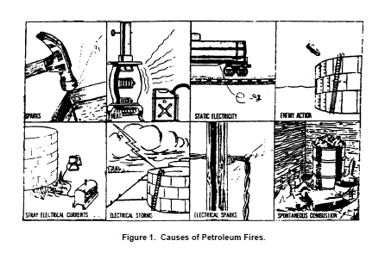

Slide 10
5. EXAMINING AND OPENING TANK. The supervisor should know what product is
stored in the tank and the purpose of the cleaning operation. He should know the condition of
the tank, its state of repair, and the approximate amount of corrosion and sludge. History of the
tank should be determined, including type of products contained, date of last cleaning, and
nature of cleaning performed. Such information could have a bearing on the method and extent
of cleaning and affect the preparations for sludge removal and disposal. The supervisor should
insure that cleaning personnel isolate the tank as described below. When this is completed and
the sources of ignition have been removed, the tank may be opened. The men who open the
tank must avoid breathing the vapor.

Slide 11
a. Removing the Product. Before the tank is opened the product should be pumped or
drained off to the lowest possible level through the lowest tank connection. Pumping or draining
may be helped by adding water through the water drain off line for floatation of remaining
product provided no water is allowed to enter product lines. When all possible product has been
removed, all valves in the lines outside the firewall should be closed, caution tags attached, and
the water drawn off.

Slide 12
b. Blanking off the lines. Blanking off the lines, the final step, is done by closing all
valves nearest the tank, breaking the connections, and placing blinds in all lines. Blanking off
prevents vapors or product from entering into the operating area. The various items used for
blanking off a line are described below.
(1) Blind flange. The blind flange (blank end) is attached to a pipe after its
removal from a tank valve (A, fig. 2).
(2) Figure-8 blind. The figure-8 blind (8, fig. 2) is the simplest and most common
positive shutoff device. It consists of a disk section and a ring section jointed to resemble the
figure 8, as shown in the illustration. The operating condition of the pipeline is noted by
observing which section of the blind is exposed. Flanged sections of pipelines must be unbolted
in order to insert or reverse the figure-8 blind.

Slide 13
(3) Slip-joint blind. The slip-joint blind (C, fig. 2) is a device which is installed in
pipelines to permit easy insertion or reversal of the standard figure-8 blind without unbolting
pipeline flanges. The figure-8 blind, seated in an enclosed slot, is released or clamped by worm
and ring gears controlled by an upright handwheel.

Slide 14
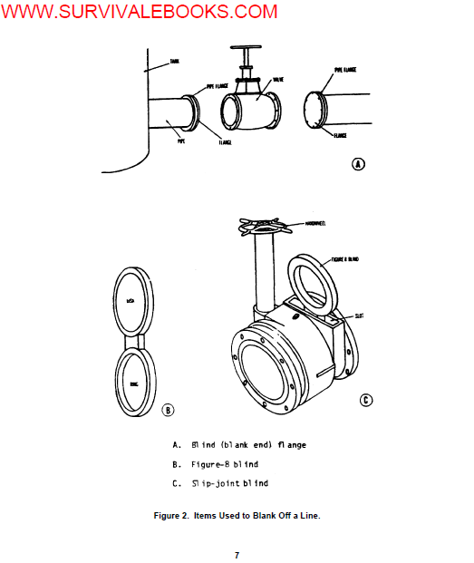

Slide 15
6. NEED FOR VAPOR TESTING AND VAPOR FREEING. The atmosphere of any tank
that has held petroleum products should be tested to determine whether it is safe for the
personnel doing the cleaning. The tank atmosphere should be tested for the presence of
concentrations of vapors and should be examined for oxygen deficiency. Vapor freeing a tank
is a hazardous operation, and the area should be vacated except when vapor testing is
necessary to check on the progress of vapor freeing.

Slide 16
a. Petroleum Vapor. Petroleum or hydrocarbon vapor is found in all tanks which have
product. The combustible range of any petroleum vapor is between 1 and 6 percent of any
given volume, as indicated by chemical test. The toxic limit is 500 parts per million, or
approximately 4 percent of the lower combustible limit. (See figure 3.) This concentration is
safe for 8-hour exposures without respiration equipment. Other significant percentages are
given in figure 3.
b. Tetra Ethyl Lead Vapor (TEL). Tetra Ethyl Lead vapor is present in all tanks used
to store leaded gasoline. The toxic effect of this vapor exceeds that of petroleum vapor and is
also cumulative. Ventilating and vapor freeing tanks used for leaded gasoline is not enough for
the safety of personnel. These tanks are considered unsafe without respiration equipment until
they are cleaned of all sludge, sediment, rust, scale, and dust, down to bare metal.

Slide 17
c. Hydrogen Sulfide. Hydrogen sulfide is rarely found in finished products but may be
expected in tanks which have held crude products with a high sulfur content. Hydrogen sulfide
is present if moistened lead acetate paper turns black. Concentrations of hydrogen sulfide
vapor are measured by the hydrogen sulfide detector. Its combustible range is between 4.3 and
46.0 percent by volume. The toxic limit is only 20 parts per million, far below that of petroleum
vapor (a above), and therefore hydrogen sulfide vapor is much more hazardous. The toxic
effect of hydrogen sulfide is not cumulative as is TEL vapor.
d. Oxygen Deficiency. Because of oxidation, the atmosphere of an inactive tank may
be deficient in oxygen even though the tank is empty and clean. Personnel should not enter
such tanks without fresh-air respiration equipment or until the tanks have been properly
ventilated.

Slide 18
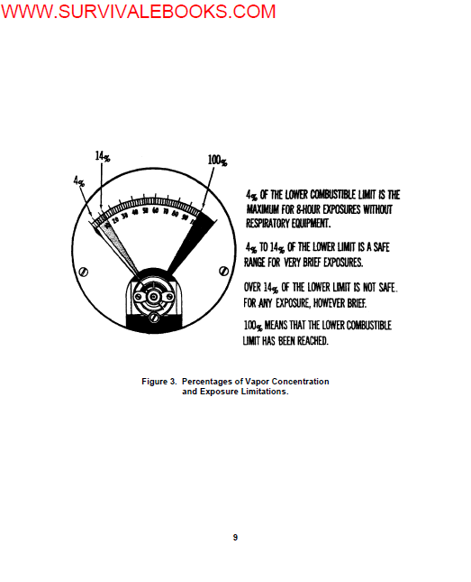

Slide 19
7. PROCEDURES FOR VAPOR TESTING. Gasoline and other petroleum product
vapors except JP-4, which is always potentially dangerous, may be too rich to burn when mixed
with air. However, as the amount of vapor in the tank decreases to the range of 1 to 6 percent
vapor by volume, the vapor enters the flammable range. Safety requires a continuing
knowledge of conditions within the tank vapor space at all times. Frequent tests should be
made during ventilation or vapor freeing, and during subsequent cleaning. Original
concentration of vapor and rate of ventilation govern the frequency of tests. Generally, a tank is
considered to be vapor free if its atmosphere is free enough of petroleum vapor to be neither
toxic nor combustible, and personnel can work within the tank without fresh-air respiration
equipment. These conditions do not apply, however, to tanks which contain TEL vapor or
hydrogen sulfide.

Slide 20
a. Equipment. Instruments for detecting and measuring petroleum vapor
concentration are required for tank cleaning operations. These instruments are designated as
vapor indicators, combustible-gas indicators, or explosimeters (fig. 4) and most of them operate
by the same principle. Hydrogen sulfide detectors (fig. 5) are used to measure concentrations
of hydrogen sulfide vapor.

Slide 21
b. Operations. The items of equipment mentioned above operate as follows.
(1) Explosimeter. A sample tank vapor is drawn into the instrument through the
sampling line by means of a rubber aspirator bulb. The sample is drawn through an analyzer
unit where it comes in contact with a heated platinum filament, on the detector filament. The
surface of this filament is catalytically heated to burn the vapor on contact. This small flame is
protected by a flame arrester which prevents ignition of the tank atmosphere. The burning of
the vapor sample causes an increase in the temperature of the filament unit and a
corresponding increase in its electrical resistance. The greater the concentration of vapor, the
greater will be the proportional increase in resistance. The change in resistance affects the
small current that flows from a dry-cell battery, and this is indicated by a galvanometer needle.
Calibration of the instrument is such that the needle deflection is proportional to the
concentration of vapor. The dial of the explosimeter indicates directly the vapor concentration
as a percentage of the lower combustible limit but does not indicate percentage by volume. The
lower combustible limit is 1 percent by volume. A reading of 100 percent on the explosimeter
means that the tank atmosphere is 100 percent explosive, or that a vapor concentration of at
least 1 percent by volume is present.

Slide 22
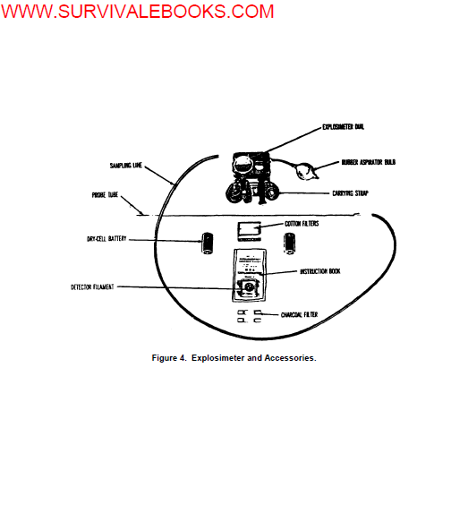

Slide 23
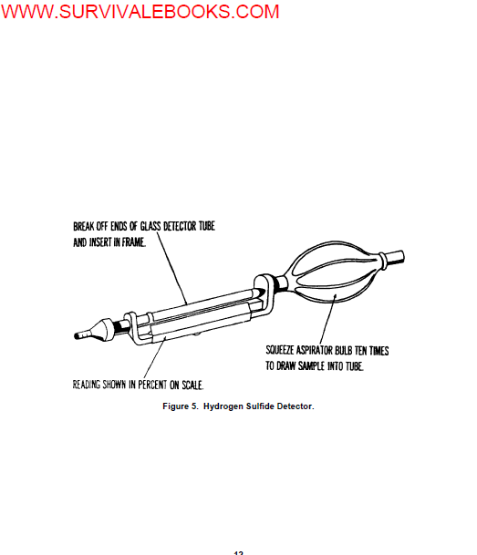

Slide 24
(2) Hydrogen sulfide detector. A hydrogen sulfide detector measures
concentrations of hydrogen sulfide vapor. A sample is drawn into the tube of the detector by
means of the aspirator bulb, and the reading is shown on the scale in percent by volume

Slide 25
c. Frequency. While the tank is being ventilated, vapor concentration should be
tested frequently where the vapor is leaving the tank (fig. 6). Ventilating and testing should
continue until readings on the instrument show no more than 14 percent of the lower
combustible limit where the vapor is leaving the tank. If the tank has contained lead, the tester
enters the tank with respirator equipment. Readings should be taken at a level of about 1 foot
above the sludge. If the tank is being vapor freed by forced ventilation, the ventilator should be
turned off while testing to get a true sampling of the air. The interior of the tank is considered
safe when a maximum reading is 4 percent of the lower combustible limit. This reading
indicates the air is suitable for breathing without respiration equipment and is well below the
combustible limit. After the tank has been found to be vapor free and cleaning operations can
begin, periodic testing is continued.. Cleaning operations may generate additional vapors.
Although a reading of 4 percent is considered safe for an 8-hour exposure and higher readings
safe for very short periods, a reading in excess of 14 percent is not safe for any exposure.
Cleaning personnel must leave the tank or wear respiration equipment if the explosimeter
reading indicates concentration of 14 percent of more.

Slide 26
8. METHODS OF VAPOR FREEING. Large storage tanks can be vapor freed by natural
ventilation or forced ventilation. They may also be vapor freed by water displacement if an
unlimited supply of sea water is available. Tanks to be vapor freed by natural ventilation or
forced ventilation must be opened at top and bottom, in that order. Personnel who open tanks
should face away from the wind and avoid breathing vapors.
a. Natural Ventilation. Natural ventilation is the simplest but slowest method of vapor
freeing. When this method is used alone, further operations should be stopped until tests
indicate that a safe concentration of vapor has been reached.
b. Forced Ventilation. Forced ventilation is a faster way to vapor free a tank, and this
may be done by either of the methods described below

Slide 27
(1) Blowers. Blowers or fans produce a forced draft which can be applied to the
bottom tank opening by means of canvas ducts. An electric motor, a gasoline engine, or a
steam turbine may be used as the source of power to drive a blower. When using an electric
motor (unless explosionproof) or gasoline engine, the blower must be set up upwind of the tank.

Slide 28
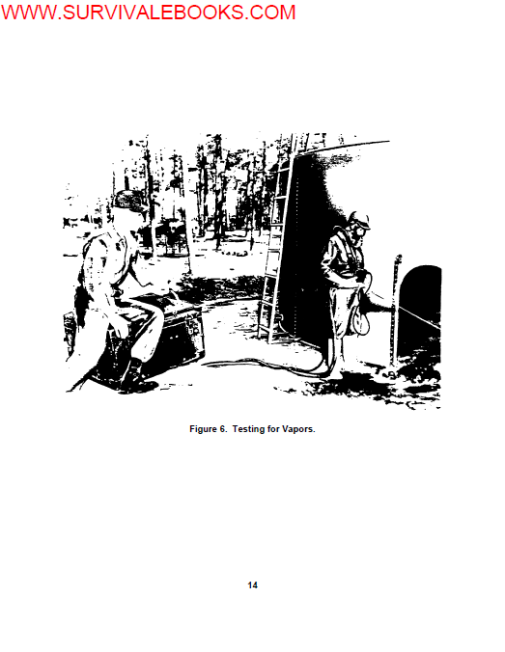

Slide 29
(2) Ejectors. Ejectors or air movers (sometimes called eductors or exhausters)
are powered by steam or compressed air. They are applied to the top opening, where tank
vapors are drawn out by suction (fig. 7). When ejectors are used for vapor freeing, the work of
sludge removal can continue uninterrupted.
9. SAFETY PRECAUTIONS. Tank cleaning requires close supervision to assure a
reasonable degree of safety. In addition to fire and health hazards, many other hazards, mostly
physical, are also encountered in cleaning operations. Various physical hazards and applicable
precautions are presented below.

Slide 30
a. Ladders and stairways should be secure.
b. Where roof plates have become thin, planks should be used to distribute the
weight.
c. Line blanks should be strong enough to withstand pressures put on them.
d. After a tank has been vapor freed, there should be no loose members or fixtures
that could be knocked down during cleaning operations.
e. Personnel should use care in moving about with hose and lifeline. Tank floors are
very slippery. To avoid slipping or tripping, men should step over pipe and fittings and not on
them.

Slide 31
f. Swing lines should be lowered when men are working in the tank to avoid
accidental release of the lines.
g. Tools should be handled carefully and used only for their intended purposes.
h. Care should be used in walking on tank roofs, scaffolding, stairways, or on ladders,
particularly when icy conditions exist.
i. Before a tank is entered, it should be properly lighted. Explosionproof lamps should
be used, and the portable cords used with the lamps and electrically operated tools should be
connected to a grounded third wire. Fixtures and wiring used in the presence of vapor should
be examined for broken conductors or frayed insulation.
j. When men are inside a tank completing the cleaning process, a man should be
available outside the tank to assist them in an emergency

Slide 32
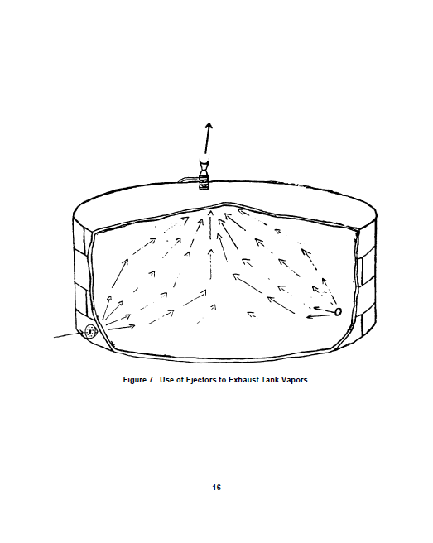

Slide 33
10. SAFETY EQUIPMENT. Each person on the cleaning team should be given
adequate protective clothing and equipment to provide maximum protection for their health and
safety.
a. Safety Equipment Set. The safety equipment set (fig. 8) is a standard item that is
provided for the safe cleaning of tanks. The set consists of two fresh-air respirators, one handoperated
centrifugal blower, necessary airhose, two leather harnesses, two lifelines, one
explosimeter with accessories and instructions, two pairs of rubber boots, and two pairs of
rubber gloves. A chest is provided with the set for ease of carrying and for safe storage of the
equipment. The blower is permanently mounted in the chest for convenience of operation. A
removable blower handle permits closing the chest lid, through which the blower is operated. A
cutout in one end of the chest provides space for the two air lines.

Slide 34
b. Respiration Equipment. The fresh-air respirator, which is used with a blower, is the
only equipment recommended for use inside of tanks which have not been vapor freed, in tanks
which contain TEL vapor or hydrogen sulfide, or in active tanks which have not been ventilated.
The fresh-air respirator provides an independent supply of fresh air delivered to the facepiece
under positive pressure. The testing and use of respiration equipment must be supervised
closely

Slide 35
(1) Inspecting and testing. Respiration equipment must be tested frequently. It
must always be inspected before use and before being stored. If repairs are needed, they
should be made immediately. In case of an emergency, a man's life could depend upon the
availability of spare equipment. To test the respirator for leaks, the user puts on the equipment.
Chewing material in the mouth should be forbidden. With respirator in position and straps
adjusted, the end of the connecting tube should be closed with the palm of the hand or by
pinching the tube. If the facepiece collapses, there are no leaks and the fit is satisfactory.
Connections on the air hose should be examined for tightness. Gaskets supplied with the set
should be used.

Slide 36
(2) Using. Some precautions are necessary in using this equipment. Several of
these are as follows:
(a) The blower should be set up to face the wind to insure that fresh air is
delivered to the respirators.
(b) The blower must be attended constantly.
(c) When a man enters the tank, someone must tend his lines and keep him
under constant observation. The person tending the lines must be properly equipped to enter
the tank for immediate rescue work.

Slide 37
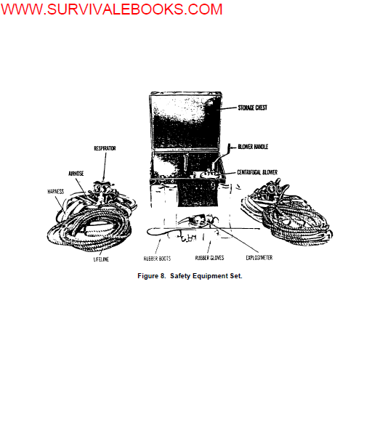

Slide 38
(d) Hoses should be lifted over the edge of the manhole and not permitted to
drag. Padding under the lines is recommended to prevent damage.
(e) Cleaning personnel must not remove respirators inside the tank. Even
though the tank is vapor free, the facepiece could be contaminated.
(f) Cleaning personnel should leave the tank immediately if the odor of
gasoline is noticed. They must not reenter the tank until the cause of the odor is determined
and the problem is corrected.
(g) Men in the tank should not step over the hose lines. Connections may be
loosened if the hose is pulled or twisted.
(h) Personnel should be cautioned about walking the line around columns or
other obstructions because of the possible difficulty of escape in case of emergency.

Slide 39
(i) Enough men should be available for emergency duty. Should it be
necessary to send rescuers into the tank, they must be equipped with respirators and lifelines
and must be kept under constant observation.
(j) Men should be checked for physical condition and should be relieved
frequently while on duty. Illness, fatigue, and overheating lessen resistance to toxic effects.
(k) Respirators should be washed with soap and water at the end of the day's
work. Hose, harness, and lifelines must be thoroughly cleaned and dried naturally before they
are stored.

Slide 40
c. Other Protective Equipment and Clothing. In addition to the equipment mentioned
above, the following equipment and protective clothing may also be used in cleaning operations.
(1) Canister gas masks. Canister gas masks equipped with canisters approved
for organic and acid gases (yellow) can be worn for protection outside the tank or in other
hazardous outdoor areas. This mask is acceptable for use by personnel who blank the lines
and open manholes of tanks which contain TEL vapor and hydrogen sulfide. Accurate time
records must be kept when canister gas masks are used so that the canister safe life will not be
exceeded.

Slide 41
(2) Goggles. Personnel who wipe down tank walls with solvent during the
cleaning operations should wear tight-fitting goggles to protect the eyes. Also, personnel who
enter the tank to knock down loose scale or other deposits with high-pressure hose or scrapers
should wear goggles to protect the eyes from flying particles.

Slide 42
(3) Rubber boots and gloves. Rubber boots and gloves are necessary items of
protection for cleaning tanks. Knee-length or hip-length boots with safety toes are preferred.
Rubber gloves should be strong and long enough for adequate protection. Boots and gloves
should be acidproof and should be resistant to gasoline, oil, and water. Personnel who wear
boots and gloves are insulated. If the boots do not have copper rivets, they should be inserted
in the heels to discharge any accumulating static electricity.
(4) Outer garments. Cotton clothing should be used to decrease the generation of
static electricity in the clothing. White cotton coveralls and white cotton caps are recommended
for personnel assigned to cleaning duty. A complete fresh change of clothing should be worn
each day. Sludge or gasoline stains are more noticeable on white or light-colored clothing. If
the clothing becomes wet, particularly with gasoline, it should be changed immediately.

Slide 43
11. SPECIAL PRECAUTIONS RELATED TO LEADED GASOLINE. If a tank that has
held leaded gasoline must be entered for cleaning or repair work, the specific precautions below
must be followed in addition to the general precautions already covered.
a. A tank used for leaded gasoline must have a warning stenciled above the cleanout
door or near the manhole.
b. Sources of ignition should be removed, and the tank should be examined and
isolated.
c. Personnel who enter the tank must wear respiration equipment. Respirators must
be worn until all sludge, rust, and scale have been removed from sidewalls, bottom, and piping.
Forced ventilation should be provided.

Slide 44
d. Necessary work within the tank should be performed in the shortest time possible,
and all contact between tank liquids and the skin must be avoided. Unavoidable exposures to
vapors should be brief and widely spaced because the toxic effect of leaded vapors is
cumulative.
e. If the sludge is to be buried or spread out for weathering in a designated area, all
absorbent materials used for removing sludge or drying the tank after it has been hosed should
be disposed of with the sludge.

Slide 45
f. White cotton outer garments, white cotton underclothing, and rubber boots and
gloves should be worn. Clothing should be laundered and the body bathed each day. If
clothing should become soaked with gasoline or sludge, wet the clothes with water before you
take them off. If there is not enough water at the site to wet the clothes thoroughly, ground
yourself to a piece of grounded equipment by taking hold of it with both hands before you take
off the fuel-soaked clothes. Then the clothing should be washed promptly and the body bathed
before fresh clothing is put on.

Slide 46
g. Respirators, boots, gloves, and hose should be washed with soap and water at the end
of each day. Boots and gloves should be washed before they are removed.
h. After the usual cleaning, if repairs are planned that involve heating the tank shell or that
may result in dust, the part of the tank to be repaired should be cleaned further by sandblasting
down to bare metal.

Slide 47
12. SPECIAL PRECAUTIONS RELATED TO HYDROGEN SULFIDE. Hydrogen sulfide
attacks exposed interior parts of a tank .and forms a scale of iron sulfide. During galvanic
action, which takes place between the scale and metal, a chemically generated electric current
flows from the tank metal to the scale. Flexing of the tank roof causes pieces of the scale to
break loose and fall to the bottom. The galvanic action then takes place on the bottom, often
resulting in deep pitting and leaks. Iron sulfide scale is capable of spontaneous combustion.
Rapid oxidation of the scale takes place when the tank is open for ventilation. Heat is
generated to the point where the deposits actually glow, and combustible vapors could be
ignited. Precautions presented below must be observed when hydrogen sulfide is present.

Slide 48
a. Personnel who blank lines and who open hatches and manholes should wear freshair
respirators or canister gas masks approved for hydrocarbon vapors and acid gases (yellow).
Field protective masks are not adequate.
b. Both the explosimeter and hydrogen sulfide detector must be used to test the tank
atmosphere. Personnel must not enter the tank without fresh-air respirators until tests show no
more than 4 percent of the lower combustible limit of petroleum vapor and no more than 20
parts per million of hydrogen sulfide.

Slide 49
c. Contact between air and iron sulfide scale should be prevented or the heat
generated by oxidation should be dissipated until the tank atmosphere is below the combustible
limit of hydrogen sulfide and petroleum vapor. When the tank can be steamed effectively, the
iron sulfide on the roof and sidewalls will be adequately blanketed and soaked by condensate
until the tank atmosphere is no longer combustible.
d. When the tank atmosphere is safe, a high-pressure water hose is used to knock
down the scale into the sludge and water where it will be safe until it is removed with the sludge.
To prevent spontaneous combustion after removal, the sludge. is kept wet until it is disposed of
properly.

Slide 50
13. CLEANING TANKS. A number of cleaners designed to remove sludge, rust, and
scale from tanks by chemical action are available on the commercial market. Currently, they
are not standard items of issue in the Army supply system but may be obtained by local
purchase. Some of them produce excellent results on steel bolted tanks, and save time and
manpower in cleaning large permanent-type tanks. Chemical cleaners emulsify the sludge and
film on the floor and sidewalls of the tank. The grease is loosened and suspended in the
emulsion, similar to the action of soap and water when washing and is then washed away with
water. To clean a tank, a solution of the cleaner is mixed in water according to the
manufacturer's instructions and sprayed inside the tank. It is usually allowed to remain in the
tank overnight. Then the walls and floor are hosed down with water and the emulsion flushed
out the cleanout door into the sump

Slide 51
14. CLEANING ABOVEGROUND TANKS NOT VAPOR FREED. Personnel should not
be required to enter tanks that contain vapors if it can be avoided. However, cleaning without
vapor freeing may be justified under certain circumstances. Some of these are: when TEL
vapor and hydrogen sulfide are known to be absent; when facilities for vapor freeing are limited;
when water is not available in sufficient quantities for vapor displacement and flushing; or when
the quantity of sludge and corrosion is small. If a tank must be cleaned without being freed of
vapors, all safety precautions should be followed, sources of ignition must be removed, and the
tank must be examined and isolated. Liquid sludge is then pumped from the tank. Pumping
can be facilitated and loose scale and rust removed by means of a high-pressure water hose
directed from the outside. If a hose is used, the hose nozzle must be bonded to the tank shell.
All personnel entering the tank must be equipped with fresh-air respirators, hose lines, lifelines,
impermeable rubber boots and gloves, paddles or wooden scrapers, buckets, brooms and
mops, rags, or other absorbent and lint-free materials. After the remaining sludge, rust, scale,
and other deposits are removed from tank walls and floor by scraping, the sludge and other
deposits are removed from the tank in the shortest time possible. The tank is rinsed by hosing
and then mopped or wiped with cloths.

Slide 52
15. CLEANING UNDERGROUND TANKS. Underground petroleum storage tanks are
usually of welded-steel or concrete construction. Underground steel tanks are similar to
aboveground welded-steel tanks except that they are designed to withstand severe weight
stresses. Most vertical steel tanks, and most horizontal steel tanks of 3,000-gallon capacity or
over, are provided with manholes to permit entry of cleaning personnel. Interiors of steel tanks
may be coated. A variety of shapes and designs of underground concrete tanks may be found
in oversea areas; however, rectangular and cylindrical tanks are the most common.
Rectangular tanks are usually installed horizontally, and cylindrical tanks are usually installed
vertically. Most concrete tanks are provided with manholes to permit entry, and most are lined
to prevent leakage and to provide a chemically inert barrier between the product and the
concrete surface. Tanks that are used for heavy products are usually coated with

Slide 53
sodium silicate solution; those used for light products are usually surfaced with laminated linings
of organic material, such as synthetic rubber sheets, synthetic rubber latex with membranous
material, or synthetic resin. Some of these tanks are equipped with sumps for accumulation of
water and sediment and may also have permanently installed pumps for removing liquid sludge
from the sump. Some tanks may have a sludge disposal system which includes the pump and
piping for evacuating the sludge to a disposal area.

Slide 54
a. Vapor Freeing. Underground storage tanks which do not have side openings are
more difficult to vapor free than aboveground tanks. Because vapors tend to settle at tank
bottoms, vapor freeing by natural ventilation is considered impracticable. Tanks should be
tested for presence and concentration of vapors and vapor freed by one of the following
methods.

Slide 55
(1) Forced ventilation. Blowers can be used for forced ventilation if roof manholes
are opened and blowers are attached either to pipes leading into the tank near the bottom or to
ducts or hose extending through the roof openings to the tank bottom. Pipes suitable for this
purpose may be drain lines, lines used in a sludge disposal system, or product input or output
lines. Ejector or air movers attached to roof openings can be used for forced ventilation if pipes
leading into the tank near the bottom are opened to provide drafts to agitate accumulated
vapors at the tank bottom.
(2) Water displacement. Underground tanks, except those used for aviation fuel,
may be vapor freed by water displacement when suitable means for handling overflow water is
provided. Any fuel removed by water displacement must be placed in drums or other suitable
containers.

Slide 56
(3) Steam displacement. Small steel tanks may be vapor freed by steam
displacement when steam generating equipment is available. Steam should never be used in
concrete tanks because the high temperature is damaging to concrete and to tank linings and
coatings.
b. Cleaning Procedures. Procedures for cleaning an underground tank are
determined mainly by tank construction, that is, whether the tank is welded steel or concrete
and whether or not it is provided with a manhole to permit entry of personnel. All applicable
precautions must be observed when cleaning underground tanks.
(1) Tanks that permit entry of personnel. Tanks that are provided with manholes
to permit entry should be cleaned by personnel working inside the tank. Procedures for the
cleaning of aboveground tanks are followed. Vapor tests are taken frequently. Unfavorable
changes in vapor concentration must be detected early because quick exit is more difficult
through the roof manhole than through a side opening of an aboveground tank. Steam is never
used as a cleaning agent for

Slide 57
concrete tanks. Water is applied under pressure and the tank interior is scrubbed with brushes
and a suitable solvent, such as kerosene. Tank linings or coatings must not be damaged.
(2) Tanks that do not permit entry of personnel. 'Tanks that are not provided with
maholes to permit entry and those that are so small that work within the tank would be
impracticable must be cleaned by applying cleaning agents from the outside. The best cleaning
agents for this purpose are steam and a combination of steam and a suitable solvent, such as
kerosene. If a 50-g.p.m. pumping assembly is used to remove sludge and cleaning agents from
the tank, the pumping assembly is placed front to the wind well away from the tank unless the
pumping assembly has an explosionproof electric motor. The cleaning process is repeated until
the tank is clean. Heavy deposits of sludge can sometimes be loosened by scrubbing the tank
interior with brushes attached to long poles.

Slide 58
16. CLEANING THE PUMPING ASSEMBLY. When the 50-g.p.m. pumping assembly and
hose have been used to remove sludge from the tank, the equipment is contaminated and
should be cleaned as follows. When the sludge and water have been removed from the tank or
sump, the suction hose should be inserted in a drum of clear water or coupled to a source of
supply. The pump should be operated until the pump and its suction and discharge lines are
thoroughly flushed. After the pump and lines have been flushed with water, they should be
flushed with a gallon or two of solvent. The solvent from both hoses should be drained into the
pump, and the solvent drained from the pump. The solvent should be examined to determine
whether further flushing is necessary.

Slide 59
17. REMOVAL OF SLUDGE. Procedures for removing sludge from tanks are discussed
below.
a. The liquid sludge should 'be pumped directly from the tank to the disposal area or
to the tank vehicle (fig. 9). This can be done by inserting the suction hose of a 50-g.p.m.
pumping assembly through the manhole or lower tank opening.
b. A high-pressure water hose can be used to knock down loose rust and scale and to
wash material into the prepared sump. In addition to dumping the sludge out of the tank, the
sludge can be shoveled into wheelbarrows or trucks and moved to the disposal area, or a 50-
g.p.m. pump used to move the sludge from the sump to the tank vehicle (fig. 10).
c. Testing for vapor concentration should be continued. Agitating the sludge will
probably release additional vapor. If vapor is being generated in excessive quantities,
personnel should leave the tank until tests prove that the tank atmosphere is safe.

Slide 60
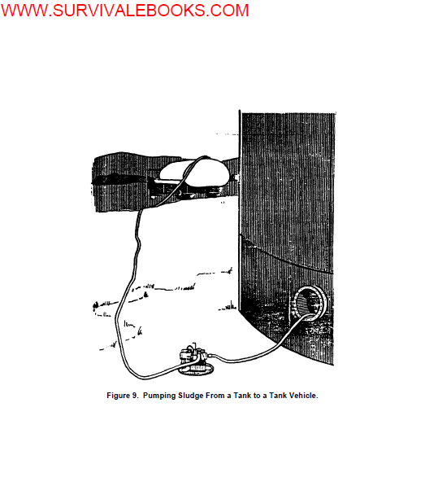

Slide 61
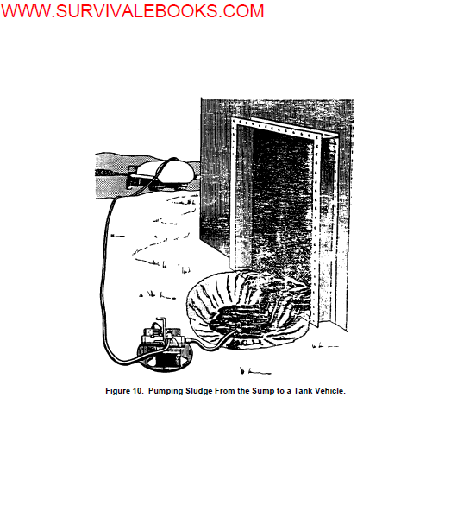

Slide 62
d. Remaining sludge should be removed by scraping. It can be shoveled into buckets
and handed through the manhole or cleanout door or loaded in wheelbarrows and removed
through the lower tank opening of a permanently installed tank.
e. The remaining rust, scale, and other deposits can be removed with scrapers or wire
or fiber brushes. In cases of extreme corrosion, sandblasting may be necessary. Scaffolding
may be erected for work in the upper areas of the tank.
f. Deadwood should be freed of product, scale, and sludge. Holes may be drilled at
the bottom of hollow roof supports to allow drainage and flushing from the top.

Slide 63
g. If necessary, walls and floor of the tank can be wiped down with kerosene.
h. The tank should be rinsed by hosing walls and floor. Moisture can be taken up by
mopping or wiping with lint-free cloths.
i. The inspection date, services performed, and the cleaning date should be entered
on a Utilities Inspection and Service Record (DA Form 4177). The cleaning date should be
stenciled near the manhole, cleanout door or any other place that is easily seen.

Slide 64
18. SLUDGE DISPOSAL. The method of sludge disposal depends upon whether the
sludge is leaded or unleaded and on the availability of disposal areas. Prior to disposing of
sludge, coordinate with the local environmental engineer. Insure that disposal method complies
with local, state and Federal laws on environmental protection as specified in AR 200-1.
a. Leaded Sludge. Leaded sludge may be disposed of through the Property disposal
office (PDO). Otherwise leaded sludge should be kept wet until buried or spread out for
weathering. Personnel should wear the same protective clothing utilized for tank cleaning.
Respirators and masks are not needed unless vapors can be detected at face level.

Slide 65
(1) Burying. Sludge may be buried in pits in a designated area away from
population concentrations. The sludge must be covered over and posted to prevent its being
disturbed in future operations.
(2) Weathering. Decontamination of sludge by weathering offers a means of
disposal where space for repeated burying is not available. The location should be remote,
smooth, well drained and ventilated and if possible sunny. Sludge should be spread to a depth
of 3 inches or less and the area roped off and posted. The sludge is left in place for a period of
4 weeks during which the temperature is above 32°F (0°C). If the temperature goes below
freezing the weathering period should be extended for a corresponding length of time. After
weathering, the sludge can be treated as any nontoxic waste or left in place, with ropes and
signs removed.

Slide 66
b. Unleaded Sludge. Unleaded sludge may be buried or pumped into dry wells. It
may also be destroyed by burning with high intensity furnaces

