Slide 2
LESSON
INTRODUCTION TO HYDRAULICS
Critical Tasks: 03-5103.00-0024
03-5103.00-0080
03-5103.30-1147
01-5103.00-0003
03-5103.00-0024
03-5103.00-0078
03-5103.00-0086
03-5106.00-0135
03-5103.00-0085

Slide 3
INTRODUCTION
Since machines were first introduced to the battlefield, military leaders depended on continual sources
of petroleum to power these machines. In fact, throughout the many wars of the 20th century, battles
and wars have been won and lost based on who controls the fuel. As military weapon systems have
become more lethal, they have also become vast consumers of petroleum fuels. In fact, a single U.S.
Army mechanized infantry division of today uses over a million gallons of fuel in a single day during
offensive operations. Our mission as Army petroleum leaders is to feed the ravenous hunger of our
mighty war machine. It is important to make every attempt to protect the environment while still
accomplishing this mission. As such, you must conduct an environmental assessment before beginning
fuel operations. The unit environmental

Slide 4
officer coordinates with the EPA representative, the unit petroleum officer, and the environmental
regulators to make an assessment of the petroleum operation. This assessment is used to determine how
the petroleum operation will affect the wildlife and local population within the unit's area of operation.
Environmental compliance officers use the results from the assessment to verify whether or not the
petroleum operation is IAW the prescribed environmental compliance. The unit environmental officer
works with the following personnel: the environmental compliance officer, the EPA officer, the unit
petroleum officer, and environmental regulators. As with any operation, the unit environmental officer
must stress spill prevention

Slide 5
The unit environmental officer is also responsible for knowing the governing spill contingency policy,
the installation policy, the CONUS policy and or the OCONUS policy, and any host nation policy that
applies to the area in which the petroleum operation will be conducted

Slide 6
In the years since World War II, the U.S. Army Quartermaster Corps has operated petroleum pipelines
throughout the world in locations such as Korea, Japan, Europe, and Alaska. More recently, tactical
pipelines have been deployed to support Desert Shield, Desert Storm, and Somalia. Also, military
exercises such as Roving Sands, Market Square, Bright Star, and Tandem Thrust have seen deployment
of tactical, multiproduct pipelines.

Slide 7
Although often thought of as insignificant during peacetime, all petroleum NCOs and Officers will find
themselves sought out by field commanders during wartime. Battles and wars hinge upon a leader's
ability to bring overwhelming destructive firepower upon the enemy. Good leaders recognize they must
include petroleum leaders during initial planning phases of any operation. Otherwise, they may find
themselves and their command nonmission capable. All petroleum leaders must strive to educate their
superiors on the importance of adequate petroleum support. You must also teach your subordinates to
know, understand, and be able to execute their responsibilities to support the force

Slide 8
1. Terms. Here are some of the terms and definitions you will encounter during this lesson.
a. Darcy-Weisbach Equation -- Used to calculate friction head loss in a pipeline.
b. Design Fuel - Fuel type for which a pipeline system is designed; military pipelines will most
likely transport kerosene-based diesel and jet fuels.
c. Friction Loss - Loss of pressure, in terms of feet of head per unit of pipe length, from internal
resistance to flow in the product itself (viscosity) and from resistance offered by pipe walls, pipe fittings,
and reductions in pipe diameter.
d. Reynold's Number - An equation used to determine the friction factor required in the Darcy-
Weisbach equation.
e. Specific Gravity - A physical property of liquids; the ratio of the weight of a volume of liquid to
the weight of an equal volume of water.
f. API Gravity - Scale developed by the American Petroleum Institute (API) and used by the
petroleum industry, that is based on reciprocals.

Slide 9
2. Basic Petroleum Mathematics.
Now that you are familiar with the terms related to petroleum hydraulics and pipeline design, we will
begin with an introduction to mathematics. As a student in the petroleum officer course and, more
importantly, as a petroleum officer, you will often encounter problems requiring more than just basic
mathematical abilities. These problems will require an officer able to not only solve a given problem,
but determine multiple unknowns along the way, each of which can greatly affect the final solution.
This mathematical evaluation is designed to test not only your mathematical skills but also your
analytical thinking abilities. To be successful, you must learn and understand flow rates and velocities.
You must learn to perform basic calculation related to flow rates and velocities, determine mathematical
hierarchies using rules of mathematics, and solve for an unknown variable given all other variables in an
equation.

Slide 10
a. Flow Rates. Throughout the Petroleum Officer Course, you will encounter flow rates and their
applicability in solving petroleum-related problems. It is very important to understand what flow rates
are, how they are measured, and their significance to solve these problems.
(1) A flow rate can be defined as that which measures a specific volume of liquid delivered
over a specified period of time. Note that the two most significant elements of this meaning are volume
and time. Flow rates can be distinguished from velocities, which we will discuss later, by these units of
measurement

Slide 11
(2) If you know the amount of volume in a liquid and the amount of time it was measured in,
you can determine the specific flow rate of that liquid. Flow rates are generally denoted by the
abbreviation "Q".
(3) Volumes can be measured by many different units of measurement. The most common
ones we use in the petroleum industry are cubic feet, gallons, and barrels. The most common time
measurements we use when dealing with flow rates are seconds, minutes, hours and days

Slide 12
(4) When you put volumes of measurement together with units of time, you have different
measures of flow rates. Some of the more common flow rates we will discuss throughout the course are:
gallons per minute, barrels per hour, and cubic feet per second.

Slide 13
b. Conversion of Flow Rates. Often, when working in the petroleum field, we are required to take a
flow rate that is given in one unit of measurement and convert it to another in order to solve a specific
problem. For example, we may be given a flow rate of gallons per minute but may have to convert that
unit of measurement to barrels per hour to satisfy a specific scenario. Luckily, most flow rate
conversions we are required to make have already been figured out mathematically and placed into FM
10-67-1, Appendix M. All you have to do is take the correction unit from FM 10-67-1 and multiply it
by your answer to convert the flow rate. However, there may be some cases in which a specific flow
rate is not listed in that reference manual. Therefore, we need to discuss how to perform these
conversions so that you can understand how they were calculated.

Slide 14
(1) Let us take an example and solve it together. Problem: You re operating a hose line
system, and you have a meter in-line. You have received 500 gallons over the past two minutes, but
your supervisor needs to know how many cubic feet per second it equals. To solve, you follow this
order:
(a) The first requirement in this example is to convert the time down to a minute of
measurement. Since we are dealing with two minutes, divide by two to convert to a by-minute unit of
measurement. Thus, 500 gallons over two minutes convert to 250 gallons per minute.

Slide 15
(b) Using FM 10-67-1, Appendix M, note that converting from gallons per minute to
cubic feet per second requires multiplying your answer by 0.002228. By multiplying this factor by the
250 gallons per minute, we can determine that a flow rate of 250 gallons per minute is equal to 0.557
ft3/second.
(2) Where do the conversions come from? As was previously stated, it is important to
understand where these conversion factors in FM 10-67-1 come from, since not all possible flow rates
are listed in that reference.

Slide 16
(a) All units of measurement are convertible, as long as you know their characteristics.
For example, most people do not know offhand that 1 hour equals 3,600 seconds. But, everyone knows
that 1 hour equals 60 minutes and 1 minute equals 60 seconds. By multiplying these two conversions
together, we can quickly determine that 1 hour equals 3,600 seconds.

Slide 17
(b) Looking at the previous example, the flow rate gallons per minute had to be
converted to cubic feet per second. How was this conversion derived? One of the first things to
remember is that whenever we have measurement units in a numerator or denominator, the only way to
cancel those units is to put them on the other side of the fraction.
(c) Starting with the flow rate gallons per minute, we can write that flow rate as a
fraction, gallons over minutes. This flow rate must be converted to cubic feet per second, or cubic feet
over seconds. Breaking these fractions down, we see that we are required to convert gallons to cubic
feet for the volume measurement, and minutes to seconds for the time measurement

Slide 18
(d) Gallons can be converted to cubic feet by determining the number of gallons in a
cubic foot. That number is 7.48. So, if you start with your fraction gallons over minutes and multiply
that by
1-4 QM5203
1 cubic foot over 7.48 gallons, you can cancel out the gallons measurements in the numerator and
denominator, and you are left with 1 cubic foot over minutes multiplied by times 7.48.

Slide 19
(e) For the minutes to seconds conversion, simply multiply the fraction by 1 minute over 60
seconds. This will cancel out the minutes in the equation. You now are left with a unit of measurement
of cubic feet over seconds, just what you were supposed to convert to. The rest is just a math problem.
Along with the factors, you have 1 multiplied by 1 in the numerator and 7.48 multiplied by 60 in the
denominator.
That equals 1 over 448.8 or 0.002228, which is the conversion factor found in FM 10-67-1. Figure 1-1
illustrates how to accomplish this action.

Slide 21
c. Velocity. Velocity, like flow rate, uses one unit of measurement over another. While flow rate
measures volume of liquid over time, velocity measures distance traveled over time. More simply
stated, it is a measure of speed. The common abbreviation for velocity is "V."
(1) Distance is commonly measured in miles, feet, and inches. However, it can also be
measured in metric measurements. Since the denominator in velocities (hours, seconds, etc.) is the same
as for flow rates, common velocities we use in the petroleum field are: miles per hour and feet per
second.

Slide 22
(2) Since there are no conversion factors for velocity listed in FM 10-67-1, we must convert all
velocities by hand using the same process we used to convert flow rates.
(a) In this instance, the required conversion is from miles per hour to feet per second. As
with the conversion for flow rates, both numerators are in the same type of measurement (distance) and
both denominators are measured in time.
(b) To convert from miles to feet, multiply by 5,280 feet over 1 mile. This allows
elimination of the miles and leaves you with 5,280 multiplied by feet over hour multiplied by one.

Slide 23
(c) Converting from hours to seconds can be done one of two ways: first, if you know
that 1 hour equals 3,600 seconds, then you can multiply by 1 hour over 3,600 seconds to eliminate hours
from the equation. In this example, we use the second method, first breaking hours down into 60
minutes and then breaking minutes down into 60 seconds.

Slide 24
(d) Once these conversions are completed, we now have the correct units, feet over
seconds. All that is left is to perform the math calculations. On the numerator side, multiply 5280 times
1 times 1. On the denominator side, multiply 60 times 60. The resulting solution (5,280 over 3,600)
equals 1.47 feet per second. Thus, through inferential mathematics, we can conclude that for every onemile
per hour, distance traveled in feet per second equals 1.47.

Slide 25
d. Area. Area is the unit of measurement defined inside a figure. For different types of figures,
each has their own equation to figure out the area of that object. Area is always measured in square
units. For instance, we may measure area in square feet, square inches, or square miles.
(1) The area for squares and rectangles is very easy to determine. Just multiply the length of
two adjacent sides to determine the area inside the figure. For squares (which have all equal sides), just
multiply the length of one side twice to determine the area.

Slide 26
(2) Determining the area of circles is more difficult since it involves rounded area
Mathematicians in the past came up with a unit of measurement to figure the area of a circle, which they
labeled  or pi. Pi is the ratio of the circumference of a circle to its radius. As you all know, pi is equal
to approximately 3.14, which means that for any given circle, its circumference will always be 3.14
times greater than its radius.
(3) Computing the area for a circle can be performed in one of two ways. The first way is to
take the radius and square it multiplying the product by pi (use 3.14 if you don't have a  button on your
calculator). The second way is to multiply pi times the diameter squared (D) over four, or 0.785 times
the diameter squared. Make sure that the units agree (both in feet or both in inches, etc.).

Slide 27
(4) Example. Although determining the area for a rectangle and square is fairly straight
forward, many find determining the area of a circle to be more demanding. To illustrate, we will
determine the area of a circle in two different ways. For our example, we want to find the area of a
circle, in square inches, that have a diameter of two feet.
(a) After the calculation: Multiply the radius (one-foot) squared by 3.14. The area is
3.14 ft2. To convert this to square inches, multiply by the number of square inches in one foot (12 x 12
= 144). Take 144 and multiply it by the answer (3.14 feet squared) and the final answer is 452.16 square
inches.

Slide 28
(b) Before the calculation: Convert the radius from feet to inches (1 foot = 12 inches).
Multiply the radius squared (144) by pi (3.14) and the answer is 452.16 square inches.
e. Solving for Unknown Variables. The last major section we must discuss is solving for unknown
variables. When given an equation with multiple variables and all other variables are known, the
equation can always be solved for the unknown variable. When solving for an unknown variable,
always delete all other variables from that side of the equation to separate the unknown variable. The
important thing to remember when solving for an unknown variable is that when deleting other variables
from one side of the equation, you must perform the opposite calculation to remove that variable.
Before solving for unknown variables, it is important to understand the hierarchies of mathematics to
correctly solve equations.
The correct hierarchies are as follows:

Slide 29
(1) Perform all functions within parentheses first.
1-6 QM5203
(2) If there are any exponents in the equation, perform those calculations directly after
any parentheses, if there are any parentheses in the equation.
(3) Next, perform all multiplication and division required. Always perform these
functions from left to right in the equation.
(4) Finally, perform any addition and subtraction required by the equation. Again,
perform all addition and subtraction functions from left to right in the equation.
(5) For example, perform the following equation using the mathematics hierarch

Slide 30
1 + (10 - 2) x 9 / 62 = x.
(a) According to the hierarchies of math, the first calculation to perform is the
calculation within the parentheses. The calculation performed is 10-2 which equals 8. The equation
now reads:
1 + 8 x 9 / 62 =x.
(b) Next, perform the required exponential calculation. Six squared equals 36. The
equation now reads
1 + 8 x 9 / 36 = x.
(c) Now, perform the multiplication and division from left to right in the equation.
The first calculation should be 8 multiplied by 9. The equation now reads
1 + 72 / 36 = x.
(d) Perform the other multiplication/division function, which is 72 / 36 equals two.
The equation now reads
1 + 2 = x.
(e) The final calculation is addition/subtraction; one plus two equals three. Thus,
the solution to the equation 1 + (10 - 2) x 9 / 62 = x is 3.
(6) Solving for Unknown Variables. Now that we have discussed mathematical
hierarchies, we can solve equations for unknown variables. Given the following equation, solve for
variable "A":
(A + B)
X * Y = -----------
C
Figure 1-2 shows the proper way to solve this problem:

Slide 31
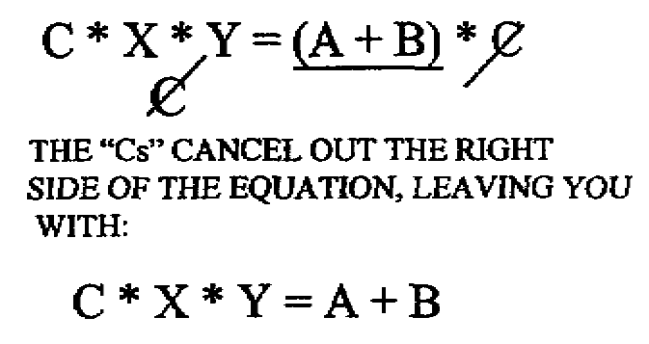

Slide 32
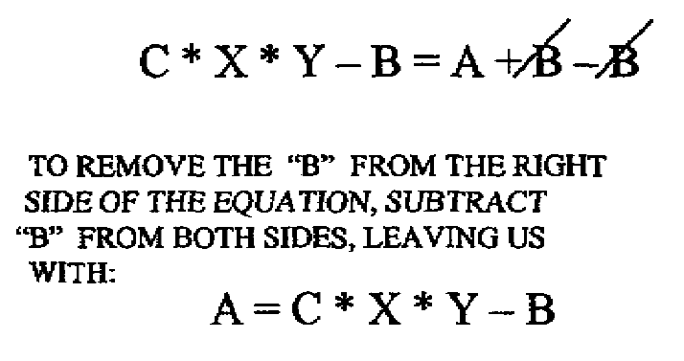

Slide 33
3. Calculating Fuel Characteristics Using Mathematical Formulas.
a. It is very important to understand the concept of what API gravity and specific gravity are before
performing calculations. It will give you a much better understanding of what the calculations mean
when you understand the concept of those functions. Both definitions can be found in FM 5-482,
Chapter 4 and in the glossary.

Slide 34
(1) Specific Gravity (SG). Specific gravity is a physical property of liquids. The specific
gravity is the ratio of the weight of a volume of liquid to the weight of an equal volume of water. The
API has given water at 60 F specific gravity of 1.0000. Traditional petroleum fuels, oils, and lubricants
are lighter or less dense than water, and thus have a specific gravity of less than 1.0000. For example,
MOGAS has a specific gravity of 0.7250, which is computed by comparing the weight of 1 gallon of
MOGAS (6.04 pounds) to 1 gallon of water (8.33 pounds).

Slide 35
(b) API Gravity. API gravity is a scale used by the petroleum industry based on reciprocals of
specific gravity and, therefore, produces whole numbers having a greater numerical spread. Both API
gravity and specific gravity measure the density of liquids. During prior blocks of instruction, you
learned that the API has established an arbitrary scale to express the gravity or density of liquid
petroleum products. Each fuel takes on a certain range of API gravity values, as shown in Figure 1-3
below:

Slide 36
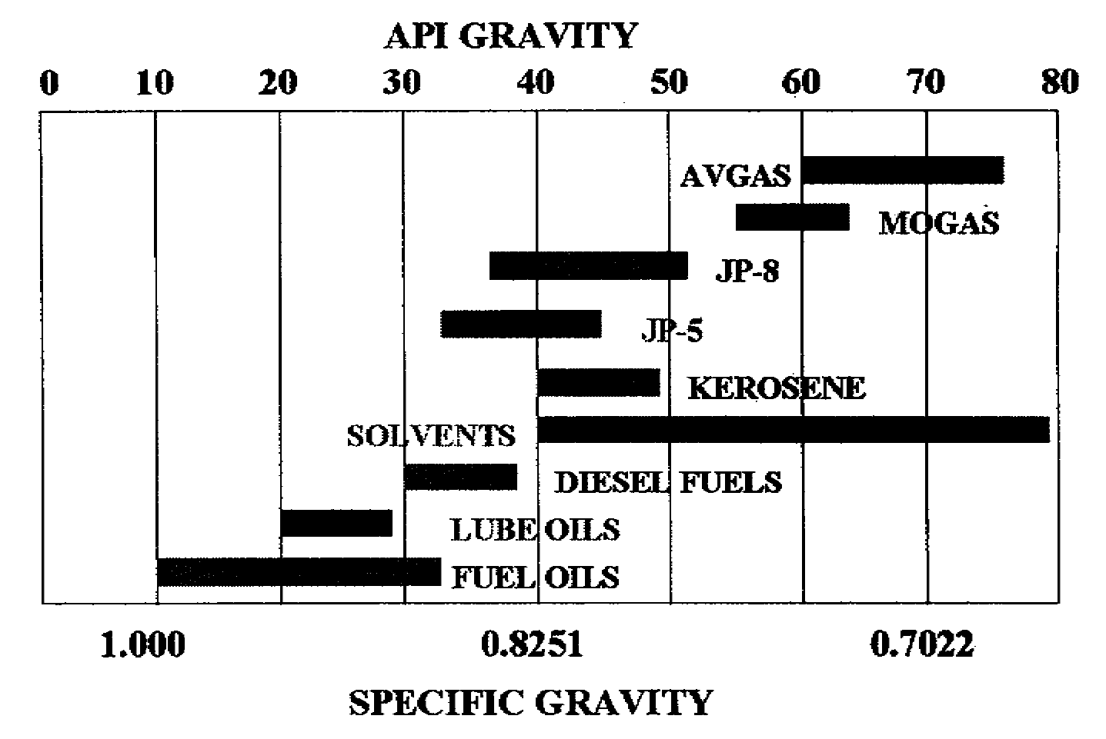

Slide 37
As you see, this chart shows the specific gravity ranges for the major fuels, oils and lubricants we use in
the military system. The numbers at the top of the chart are the API ranges, while the numbers at the
bottom of the chart show a few of the specific gravity ranges. As would seem apparent, the fuel, oils,
and lubricants are the heaviest petroleum products we use, and are nearly as dense as water.

Slide 38
b. Calculate API Gravity at 60° F.
(1) Normally, your API gravity reading will be at some temperature other than 60°F. To
convert an API gravity reading to 60°F, we use ASTM Table 5B. The left and right margins of the table
are annotated with the temperature of the sample. The upper margin lists the API gravity readings.
(2) Once you have located the temperature value, follow the row across until you intersect the
column of your API value. The intersected value is your API gravity corrected to 60F.
See if you get the correct answer for the following set of data. Determine the API gravity at 60°F:

Slide 39
See if you get the correct answer for the following set of data. Determine the API gravity at 60°F:
Observed API Temp(F) API
32 78 30.7
46 48 47.1
52 60 52.0
66 50 67.4

Slide 40
(3) Calculate Specific Gravity. The SG of a liquid is the ratio of the liquid's weight to the
weight of an equal volume of water. Again, it is a measure of the density of a liquid.
SG(fuel) = SW fuel SW water (SW water = 8.33 lb/gal)
Specific Weight, SW = Fuel Weight Fuel Volume (Pounds/Gallons)
(4) Conversion Formulas. The following formulas are used for conversion between API
gravity and specific gravity:
141.5 141.5
API = ------- - 131.5 SG = ----------------
SG API + 131.5
See if you get the correct answer for the following set of data. Convert the following APIs into
SG:
API SG
10 1.0000
40 0.8251
65 0.720

Slide 41
Convert the following SG into API:
SG API
.8445 36.1
.7252 63.6
.8112 42.9

Slide 42
f. Volume Correction to 60F. Volume correction is the correction of a measured quantity of
product, determined by gaging at observed temperature and gravity, and referenced to a gage table, to
net quantity of product at 60F after deducting bottom water and sediment. After determining API at
60F, and using the average temperature of the product in the tank (measured during gaging), correct the
fuel volume by using a volume correction factor obtained in ASTM Table 5B. Corrected volume =
(Innage - BS&W) x CF

Slide 43
g. Feet of Head: The measure of pressure in terms of height of a column of a given fuel is known as
feet of head (Hf). While this is a direct correlation to PSI (pounds per square inch), it is useful to us in
the petroleum field in that we can measure friction loss pressures over distances with feet of head, while
PSI can only measure pressure at one given point.

Slide 44
(1) Converting Feet of Head (Hf) to PSI:
Head (Hf) X SG
Pressure (PSI) = ----------------------
2.31
(2) Converting PSI to Feet of Head (Hf):
2.31 X Pressure(PSI)
Feet of Head (Hf) = ---------------------------
SG

Slide 45
Determine the feet of head:
PSI SG Hf
20 0.7250 63.7
60 0.8420 164.6
100 0.8035 287.5
Determine pressure in PSI:
Hf SG PSI
120 0.7040 36.6
205 0.7777 69.0
500 0.8250 178.6

Slide 46
4. Basic Principle of Military Pipeline Systems.
Now that you have refreshed your memory on basic mathematical equations, you should feel
comfortable with what is to come. After all, one of the most complex, challenging, and interesting
aspects of petroleum operations is the study of hydraulics. Yet, knowing the basics will lead you
through successful completion of this course, plus provide valuable guidance and knowledge for your
use throughout you career as a petroleum leader head loss due to friction.

Slide 47
a. Advantages and Disadvantages of Military Pipelines. There are many advantages to using this
distribution method unique to liquid logistics. However, pipelines and hose lines have their limitations
also. Below we will discuss each.
(1) Advantages.
(a) Pipelines offer many advantages over other conventional means of transporting
petroleum products. From an economic standpoint, the pipeline is the least expensive means in which to
send large quantities of products over distances.

Slide 48
(b) Pipelines are all-terrain modes of transportation which allow access to areas not
suitable for other forms of transportation.
(c) Pipelines relieve the burden of fuel transportation from rail and road nets, which are
more expensive and congested. Remember, approximately sixty percent of logistical tonnages is bulk
petroleum. Our current tactical pipeline system, the IPDS, can deliver almost one million gallons of fuel
forward each and every day. This frees up a least 200 military tankers to move forward to support the
tactical fight.

Slide 49
(d) Pipelines offer extremely poor targets for enemy aircraft.
(e) Pipeline damage can be repaired much faster than damaged railroads or highways.
(f) Pipeline operations are not affected by adverse weather conditions.
(g) Pipeline use releases large numbers of personnel and vehicles for other logistical
activities.
(2) Disadvantages.
(a) Pipelines are subject to disruptions by sabotage and guerrilla attacks.
(b) Marine terminals, pump stations, and tank farm complexes are attractive targets for
enemy air and missile attacks.
(c) Locating leaks and damage is time consuming.
(d) The pipeline construction rate may lag behind the rate of combat advance

Slide 50
b. Future Role of the Military Pipeline System. Although the face of modem warfare continues to
evolve, one thing remains certain. For the next several decades, our military machines will continue to
rely upon petroleum fuels. As such, our doctrine must continually expand to meet new missions.
(1) Bulk Supply Concepts

Slide 51
(a) Conventional warfare with large-scale military operations will be supplied with bulk
fuel up to or near front lines. It is reasonable to expect that packaged fuels will be only used as a
supplement to bulk supply methods when some forward areas are not accessible to bulk fuel
transporters; or in some cases, when rapidly advancing tactical situations dictate the need for additional
fuels to exploit the situation. To some extent, some fuels may be packaged strategically and delivered
directly into a combat theater to the end used. Regardless, throughput will be used as much as possible
to bypass levels of storage. Velocity forward is the key.

Slide 52
(b) Petroleum products will be shipped overseas to ports, harbors, and beachheads in
large tankers. The fuel will be pumped ashore by the use of a marine dock facility, a submarine
(underwater) pipeline, a floating pipeline, or by lightening the tanker by the use of large flat bottom
barges. Ashore, the products will be at major marine-terminal storage facilities constructed to offer as
unprofitable a target as possible, to ensure the products' security. To meet these requirements, the
facility may consist of an existing commercial marine terminal, portable bolted steel storage tanks, or
collapsible fabric storage tanks. Obviously, these are not the only solutions to bulk storage problems in
the future.

Slide 53
(c) From the marine-terminal storage facility, fuel will be pumped forward through
pipelines to large intermediate or head terminal tank farms. In forward areas one may find collapsible
drums, collapsible tanks, flexible hose line systems, large capacity cross-country mobile dispensing
vehicles as well as tank trucks, trailers, and pods.
(2) Concepts of Warfare.
(a) Conventional warfare will employ pipelines in much the same way as they were
during World War II and the Korean War. Although equipment and technology change, the concept
does not change. Employment, however, will require increased quantities of fuel and a pipeline system
capable of quick deployment and emplacement.

Slide 54
(b) Limited nuclear warfare will modify the use of the military petroleum pipeline
system. More reliance will be made upon dispersed storage collapsible fabric storage tanks rather than
in highly vulnerable aboveground fixed facilities. Also, the use of flexible hose line systems is expected
to increase during limited nuclear warfare.
(c) Unlimited nuclear warfare will place the greatest emphasis on stabilizing an area and
capitalizing on the existing facilities, which will be used depending on their state of repair. All in all,
the bulk supply concept will still need to be performed

Slide 55
(3) Pipeline System Concepts.
(a) When classified according to use, pipeline systems fall into three general types:
assault, tactical, and logistical.
(1) An assault system is generally a temporary system, which can be quickly
installed to provide petroleum products in rapidly moving combat situations.
(2) A tactical system is one that can be rapidly constructed or relocated in order to
provide sufficient fuel to a larger area or scope of operations.
(3) A logistical system is a more permanent pipeline designed to provide large
quantities of fuel to stabilized areas

Slide 56
(b) When classified according to construction, pipeline systems also fall into three
general types: hoseline, coupled, and welded. All three methods of construction may be found in a
military bulk distribution system. Usually, these construction types parallel the use classifications.
(1) Hose line systems are constructed of collapsible hose mounted for rapid
placement as a temporary extension of lateral from a more permanent location. The pumping units are
portable with relatively low flow rates and pressures.

Slide 57
(2) Coupled systems are constructed by stringing the pipe (placing the pipe along
the route and then stove-piping it one joint at a time like a chimney stovepipe). Various coupling
methods may be used including bolted joiners or mechanical clamps.
(3) Welded construction is used almost exclusively for civilian or industrial
petroleum applications. In comparison, welded construction is a bulk military distribution system that is
used largely for ship-to-shore tankers unloading lines (submarine or dock) or at locations where the
situation dictates buried pipelines.

Slide 58
c. Army Pipeline Responsibilities. While many personnel think of pipelines as a pure
Quartermaster Corps mission, it is truly a team effort among several branches of the service as discussed
below.
(1) Quartermaster Corps responsibilities are to:
(a) Establish POL use requirements.
(b) Operate military pipeline systems.
(c) Provide organizational level maintenance to pipeline systems once in place.
(2) Engineer Corps POL responsibilities include designing, constructing, and maintaining:
(a) Pipelines.
(b) Bulk storage facilities.
(c) Marine terminal facilities.
(d) Fixed dispensing equipment.
(3) Other technical service responsibilities:
(a) The Transportation Corps responsibility for movement of POL by means other than

Slide 59
pipeline and local distribution.
(b) The Ordnance Corps maintains and forms petroleum product specifications because
of their role as developer and maintainer of engines requiring fuel.
(c) The Signal Corps provides communications support to pipeline operations.
d. Design Fuel. Before we build any pipeline, many factors must be taken into account. The first
we will discuss is the design fuel. The definition for design fuel is the heaviest fuel making up 24
percent or more of the total annual fuel requirement. Below is an example of how to determine the
design fuel:
(1) Given the following total annual fuel requirement for a theater by fuel type:
JP-8: 1,200,000 BBL
DF-2: 900,000 BBL
MOGAS: 1,600,000 BBL's
Total: 3,700,000 BBL's

Slide 60
(2) Divide each product by the total barrels.
JP-8: 32.4%
DF-2: 24.3%
MOGAS: 43.3%

Slide 61
(3) Discard from consideration any not meeting criterion of 24 percent or more. Here,
however, all three products met the criterion of 24 percent or more. We must now determine which
product is the heaviest. Using FM 5-482, Table 4-1, find the average specific gravity for each product.
Since DF-2 is the heaviest product, it will become the Design Fuel.

Slide 62
e. Theory of Flow. Theory of flow studies the characteristics of liquids in motion. This is of
particular importance when we design pipelines. To ensure we correctly place our pump stations along
the pipeline and can maintain a desired flow rate we must understand how flow rates are affected by
friction. There are several steps, which must be done to determine head loss due to friction (Hf).
Understand that when a liquid moves through a pipe, friction occurs between the liquid and the inside
pipe wall. It is this friction that causes the liquid to slow its advance forward. We can overcome our
head loss due to friction if we know what the head loss per given distance is going to be. The Reynolds
number is the pivotal formula in determining our head loss due to friction. Remember, Reynold's
number is dimensionless.

Slide 63
(1) The effect of pipe diameter, internal forces, and viscous forces is considered in the
Reynold's number. Two formulas can be used in determining Reynold's number depending on whether
the pipeline is in a developmental stage or in place. If the pipeline is in development, use the Design
Data formula; otherwise, use the field data formula.

Slide 64
(a) Formula for Reynold's Number using design data:
R = V D Where: V = velocity in feet per second
Y
D = inside diameter of pipe in feet
Y = Kinematic viscosity in squared feet per second
(b) Formula for Reynold's Number using field data:
R = 3160 x Q Where: 3160 = constant.
d x k
Q =flow rate in GPM
d = inside diameter of pipe in inches
k = Kinematic viscosity in centistokes

Slide 65
(c) Now, let's solve a problem. Given the following data, determine Reynold's number
using the design data formula.
Velocity = 540 ft/min
ID = 6.415 inches
Fuel = DF2 @ 50 F
Find V in ft/sec
540 ft x 1 min = 9 ft/sec
min 60 sec
Find D in feet
6.415 in x 1 ft = .534 ft
12 in
Find Y in ft/sec squared (FM 5-482, Figure C-7)
4.9 cs = .0000527ft2/sec
92,900
Solve for R
9 ft/sec x .534 ft = 91195.446
.0000527 ft2/sec
Finally, convert to a scientific notation
91195.446 = 9.12 x 104

Slide 66
(d) Now, let's solve a problem using the field data formula.
Given the following data determine Re using the field data formula.
Q = 350 GPM
d = 6.415 in
K= JP4 @ 50F
Solve for R
3160 x 350 = 1106000 = 144881
6.415 x 1.19 7.63385
Convert into scientific notation
144881 = 1.45 x 105

Slide 67
(e) Now that you know how to find Reynold's number, it is time to interpret it and put it to good
use in designing a military pipeline. Quite simply put, Reynold's number is used to determine the type
of flow in a pipeline, and is broken down into three categories:
QM5203 1-15
(1) 0 - 2000 Laminar (smooth and well defined)
2000 - 4000 Transitional (not smooth)
4000 - UP Turbulent (chaotic, not defined)
In a multiproduct pipeline, a turbulent flow is desired, as it reduces the size of the interface by reducing
the amount of product mixing during flow.

Slide 68
(2) Determine Friction Factor for a Pipeline. The friction factor is a function of the roughness
of the pipe and of the Reynold’s number. The friction factor is determined by using Reynold's number,
nominal pipe size, and Figure C-8, FM 5-482,
(a) Given the following information, determine the friction factor.
R = 8.0 x 104
4 in nominal pipe size
(FM 5-482, Figure C-8)
F = .021

Slide 69
(3) Determine head loss due to friction (Hf). The Darcy-Weisbach equation is used to
determine Hf. As with the Reynold's Number, this equation has two formulas: Design and Modified as
shown below in the figures

Slide 70
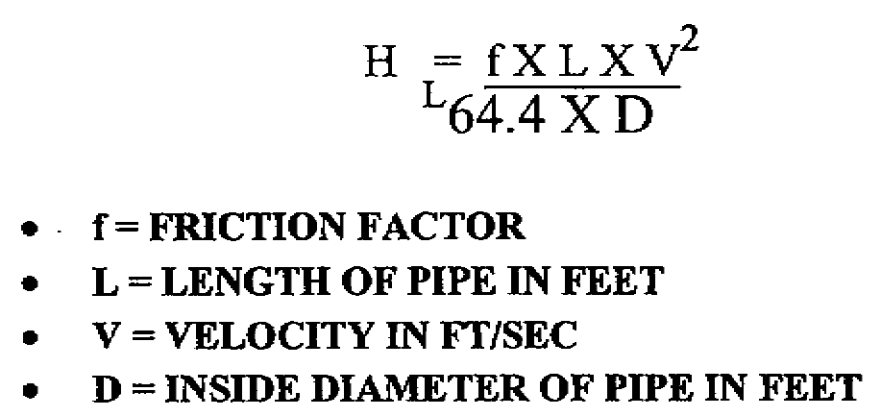

Slide 72
(4) Given the following data, determine Hf using the design formula:
Pipe =.701 ft
Fuel = DF2 @ 50F
Vel = 4.0 ft/sec
Length of pipeline = 4000 ft
First, we must find "f"
Determine Reynold's Number R = V x D
Y
V = 4.0 ft/sec (Given)
D =.701 (Given)
Y = 4.9 cs = .0000527 ft/sec
92,900
Re = 4.0 ft/sec x .701 ft = 53206.8 or 5.3 x 104
.0000527
From FM 5-482, Figure C-8 f = .0216
Hf= .0216 x 4000 x 16 = 1382.4 ft
64.4 x .701 45.1444
Hf= 30.62 ft

Slide 73
(5) Given the following data, determine Hf using the field modified formula:
Pipe = 8.415 inches
Fuel = DF2 @ 50F
Q = 700 GPM
Pipe Length = 4000 ft
First, you must find “f”
Determine Reynold's Number Re = 3160 x Q
d x k
3160 = constant
Q = 700 GPM (Given)
d = 8.415 (Given)
k = 4.9 cs (FM 5-482, Figure. C-7)
Re = 3160 x 700 = 2212000
8.415 x 4.9 41.234

Slide 74
Re = 53645.05 or 5.35 x 104
From FM 5-482, Figure C-8 f=.0216
Next, determine d5
Appendix C, TABLE C, ACCP 5203, pg. C-1
8.4155 = 42,196
So, Hf= .031 x 4000 x 490,000 = 1,312,416
42,196 42,196
Finally, you find the total headloss due to friction, Hf= 31 feet.

Slide 75
f. Advanced Hydraulics Mathematics. Now you have a basic understanding of the reason for
pipelines, and general characteristics and properties of petroleum fluids. Next we will attempt to
familiarize you with some of the advanced petroleum math computations that will help you in your
future petroleum assignments. Specifically, you will be able to calculate volume correction, feet of
head, flow velocity, flow type, and head loss.
(1) You must be able to quickly apply each principle you have learned thus far before you can
begin to physically design a pipeline or hose line. Therefore, a thorough problem solving exercise must
be completed. Let us begin:

Slide 76
(a) Volume Correction to 60F: Volume correction is the correction of measured quantity
of product to the net quantity of product at 60°F after deducting bottom sediment and water.
(1) After determining API at 60°F, and using the average temperature of the
product (measured during gaging) in the tank, correct the fuel volume by using a volume correction
factor obtained in ASTM Table 6B. The correction factor (CF) is used as a multiplier

Slide 77
(2) Corrected volume = (Innage - BS&W) x CF
Calculate the corrected volume at 60°F
Data: Innage = 24,816 gallons
BS&W = 240 gallons
API @ 60F = 58.5
Avg Temp = 70°F
SOLUTION: CF = .9932 (TABLE 6B)
Corrected volume = (24,816 - 240) x .9932
=24,576 x .9932
= 24,409 gallons
(b) Feet of Head: The measure of pressure in terms of height of a column of a given fuel
is known as feet of head (HL).
Pressure (PSI) = Height (ft) x SG Height = 2.31 x Pressure
2.31 SG

Slide 78
PROBLEM: Determine the feet of head: SOLUTION:
PSI SG HL
25 .7250 79.7
50 .8420 137.2
100 .8035 287.5
PROBLEM: Determine pressure in PSI: SOLUTION:
HL SG PSI
100 .7040 30.5
250 .7777 84.2
500 .8250 178.6

Slide 79
(c) Velocity of Flow: It is the flow speed usually measured in feet per second, equal to
flow rate (Q) in cubic feet per second, divided by the cross sectional area (A) of the pipe in square feet.
V=Q/A A = 0.785 x D2 D = Inside diameter in feet
PROBLEM: Determine the flow velocity in ft/sec:
Data: Q = 1,000 barrels per hour
D = 6 inches
SOLUTION:
Q = 1000BBL x 42 Gal x 1 ft3 x 1 Hr x 1 Min =1.56 ft3
Hr 1 BBL 7.48 Gal 60 Min 60 Sec Sec
D = 6 in x l ft =.5ft
12in
A = .785 x .52 = .785 x .25 = .2 ft2
V = 1.56 = 7.8 ft/sec
.2

Slide 80
(d) Flow Type: There are three types of flow Laminar, transitional, and turbulent. To
find out the flow type in a military pipeline we use the Reynold's number (Re) formulas.
(1) Re formula using field data formula:
Re = 3160 x Q Where Q = Flow rate, GPM
d x K d = Pipe inside diameter, inches
K = Viscosity, centistokes, cSt
(2) Re formula using design data:
Re = VD/Y Where V = Velocity, ft/sec
D = Pipe inside diameter, feet
Y = Viscosity, ft2/sec

Slide 81
(3) Re vs Flow type: Remember the different types of flow. Always maintain
turbulent flow within a multiproduct pipeline.
Reynold's Number Flow Type
0 <Re<2000 Laminar
2000 <Re<4000 Transitional
4000 < Re Turbulent (Preferred in military pipelines)
PROBLEM: Given: V = 3.7 mile/hr
ID = 6.145 in
Y = 0.08 ft2/min
Calculate Re, and determine the flow type.
SOLUTION:
V = 3.7 mile/hr x 5280 ft/mile x 1 hr/3600sec = 5.43 ft/sec
ID = 6.145 in x 1ft/12in = 0.512 ft
Y = 0.08 ft2/min x 1min/60sec = 0.0013 ft2/sec
Re = 5.43 x 0.512 = 2,138 (TRANSITIONAL)
0.0013
PROBLEM: Given: V =

Slide 82
PROBLEM: Given: V = 5 mile/hr
ID = 8.145 in
Y= 12 ft2/min
Calculate Re, and determine the flow type.
SOLUTION:
V = 5 mile/hr x 5280 ft/mile x 1 hr/3600 sec = 7.33 ft/sec
ID = 8.145 in x 1ft/12in = 0.679 ft
Y = 12ft2/min x 1min/60sec = 0.2 ft2/sec
Re= 7.33 x .678 = 24.8 (Laminar)
.2
PROBLEM: Given: Q = 500 BPH
ID = 6 in
K = 42 cSt
Calculate Re, and determine the flow type.
SOLUTION:
Q = 500 x 42/60 = 350 GPM
Re = 3160 x 350 = 4,389 (Turbulent)
6 x 42

Slide 83
g. Head Loss (HL): It is the pressure loss in a pipeline due to friction, measured in feet of head.
The most accurate method of determining HL, is using the Darcy-Weisbach's equations.
(1) Darcy-Weisbach equation (Design Model)
HL = f x L x V2 Where f = Friction factor, dimensionless
64.4 x D L = Pipe length, feet
V = Velocity, ft/sec
D = Inside diameter, feet
(2) Darcy-Weisbach equation (Modified Model)
HL= 0.031 x f x L x Q2 Where f = friction factor
d5 L = Pipe length, feet
Q = Flow rate, GPM
d = Inside diameter, in
PROBLEM: Given: f = 0.035
L = 0.5 mile
V = 300 ft/min
D = 0.5 ft
SG = 0.8260
Determine HL in PSI.
SOLUTION:
L = 0.5 mile x 5280 ft/mile = 2640 ft
V = 300 ft/min x 1min/60sec = 5 ft/sec
V2 = 25 (ft/sec2)
HL = 0.035 x 2640 x 25 = 71.7 FT
64.4 x 0.5
PSI = - HL x SG = 71.7 x 0.8260 = 25.7
2.31 2.31
PROBLEM: Given: f = 0.92
L = 2 miles
Q = 300 BPH
d = 8 in LWST
SG = 0.8448
Determine HL in PS

Slide 84
SOLUTION:
L = 2 miles x 5280 ft/mile = 10,560 ft
Q = 300 BBl/hr x 42 Gal/BBL x 1hr/60min = 210 GPM
Q2 = 44,100
d5 = 32,768
HL = 0.031 x.92 x 10,560 x 44,100 = 315 ft
42,196
PSI = HL x SG = 315 x 0.8448 = 115.2
2.31 2.31

