Slide 1
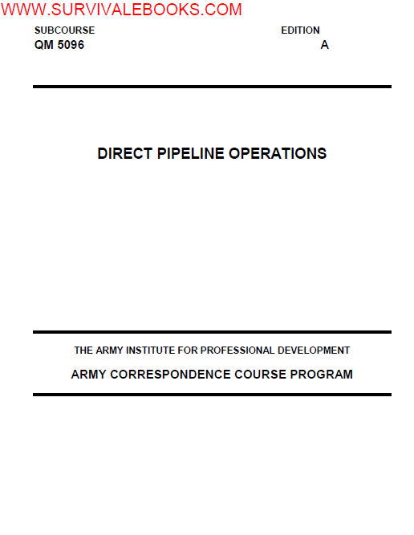

Slide 2
LESSON 1
MONITOR TANK CLEANING, VAPOR FREEING, CLEAN STORAGE TANKS

Slide 4
INTRODUCTION
Tank cleaning is a task that should not be approached lightly as there are many hazards involved in the
process. These hazards are lead, hydrogen sulfide, and explosive vapors, just to mention a few. If you find
yourself in a position to supervise the cleaning of storage tanks, you must be thoroughly familiar with these
hazard

Slide 5
PART A - DESIGN AND USAGE OF PETROLEUM STORAGE TANKS
The following factors that must be considered when designing and using petroleum storage tanks:
Losses result from filling, breathing, and seepage.
•  Filling loss: As an atmospheric storage tank is filled, the vapor above the product will be forced out of the
tank which results in a loss of product.
•  Breathing loss: An atmospheric storage tank used for static storage will lose product as vapors are forced
out of the tank due to the expansion of the product as it heats up during the day. Conversely, as the
product cools and contracts, the air will be drawn in.
•  Seepage loss: Due to small ruptures in the tanks.

Slide 6
Security against fire hazards:
•  Escaping vapor: Vapors, being heavier than air, will tend to seek low spots and will present hazardous
conditions. This is particularly dangerous during filling operations.
•  Leaks: Leaks are always a hazard and must be corrected as soon as observed.
•  Real estate: The proximity of storage tanks to one another and other facilities must be taken into
consideration when surveying potential hazards. Firewalls, dikes and berms, must be constructed in order
to minimize some of the risks involved with bulk petroleum storage and distribution.

Slide 7
PART B - TYPES OF TANKS
Keeping in mind the problems we have just discussed, let us classify and discuss the various types of tanks
according to the job they will do so that we can employ them to best solve the problem.
Fixed Roof Tanks.
•  Bolted steel cone roof. This is the type used extensively by the military. It comes in various sizes and is
classified as semipermanent and can be moved. This tank cannot withstand pressures of more than 1 to 3
ounces (oz.) per cubic in. and a vacuum of no more than 1/2 oz. cubic inch. For this reason, the tanks
have free vents and have a high vapor loss.
•  Welded steel cone roof. This type of tank is the most commonly used tank for permanent installations.
Because of the construction, it requires skilled personnel. This type of tank will withstand pressures from 3
to 8 oz. cubic inch in a vacuum of 1/2 oz. per cubic inch and is equipped with pressure vacuum vents. For
this reason, the welded cone roof tank is better suited for the storage of high volatile products than the
bolted steel tank.

Slide 8
Floating Roof Tanks. The floating roof “floats” on the surface of the product and virtually eliminates
breathing and filling loss. There are three types of floating roofs which we will discuss.
•  Pan type. A large, floating pan, slightly smaller in diameter than the tank shell. A system of flexible “shoes”
closes the space between the edge of the roof and the tank shell.
•  Pontoon type. System of closed compartments or “pontoons” to increase floating stability and simplify the
structure.
•  Double deck. Two separate decks over entire back surface. Provides insulation from the sun’s rays and
cuts down on loss of product from evaporation.
All tanks with floating roofs have a wind girder around the top edge to stiffen the shell when the roof is down.
Many commercial firms and Air Force bases employ these tanks for gasoline and JP4. (Best adapted where
tanks are filled and tied frequently.) They are somewhat of a maintenance problem because of the sealing
material used between the tank shell and the roof.

Slide 9
Cone Roof With Floating Pan. Floating roof tanks present a problem in cold climates because of the
accumulation of ice and snow. Because of this problem, floating roof tanks can be modified and a fixed roof
installed. This procedure employs the advantages of the fixed roof and the floating roof.

Slide 10
Underground Tanks.
•  Construction. Underground tanks are coated with a coal tar coating to prevent corrosion. They may have
a concrete supporting wall around the exterior surface.
•  Vapor loss. Underground tanks also come equipped with deepwall pumps and pressure vacuum vents.
Because of the stabilized temperature (mid 50s), underground storage tanks have very little vapor loss.
•  Leakage. Leaks in underground storage tanks are very hard to detect and may show up in water tables
after the leak has occurred.

Slide 11
Cut and Cover Tanks. Cut and cover tanks are constructed by scooping out a hole or depression in the
earth, setting a steel storage tank in the cut, and covering it with earth so that the only part of the structure
above ground would be a small shack or manhole and vent to permit access to the tank and allow excessive
vapors to escape.

Slide 12
PART C - TANK ACCESSORIES
•  Pressure-vacuum vent. The pressure and vacuum vent (breather valve) (Figure 1-1) is an automatic
device designed to reduce evaporation loss and to help relieve excessive pressures or vacuums built up
during operations or as a result of atmospheric temperature variations. The vent consists of a pressure
section and a vacuum section. Each section opens according to a predetermined setting. To ensure
efficient operation, vents should be inspected monthly.
•  Flame arrester. Flame arresters (Figure 1-2) are used to prevent flashback into a tank in case of fire. The
flame arrester is usually placed between the roof and the vent. One type of flame arrester consists of a
tight coil of fine wire mesh enclosed in a heavy casing which is flanged to the roof.

Slide 13
•  Manometer. Manometers are installed on the roofs of floating roof tanks to facilitate gaging. They are
used to measure the difference between the level of product in the tank and the level of product in the
gaging well, and to subsequently arrive at an accurate gage.
•  Gage hatch. Self-explanatory. Individuals involved in gaging should be careful not to drop articles down
the gaging hatch in as much as this has a bad effect on the product and also might block valves and
damage pumps.
•  Manhole (or clean out door). Opening designed to permit entry for such purposes as cleaning the tank
and making repairs.
•  Grounding. Some tanks are inherently grounded by their contact with the ground, and grounding wires are
not required

Slide 14
Determining the Need.
•  Visual inspection. The inspection of the interior of the tank from the manway opening or by any other
suitable means without actual physical entry into the tank.
•  Physical entry inspection. The inspection of the interior of a tank by physical entry. This requires special
preparations according to existing safety regulations.
•  Change of product service.
•  Contaminated product.
•  Any type of major repairs or maintenance.
•  Scheduled cleaning in accordance with MIL-HDBK 200.

Slide 15
General Procedures.
•  Selection of personnel. Only component personnel should be selected for tank cleaning.
•  Medical certification. All personnel should be cleared by the medics to ensure they are physically fit to
work with the hazards involved.
•  Training program. All personnel should be required to attend training on the hazards involved and any
special hazards pertaining to a particular tank.
•  Job assignments. Job assignments should be controlled by the supervisor. This prevents personnel from
overexposure to the hazards.

Slide 16
Preparation. The area surrounding the tank should be inspected for:
•  Low places where vapors could collect.
•  Any fire hazards such as electrical equipment, hot work, or open flames.
•  Entrance to the area. The entrance to the area should be posted with warning signs and guards to keep
unauthorized personnel from entering the area.
The tank should also be inspected for the type and amount of sludge to be removed. The type and amount of
equipment required will depend on the condition of the tank and the amount of sludge to be removed.
Emergency first aid should be available in the immediate area.
•  Vacuum trucks.
•  Safety set. The safety set will include such items as fresh air masks, boots, gloves, and hard hats.
•  Shower and washing facilities will be available for all personnel.
•  Firefighting equipment

Slide 17
PART E - EMPTYING, BLANKING OFF THE TANK LINES, AND VAPOR
FREEING
Blanking Off of Tank Lines. Before the tank is opened, all the product should be pumped or drained
to the lowest point. In a situation where a contractor is to clean a tank, a statement should be written stating
that all product recovered is the property of the US government. Blanking off is accomplished by first closing
all the valves nearest the tank, then breaking the connections and placing blinds in all the lines. The clean out
door is then removed, allowing access to the interior of the tank.

Slide 18
Vapor Freeing. There are several means of vapor freeing tanks; however, the best method may not be
the one you use because of environmental considerations. The most commonly used is by forced ventilation.
•  Mechanical ventilation. Electric fans are used in this method. All wiring and connections must be
vaporproof.
•  Natural ventilation. The top of the tank is opened and air is allowed to circulate through the tank until all
vapors are removed.
•  Steam ventilation. Steam is one of the most effective methods of vapor freeing tanks, but because of their
size, it is not effective on large diameter tanks. Steam is effective on tank trucks and railcars

Slide 19
During the vapor freeing stages of the operation, have a well-trained man to test the vapors. A variety of
instruments are used to check for vapors.
•  Explosimeter. Used to indicate the concentration of vapors as a percent of the lower combustible limit,
and not as a percent of vapor by volume. A reading of 100 percent on the explosimeter means that the
tank atmosphere is 100 percent explosive or that a vapor concentration of at least 1 percent by volume is
present. If the tank being readied for cleaning has contained leaded product, the tester may enter the tank
with respiratory equipment when readings on the explosimeter show less than 100 percent of the lower
limit. Inside vapor readings should be taken about one foot above the sludge. If the tank has not
contained lead, it is safe to enter without respiratory equipment when the readings are between 0 percent
and 4 percent of the lower limit.
•  Hydrogen sulfide detector. The hydrogen sulfide detector consists of a suction bulb, a glass detector tube,
and a frame with a scale. To use the detector, break off the ends of the glass detector tube. The reading
on the scale is shown in percent.
•  Oxygen detector. The oxygen detector is similar to the explosimeter, and in some cases they are a
combination.

Slide 20
PART F - HAZARDS
There are many hazards involved in tank cleaning, and personnel must understand the hazards before the
cleaning starts.
•  Tetraethyl lead. A tank that has been used to store leaded gasoline is a hazard throughout the cleaning
process. Even though the tank has been vapor freed, respiratory equipment and protective clothing must
be worn at all times. Lead affects the central nervous system and can cause permanent brain damage or
even death. In order for a tank to be declared lead free, it must be sandblasted to clean bright metal, and
certified by a safety engineer.
•  Hydrogen sulfide. Hydrogen sulfide is rarely found in finished products but may be found in tanks that
have held crude products, Navy special fuel oil (NSFO), and heating oils of high sulfur content. Its
combustible range is between 4.3 and 46 percent by volume. The toxic limit is 20 parts per million. This is
far below that of petroleum vapors. The presence of hydrogen sulfide can be detected as a rotten egg
odor.

Slide 21
•  Fuel vapors. Fuel vapors are narcotic; inhaling these vapors can slow the nervous system to the point that
breathing stops. In addition, inhaling even small amounts of these vapors can irritate the lungs and
respiratory system.
•  Lack of oxygen. Normal air contains 21 percent oxygen. A concentration of less than 7 percent is
dangerous. Fuel vapors, in addition to being narcotic, displace oxygen in a tank.
•  Regardless of the type of safety equipment you use, it must be approved by the Bureau of Mine Safety.
The kit consists of: respirator (fresh air mask), rubber boots with steel toes, white coveralls, lifeline and
harness, air hose, hard hat, and rubber gloves. The safety set should be inspected and cleaned before
and after each use.

Slide 22
PART G - GENERAL TANK CLEANING PROCEDURES
Prepare a waterproof sump beneath the tank cleanout door to receive the flow of sludge water. There are a
number of commercial cleaners used to clean the inside of the tank. These cleaners emulsify the sludge and film
on the floor and sidewalls of the tank. The solution is allowed to remain on the floor and walls for a recommended
period of time. Then the walls and floor of the tank are hosed down with high-pressure water and the emulsion is
flushed out the door to the sump. The common method used to finish the cleanup is to sweep and squeegee the
sludge out of the door.

Slide 23
PART H - DISPOSAL OF SLUDGE
Strict state and federal environmental programs make it imperative that all personnel be aware of the pertinent
laws before any disposal action is taken. Leaded sludge is disposed of by high intensity heat. Unleaded sludge
may be disposed of by aeration, landfill sites, and burning (high intensity heat). However, any method used must
be approved by EPA. All trucks used to transport sludge must be approved by state and federal agencies and a
certificate issued for each vehicle. The disposal sites must also by approved by EPA. As with any operation
involving POL storage and distribution, it is extremely important that all personnel are familiar with the procedures,
guidelines, and methodologies outlined in FM 20-400 (Military Environmental Protection), TC 20-401 (Soldier and
the Environment), and all other publications related to environmental protection.

Slide 24
LESSON 2
INLAND PETROLEUM DISTRIBUTION SYSTEM

Slide 25
INTRODUCTION
Since the days of World War II, petroleum NCOs have grappled with the challenges of moving fuel to the front
lines of battle quickly and efficiently. Today’s NCOs now have an advantage over their predecessors because
they accomplish the task with the Army’s inland petroleum distribution system (IPDS). The IPDS is the Army’s
primary method of receiving, storing, and distributing bulk fuel to support military forces deployed in worldwide
contingency operations. The system consists of both commercial and military petroleum equipment made up
of three primary subsystems: the tactical petroleum terminal (TPT), pipeline components, and pump stations.
By successfully integrating these elements, troops can move fuel from any source forward into the theater of
operations.

Slide 26
PART A - COMPONENTS
Inland Petroleum Distribution System (IPDS) is designed as a lightweight, rapidly deployable pipeline and
terminal system that can be used in undeveloped and developed theaters of operation. It can interface with an
existing host nation fuel source, such as a refinery, or with the Navy’s Offshore Petroleum Discharge System
(OPDS). The Navy is responsible for delivery of petroleum from offshore tankers to the high-water mark. The
system is modular in design and can be tailored for any locality or operation.

Slide 27
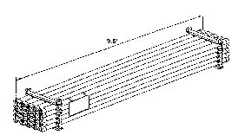

Slide 28
Pipeline. The pipeline is configured in 5-mile pipeline sets. There are 2,779, 9.5 foot pipe sections in each
5-mile set and 10 sections with each pump station. As they are of a constant wall thickness (0.404``), they can
be cut to any length required and regrooved using the cutting and grooving tool furnished. They are used to
close short gaps in the pipeline. Each section has a black line down the length for easy identification of nipple
material.

Slide 29
Major Components.
5-Mile Pipeline Set:
•  Valves, Elbows, and Supplies, Container 1 of 13.
•  Coupling Clamps and Nipples, Container 2 of 13.
•  Coupling Clamps, Containers 3 and 4 of 13.
•  Pipe, Containers 5 through 13 of 13.
Pipe Connection Assembly:
•  Switching Manifold, Container 1 of 5.
•  Contaminated Fuel Module, Container 2 of 5.
•  Fire Suppression Equipment, Container 3 of 5.
•  Transfer Hoseline Assembly (Tricon), Container 4 of 5.
•  PLCA Support Assembly, Container 5 of 5.

Slide 30
Pipeline Support Equipment:
•  600-GPM Pump and Spare parts, Container 1 of 5.
•  Cutting and Grooving Machines, Container 2 of 5.
•  Pipe Nipples, 3 of 5.
•  Pioneer Tool Kits and Valves, Container 4 of 5.
2-3
QM 5096
•  Gap Crossing and Sandbags, Container 5 of 5.
Recovery Equipment:
•  Pumps and Tools, Container 1 of 3.
•  Safety Supplies and Forms, Container 2 of 3.
•  Cleaning Compounds and Paint, Container 3 of 3.
Suspension Bridge:
•  100-Foot Pipeline Suspension Bridge.
•  200-Foot Pipeline Suspension Bridge.
•  400-Foot Pipeline Suspension Bridge.
•  Base, Towers, and Anchors, Container 1 of 2.
•  Cable and Supplies, Container 2 of 2.

Slide 31
Pump Stations. Each pump station has two skid-mounted, diesel engine driven (three stage centrifugal)
mainline pumps, with an operational output of 800 GPM (Figure 2-2) at 1,800 feet of head, at 2,100 rpm. Only
one is operated at a time. Launcher and receiver assemblies (Figure 2-3), a dual in-line strainer assembly
(Figure 2-4) located on the incoming side of the station, and a floodlight set are also components of pump
stations. Except for the mainline pumps, all pump station equipment will be stored in four 20-foot ISO
containers. More detailed descriptions and illustrations of pump station equipment can be found in FM 10-67-
1 (Concepts and Equipment of Petroleum Operations), Chapter 7.
Pipeline Pump Station:

Slide 32
•  Launcher and Receiver Assembly, Container 1 of 6.
•  Valves and Fittings, Container 2 of 6.
•  Floodlight Set and Spare Parts, Container 3 of 6.
•  Strainer and Auxiliary Fuel Assembly, Container 4 of 6.
•  800-GPM Mainline Pump, Container 5 of 6.
•  800-GPM Mainline Pump, Container 6 of 6.

Slide 33
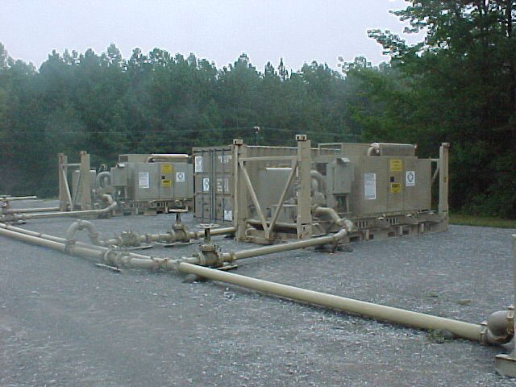

Slide 34
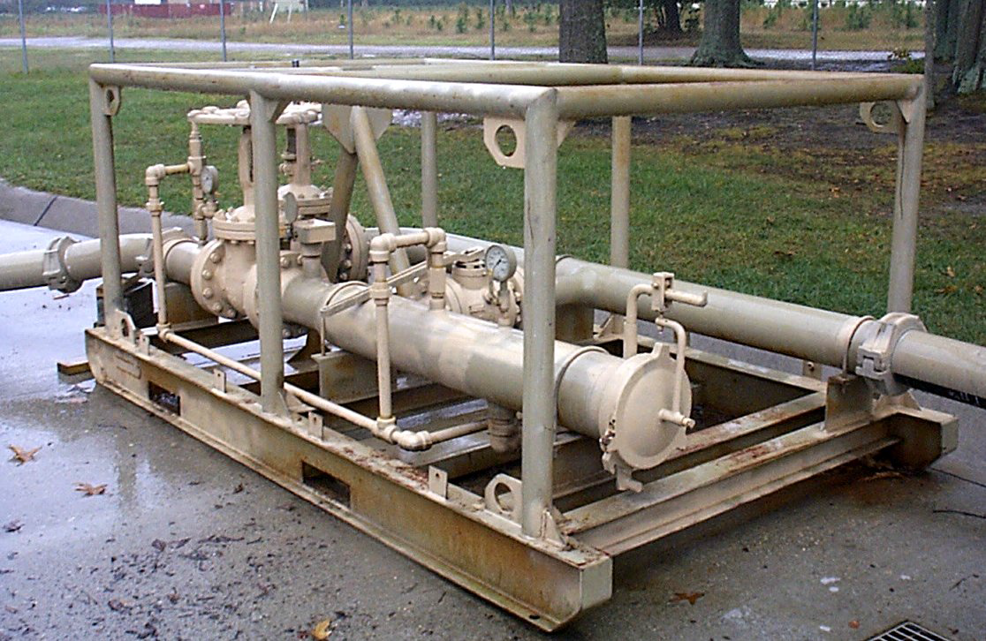

Slide 35
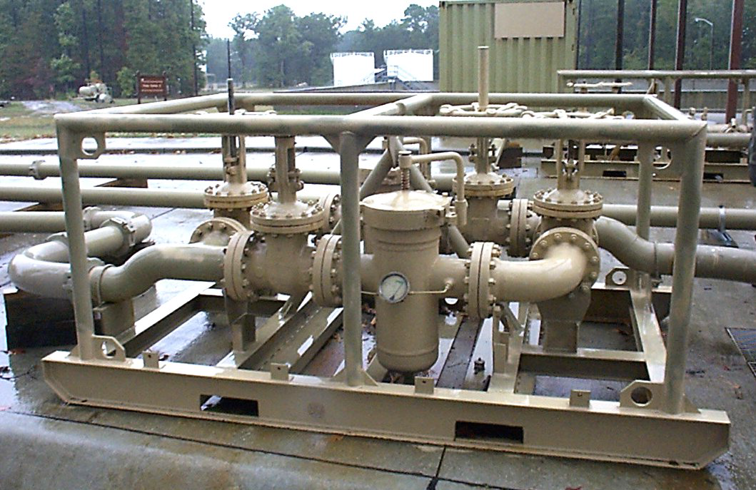

Slide 36
Tactical Petroleum Terminal (TPT). The mission of the TPT is to receive, store, and dispense liquid
fuel, specifically JP-8, motor gasoline, and aviation jet fuel (Figure 2-5). It serves as a base terminal in an
undeveloped theater and can be used in the developed theater to supplement existing facilities that are
inadequate or damaged. The TPT was designed to operate at a maximum allowable operating pressure of
150 psi. The standard TPT has a storage capacity of 3,700,000 gallons in eighteen 5,000-barrel (210,000
gallons) collapsible fabric tanks. The TPT is modular with three identical fuel units. Each TPT also has one
pipeline connection assembly. The total TPT is stored in 77 ISO containers.
The fuel unit consists of three tank farm assemblies, with two 5,000-barrel fabric tanks each, a tankertruck
receipt manifold, a fuel dispensing assembly, a transfer hoseline assembly, six fire suppression
assemblies, a 50,000-gallon optional tank configuration, and a fuel unit support assembly. A total of 24 ISO
containers is used to store one fuel unit (minimum 600’ between units).

Slide 37
Tank farm assembly. Consists of two 5,000-bbl fabric tanks, a hoseline pump, and associated hose,
valves and fittings; a total of three containers for each assembly (at least 400’ between assemblies).
•  5,000-BBL Tank and Accessories, Container 1 of 24.
•  5,000-BBL Tank and Accessories, Container 2 of 24.
•  600-GPM Pump and 6-inch Hose, Container 3 of 24.
•  5,000-BBL Tank and Accessories, Container 4 of 24.
2-5
QM 5096
•  5,000-BBL Tank and Accessories, Container 5 of 24.
•  600-GPM Pump and 6-inch Hose, Container 6 of 24.
•  5,000-BBL Tank and Accessories, Container 7 of 24.
•  5,000-BBL Tank and Accessories, Container 8 of 24.
•  600-GPM Pump and 6-inch Hose, Container 9 of 24.

Slide 38
•  Tanker-truck receipt manifold. Consists of a hoseline pump and associated equipment to provide four
defueling stations. It is used to receive fuel from fuel tanker-trucks (two containers).
•  Hoses, Valves, and Fittings, Container 16 of 24.
•  600-GPM Pump, Container 17 of 24.
•  Fuel dispensing assembly. Dispenses fuel directly to user’s bulk fuel transporters and to 500-gallon
collapsible drums. There are six stations for trucks and two for drums (one container). Container 19 of 24.

Slide 39
•  Transfer hoseline assembly. Is used to connect the tank farm assemblies, switching manifold, fuel
dispensing assembly, and tanker-truck receipt manifold into an operational TPT. There are four transfer
hoseline assemblies in a TPT, one in each fuel unit and one in the pipeline connection assembly. Each
assembly has fifteen 500-foot by 6-inch hoselines packed in three Tricons (5 hoses per Tricon) to tie the
major components into a total system (one ISO container equivalency). Container 18 of 24.

Slide 40
•  Fire suppression assembly. The main component is the wheel mounted fire extinguisher. Skid mounted
on a two wheeled trailer, the system is designed to apply the dry chemical (Purple K) until fire is under
control and then apply the aqueous film forming foam (AFFF) creating a blanketing effect. The chemical
should continue to be applied with the AFFF until the solution is exhausted or until there are no existing
smoldering pockets remaining that could cause reignition (one container for each of the six assemblies).
Containers 10 through 15 of 24.
•  50,000-gallon tank option. Consists of two 50,000-gallon collapsible fabric tanks, one transfer pump (350
GPM) and one 350-GPM filter separator. This option gives the commander an additional 100,000 gallons
of storage space to use as the situation dictates (total option is stored in one container). Container 20 of
24

Slide 41
The fuel unit support assembly consists of the fuel unit’s interim support item list (ISIL), two floodlight sets, one
displacement and evacuation kit, one hoseline suspension kit, two hoseline installation and repair kits, and a
spare hoseline pump (600 GPM) (four containers to store the assembly).
•  600-GPM Pump, Container 21 of 24.
•  Floodlight Sets, Container 22 of 24.
•  Hoses and Fittings, Container 23 of 24.
•  Spare Parts and Supplies, 24 of 24.

Slide 42
The floodlight set is trailer-mounted and designed to hold all components. The engine/generator set
includes a 6.0 kW, two-cylinder, four-cycle, air-cooled diesel engine and a four-pole brushless, revolving field
generator with external voltage regulation. It has an 18-gallon fuel tank with a wide mouth fill cup. Starting
power is supplied by a 12-volt, 4D size battery. The telescoping tower assembly, when extended, is stable in
gusty winds up to 40 mph. The portable tripod masts are stable in winds up to 15 mph.
The displacement and evacuation kit is used to remove fuel and evacuate the small residual quantity of
fuel, vapor, and any air within the hose. The kit consists of a displacement ball, an injector for displacing fluid
with the ball, a ball receiver, end caps to seal off the hoseline, and an air ejector, used to evacuate residual
fuel and vapor from the hoseline.

Slide 43
The suspension bridge is prefabricated and packed in kits in 100-, 200-, and 400-foot sizes. They are
provided for crossing rivers, chasms, or ravines identified in potential areas of operation. The major
components are: towers, guy wires, deadpan anchors, main cable suspenders and cross bearers, staging
boards, tension cables, wind guys, and hand rope.

Slide 44
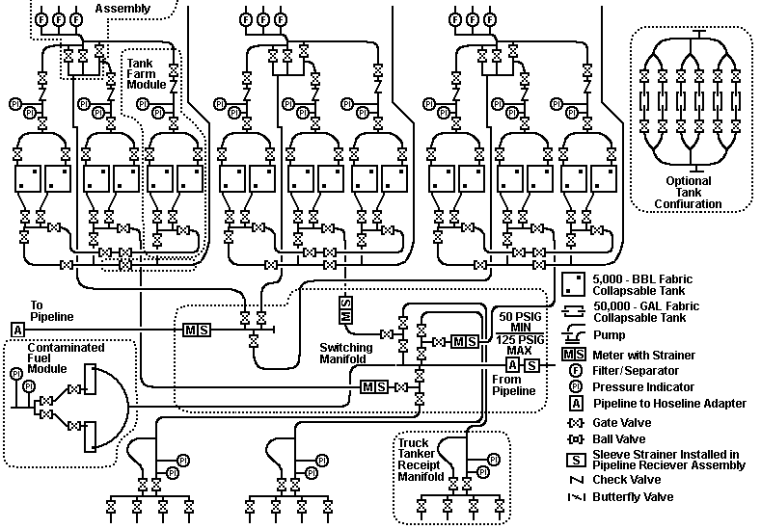

Slide 45
Pipeline Connection Assembly. The pipeline connection assembly is required if fuel is to be received
from or issued to pipeline. The total assembly is stored in four containers and three Tricons.
•  Switching manifold. Allows the TPT to be connected to the pipeline and controls the fuel flow in, out, and
within the TPT (one container).
•  Contaminated fuel module. Consists of two 50,000-gallon collapsible fabric tanks used to hold
contaminated fuel for blending or disposal and a transfer pump to load tanker-trucks (one container).
•  Fire suppression assembly. Main component (one container).
•  Pipeline connection support assembly. Contains additional ISIL items, one aviation petroleum test kit, one
hoseline suspension kit, one displacement and evacuation kit, and two hoseline installation and repair kits
(one container

Slide 46
Special assemblies are available to aid in the total system construction and interface.
Beach interface. The beach interface is an assembly of adapters to connect IPDS to OPDS. It also
allows access to the pipeline for shore-based forces (for example US Marines).
Pipeline support equipment (PSE). The basis of allocation is one set of pipeline support equipment per
100 miles of pipeline to be installed. The assembly contains those items required to assist in the construction
and operation of a pipeline. PSE will accompany each deployed pipeline segment (five containers). Equipment
includes:

Slide 47
•  Two wheel mounted hoseline pumps (600 GPM) used as source pumps if the pipeline receives fuel from
commercial storage.
•  Two cutting and grooving machines for cutting of pipeline and pump station nipples.
•  Four hydraulic drive heads for anchor installation.
•  Two tapping machines for tapping into a pipeline in order to drain a portion of the line. Usually needed
when required to repair a leak.
•  A deadweight tester used to calibrate gages.
•  Five additional elbow sets.
•  Tool kits with pump alignment tools.
2-7
QM 5096
•  Additional 9.5-foot pipe sections

Slide 48
PART B - QUALITY SURVEILLANCE
Quality surveillance (QS) includes all procedures used by operators of the TPT to ensure petroleum products
received, stored, and dispensed by the IPDS meet the minimum specifications when delivered to the user.
Quality control (QC) is the inspection performed by refinery personnel to monitor the production of a
particular petroleum product. Quality assurance (QA) is the Army’s program to determine if a refinery or other
source has fulfilled its contract concerning the quantity and quality of petroleum products. QA is complete
when the product is accepted by the Army and becomes Army-owned. QS consists of the measures taken to
ensure that petroleum products, which have been accepted by the Army, are still of the required quality when
delivered to the user. QS is the responsibility of the organization having physical possession of the Armyowned
products.

Slide 49
Sample Points. The high-pressure fuel sampling assembly is installed in the pipeline one-half to one mile
upstream from the TPT. This assembly is used to spot the interface as it approaches the TPT and to give
advance warning of its arrival.
The low-pressure fuel sampling assembly is installed in the header, feeding the TPT switching manifold
from the pipeline. The primary use of this fuel sampling assembly is to check incoming fuel and establish the
end or last of the interface between batches of different specification fuel. It can also be used to spot sample
and check the quality of incoming fuel and to draw samples for laboratory testing.

Slide 50
The water detector kit adapter is in the discharge line of each filter separator. The primary purpose is to
check the quality and make sure no water is carried over the dispensing assembly. Samples from the adapter
using the aviation fuel contamination test kit are taken downstream of each filter separator to ensure that the
filter separators are performing properly and customers are provided quality fuel that meets specification.
•  Test once every 4 hours of operation of dispensing assembly.
•  Perform three checks at 15-minute intervals after filter separator is first put into operation or whenever the
elements are changed.

Slide 51
PART C - PIPELINE CONSTRUCTION
Pipeline Installation. The aluminum pipe used in the IPDS is highly susceptible to heat. Changes in
temperature cause the pipe to expand and to contract. This tendency requires pipeline installation to follow
certain rules exactly. The pipeline must be installed as straight and level as possible. Any desired turns or
changes in direction must be made using elbows, vertical as well as horizontal directions. Anchors are used
to direct expansion and contraction of the pipeline into expansion and contraction devices. Aluminum pipe is
subject to thermal expansion that can overstress couplings and cause breaks in the pipeline. Since the
pipeline will be installed above ground, the pipe will move as it expands and contracts with temperature
variation. In some geographical locations where the pipeline may be used, the temperature can vary by as
much as 100 degrees Fahrenheit in 24 hours, which can cause an expansion of up to 20 inches for 50
sections of pipe. Expansion can cause the pipeline to fail at a coupling if side pressure deflects the joint more
than 4 degrees. This expansion must be controlled and directed to spots specifically designed to move with
pipeline expansion and contraction.

Slide 52
Controlling Expansion and Contraction. To control this expected expansion/contraction
movement, the pipeline must be equipped with anchors and expansion devices. The anchor fixes the pipeline
to the ground and directs any expansion towards the expansion device. The flex in the couplings at the elbows
allow these devices to move without breaking the integrity of the pipeline. In a desert environment, where the
temperature change can be anywhere from 50 to 100 degrees, there must be a maximum of 50 sections of
pipe between expansion/contraction devices, with an anchor in between. In a more temperate environment
with an expected temperature change of less than 50 degrees, the distance between expansion/contraction
devices can be extended up to 100 sections of pipe. There still must be an anchor between devices. The
pipeline must be laid in an anchor - expansion device - anchor sequence with the anchor just outside of each
pump station starting the sequence. Expansion loops on hills should be no more than 15 sections of pipe
hanging downhill from an anchor

Slide 53
There are two types of expansion devices used with the IPDS. The “U” shaped loop and the “Z” shaped
offset. Both devices provide required pipeline flexibility and are considered equal from that standpoint. The “Z”
QM 5096
2-8
shaped offset should be used if sufficient cleared trace (width 30 feet) is available. If the trace is not available,
the “U” shaped loop should be installed. A cleared area of about 30 feet. by 30 feet is required for each “U”
loop.
•  “U” shaped loop, will normally be constructed with one pipeline length (19 ft.) on a side and may use 45 or
90 degree elbows or a combination thereof. As elbows are limited, 90 degree elbows should be used
whenever possible. The deflection at the loop can be as much as 20 inches from the cold to the hot
position.
•  “Z” shaped offset will normally be offset one 19-foot pipe length. To allow for proper expansion, the “Z”
should be constructed only with 45 degree elbows unless two 19-foot lengths of pipe are used in the
offset.

Slide 54
Mandatory anchor points are located:
•  Always between expansion loops to direct expansion into the loops.
•  On the first or second section of pipe outside pump stations at the launcher and receiver assemblies.
•  On the first section of pipe downstream of gate and/or check valves in the pipeline.
•  On the first or second section of pipe on both sides of elbows that change the direction of the pipeline
(both horizontal and vertical).
Anchors must be located at the bottom of a hill with the expansion loop up the hill. There must be no more
than 15 sections of pipe hanging downhill from an anchor.

Slide 55
Pipe Support and Guides. Must be installed where required to ensure that joint alignment is
maintained. Pipe supports and guides may be constructed of pickets, sandbags, or other available materials.
Sandbags, if used, should always be stacked in a pyramid to provide support during pipe movement; never
stack one on top of the other. Pickets are used to keep the pipeline from slipping downhill when laid along a
slope. There are 225 pickets and 2,000 sandbags in each 5-mile set. Obstacle crossings include:
•  Road crossing. Use existing culverts whenever possible. Make sure that the cross sectional

Slide 56
•  Road crossing. Use existing culverts whenever possible. Make sure that the cross sectional area of the
culvert is not significantly reduced as this may prevent or restrict the run-off of water. Eighty linear feet
(eight 2-foot halves) of 24-inch diameter, nestable, corrugated steel culvert are included in each 5-mile
pipeline set.
•  Critical gap crossing kit. To aid in crossing gaps along the trace in difficult terrain, a special critical gap
crossing kit has been developed and added to the IPDS operational stocks. The kit consists of 4-inch steel
pipe, cross beams, braces, and roller assemblies. The steel pipe can be cut/welded to any length
required. A kit has enough material to cross up to a 250-foot gap.

Slide 57
PART D - PUMP STATION OPERATION
Pump stations are located along the pipeline to boost the pressure of the fuel. Maintaining adequate pressure
is a must. Without adequate pressure, the flow of fuel would decrease to a point that little or no fuel would
reach the head terminal.

Slide 58
Information Source for Pumping Order. All users of military fuel in the theater are required to
forecast their fuel requirements. These are consolidated at all levels, giving the theater fuel activity estimated
fuel requirements at each terminal. The pipeline dispatcher uses this information to schedule fuel flow into
each terminal, ensuring that enough fuel is on hand to meet expected demand. The dispatcher sets up a
schedule which includes the type and quantity of fuel, flow rate, and the batch number assigned to that fuel
shipment. The batch number is a designation given to each fuel shipment. One of the most common ways of
assigning batch numbers to fuel shipments is to assign a number to a type of fuel, for example, 1 = MOGAS, 2
= DF2, 3 = JP4. The second number would be the number of shipments of that type of fuel that have been
shipped this fiscal year; for example, 1st shipment = 1; 2d shipment = 2. Batch 1-14 would be the 14th
shipment of MOGAS. Once the dispatcher has set up the schedule, a pumping order is made each day and
sent to all pipeline areas

Slide 59
Daily Pumping Orders. The dispatcher issues daily pumping orders to pump station and terminal
operators. Pumping orders include:
•  Type of fuel.
•  Batch number.
•  Destination of each batch.
2-9
QM 5096
•  Amount of fuel in batch.
•  Estimated size of interface.
•  Estimated times of arrival of interface at terminals.
•  Starting and stopping times of all pumping operations.
•  Type of interface to cut.
•  Pipeline pump station pressures and pipeline flow rates.

Slide 60
PART E - SITE SELECTION AND PLANNING
When conducting a site and route reconnaissance, you must have two known points - where the fuel source is
or will be located and where the forces will be located requiring support.
Site and Route Selection. A survey using a topographic map must first be conducted and a profile of
the best trace made. Using the profile and the hydraulic limitations of the pumps, mark the pipeline trace and
the required locations for pump stations. When conducting the physical reconnaissance on foot or by vehicle,
stakes or other marking devices must be used to indicate the actual path of the pipeline. Location of valves,
anchors, expansion/contraction devices, and any obstacles must be marked on the trace. Actual pump station
locations can be adjusted somewhat from the ideal locations selected from the profile and hydraulic analysis.
But every effort should be made to locate pump stations within 2,000 feet of their ideal locations

Slide 61
Plot Plan. After the site has been selected, a preliminary plot plan should be made that shows all the major
equipment and system locations. After the plan has been reviewed and corrections made, roadway and berm
construction can begin according to the plan.
•  Pump station. A space of 140’ by 85’ is ideal, especially if it is flat. Pumps must be positioned for access
in case one needs to be replaced during operation. This requires at least 50’ to the rear of pumps and
should be 10’ off the road. Stake anticipated location of the inlet and outlet piping about 95’ from the edge
of the road with 140’ between stakes to align the incoming and the outgoing pipeline.

Slide 62
•  Tank farm assembly. Should be located to provide wide spacing between fuel units and to provide fire
protection and suppression. Tank farm assemblies within a fuel unit should be at least 400’ apart. There
should be a minimum of 600’ between fuel units.
•  Fuel dispensing assembly (FDA). The FDA should be located on a road capable of supporting heavy
vehicle traffic during weather changes and at least 100’ from the nearest fabric tank. The plot plan
requirements for the FDA are approximately 750’ long by 50’ wide. An area alongside, 120’ wide by 850’
long should be graded for vehicle traffic and parking while loading.
•  Tanker-truck receipt manifold. The most important factor in choosing the exact site is road excess, since
heavy traffic will occur in this area of the TPT. A graded area of 120’ wide by 250’ long is required per
receipt manifold

Slide 63
PART F - EXTERNAL IDENTIFICATION
•  Each ISO container is marked with a large black bordered symbol.
•  The pipeline components are represented by a circle.
•  The TPT is a triangle. Each container has identification information stenciled on it and is marked as part of
a series, for example, box 1 of 5.
•  The pump station is marked by a diamond. Note that a packing list is secured to the outside of each box
or crate.

Slide 64
PART G - COMMUNICATIONS
An efficient communication system is a must for the construction, operation, and maintenance of a military
pipeline. The system must be separate, continuous, and dependable. Ideally, the chief dispatcher will have
direct communication to each pump station operator and to each TPT. Each unit will set up their own
communication system along the pipeline with their capability (teletypewriters, field phone, or radios for
example). No operation will start until there is communication between the issuing and receiving stations.
Pipeline patrol will carry radios at all times. Establishing hand signals can be an effective form of
communications within small sections such as pump stations and tank farms. All personnel within the
communication network must be familiar with all requirements that could be placed on them and what action
must be taken in each situation

Slide 65
LESSON 3
COMPUTE BERM REQUIREMENTS

Slide 66
INTRODUCTION
Fire walls are designed to contain 100 percent of the volume of a storage tank plus one foot of freeboard. These
walls are intended to contain fuel spilled when tanks leak, overflow, or burst and to help prevent the spread of fuel
or fire to neighboring tanks and other installations. This block of instruction is designed to further your training so
that you can better supervise your personnel in terminal operations.

Slide 67
PART A - FIRE WALLS
Fire walls should contain 100 percent of the capacity of the storage tank plus one foot freeboard, and in the case
of earth fire walls (refer to Figure 3-1), they should be at least 18 inches wide at the top. The exact height of the
fire wall will depend on the amount of “real estate” or space available in the area in which you are operating. In
theaters of operation, it is not uncommon to have “splinter walls” of brick or concrete, 8 or 10 feet high around the
tank. These serve as fire walls and protection against such things as low trajectory fire, and blast. A sump will be
provided at the lowest point inside the fire wall, and the rest of the area will be graded or drained to the sump. The
sump will connect to the outside of the firewall by a drain line with an elbow (swing point) leg on the outside to
drain water from the sump. The drain is closed by elevating the swing joint.

Slide 68
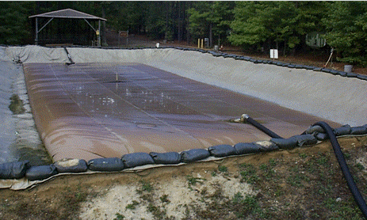

Slide 69
PART B - FORMULAS
Table 3-1. Tanks size and berm dimension requirements.
Tank Capacity (Gallons) Fire Wall Dimensions (Feet) Inner Dimensions (Feet)
10,000 3 high, 1.5 wide 26 by 26
20,000 4 high, 1.5 wide 31 by 35
50,000 4 high, 1.5 wide 73 by 33
210,000 5.5 high, 1 wide
6.5 wide at bottom
73 b

Slide 70
The formula for determining the inside diameter of the firewall is:
D = 2.68 x √ ( C / H-1)
C = Tank capacity (Known/barrels)
H = Height of fire wall (Known/feet)
D = Diameter of fire wall (Unknown/feet)
√ = Square Root
Example: We must construct a six foot berm around a 3,000 bbl tank.
D = 2.68 x √ ( 3,000 )
6 – 1
D = 2.68 x √ ( 3,000)
5
D = 2.68 x √ 600
D = 2.68 x 24.49 = 65.6
D = 66 ft.

Slide 71
The formula for determining the height of a fire wall based on the diameter is:
H = C + 1
(D / 2.68)2
Example: Capacity of the storage tank is 3,000 bbl, the diameter is 65.7:
H = 3,000 + 1
(65.7 / 2.68)2
H = 3,000 + 1
(24.51)2
H = 3,000 + 1
600.74
H = 4.99 + 1 = 5.99
H = 6 ft.

Slide 72
Another important factor to be considered when constructing a berm is the amount of soil required. Figure 3-2
identifies the general dimensions that must be considered when using the formula below. Figure 3-3 and
Table 3-2, identify more specific dimensions for given tank sizes. The formula for determining the amount of soil
required for a particular sized berm is:
V = A x L
A = W + B (h)
2
V = W + B (h) L
2
V (cubic yards) = V
27
Example: Amount of soil required for a berm around a 3,000-gallon tank

Slide 73
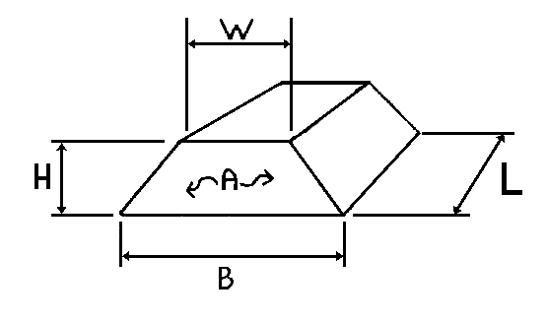

Slide 74
V = 3 + 1 x 3 x 12.6 Figure 3-2. General dimensions for soil quantity.
2
V = 2 x 3 x 12.6
V = 25.2 square yards

Slide 77
LESSON 4
RECOMMEND PLACEMENT OF TERMINAL EQUIPMENT
Critical Task:
101-519-3309

Slide 78
INTRODUCTION
As a petroleum manager, you will be required to oversee the minor repair of terminal equipment. It is in your
best interest to know the proper procedures and reference material available to you. You will also be
responsible for managing the on-the-job Training (OJT) of newly assigned personnel. The more
knowledgeable you are in the area of equipment repair, the more effective your training program will be. You
will also be responsible for knowledge of the manifold system within the petroleum terminal. Until bulk
petroleum products are issued for consumption from the terminal, they must first be received and stored in
storage facilities of varying capacities. All facilities have a common feature that allows control of the products
entering, leaving and transferring within the system: This control feature is the manifold

Slide 79
PART A - TYPES OF PIPE AND COUPLINGS
•  Lightweight Steel Tubing - Lightweight steel tubing is made of light gage steel with API STD 5L pipe
nipples welded to each end. This tubing is furnished in 20-foot sections in 4-, 6-, 8-, and 12-inch nominal
sizes. Lightweight steel tubing is normally used in long stretches of cross-country pipeline due to greater
ease of handling, and because under this condition it will experience only normal operating pressures.
Due to its thin wall, the pipe is not to be buried nor is it to be used for submerged stream crossings

Slide 80
•  API S&D 5L Pipe - API S&D 5L pipe has a thicker wall than the lightweight steel tubing pipe and is
furnished in 4-, 6-, 8-, 12-, 16-, and 20-inch nominal sizes. It is furnished in 20-foot sections grooved for
coupling, and it is beveled for welding in random lengths. It is used at critical points and high pressure
areas such as downhill slopes, manifold areas, and pup joints.

Slide 81
•  “Victaulic” Couplings - “Victaulic” couplings are used to join the lightweight steel tubing and API S&D 5L
pipe sections together. “Victaulic” is a trade name associated with the couplings which consist of two
housing segments, two bolts and nuts, and a synthetic-rubber, oil-resistant, self-sealing gasket. The
coupling and gasket are designed so that the pipe joint seals under pressure and vacuum. The coupling
also provides a sufficient amount of angular deflection and slack adjustment for expansion and contraction
of the line between adjacent joints. The gasket used with the coupling should be greased to prevent
pinching or sticking of the gasket.

Slide 82
•  Aluminum Pipe - Aluminum pipe is a new type of pipe being evaluated for future use by the Army. It is
lightweight, yet meets static and dynamic pressure requirements of the fuel systems. This pipe has fewer
corrosion problems and is available in 9.5-foot sections. It is used in locations similar to the lightweight
steel tubing and API STD 5L pipe. High-pressure situations are corrected by the use of pressure
reduction stations.

Slide 83
•  Hinged Snap-Joint Coupling – The hinged snap-joint coupling is standard for single-grooved aluminum
pipe and has a two-piece integral gasket. The coupling consists of two sections that are hinged together
and a pin for closing the coupling over the pipe ends. The coupling and gasket are designed to seal under
pressure and vacuum. The hinged coupling allows for a 2 percent deflection between joints and a
maximum allowable working pressure (MAWP) of 740 psi.

Slide 84
Cutting and Grooving Procedures for Steel Pipe. Grooved pipe is used for coupling pipe
sections together with the split-ring, groove-type coupling. Due to layout or damage, a section of pipeline must
be cut to a nonstandard length and regrooved to allow for proper assembly. A portable cutting, grooving, and
beveling machine is used to perform this task. These machines are packaged in a kit and are included in the
welded pipeline construction tool set. The kit includes two large suitcases and two pipe stands. The machine
is powered by a 250 cubic-foot-per-minute (CFM) air compressor or by a generator and can also be operated
using a 24 volt system from a tactical vehicle. It is used primarily during mainline pump station construction. It
takes about 30 minutes to cut and groove each end of the pipe.

Slide 85
Welding of Pipeline. Pipe to be welded will have a beveled edge on it to facilitate making a good weld.
Rebeveling, because of damage to the edge, or cutting and beveling are accomplished with the machine
described above. The bevel is cleaned of slag with a bevel grinding machine.

Slide 86
PART B - VALVES
•  Gate Valves - Gate valves have a gate in the form of a disk or wedge, which is raised to permit the flow
of fuel and lowered to stop the flow of fuel.
•  Rising-Stem Gate Valves - Rising-stem gate valves are threaded on the upper end of the stem. The
lower end is attached to a disk. When the hand wheel is turned, both the stem and disk are raised and
lowered. When the valve is fully opened, it will allow pipeline scrapers, poly pigs, etc., to pass through. By
looking at the valve from a distance, you can tell whether or not the valve is open or closed. The stem of
the valve is easy to sabotage. The exposed surface of the upper stem on the rising stem gate valve
should be protected by placing a split, one-inch hose or some similar device around the stem in the yoke
area. A fine film of motor oil can be used to lubricate the thread on the stem. This valve is used in the
pipeline at intervals, at the bottom of long slopes, on both sides of a stream crossing, and at storage
tanks.

Slide 87
•  Nonrising-Stem Gate Valves - The threaded lower end of the stem on a nonrising-stem gate valve
screws into the disk, thereby raising or lowering the disk while the stem is retained in place by a thrust
collar. The packing gland must be monitored and replaced as necessary.
•  Globe Valves - Globe valves are used to throttle the flow of product inside a pipeline. This is the same
type of valve used at home on kitchen or bathroom sinks. Packing, disks, and seats will become worn
and will need replacing depending on usage. These valves are used in areas where the throttling of
product flow is desired

Slide 88
•  Check Valves - Check valves permit fuel to flow one way only by means of a hinged disk or clapper which
is pushed aside by the fuel when it flows in the desired direction. When flow stops and back pressure
develops, the clapper is pushed against its seat, stopping back flow. These valves are self-operating and
need little maintenance other than tightening the cover nuts regularly. Typically they are used on the
discharge sides of pumps and at pump stations between the suction and discharge lines of each pump at
the pump station. They are also used at the foot of upgrade slopes in lieu of gate valves, but they must be
removed if the line is ever pumped in reverse

Slide 89
•  Flow Control Valves (Pressure Reducing Valves) - Flow control valves are activated by pressure. If
pressure in the pilot is great enough to overcome the force of the spring, the excess pressure activates
the diaphragm to throttle the flow in dynamic situations, and in static conditions it will decrease the head
acting against a particular point in the pipeline. These valves require little maintenance beyond checking
the pilot strainer at least every 3 months and inspecting the diaphragm once a year. They are used on
downhill slopes.
•  Pressure Relief Valves - Pressure relief valves are set to open at certain pressures and are triggered by
a spring. The pipeline is tapped at points which may experience excess pressures under static conditions.
If pressures reach the upper limit set on the valve by the operators, the valve activates by opening and
bleeding fuel off until safe pressures are again reached and the valve resets itself to the closed position.
Typically these valves are used at locations where the pipe is going to a storage tank to bleed-off excess
pressures built up in the line because of heating by the sun under shut down conditions. These valves
should be tested once a year using a reliable pressure gage.

Slide 90
•  Plug Valves - Plug valves are small, compact valves activated by turning the head of the valve 1/4-turn.
This valve may or may not open to the full diameter of the pipe depending on the type of plug valve used.
As a result, plug valves which do not open to the full diameter of the pipe cannot be used in portions of the
pipeline through which a scraper is designed to pass. This valve can be lubricated in the open or closed
position. Lubrication is done through the lubrication screw at the top by the use of a high pressure grease
gun, or the screw can be screwed down. This valve also has rope-type packing which must be
periodically replaced. Plug valves are commonly used at tank farm manifolds or in places requiring quick,
positive shut-off such as at a scraper launching station.

Slide 91
Additional pipeline components.
Line Strainers - Line strainers catch debris in fuel as it comes down through a basket or strainer and then
passes through the discharge side. The basket has a wire-mesh or screen which catches the debris and
prevents it from continuing to flow downstream and damaging things like pump impeller blades and meters.
The baskets or screens need to be pulled from the devices in which they are installed on a periodic schedule
to remove the debris (once a week). Line strainers are found on the suction side of pumps and meters and
on the discharge side of filter separators.

Slide 92
PART C - FITTINGS AND PIPE REPAIR ACCESSORIES
Fittings. Standard, groove-type fittings include elbows, tees, and reducers such as the following:
•  Standard Tee Fittings - Standard tee fittings provide a splitting of the fuel stream. These fittings have a
characteristic “T” shape.
•  Reducing Tee Fittings - Reducing tee fittings allow reduction in one leg of the branch, either through the
tee portion or through the branch portion of the tee.
•  Elbow Fittings - Provide for the change in the pipeline direction by 90 or 45 degrees.
•  Reducers - Provide a connection from one diameter of pipe to some smaller diameter of pi

Slide 93
Repair clamps. Listed below are some of the more common types of clamps used to repair leaking
pipelines.
•  Pit Leak Clamps - Pit leak clamps are designed to temporarily repair a leak caused by a small hole such
as a pit.
•  Split Leak Clamps - Split leak clamps are designed to temporarily repair a leak caused by a split pipe.
This clamp is limited in the size of the split which can be repaired due to its limited length.
•  Over-Coupling Leak Clamps - Over-coupling leak clamps are designed for placement over the regular
split-ring, groove-type coupling when a leak develops from the initial coupling.
•  A pipeline leakage report will be completed for all leaks occurring in a pipeline

Slide 94
PART D - PUMPS
Pipeline pumps consist of one or more impellers mounted on a rapidly rotating shaft. Liquid enters the
impeller at its center and is impelled outward by centrifugal force into the volute of the pump casing. The
volute catches the discharge and converts peripheral velocity into head pressure while conducting the liquid at
a reduced flow rate to the discharge nozzle of the pump casing. Different pumps are used on aluminum and
steel pipeline systems.

Slide 95
•  6-inch, Single-Stage Pump - The 6-inch, single-stage pump is a self-priming, centrifugal pump equipped
with a mechanical shaft seal. Suction and discharge connections are grooved pipe. Maximum safe
working pressure is 207 PSI or 660 feet of head for fuel with a SG of 0.725.
•  6-inch, Two-Stage Pump - The 6-inch, two-stage pump is a multi-stage pump fitted for external
connection to operate either in series or in parallel. Maximum safe working pressure is 700 PSI or 2,390
feet of head for a fuel with a SG of 0.725.
•  800 GPM Mainline Pump - The 800 GPM mainline pump is a new pump used for operation in an
aluminum pipeline system. It is a skid-mounted, three-stage centrifugal pump.

Slide 96
PART E - PIPELINE SCRAPER OPERATIONS
Scrapers are devices inserted into the pipeline to remove internal scale, rust, or other foreign material. In the
petroleum industry, scrapers are often called “pigs” or “go-devils.” Two types of scrapers are used:
•  Steel Brush Scraper - The steel brush scraper is constructed of a tubular shaft on which are mounted
two sets of four spring-loaded steel brushes and two synthetic rubber cups. The spring-loaded steel
brushes clean the walls of the pipe. The front and rear brush groups are staggered to cover the entire
pipe surface. The tubular shaft of the scraper is open at the rear, which permits a fraction of the stream to
flow into the scraper and escape through small ports near the front end, thereby agitating and propelling
the loosened scale forward. This prevents the scale from accumulating ahead of the scraper, causing the
line to become clogged. This type of scraper comes in 6-, 8-, 10-, and 14-inch sizes. The 10- and 14-inch
scrapers have three synthetic rubber cups

Slide 97
•  Poly Pig Scraper Device - The poly pig scraper device is constructed of foam-type material and wrapped
with abrasives to clean the pipeline. They are able to make 90-degree turns in the pipeline and are
inexpensive, though they do not clean as thoroughly as, steel brush scrapers nor are they as durable.
Military pump station manifolds have two scraper stations; one for launching and another for receiving. Before
launching a scraper, lines should be free from sharp bends and valves that do not open the full diameter of the
4-5
QM 5096
pipe. To provide free passage for scrapers, changes in pipeline direction are made by bending pipe rather
than using elbow or tee fittings.
Sandtraps are, in effect, sediment or settling chambers which collect dirt, scale, sludge and floating debris
pumped through the pipeline or accumulated during pipeline cleaning. They are installed on the suction side
of each pump station. Sandtraps split the flow into two 14-inch barrels, thus reducing the velocity of the flow.
This allow sediment to settle out. They must be cleaned periodically and after each scraper run.

Slide 98
PART F - MANIFOLD DESIGN FACTORS
The following factors are affected by the theater support requirements:
•  Number and quantity of products - The number of and quantity of products depend on theater needs
(for example troops, equipment).
•  Number of tanks - The number of tanks depends on the quantity and type of product stored and the
facility size (a minimum of two tanks per product is preferred).
•  Number of incoming lines - The number of incoming lines entering the facility is determined by the
supporting locations.
•  Number of outgoing lines - The number of lines leaving the facility is determined by the locations
supported.

Slide 99
•  Future expansion - Future expansion is based on the expansion of the theater and an increase in
corresponding support requirements.
•  Location - The location of a facility is given with the manifold centrally located within it.
•  Layout - The layout requires that the manifold is located at the low point near the center of the tank farm
piping network. The minimum distance to any tank should be 250 feet.
•  Construction - The manifold consists of API standard pipe sections and plug valves. The API pipe will
accommodate higher pressures associated with the sharp angles and close proximity to the fuel source.
Plug valves provide control in switching products as they require only a 1/4-turn to open or close the valve.

Slide 100
•  Manifold design - A manifold is designed to support the facility in which it is located. The basic manifold
used in a facility is called a switching manifold which is an assembly of pipe, fittings, and valves used for
controlling the flow of petroleum products into, out of, and within, a tank farm complex. The manifold is
located at the lowest point within the facility to assure positive suction to the transfer/feeder pumps. The
manifold connects a number of tanks with incoming and outgoing lines as well as pumps used in
transferring products. A single tank connected to a pipeline does not provide the flexibility to accomplish
more than a single function. Multiple tanks connected to a pipeline, even while providing increased
capacity, can only perform a single function. The manifold system permits simultaneous receipt and
delivery of petroleum products by the facility. By adding pipe, fittings, and valves, control of the product to
complete multiple tasks can be accomplished. Products can be received into one tank while issues can
continue simultaneously.

Slide 101
Manifold identification markings - An identification system is essential for control within a facility. The
facility commander will establish the identification system where one is not established or if a current
system needs changing. Identification systems should be kept simple. The system should identify each
tank, pump, line, and valve. A schematic of the facility tanks, pumps, lines, and valves identifying each
needs to be available within the facility for reference. Schematic and facility markings are suggested as a
method for identification of the system. Whatever method is utilized, the actual facility schematic must
match what is actually in place. The following identification method is suggested:

Slide 102
Valves - Valves located along the main line (ML) are identified by the office of the chief dispatcher,
starting at the beginning of the pipeline and ending outside the last facility of the head terminal. These
valves are identified by the letter ML followed by a dash (-) and a number. For example: ML-1,
denotes a valve as being the first in the pipeline system.
Tanks - Tanks are identified by numbers. When numbering the tank valves, start with the first valve at the
tank and number across the manifold in sequence. Write the tank number down first, followed by a
dash, and then the valve number. For example, if identifying Tank 10, all valves starting from the tank
would be numbered sequentially beginning with 10-1, then 10-2, then 10-3, and so on to the last valve
in the manifold for that particular line.
Pumps - Pumps are identified by numbers. Pump valves may be identified with a letter or numbering
system. For example, pump 1 can have its suction and discharge valves identified individually or in
sequence. For example, P-1 or pump suction valve (PSV)-1, and P-2 or pump discharge valve
QM 5096
4-6
(PDV)-2. An alternative that would identify valves to a specific pump is P-1-1 or PSV-1-1 and P-1-2 or
PDV-1-2 for pump 1 suction and discharge valves.

Slide 103
Pipelines - Pipelines, both incoming from and outgoing to the manifold, are identified by a letter. The
incoming lines of a pipeline begin where they enter the facility and end where they connect to the
manifold. For example, a line entering the facility is identified with a letter (starting with A). Valves
located in the line are identified with the line letter followed by a dash (-), and then in numerical
sequence starting with 1. The highest number identifies the valve in the line just prior to its connection
to the manifold. If line A has five valves in it, then they would be numbered starting with A-1 (the valve
nearest the entry to the facility) and ending with A-5 (the valve closest to the manifold). The outgoing
lines begin at the furthest point inside the manifold and are identified with the line letter, a dash, and a
number. The last valve in an outgoing line is the one at the point where the line ends in, or exits, the
facility.

Slide 104
Additional markings used in a system for identification include the following:
Direction of Flow - The direction of flow in a line is indicated with an arrow physically placed/painted on the
line. The direction can be in one direction only or in both directions.
Product Identification for Products - The product identification for products should relate to the product in
the line (that is, tank lines immediately outside the manifold should show the product).
Product Identification for Facilities - The product identification for a facility will be applied where practical
depending on the tactical situation and the commander’s guidance.

Slide 105
LESSON 5
INTERPRET PUMP GRAPHS
Critical task:
101-519-3201

Slide 106
INTRODUCTION
Pumps can be operated over a wide range of speeds in order to compensate for variations in the pumped
product’s specific gravity, temperature, and the pipeline topology. The speed at which the pump is operated
also determines the efficiency and therefore the cost of operation. To effectively direct a pumping operation
you must be able to balance all the operating parameters of the pumps. This is accomplished by the use of
pump graphs.

Slide 107
PART A - FEET OF HEAD AND POUNDS PER SQUARE INCH
A pump graph is constructed to show feet of head, flow rate in gallons per minute (GPM), and barrels per
hour. Pumps are equipped with gauges that register the suction and discharge pressure in pounds per square
inch (PSI). Therefore the operator must be able to convert PSI to feet of head to determine the flow rate and
efficiency of the pump.
The equation for converting PSI to feet of head is H
xPSI
SPGR
 2.31
.

Slide 108
2.31 is a constant based on a column of water at 60 degrees Fahrenheit and 2.31 feet high and
measuring 1 inch by 1 inch. 2.31 feet of head of water at 60 degrees Fahrenheit equals 1 PSI. One foot of
head is equal to 0.433 PSI (1 divided by 2.31). By using the specific gravity of different fuels in the equation
the operator can determine the difference in PSI.
EXAMPLE: The fuel being pumped (DF) has a specific gravity of 0.8254. The pressure at which it is being
pumped is 325 PSI. Using the following equation, it is calculated that the feet of head is 909:
H
x

2 31 325
08254
.
.
.

Slide 109
The operator knows the pump can overcome 909 feet of head.
The equation for changing feet of head to pressure is P
HxSPGR 
2.31
.
EXAMPLE: A pump operator must overcome 909 feet of head while pumping DF with a specific gravity of
0.8254 and needs to know the pressure which must be maintained. Using the equation:
P
x
  PSI
909 8254
2 31
325
.
.
.

Slide 110
PART B - EFFECT OF PUMP STATION OPERATION ON HEAD CAPACITY
AND FLOW RATE
The normal head capacity of a pump station is the total head against which it will pump at the most efficient
operating point, that is the design speed of the pumping units. RPM must be considered, together with the
required head and desired throughput (GPM or BPH), to establish maximum efficiency in design. Optimum
standard military pipeline head capacities are contained in FM 5-482 (Military Petroleum Pipelines Systems),
and provided in Table 1. The maximum head capacity of a pump station is the total head against which it will
pump to provide maximum pipeline capacity. Maximum head capacities are only for use in emergency
operations and are never used in normal operations. Pump stations should not be operated at maximum
capacity except for emergencies. Operation under emergency conditions should not exceed 24 consecutive
hours

Slide 111
PART C - PARALLEL AND SERIES INSTALLATION OF PUMPS
Electrical storage batteries are described in terms of series or parallel hook-up. In order to get 12 volts of
electricity, two 6-volt batteries may be connected in series. The same two 6-volt batteries connected in
parallel provide 6-volts of electricity, but the current is doubled. A hydraulic system is very similar to an
electrical system because the head capacity resembles voltage and the flow rate resembles the current.
Two pumps connected in series double the head capacity of a single pump while the flow rate in GPM or
brake horse power (BPH) remains the same as for one pump. Two pumps connected in parallel double the
flow rate, while the head capacity remains the same as for one pump

Slide 112
Parallel operation is not normally used on petroleum pipelines. Pump stations are costly to operate and
require man power. The objective in pipeline design is to use as few pump stations as possible. The size of
the pipeline maintains the required volume. Pump stations are designed to push fuel products as far as
possible down the line. As a result, pump stations are connected in serie

Slide 113
PART D - PUMP GRAPHS
Observe how the pump graph is constructed (Figure 5-1). The graph consists of a coordinate system. It is a
uniform scale which means there is an equal space between all units on the graph in both directions. Rate of
flow is plotted along the X or horizontal axis increasing from left to right in GPM on the bottom and BPH on
top. The remaining variables are plotted along the Y or vertical axis. The RPM curve defines what is referred
to as the operating speed of the pump.

Slide 114
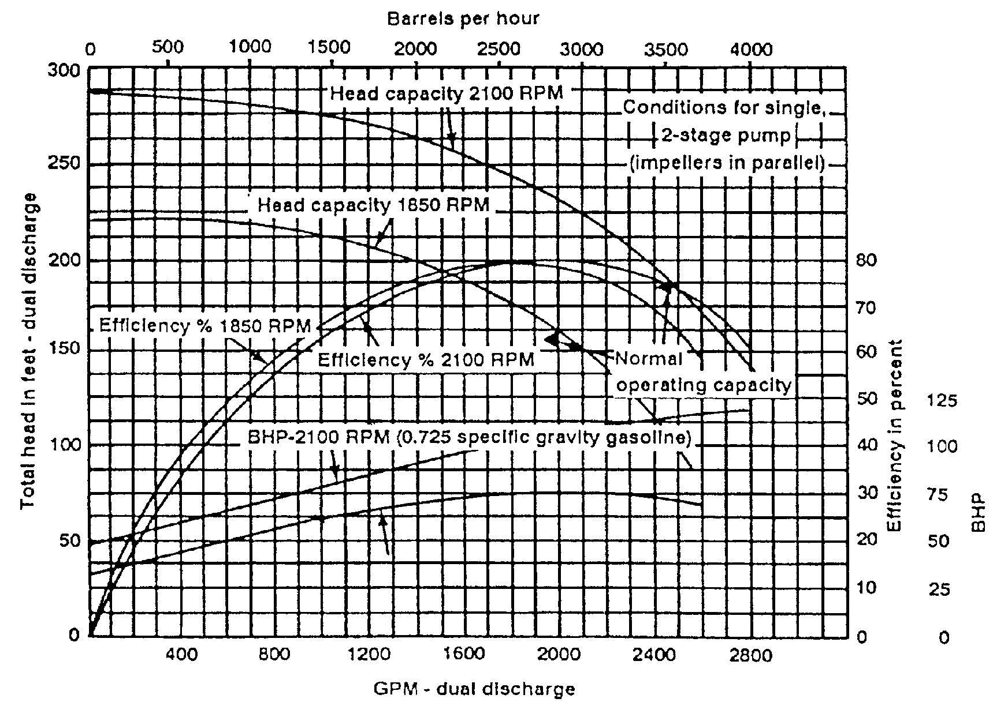

Slide 115
Pump Graph Application. A common application of a pump graph (Figure 5-1) is its use in determining
the rate of flow, efficiency, and BHP given the total dynamic head in feet and operating speed of the engine in
RPM. Recall the definition of dynamic head--the height to which a pump can push a column of liquid. Rate of
flow is the most commonly desired variable on the graph, and it can be expressed in either GPM or barrels per
hour. At an engine speed of 1,800 RPM and total dynamic head of 160 feet, determine the following:
•  Rate of flow (GPM).
•  Efficiency (%).
•  Brake horsepower (BHP).

Slide 116
To solve this problem enter the graph on the Y axis at 160 feet of head. Follow this line to the right until it
intersects the head capacity curve for 1,800 GPM. At this point, all answers are determined vertically up and
down.
•  To read rate of flow in GPM, drop down to the X axis and read the answer 850 GPM.
•  To determine the efficiency, drop down to the efficiency curve and read the percent efficiency in the righthand
margin (70%).
•  The BHP is similarly read. Drop down to the BHP curve for gasoline and read the answer (35 BHP).
QM 5096
5-4
NOTE: BHP is expressed with a given specific gravity fuel. For design purposes, we use 0.8524 specific
gravity diesel fuel.

Slide 117
PART E - DETERMINATION OF PUMP SPEED
Individual pump stations must regulate pump speed to keep suction pressures at the next pump station
downstream above the minimum. The normal suction pressure at a pump station is 20 PSI for elevations less
than 5,000 feet and where temperatures are below 100 degrees Fahrenheit (20 PSI is equivalent to 64 feet of
head of MOGAS). The minimum suction pressure at a pump station must be 5 PSI because of pump
entrance friction losses and the possibility of vapor lock in the pump. Five (5) PSI is equivalent to 16 feet of
head of MOGAS. To determine flow rate, efficiency, and BHP in pump station operations, the total pressure
produced on the discharge side of the pump station must be determined first

Slide 118
EXAMPLE: There are three pumps on line connected in series and operating at 1800 RPM with a discharge
pressure of 480 PSI and a suction pressure of 20 PSI. They are pumping a product which has a
SP/GR 0.8254.
480 PSI minus 20 PSI = 460 PSI.
H
x
 
2 31 460
0 8254

Slide 119
In order to use the pump graph, divide 1,287 ft/hd by three because there are three pumps on line (429 ft/hd).
Locate 429 feet of head on the graph, read to the right of the head curve (1,800 RPM). Read down to 600
GPM. At that flow rate, read up the graph until the line intersects the brake horsepower curve at 1,800 and
read 68 BHP. This represents one pump and there are three on line. Multiplying by three gives you 204 BHP
for the station. In the same manner, read up to the efficiency curve and read 74 percent. As shown, the
graphs can be used for pump stations as well as individual pumps.

Slide 120
800 GPM Main line Pump Graph. This pump graph (Figure 5-2) looks different but is constructed and
interpreted the same as the other pump graphs used. It shows total dynamic heads in PSI, feet of head, and
flow rate for water (1.0 sp/gr), DF-2 (0.8254 sp/gr), and MOGAS (0.7254 spgr) from 770 RPM to 2,100 RPM.
For example, at a flow rate of 500 GPM and 1,800 RPM pumping DF-2, the pressure and feet of head can
be determined. Locate 500 GPM and read up to the 1,800 RPM curve. Reading to the left gives 1,359 ft/hd at
500 PSI

Slide 121
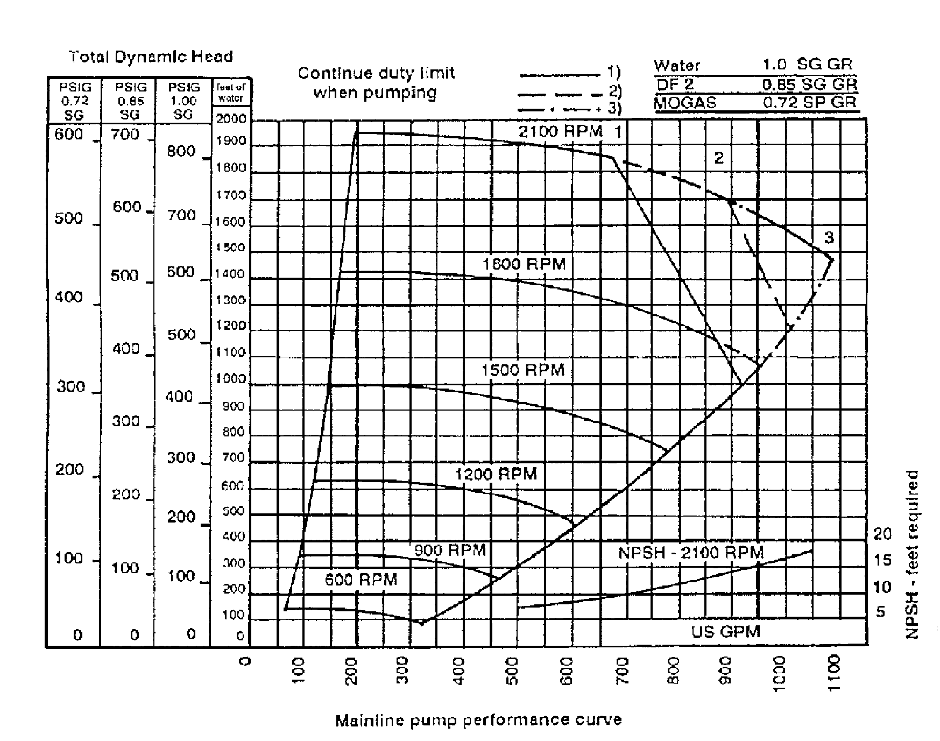

Slide 122
LESSON 6
SCHEDULE AND EVALUATE METER VERIFICATION

Slide 123
INTRODUCTION
Accounting for fuel is one of the most important aspects of operations in the field. If you are using meters for
accountability, then you must understand how they work in order to properly protect the meter and ensure that
they are properly calibrated.

Slide 124
PART A - TYPES OF METERS
Positive Displacement (PD) Meters. As the name implies, a positive displacement meter measures
the flow by separating the flowing stream into volumetric segments and counting them. There are typically
three basic subassemblies in a PD meter.
•  External housing. This is the pressure vessel with inlet and outlet connections. Meters may be of single
or double case construction. The single case acts as a pressure vessel and as the outer wall of the
measuring element. Small meters (less than 6 inches) are normally single case. Double case
construction is used on meters over 6 inches. The advantage of double case construction is that the
piping stress or pressure is not transmitted to the measuring element.

Slide 125
•  Internal measuring element. Measures the volumetric flow by continuously separating a flow stream into
discrete volumetric segments and counting them. It is also used to drive the counter.
•  Counter drive train (counter or totalizer). The gear ratio of the drive train is designed to convert the fixed
volume per revolution to the number of gallons or barrels and transmit it to the counter. The calibrator
(adjuster) is used to adjust the counter for slippage through the meter. It may be used if the meter is
outside the authorized tolerance.
Because of the design of the PD meter it must be protected from dirt and trash. Any solid material passing
through the meter will cause it to malfunction. The meter will also register any air passing through the
housing. The clearance between the housing and the van is usually .004 inches to .005 inches. Because of
their simplicity, positive displacement meters are the most commonly used in petroleum operations and are
used as master meters in the place of provers.

Slide 126
Turbine Meters. Turbine meters are precise measuring devices, even though they are classified as
inferred rate meters. They go from simple measuring devices to very complex instruments, and they are
much smaller than PD meters. There are three basic subassemblies in a conventional turbine meter.
•  Meter housing. The meter housing assembly is constructed of a flanged pipe spool and houses the
internal parts.
•  Internal parts. The heart of the internal parts subassembly is the rotor blade suspended in the flowing
stream on the platform bearing and rotor shaft.
•  Detector subassembly. In the more complicated meters you have the viscosity compensator and the
magnetic reed switch. In this kind of meter the flow is corrected to 60 degrees Fahrenheit

Slide 127
When the meter is installed it must have straightening vanes upstream and downstream of the meter. The
pipes are usually 5 pipe diameters long downstream and 10 pipe diameters upstream. This prevents fluid
swirl and cavitation due to back pressure, which will cause the thermometer to lose accuracy. The meter is
accurate up to 1/10th of 1 percent and is used for custody transfer. However, the meter requires a lot of
maintenance and expertise. (They are generally not used by the military.)
Turbine meters, like the PD meters, will register air and any obstructions from trash which can effect the
flow (the meter must be protected while in operation). Protective devices consist of air eliminators and basket
type strainers.

Slide 128
Inferential Rate Meters. The inferential rate meter is an instrument whose primary element (orifice
plate), when placed in a flowing stream, infers the flow rate by known physical laws (pressure drop based on
the viscosity of the fuels). The orifice plate is machined to exact tolerances.
The secondary element is used to record the quantity of fuel passing through the meter. It consists of
piping, high- and low-pressure sealing pots, and a 24-hour recording chart. The 24-hour chart registers the
viscosity of the fuel (based on pressure drop) and the flow rate in barrels over a 24-hour period.

Slide 129
When the meter is installed it must have straightening vanes upstream and downstream. The length of
the pipe depends on the size and type of valves used. The meter also requires protection from trash in the
flowing stream (line strainers). The meter itself requires a great deal of maintenance and expertise to keep it
in proper operating condition. Orifice meters are used in pipelines where the interface passage needs to be
monitored.

Slide 130
PART B - METER INSTALLATION AND PROTECTIVE DEVICES
Meter Installation. A typical meter installation would be set up as follows:
DIRECTION OF FLOWFilter separator Strainer Air eliminator Meter.
The strainer is downstream of the filter separator in case you have a ruptured element. The strainer will
catch any fiberglass or filter paper that might get into the meter and cause it to hang up. There is also a
strainer in the system on the suction side of the pump. This would prevent any trash from entering the filter
separator.

Slide 131
Line Strainers. Line strainers consist of a metal housing which holds a canister-shaped wire mesh
strainer. The mesh is usually 25 mesh or more.
•  Uses. Line strainers are used in the suction side of pumps and on the inlet side of meters preventing
debris from entering the pump and damaging the impeller or meter.
•  Maintenance. Line strainers should be inspected and cleaned on a periodic basis (recommended at once
a week). The gaskets are checked for damage, cleaned, and returned to use.

Slide 132
Air Eliminators. Air eliminators are placed in the line on the intake side of the meters. It consists of a
cylinder usually 14 inches to 20 inches in diameter, containing baffles that are designed to force the flow of
fuel to the bottom of the cylinder and to force air to the top. On the top of the cylinder is a diaphragm floatactivated
valve. The float holds the valve open, allowing air and vapors to escape to the atmosphere; when all
air is removed, the float rises in the product and closes the valve.
The flange gaskets should be checked daily for leaks. The diaphragm valve should be checked daily to
ensure it is working properly or to be replaced if needed. Remove any rust and paint.

Slide 133
PART C - PROVING DEVICES
•  Prover tanks. There are several types of provers available for proving meters. They are primarily tanks or
piping of a known volume. When they are filled, the known volume is compared to the metered volume
(unknown). Prover tanks normally range in size up to 600 gallon capacity.
•  Five gallon prover. The 5-gallon prover is used for proving small meters on tank trucks and at service
station type installations.
•  Mechanical displacement provers. These provers have a calibrated continuous loop and a spheroid. The
sphere displaces a known volume from the number one sensor to the number two sensor, and the amount
displaced is compared to the meter reading. You will find this kind of meter in fixed installations, or they
may be trailer-mounted.
•  Open volumetric prover. Open provers can be trailer-mounted or in a fixed installation. They consist of
the tank, the neck of the prover, a splash dome, overlapping site gage glasses, and a gage glass scale in
the neck of the prover. Thermometers are at the top and bottom. Provers are used in any installation
where you have to calibrate meters in pipelines, loading docks, and dispensing areas. The maintenance
of meters is very limited. Check for dents or distortions, and make sure the sight gages are in good
working order. Make sure the thermometers are certified.

Slide 134
PART D - VERIFICATION REQUIREMENTS
Meters must be verified based on the following factors:
Size of Meters (GPM) Total Gallons Measured
10-99 200,000
100-299 800,000
300-599 1,200,000
600 and over 2,000,000
Meters will be calibrated at least every 12 months or whenever the meter is suspect, whichever comes first.
The meter must be within .0025 (1/4 gallon) for every 100 gallons registered by the master meter. If the meter
is out of tolerance by more than .0025, then it must be adjusted or taken out of service. If this cannot be done,
then you may use the meter factor or meter percent error to adjust the meters registered reading on the
QM 5096
6-4
gallons pumped. The instructions for adjusting the meter are normally placed inside the top cover or in the
manufacturer’s manua

Slide 135
Preparation.
•  Meters must be checked under normal operating pressure and flow rate.
•  The prover must have the capacity for no less than the volume delivered through the meter in one minute.
•  Fill the prover and then empty to the zero mark (dry run). This removes air pockets in the line and warms
up the meter.
•  During the dry run, the time and flow rate can be determined.
•  All gages and thermometers will be checked for accuracy.
•  All fittings and valves must be checked for leaks.

Slide 136
Verification Records and Reports.
Meter test results. The following information will need to be included on all meter verification
reports and records in order to obtain reliable meter performance rating:
•  Closing meter reading, after the prover is full.
•  Opening meter reading; this is for meters that cannot be set to zero.
•  Registration; quantity recorded by the meter.
Example: * Closing meter reading = 2,762
* Opening meter reading = 1,920
* Quantity Recorded = 2,762 - 1,920 = 842 gallons
•  Temperature of metered stream.
•  Temperature correction factor

Slide 137
•  Temperature correction factor.
•  Registration corrected to 60 degrees Fahrenheit equals amount pumped times the correction factor.
•  Elapsed time. Elapsed time for test in seconds. (It will usually take less than a minute to fill the prover.)
Elapsed time for test in minutes. (The flow rate is in GPM, so seconds must be corrected to minutes.)
•  Rate of flow. The total register reading corrected to 60 degrees Fahrenheit divided by the elapsed time for
the test equals the rate of flow. (This tells you whether the meter is running at its prescribed flow rate in
one minute.)
•  Closing prover tank reading (percent). The prover is allowed to be in excess of the rated capacity by
+1percent or -1percent. (The graduations are in 10ths.) If the prover is rated at 840 gallons and the
closing percent is +2, then change the percent to a decimal (for example 2percent is changed to .002);
multiply the prover capacity (840) by .002 = 1.68 gallons. (Note: You pumped 841.68 gallons).
•  Closing prover tank readings (gallons). 841.68 gallons.
•  Opening prover tank reading is always 0.
•  Delivery. The closing prover tank reading minus the opening reading equals the delivered amount.
•  Prover temperature. If the prover has an upper and lower thermometer this would be the average of the
two.

Slide 138
•  Delivery correction to 60 degrees Fahrenheit.
•  Meter factor. The meter factor equals the prover quantity at 60 degrees Fahrenheit divided by the meter
quantity at 60 degrees Fahrenheit divided by the meter quantity at 60 degrees Fahrenheit. The factor is
carried out to four (4) decimal places.
Meter certification record. The meter certification record in conjunction with the meter test results is
your proof that the meter has been properly calibrated. The following items will be included in the meter
certification and recorded to ensure that the meter has been properly tested and calibrated when required:
•  Date meter was verified.
•  Meter factor.
•  Was meter factor within .0025.
•  Verification adjustment

Slide 139
Not Required___________Performed Date__________
Required but Not Performed______________________
•  If adjustment is required but not performed, the meter factor should be used to adjust all issues or receipts
through the meter.
•  Use of the meter verification record.
•  Remarks: Any repairs or adjustments to the meter should be recorded.

Slide 140
LESSON 7
PRESSURE TESTING PIPE AND HOSELINE

Slide 141
INTRODUCTION
Periodically, due to corrosion and/or erosion, leaks and cracks occur which must be corrected immediately
after they happen. This lesson will explain the procedures involved

Slide 142
PART A - CORROSION
Corrosion is the process of any refined metal returning to its natural form. What happens during corrosion is
similar to the chemical actions that take place in a battery. Negatively charged atomic particles called
"electrons" are given up by a metal called an "anode." These particles form an electrical current which passes
through an electrical conductor called an "electrolyte." The electrons are attracted to another metal called a
"cathode." The circuit is completed when current returns to the anode by way of a metal connection. During
this process the metal acting as the anode breaks down and deteriorates. The metal acting as a cathode is
protected and suffers no damage

Slide 143
Different and Same Metals. Corrosion can involve two different metals. Also, it can occur when the
anode and cathode are the same metal. For example, a newly cast metal will act as an anode to an older
similar metal. A metal in acidic surroundings will act as an anode to the same metal in less acidic
surroundings. A metal in an area lacking in oxygen will act as an anode to the same metal in an oxygen-rich
atmosphere.

Slide 144
Causes of Pipeline Corrosion. For corrosion to take place, there must be an anode, a cathode, an
electrolyte, and some metallic connection between the anode and the cathode. Corrosion can occur in a
pipeline under the following conditions:
•  Different metals come in contact. This occurs where sections of pipe are joined by couplings and where
fittings and valves are used. Moisture and chemicals in the surrounding ground and air act as the
electrolyte. The pipeline provides the necessary metallic connection between the anode and cathode.
•  A new section of pipe is put in the place of an old one. The new pipe acts as an anode to the neighboring
old pipe.

Slide 145
•  The pipeline passes through different kinds of soil. Electrons will move from pipe sections laid in high
acidic soil to sections in low acidic soil and from pipe sections in high alkaline areas to sections in low
alkaline areas. (A swamp is an example of an acidic area. Ground made up of moist clay is alkaline.)
•  The pipeline moves from under ground to above ground, and it moves from under water to above water.
•  The pipeline passes through fine soil. Fine soil holds more water and dissolved minerals and acts as a
better electrolyte than coarse sand and earth.
•  Stray electrical currents from outside power sources flow into the pipeline. They are carried along and
then leave the pipeline to reenter the soil. The area of the pipe where the stray current enters will act as a
cathode, and the area where it leaves will act as an anode. An example of a possible source of stray
currents is the ground wire of an electrical device such as an electrically powered pump.

Slide 146
Prevention of Internal Corrosion. A pipeline can corrode on the inside as well as the outside.
Internal corrosion is caused by the accumulation of moisture, wax, and mill scale in the pipeline. Friction in the
pipeline caused by the rapid movement of fuel products produces heat which speeds up the corrosion
process. Internal corrosion can be cut down in two ways.
•  Scrapers. One way is to run scrapers through the pipeline to prevent material from building up in the line.
•  Corrosion inhibitors. The other method involves the use of corrosion inhibitors. Corrosion inhibitors are
chemicals added to fuels to prevent the formation of rust inside pipelines and storage tanks

Slide 147
Prevention of External Corrosion. Several techniques are used to prevent external corrosion. None
is perfect, so a combination of several methods is usually used to cut down on corrosion as much as possible.
•  Design. Corrosion control is considered before the pipeline is built. Soil studies are made, and the
planners try to avoid high acidic areas such as swamps and high alkaline areas such as clay deposits.
•  Protective coverings. Pipe sections are coated at the factory or at the construction site with coal tar
enamel. Protective wrappings are put around the pipeline before it is buried. The enamel and wrappings
are waterproof. They act as a barrier between the pipeline and surrounding ground and atmosphere, and
7-3
QM 5096
they prevent current from leaving the pipeline. When a pipeline is repaired, it is important that these
protective coverings be restored to their original condition.

Slide 148
•  Sacrificial anodes. Another way to protect the pipeline is to use sacrificial anodes. One type of sacrificial
anode is magnesium. Bars of magnesium are buried in ground beds that are located away from the
pipeline. The anodes are connected to the pipeline with insulated copper wires. In this way, the pipeline
becomes the cathode, and the magnesium anode is sacrificed to protect the pipeline. Corrosion is not
stopped; it is only directed to a less important surface.
•  Mitigation bonds. Mitigation bonds are used to protect the pipeline from stray electrical current. These
bonds are insulated grounding cables that serve as paths of least resistance to stray electrical currents.
Stray current will tend to flow through these cables instead of the pipeline.

Slide 149
PART B - PIPELINE TESTING
A new coupled or welded pipeline should be tested before it is accepted for service by the using organization.
Testing is done to locate leaks, blockages in the line, and flaws in construction. Testing may be done with
water, fuel, or compressed air.
Water. Although testing with water is safer than testing with fuel, there are disadvantages to using water.
Water may be scarce in some area. It may not be practical or possible to pack the line with water. Water
expands as it freezes. It should not be used to test a line if there is any chance of the temperature falling low
enough to freeze the line. All water should be removed or displaced entirely from the line before it is packed
with fuel. In a combat situation, this process could use valuable time

Slide 150
Fuel. Since there are problems testing with water, testing is usually done with fuel. Several conditions
should be met when fuel is used.
•  The test section should be outside of a city or heavily populated area.
•  Each building within 300 feet of the test section should be empty of people.
•  The test section should be watched by a patrol during the test.
•  The people running the test should be in constant contact with the patrol.
•  The fuel used should be a low-grade, noncritical fuel that does not vaporize quickly.

Slide 151
Compressed Air. If the test section is in an area with many people, the line should be tested with
compressed air. Compressed air should also be used to test a section of line that crosses a river.
NOTE: Compressed air can only be used on clean, vapor-free lines. Do not use compressed air testing for
high-pressure overland pipelines.
To test coupled and welded pipelines with compressed air:
•  Divide the pipeline into smaller sections than those used in testing with fuel or water. Consider the size of
the pipe and air compressor before deciding how long of a section should be tested. Do not try to test
more than 5 miles at a time. Use the gate valves placed 1 mile apart in the pipeline to break the test
section into 1-mile pieces. If the pipeline must be tested quickly, test the line mile by mile instead of by 5-
mile sections. Break the line at each gate valve. Uncouple and move the air compressor forward for each
test. This method cuts down on the time it takes to empty a line of air.
•  Uncouple the beginning of the test section from the rest of the pipeline

Slide 152
•  Cap off this section with a coupling made from a blank end. (To make this coupling, cut a hole in a blank
end and weld an air hose coupling to the blank end over the hole.)
•  Attach the air line from the air compressor to the blank end.
•  Close the gate valve at the end of the first mile of test section.
•  Pressurize the line at 90 pounds per square inch to the closed gate valve.
•  Patrol the line and swab the couplings with soapy water. Look for bubbles caused by air escaping at a
leak. Also, listen for the hissing sound of escaping air.
•  If a leak must be repaired: close the gate valve at the end of the next mile of the test section, open the
gate valve at the end of the first mile to relieve pressure, repair the leak, close the gate valve at the end of
the first mile, pressurize the first mile of pipeline, and patrol again to look and listen for leaks.
•  If the first mile checks out all right, close the gate valve at the end of the second mile of the test section
and open the gate valve at the end of the first mile.
•  Pressurize the first 2 miles of pipeline

Slide 153
•  Patrol for leaks in the second mile.
•  If there are leaks: close the gate valve at the end of the first mile of pipeline to prevent loss of air
pressure, open the gate valve at the end of the second mile to relieve pressure in the section to be
repaired, repair leaks, close the gate valve at the end of the second mile, open the gate valve at the end of
the first mile, pressurize the first 2 miles of the pipeline, and patrol again to look and listen for leaks.
•  Repeat the above steps until the 5-mile section of pipeline has be tested and all leaks repaired.
•  Pressurize the whole 5-mile section for a 24-hour test if there is enough time.
•  Anchor the end of the pipeline after the test is over or hold it down with heavy equipment so that it cannot
whip around. Warn everyone in the area to stand clear of the line. Then empty the air from the line by
opening the gate valve at the end of the test section. Open the gate valve as quickly as possible.

Slide 154
Preparations for Testing. Before the test is begun, several actions should be taken. To ensure that
the test runs smoothly:
•  Test all radios and telephones.
•  Check the accuracy of all gages.
•  Make sure enough repair clamps are on hand.
•  Move in fire fighting equipment.
•  Make sure a tank vehicle and drums are nearby in case a section of line has to be drained.
•  See that shovels and material to dig and line a pipe are at the test site in case there is a spill.
The pipeline should be divided into test sections. The usual test length is the distance between pump
stations (about 15 miles). Shorter distances can be tested by using gate valves to divide the pipeline into
smaller segments.

Slide 155
During testing, line pressure in welded pipelines is measured by gages at pump stations and at line taps
between pump stations. Before the test is begun, over-coupling leak clamps with pressure gages are
mounted on coupled pipelines to measure line pressure. The clamps are mounted every one-third mile, if
practical. If not, they are used at least every mile. To mount an over-coupling leak clamp for a pressure test:
•  Remove the vent plug and put a pressure gage in the vent plug hole.
•  Loosen the split ring coupling on the pipeline.
•  Remove the gasket or push a nail under the gasket to make a small leak. (The nail should not damage
the gasket and should not get in the way of the over-coupling leak clamp.)
•  Remove nuts and bolts from the over coupling leak clamp.
•  Fit the two halves of the leak clamp and the two part gaskets over and around the split ring coupling.
•  Put the large side bolts back in on each side of the clamp and tighten them.
•  Tighten smaller packing bolts around the housing on the leak clamp to form seal between the gaskets and
the pipe

Slide 156
PART C - PIPELINE PATROLLING
When put into service, pipelines are patrolled by at least two people. The patrols look for leaks and signs of a
leak such as an oil slick on a stream and/or dead or wilted plant life nearby. They report all leaks on a DA
Form 5464-R (Petroleum Products Pipeline Leakage Report). Patrols also prevent or hinder sabotage or theft.
They are sent out often and at different times each day so that no one can predict when a patrol may be in a
specific area. Usually, patrols are not sent out during the night because leaks are hard to spot when
flashlights must be used. Patrols can be made on foot, by using a jeep or truck, or by using a small airplane
or helicopter.

Slide 157
Foot and Motor Patrols. Foot and motor patrols are equipped with radios or telephones, coupling
wrenches, grease, gaskets, and repair clamps to make minor on the spot repairs. Motor patrols can carry
more equipment and cover more territory than foot patrols, but they are limited to areas where the pipelines
run alongside a road. Foot and motor patrols report major leaks to the pump operator as soon as possible

Slide 158
Air Patrols. Air patrols are used only when there is a need to check out the pipeline quickly. They are also
used in areas where foot and motor patrols are difficult or impossible to use because of the rough terrain.
This is especially true in mountainous areas. Air patrols require fewer persons to patrol more pipeline than do
foot and motor patrols. However, air patrols may be limited because of bad weather. Air patrols report all
problems by radio so that repair crews can be sent to work on the pipeline.

Slide 159
LESSON 8
DISPOSITION OF INTERFACE

Slide 160
INTRODUCTION
As a petroleum supervisor, you must be able to determine where thousands of barrels of product are in a
pipeline system at any time. In order to do this and to provide efficient distribution to using units, you must be
able to schedule a pipeline and keep accurate records of products received and issued to base, intermediate,
and head terminals.

Slide 161
PART A - DUTIES
Chief Dispatcher. Is usually the Petroleum Distribution Officer in a petroleum pipeline and terminal
operating battalion or petroleum group. The chief has operation control over the whole pipeline system. As a
rule the chief officer is normally located at the headquarters responsible for the control of the pipeline. Some
of his duties are:
•  Coordinate the development of monthly and daily schedules.
•  Relay pumping orders to district dispatcher.
•  Keep records based on hourly reports from pump stations, tank farms, dispensing stations, and other
installations.
•  Keep record of fuel received, fuel delivered, fuel left in the system, and fuel lost.
•  Report daily information to higher headquarter

Slide 162
Shift Dispatcher. Responsible for control of the pipeline in the name of the chief dispatcher during a
working shift.
District Dispatcher. Exercises control over the pipeline in his district in accordance with instructions from
the chief dispatcher. The petroleum operating companies would have a district dispatcher (normally the OIC
of product control section) controlling their 60-mile section of pipeline. The district dispatcher transmits hourly
pumping and delivery reports to the chief dispatcher. These reports include:
•  Barrels pumped and/or received, corrected to 60 degrees Fahrenheit.
•  Suction and discharge pressures at pump stations.
•  RPM at which pumps are running.
•  Batch changes.
•  Rate of flow.
In case of an emergency, the district dispatcher assumes complete control of the pipeline to include:
•  Diverting upstream pumping into empty tankage or shutting down the line.
•  Halting pumping in affected area and pumping from intermediate tankage when required.
•  Informing the chief dispatcher of the problem and actions taken.

Slide 163
PART B - ANALYZE A CONSUMPTION GRAPH
The dispatcher should maintain a consumption graph for each product storage point. Such graphs are
valuable for visualizing present and future stocks on hand and storage positions. The graph is set up to show
the total barrels or product storage available at each terminal, NOT individual tanks. Allowance for vapor
space will be calculated at 5 percent of total storage capacity. Safety level will normally be based on four days
of supply average daily consumption. This may vary based on command guidance. Calculated issues and
receipts will be shown starting at 0001 of one day to 0001 of the next day, with a starting balance in mike
barrels as of 0001 the first day. Projected tank cleaning will also be shown on the consumption graph.
Storage capacity will be plotted on the vertical axis against time on the horizontal axis. Vapor space is shown
at the top of the graph and safety level at the bottom of the graph. Storage tank cleaning will be shown at the
top of the graph and deducted from the total capacity. Issues and receipts will be shown over a 20-hour
period.

Slide 164
PART C - ANALYZE A MONTHLY PIPELINE SCHEDULE
The monthly pipeline schedule shows programmed movements through the pipeline. While it is known what
products are required for a 30 day period, a schedule can be prepared to determine how long it will take for
the product to reach its destination. After the product has started into the pipeline, the schedule is merely a
graph which shows line capacity in barrels (distance) plotted against time (hours). Preparation includes:
•  Before the graph is made, the number of hours a line is to be pumped each day must be determined.
Time is show from the beginning to the end of a given working day. The chart is drawn with the vertical
axis showing line fill.
•  The horizontal axis is drawn to show the time period.
•  Terminals are located on the chart by their respective line fill distance downstream from the base terminal.
The terminals are plotted vertically.
•  Each batch is labeled by product and batch number. Each type of product is marked on the graph with a
different color.

Slide 165
•  The distance in barrels divided by the pumping rate equals the number of hours it will take for a given
batch to reach a designated place.
•  The slope of the throughput lines stays constant when there is no intermediate stripping and when the
pumping rate stays the same. Stripping is when all or part of one or more batches is taken off the pipeline
at an intermediate terminal.
•  When products are taken into a terminal and half of the pipeline is shut down, this is plotted on the
monthly pipeline schedule. A dotted line on the horizontal time axis shows time the pipeline is shut down.
A second vertical dotted line shows when the pipeline goes back on stream. It should be noted on the
schedule that this is a static condition.
•  Stripping of product at a terminal is shown in the same manner as a static condition with horizontal and
vertical dotted lines. It is noted in the block formed by the dotted lines that a stripping action is taking
place.
•  The vertical line represents terminal and stations. The points at which the sloping lines intersect the
vertical lines show scheduled arrival times.
•  When all of the throughput lines have been drawn, the graph represents all scheduled pumping and
delivery operations for the month.

Slide 166
PART D - ANALYZE A DAILY PUMPING SCHEDULE
This schedule is used as a basis for preparing pumping orders. It is an abbreviated tabular form of the
monthly schedule for each day concerned. This schedule shows change and emergency needs. It is usually
prepared a week in advance so that the dispatching section can have a week’s supply. The dispatching
section uses the daily pumping schedule to prepare the graphic progress chart and the daily pumping order.

Slide 167
PART E - ANALYZE A GRAPHIC PROGRESS CHART
The graphic progress chart provides a means of visualizing the positions of batches and their progress
through the pipeline. It is prepared one day in advance to indicate what is expected to take place. Its
construction is primarily the same as the monthly schedule except that it is for a 24-hour period. Preparation
includes:
•  Hours are shown on the vertical axis starting at midpoint on the graph, counting down the numbers of
hours in the pumping day.
•  Line fill, terminals, and pump stations are shown on the horizontal axis. Line fill is shown from the
midpoint at zero barrels (base terminal) moving to the right to intermediate terminal. Batches scheduled
to enter the pipeline are plotted on the left of the base terminal (the zero barrel line).

Slide 168
To plot the number of barrels scheduled to enter the pipeline at the base terminal, draw a horizontal line to
the left equal to the number of barrels scheduled to enter the line. Draw a broken sloping line back to the
base terminal time line. For example, the point where the broken line crosses the base terminal time line
shows the time that the new product must be started.
•  A solid sloping line is extended to the right from the base terminal time line at the same rate of flow. The
degree of slope of this line shows the pumping rate of the throughput line. If a terminal is told to strip
QM 5096
8-4
product from the pipeline, the slope of the throughput line must be changed. The stripping action is shown
by a broken vertical line.
•  Any shutdown of the line is shown by a broken horizontal line. The solid sloping line will then be plotted
vertically for the duration of the shutdown.
•  When batches are moving ahead of or behind schedule, the dispatcher can either adjust the chart or
adjust the flow rate.
•  The points at which the sloping lines intersect the vertical line (terminal and stations) show scheduled
arrival times.

Slide 169
PART F - BATCHING PROCEDURES
Batching is the sequence in which two or more products are to be pumped and is the introduction of those
products into the pipeline in a sequence that results in the least formation of Interfacial material. In addition to
creating usable interfaces, the batching sequence also aids in quality and quantity control. Products likely to
be batched in the military multiproduct pipeline include MOGAS, diesel, kerosene, and jet fuel. Exact batching
procedures are not fixed. However, batches should be arranged to protect critical products and to produce
interface that can be used.

Slide 170
Batch Designation (Batch Number). This batch designation (number) has three parts. The first part
consists of the product code numbers. These code numbers are the sequence that the fuel is going into the
pipeline. The second part is the batch number. This number tells you how many batches of each product
have been pumped since the first of the fiscal year. The third part is the amount of mike of barrels per batch.
Example: 2-15-20, JP-4, 15 batch fiscal year, and the amount of the batch is 20,000 barrels. (20M

Slide 171
Detection of Batch Change. In control of product flow through the pipeline, it must be determined
where one batch ends and another batch begins. The following methods are used to detect batch changes in
the pipeline:
•  Gravity difference.
•  Color change.
•  Liquid buffers - MOGAS, neutral product.
•  Physical buffers - scraper, rubber ball.
•  Dye plug - colors

Slide 172
Direct Personnel to Verify Arrival Time by Sampling. The terminal operations officer or the
dispatcher sets the time and frequency of observation before and during the batch change. The suggested
procedure is to begin taking readings 20 minutes before the expected arrival time of the interface at 5 minute
intervals. Five minutes prior to the arrival, take readings at 1 minute intervals when the interface arrives.
Samples are taken at intervals of one minute or less, and the sample line may be left open and flowing. This
ensures representative samples during the actual change.

Slide 173
Interface Control. Pipelines between bulk terminals are multiproduct lines. Interface is a mixing, or
commingling, between adjacent products in a multiproduct pipeline, an interfacial mixture. Problems caused
by pumping more than one product through a pipeline involves mixing of the products and disposing of the
mixed portions. The progress of the different products and the interfaces must be followed so that the
products can be taken off the line at the right place. The volume of interfaces depends on differences in
gravity and viscosity of adjacent products and on the pressure and velocity of the stream. It also depends on
the interior condition of the pipe, the number of pump stations, and the distance traveled by the interface. The
differences in gravity and viscosity will also effect interface disposal. Interface size can be reduced by
maintaining a pumping rate needed to keep the heaviest product in the line in turbulent flow. The size also
can be reduced by putting products in the line in proper batching sequence and by keeping the line
pressurized during a shutdown. Positive pressure will limit the speed of the interface and the interface volume
will be cut down whether the interface stops on level ground or on a slope

Slide 174
Determine Interface Cut Points.. Cut points make up the interface between two products in the
pipeline and are controlled as follows: a head cut, midpoint gravity, tail, and heart cut.
•  Head cut is made at the front end of interface at the first gravity change.
8-5
QM 5096
•  Midpoint is made at the middle of the interface.
•  Tail cut is made at the last gravity change before pure products.
•  Heart cut. A narrow-range cut, usually taken near the middle portion of the stock being distilled or treated.
A delivery of pure product is taken from the middle of a batch at some intermediate point of the pipeline.
A portion of pure product is taken from the line before and after the interface at intermediate terminals

Slide 175
Disposition of Interfacial Mixture. The disposition of interfaces is determined by product use limits.
Off-specification products whose qualities fall within established use limits may be used for their intended
purposes. The extent to which a product can be safely thrown off specification determines how much
adjacent product can be blended with it.
There are three alternatives for disposing of interfaces. These alternatives depend on the type of batch
change. They are as follows:
•  All of the mixture is cut in one or the other of the adjacent products. This protects critical products and
creates usable interfaces. The dispatcher should determine percentages if each product in the interface
is to be cut into the adjacent products

Slide 176
•  The mixture is divided between the two adjacent products, usually at the mid gravity point. This provides
minimum contamination for both products if blending tolerances are considered. Dispatching personnel
should determine percentages of each product in the interface to be cut into the adjacent products.
•  The whole interface is taken off the line into a slop tank and is later blended with incoming product. This
mixture becomes a new product with its own identity. Dispatching personnel should determine the
percentages of product in the slop tanks that are to be used in blending

