Slide 1
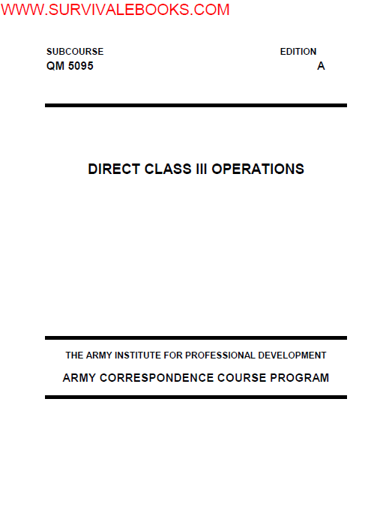

Slide 2
LESSON 1
SUPERVISE THE SELECTION AND PREPARE A CLASS III SITE
Critical Task:
101-519-3304

Slide 3
PART A - PREPARATION FOR MOVEMENT
Tactical Operations. As the petroleum section chief, you can expect to be either in the advance party or
main body during a movement operation. Since it is the advance party that does the actual on-the-ground site
selection, the majority of this block of instruction will be based on your role as a member of the advance party.
As a section chief, the first notice you would receive of an impending move would be a warning order from
your platoon leader. The warning order will probably be an oral order with general information on the time and
date of the move, information on the destination, and the probable route.

Slide 4
After you get the warning order, the platoon leader will probably leave the area and begin a route and site
reconnaissance of the area assigned to him by the battalion S3. While that is occurring, you should be
preparing to move. Information needs to be passed out to your section and equipment needs to be checked.
PMCS needs to be performed on your equipment, and if you have the time, all of your equipment needs to be
laid out and checked for serviceability before it is loaded into the vehicles.

Slide 5
When the platoon leader returns, he should have a sketch map of the route and the site. The
map/diagram should show the route to the site and the general location where each section will set up. If at all
possible, the site should be as close to supported units as the tactical situation permits. The site should also
be large enough to provide for two balanced storage sites because you do not want to put all of your product in
one location. By splitting your storage assets, you reduce the possibility of losing all of your product to one
accident or attack. The site should also have easy access to road nets with at least one road running through
the supply point, but never near populated areas. These conditions should be discussed with the platoon
leader prior to you leaving with the advance party because you will be the one making the final site selection
from the area allocated to you by the platoon leader

Slide 6
Advance Party. The platoon leader will make the personnel selection for the advance party. The advance
party should consist of at least one member from each section of the company. The XO or senior lieutenant is
usually the advance party leader. Your local SOP should detail what equipment should go with the advance
party, but at the very least, you will want to bring some engineer tape and marking devices to mark off the
areas where you want the equipment to go.

Slide 7
Designated Area. Once you have identified exactly where you want each operation to go, designate the
areas with engineer tape and signs. When the main body arrives, you or your representative should
personally escort each truck to its designated area.

Slide 8
PART B - PLANNING AND ENGINEER SUPPORT
Planning. Before you begin to move the Class III and FSSP supply point, you must develop a plan. You will
need to make sure you have all your personnel and equipment on hand when you begin to move the supply
point. Find out how much time you have in which to prepare your crew and equipment for the move. There
are some tasks that should be taken care of before you move. These include surveying the area to which you
will be moving, coordinated with an engineer unit, and developing a flow plan.

Slide 9
Take an Area Survey. Go over the area where the supply point will be located. Decide where to place
the entire supply point. Choose an arrangement for the FSSP that fits the situation and the terrain. Also,
decide where you want the truck parking, bulk storage (50,000-gallon collapsible tanks), and bulk reduction
storage areas and other bulk reduction equipment.
Coordinate Engineer Support. When you go to look over an area for the first time, take a member of
an engineer unit with you. After you choose a site for each part of the supply point, you can give this
information to the engineers. With this information, the engineer unit can prepare individual tank sites, remove
underbrush from bulk reduction areas, clear truck parking areas, and build an improved road through the site
(if one is needed). If you do not have engineer support, your unit needs to prepare the site before you start
setting up the equipment at the new site.

Slide 10
Develop a Flow Plan. After you select the specific sites for the parts of the Class III supply point,
develop a flow plan so that you do not handle products and containers more than is needed. The flow plan
1-3
QM 5095
identifies steps which can be eliminated, combined, or changed to make the operation more efficient. It can
also show unnecessary delays in handling and transporting. When developing the plan, consider the location
of bulk storage, packaged product storage, bulk reduction, and can and drum cleaning areas. Also consider
the flow of traffic through the supply point. Only one-way traffic should be permitted in the supply point. Study
the area, and make up a flow plan before the supply point moves to the new location

Slide 11
PART C - SELECTION OF CLASS III SUPPLY POINT
Layout Design. Once the area has been declared safe for use by the advance party and communication
has been established with the main body, actual site selection begins. In determining the layout of the system,
you should use some of the factors the commander used in making his site selection such as:
•  Adequate space to provide storage space and truck parking requirements for both your vehicles and your
customer vehicles.
•  A good road net with at least one road running through your operations. A good road is not a trail. A good
road is one that will hold up under heavy traffic and will not turn into a mud trap when it rains.
•  Location is away from populated areas.
In addition to the above, you need to consider the following when you are making your selection:
•  Use vacated forward sites or existing facilities if possible. Many times you will be able to inherit a site that
was previously occupied by some other units. Usually they will leave behind many improvements such as
fighting positions or improvements to the existing road network that you will be able to use for your
operations

Slide 12
•  Avoid low areas so vapors do not get the chance to collect.
•  Use reasonably level ground with no more than a 3-degree incline on any surface. If you set up on a
larger incline, your storage tanks could roll when you start to fill them.
•  Do not set up upstream of troop concentrations. Spills and accidents could pollute their water supply.
•  Maximize use of cover and concealment. Often, many of the components of a Class III supply point can
be concealed inside a wooded area or along a tree line. Other components can be hardened with
sandbags.
•  Distance between each storage tank. Forty feet is recommended for safe operations; however, the
physical terrain features of the final site will dictate the actual distance between the tanks.
•  One-way traffic flow with checkpoints at the entry and exit points.
•  Different space requirements for bulk, retail, and packaged operations. The operating space to service
retail customers may not be the same as for bulk customers. Usually, you will need a much larger
operating space for your bulk customers than your retail customers,
•  Availability of other transportation modes. You should always try to take advantage of any rail loading
facilities or barge loading points whenever possible.

Slide 13
Site Selection. Select a reasonably level site that can hold container stacks. Choose a site with good
drainage so that water does not damage the containers. Avoid low areas because dangerous vapors collect in
them. Do not use an area with a cinder base or marshland and wasteland overlaid with peat; they are usually
damp. Use such areas only if no other site is available. Be sure the site has natural cover and concealment
and is large enough for future expansion. Do not locate near other areas of operation
(Figure 1-1). Stay at least 500 feet away for low-flash products and 200 feet for high-flash products. Your site
must be away from overhead electric lines so a broken wire cannot fall on the drums. Clear the site of all
underbrush that may get in the way or present a fire hazard. Spread sand, gravel, or similar material over
areas where you store containers. They help drain the area and provide a more stable base for the stocks.
Do not use ashes or cinders because they are corrosive. Build a dike at least 18 inches high around each
major storage division in which low-flash products are stored. This dike must be able to hold all the liquid in
the drums stored in the area and have a freeboard of at least 6 inches. Choose a site for at least two clearing
(incoming and outgoing) areas. These will be used to segregate incoming and outgoing mixed loads (railroad
cars or truckloads). Each area should have its own site. The sites should be located next to each other so
that the same personnel can operate both areas.

Slide 14
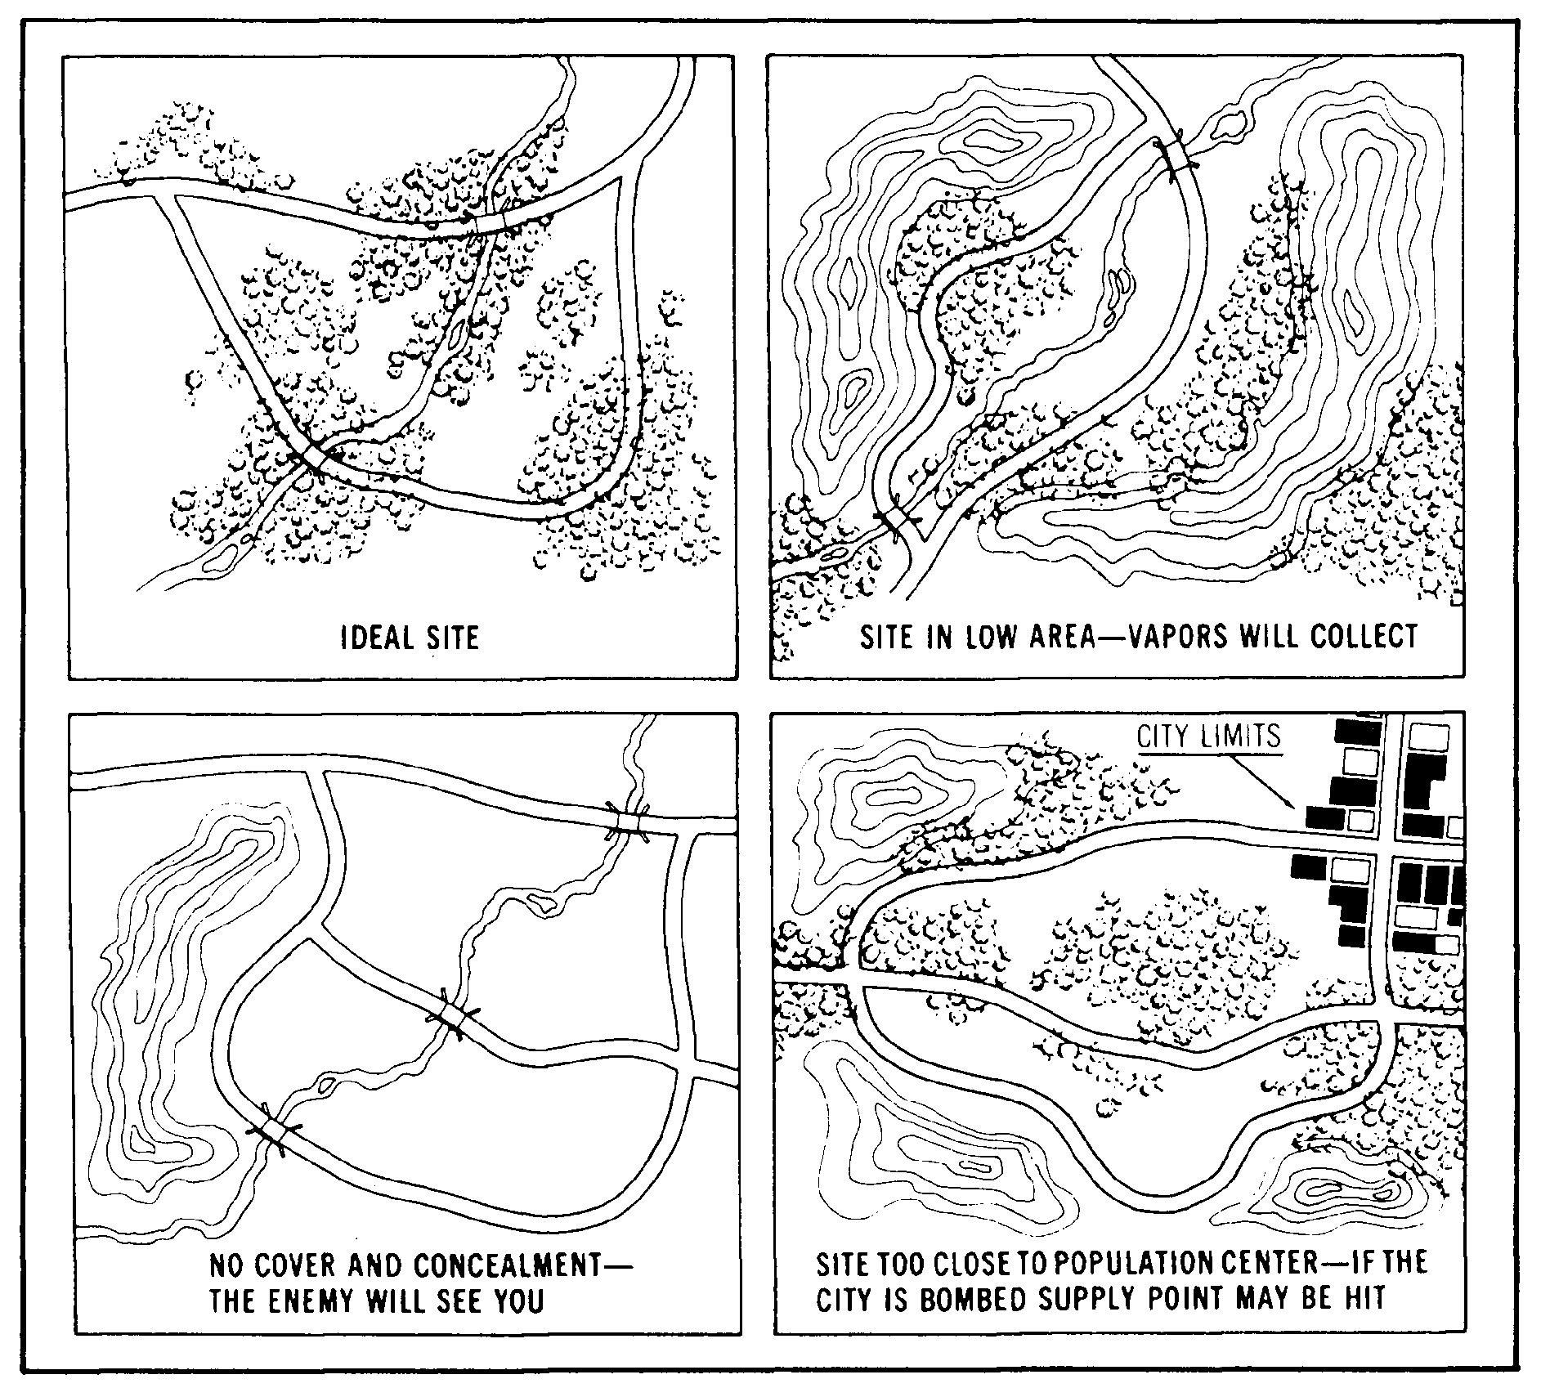

Slide 15
Selection Criteria for Equipment. You must also select a site for other equipment in the Class III
supply point. This equipment includes 20,000-gallon collapsible tanks, 50,000-gallon collapsible tanks, and
500-gallon collapsible drums.
The site you choose for the 20,000-gallon collapsible tanks should be similar to that for the 10,000-gallon
collapsible tanks. Choose a site that is nearly level with a gentle slope toward the manifold end of the tank.
Space the tanks about 150 feet apart. Build a fire wall around each tank. Make it large enough to hold the
contents of the tank and 1 foot of freeboard. To do this, build the fire wall 4 feet high and 18 inches wide at
the top, and make the inside dimensions of the fire wall 35 feet long and 31 feet wide. Maintain a distance of
4 feet from the edge of the tank to the base of the fire wall. If an engineer unit prepares the site, you must
ensure they follow these design factors. Place the discharge pumps at a level lower than the tanks to aid
pump suction.

Slide 16
Choose a site for the 50,000-gallon collapsible tanks that is similar to that for the 10,000- and 20,000-
gallon collapsible tanks. Build the fire wall 4 feet high and 18 inches wide at the top, and make the inside
dimensions of the fire wall 73 feet long and 33 feet wide. Place the discharge pumps at a level lower than the
tanks to aid pump suction.
For the 500-gallon collapsible drums, select a firm, level site near the source of supply. Select a site that
allows drums to be easily lined up for filling and rolled away after filling.

Slide 17
LESSON 2
SUPERVISE THE MOVEMENT OF A FUEL SYSTEM SUPPLY POINT (FSSP)
Critical Task:
101-519-3304

Slide 18
PART A - PLANNING THE MOVEMENT OF THE FSSP
The FSSP is used at distribution points to provide storage facilities for transferring bulk fuel from one means of
transport to another and at dispensing facilities for bulk reduction or delivery of fuel to using vehicles. The
FSSP can receive product from tank trucks, railway cars, pipelines, hoselines, and aircraft. Since it can also
receive fuel from ocean tankers, it is capable of supporting beach operations. It can store 60,000 gallons of
bulk petroleum. It can store even more if additional or larger collapsible tanks are added. However, this
expansion requires additional hoses, fittings, and valves. The FSSP can be easily moved from one location to
another, and it can be divided in half to handle two different types of fuels at two different locations. It can also
be changed to a 10-point, rapid-refueling system for rotary aircraft.

Slide 19
The first step in moving an FSSP is to receive the mission. Normally, as a section chief you receive the
mission from the platoon sergeant or even the platoon leader. The mission can come in one of three different
ways: a warning order, an operation order, or a fragmentary order. Once received, there are some questions
you need to ask yourself:
•  What is the mission?
•  What is known about the enemy?
•  How will the terrain affect the operation?
•  What troops are available?
•  How much time is available?
•  What supplies and equipment are needed?
•  What special tasks need to be assigned?

Slide 20
Personnel. Make sure that all personnel are on hand for the move to the new site. The usual strength level
of a supply section in a petroleum supply company consists of: section chief E7, petroleum heavy vehicle
operator E5, petroleum inventory control E5, two petroleum heavy vehicle operators E4, five petroleum supply
specialists E4, and ten petroleum supply specialists E3. In some situations, you will have to augment
personnel.

Slide 21
Equipment. Make sure your Class III supply point equipment is on hand and ready for use. If any items
are not working properly, try to have them repaired or replaced before you move. The equipment may vary
according to the situation.
•  One Fuel System Supply Point.
•  One collapsible fabric tank repair kit.
•  Three 500-gallon collapsible drums.
•  Three pressure controls for filling nonvented drums.
•  One 500-gallon collapsible drum tie-down kit.
•  One 500-gallon collapsible drum towing and lifting yoke.
•  Six 50,000-gallon collapsible tanks.
•  Four 20,000-gallon collapsible tanks.
•  Four 10,000-gallon collapsible tanks.
•  Ten 350-GPM pumping assemblies.
•  One fuel handling hose line outfit (assault hose line).
•  One electric floodlight.
•  One gas engine generator (3 kW).
•  Eight filter/separators.
•  One FARE system

Slide 22
Make sure you have the necessary vehicles needed to transport the equipment to the new site.
•  Four semitrailers, stake, 12-ton, with equipment.
•  Four tractor trucks and 5-ton, 6x6, long wheelbase, with equipment.
•  Two cargo trucks and 5-ton, 6x6, long wheelbase, with equipment.
•  Two cargo trailers, 1-1/2 ton, 2-wheel, with equipment.
Loading Plan. Next you must develop a loading plan, a tentative plan, and issue a warning order to give
soldiers time to prepare for the mission. Determine the total number and types of fuel transporters needed to
move the product on hand. Determine the type and number of transporters needed to move the system.
Determine the type and number of transporters needed to move personnel

Slide 23
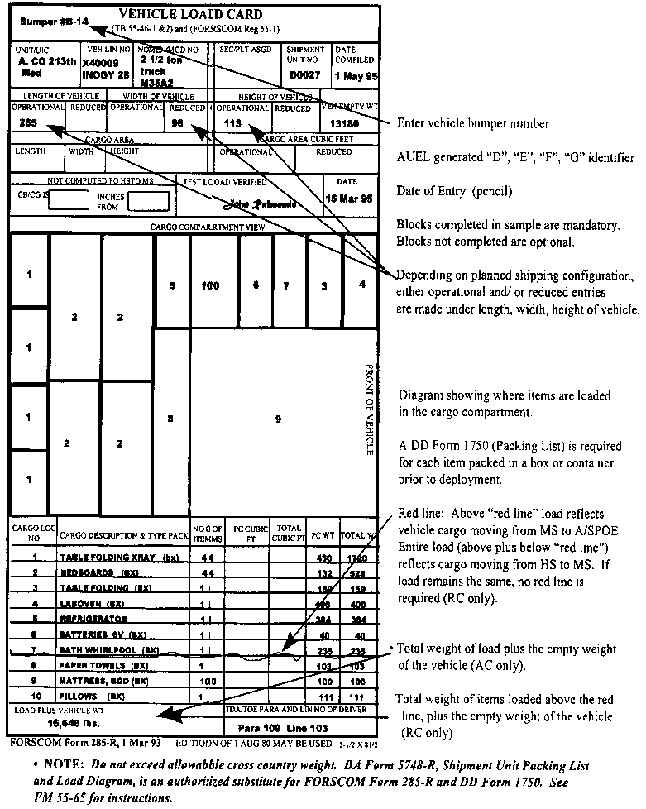

Slide 24
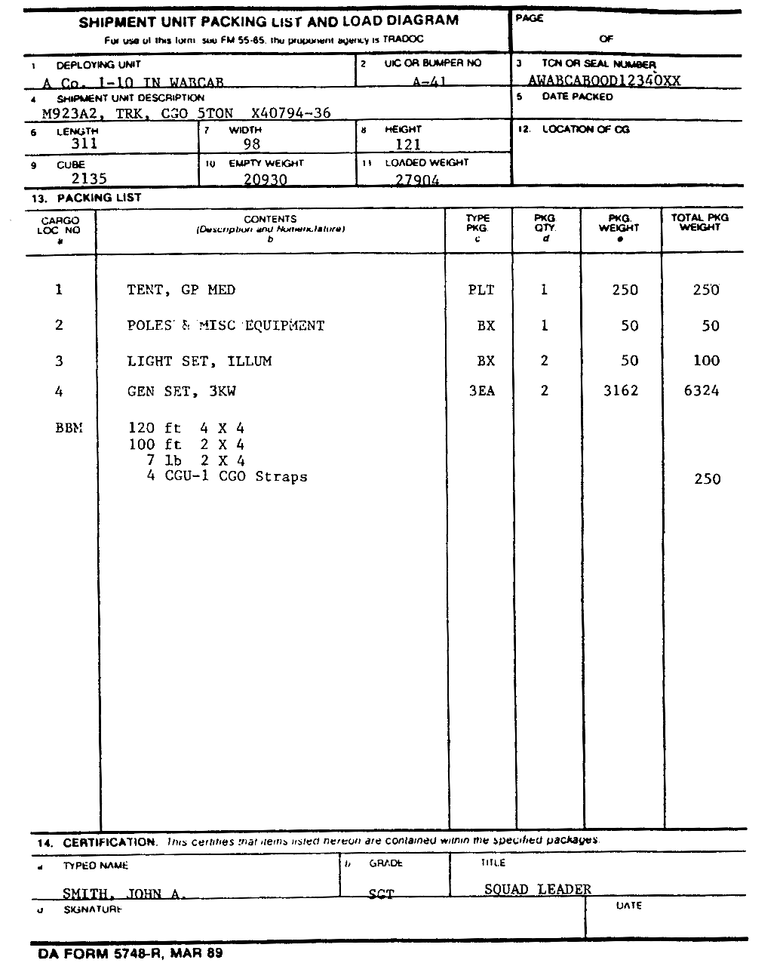

Slide 25
Your plans for loading personnel and equipment should apply to every type of transport that may be used
in a movement. Make the plan before the move to allow time for packing. Base your plan on the type of
transport to be used; the number of persons involved; and the type, size, weight, and quantity of supplies and
equipment to be moved. When preparing the plan, consider the priority of loading and the safety of equipment
and supplies in transit. Design the plan to permit quick and orderly unloading and regrouping of personnel and
equipment. Once the equipment is loaded, make sure it is properly secured and make sure the pumps are
braced, blocked, and tied.

Slide 26
Before you complete your plan, you need to have an idea where you will operate and what the terrain
looks like. Consult the latest intelligence map or, if possible, conduct a reconnaissance and walk around the
area. This will give you an idea about the type of terrain in which you will be working. Information from the
reconnaissance can either change or delay the mission

Slide 27
Once you complete your plan, issue an operation order. Once you complete the operation order, issue
your order orally. Whenever possible, issue the order from a location where your soldiers can see their
objective. If this cannot be done, use a terrain model or a sketch. When you issue the complete order, make
sure your soldiers understand it. Be sure they know how you expect to accomplish the mission and how they
fit into the overall plan. Explain to them what to do if you lose communication, and make sure you give the
order in language they understand. The final step in troop-leading procedures is supervision. After you issue
the warning order, you must diligently and constantly check details, conduct back briefs and rehearsals, and
before the operation begins, inspect. Troop-leading procedures help you prepare your soldiers for any type of
operation using logical step-by-step procedures. Use it as a mental checklist to make sure you do not
overlook anything important. Keep in mind that no single individual can do everything by himself or herself,
not even you. Use your subordinates and get the job done right.

Slide 28
Communications and Status Reports. The unit status report produces information to help the
Army manage its resources. The payoff is military readiness. The Army wants the company to have its
authorized personnel on board, its authorized equipment available in working order, and its required supplies
on hand. Additionally, the Army wants the company to do what it is supposed to do--turn out soldiers who
assist the unit mission.
The Petroleum Supply Sergeant assists the platoon sergeant by supervising two shift operations and
maintains close coordination with the petroleum operations sergeant. Every 24 hours the status report data
from the supply sections will be consolidated, and a report will be sent to the supply control section. The
format for the status report should be detailed in both the company and battalion SOPs.

Slide 29
PART B - SELECTING THE SITE FOR CLASS III SUPPLY POINT AND
FSSP OPERATION
Selection Criteria for FSSP. When you select the FSSP site, consider cover and concealment, road
nets, dispersion factors, terrain, and site preparation requirements. Make sure the site is suitable for the fuel
system layout (Figure 2-3, Figure 2-4, Table 2-1).
Select a site for the collapsible tanks, pumps, and filter/separators that is in the woods or in a tree line
where the natural shadows disguise the telltale shapes. Use camouflage nets if you have them. When you
lay hoseline, make use of natural terrain contours and vegetation to break up straight lines. One way to do
this is to cut branches, stick them in the earth under the hose, and then weigh them down with the hoseline.
Where you have deep grass or other vegetation, bend it over the hoseline to hide the hose so that it is not
seen from the air.

Slide 30
seen from the air.
Choose a site for the receiving, truck bottom loading, and vehicle refueling points that is next to a road in
the Class III supply point. You can then load or unload trucks and refuel vehicles without leaving the road nets
in the supply point.
You must consider the distance between items when you select the sites for the equipment in the FSSP.
The distances can vary with the terrain, natural cover, concealment, hose available, and road nets. However,
you must put the 10,000-gallon collapsible tanks at least 40 feet apart.
Select level terrain for the FSSP. Look for a tank site without slopes. A large slope may cause filled tanks
to roll sideways, backwards, or forward. Put the pumps and filter/separators on level ground. Try to place the
discharge pump at a lower level than the collapsible tanks so that there will be good suction to the pump

Slide 31
Deal with these three major items of equipment in the FSSP--the collapsible tanks, the pumps, and the
filter/separators. Slope the tank sites gently toward the manifold end to help drain the tanks when they are
removed. Slope the site for each tank no more than 3 to 6 inches in the direction of the tank’s fill port. Build a
fire wall around each tank. Make it large enough to hold the contents of the tank and 1 foot of freeboard. To
do this, build the fire wall 3 feet high and 18 inches wide at the top. Make the inside dimensions of the fire wall
26 feet by 26 feet and maintain a distance of 3 feet from the edge of the tank to the base of the fire wall. If an
engineer unit prepares the site, you must ensure they follow these dimensional and procedural specifications.
The pump and filter/separator sites must be cleared of any dry grass, leaves, and trash.

Slide 32
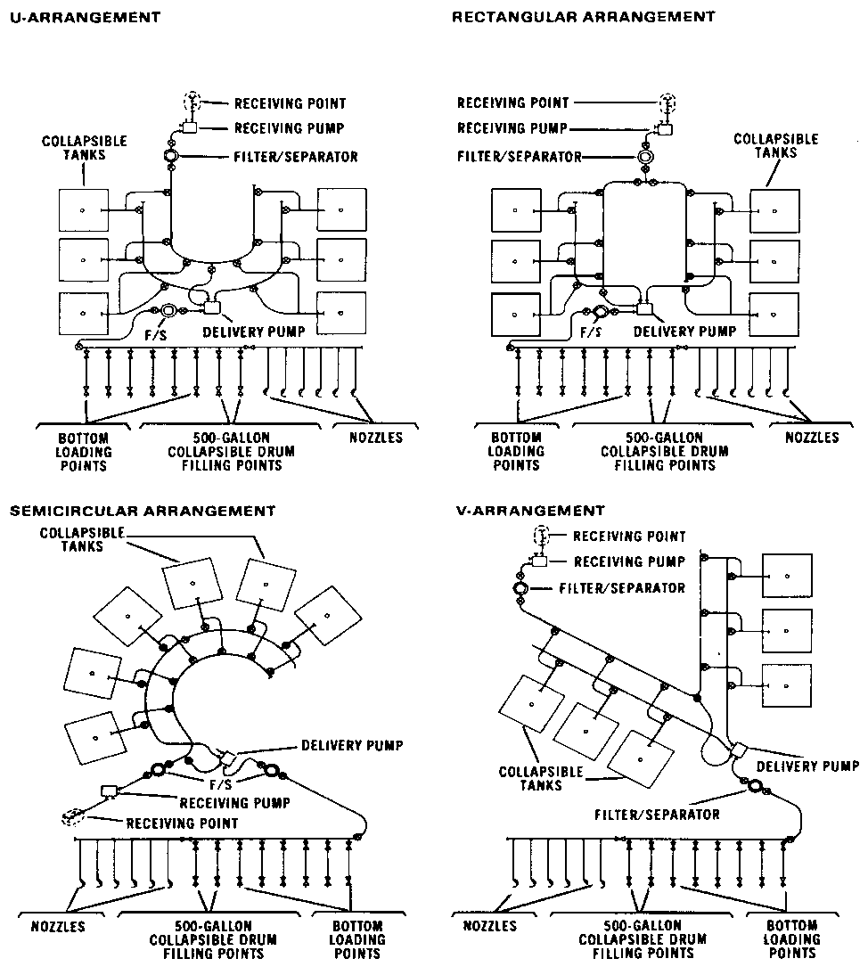

Slide 33
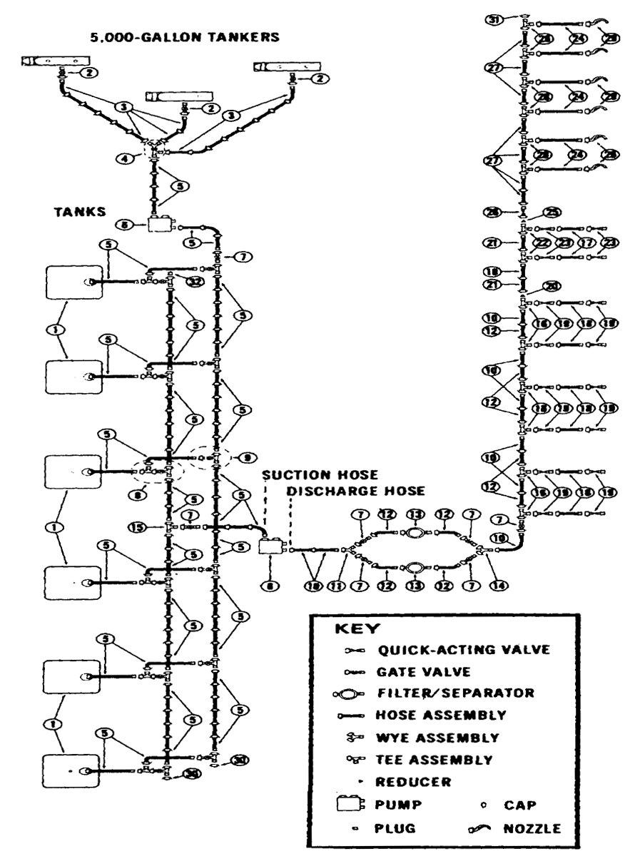

Slide 34
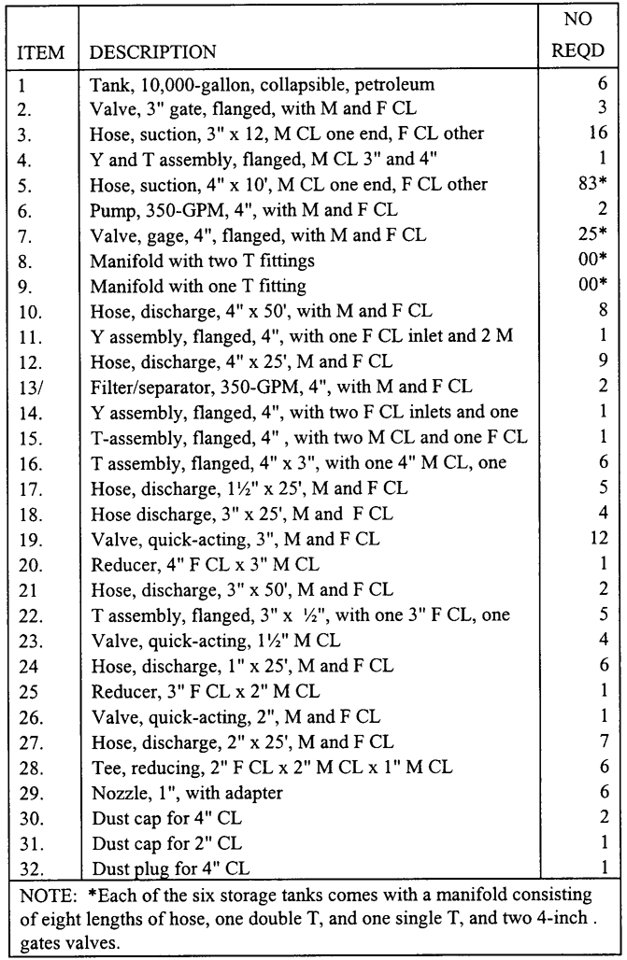

Slide 35
GPS Navigation. Each satellite transmits a unique signal that contains data needed by the SLGR to
determine your location. The signal cannot penetrate objects such as buildings, metal, mountains or very thick
vegetation, and your body tends to block it. Clouds, rain, snow and even severe weather have little effect on it.
Canvas and Kevlar covers do not effect it either. If you are not receiving signals from enough satellites, the
SLGR will tell you this.
Move to a more open position, away from buildings and steep slopes so the antenna can receive the
signals. Since the satellites are always moving, sometimes a short wait is needed until three or four satellites
have moved into the view of the receiver

Slide 36
•  Go to the SETUP UNITS page and set Elevation, MSL, DEG, MAG.
•  Go to the SETUP MAGVAR page and set CALC and DEG.
•  Set the time.
•  Perform the SETUP I/O if required.
•  Set the AUTOMARK Mode to OFF.
•  Set the BULLSEYE screen as required.
•  Set the OPERATOR ID if required.
•  Set the APPROACH if required.
•  Set the REHEARSAL if required.
•  Initialize the unit.
•  Obtain a position, record the Estimated Position Error, time, time error, date/day, speed, satellites being
tracked, datum, magnetic variation, and if required, the azimuth and range to the bullseye.
•  Enter and store waypoints.
•  Set the Navigation mode to 2D FAST and DIRECT.
•  Select a waypoint.
•  Record the distance, tracking azimuth, and azimuth to the waypoint.
•  Navigate to a waypoint.

Slide 37
PART C - SUPERVISING THE MOVEMENT OF THE FSSP
Your next task is to direct the preparation of the FSSP equipment for transport. Make sure the system is
drained of all product. Ensure that all spills are cleaned up and reported as required by unit policies and
procedures and applicable environmental laws. Dispose of contaminated fuel and materials in an
environmentally safe way in accordance with unit policies and procedures and applicable environmental laws.
Direct personnel to roll or fold all collapsible tanks and put them in their storage containers, attaches all caps
and plugs to the hose assemblies as they are dismantled. Make sure equipment is properly loaded and that
components are correctly placed, blocked, or braced as needed to prevent damage during transport.

Slide 38
Movement Methods. Moving (or displacing) the supply point consists of taking it down at one place,
loading it on transporters, and moving it to the new site. There are two ways you can do this, and the one you
use depends on your situation. One way is to move the entire supply point to the new site. The other way is
to move by leapfrogging. This means you move one-half of the FSSP to the new site and leave the other half
at the old site to give limited service. In this way, support to the user is not interrupted during the move.
Divide the system in half. The first thing you do when moving is to transfer product at the supply point to fuel
transporters. Tell the drivers of these vehicles how to get to the new site or to meeting points where they can
exchange trailers or transfer the load to other tank vehicles. You can also use these transporters to store and
issue product on a temporary basis at the old and new supply points. You can start to take down the supply
point just as soon as you move the fuel. The sequence in which you take down the equipment should be
based on the requirements at the old and new sites. Usually, you dismantle the FSSP first unless you are
using the leapfrogging method. In any case, it is important that you work quickly once the order is given. Your
main concern is to get to the new site as soon as possible and get set up.

Slide 39
Bulk Reduction Storage Area. Set up, in the bulk reduction storage area, a separate stocking area for
each product and type of package. If you have an area for each, you can inventory and control the stock more
easily, and you are not as likely to identify the product incorrectly. Use a block system to separate large
amounts of stored supplies so that the entire stock of one product is not lost if there is an enemy attack or a
fire. Plan the exact layout and size of the stacking area according to local conditions and safety requirements.
Aisles between double rows of drums (units) are usually 9 to 10 feet wide. You can reduce the width to 4 feet
if this leaves you enough room to handle the product. Allow 15 to 30 feet for aisles between sections of
containers and 50 to 150 feet between blocks. A specific layout of a stacking area for 5-gallon cans is
suggested.

Slide 40
PART D - ENVIRONMENTAL CONSIDERATIONS
Supply and storage facilities often contain HM. You must take precautions when storing and transporting
these materials. Keep a copy of the applicable MSDS for each HM on hand in a binder in the storage area.
You can support your installation’s environmental goals in supply areas by doing the following:
•  Compliance. Store materials according to the manufacturer’s guidelines, as stated on the MSDS.
•  Prevention. Reduce the amount of solid wastes and HW in the supply room by avoiding stockpiling or
keeping items around “just in case they are needed.” Reuse containers whenever possible. Recycle
materials as required by your installation’s recycling program.
•  Conservation. Dispose of all solid wastes and HW according to local policy.

Slide 41
LESSON 3
SUPERVISE THE OPERATION OF THE FSSP
Critical Task:
101-519-3304

Slide 42
PART A - SUPERVISING THE OPERATION OF THE FSSP
Flow Through the FSSP. Inspect the fuel when it arrives. The product then enters the system through
the receiving manifold. It usually moves under suction from one of the 350-GPM pumps used as a receiving
pump. The product may also move under positive pressure from a transporter, pipeline, or hoseline. When
you have both filter/separators installed on the delivery side of the system, the receiving pump distributes the
product directly to the tanks through the hoseline manifold. The other 350-GPM pump is used to draw fuel
from the tanks and discharge it through the two filter/separators into the hose header system. When you
leave one filter/separator installed on the receiving side of the system, the receiving pump distributes the
product to the receiving filter/separator and then to the collapsible tanks. After that, the flow of product is the
same, except the fuel is drawn through only one filter/separator on the discharge side of the system instead of
two. You can also draw from the supply source directly to the discharge side of the system. This procedure
bypasses the storage tanks. You need only one pump and one filter/separator for this operation.

Slide 43
Flow Through the 50,000-Gallon Collapsible Tank. The first step is the inspection of the
product. The fuel then enters from the transporter through a receiving manifold made up of a suction hose
and gate valve. The product usually moves under suction from a 350-GPM pumping assembly that distributes
it into the 50,000-gallon collapsible tank. Another 350-GPM pumping assembly acts as a discharge pump and
distributes the fuel from the tank to the discharge hose assembly. The discharge hose assembly consists of a
gate valve and discharge hose. From the discharge hose assembly, the product moves into a transporter
(Figure 3-1).

Slide 44
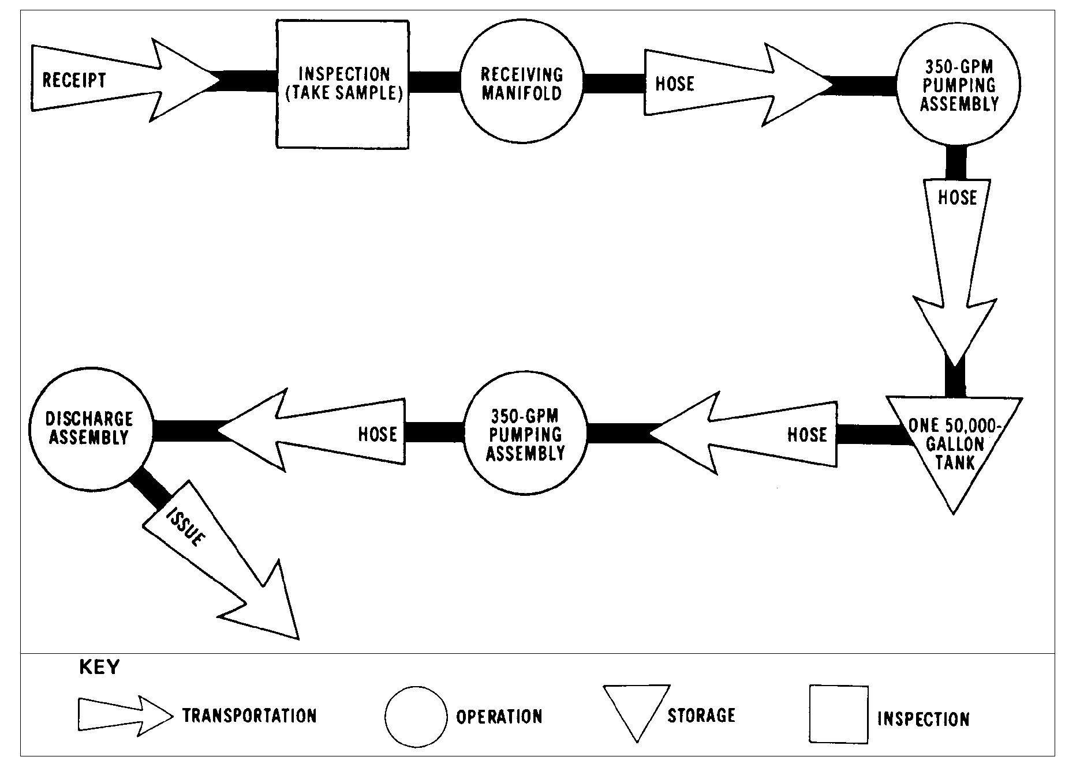

Slide 45
Personnel. How you use your personnel is one of the most important parts of managing a Class III supply
point. In other words, how many do you need for a specific operation? Where should you place them in
relation to the equipment? What tasks should you give them to do? It is important that you assign specific
tasks to your personnel at the Class III supply point, but you should also try to be flexible. The best way to use

Slide 46
all of your personnel wisely is to let the job determine the assignment. For example, if you have no issues
scheduled for the FSSP, you can use the workers assigned there to improve the fire walls around the
collapsible tanks. There may be a time when the supply point, or a section of it, is not busy. You may then
use your workers to improve the camouflage and concealment of the area, improve drainage ditches and
roadways, make sure the safety equipment is serviceable, and do operator and organizational maintenance on
the equipment in the supply point. Although the number of persons you assign to a specific task may vary
greatly with your mission, it is still possible to obtain an average number for each operation.

Slide 47
FSSP Operations. For a single shift, you need eight workers to operate the FSSP efficiently. Place them
at certain strategic points in the operation as described below.
•  Receiving Side. Assign two workers to the receiving manifold. Make them responsible for transferring
bulk petroleum from the transporter to the fuel system. They operate all valves at the receiving point and
make all necessary hose connections.
•  Pumps and Valves. Assign three workers to the pumps and control valves. Have one worker operate
each pump, and have the third worker control the valves on the discharge and receiving manifold of the
collapsible tanks. Once the pumps are started, they can be monitored by one worker. This enables two
workers to devote their full time to valve control and fuel flow problems.
•  Dispensing Side. Assign three workers to the delivery side of the system (six 5-gallon can and 55-gallon
drum filling points and two 500-gallon collapsible drum filling points). Make them responsible for
dispensing petroleum and controlling the flow. They prepare the various filling points, operate the control
valves, and make all necessary hose connections. When tank vehicles are filled, have the truck driver
help dispense the fuel.

Slide 48
The 50,000-Gallon Collapsible Tank Operations. For a single shift, you need four workers to
operate one 50,000 gallon collapsible tank. You generally have one 50,000-gallon collapsible tank, two 350-
GPM pumping assemblies (one receiving and one discharge pump), and one dispensing line. In the Class III
supply point, you use the 50,000-gallon collapsible tank mainly for large volume distribution of bulk petroleum.
Place the workers as follows.
•  Place one worker at the receiving point. Make this worker responsible for transferring bulk petroleum from
the transporter to the tank. Have the worker operate the valves and make all necessary hose
connections.
•  Place one worker at each of the two 350-GPM pumping assemblies. Make each worker responsible for
coordinating the flow of petroleum.
•  Place one worker at the dispensing line. Make this worker responsible for issuing bulk petroleum and
controlling the fuel flow in the dispensing line.

Slide 49
The 500-Gallon Collapsible Drum Filling Operations. You need only two workers to do this job
efficiently. However, there are several methods of filling 500-gallon collapsible drums. Two of the most
commonly used methods are to fill the drums directly from the FSSP or to use the 50-GPM pumping
assembly. The positioning and the tasking of the crew vary with each of these methods. When drums are
filled directly from the FSSP, assign one worker to control the valves of the filling point. Make this worker
responsible for controlling the flow of petroleum to the drums. Assign the other worker to the drums. Make
this worker responsible for preparing the drums for filling, making all connections, and monitoring the filling
operation. When the 50-GPM pumping assembly is used, you still need two workers for the filling operation.
Have one worker operate the 50-GPM pumping assembly and control the flow of petroleum. Assign the other
to the drums with the same responsibility as in the method described before. For both methods, you need a
vehicle to remove the filled drums to the bulk reduction storage are

Slide 50
The 55-Gallon Drum Filling Operations. Although you usually fill 55-gallon drums directly from the
FSSP, you can also use the 50-GPM pumping assembly with the hose and fitting kit. When you use six fueland
oil-servicing nozzles on the FSSP, you need 1 workers at each nozzle. You also need two workers to
bring empty drums to the filling points and two workers to remove filled drums to the bulk reduction storage
area. Make the six workers at the servicing nozzles responsible for bonding the nozzles to the containers and
filling the drums to the proper level. If you have a forklift, use it to move the filled drums to the storage area.

Slide 51
The 5-Gallon Can Filling Operations. There are two methods of filling 5-gallon cans. You can use
the fuel- and oil-servicing nozzles at the FSSP or the 50-GPM pumping assembly with the hose and fitting kit.
The number of workers you need to fill the cans varies with the method you use. When the cans are filled
directly from the FSSP, the operation is essentially the same as for the 55-gallon drum. When the cans are
filled using the 50-GPM pumping assembly with the hose and fitting kit, you need seven workers. Because
this method is usually conducted near the bulk reduction storage area, you need only one worker to bring
empty cans and one to remove the filled ones. Also, have one worker operate the 50-GPM pumping
assembly and control the flow of petroleum. Place one worker at each of the four dispensing nozzles of the
hose and fitting kit. Have them bond the nozzles to the cans and fill them to their proper level.

Slide 52
Receipt. Before a product arrives, you should be notified of the type and amount of product and the
approximate date and time it will arrive. This will give you time to prepare a delivery schedule to avoid delays
and interruptions at a Class III supply point.
Storage. At the tactical Class III supply point, you should always store bulk petroleum in collapsible tanks.
If you are in a supply section of a petroleum supply company, you can store up to 420,000 gallons of bulk
petroleum (120,000 gallons in the FSSP and 300,000 gallons in the six 50,000 gallon collapsible tanks.) But
storage is much more than putting product in a tank. It involves such things as inspections, product
circulation, tank repair, and even the disposal of excess product. The storage of bulk petroleum can be as
dangerous as its receipt and issue, so always follow applicable procedures.

Slide 53
Inspection. Inspections are the key to finding out how well your Class III supply point is performing. They
give you firsthand information on how the equipment and products are maintained from day to day.
Inspections let you make on-the-spot corrections. They also give you information on the availability of required
publications, accuracy of supply records and procedures, supply economy practices, care of tools and
equipment, and status of authorized stock levels of equipment and repair parts.

Slide 54
Product Consolidation and Circulation. When you consolidate or circulate product, you simply
move it from one storage tank in the supply point to another. You should consolidate your stock so that
several storage tanks are filled with product and several are empty. This way you can be ready to receive and
issue large quantities of bulk petroleum on short notice. You also cut down on the number of tank switches
you have to make during receipt and issue. Circulate the stock in your supply point so that the heavier
portions of the product do not settle to the bottom of the tank and the light ends do not come to the top. Also,
circulation ensures a good mixture of all the additives in the fuel.

Slide 55
Disposal of Excess. If you are in CONUS or an overseas activity and you have an excess in bulk or
packaged fuels of 500 gallons or more per product grade, report the excess by sending a message to the
Commander, USAPC. Include in your message the quantity, type of product, NSN, and the latest laboratory
test results. If you are in an overseas command, also report the excess to the appropriate DFSC field office or
the JPO.

Slide 56
Issue Considerations. Issuing bulk petroleum is perhaps the most important responsibility you have at
the Class III supply point. The reason you are in the field is to get large quantities of petroleum to the units
you support. In the theater of operations, you issue liquid petroleum in bulk as far forward as the tactical
situation permits. Usually the units you support pick up the bulk petroleum from the supply point in their own
vehicles. When you use the FSSP, make your bulk issues from the bottom loading points. Before issuing
bulk petroleum from your Class III supply point, preferably before any transporters arrive, you must prepare an
issue schedule. Start by telling your customer how much and what type of product you have on hand and
when he can pick it up. If your transporters are delivering the product, tell the customer when it will arrive at
his supply point. Try to avoid delays and interruptions when you are scheduling issues; that is, do not
schedule more transporters to arrive at your supply point than you can handle at one time. Also, ensure that
you have enough product on hand to fill all scheduled issues.

Slide 57
Safety and Security Items. Once your supply point is set up, you must take steps to make sure it is
safe and secure. Set up a checkpoint at the entrance and one at the exit of the operating area. Give
personnel coming to the area a safety briefing at the entrance checkpoint. Use the checkpoints not only to
3-5
QM 5095
control the vehicles going in and out, but also to account for the receipt and issue of petroleum in the supply
point. Develop a fire plan. You must set up many different types of signs in the area of operation. Place
stock locator signs at petroleum storage areas, including bulk reduction storage sites. Place signs identifying
NO SMOKING areas and dangerous areas throughout the supply point. You must also set up speed control
and traffic direction signs

Slide 58
PART B - DEFENSE PLAN
Rear Area Protection (RAP). Rear area protection operations may be defined as all actions taken to
prevent or neutralize localized enemy threats to units, activities, and installations in the rear area. It includes
area damage control (ADC) prevention and control measures which are taken before, during, and after an
attack or natural disaster to minimize its effects. Together, these actions represent an added dimension to the
responsibilities of theater army area command (TAACOM), corps support command (COSCOM), and division
support command (DISCOM) commanders. Thus, combat service support units may have to be diverted
temporarily from their primary missions to rear area protection tasks such as local security, base defense, fire
fighting, decontamination, emergency medical treatment, and traffic control. The commander responsible for
rear area protection operations determines the manner and extent to which these units will be diverte

Slide 59
The theater army commander has overall responsibility for RAP operations within the COMMZ. In the
corps, the deputy corps commander is the RAP officer who directs the rear area battle. To assist these
individuals in defining and assigning RAP responsibilities, a rear area operations center (RAOC) is assigned to
each TAACOM, area support group, and corps. The RAOC’s mission is to plan, coordinate, advise, monitor,
and assist in directing the execution of the rear area battle. Petroleum units interface with the RAOC.
Phases. Rear area protection may be divided into two phases -- the preparation phase and the operational
phase.

Slide 60
The preparation phase includes preventative readiness measures taken before an enemy attack. These
operations range from the initial planning to the actual reconnaissance, surveillance, and counterintelligence
operations. Measures taken during this phase include establishing local security elements; organizing,
equipping, and training units specifically designed for these missions; assigning area responsibilities; and
establishing communications and warning systems. SOPs are written and rehearsed, and route patrolling and
convoy escorting are carried out

Slide 61
The operational phase includes measures taken during or after an attack or a natural disaster. These
actions begin when an incident occurs and include units sending reports to the commander concerned on the
nature and extent of the damage. These reports allow for necessary estimates and orders for establishing
route clearances and redirecting supply flow. Thus, interruption of support to combat forces is reduced.
Combat forces receive data in time to change priorities and tactical plans if needed. Fire prevention and fire
fighting actions are conducted. Salvage and search and recovery operations begin on order. Traffic and
personnel movement controls are established. If necessary, nuclear, biological, chemical (NBC)
decontamination is begun. Emergency supplies are distributed, and communications are reestablished.

Slide 62
Petroleum Group. The extent to which the petroleum group becomes involved in rear area protection is
prescribed by higher authority. The group and its units stand ready to participate in these operations as
directed. Consequently, the group security officer stays in close contact with the RAOC. The group security
officer also supervises development of petroleum group rear area protection plans and procedures. He
directs implementation of plans and procedures by subordinate elements.

Slide 63
Protection of Petroleum Supplies. Protective measures for petroleum supplies include special
packaging, proper storage, dispersion of supplies and installations protection against chemical contamination
and nuclear fallout, and maximum use of natural and artificial protective shelters or other shielding devices.
Every advantage is taken of natural cover and camouflage for pipelines located above ground. Underground
pipelines are used whenever possible. Embankments and underground storage facilities can be effectively
used to reduce blast damage. Dispersion of packaged supplies limits and keeps under control fires that start
as a result of a nuclear explosion. Care is taken to keep combustible materials to a minimum in and around
petroleum supply installations

Slide 64
Demolition. Demolition is a command responsibility. It is performed only as a last resort and only to
prevent supplies and equipment from falling into enemy hands. Except in emergencies, demolition is
QM 5095
3-6
performed only on orders from higher headquarters. Unless otherwise specified, petroleum stocks are
destroyed by burning.

Slide 65
PART C - ENVIRONMENTAL CONSIDERATIONS
Supply and storage facilities often contain HM. You must take precautions when storing and transporting
these materials. Keep a copy of the applicable MSDS for each HM on hand in a binder in the storage area.
You can support your installation’s environmental goals in supply areas by doing the following:
•  Compliance. Store materials according to the manufacturer’s guidelines, as stated on the MSDS.
•  Prevention. Reduce the amount of solid wastes and HW in the supply room by avoiding stockpiling or
keeping items around “just in case they are needed.” Reuse containers whenever possible. Recycle
materials as required by your installation’s recycling program.
•  Conservation. Dispose of all solid wastes and HW according to local policy.

Slide 66
PART D - PMCS
Emergency Tank Repair. If any of the collapsible tanks develop a leak, repair them at once with
emergency repair items (Figure 3-2 and Figure 3-3). There are two methods of repair: one uses sealing plugs
(Figure. 3-4) and one uses sealing clamps (Figure 3-5). The one you use depends on the size of the rupture.
Use a sealing plug if the hole in the tank is 3/8 of an inch or smaller. Use a sealing clamp if the hole is larger
than 3/8 of an inch. Whatever method you use, ensure you put on rubber gloves and the protective hood
before
starting the repair operation.

Slide 67
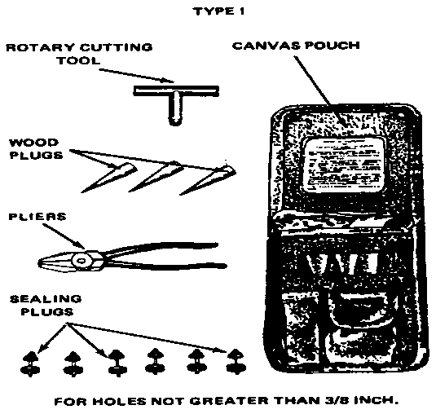

Slide 68
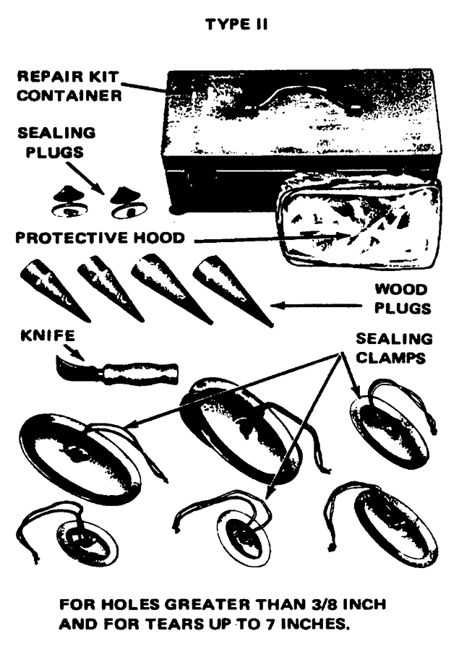

Slide 71
Forms. During operation of the FSSP, operator maintenance is performed on pumps, filter/separators, and
related equipment. Forms are prepared to schedule inspections and preventive maintenance and to record
the results of inspections and the need for repairs. They are also used to report preventative maintenance
performed, to note repairs made, and to request services of support maintenance. In addition, forms are used
to keep track of the time equipment is in use or out of service and to provide data for reports on the condition
and status of equipment.

Slide 72
•  DD Form 314 (Preventive Maintenance Schedule and Record) is used to show when equipment is
scheduled for periodic preventive maintenance and when maintenance has been performed.
•  DA Form 2404 (Equipment Maintenance and Inspection Worksheet) is used to report faults or
malfunctions discovered by an equipment operator.
•  DA Form 2407 (Maintenance Request) is used by organizational maintenance personnel mainly to request
support maintenance.
•  DA Form 2409 (Equipment Maintenance Log (Consolidated)) is used to keep a complete maintenance
history on a piece of equipment.
•  DA Form 4177 (Utilities Inspection and Service Record) is used to schedule inspections and preventive
maintenance on a fixed utility or structure such as a storage tank.

Slide 73
LESSON 4
DIRECT ASSAULT HOSELINE OPERATIONS
Critical Task:
101-519-3315

Slide 74
INTRODUCTION
The assault hoseline system is intended to be used as a temporary pipeline and can transport fuel at a
maximum rate of 500 to 550 barrels per hour across 10 miles of flat terrain. The use of the assault hoseline
for transportation of bulk petroleum has become increasingly important as an expedient means of providing
adequate quantities of bulk petroleum in the shortest time possible.

Slide 75
of bulk petroleum in the shortest time possible.
PART A - THE ASSAULT HOSELINE SYSTEM
Refer to FM 10-67-1 (Concepts and Equipment of Petroleum Operations), Chapter 27, for illustrations and a
more detailed description of the assault hoseline equipment. Six soldiers and the following equipment are
needed to lay out and assemble the hoseline:
•  Thirteen flaking boxes – The 4-inch, lightweight, collapsible rubber hose is packed into the flaking boxes
with 1,000 feet to a box.
•  One 350-gallon-per-minute (GPM) pumping assembly – The 350-GPM pump is equipped with a pressure
regulator that controls the idle of the pump and adjusts the pressure if there is a significant decrease in
pressure in the hoseline.
•  A flow control kit – The flow control kit consists of two 4-inch gate valves; one 4-inch T; two check valves;
two 4-inch hose assemblies; one strainer assembly; one roll of electrician’s tape; and couplings, nipples,
adapters, and coupling halves.

Slide 76
•  Ten steel roadway crossing guards – The roadway crossing guard must be installed to protect the
hoseline when it crosses a roadway.
•  A hose suspension kit – The hoseline suspension kit consists of 350 feet of wire rope, 350 feet of manila
rope, 25 wire-rope clips, 60 shackles, 60 hose saddles, 14 steel pickets, 4 steel blocks, 4 turnbuckles, and
4 wire-rope thimbles.
•  A hoseline displacement and evacuation kit – The hoseline displacement and evacuation kit consists of a
ball injector, a ball receiver, a displacement ball, an air eductor, 8 grooved couplings, and 16 pipe caps.
•  A hoseline packing kit – The hoseline packing kit consists of a chain hoist, a hose puller, two hose clamps,
and a metal storage chest.
•  A hose repair kit – The repair kit contains tools and materials needed to repair the hoseline system.

Slide 77
PART B - SAFETY AND ENVIRONMENTAL CONSIDERATIONS
Prior to the start of the mission, the troops must be briefed on any safety or environmental hazards they may
encounter. The briefing should include the proper response to such hazards and other information which will
enable them to correctly address less serious infractions independently. Each mission encompasses different
situations and unit interactions so you need to develop a mission-specific briefing for each; therefore no one
solution can or will be presented in this lesson. If your experience does not afford you a basis for preparing a
briefing, a supervisor should be contacted for additional information

Slide 78
PART C - SUPERVISING THE LAYOUT, ASSEMBLY, AND TESTING OF
THE ASSAULT HOSELINE
Choosing a Route. Select a direct route which is free of obstacles. If possible, try to parallel an existing
road to aid construction, operation, and security. A route parallel to a secondary all-weather road is better
than a heavily traveled main supply route. Take advantage of natural cover such as fencelines, woods, and
hedgerows. However, do not disturb the natural cover by grading or leveling. Try to avoid rocky areas which
might damage the hose.
It is possible to distribute the hose at speeds up to 35 MPH. However, the recommended maximum
speed is 20 MPH. As the hose is distributed, men spread out along the route (at least two each 1/4 mile),
walk the line to straighten out undesirable kinks or bends, and remove small obstructions which might cause
damage when the hose is pressurized. When distributed on a road, the hose must be picked up from the
roadway itself and moved to a position in the road ditch (Figure 4-1).

Slide 79
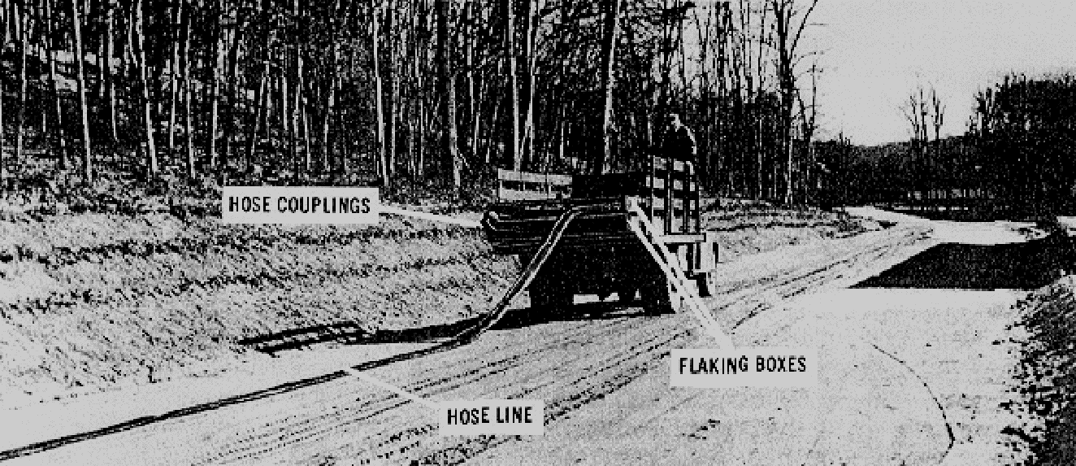

Slide 80
Crossing Streams. There are several ways you can lay the hoseline across a stream or water course. If
there is a bridge, suspend the hoseline on improvised brackets outside the bridge railing. If there is no bridge,
you may lay the hoseline directly in the streambed if it is narrow and not apt to flood. Use the hoseline
suspension kit to cross a wide stream. Fabric saddles, with eyes for easy wire attachment, come with the kit.
Crossing Gaps. You should also use the hoseline suspension kit to span small gaps with steep sides.
For a wide crossing, build a suspension bridge with a flat deck or floor to hold the hose. This eliminates the
sags that occur when the suspension kit is used.

Slide 81
Crossing Roads. To cross a highway or railroad, run the hoseline under a bridge or through a culvert, if
possible. You can pull the hoseline through the culvert with a rope or push it through with a piece of lumber or
a small-diameter pipe. If there is no bridge, install the roadway crossing guard to protect the hoseline. Never
bury unprotected hoseline in a railbed. When crossing a railbed, you can either install a piece of heavy wall
pipe in a shallow ditch under the rails or suspend the hose over the railbed at a suitable height. As soon as
possible, replace the hoseline at a railway crossing with welded pipeline because of the fire hazards caused by
trains.

Slide 82
Pumping Stations. Assault hoseline pumping stations have one 350-GPM pumping assembly. If you are
using only one hoseline outfit, place the pumping assembly at the beginning of the hoseline system. Because
this pump does not have a pressure-regulating device, you must monitor it at all times for changes in hoseline
pressure. You must set up pumping stations when you connect hoseline outfits together. There is a formula
you can use to locate pumping stations on level ground using motor gasoline in the hoseline. If you use a
product other than motor gasoline, the distance between pumping stations (given by this formula) changes.
For example, if you use a product heavier than motor gasoline, the pumping stations should be closer
together. if the product you use is lighter than motor gasoline, the pumping stations should be further apart.
The distance between pumping stations (given by this formula) also changes with the height of the terrain. For
example, if you place the hoseline on an uphill slope, the pumping stations should be closer together. If you
place the hoseline on a downhill slope, the pumping stations should be farther apart.

Slide 83
Hoseline Testing. Once you have set up the assault hoseline, fill it, pressurize it, and check the hoseline
for leaks. Start the pumps slowly and raise the fluid pressure in the system gradually in increments of 50 PSI.
Hold the pressure each time you raise it, and inspect the hoseline for leaks. Keep doing this up to and
including 150 PSI. Even though the design burst pressure of the hose is higher, your test should not exceed
the rated safe-working pressure of 150 PSI. If the line pressure does not build up, stop and check the
hoseline for a leak. You can usually fix leaks at couplings, fittings, or valves by tightening, adjusting, or
replacing gaskets.

Slide 84
Observe operations for safety and environmental infractions. Immediately shut down operations and
correct any problems detected.
PART D - SUPERVISING THE EVACUATION AND DISPLACEMENT OF
THE ASSAULT HOSELINE
Removing fuel, vapor, and air from the hoseline causes the hoseline to collapse into a flat ribbon-like form.
This allows for the most compact storage of the hose for transportation to the next site. The hoseline is
evacuated as follows:
•  Remove the ball from the ball receiver; replace it with an airtight cap (use a blank cap with grooved
coupling).
•  On the inlet end, disconnect the compressor hose from the ball injector.
•  Attach the suction connection of air eductor.
•  Attach the air compressor hose to the inlet side of the eductor, and set the pressure at 20 to 25 PSI.
•  Operate the eductor approximately 10 minutes for each 1,000 feet of hoseline.
•  When the hose has flattened as much as possible, fold it back and tie a knot.
•  Remove the ball injector and eductor.

Slide 85
When displacing the assault hoseline, pack the hose into the flaking box making successive folds from left to
right until you reach the front. Be sure to bend the hose so that it fills the entire width of the box. Also, make
sure the folds are packed tightly together so that you can get 1,000 feet of hose in the box. If the temperature
is below 40 degrees Fahrenheit, you may have to use the hoseline packing kit to get the hose in the flaking
box.

Slide 86
PART E - MAINTAINING COMMUNICATIONS
Communication breakdown is the single non-equipment-related item which can start a domino effect capable
of bringing an entire mission literally to a halt. A missed communication regarding the emergency shutdown of
the assault hoseline could leave an FSSP or FARE system without a source of fuel and strand dozens of
aircraft and vehicles miles from a secondary source of fuel. The vulnerability of such vehicles and the loss of
them to the enemy cannot be overstated. Accurate and timely communications with all levels of the supply
team and command headquarters is imperative for the success of any mission requiring the use of the FSSP,
FARE, and assault hoseline.

Slide 87
An efficient communication system is a must for the operation and maintenance of military pipelines. The
system must be separate, continuous, and dependable. The communications system must have high-quality
transmission to keep errors to a minimum, enough channels or circuits to carry the traffic load efficiently,
prompt connections to avoid delays, and immediate alternate systems so there will be no interruptions in
pipeline operations

Slide 88
LESSON 5
DIRECT THE ASSEMBLY, OPERATION, PMCS, AND DISASSEMBLY OF THE FORWARD AREA REFUELING
EQUIPMENT (FARE)
Critical Tasks:
101-519-3215
101-519-3317

Slide 89
INTRODUCTION
Unit-level refueling operations in theaters of operation are usually carried out by individual aviation units. A
lightweight, air-transportable, refueling system is used at the unit level. At present, the system authorized to
most units that have the mission to refuel aircraft in forward areas is the Forward Area Refueling Equipment
(FARE) system. This system can be set up by skilled personnel within 15 minutes of delivery to a site.
The FARE system is designed for refueling helicopters in forward areas. It is lightweight and can be flown
to the refueling point by helicopter or fixed wing aircraft. The fuel for the system is usually flown to the site in
500-gallon collapsible drums. The FARE system can also use various size collapsible tanks, tank vehicles, or
semitrailers as fuel source

Slide 90
PART A - FARE COMPONENTS
Components. The FARE system consists of a pumping assembly, filter/separator, and valves and fittings.
Pumping Assembly. The pumping assembly is made up of a 100 GPM centrifugal pump and a twocylinder,
four-cycle, 3-horsepower gasoline engine that powers the pump. The inlet and outlet connections are
2 inches in diameter. The pump has a priming port on the top of the pump casing. The pumping assembly
and the engine’s fuel tank are all housed in a tubular aluminum frame.
Filter/Separator. The 100 GPM filter/separator is an aluminum tank with a removable cover. Five filter
elements, each in a canister, are set in a mounting plate near the bottom of the tank. The filter/separator has
an air vent valve, a pressure differential indicator, a water sight glass, and a water drain valve that is turned by
hand. The flow rate of the filter/separator is 100-GPM, and its top working pressure is 75 PSI. The
filter/separator is mounted in a frame of tubular aluminum

Slide 91
Discharge Hose, Suction Hose, and Fittings. The FARE system has two sets of discharge hose, fittings,
and nozzles. Each set is mounted in a tubular frame. Two canvas carrying cases hold the suction hose and
their fittings.
Fire extinguishers are not components of the FARE system. Providing the extinguishers is a command
responsibility. Three fire extinguishers are required for each FARE system used in aircraft refueling--one to be
within reach of the pump operator and one for use at each nozzle. The recommended fire extinguisher is the
20-pound Halon 1211.
No fuel source is provided as a component of the FARE system. Generally, 500-gallon collapsible drums
are used because they can be airlifted, full, to the FARE point. But the FARE system can also be adapted to
use larger fuel reservoirs. The number of drums and tanks, as well as the type of fuel to be used, is
determined by the number and type of aircraft the FARE point is to suppor

Slide 92
PART B- FARE LAYOUT
Planning. The S3 of the aviation battalion or the operations officer of an aviation company plans the unit
operations. As part of these plans, he chooses the general area for a refueling point and specifies the amount
and type of refueling support needed. He or a pathfinder team must choose a site that has enough open
ground for the aircraft to land and lift off safely. The site must be flat or have only a slight grade. When
planning the layout of a FARE system, five factors must be considered.
•  Spacing Between Aircraft: There must be at least 100 feet of space between these aircraft (center rotor
to center rotor).
•  Wind Direction: Lay out the FARE system so that the helicopter can land, refuel, and take off into direct
head wind or a left or right quartering head wind.
•  Vapor Collection: The system should beat right angles to the wind for helicopter landing and takeoff,
allowing wind to carry the fuel vapors away from the site.
•  Drainage: Do not put the equipment in a place where a spill will drain into a stream or river. Choose a
part of the site that is firm enough to support the weight of the aircraft and the fuel drums.
•  Camouflage: Camouflage is the only protection at a FARE point in a combat zone. Site features are
depended upon because airlifting in camouflage materials is not practical

Slide 93
Site Preparation. All sticks, stones, and debris should be cleared from the area. To prevent fires, clear
dry grass, leaves, and brush away from the pumping assembly. In some cases, engineer personnel prepare
the site.
Layout. Once all equipment is on-site, lay out the FARE system in the way that is best for the specific
situation. Tailor the layout to avoid obstacles, take advantage of terrain features, achieve maximum
dispersion, and operate with a restricted amount of space. The only mandatory feature of the FARE system is
the spacing between the aircraft (Figure 5-1). The suggested sequence of setup is as follows.
•  Position pump and filter/separator.
•  Ground pump and filter/separator.
•  Assemble discharge hose.
•  Assemble dispensing points.
•  Connect to two 500-gallon collapsible drums.
•  Position fire extinguishers.

Slide 95
PART C - QUALITY SURVEILLANCE
The quality and cleanliness of turbine fuel are vital to the safety of turbine-engine-powered aircraft. Turbine
engines have more stringent cleanliness requirements than do reciprocating engines. Because turbine
engines have high fuel consumption rates, contaminants accumulate in them rapidly. Turbine engine filters
cannot remove fine sediment, excess amounts of sediment, or water from the fuel. Separating the
contaminants from JP-5 and JP-8 is time-consuming and further complicated by their high viscosity and
specific gravity. Any unit or organization that has military-owned aviation fuel in its physical possession is
responsible for establishing and maintaining an adequate quality surveillance program. Each person involved
in aircraft refueling is responsible for ensuring that the fuel pumped into an aircraft is clean, bright, on
specification, and does not contain any free water or sediment

Slide 96
Quality surveillance testing and sampling are used to find common contamination hazards. The hazards
that may affect aircraft are sediment, water, microbiological growth, and commingled fuel. Since each aircraft
engine is designed to burn one particular type and grade of fuel, the consequences of using a mixture of
QM 5095
5-4
different fuels can range from small variations in engine performance to total loss of power and engine failure.
The consequences of commingling depend on the physical properties of the fuel.

Slide 97
Sampling and Testing. How often aviation fuels are sampled and tested depends on several factors. It
depends upon whether the fuel is taken from a fuel source, a system or refueler, or an aircraft tank. Fuel
supplies must be tested to confirm their identities (API gravity test) and detect water (Aqua-Glo test) and
particulate contaminant by color comparator ratings. Samples of fuel to be dispensed to aircraft should
contain no more than 10 fibers when a 1-quart sample is visually examined. The aviation fuel contamination
test kit is designed to provide a final check on aviation fuel just before the fueling of an aircraft. It includes the
API gravity test, the Aqua-Glo test, and the Millipore test (a test for particulate contaminants). Fuel in aircraft
tanks must be checked by the aircraft crew before flight operations begin. Taking a preflight sample is the
only way of ensuring that the fuel on board does not contain water or other visible contaminants. Any fuel that
fails a visual check should be segregated and held until laboratory test results are received. To check a fuel,
choose a clean sample bottle, draw a fresh sample, visually inspect it, and test it for debris, foreign matter, or
water. Laboratory testing ensures that the fuel’s quality meets specifications, unknown products and existing
or potential contaminating causes are identified, unfavorable field test results are corroborated, and offspecification
fuels are not used.

Slide 98
PART D - MAINTAINING COMMUNICATIONS
Communication is the single non-equipment-related item that can enable the FARE site to be a major factor in
the successful mission. This communication is multilevel. Unless otherwise directed, you are responsible for
informing the chain of command of the following:
•  When the site becomes operational.
•  When the site is shut down for any reason before the scheduled shutdown time.
•  Report status of operations and any problems encountered as required by unit policy and procedures.
•  When the site is shut down as indicated in the operations orders.

Slide 99
site is shut down as indicated in the operations orders.
PART E - SUPERVISING THE OPERATION OF THE FARE
The FARE system should be primed and ready for operation as soon as it is laid out and the fuel has been
sampled. There should be at least three people in addition to the ATC or pathfinder present during refueling
operations. At least two of these people should hold MOS 77F. The proper procedures for the refueling of
aircraft are as follows:

Slide 100
•  Land aircraft. Check to see that the armaments aboard the aircraft have been set to SAFE.
•  Deplane crew and passengers. Only the pilot may remain in the aircraft during refueling. If required, a
crew member may assist with the refueling by manning the fire extinguisher.
•  Position fire extinguisher on the side of the aircraft by the fill port.
•  Turn off radios. The pilot may monitor the radio used for air traffic control, but must not transmit while
actual refueling is taking place. The pilot and crew chief may talk by intercom during refueling.
•  Ground and bound the nozzle to the aircraft. It should never be attached to the radio antenna or to a
propeller.
•  Remove dust cap from the nozzle, and remove the plug from the aircraft fill port.
•  Begin refueling. Be certain to observe the safety precautions associated with closed-circuit or open-port
refueling, as the case may be.
•  Replace aircraft fill port plug, and replace nozzle caps/plugs.
•  Remove nozzle bond. Carry the nozzle back to its hanger.
•  Remove fire extinguisher.
•  Board crew and passengers.
•  Direct aircraft to lift-off.

Slide 101
Additionally, you are required to monitor fuel stocks and accountability procedures and render status reports
as required by unit policy. If any leaks or hazardous conditions are found the system must be shut down and
the problem corrected before resuming operations. All spills must be cleaned up and reported as required by
unit policies and procedures and applicable environmental laws. Dispose of contaminated fuel and materials
in an environmentally safe way in accordance with unit policies and procedures and applicable environmental
laws. You must also ensure that during and after PMCS are done and that DA Form 2404 or DA Form 5988-E
5-5
QM 5095
(Equipment Inspection Maintenance Worksheet) is annotated with any faults or deficiencies found. The
completed DA Form 2404 or DA Form 5988-E is returned to the motor pool with the equipment

Slide 102
PART F - SAFETY
Switch Fueling. Switch fueling means supplying an aircraft with fuel that has flammability characteristics
different from that which is already in the tank. The flammability characteristics of the mixed fuel will be
different from the two fuels involved. The danger is that if a spark should occur in the tank, the vapor-air
mixture above the fuel may be in the flammable range and an explosion could result. If an aircraft is to be
switch fueled, the rate of flow at the nozzle should not exceed 50 percent of the rated flow. Changing to JP-4
after using a kerosene-grade fuel also constitutes switch fueling.

Slide 103
Heat. Aircraft, vehicles, and engine-powered equipment generate heat by burning fuel. They also generate
static electricity because of friction between moving parts. The engine heat of an idling aircraft turbine engine
is in the auto-ignition range of JP-4. Poorly maintained vehicle engines may backfire or discharge sparks. Do
not allow any work to be done on an aircraft’s batteries while the aircraft is being refueled. Aircraft radios may
operate to receive messages during refueling, but radio transmissions from the aircraft are not allowed
because of the danger from arcing. Do not use flashlights within 50 feet of the refueling operation unless they
are approved explosion-proof type. Do not allow electric handtools to be used in the refueling area. The
electric circuits of tools used in refueling operations must be maintained in top condition to prevent short
circuits around defects. And in addition, the beam of high-frequency radar equipment can ignite a flammable
vapor-air mixture.

Slide 104
Open Flame. The danger of an open flame is that it will ignite fuel or a flammable vapor-air mixture. Do
not allow any type of open flame, or any flame-producing device within 50 feet of an aircraft refueling
operation.
Static Electricity. There are two ways to prevent static electricity from sparking. The charges on different
materials can be equalized by connecting them with a conductor (bonding). Also, a way can be provided for
the charges to dissipate harmlessly (grounding). The Army uses both of these methods to control static
electricity.
Bonding is the process through which two conductive objects are connected to lessen their potential
differences. Bonding does not dissipate the static electricity. It equalizes the charges on two unlike objects
(an aircraft and a refueling nozzle) in order to preclude arcing as the two objects are joined. A nozzle-toaircraft
bond is required. This bond is made before the nozzle dust cap or fuel tank cap is removed. Likewise,
do not disconnect the bond until refueling is complete and the fuel tank cap and nozzle dust cap are replac

Slide 105
Grounding is the process that provides a conductive path into the ground so that a static charge is not
trapped on the surface of the equipment where it can discharge as a spark. This conductive path is made by
connecting a conductive cable from the piece of equipment to a conductive metal rod that is driven into the
earth to reach the level of permanent moisture. Common sources of static electricity are identified as follows:
•  Vehicles.
•  Human body.
•  Lightning.

Slide 106
Air Traffic Control. Air traffic control (ATC) is required for safe refueling operations. An air traffic
controller or some other adequately trained person is required at each refueling point that serves more than
one aircraft. This person controls and directs refueling traffic and resupply aircraft. He provides flight
personnel with information such as wind direction and velocity, remaining fuel supply, enemy activity in the
immediate area, hazards or obstructions to landing, and emergency situations. At a fixed airfield, full radio
communication equipment is provided for controlling air traffic. At a large semipermanent or temporary
refueling point a radio control tower should be used whenever aircraft are being refueled. In forward areas,
personnel controlling air traffic should have an FM radio suitable for ground-to-air or ground-to-ground
communication. Aircraft marshaling signals and landing aids are necessary at semipermanent and forward
refueling points. In marking landing and refueling areas in the field, procedural principles should be followed
closely, especially in forward tactical areas.

Slide 107
PART G - ENVIRONMENTAL CONSIDERATIONS
You must pay close attention during refueling operations because of the potential for spills and fires. If you
take simple precautions you will prevent large pollution problems. During refueling you can protect the
environment by doing the following:
•  Compliance. Follow your unit SOP concerning the types and quantities of items you can store at a fuel
point.
•  Prevention. Reduce the amount of soil contaminated during refueling by being careful not to spill fuel.
Reuse rags and absorbent materials. Recycle used or contaminated petroleum, oil, and lubricant (POL)
products.
•  Conservation. Dispose of contaminated soil and absorbents according to the installation’s policy and the
unit’s SOP

