Slide 2
John B. Wiggins, district sales manager for Forrester Products, hurried
through the train gates at Central City and boarded a waiting passenger
train to Criner. To express it mildly, Mr. Wiggins was not in the best of
humor. Arising late and being forced to skip his usual substantial
breakfast had started it off. Then having to leave his cab in a traffic jam
and practically run the last block to the station had not helped to improve
his frame of mind.

Slide 3
As Mr. Wiggins selected a seat near the front of a coach, the train
started to move. He opened his morning paper and glanced at the headlines,
but his thoughts soon strayed from them. The weekly sales meeting to which
he was going, a trip which he contemplated with no particular relish, was on
his mind. He hadn't quite met his monthly sales quota, and he could almost
hear the highpressure
lecture he was certain to receive. Could he help it
if his district was in its normal seasonal slump? Another thing, why didn't
his expense account allow for a plane trip to the home office instead of
this slow train ride?

Slide 4
An hour later, at a point halfway to Criner, a jerking motion told him
that the train was stopping. Looking out a window, he was mildly surprised
to see that the stop was far out in the country away from any town or
station. Mr. Wiggins fussed, "Why couldn't the railroad confine its stops
to those listed in the timetable?" He saw the conductor alight almost
before they had completely stopped,
and in some 3 or 4 minutes return to
the coach. Then the conductor pulled
a bell cord to signal the engineer to
start moving. Mr. Wiggins noticed,
after the train progressed a few
yards, a square twostory
building
bearing the sign "VO Tower." He
wondered idly whether they had
stopped for the conductor to make a
phone call or to transact some other
routine business.

Slide 5
Once under way, the train soon reached maximum speed, but in a few
minutes started to slow down once more. Now what? Soon the coach lurched;
the train was changing tracks. Now Mr. Wiggins became alertand
concernedeven
though he knew nothing about the technical side of
railroading. But he had made this trip often enough to know that westbound
trains always traveled on the righthand
track, and the track they were now
entering was always reserved for trains running in the opposite direction.
Why, this didn't make sense! Suppose another train were approaching in the
opposite direction and there was a headon
collision! This was terrible.

Slide 6
Mr. Wiggins soon noticed the reason for changing tracks, but this, in
itself, was scarcely reassuring. A long freight train, apparently stopped,
was on the track they had just left. Even so, how did the engineer know it
was safe to proceed at such speed? Had someone been told to keep the track
they were now on clear? Suppose he forgot? Why, it was almost like a
motorist speeding the wrong way down a oneway
street! But soon the
passenger train passed the head end of the halted freight, reduced its
speed, and crossed back to its original track. Mr. Wiggins breathed easier,
but he still wondered.

Slide 7
High up in an office building a long way from our fidgety, confused
traveler, a man wearing a green eyeshade makes some notes on a large sheet
on the desk before him. It is he who caused the train to stop at VO Tower,
take the opposing track, and later return to its original track. Scarcely a
day passes during which he doesn't cause both passenger and freight trains
to diverge and move onto any track he desires, much the same as a hobbyist
with a model train having automatic track control. In his daily
manipulation of trains, however, he seldom has an audience to watch, marvel,
and sometimes worry about consequences. Also, he is the man who had,
through years of training and experience, prevented some of Mr. Wiggins'
apprehensions from becoming realities. However, he is not nearly so well
known and honored by the traveling public as is the engineer, yet he is the
individual whose planning, watchfulness, and unfailing accuracy provide a
safe, speedy trip for all trains. He is one of the least known, yet one of
the most important, of all railroaders. He is the train dispatcher.

Slide 8
This reference text on dispatching bridges a span of knowledge that
would probably approach a lifetime of practical experience in telegraph and
dispatching offices. However, it avoids those aspects of the subject that even chief dispatchers disagree on. Moreover, it condenses
and limits discussion on certain phases of the subject, especially where
lengthy elaboration might tend to confuse rather than enlighten the average
reader. For example, complete textbooks could be written on the subject
covered by a single paragraphchange
of timetable and loss of schedule.
Although the lay reader is kept foremost in mind throughout the five
chapters, it is realized that a reader without railroad operating experience
may not grasp all of the lessons stressed in a first reading of the text.
Therefore, a second reading is recommended, especially of chapters 1, 4, and
5. This may clarify some of the important points that make for safer, more
efficient train operation.

Slide 9
Always remember: every operating rule, every trainorder
rule, and every
form of train order are the direct results of wrecks that occurred before
the rule or the particular form of train order existed. Study thoroughly
the principles of right, class, and direction, and their ramifications in
and applicability to singletrack
railroading. When you have mastered this
phase, you will be ready for operations under any conditions. But remember
that study must always be combined with practical experience. Learning the
material in the reference text does not qualify you as a train dispatcher.
However, it does acquaint you with the nerve center of the operating
department of all railroads. This knowledge places you in a better position
to understand how train dispatching can affect almost any military
assignment involving rail transportation of men and supplies.

Slide 10
The text contains five chapters. The first explains principles of
dispatching; the second discusses the dispatching staff and the documents
and forms they handle. Chapter 3 informs you of the dispatcher's means of
communications, chapter 4 discusses train superiority, and chapter 5
explains various forms of train orders.

Slide 11
Four appendixes and four annexes are included. Appendix I is a list of
the references used in preparing the text; appendix II is an example of
employees' timetable; appendix III contains pertinent railway operating
rules; and appendix IV is a glossary of some of the terms used in
dispatching. Annex A portrays the singletrack
Elwood Division; annexes B
and C are a dispatcher's records of train movementstrain
sheetsone
for
single track and one for double track; and annex D contains a consolidated
empty car report.

Slide 12
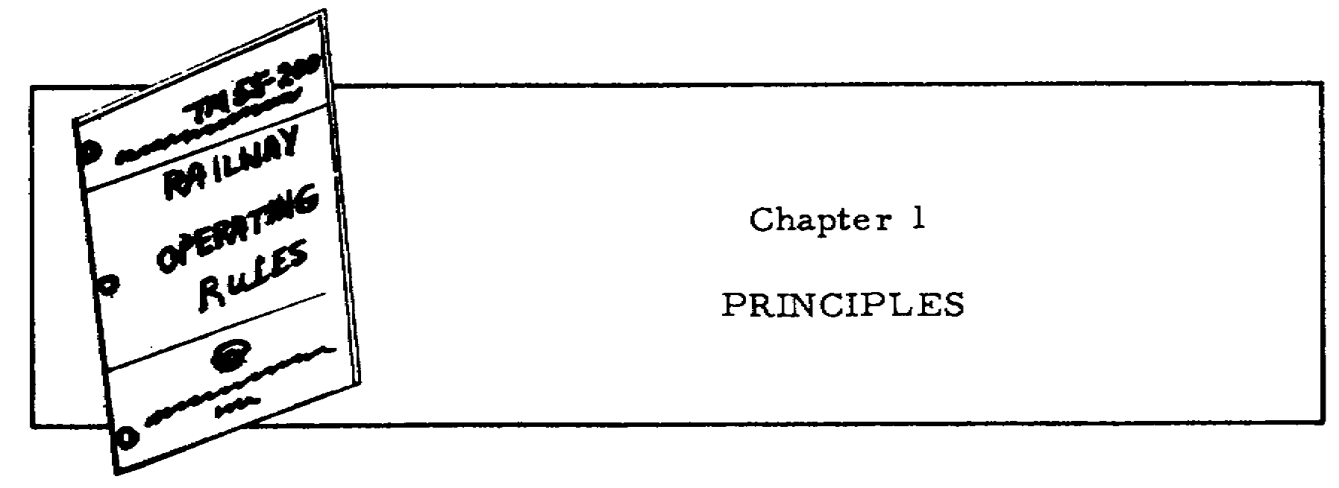

Slide 13
1.1. GENERAL
During World War II when the manpower barrel was nearly empty, a local
Selective Service Board official told a railroad executive that a train
dispatcher could easily be trained in 6 months. If this official, who
obviously knew little about railroading, eliminated the word "easily" and
revised his estimate to 6 years, he would have been more nearly correct.
Without doubt, dispatching trains on a busy section of railroad is one
of the most exacting tasks in the entire transportation field. The
requisitesand
sometimes the unhappy lotof
a train dispatcher are dear,
rapid, and correct thinking; making instant decisions with absolutely no
margin for error; lacking time for conferences with superiors, and being
unable to relegate decisions to subordinates.

Slide 14
A dispatcher needs to know the minute details of the physical
characteristics of the maintrack
layout of his division. To refresh this
knowledge, he is required to ride over his division periodically. Why?
Because each dispatcher must be able to sit at his desk and visualize what
is happening at the other end of his division. When, for instance, he
instructs a road conductor to "Head in at BO tower, pull through the cutoff,
back your head end off on the river lead, and cut the road crossing," he
must be intimately familiar with every detail of the area and with the
location of every switch, crossover, and derail so that his instructions can
be carried out.

Slide 15
A dispatcher must have full knowledge of the capabilities of the various
types of locomotives in use and frequently judge the capability of
individual locomotives only by their number designators. Moreover, he
frequently possesses, and often bases decisions on, an intimate knowledge of
the ability of individual engineers to get their trains over the road, Every
railroad has engineers with reputations for making good time under
almost any conditions, and occasionally a
smaller number who never seem to maintain
schedules or come up to reasonable
expectations despite a good locomotive and
the most favorable conditions.

Slide 16
Centralized Traffic Control, twoway
radio communication between moving engines
and cabooses, and other modern innovations
in train dispatching have probably
partially taken some of the occupational
strain off many dispatchers. However,
many singleand
doubletrack
lines still
operate without these refinements. On
many railroads where the number and length
of sidings have not increased with the greater train density of the past few
years, the job of train dispatching is more exacting than ever.

Slide 17
Chapter 1 describes dispatching principles and the methods used in
moving trains over the various track systems. First, the timetable, the
dispatcher's train orders, and the operating rules are explained. Then the
dispatching methods used on single,
double,
and multipletrack
lines, and
the Centralized Traffic Control method are described

Slide 18
1.2. TIMETABLE
A timetable authorizes the movement of scheduled trains. A sample
timetable representing the division illustrated and discussed in this text
is contained in appendix II. It shows trains as first, second, third, and
even fourth class: their relative superiority is established by the
designators shown for them in the timetable. Firstclass
trains are
superior to all others, secondclass
next, and so on. Extra, or
unscheduled, trains are inferior to all regular trains having a class
designator; no superiority or inferiority exists between extra trains.
However, the timetable on single track specifies the superior direction,
which was decided on by the railway's officials. On the Elwood division
used as an example in this text, the superior direction is east. This means
that if firstclass
trains were opposing each other, the eastbound train
would be superior. Opposing trains are those traveling toward each other on
single track. Direction is superior only between regular trains and only if class is equal; it does not apply to two extra trains in opposing
directions on single track. Thus, in this text, a firstclass
westward
train is superior to a secondclass
eastward train.

Slide 19
1.3. TRAIN ORDERS
Train orders are written orders delivered to train crews to convey the
dispatcher's instructions. The orders may help or restrict; they may amend,
annul, or supersede the class and directional superiority that the timetable
establishes, as chapter 4 explains. They are the tools a dispatcher uses to
operate trains not listed in the timetable. On occasion, he also uses them
to establish rules for moving trains efficiently over a division when
unusual operating problems occur. A train order, however, does not waive
compliance with a rule for one train unless it instructs another crew to
protect the first train. Train orders are discussed further in chapter 5.

Slide 20
1.4. OPERATING RULES
Each American railroad has its own set of operating rules. They are
based on a standard code but are tailored to fit the operating needs of the
particular line. Even though the rules themselves may be modified, the rule
numbers remain the same. Rule 99, for instance, means the same thing to a
railroader in Iowa as it does to one in Ohio. Although the rules number in
the hundreds, all are important to the safe and efficient operation of
trains. The rules cover standard time, timetables, signals, train
superiority, movement of trains and engines, and train orders

Slide 21
Operating rules for military railroads are contained in Technical Manual
(TM) 55200,
Railway Operating Rules; a number of them are quoted in
appendix III. Two rules are of particular importance to the immediate
discussion, rules 86 and S87,
which are quoted and discussed in the
subparagraphs following. Note that a rule number without a letter prefix
applies to single and two or more tracks, one with an S to single tracks,
and one with a D to two or more tracks.

Slide 22
a. Rule 86 reads: "Unless otherwise provided, an inferior train will
clear the time of a superior train in the same direction by not less than 10
minutes, but must be clear at the time a superior train in the same
direction is due to leave the next station in the rear where time is shown."
7

Slide 23
b. Rule S87
provides: "An inferior train must keep out of the way of
opposing superior trains and, failing to clear the main track by the time
required by the rules, must be protected as prescribed by rule 99. Extra
trains must clear the time of opposing regular trains not less than 5
minutes, unless otherwise provided, and will be governed by train orders
with respect to opposing extra trains "

Slide 24
c. Rules 86 and S87
mean that extra trains must operate with respect
to train orders, the timetable, and the operating rules. They may proceed
until the crew notes from the timetable that a superior train is getting
close; then they must enter a siding or a yard to clear the train.
Similarly, when operating againstopposinga
superior train, the crew
knows from the timetable when to take siding to clear the opposing train.
However, if a train has certain types of orders, they may conflict with
rules 86 and S87.
When this occurs, the orders automatically supersede the
rules. Also, train orders may confer superiority to a westbound train and
restrict an eastbound one of equal class. This conflicts with superiority
of direction established by the timetable and, again, the orders supersede
the timetable. They may also grant a secondclass
train right over a firstclass
one; they have then superseded the established class of trains as set
forth by the timetable. In brief, train orders may supersede any normal
method of regulating train movement, or they may temporarily set aside
certain operating rules and the timetable. Therefore, train orders are the
last word of authority and remain in effect until fulfilled, superseded, or
annulled. The crew's actions can fulfill the orders, but nothing can
supersede or annul them except other orders from the dispatcher.

Slide 25
1.5. METHODS
The method of dispatching varies according to the type of rail
operations. The four basic types are: single track, double track, multiple
track, and Centralized Traffic Control (CTC) which applies chiefly to single
track. Since CTC and multiple track are refinements rarely encountered in
foreign theaters, this text deals principally with singleand
doubletrack
systems. However, to ignore CTC and multipletrack
operations entirely
would restrict a reader's understanding of the subject as a whole.
Therefore, they are discussed but not stressed as much as the other
dispatching methods. The remaining paragraphs of chapter 1 discuss the
various methods, but before that discussion begins, the method used in a
theater of operations is described

Slide 26
Train dispatching in a theater of operations necessarily differs from
that on commercial railroads. In a theater where civilians operate the
trains and the military control them, dispatching may remain unchanged if
passengertrain
service is continued. However, troop, ambulance, and
ammunition trains may be assigned even higher priority than passenger
trains. As armies advance, however, and the railroad is operated by the
transportation railway service exclusively for military purposes, the method
of dispatching trains may undergo radical changes dictated by the particular
combat or logistical conditions. Retreating enemy forces may destroy
trackage, bridges, signals, and other facilities to retard advances over the
line. When service is resumed, what was formerly a doubletrack,
highspeed
road with automatic block signals may be a single track with restricted
speed and an improvised signal system. Then dispatching becomes more
difficult and complex. Singletrack
operation will prevail; light trains
carrying less tonnage at lower speeds will be the rule; and circumstances
will determine movement priority.

Slide 27
1.6. SINGLETRACK
OPERATION
In singletrack
operation, dispatching is carried out by written train
orders. These are the dispatcher's instructions received over telephone or
telegraph wires by operators along the line who copy them in longhand and
deliver copies to the train and engine crews to whom addressed. As chapter
5 explains, many types are used to cover every conceivable situation, and
they may be either helpful or restrictive. They tell a crew what to donever
what not to do, and they frequently carry qualifications.

Slide 28
Basically, a firstclass
train depends upon the timetable schedule for
its authorization. On leaving the starting terminal, the crew is authorized
to travel along the route according to the published time figures in the
schedule columns of the timetable. On a singletrack
line, the timetable
specifies the superior direction, for example, eastward. Therefore, a
firstclass
train traveling east (Maxey to Conroy, figure 1.1) would be
superior to all other trains on the line. The crew would expect all trains
in each direction to clear and not delay their train. A crew with a firstclass
train traveling westConroy
to Maxeywould
expect all trains except
firstclass
eastbound trains to clear them. “To clear" means to get a train
completely off the main track by going into a siding or yard, and to line
the switch for the main track.

Slide 29
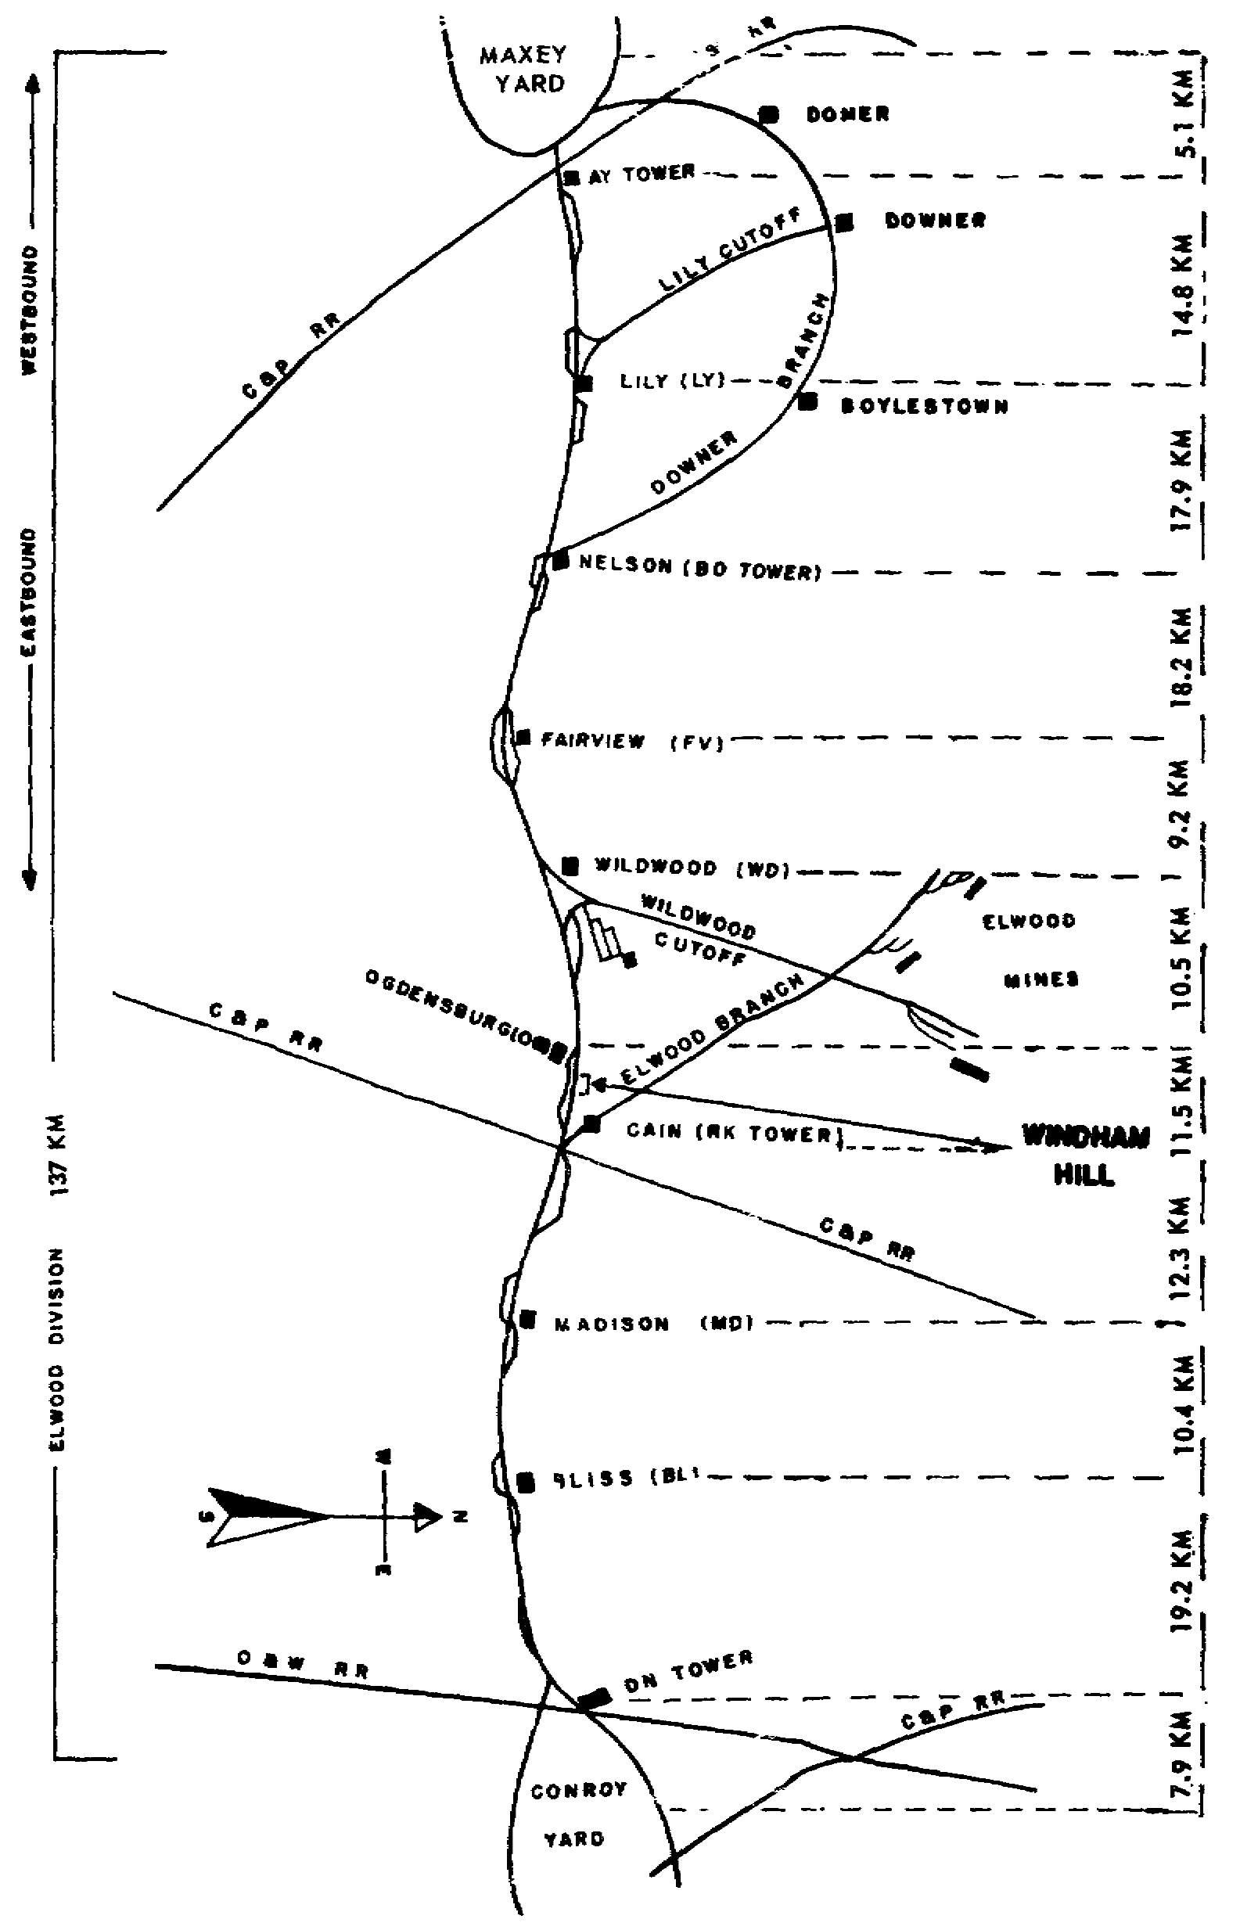

Slide 30
Extra trains are not scheduled in the timetable, have no class, and
hence have no superiority. When extras are moving without train orders
other than the ones that created them, they are said to be "operating with
respect to the timetable." This means that they are adhering to the
provisions of rule S87,
by clearing the main track for trains scheduled in
the timetable. When it is impossible to clear the track for a superior
train, the rules require that the train be protected against the movement of
other trains. To do this, a flagman is sent in the direction from which the
train is expected to flag it to a stop. On double track, one is sent to the
rear; but on single track, one must be sent to the front as well as one to
the rear to stop any trains. Rule 99 is the rule requiring such protecting
or flagging. Proper clearing and clearing without delay are said to be
accomplished when the trains being cleared are not stopped or delayed, as
paragraph 1.4 explains.

Slide 31
If all extras on single track could always operate with respect to the
timetable only, the subject of train dispatching would be much easier to
understand. An extra train, after being allowed to move out of its starting
yard, would proceed on its way until the timetable, rule S87,
and the
crew's watches told the crew to "take siding." After the superior train
passed, the crew would again consult the timetable. They would know the
exact distance to the next siding, and the approximate number of minutes it
would take to reach there. If the crew could make the siding without
stickingdelayinga
superior train that was close, they would proceed. If
they lacked sufficient time to clear a train in either direction or had the
least doubt that their train could clear in time, the crew would remain
where they were until they did have enough time. Thus, an extra train would
travel over a division in stages, heading into a siding when necessary and
remaining until the superior train passed. It might then possibly pass up
the next siding, and perhaps enter a third, to clear one or more scheduled
trains in either or both directions.

Slide 32
The method just described is cited primarily to show the principle of
extra movement, but it seldom works out in actual practice. The reason for
its being more theoretical than practical has not been taken into account:
the extra trains that may be, and generally are, operating in the opposing
direction. Regular trains have no way of knowing about extras, and extras
ordinarily do not know about other extras in the same or opposing direction.
Therefore, they are advised of the presence of opposing extras by the
dispatcher's train orders. When operational difficulties occur, the
dispatcher's train orders affect scheduledsuperiortrains.

Slide 33
A dispatcher may assist an inferior train by giving it a helping train order.
When he does, this same order restricts a superior train which is also given
a copy of the order. Similarly, a dispatcher often assists a heavy extra at
the expense of a light train of superior direction.

Slide 34
1.7. SINGLETRACK
EXAMPLE
The singletrack
Elwood division, which is 137 kilometers long, is
illustrated in figure 1.1. The various stations are marked by the name of
the city or town, with the call letters of the telegraph office of each
shown in parentheses. Each office is manned by an operator who works with
the dispatcher; who copies orders and delivers them to the proper train
crews; and who reports arrival, departure, and passing times of trains.

Slide 35
To condense much of the information given in paragraph 1.6, a typical
example is presented. It is explained and discussed in some detail in
subparagraphs a through g following. In addition, figure 1.1 is duplicated
in annex A and cutout blocks provided to enable you to move three trains
exactly as specified by the train orders that follow. The oblong blocks
printed at the left of the illustration represent the three trains. Cut out
the blocks and place them as follows: No. 9 Eng 345 at Conroy; Extra 4220
East at Maxey yard; and Extra 9552 West along the line with the wording
"Wildwood cutoff." Point the blocks in the directions the trains are
heading. When they are correctly placed, lay the entire sheet aside where
it cannot be disturbed and continue with the text.

Slide 36
a. Statement of problem. Assume that Extra 9552 West is ready to leave
the Wildwood cutoff and proceed over the main track toward Maxey. Number 9,
a firstclass
train running from Conroy to Maxey, left Conroy a few minutes
before. Some 5 minutes before No. 9 departed, Extra 4220 East left Maxey
with orders to "run extra Maxey to Conroy." From the timetable, the
conductor of Extra 9552 West knows of the presence of No. 9 on the railroad
and that he must clear this train as specified by rule S87.
Without
specific orders to the contrary, it is left to his judgment as to exactly
where he is to clear No. 9. A glance at the division map in the employees'
timetable tells him that Fairview (FV) would probably be the most logical
place, for Extra 4220 East to take siding and permit No. 9 to pass. With
Extra 9552 West in the picture, the dispatcher must now enter the scene with
his train orders. Up to this point, the running orders of Extra 4220 East
authorizing movement from Maxey to Conroy and the timetable schedule of No.
9 from Conroy to Maxey have governed.

Slide 37
b. Action of dispatcher. Before the dispatcher can permit Extra 9552
West to leave the Wildwood cutoff, he must issue a train order to establish
a meet for the two extras. This particular point is explained and stressed
in paragraphs 2.6 and 5.15the
lesson they teach must never be forgotten in
dispatching trains. The dispatcher calls the operators at Nelson (BO) and
Wildwood (WD) and dictates the following train order: "Extra 4220 East Meet
Extra 9552 West at FV." This order is given to Extra 4220 East at BO. A
copy of it, addressed to the conductor and engineer of Extra 9552 West, is
delivered to the crew at WD, along with running orders authorizing the train
to run extra WD to Maxey. The order is also given to the operator at FV
under rule 208(2). Holding this order, Extra 9552 West will take siding at
the meet, and the other train will "hold main track," as paragraph 4.4a
explains.

Slide 38
c. First move of all blocks. You are now ready to make the first move
of the cutouts on your division map in annex A. Move No. 9 to Bliss, its
approximate position when Extra 9552 West leaves Wildwood cutoff. Now, move
Extra 4220 East to BO tower where the crew is given the meet order. Move
Extra 9552 West to the siding north of the main line between Wildwood and
Fairview. Now, bring Extra 4220 East past the westbound extra on the
siding, and advance No. 9 to Madison. Move Extra 4220 East into the siding
opposite Ogdensburg; advance Extra 9552 West to the siding at BO tower.

Slide 39
d. Explanation of first move. Why was this first move made in this
way? When Extra 4220 East arrived at FV siding, it could not proceed unless
Extra 9552 West was there. If Extra 9552 West arrived first, it would have
to wait for the eastbound extra. Technically, a train is not a train unless
the last car or caboose displays the rearend
markers shown in figure 1.2.
Therefore, a meet cannot be properly fulfilled until the markers are met.
If a train loses its markers, it is no longer a train. Consequently, one
train cannot meet another unless it meets the markers. For example, if
Extra 20 East had a meet with Extra 21 West at RK, and Extra 21's caboose
became detached before it reached the siding at RK, it would enter the
siding without rearend
markers. Extra 20 East could not proceed past RK
because, technically, it would not meet a train, and the meet order would
not be properly fulfilled. The reason and importance of this is obvious: if
Extra 20 East did pass RK siding, there would be a danger of its colliding
with a stationary caboose somewhere beyond RK.

Slide 40
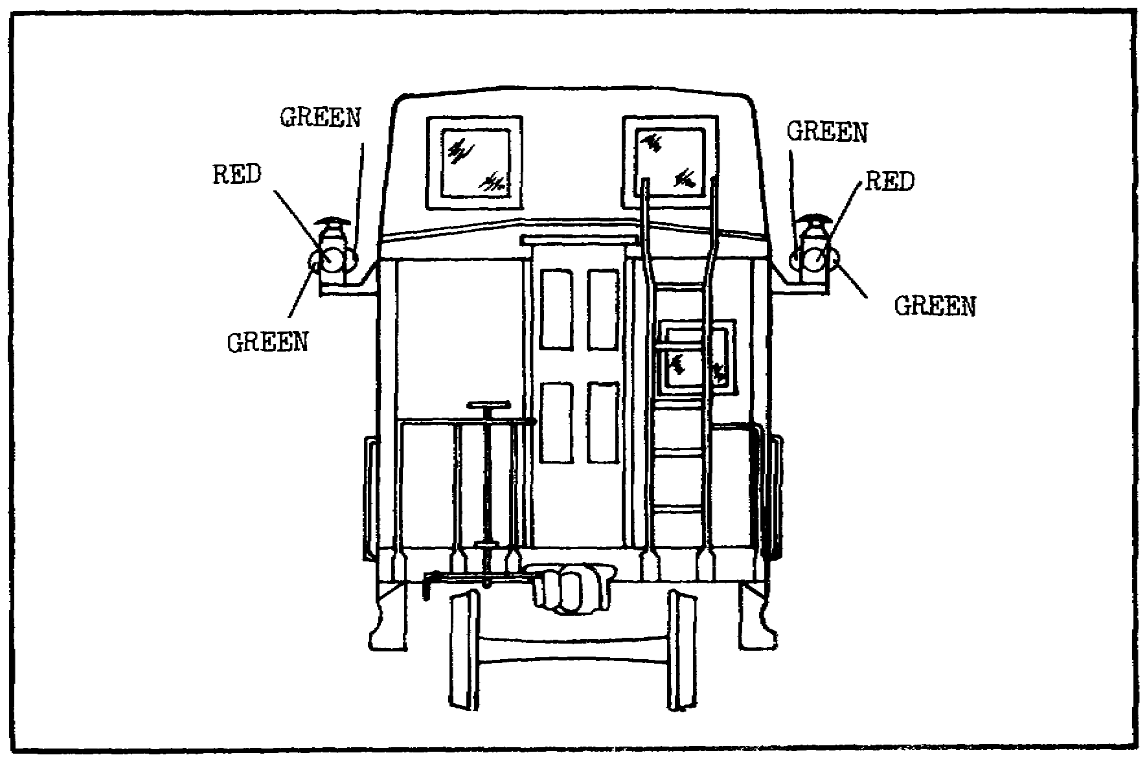

Slide 41
e. Move of No. 9. The next move is to be made by No. 9. Move it past
the sidetracked train at OgdensburgOGand
past the westbound extra, which
is in the clear at BO tower, into Maxey. Now each extra is free to proceed
in its respective direction until other orders or the timetable schedule of
a superior train restricts it. When No. 9 passes the two extras in their
respective sidings, the presence or absence of the two extras is of no
concern to the crew of No. 9. It holds no orders that involve either extra
and, consequently, their presence on the railroad is not known to the crew
of No. 9. In brief, the timetable, as shown in the sample in appendix II,
notifies all trains what regular trains are to be expected and the departure
time from each station. The dispatcher's train orders notify the crews of
extra trains of the presence of opposing extras. Unless such orders
interfere with or restrict the progress of regular trains, their crews are
not given copies.

Slide 42
f. Move of extras. To complete the example, move Extra 9552 West into
Maxey and Extra 4220 East into Conroy. One aspect of the advancing after
the meat needs further explanation. After the meet between the extras, the
eastbound train moved from FV to OG siding on the authority of rule S87.
Similarly, the westbound extra advanced from FV siding to BO tower under the authority of rule 86. If each
train had lacked time to conform to the respective rule, each would have
remained in its respective FV siding and cleared No. 9 there.

Slide 43
g. Relation to actual practice. This greatly simplified example shows
how a dispatcher keeps two inferior trains out of the way of a superior
train, and how he progresses each as far along the way as possible before
putting it into a siding. In actual practice, however, a division of this
length would be much more congested. When five or six trains are operating
on a single track, the dispatcher is required to do much more planning and
issue many more orders to carry out his objective

Slide 44
1.8. DOUBLETRACK
OPERATION
When operating on double or multiple tracks, a dispatcher is relieved of
considerable strain, and his advance planning is reduced materially.
However, he is still thinking and planning 3 or 4 hours ahead but chiefly
about new trains that may come out on the road. With double track, one is
designated, for example, westbound and the other eastbound; no deviation by
crews is permitted without the dispatcher's specific orders. Since no meets
are scheduled and opposing trains are separated, he proceeds as though
operating separate railroads. His work of keeping inferior trains moving,
yet out of the way of superior ones, still goes on. If it appears that
doubletrack
operations are quite a bit simpler than singletrack
operation,
remember that the density of traffic is generally two or three times greater
than on a single line. Doubletrack
procedures are discussed in the
following subparagraphs.

Slide 45
a. Signals. Most doubletrack
lines are equipped with automatic block
signals by which it is possible for an observer to determine if any trains
occupy the track for the next couple of kilometers ahead. Many kinds of
signals are used, but only the positionlight
block signals, currently used
on most American railroads, are discussed. This signal and the name,
indication, and significance of each aspect is shown in figure 1.3. An
aspect is the color or position of a signal as it faces an approaching
train. With the use of such signals, the dispatcher has the problem of
spacing the trains so that the progress of none is hindered by the reducespeed
and stop signals of the train ahead of it.

Slide 46
Proper train spacing is a delicate phase of dispatching. If trains
get too close to each other, a great deal of stopping and starting occurs. Starting from a standstill requires a great deal of fuel
and often delays other trains excessively. Conversely, a dispatcher cannot
deliberately hold trains back to the extent that the train capacity of his
division would be seriously reduced.

Slide 47
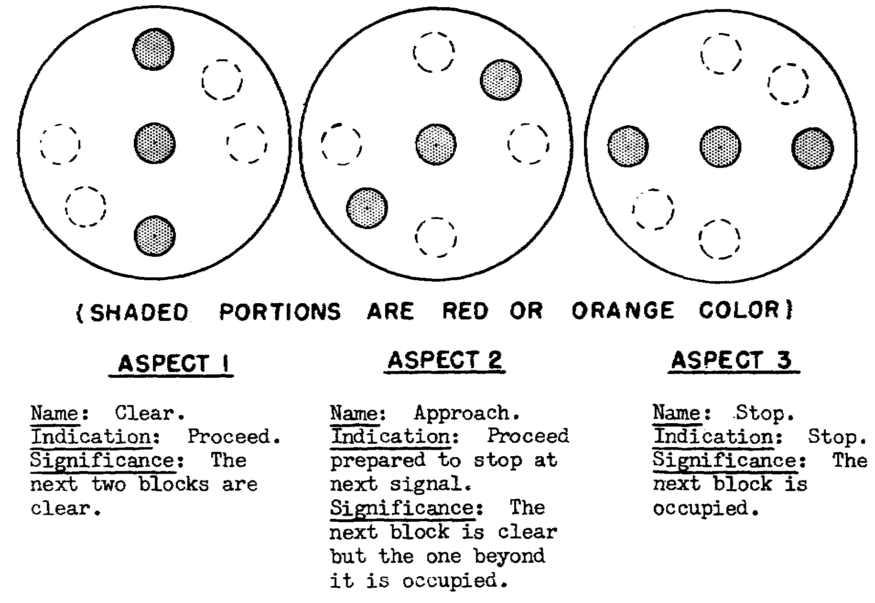

Slide 48
b. Current of traffic. The movement of trains on a main line in the
direction specified in the rules of the railroad is called the current of
traffic. As an example, look at figure 1.4 that shows the Elwood division,
the same one illustrated in figure 1.1 except that it is now pictured as
double track. Trains traveling west from Conroy to Maxey use the righthand
or westward track and those in the opposing direction, the lefthand
or
eastward track. However, because of any one of numerous operational
difficulties, the dispatcher night frequently be required to run trains
against the current of traffic to pass stalled or disabled trains. Other
reasons for running a westbound train over an eastward track might be a rock
slide, a washout of ballast, or temporary removal of rails by a section
gang.

Slide 49
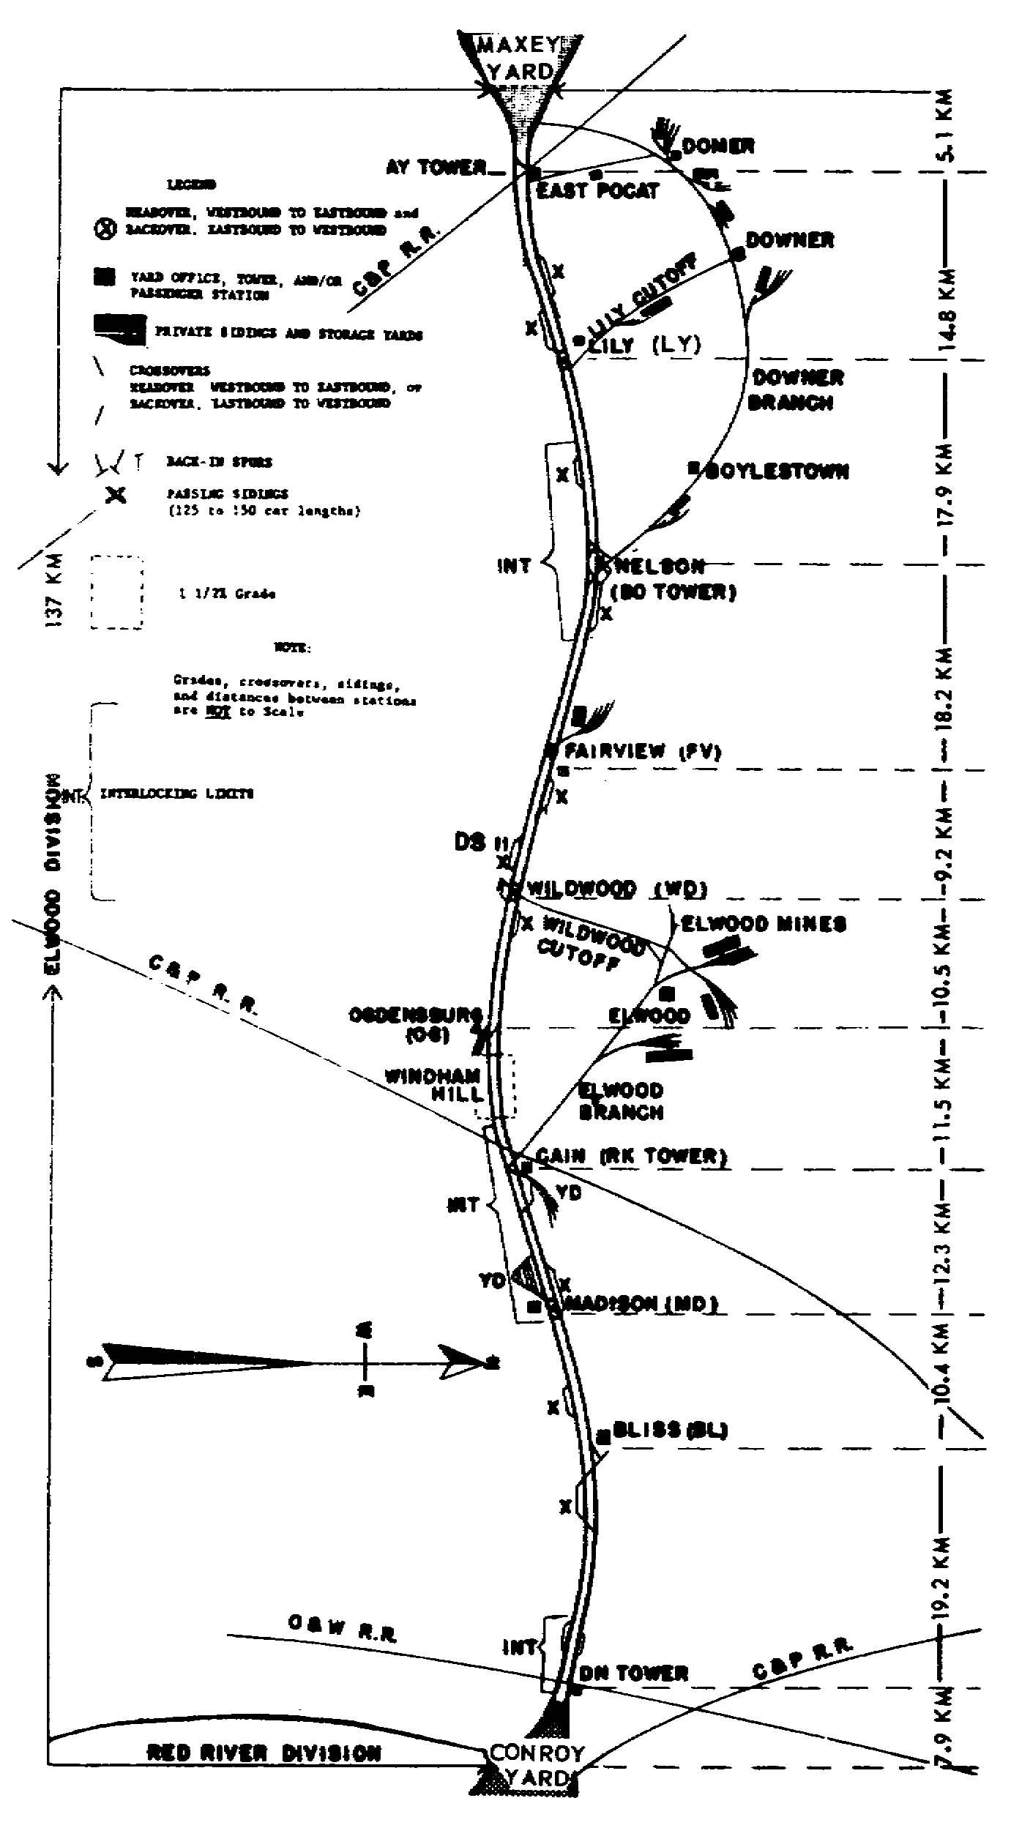

Slide 50
c. Reverse movement. Getting a train around an obstruction by running
it against the current of traffic is called singlelining
or reverse
movement. The first term comes from the dispatcher's changing,
operationally speaking, a section of double track to single. Refer to
figure 1.4 and assume that a dispatcher has an extra westbound train
disabled halfway between FV and BO. If restricted by the current of
traffic, he would be forced to let all his westbound movements pile up
behind the disabled train. Instead, he looks over his train sheet,
discussed in paragraph 2.5, and notes that a westbound firstclass
train is
at RK, and a secondclass
eastbound train is nearing LY. Normal running
time would put both trains in the vicinity of the obstruction at
approximately the same time.

Slide 51
d. Train orders. The dispatcher must know how to make use of his train
orders to keep delay to the firstclass
train to a minimum. He rings BO
tower and dictates a holding order the secondclass
train. This type of
order, called a form J order, is illustrated and explained in paragraph
5.20. It may cite the secondclass
train by train and engine number, or it
may instruct the operator to hold all eastbound trains. The dispatcher then
rings OG, WD, and FV operators and tells them to stand by for a for DR
order (explained in paragraph 5.27), one that allows the firstclass
train
to turn against the current of traffic. When they are ready, he dictates an
order for the firstclass
train to use the eastward track from FV to BO.
Although all three operators copy the order simultaneously, only the BO
operator is responsible for delivering it to the train crew. The FV
operator must know the provisions of the order because the train is going to
cross over to the eastward track at his station. Having the WD operator
copy the order is a precautionary measure. If the telephone at OG should
fail before the dispatcher finished the order, it could be delivered to the
firstclass
train at WD. Or if something occurred that allowed the train to
get past OG without getting the order, it could be delivered at WD. When
the reverse movement is completed, the dispatcher will annul the form J
order to the BO operator. The transmission and delivery of all forms of
train orders are covered in chapter 5.

Slide 52
1.9. MULTIPLETRACK
OPERATION
Although multipletrack
systems are rare in military operations, their
principles of operation are decidedly pertinent to the teaching of train
dispatching, Logically, on threeand
fourtrack
systems, the operating
problems are further reduced. Four tracks are ideal because they provide
highand
lowspeed
tracks in both directions. Normally, the highspeed
tracks are on the outside to
permit passenger trains to load at stations. Although these tracks are
often thought to be reserved for passenger trains only, many dispatchers
permit their express trains and fast freights to use them if they can make
passengertrain
running time. The current of traffic, defined in paragraph
1.8b, can be more rigidly enforced on a fourtrack
system because of the two
tracks in each direction. If a dispatcher lets a fast freight out on the
highspeed
track and it has trouble or fails to progress as expected, he can
have it switched bark to the lowspeed
one. As the following subparagraphs
point out, a distinction may or may not be made between the standards of the
highand
lowspeed
tracks.

Slide 53
a. Some railroads make a strict distinction between the standards of
the two types of track. On the lowspeed
track, lighter rail is used and
less ballast and subballast maintenance performed. Tie renewal may be
considerably less frequent than on the highspeed
track. The tracks are
generally designated either freight or passenger, and interchangeability of
types of trains is not permitted except in emergencies. Continual operation
of heavy freights over passenger tracks requires constant maintenance work,
to keep them in the condition required to give maximum riding comfort.
b. Many railroads make no distinction between the standards of the two
types of track; the weight of the rail is identical, and the ties and
subgrade are the same. The terms "high speed" and "low speed" are used to
describe these tracks, but the timetable would refer to them as Nos. 1, 2,
3, and 4. Generally, the only time it would be necessary to run against the
current of traffic would be when both tracks in one direction were blocked
or unsafe.

Slide 54
1.10. CENTRALIZED TRAFFIC CONTROL
Operating a rail division controlled with Centralized Traffic Control
(CTC) is much simpler than by the other methods. The dispatcher, who may be
many kilometers from the point where a train crew wants to enter the main
track, merely flips a switch on his CTC panel that opens a yard switch and
lights a proceed signal for the train. A modern CTC panel is shown in
figure 1.5. The dispatcher does not advise the train crew of his plans nor
are written orders necessary. Tracks have signals facing in each direction,
and there is no established current of traffic in CTCcontrolled
areas.
This gives the dispatcher complete flexibility of train movements; he may
run trains on any track in either direction. Regardless of the class of a
train, it can continue to move against or ahead of trains of a superior
class as long as a signal tells it to do

Slide 55
so. When a dispatcher wants a train to stop, wait for, and meet an opposing
train, a signal light shows where and when to make the stop. When the
opposing train clears, the stop signal changes to proceed.
Figure 1.5. Dispatcher Working at CTC Panel.
This system eliminates reading, repeating, interpreting, and remembering
the provisions of numerous train orders that would ordinarily be received as
much as 2 hours before the time to carry them out. The crew receives visual
orders, as it were, from the signal lights at the time and the point where
they are to be executed. Rules 86 and S87
do not apply in CTC territory.
The following subparagraphs discuss the CTC's system control panel, safety
features, and advantages, but before that discussion begins, electric
interlocking controls are explained.

Slide 56
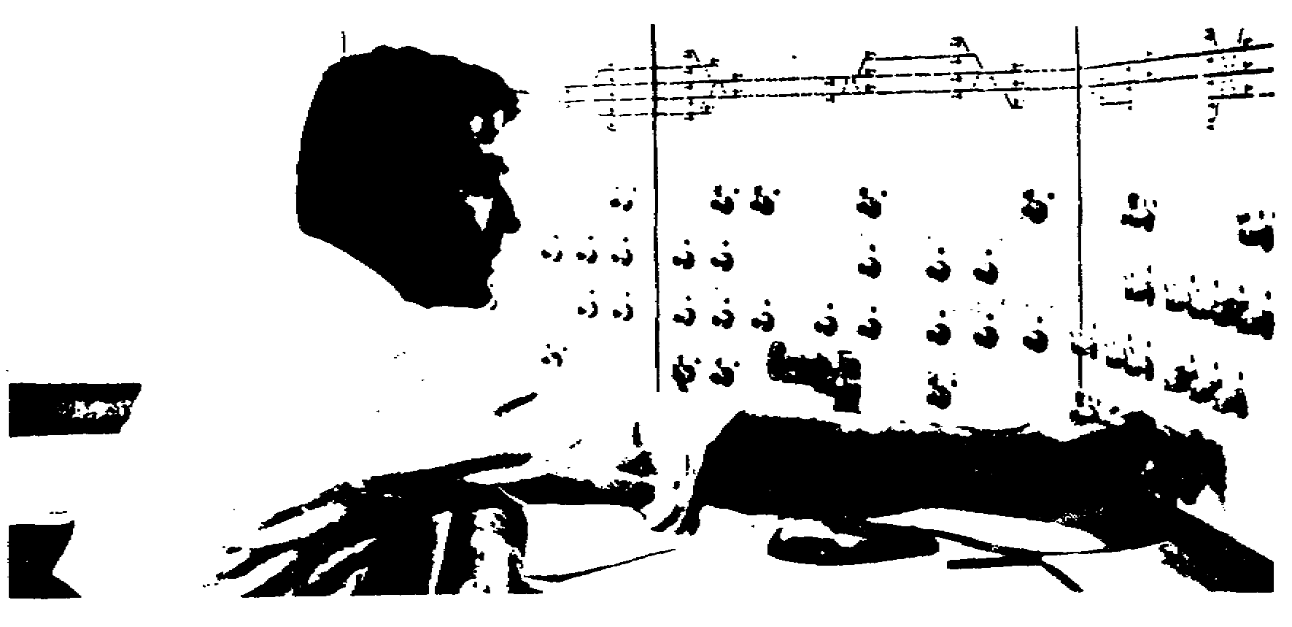

Slide 57
Electric interlocking, an early form of CTC, is used on foreign
railroads. The layout may extend for several kilometers on each side of the
control tower from which the interlocking plant is operated by a towerman.
However his control ends where the tracks join the area under the control of
the dispatcher. A towerman at work is shown in figure 1.6. Such
installations, generally used at congested junctions and terminals, allow
the dispatcher and the tower operator more flexibility in handling trains
and yard movement in yard limits.

Slide 58
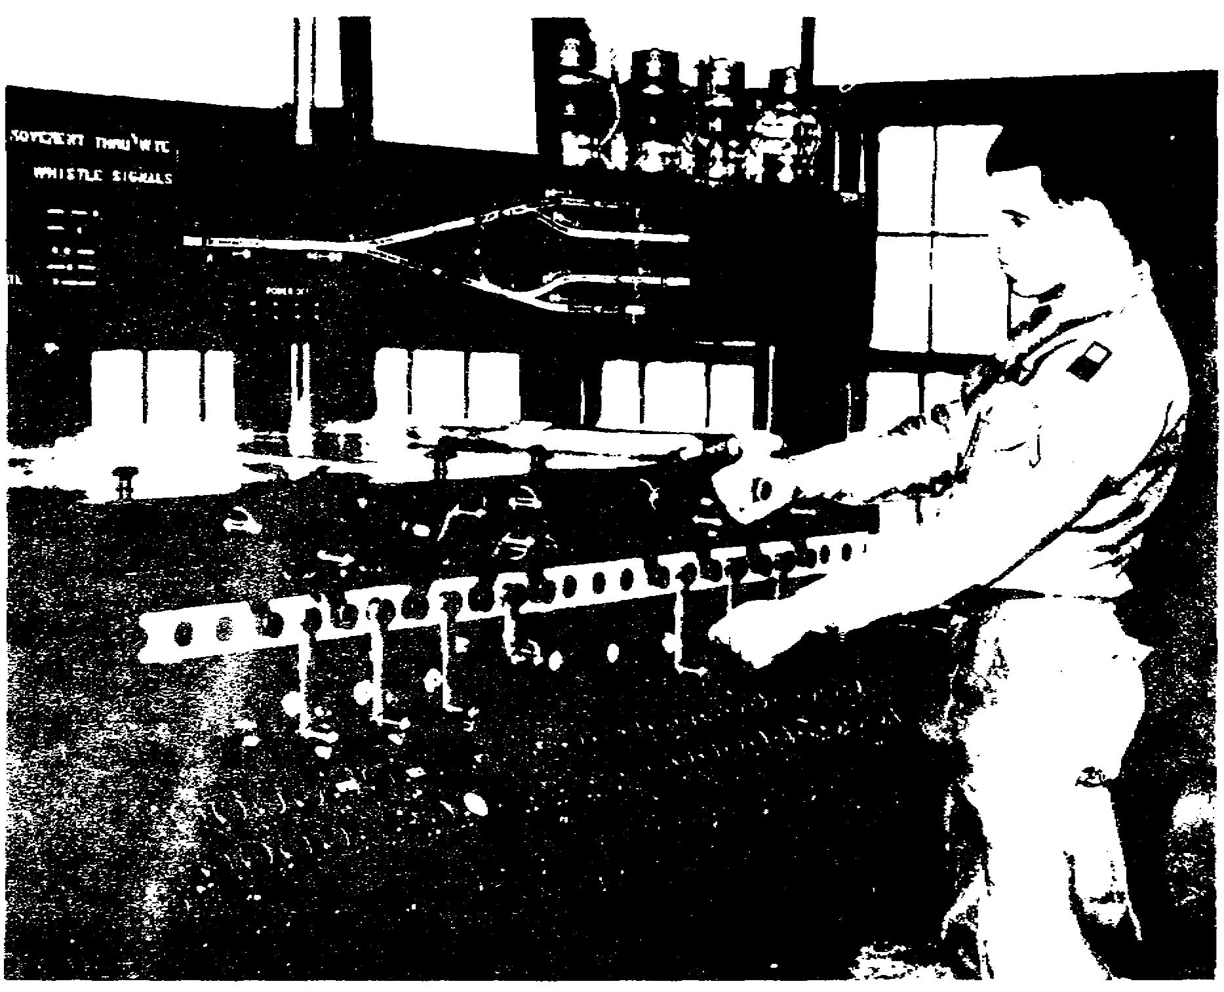

Slide 59
a. Control panel. The dispatcher's control panel, or board, has
diagrams representing the track layout, as shown in the upper part of figure
1.5. All areas under his jurisdiction controlled by CTC are shown on the
panel. Small indicators, mounted at intervals along the board, light up as
the train reaches the point on the railroad represented by each particular
indicator. Thus, a dispatcher can watch the progress of any train withinhis
jurisdiction merely by observing the lights, and he can check the speed
of a train by timing it between two lights. Also, he knows when a train
makes an unscheduled stop or when it is losing considerable time. He can
direct a train into any siding and let it out the other end, or he can
switch a train from the eastbound to the westbound, or from the highto
the
lowspeed
tracks and back again, merely by manipulating the small electric
switches before him. The engine crew

Slide 60
never knows its exact path of travel until a short distance before reaching
a point of divergence. Reducespeed
signals, however, are displayed
sufficiently in advance of a change of track to give an engineer time to
slow down. The engine crew relies on the permissive and restrictive aspects
of the signals, automatically displayed when the dispatcher opens or closes
switches ahead of them, and they know they are taking the route prescribed
by the dispatcher.

Slide 61
b. Safety. The Centralized Traffic Control system has a safety feature
that makes it impossible for a dispatcher to suddenly take away a permissive
route for a train after the engineer comes in sight of the signal. Although
the dispatcher can take away the displayed permissive signal and flash a
restrictive signal "in the face" of the crew, the switches controlling the
track route cannot change if the engineer lacks sufficient time to comply
with the changed signal. The system is so wired that the dispatcher cannot
set up conflicting moves. Singletrack
installations are so connected that
if a train fails to make a stop specified by a signal, other signals in
advance of the train are automatically displayed to stop a train that may be
approaching on the same track from the opposite direction. Also, the CTC
system eliminates misunderstandings among crew members about the
interpretations of written train ordersmisunderstandings
that have
accounted for numerous collisions on single track.

Slide 62
c. Advantages. Since Centralized Traffic Control is used principally
on singletrack
sections, some railroads have converted doubletrack
sections to singletrack
layouts. Reduced maintenanceofway
costs and
accelerated freight train schedules resulted. Use of CTC frequently permits
an increase in train density, because the delay formerly caused by waitandmeet
orders is reduced. With CTC, a dispatcher is frequently able to get
two trains by a given point without stopping either one, by keeping one
moving through a siding while the other passes on the main track. If a
siding is long enough or if a single track branches for several kilometers
into a double track, a dispatcher may likewise have a train pass another in
the same direction without reducing the speed of either. A nonstop meet can
be fully appreciated only by crews who in past years waited for hours for
other trains, or by dispatchers who were once required to dictate several
complicated train orders to do what CTC may often get done with less delay
by the dispatcher's moving two or three controls.

Slide 63
1.11. SUMMARY
A division's timetable is the authority for moving scheduled trains; it
establishes their superiority and the superior direction of the tracks. For
example, firstclass
trains are superior to second class. Unscheduled
trainsextrasare
inferior to scheduled ones and have no class designator.
The superior direction is decided by the line's officials. Train crews
receive train orders from the dispatcher. They supersede the superiority
established by the timetable. Operating rules of both civilian and military
lines are based on a standard code, to provide safe and efficient train
operation. Rules 86 and S87
cover procedures followed by extra trains.

Slide 64
The four methods of dispatching are singletrack,
doubletrack,
multipletrack,
and Centralized Traffic Control. Singletrack
dispatching,
conducted by using written train orders to tell the crew what to do, is more
complicated than doubletrack
dispatching. The latter depends mainly on
automatic block signals and on proper spacing of trains. However, the
dispatcher must enforce the established current of traffic except when
singlelining
or reverse movement is called for. Train orders, too, are
used to avoid delay to toppriority
trains.

Slide 65
Operating problems are further reduced on multipletrack
lines,
especially where there are four tracks: highand
lowspeed
tracks for each
direction can be designated. Some railroads make a strict distinction
between the highand
lowspeed
tracks, with lighter rail being used and
less roadbed maintenance being performed on the latter. Other lines make no
distinction between the two; the rail, ties, and subgrade for both are the
same

Slide 66
Centralized Traffic Control is the simplest method of dispatching and
provides the dispatcher the greatest flexibility in manipulating trains.
Small indicator lights on a control panel come on as trains reach particular
points on the line. The lighted indicators permit the dispatcher to check
the train's progress and speed. By flipping a switch on the panel, the
dispatcher can give a train a proceed sign or divert it to another track.
The system is safethe
dispatcher cannot set up conflicting moves, and
restrictive signals flashed in the crew's face cannot be complied with if
there is too little time. Among the system's advantages are reduced
maintenanceofway
costs, accelerated freight train schedules, increased
train density at times, and less delay because of fewer waitandmeet
orders.

Slide 68
2.1. GENERAL
Operating trains over a division involves considerable paperwork for the
dispatcher and his staff. The train sheet, a written record that depicts
the progress of each train from one end of the division to the other, is
maintained by the dispatcher. Other forms dealing with clearances and
messages affecting operations, while usually dictated by the dispatcher, are
frequently compiled by the telegraph operator. To present a clearer
picture, the timetable, which governs to a great extent the dispatcher's
method of operation, and the train sheet, which presents an animated, everchanging
picture of each train's progress, are discussed before the specific
duties of the key individuals in the dispatching office.
Additionally, written accounts of train dispatching frequently deal
solely with loaded cars and trains from which the railroad derives its
revenue. Often overlooked, however, are the empties which the railroad must
move over its lines and furnish to shippers. Many think of this particular
phase of railroading as relating principally to the freight or traffic
department and being handled through the car distributor in the operating
department. There is a direct connection between the car distributor and
the dispatcher in moving trains of empty cars. Therefore, the car
distributor's function, how he maintains a record of empties on the
railroad, and how it affects the dispatcher, are covered in some detail.

Slide 69
2.2. EMPLOYEES' TIMETABLE
The employees' timetable is the authority for moving all regular trains.
Its pages dealing with schedules appear similar to those in the timetables
furnished to the traveling public. However, the two timetables should not
be confused because the employees' timetable goes much further. In a sense,
it becomes a supplementary book of rules. It may amend, supplement, extend,
and even interpret many of the standing operating rules, because of peculiar

Slide 70
operating instructions or because of unusual physical characteristics of the
rail layout. For example, under "Special Rules" in the employees' timetable
of a large commercial rail line, the following appears:
Rule 813. Amended to include: when radio
communication is being used in connection with a train
or yard movement, in lieu of hand signals, proper
identification and continuous contact must be
maintained. Should contact be lost with employee
directing the movement, immediate stop must be made
until communication is restored or other signals are
used to complete the movement.

Slide 71
In addition to the schedule of trains, a typical employees' timetable
includes a variety of information. Listed below are the various types of
data and instructions that may be found in an employees' timetable.
Reducespeed
areas
Yard limits
Weight limitations ofTrack
Bridges
Trestles
Coal tipples
Engine restrictions
Closeclearance
points
Location ofFuel
and watering facilities
Standard clocks
Telegraph offices
First aid supplies and stretchers
Company doctors, surgeons, and oculists
Special signal indications by name, location, and significance
Passing sidings and their capacity in cars
Location of and special instructions regardingSpring
switches
Time relay switches
Derails
New or nonstandard switching and signaling mechanisms
Special instructions on, for example,
Care and lubrication of journal boxes
Handling of cars having overheated journal bearings
(hotboxes)

Slide 72
2.3. ISSUING AND SUPERSEDING TIMETABLES
All employees whose duties are connected with train operation must
secure and carry a copy of the current employees' timetable. They must
study it carefully and familiarize themselves with all portions affecting
their duties. Such persons are required to sign a receipt showing that they
have received a copy. Each time a new timetable is issued, employees must
note the time and the date it becomes effective and study it carefully for
changes in train schedules; special rules seldom change. The old timetable
must be destroyed or turned in. Because of changes in train schedules, to
leave an outofdate
timetable laying around is to invite trouble

Slide 73
2.4. TYPICAL TIMETABLE
Appendix II consists of a sample timetable based on the doubletrack
division illustrated in figure 1.4. The timetable contains some of the
information specified in paragraph 2.2. The purpose is general
familiarization only; in actual practice it would require considerably more
information and detail to cover all operating procedures and details of a
division 137 kilometers long. Most of the special instructions could also
apply to the singletrack
division in figure 1.1. However, the time figures
on the two pages showing the schedules of the 12 trains would be changed
completely because of twoway
operation over a single track.

Slide 74
2.5. TRAIN SHEET
The Dispatcher's Record of Train Movements, usually called the train
sheet, is maintained by the train dispatcher and is an important written
record in the dispatching office. It shows at all times the picture of
train movements over the division, what trains are in transit, and the time
each one passes each station along the line. Knowing the running time
between two stations, the dispatcher can determine at a glance whether a
train is having difficulty in its progress. At the same time, he knows
whether it is exceeding established speed limits. When the rear end of a
train passes a telegraph station, the operator reports the exact time to the
dispatcher who enters it on the train sheet in the column opposite the
station's call letters. When the operator reports the train's time, he is
said to "OS" the train. Using the train sheet in dispatching operations is
discussed further in the following subparagraphs.

Slide 75
a. Typical train sheet. Annex B shows a train sheet as it would appear
in use on the singletrack
division in figure 1.1. The columns to the left
of the station call letters indicate the westwardtrains; those to the right, the eastward. The "OS" time of the westbound
trains as they pass each station reads from the top to the bottom, while the
eastbound side reads from bottom to top. This method of recording the time
in opposite order makes it easier for the dispatcher to make plans for
changing meeting points. The three extra trains shown in columns 1, 2, and
8 have completed their runs, while Extra 194 West (col 4) and Extra 210 East
(col 3) are approximately halfway over the division. The figures
beside Extra 205's time out of Maxey yard show that it had 125 loaded cars,
no empties, and a gross tonnage of 11, 500 tons. The figures are reduced at
BO tower because the train made a setoff of cars and tonnage amounting to
the difference between the two sets of figures. Where two time figures are
shown at a station, the earlier time is the arriving time and the later one
is the departing time. Passing time is written diagonally across
both blocks . When a train terminates its run, a
diagonal line is
drawn through the next block .

Slide 76
Officially, the stops are considered delays and they must be explained
on the train sheet, usually on the reverse side. For quick reference,
delays are shown on the face of the sample train sheets. Freight trains
generally have 30 minutes preparatory time, and the delays shown for making
an air test do not start until 30 minutes after the time shown in the “Time
Reporting" column.

Slide 77
b. Meets. An examination of columns 3 and 4 of the train sheet shows
that either Extra 210 East or Extra 194 West will have to take siding to
clear the other. This has already been arranged by the dispatcher before
Extra 194 West left the yard. It is explained in paragraph 1.7b, and the
reasons are stressed in later chapters. Assume, then, that the dispatcher
has set up a meet at WD by instructing the crew of Extra 210 East to meet
Extra 194 West there. Because eastward direction is superior on this
railroad, Extra 210 East will hold main track, and Extra 194 West will take
siding. Suppose, however, that Extra 210 East had 70 cars instead of 90,
and that Extra 194 West had 90 cars instead of 70. Because the capacity of
WD cutoff is only 85 cars, the dispatcher would be forced to permit the
train moving in the inferior westward direction to hold main track, and make
the train in the superior eastward direction take siding. This would have
to be specified in the meet order. This example illustrates how the
dispatcher may supersede the superiority of direction; later chapters show
how he may supersede any normal procedure to regulate superiority.

Slide 78
c. Doubletrack
train sheet. Annex C shows a train sheet as it might
be maintained for the doubletrack
division illustrated in figure 1.4. The
method of compiling the sheet is identical with that of the singletrack
sheet. Outwardly, the sheets are the same; however, one difference can be
noticed upon close examination. When two trains in opposing directions pass
a given point, no delay is shown for either train. On double track,
movements are separated and cannot interfere with each other. In contrast,
note the time entries at RK tower in columns 1 and 2 on annex B when trains
met on single track.

Slide 79
d. Weather entries. In addition to the train entries, the weather
columns are also important. Every 6 hours the dispatcher receives from
various stations along the line a report on the weather at the reporting
office. These weather columns, in the lower right of the train sheet, are
more than routine. Knowledge of the weather along the line may well enter
into the dispatcher's planning. A sudden drop in temperature 75 kilometers
away might require that tonnage be reduced on future trains. Heavy snow,
wind, and sleet storms, as well as torrential rains that may cause flood
threats, must be reported and recorded so that the dispatcher may use this
information in his planning. Knowing exactly what the weather is at various
points on the line enables the dispatcher to issue reducespeed
orders if
necessary, or provide engine pusher assistance at points where trains may be
stalling on wet or icecovered
rails. Any other unusual occurrences during
the dispatcher's tour of duty, which might be useful as a matter of
permanent record, should be entered on the reverse side of the train sheet.

Slide 80
2.6. HANDLING EXTRA TRAINS
Chapter 1 shows how a dispatcher may create an extra train and permit it
out on the main line to run with respect to the timetable. Because the
train sheet serves as a quick, visual aid for the dispatcher to fix meeting
points for extra trains, the method of handling extras is recounted in some
detail at this point in the text. If extras on single track ran in one
direction only and regular trains were always on time, train orders would
seldom be required. However, extras must be operated in both directions,
and the dispatcher's orders are the only means of notifying crews of the
presence of opposing extras. Additionally, when scheduled trains run behind
schedule, as so frequently happens, operations on the division are
disrupted. Then the orders are used to lessen delay to other trains and to
assist late trains in getting back on schedule. The following subparagraphs
describe some of the tasks involved in operating extra trains.

Slide 81
a. Creating an extra. When the dispatcher authorizes an extra to go
out on the main track and proceed over the road to a specified point, he is
said to "create" the train. Once the extra is created, it proceeds toward
its destination with only the timetable or train orders to restrict it.
Read rule 201(1), given in appendix III.
b. Fixing meets. If a dispatcher creates an extra at a time when there
is another moving on single track toward the newly created train, he must
immediately set up a meeting point for the extras and inform each train crew
where it is. If he fails to establish one in a meet order given to each
train, they will collide. Look again at figure 1.1. If a dispatcher had a
westbound extra by DN tower at 0711 hours and an extra ready to leave AY
tower going in the opposite direction, he would probably establish a meet at
WD. Each train crew would be given orders to meet at WD. The objective is
not to attempt to determine in advance the actual meeting point, but to set
one even if selected at random.

Slide 82
c. Changing meeting points. Assume that the westbound train mentioned
above had 100 loaded cars and had workstopsat
both MD and RK, while the
eastbound train at AY had only 65 empty hoppers. Obviously, the lighter
train would arrive at the WD meet before the heavier one. Initially, this
does not concern the dispatcher. The important thing is to establish a meet
somewhere on the railroad before one extra starts to oppose another. The
meeting point can always be changed later after the dispatcher watches the
progress on his train sheet for an hour or so.
To permit two extras to oppose each other without having an
established meet and to plan to give them one when they come within 20
kilometers of each other is not only highly dangerous but also universally
prohibited. The dispatcher might drop dead and the relieving dispatcher
might not notice that the trains were without a meet until they collided.
More likely, however, the dispatcher would get busy with other work and
simply forget about the lack of a meet until it was too late.

Slide 83
d. Superseding meet orders. Actually, to try to fix the final meet
exactly in the first order is almost pointless. Normal running time,
generally the only basis that could be used, depends on the type of
locomotive and the tonnage of the train. However, one train might make
excellent time while the other might encounter delay caused by one or more
of such things as engine failure,

Slide 84
stalling, setting out hotboxes, doubling a hill*, or even a gradecrossing
accident. Therefore, the dispatcher picks a meeting point at will and then
watches the progress of the trains until they are an hour or so apart.
Then, if necessary, he changes the meeting point by issuing another train
order to supersede the first.
e. Figures. When extra trains leave a terminal on a doubletrack
line,
the dispatcher has the telegrapher send a wire to the destination yard to
acquaint the yardmaster with the details of the train. These include engine
number, conductor's name, number of cars, the tonnage, and the estimated
arrival time or "figure." Often, a breakdown of the train according to the
grouping destinations of the cars may be included. All of these details,
popularly known as "lineups," make it possible for a receiving yardmaster to
make plans for handling the train.

Slide 85
Dispatchers in general have a remarkable ability for figuring
accurately in advance the time of a train's arrival into a yard 75 to 100
kilometers distant. Often, the actual arrival time does not vary 10 minutes
from the figure. In calculating this time figure, dispatchers include the
capability of the locomotive, the engineer's ability, the train's tonnage,
the stops for picking up and setting off cars, the possible stops for fuel
and water, the train density of the division, and the weather. On single
track, all of these as well as delays at meeting points must be included in
the figure. Occasionally, of course, operational difficulties may delay a
train, discussed later in paragraph 3.4d. When a train "falls back" 30
minutes or more, the dispatcher generally calls the yard and gives the
yardmaster a revised figure. On the whole, dispatchers' estimates are
remarkably accurate; however, this particular phase of their work, which
many yardmasters think of as routine, is in reality one of the most exacting
aspects of train dispatching.

Slide 86
2.7. CHIEF DISPATCHER
A dispatching office is generally located at a division terminal, and a
chief dispatcher is always in charge. He directs train movement over the
division, supervises the men under him, reroutes rail traffic in an
emergency, determines train tonnage, orders motive power, determines railline
capacity, and establishes trainmovement
priority. He reports to,
receives instruction from, and is responsible to the superintendent; but all
orders, messages ______________
*Taking the train over a hill in two sections.
and instructions are signed with the chief dispatcher's initials. In any
matter affecting maintrack
operations, he speaks for the superintendent.

Slide 87
2.8. ASSISTANT CHIEF DISPATCHER
Assistant chief dispatchers may be assigned at division terminals. An
assistant chief must be qualified to assume full charge in the absence of
the chief dispatcher, as well as to take over the desk of any train
dispatcher working in the particular office. In emergencies, he is required
to relieve the dispatcher working a particular shift, sometimes called the
trick dispatcher. A large portion of his work may be devoted to processing
telegraphic accident reports and to preparing traindelay
reports needed by
the office trainmaster or superintendent. He does other related work as
prescribed by the chief dispatcher. On some railroads, the chief dispatcher
works days only, while assistant chief dispatchers are assigned to the two
night shifts.

Slide 88
2.9. TRAIN DISPATCHER
A train dispatcher is responsible for mainline
movement of passenger
and freight trains on a division. His objective is to get scheduled trains
from one end of the division to the other according to their published
timetables, and to get extras over the road in the briefest possible time
consistent with safety. To do this, the dispatcher wages a mental battle
with a basic problem of maintrack
railroading: preventing the secondclass
and extra trains from delaying the firstclass
ones, and preventing the
extras from delaying firstand
secondclass
ones. Paragraph 1.1 gives
further details of the dispatcher's job.
Since modern, economical railroading often prescribes as much tonnage
for extra trains as the locomotives are capable of handling, another facet
of the dispatcher's basic problem is to keep the extra trains on the move as
much as possible and to prevent their stalling and requiring pusher
assistance from other engines along the line. Their stalling with the
resultant delays would not in itself be serious, because, being extras, they
are not hauling expedite freight. However, they must be kept moving, to
prevent delay to superior class trains that may be following them.

Slide 89
2.10. TELEGRAPH OPERATOR
A telegraph operator is generally assigned to the dispatching office,
and frequently he is qualified or is being trained as a
31
dispatcher. When the dispatching office is not located directly adjacent to
the tracks, the operator is relieved from reporting trains by "OS'ing.”
Often, his work is purely telegraphic and involves wiring train consists,
messages dealing with highpriority
freight, and administrative
communications from the superintendent's office to all points on the
railroad. Frequently, the operator relays messages to connecting railroads
delivering rush cars to their final destinations. When he receives consists
of trains moving toward his terminal, he relays them by telephone to the
yardmaster. Where teletype is used, they are received by the yardmaster and
the operator simultaneously. Messages from all departments on the railroad
as well as from connecting railroads are received by the operator, who sees
that they are transcribed and delivered to the proper officer or department.
He also receives telegraphic accident reports and transcribes them for use
by the pertinent officers.

Slide 90
2.11. CAR DISTRIBUTOR
The car distributor is usually located in the dispatching office. He
has the important function of seeing that enough empty cars are on hand at
all points on the railroad where they are needed for loading. In general,
he is not involved with loaded cars. The following subparagraphs discuss
his functions in detail.

Slide 91
a. Duties. A car distributor's chief function in moving empty cars is
to act as a link between yardmasters and the dispatcher, and between the
freight department and commercial shippers. From reports telephoned or
wired to him at regular intervals, he always knows where empty cars of all
types are located. He knows, too, from reports the freight department gives
him where and when empties are required for loading. He advises the
dispatcher of this, who in turn arranges to have trains of empties moved
from where they have accumulated to where they are needed. Frequently,
storing empties in a yard handicaps the yardmasterhe
is almost always
pressed for clear tracks. The yardmaster confers almost continually with
the car distributor and attempts to get his empties moved, especially when
they are occupying an entire track. If they are a type needed for immediate
loading, generally no difficulty is encountered in getting them moved. But
if they are a type not particularly in demand, the dispatcher is generally
reluctant to move them from one yard to another. While easing the crowded
condition in one yard, he may be creating a storage problem in another.

Slide 92
Unwanted empties may be moved along a division in stages to relieve
congestion if taken toward a point where they will ultimately
32
be loaded. For example, empty coal cars accumulating at Conroy or Maxey
could be moved toward or directly to the Elwood mines, about midway between
the two points, as figure 1.4 shows. They could be accepted to the limit of
the area's storage capacity since it would be known that they would
eventually be loaded. Car distributors, however, must be careful not to
advise moving empty cars to a particular point where they may remain
unloaded for several days, only to have them needed at a point past which
they have just been hauled. With few exceptions, to backhaul loaded cars is
regarded as inefficient, but to backhaul empties, except in rare instances,
is not tolerated. To backhaul means to move a car or shipment back toward
its origin after it has reached a more distant point.

Slide 93
b. Special cars. Not only does the car distributor have the
responsibility for providing a great many of the common types of empty cars
for largescale
loading but also for furnishing a smaller number of those of
special type and design. These include automobile boxcars, depressedcenter
flatcars, extralong
flatcars, boxcars, and gondolas. Freight agents along
the line receive requests for empties from individual shippers. The
requests are consolidated and forwarded to the car distributor through the
freight or traffic department. The location of specialpurpose
empties is
usually furnished the car distributor by the office of the superintendent of
car service, the office that always knows the location of every car the
railroad owns. However, information on the location of large quantities of
commonly loaded equipment comes to the car distributor from situation
reports telephoned or wired to him by all yards on the division.

Slide 94
c. Situation reports. At regular intervals, usually every 4 or 6
hours, situation reports are compiled to show the status of empties at a
particular yard. The reports are telephoned or wired to the car distributor
who consolidates all reports and enters the information on a master sheet.
The yard reports are usually divided into two parts: empties that are
switched and ready to be moved, and those on hand which are not switched.
Some cars are separated on reports according to capacities and others
according to length. Boxcars are always reported according to their class:
1, 2, 3, or 4. Class 1 boxcars are comparatively new, clean inside, and
suitable for loading grain or other highclass
merchandise. The other
classes, 2 through 4, range from perfect condition and fairly clean
interiors to cars with rough, greasy floors and leaky roofs. The latter are
often used for such rough lading as steel castings and car wheels. Any
other commodity that would be unharmed by dirt, grease, moisture, and floor
nails may also be loaded in class 4 boxcars. The following subparagraphs discuss two of the reports a car
distributor uses in performing his duties: The yard situation report and the
consolidated empty car report.

Slide 95
(1) Yard situation report. Figure 2.1 shows a yard situation report
for Maxey Yard at 2400 hours. It includes columns for practically all types
of empties, although those on hand are principally boxcars and hoppers.
Empty tank and empty refrigerator (reefer) cars do not appear on the report.
Empty tank cars travel on revenue waybills to specified destinations; empty
reefers almost always belong to private companies and are handled in strict
accordance with the owners' standing instructions.

Slide 96
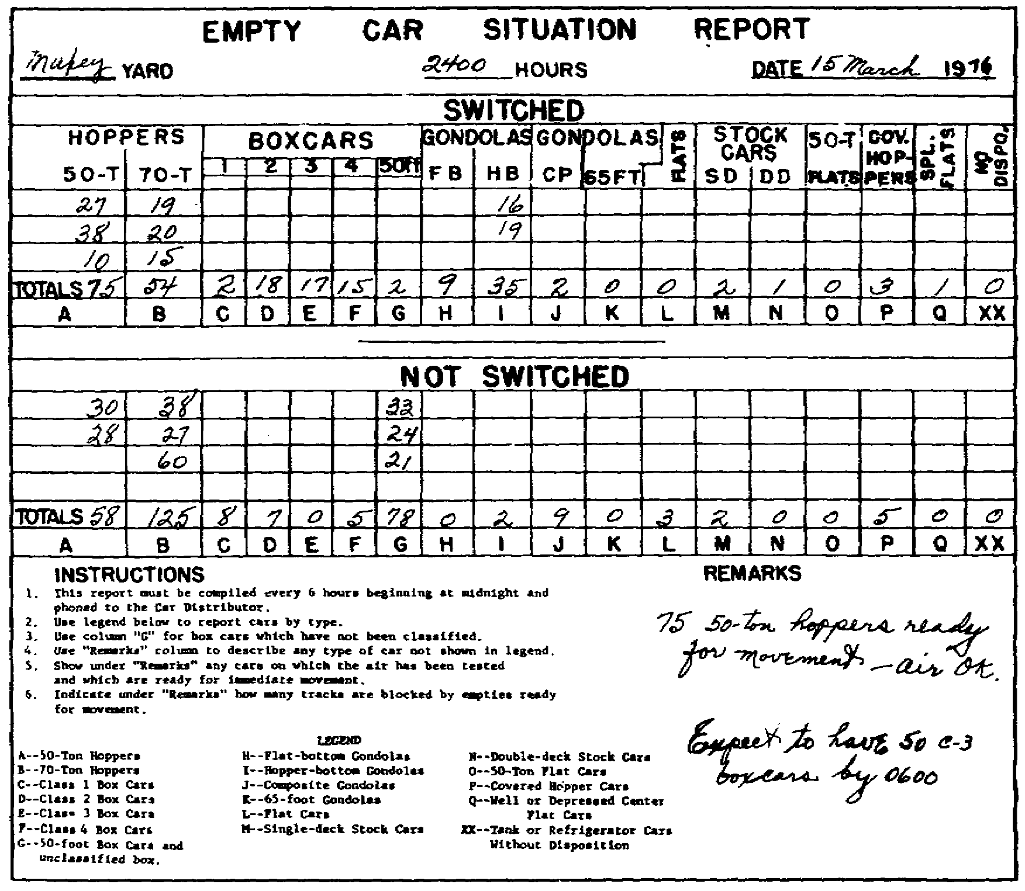

Slide 97
(2) Consolidated empty car report. The number of empty cars shown on
the various yard reports are totaled by the car distributor and entered on
the consolidated empty car report.

Slide 98
The forms of the reports vary considerably among railroads and between
civilian and military railroads. Basically, they serve the same purpose
wherever and however used. As empties move out of a yard, the car
distributor deducts them from his master report. The next report from the
yard forwarding the empties omits those moved but includes others
accumulated since the previous report. Frequently, a report from a yard
does not change greatly from its previous one, the principal change being in
the "switched" and "not switched" figures. Over a period of 8 or 12 hours,
however, considerable changes may be reflected in the reports. Annex D
shows a consolidated empty car report representative of what might be
maintained on the Elwood division shown in figure 1.1.

Slide 99
2.12. CAR DISTRIBUTION IN A THEATER OF OPERATIONS
In time of war, and particularly in a theater of operations, car
distributing differs radically from that described in the foregoing
paragraphs. No surplus of empties will exist; the opposite will prevail.
In a theater, adherence to boxcar classification will scarcely be practical
and any piece of equipment that will haul any type of freight will have to
be used. Hopper and gondola cars constructed to haul bulk commodities or
aggregates may have to be pressed into service to haul crated goods; they
might be the only ones on hand. Cars with leaky roofs might have to be used
to haul highgrade
commodities even if it requires covering the lading with
tarpaulins or other protective covers. Few rules can be given for full and
efficient use of equipment because of unknown and highly varying conditions
in a theater, but two basic rules must be strictly followed: unload all cars
with dispatch when received at forward points, and keep all empties moving
from front to rear for reloading.

Slide 100
2.13. SUMMARY
Moving trains over a rail division involves considerable paperwork for
the dispatcher. Included in it is one important document known as the train
sheet. It provides a clear picture of the movement of trains on a rail
division. The dispatcher can determine from looking at the train sheet how
many trains are operating and whether they are exceeding the speed limits or
losing time. He can also find out about the weather at various points along
the line: it may very well enter into the dispatcher's plans. For example,
a severe drop in temperature may cause the dispatcher to reduce the tonnage
on future trains, issue orders to reduce speed, or provide for engine pusher
assistance at points where trains may stall.

Slide 101
Another document, the employees' timetable, authorizes the movement of
all regular trains. It determines the method the dispatcher should use in
moving trains. Along with the time schedule of all regular trains, it
contains such special instructions as a list of company doctors and
oculists, speed restrictions at specific locations within the division,
number of handbrakes to be used on cars on certain tracks, capacity of
sidings, engine restrictions, and closeclearance
points.
Because of the large amount of work the chief dispatcher has to do, an
assistant chief dispatcher assists him in carrying out his duties. The
assistant chief must be able to assume the duties of the chief dispatcher
and also the duties of any train dispatcher in the office. Others on the
chief dispatcher's staff are a telegraph operator and train dispatchers.

Slide 102
The car distributor is also usually located in the dispatching office,
and he sees that enough empty cars are on hand wherever they are needed for
loading along the rail line. He works closely with the dispatcher and the
yardmasters. A car distributor must be careful when advising the dispatcher
on moving empty cars. They must not be moved to a point where they will sit
empty while they are needed at another station. The two documents a car
distributor uses in doing his job are the yard or situation report and the
consolidated empty car report. From them, the car distributor can tell the
numbers and types of all empty cars he has on hand. Two important things to
remember about car distributing in a theater of operations are that all cars
should be unloaded as soon as possible after arriving at forward areas, and
all empty cars should be kept moving toward the rear for reloading.

Slide 104
3.1. GENERAL
Operating a railway, involving the movement of trains over hundreds of
miles of track, makes adequate and dependable communication systems
imperative. To control trains properly, a train dispatcher needs adequate
communications. A special system results: the dispatcher's telephone
circuit. Also, in the early stages of an operation, the transportation
railway service (TRS) may need radio communication. When wire lines are
cut, down, destroyed, or nonexistent and when the building or rebuilding of
them does not keep pace with track reconstruction, the TRS can request the
installation of radiocommunication
facilities. When there are no
communication facilities and manual block systems are not in operation, the
fleet operation method is another way that the dispatcher can control train
movement.
The next six paragraphs describe the telephone circuit and its use in
getting trains over the rail lines. Radio communications for the dispatcher
are discussed in paragraphs 3.8 through 3.12, followed by one paragraph
describing the feet method of operation.

Slide 105
3.2. TELEPHONE CIRCUIT
The train dispatcher's telephone circuit is used for train movements by
train order and for control of trains through towermen and station agents
within a division. The telephones connected to this circuit and located at
strategic points along the division are equipped with a pushtotalk,
releasetolisten
button. A typical dispatcher's telephone is shown in
figure 3.1. The button holds the circuit open when a particular telephone
is not in use. Consequently, anyone on the division may lift a receiver at
any point on the line and listen to all conversations.

Slide 106
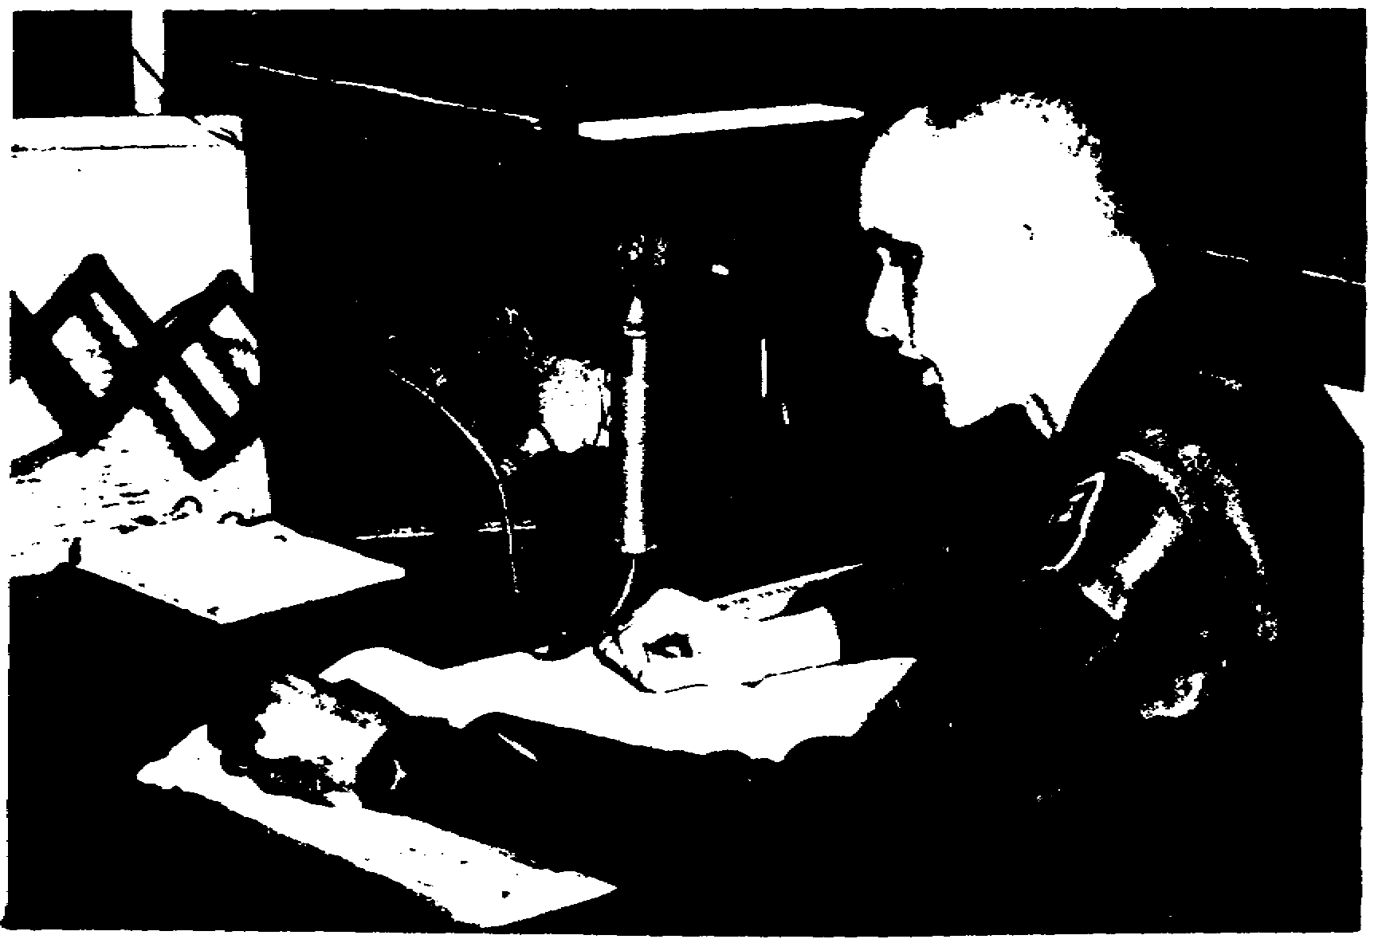

Slide 107
In the dispatcher's office, a foot pedal instead of a button is cut into
the telephone circuit. The dispatcher depresses the pedal to talk and
releases it to listen. This gives him free use of both hands. The
telephone circuit has selective ringing that permits the dispatcher to call
any station individually or all stations simultaneously. Usually, the
ringing keys are connected with an answerback
signal so that a dispatcher
knows the telephone in the station he is calling is actually ringing. This
assures promptness in answering a dispatcher's telephonesomething
that is
vital to safe and efficient railroading.

Slide 108
A large part of a dispatcher's work may consist of answering questions
from and furnishing information to workmen along the line. On a division
with high traffic density, a dispatcher's wire is a busy one with
conversations going on almost continually. Ideally, there will be three
circuits: a dispatcher's circuit used exclusively for the transmission of
train orders, a message circuit used for messages concerning train movement
other than train orders, and a third circuit for messages of a general
nature not directly concerned with train movement.

Slide 109
3.3. PRIORITIES
Transmitting train orders over the telephone circuit carries the highest
priority. Such conversations may account for most of those held over the
wire, particularly if the division consists of a single main track.
Ordinarily, a dispatcher does not permit train order transmittal to be
interrupted because of the importance of his listeners' copying and
repeating the orders correctly. An interruption should not be made unless a
person is certain it is warranted. However, on rare occasions interrupting
a conversation is justified. A person may want to break in upon a train
order transmittal to report a wreck, washout, rock slide, or some other
occurrence which conceivably might cause the dispatcher to change the train
order he is dictating or having repeated. Other reasons might be an
immediate need to contact the dispatcher to prevent a wreck or serious delay
to mainline
trains.

Slide 110
Most users calling the dispatcher try to establish their own priorities.
However, because of the extreme complexity in trying to set such priorities,
no hardandfast
rules as to who may speak first can be made. The callers
simply compare the importance of their business with what is being discussed
at the particular time. A silence of 3 or 4 seconds after a conversation
ends generally signifies that nobody is going to speak and that anyone with
lowpriority
business can break in.
Frequently, several individuals may be waiting for an opportunity to
talk to the dispatcher when train orders are not being transmitted. Again,
this brings up the problem of priority of business which is probably best
explained by discussing the types of calls ordinarily made over the usual
dispatcher's circuit. These may be roughly divided into three categories
and are treated in paragraphs 3.4 through 3.6 in the general order of their
importance. Emergency calls that are not directly related to maintrack
operations are covered in paragraph 3.7. The detailed conversations in the
following paragraphs are keyed to the doubletrack
Elwood division
illustrated in figure 1.4. To gain a better understanding of the types of
calls made over the circuit, refer to the map and try to place yourself in
the caller's location

Slide 111
3.4. FIRST CATEGORY
Frequent calls to the dispatcher deal with matters directly connected
with maintrack
operation. The five principal sources of calls in this
category are telegraph operators, yard crews, yard masters, road crews, and
tower operators.

Slide 112
a. Telegraph operatorsalong
the line who report the passing of each
train.
Caller: "Dispatcher?"
Dispatcher: "Yes?"
Caller: "Extra 4886 West by RK tower at 1143 with 124 cars."
Dispatcher: "Okay."

Slide 113
b. Yard crewsalong
the line who wish to use or cross the main tracks
and must request the dispatcher's permission to make such moves.
Caller: "Dispatcher?"
Dispatcher: "Yes?"
Caller: "Yard engine 337, Conductor Brown, light*, would like to
cross No. 1 and 2 main at Bliss for work at Standard Brick
Company."
Dispatcher: "Okay. I have an extra going by DN in a couple of minutes
so make it snappy and don't stop him."
Caller: Okay.

Slide 114
c. Yardmasters or telegraph operatorswho
request permission for yard
crews to use, cross, or block the main track in doing their work. A typical
example follows.
Caller: "Dispatcher?"
Dispatcher: "Yes?"
Caller: "This is Jones, yardmaster at Wildwood. I have to make a
50car
double** and must go out on the westbound main.
After No. 61 goes, how about Conductor Williams on engine
314 using the westbound for about 10 minutes?"
Dispatcher: "Okay; after 61."
Caller: "Okay."

Slide 115
d. Members of a road crewwhose
train may encounter trouble while
occupying the main track, be stalled, or be faced with the necessity of
making an unscheduled stop. The following example is typical.
Caller: "Dispatcher?"
Dispatcher: "Yes?"______________
* Without cars or caboose.
** Moving cars off one track and coupling them to cars on another.
40
Caller: "This is Conductor Folan on Extra 194 West. We have just
made an emergency stop about 2 kilometers west of Wildwood.
We have probably broken in two or maybe broken an air hose.
Is anyone close to us in either direction?"
Dispatcher: "No, nobody close. Where are you calling from?"
Caller: "Phone box DS11."
Dispatcher: "Where's your caboose?"
Caller: "About 20 car lengths west."
Dispatcher: "All right, let's see. You have 125 cars, and you are 20
car lengths back of the caboose. The track between the
phone and the road crossing holds less than 100 cars. That
right?"
Caller: "Correct."
Dispatcher: "Okay. That means your engine is well past the crossing,
so it's probably not involved in a gradecrossing
accident.
Your engine should be pretty close to that phone box near
the Sands River bridge, so I should soon be hearing from
your head end. Have your flagmen protect both eastbound
and westbound mains*, and then you start going over your
train. I want a report on whether anything from your train
is fouling the eastbound main as soon as I can hear from
you. The eastbound local just passed AY tower and has work
both at Lily and Fairview, so he shouldn't be looking at
you for at least an hour. If you are fouling the
eastbound, I can hold the local at Fairview. Let me hear
from you as soon as you know."
Caller: "Okay."

Slide 116
e. Tower operatorswho
are seeking information for crews who cannot
reach the dispatcher. Frequently, a road crew may be having difficulty in
making progress and may throw off a message rather than stop to call the
dispatcher. An example of each situation follows.

Slide 118
(1) Towermanrelaying
a road crew's message.
Caller: "Dispatcher?"
Dispatcher: "Yes?"
Caller: "RK Tower. Extra 198 West by at 1531 hours with a hotbox
38 cars back from the engine. The head end threw off a
message advising that they want to set it off at
Ogdensburg."
______________
*Rule 102.
41
Dispatcher: "Okay. Does the rear end know about it?"
Caller: "Yes. I read the message and handed it to the caboose when
it passed."
Dispatcher: "Good. He's about 40 minutes ahead of No. 87 and should be
able to make Wildwood siding to clear 87's time. I'll line
up the operator at OG and see if he can have his yard
engine reach out and take the hotbox when they pull up to
clear the crossover. Okay?"
Caller: "Okay."

Slide 119
(2) Towermanreporting
on a train's poor progress.
Caller: "Dispatcher?"
Dispatcher: "Yes?"
Caller: "RK tower. Extra 210 West has started by me, but he's not
doing too well."
Dispatcher: "You haven't given him a yellow block* since he left
Madison have you?"
Caller: "No, he's had a clear block all the way. It's getting a
lot colder here."
Dispatcher: "What's the temperature?"
Caller: "It's 18 above. It's dropped 5 degrees in the last couple
of hours."
Dispatcher: "Well, it looks like I'll have to cut the tonnage again.
How's he doing nowpicking
up any?"
Caller: "About the same. His rear end is in sight now, so he'll be
able to make it past the tower.”
Dispatcher (ringing Conroy yard): "All right, the pusher engine is at OG.
I'll bring him down the eastbound, and you put him up
behind the 210. Tell the pusher to shove him all the way
to OG."
Caller: "Okay."
Voice: "Are you ringing Conroy yard, dispatcher?"
Dispatcher: "Yes. That Extra 210 out of therehe
wasn't overloaded,
was he?"
Voice: "No, he had 7,527 tons. We double checked it. Why?"
Dispatcher: "Well, he's stalling even before he gets to Windham hill.
It's much colder up there so we had better figure on
cutting the tonnage to 7,000 on later trains. I'll put out
a message."
Voice: "Okay."

Slide 120
3.5. SECOND CATEGORY
Calls falling into the second category are requests for information that
do not directly affect maintrack
operations but are related. Yardmasters,
trainmasters, signal maintainers, and others may make the calls; they
request a wide range of information. Three typical examples follow.

Slide 121
a. First example.
Caller: "Dispatcher?"
Dispatcher: "Yes?"
Caller: "This is Trainmaster Duncan at RK tower. What do you have on the
railroad?"
Dispatcher: "Just about the normal run for this time of week, sir.
Have you a pencil ready?"
Caller: "Shoot!"
Dispatcher: "All right, coming east I have Extra 9525 with 125 empty
hoppers by LY at 1757. Maxey has another mixture of loads
and empties COD* at 1800. Have not received a consist yet.
Going west, an extra with 125 cars of coal should be
entering Maxey right now. Another tonnage train should be
hitting BO bell any minute. That's about the works!”
Caller: "I see. Is Conroy going to have anything else before the symbol
freights** get here?"
Dispatcher: "No, not before. It looks like a solid AY train right
after midnight and a cleanup train a couple of hours later."
Caller: "How does it look for the symbol trains?"
Dispatcher: "According to Conroy yardmaster, it looks like CM1**
will
be a little heavy75
to 80 cars. But CM3
will be about
the usual length50
to 60 cars. Both should be out of
Conroy right on time."

Slide 122
______________
* Called on duty.
** A symbol train is usually a freight train carrying highpriority
goods.
It operates on a somewhat regular schedule and may or may not be listed
in the timetable. Such a train takes priority over an extra carrying
regular freight. The designator it carries shows its points of origin
and destination as well as its direction. For example, BC3
would
indicate a westbound train traveling from Boston to Chicago. The odd
number 3 shows it is westbound; an even number would appear in the
designator of an eastbound train.
43

Slide 123
Caller: "Good. I have my car here and I am going to drive over to Elwood
mines. I'll call you from there. If anyone is looking for
me, I'll be around RK and Wildwood until after the symbol
trains go. I'11 keep in touch."
Dispatcher: "Okay."

Slide 124
b. Second example.
Caller: "Dispatcher?"
Dispatcher: "Yes?"
Caller: "West yard, Maxey. That Extra 2770 West you figured here for
1315is
he going to make that figure?"
Dispatcher: "Hardly; I was just going to ring you and change it. He's
setting off a hotbox at Lily."
Caller: "Good!"
Dispatcher: "Good? What's the matter, no clear tracks as usual?"
Caller: "Not by 1315. What time do you figure him now?"
Dispatcher: "Well, let's see. He will have to leave Lily in time to
clear No. 5 at AY tower. Let's figure him by AY at 1400
and in the yard by 1415."
Caller: "Okay. We can take him then. Thanks."

Slide 125
c. Third example.
Caller: "Dispatcher?"
Dispatcher: "Yes?"
Caller: "This is Jordan, the signal maintainer. That dwarf signal at RK
tower is back in operation at 1430."
Dispatcher: "Okay, fine. Did you get that report on the flashing
lights on the grade crossing at Elwood?"
Caller: "Yes, I did. I'm ready to leave here now with the gasoline rail
car. Do you have anything on the branch?"
Dispatcher: "I have a crew switching at Elwood mines, but they won't be
ready to leave there for an hour. You should be able to
duck over and back before they're ready to leave. I'm not
sure the lights are actually out. The report supposedly
came from a motorist, but I can't raise the station agent,
to see if he knows anything about them. Go 'over and check
on them, but don't start back without calling me."
Caller: "Okay

Slide 126
3 6. THIRD CATEGORY
Calls in the third category are frequently unimportant from the
dispatcher's viewpoint but may be important to the individual making the
call. Typical examples follow

Slide 127
a. First example.
Caller: "Dispatcher?"
Dispatcher: "Yes?"
Caller: "What is the correct time?"
Dispatcher: "2231.”
Caller: “Okaythanks."
b. Second example.
Caller: "Dispatcher?"
Dispatcher: "Yes?"
Caller: "Madison stationhow's
No. 5?"
Dispatcher: "On time."
Caller: "Okay, thanks."

Slide 128
c. Third example.
Caller: "Dispatcher?”
Dispatcher: "Yes?"
Caller: "Fairview station. Do you know whether No. 85 is going to stop
here this morning?"
Dispatcher: "Don't know yet. Haven't heard from Conroy."
Caller: "Well, I have a passenger going beyond Maxey. I'll have to flag
No. 85 if it's not going to stop."
Dispatcher: "Check with me in 15 or 20 minutes. I should know by then."
Caller: "Okay."
d. Fourth example.
Caller: "Dispatcher?"
Dispatcher: "Yes?"
Caller: "BO tower. Is conductor Bunce coming west, or COD yet at
Conroy?"
Dispatcher: "No, he isn't. Who wants to know that?"
Caller: "Just had a phone call from his home."
Dispatcher: "Suppose you call the Conroy crew dispatcher. He can tell
you how Bunce stands."
Caller: "Okay."

Slide 129
e. Fifth example.
Caller: "Dispatcher?"
Dispatcher: "Yes?"
Caller: "RK tower. How's No. 86?"
Dispatcher: "Ten minutes late leaving Maxey. 'High Wheel' Johnson is
pulling it though, so he'll probably be looking at you on
time."
Caller: "Okay."

Slide 130
3.7. EMERGENCY USE
Occasionally, the dispatcher circuit is used for conversations that have
no connection with maintrack
business, and in which the dispatcher has no
interest. An example might be that of using the dispatcher's circuit to
connect two yards 30 or 40 kilometers apart, when it is impossible to place
the calls over the usual longdistance
lines. Such calls should not be made
over the dispatcher's circuit unless they are important and cannot be
completed otherwise. The dispatcher's wire is usually the most dependable
on the railroad, and dispatchers in general are cooperative about its use if
the circuit is not particularly busy. However, they usually insist that
such conversations be as brief as possible, and they usually await a lull in
business before completing such a call. Following is a typical example.

Slide 131
Caller: "Dispatcher?"
Dispatcher: "Yes?"
Caller: "This is Billings, yardmaster at Maxey. Can you ring the West
yard at Conroy? Our operator can't raise them."
Dispatcher: "Okay, I'll try."
Voice: "West yard, Conroy."
Caller: "Billings, Maxey yard. Engine 2840, Conductor Boyle, out of
there about 4 hours ago, had UP 105104 and no waybill.
What can you tell me about it?"
Voice: "Just a minute.... Yes, we have the bill. It's a car of
merchandise for the Crawfordsville freight house. I have a
couple of new clerks here, who must have slipped up. This
place is a madhouse."
Caller: "I know what you mean, but that car is hot stuff. How soon can
you get the waybill to us?"
Voice: "Well, No. 61 will be leaving here in 20 minutes. I'll see that
the bill is put on the express car if you can have someone
meet the train.”
Caller: "We'll meet it, but make sure to address the bill to the
Yardmaster, West yard."
Dispatcher: "All right, all right, break it up."
Voice: "Okay, dispatcher. Thanks

Slide 132
3.8. RADIO COMMUNICATION
Radio communication facilities can be provided the transportation
railway service in the early stages of theater operation. Such facilities
are established only when conditions warrant their use, wire lines are not
available, and the theater army commander authorizes the installation. Then
signal units provide the required radio relay or other supplementary
communications. Teams from TOE 11500,
attached to the railway battalion,
install, operate, and maintain the radio equipment.
The TRS uses radio communications to increase control, coordination,
efficiency, and safety of rail operations and train movements. Radio
communications are employed in three ways: (1) operational control in yards
and terminals, in yard offices, of switch crews, and of yard personnel; (2)
administrative and technical control of operating and administrative units;
and (3) en route train operational control between dispatcher and stations,
train crew members, stations, dispatcher and trains if range is adequate,
stations and trains, and crews of different trains.

Slide 133
In radiotelephone transmission, certain basic rules of procedure are
observed, the phonetic alphabet and numbers and procedure words are used,
and the message has three main parts. These are discussed in paragraphs 3.9
through 3.12. Radio operating rules Nos. 680 through 686 are given in
appendix III.

Slide 134
3.9. BASIC RULES OF RADIO PROCEDURE
Delay and inaccuracy result when correct radiotelephone procedures are
not followed. Four basic rules follow.
a. Rule 1. Before transmitting, be certain no other station or
operator is transmitting.
b. Rule 2. Know precisely the content and wording of the message to be
transmitted.
c. Rule 3. Be brief and to the point. Preciseness is politeness;
"please" and "thank you" are unnecessary
d. Rule 4. Hold microphone directly in front of the mouth. Speak
directly into, rather than across, the face of the microphone. Lips should
lightly touch the mouthpiece. Without straining, raise voice pitch as much
as possible. Speak distinctly, emphasize every syllable of every word, and
avoid "ers" and "uhs" between words. Natural sentence rhythm and intonation
are preferred.

Slide 135
3.10. PHONETIC ALPHABET AND NUMERALS.
In radiotelephone transmission, the U. S. military services use the
International Civil Aviation Organization phonetic alphabet and numerals.
They follow in subparagraphs a and b.
a. Phonetic alphabet. The phonetic words used to represent the letters
of the alphabet are:
A.........Alfa N.........November
B.........Bravo (Brahvo)
O.........Oscar
C.........Charlie P.........Papa
D.........Delta Q.........Quebec (Kbeck)
E.........Echo R.........Romeo
F.........Foxtrot S.........Sierra
G.........Golf T.........Tango
H.........Hotel U.........Uniform
I.........India V.........Victor
J.........Juliet W.........Whiskey
K.........Kilo (Keylo)
X.........Xray
L.........Lima (Leema) Y.........Yankee
M.........Mike Z.........Zulu

Slide 136
b. Phonetic numerals. The phonetic pronunciation of the numerals is
given below.
0...............zero
1...............wun
2...............too
3...............thuhree
4...............fower
5...............fiyiv
6...............six
7...............seven
8...............ate
9...............niner

Slide 137
3.11. PROCEDURE WORDS
To expedite radiotelephone message handling, certain words and phrases
are universally used and understood by U. S. military service operators.
Generally called procedure words, or prowords, they are used as applicable
in TRS radio transmission to substitute for one or more sentences in a
message. The words or phrases and their meanings follow.

Slide 138
WORD OR PHRASE MEANING
Acknowledge I want an acknowledgement to be sure you
have received, understood, and will
comply with this message.
Break I hereby indicate the separation of the
text from the other portions of the
message.
Correction An error has been made in this transmission
(or messages indicated). The correct
version isthat
which follows is a
corrected version in answer to your
request for verification.
Disregard this transmission This transmission is in error. Disregard
it. (This proword shall not be used to
cancel any message already transmitted
for which acknowledgment has been
received.)
From The originator of this message is indicated
by the address designation immediately
following.
Groups This message contains the number of groups
indicated by the numeral following.
I read back The following is my response to your
instructions to read back.
I say again I am repeating transmission or portion of
message indicated.
I verify That which follows has been verified at
your request and is repeated. (This is
used only as a reply to VERIFY.)
Message follows A message which requires recording is about
to follow (to be transmitted immediately
after this call.)

Slide 139
WORD OR PHRASE MEANING
Out This is the end of my transmission to you,
and no answer is required or expected.
Over This is the end of my transmission to you,
and response is necessary. Go ahead;
transmit.
Read back Repeat this entire transmission back to me
exactly as received.
Relay (to) Transmit this message to all addressees or
to the address designations immediately
following.
Roger I have received your last transmission
satisfactorily.
Say again Repeat all your last transmission.
Followed by identification data means
repeat portion indicated.
Silence Cease transmissions immediately. (Maintain
silence until instructed to resume).
Silence lifted Resume normal transmission. (Silence can
be lifted only by the station imposing
it or higher authority.)

Slide 140
This is This transmission is from the station whose
designation immediately follows.
That is correct You are correct, or, what you have just
transmitted is correct.
Time That which immediately follows is the time
or datetime
group of the message.
Unknown station The identity of the station with whom I am
attempting to establish communication is
unknown.
Verify Verify entire message (or portion
indicated) with the originator and send
correct version.
Wait I must pause for a few seconds.
Wait out I must pause longer than a few seconds.
Wilco I have received your message, understand
it, and will comply.

Slide 141
WORD OR PHRASE MEANING
Words twice Communication is difficult. Transmit each
phrase (word or code group) twice.
(This proword may be used as an order,
request, or information.)
Wrong Your last transmission was incorrect; the
correct version is

Slide 142
3.12.
MESSAGE COMPOSITION
Each radiotelephone message is made up of three parts. They are the
heading, the text, and the ending, discussed in subparagraphs a, b, and c.
a. The heading always includes the call. An example is HICKORY 6THIS
ISMAPLE
7MESSAGE
FOLLOWS. HICKORY 6 is the call sign of the station
called, THIS IS is a proword found in every transmission, MAPLE 7 is the
call sign of the calling station, and MESSAGE FOLLOWS is a proword spoken
just before the text of the message begins.
b. The text may be in plain language, code, or cipher groups.
c. The ending of a transmission may include authentication if being
used, and concludes with either "over" or 'but," never both. Either "roger"
or "wilco," to acknowledge receipt of the message, may precede "over" or
"out."

Slide 143
3.13. FLEET OPERATION
Before signal systems and communication facilities are restored to
service in a theater, the dispatcher uses the fleet operation method to
control train movement. Fleet operation is a method of operating trains on
a single track in each direction for alternate periods. For an unspecified
length of time, all trains travel westward, for example, and when such
movements have cleared the main at the westward point, trains start moving
in the opposite direction. Assume a section of railroad runs from A to H.
Imagine that A represents a port with a rail terminal, and that H represents
a railhead 60 kilometers to the west with a capacity of 10 trains of a given
length. Arrangements might be made to run cars amounting to 60 or 70
percent of A's storage capacity. Each westbound train operated would be
classed as an extra and would carry running orders
51
authorizing movement from A to H. The last train would carry an order
stating that it was the last of the westbound movements. When this train
reaches H, the order would be the authority for the yard there to start
moving empties back to A. When the last eastward train arrives at A, the
order that it carries then authorizes westward movement to begin again.

Slide 144
order that it carries then authorizes westward movement to begin again.
Thus, trains may go in one direction for a period of several hours to
several days, before movement starts in the opposite direction. This system
can also be used by specifying certain inclusive hours or days for westward
movements and an equal period for returning empties eastward. These may be
established in 4,
8,
12,
or 24hour
periods as required. How long each
direction is used continuously depends entirely on the capacities of the
yards, railheads, and terminals at the forward points.

Slide 145
3.14. SUMMARY
In addition to transmitting train orders, the dispatcher's telephone
circuit is used for furnishing information to and answering questions for
employees along the line. Because of the importance of copying and
repeating train orders correctly, the dispatcher usually does not permit
interruption of their transmittal. However, it may be justified to make a
report which might cause the dispatcher to change the order being dictated
or to prevent a wreck or serious delay to trains.

Slide 146
Transmitting train orders is the first order of business over the
circuit. The priority of other calls must be established when several
persons are waiting to speak to the dispatcher. Usually, calls in the first
category are those dealing with maintrack
operations; in the second, those
requesting information related to but not directly affecting maintrack
operations; and in the third, those that are ordinarily unimportant from the
dispatcher's point of view but important to the person making the call.

Slide 147
In the early stages of theater operations, the transportation railway
service may request radio facilities. If approved, signal units install,
maintain, and operate the equipment. Basic rules of radio procedure are
followed to prevent delay and inaccuracy. Use of the phonetic alphabet and
numerals is standard in radiotelephone transmission. Procedure wordsprowordsare
used and understood in TRS radio transmission. A message
consists of a heading, a text, and an ending.

Slide 148
When there are no communication facilities, the method of dispatch
changes. Usually, the fleet method of operation is used. However, when
communication facilities are operational and the dispatcher's circuit is
again in use, calls are made in the order of their importance, and the fleet
operation method is no longer used.

Slide 150
4.1. GENERAL
"A train is superior to another train by right, class, or direction," as
stated in rule S71
of the railway operating rules covered in Technical
Manual 55200.
This rule and the others establishing superiority are
probably the most simply stated and easiest to understand of all railroad
rules.
Applying the provisions of these rules to any two trains of the same or
a different class moving in opposite directions on a single track is
comparatively basic. However, when three trains of different classes become
involved in twoway
movement on a single track, superiority and the correct
interpretation of numerous train orders can present a complex problem to the
persons involved. However, the right of a train to be in a particular
location at a given time is easily asserted and proven. But if that right
is not fully respected by all train crews, some may find themselves little
better off than a motorist in a hospital bed who insists he had the rightofway.
This chapter discusses the superiority of trains and the
dispatching methods involved in changing that superiority.

Slide 151
4.2. SUPERIORITY AND RIGHT
On a railroad, you may hear the words "timetable rights." However, they
convey a mistaken idea. “Right," as a dispatcher uses it, can be conferred
by train order alone. On the other hand, "superiority" is granted by the
timetable. Subparagraphs a and b define the terms and explain the
differences between the two. Both "right" and "superiority" must be clearly
understood by students of train dispatching.

Slide 152
a. Right can be conferred on a train only by train order and never by
timetable.
b. Superiority is conferred by the timetable, based on a train's
superior class or superior direction. A regular train may have timetable
authorization or timetable superiority but not necessarily superiority by
right. If such a train is issued a train order that helps it but restricts
another superior train, then the first train has superiority by right in
addition to timetable superiority.

Slide 153
4.3. RULES ESTABLISHING SUPERIORITY
The rules quoted in this paragraph from Technical Manual 55200
establish the superiority of trains. Those rules with an "S" prefixed apply
to single track, those with a "D" to double track, and those without a
prefix to both single and double track.
a. Rule S71.
General. A train is superior to another train by right,
class, or direction.
(1) Right is conferred by train order; class and direction by
timetable.
(2) Right is superior to class or direction.
(3) Direction is superior between trains of the same class.
b. Rule D71.
General. A train is superior to another train by right
or class.
(1) Right is conferred by train order; class, by timetable.
(2) Right is superior to class.

Slide 154
c. Rule 72. Class and Direction. Trains of the first class are
superior to those of the second, those of the second class are superior to
those of the third, and so on. Trains in the direction specified by the
timetable are superior to trains of the same class in the opposite
direction.
d. Rule 73. Extra Trains. Extra trains are inferior to regular
trains.

Slide 155
4.4. CLASS AND DIRECTION
Both class and direction are conferred by timetable. The two terms are
defined and discussed in subparagraphs a and b.
a. Class is conferred by the timetable and cannot be raised or lowered
by train order. However, the class can be taken away from a train if the
dispatcher annuls its schedule and runs it as an extra. Firstclass
trains
are superior to those of second class, second is superior to third, third is
superior to fourth, and so on. Some railroads even have fifth class, but in
the interest of a basic presentation, this text avoids using any below the
second in the examples given. Extra trains are inferior to all others.
However, on most railroads when two extras meet on single track, the train
going in the superior direction holds main track, and the other takes
siding.
b. Direction is also conferred by timetable. For example, a railroad
may specify that the eastward direction is superior to westward. At a
meeting point between trains of the same class, the one moving in the
inferior timetable direction must take siding unless otherwise provided in a
train order.

Slide 156
4.5. RIGHT
Right is conferred by train order, and it is superior to class and
direction. An illustration of how right may be superior to direction is
shown in paragraph 2.5b; the following illustration shows how right may be
superior to class. While reading this example, you may wish to refer to
figure 1.1. Assume that a 125car
westbound extra, loaded to the engine's
rated capacity, approaches Wildwood about 15 minutes before firstclass
train No. 62 is due there from the opposite direction. Although train No.
62 is firstclass,
it is a slow, daily local hauling mostly baggage,
express, and only a few passengers. Since 5 or 10 minutes delay to this
kind of firstclass
train is relatively unimportant, the dispatcher may
sidetrack it just before it reaches Wildwood to keep from stopping the heavy
extra. If, instead, the extra were sidetracked to clear No. 62, pusher
assistance might be needed to get it started again, and other trains in both
directions might be delayed. The extra, of course, would need a written
train order to proceed into an area on a firstclass
train's time. The
eastbound passenger train would also need a train order to take siding
because both its class and direction are superior, and consequently, its
crew expects to hold the main track against all trains. The dispatcher,
then, would issue a train order transferring the right to the extra and
stripping the superiority from the passenger train. However, this change is
effective only until the trains meet, at which time each reverts to its
former status. Remember, then, in the absence of orders to the contrary,
the superior train holds main track.

Slide 157
Many railroads sidetrack slowmoving
passenger trains to let "time" and
symbol freights pass. While usually classified as extras, these trains
operate on a time schedule even though their schedules are not listed in the
operating timetable. They haul highclass
freight that usually produces
more revenue than the firstclass
trains. They exercise no right over
regular trains, however, unless such right is conferred on them by train
order.

Slide 158
4.6. EXTRAS
A large number of the trains on any railroad may be designated as
extras. They are not listed in the timetable and run whenever sufficient
freight or tonnage is in a yard to justify their operation. Also, it may be
necessary to run additional passenger sections, especially during the
vacation and holiday seasons. In addition, extra work trainswork
extrasmay
also be run.
For the purpose of documentation, all extra trains are always so
designated, such as Extra 310 East, or Work Extra 9220. Work extras are
worktrains
from which employees perform track maintenance and construction
along the rightofway
between specified points. Because these trains must
move in both directions; no such designator is used when referring to them.
Unless otherwise provided in a train order, a work extra must clear all
regular trains and protect against other extras in both directions. A work
extra may not protect against a regular train, that is, work on the time of
an overdue scheduled train under flag protection, unless instructed to do so
by a train order.
To distinguish between extra trains and those regularly scheduled, the
extras display white flags by day and white lights at night on the front of
the locomotive. Note the white flags mounted on the passenger extra shown
in figure 4.1. If more than one locomotive is used on the head end, only
the forward engine carries the signals. These extras must always comply
with rules 86 and S87
quoted in paragraph 1.4a, b. Scheduled trains do not
display signals except under the conditions cited in paragraph 4.7.

Slide 159
4.7. SECTIONS
In handling passenger trains, running additional sections is frequently
necessary. A section is one of two or more trains running on the same
schedule. Technically speaking, and especially in the dispatching and
telegraph offices, there is no such thing as a passenger train. It is
either a train with a class designator, or it is an extra. This is
important for operating employees also. If a
Figure 4.1. Passenger Extra Displaying White Flags.
conductor were waiting "in the clear" for a firstclass
train, he could not
assume, simply because he saw a train with several passenger coaches go past
him, that that was the train for which he was waiting. He would have to
note the engine number to be certain. The one he saw might be a string of
empty coaches and might be
designated an extra. It would seem logical, then, that if technically there
were no "passenger train, " there certainly could be no "extra passenger
train.” Some railroads require that all trains be designated by class or as
extras.

Slide 160
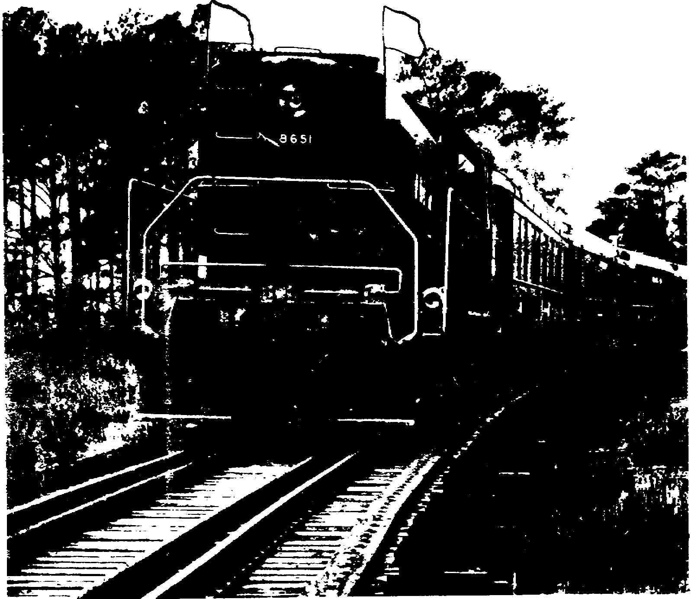

Slide 161
conductor were waiting "in the clear" for a firstclass
train, he could not
assume, simply because he saw a train with several passenger coaches go past
him, that that was the train for which he was waiting. He would have to
note the engine number to be certain. The one he saw might be a string of
empty coaches and might be

Slide 162
designated an extra. It would seem logical, then, that if technically there
were no "passenger train, " there certainly could be no "extra passenger
train.” Some railroads require that all trains be designated by class or as
extras.
Many other railroads, however, recognize the need for the extra
passenger train designation and use it for trains which cannot be run on
another train's schedule. This designator demands and receives more respect
from yard crews and from crews of trains of equal class who at least know
that this train is more important than a train of coal. Crews of scheduled
trains, however, must regard the "extra passenger" as inferior to their own.

Slide 163
When an overflow of passengers requires another train, the dispatcher
may authorizecreatean
additional train and call it a "section.” To give
this section firstclass
standing, the dispatcher often runs it as a
continuation of a firstclass
scheduled train and calls it a "second
section." As an example, assume that firstclass
No. 87 leaves Conroy at
1700 hours, and a section must be run 30 minutes later. The dispatcher can
give this section right over other trains that would otherwise be superior
by calling the section "Second 87." By doing so, regular 87 becomes "First
87." The train orders that the dispatcher issues and their interpretation
are given in the subparagraphs following

Slide 164
a. Orders. To the crew of First 87 and to all telegraph offices and
stations along the line would go this train order: "Engine 450 Display
Signals* and Run as First 87 Conroy to Maxey.” To acquaint all personnel
with details of the second section and its expected time, the following
order would also be necessary: "Engine 464 Run as Second 87 Conroy to Maxey
and Wait at Conroy Until 1730 Hours."
b. Interpretation. The first order requires that all engines and
trains clear First 87 on its regular time the same as if the order had not
been issued. In addition, it requires that the engineer of First 87 blow
one long and two short blasts on his whistle to notify every train of the
same class, every inferior train in the same direction, and all yard engines
that his train is displaying signals for another section. An engine so
notified must acknowledge this signal by two short blasts. The second order
is the authority on
______________
* On all sections except the last, two green flags are displayed during
the day and, in addition, two green lights at night (rule No. 20).
59
which engine 464 proceeds as Second 87 and requires that it be regarded
simply as though it were regular No. 87 and were running 30 minutes late.

Slide 165
4.8. WORK TRAINS AND WORK EXTRAS
Trains hauling work gangs and their tools and equipment to perform
maintenance and construction work along the rightofway
are called work
trains. They have a regular train crew in addition to the maintenance or
construction workers; however, this text deals only with the train crew.
Work trains must give way to other trains as promptly as practicable. In
emergencies, however, it may be necessary to make them superior to other
trains and, sometimes, to all trains. Paragraph 5.19c explains this
further. An example would be a wreck train that must clear the rightofway
before any train could move. The following subparagraphs discuss operations
involved in using work trains.

Slide 166
a. Protecting. A train is said to "protect" when the crew stations a
flagman sufficiently ahead or to the rear to stop any approaching train that
might otherwise collide with the stationary one. Since work trains are
nearly always stationary, it is most practical to have them protect
themselves against all trains. They generally locate where they are
reasonably close to a siding so that they can enter it to clear the main
track when another train approaches. The work train's conductor sees that
his train clears all regular trains, as specified by rules 86 and S87.
When a wayside dispatcher telephone is near, the conductor maintains almost
constant contact with the dispatcher on the whereabouts of extras and knows
when to take siding. The work train has a flagman who must flag the main
track while the work train is occupying it; he is relieved from flagging
only when his train clears the main. He is advised of this clearance by the
engineer's sounding the appropriate number of blasts on the locomotive
whistle, discussed in subparagraph e.

Slide 167
b. Work train orders. When a work train must move back and forth
frequently for the work crew to get the job done, it is impractical to have
the flagman walk ahead of the train. The dispatcher, knowing the kind of
work being done and the extras moving in the area, attempts to issue an
order that permits the work train to move unhampered. If, for instance, no
extra is to arrive at the work limits before 1001 hours, the dispatcher
would issue a train order that permits the maintenance men to carry out
their tasks without protecting against extras until that time. Such an
order might read: "Engine 325 Works Extra 0701 Hours Until 1501 Hours
Between RK and WD Not Protecting Against Extra Trains Until 1001 Hours."

Slide 168
Or, if desired, he could add: "Not Protecting Against Secondand
ThirdClass
Trains." This permits it to work on the time of these scheduled
trains without flag protection. Train orders for work trains, discussed
more fully in paragraph 5.18, are thought to be the most difficult of all to
use intelligently, to get the maximum work done with the least delay.

Slide 169
c. Protecting against work trains. Trains of superior class do not
protect against work trains. On double track, all operating crews know the
location of the work train's area both from copies of this extra's orders
and often from notices posted in crew offices along the line. In general,
the notices specify the work area, the number of days the work will be in
progress, and a reducespeed
limit for the area. On single track, however,
all trains in each direction are given copies of the work extra's train
orders. While instructions generally require all work extras to clear all
trains without delay, no approaching train, regardless of superiority,
tonnage, or importance, would run past a worktrain
flagman.

Slide 170
d. Military work trains. Frequently in a theater of operations, it may
be necessary for all trains to protect against work trains, signifying that
they are given a higher priority than those hauling troops or supplies. In
civilian practice, a work train and its crew may be in a particular location
solely to do work to improve passenger riding comfort or to make longrange
repairs necessary to protect capital investment. It is much more economical
to insist that such a work train protect against and clear the time of all
trains. Why? Because it is small, is generally close to a siding, and can
clear the main track much more conveniently than a heavy train can stop,
wait until the work train clears, and then resume its run.

Slide 171
The military work train, however, may be found blocking the main
track because of different and more pressing reasons. In a theater,
passenger comfort and longrange
maintenance are inconsequential, and work
trains operate only when absolutely necessary, to keep trackage reasonably
fit for supply and troop trains moving toward the front. At times, work
trains are justifiably superior to all other trains simply because failure
to do trackwork speedily would result in a blockade in which no trains would
be able to move. Stopping other trains while the work train clears the main
is not serious because military trains are frequently relatively short and
restarting them is not ordinarily a problem.

Slide 172
e. Proper worktrain
flagging. In discussing proper worktrain
flagging, it would be almost impossible to overemphasize its importance.
When the train is on the main track, the flagman
protects its rear by stationing himself far enough back to stop any
approaching train. On singletrack
lines, the forward end of the train must
be protected in the same way. When the worktrain
engineer pulls into a
siding and clears the main, he sounds an appropriate number of blasts on the
whistle. This is called "whistling in" the flagman. Before the train again
blocks the main, the engineer sounds a specified number of blasts and the
flagman again goes out to flag. This is called "whistling out.” The number
of blasts varies according to the direction in which the train is headed and
to the number of main tracks.

Slide 173
The alternate whistling in and whistling out, which occurs when a
work train clears and blocks the main, involves a hazard that operating
rules do not stress and safety spokesmen seldom point out. The danger stems
from a possible human failure during the flagginga
danger which is
probably best illustrated by the following true story.
An experienced flagman was assigned to flag for a work extra on a
single track not having block signal protection. The work train had about 6
hours work in one location approximately 251 meters from a siding. The
train crew held orders to protect itself against eastbound extras only. The
conductor was able to station himself close to a wayside dispatcher
telephone and, as unscheduled trains came within a few kilometers of the
area, he would have the work train enter the siding and call in the flagman.
This would relieve the flagman and he'd return to the side of the tracks and
let the approaching train by. After it passed, the worktrain
engineer
would whistle out the flagman and then return to the main track; the flagman
would again assume a position in the center of the track ready to stop all
eastbound extra trains.

Slide 174
Several hours passed during which the flagman had been whistled out
and in perhaps a halfdozen
times while as many trains safely passed. Late
in the afternoon, a fast, highpriority
freight appeared in sight of the
flagman about a kilometer away. He, in turn, was a kilometer from his train
which was around a curve and out of sight. The flagman, sitting on a pile
of ties, got up when he saw the approaching train and walked to the center
of the track. He looked in both directions and returned to the tie pile.
Soon he got up again, walked over to the track as if to flag the train, and
suddenly turned around and returned to the pile of ties. The engineer on
the approaching train, expecting to be stopped, had eased off on the
throttle, but he resumed full speed when the flagman walked to the side of
the rightofway
a second time. A kilometer up the track

Slide 175
from the flagman the 45kph
freight crashed into the work train, demolished
the caboose and two work cars, and stopped with its front end buried deep in
the worktrain
engine. Two section men were killed, and property damage was
estimated at nearly $100,000.
What happened? It's rather basic when given a little thought. The
flagman simply couldn't remember whether he was "in" or "out.” He didn't
know whether his train was on the main or in the siding. He had two
choices, and he guessed wrong. If he had recalled the simple provisions of
rule 108"
In case of doubt or uncertainty, personnel will take the safe
course," he would have stopped the train and prevented a tragedy.

Slide 176
4.9. TIMETABLE SCHEDULE
Earlier the text states that if scheduled trains were always on time,
train orders would seldom be needed. When schedules are worked outstrungfor
publication in a singletrack
timetable, the meets of scheduled
trains are planned to the extent that train orders are unnecessary.
However, scheduled trains may frequently run late. When they do, train
orders must be issued to other trains on the line to assist the overdue
trains in getting back on schedule or to prevent them from delaying other
trains or operations. The following subparagraphs further discuss operating
trains with respect to the timetable.

Slide 177
a. Running ahead of schedule. The right of a regular train to occupy
the main track at a particular time is established in the timetable.
However, the train must travel in strict accordance with the published time
figures in the train schedule columns, as shown in the timetable in appendix
II. This means that a train cannot gain time en route and arrive at the
various stations substantially before it is due. Logically, a passenger
train could not make a practice of departing stations early because of the
clamor which would surely be raised by the traveling public, and rightly so.
A train may gain time between any two successive stations, but it must not
pass the advance station earlier than the time shown in the timetable. To
do so would disrupt operations ahead of the train. When a yard crew desires
to cross or foul main tracks, or when an inferior train occupies a track
ahead of a superior one, the crews adhere strictly to the published time
figures in the timetable. They always give thought to, but never depend
upon, the possibility of the scheduled train's being late but NEVER early.

Slide 178
b. Running behind schedule. When a train becomes late on its schedule,
numerous other delays to inferior trains running over
63
the division are brought about. Likewise, yard engines required to use or
cross the main tracks in doing their work may also be delayed. When a
regular train becomes late, the average dispatcher is cautious in
authorizing movements that might interfere with its progress. Knowing that
the engineer is trying to make up lost time, the dispatcher is naturally
reluctant to authorize any movement that might conflict with the engineer's
efforts to get back on schedule. Additionally, and probably more important,
the dispatcher has no way of knowing how many minutes the engineer may have
gained since he was reported past the last station. If the dispatcher takes
no positive action, the crews on the division, even though they know the
train is late, cannot use the time represented by the number of minutes it
is running behind. They must respect the published time until they receive
a train order directing otherwise.

Slide 179
If a train were traveling on the Elwood Division from DN to BO and a
yard crew at FV knew that it was 5 minutes late leaving DN, BL, and MD, they
could not depend on using those extra minutes at FV. The reason is that the
train might make up the lost time between MD and FV and arrive at the latter
station on time5
minutes before the yard crew expected it. In brief, a
train keeps its right to the time in the published schedule unless and until
the dispatcher temporarily amends it with a train order. When he does, he
notifies the train crew and all appropriate operating employees of the
order.

Slide 180
4.10. ORDERS AFFECTING SCHEDULED TRAINS
Chapter 5 deals exclusively with the many forms of train orders; earlier
paragraphs in the text touch upon certain orders and show in detail how they
affect the overall movement of trains over a division. From an
instructional standpoint and in fairness to the reader, it seems unwise to
completely avoid discussing orders until the last chapter. Therefore, those
earlier paragraphs, in which basic dispatching principles are cited, explain
some of the train orders that dovetail with the particular discussion. In
the subparagraphs that follow, specific examples are given of some of the
train orders necessary in handling scheduled trains. In explaining many of
the orders ahead of chapter 5, you are given a working knowledge and an
understanding of the intent of some of the many orders before beginning the
detailed discussion in that chapter.

Slide 181
a. A runlate
order to a train has the same effect as changing its
published schedule for the particular trip. It sets back the schedule by as
many minutes as the train is late. Assume that No. 19, a firstclass
train
running from Conroy to Maxey, is held
64
50 minutes at its starting point awaiting a mail car from a connecting
railroad. In handling this train, the dispatcher has three choices: (1)
giving the crew a runlate
order to run 50 minutes late from origin to
destination; (2) issuing no restricting orders and permitting the crew to
make up as much of the 50 minutes as possible during the run from DN to AY;
or (3) giving the crew a wait order which would specify the earliest time
the train could depart the stations shown in the wait order, discussed in
subparagraph b.

Slide 182
If the dispatcher gave the train a runlate
order, it would read as
follows:
No. 19 Engine 3130 Run 50 Minutes Late Conroy to Maxey
FMB
This order would change No. 19's leaving time at each station. Its
regular schedule is shown below in column 1; its revised schedule in column
2.
This order would not help No. 19 because it does not permit the
train to make up any of the 50 minutes. Of course, inferior trains might
find it helpful. When a dispatcher issues such an order, he is said to be
"putting out time" on the scheduled train involved. Actually, he is
amending the timetable schedule for the particular train for the particular
trip. He is, in effect, granting to others the use of the time represented
by the difference in minutes between the advertised and the runlate
time.

Slide 183
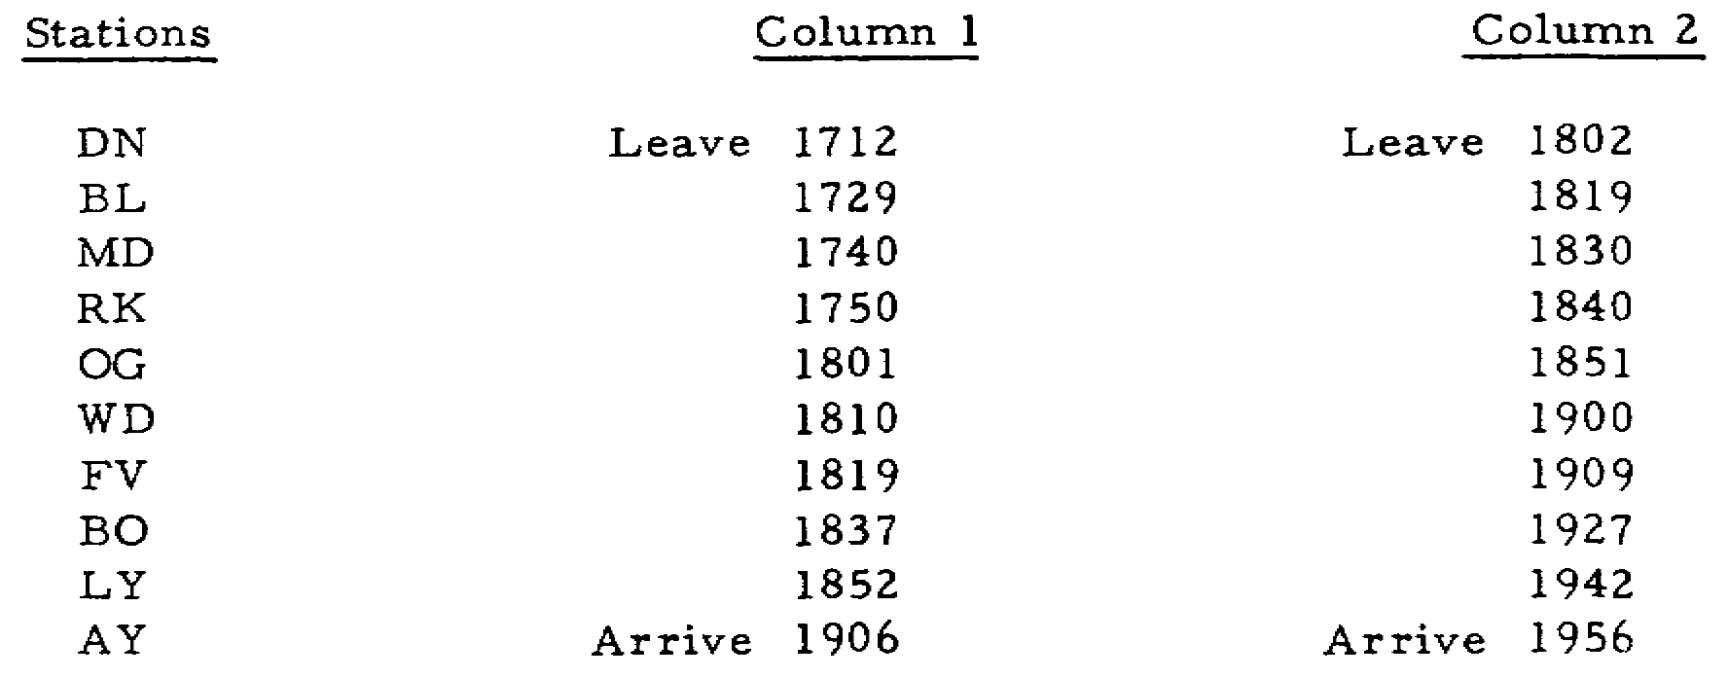

Slide 184
to make up any of the 50 minutes. Of course, inferior trains might
find it helpful. When a dispatcher issues such an order, he is said to be
"putting out time" on the scheduled train involved. Actually, he is
amending the timetable schedule for the particular train for the particular
trip. He is, in effect, granting to others the use of the time represented
by the difference in minutes between the advertised and the runlate
time.
If the dispatcher takes no trainorder
action, however, the delayed
train would be free to make up some of the time. The dispatcher would
advise anyone who inquired that the train was late and would give its
reportedOStime
past the last station. However,

Slide 185
he would not predict or guarantee to anyone that the train was going to be
50 minutes late at every station between its points of origin and
destination. Other trains and yard crews would not know the precise time to
expect the train, and they could not depend on using the full 50 minutes
because this figure might be progressively reduced as the train traveled
over the division. When the dispatcher issues the runlate
order, he is
guaranteeing to everyone concerned that the 50 minutes will not be reduced.

Slide 186
b. A wait order, also called a time order, may be issued instead of a
runlate
order. The latter is not popular with all dispatchers; some
railroads even prohibit its use. A wait order permits the engineer to make
up time and tells everyone concerned approximately how much time. It
predicts, without guaranteeing, just how much time will be made up. In
effect, it is saying: "No. X will be allowed to make up 20 minutes between
A and E. It might make up less, but it's not going to be permitted to make
up any more." The order specifies that the train may not leave a station
before the time shown opposite the station name. A wait order for No. 19,
under the conditions just given, might read as follows:

Slide 187
No. 19 Engine 3130 Wait at
Bliss Until 1815 Hours
Madison 1823 Hours
Cain 1831 Hours
Ogdensburg Until 1838 Hours
Wildwood 1845 Hours
Fairview 1852 Hours
Nelson 1905 Hours
Lily 1918 Hours
AY Tower Arrive 1929 Hours
FMB

Slide 188
The dispatcher, in effect, writes a new schedule for most of the run. Also,
he shortens by a few minutes the individual running time between certain
stations. A comparison of the running time between stations can be made by
examining the two columns that follow. The times and stations of the runlate
order are shown in column 1; the stations and departing times of the
wait order are listed in column 2.

Slide 189
Column 1RunLate
Order Column 2Wait
Order
DN Tower Leave 1802 Hours
Bliss 1819 Hours Wait at Bliss Until 1815 Hours
Column 1RunLate
Order Column 2Wait
Order
Madison 1830 Hours Madison 1823 Hours
Cain 1840 Hours Cain 1831 Hours
Ogdensburg 1851 Hours Ogdensburg 1838 Hours
Wildwood 1901 Hours Wildwood 1845 Hours
Fairview 1909 Hours Fairview 1852 Hours
Nelson 1927 Hours Nelson 1905 Hours
Lily 1942 Hours Lily 1918 Hours
AY Tower Arrive 1956 Hours AY Tower Arrive 1929 Hours

Slide 190
An examination of the two columns shows the exact number of minutes in the
shortened schedule in column 2. The engineer on No. 19 will make up all the
time he can within the limits set forth in column 2. If he fails to meet
the faster schedule, his train will be permitted to leave the stations later
than the time shown. Under no circumstances will the train be permitted to
leave earlier

Slide 191
4.11. LOSS OF TIMETABLE SCHEDULE
On occasion, a scheduled train may lose its right and its schedule.
With a loss of schedule, the train loses its right to continue occupying the
main track. Losing its schedule and having its superiority restricted,
however, are entirely different and the distinction must be clearly
understood. A train may have its timetable superiority temporarily
suspended by a train order which restricts it. Two examples would be (1)
putting a relatively unimportant scheduled train into a siding to eliminate
stopping and delaying a heavy extra or (2) sidetracking a scheduled
eastbound train (when east is the superior direction) while a westbound of
equal class is kept moving. These restrictions are only temporary, and the
train continues on its normal schedule after the train order is fulfilled.
However, on two occasions the train actually loses its schedule and hence
its superiority: when it is more than 12 hours late and when the timetable
changes.

Slide 192
a. More than 12 hours late. When a scheduled train becomes more than
12 hours late, it is said to "die on its schedule.” This means that it has
lost its schedule and that all train orders, if it holds any, are annulled.
The train can proceed from the point where it loses its schedule only on new
train orders from the dispatcher. Rule 82 of TM 55200
provides that
“...Regular trains more than 12 hours behind either their scheduled arriving
or leaving time at any station lose both right and schedule, and thereafter
can proceed only as authorized by train order."

Slide 193
Since the rule specifies both arriving and leaving time, it follows
that a train due to arrive at a station at 0700 and depart at 0707 could
continue on its schedule if it could arrive exactly at 1900 and depart
exactly at 1907. If, however, it arrived at 1901, it would then lose its
schedule, and it would have no right to leave even if it could complete its
unloading aid loading and be ready to depart by 1906. Conversely, if it
arrived before 1900 and couldn't depart until 1909, it would likewise die on
its schedule. In the first instance, it would be because of late arrival
and in the latter because of late departure. In either event, the
dispatcher would have to recreate the train as an extra, or run it as a
section of another scheduled train, as explained in paragraph 4.7. If the
schedule of no other train were convenient, the dispatcher could create the
train as an extra and, because it was so long overdue, probably confer on it
right over all other trains until its destination was reached, or until a
division terminal was reached and another dispatcher had jurisdiction. Loss
of schedule is not a common occurrence because most dispatchers take some
positive action to assist a train or annul its schedule before it becomes 12
hours late. However, this is not always possible.

Slide 194
b. Change of timetable. A train may possibly lose its schedule because
a new timetable is issued. Assume that a firstclass
train operates daily
to and from a summer resort from 1 June through 30 September. Because the
train operates exclusively for the convenience of the resort patrons, it is
annulled effective the first day of October. Therefore, at midnight on the
last day of September a new timetable takes effect. Since the train is due
to arrive at its home terminal at 2330 hours, the new timetable has no
effect on the train if it completes its last return run on schedule.
Suppose, however, on the last return trip, the train is an hour late
leaving the resort station and the dispatcher "puts out" an hour on the
train, as explained in paragraph 4.10a. At midnighttechnically
at 0001the
train loses its schedule and its right to be occupying the main track
because its schedule does not appear in the new, and now current, timetable.
The hour's time that the dispatcher has put out on the train cannot be
carried over to the new timetable. Therefore, when the train's schedule
expires at 0001, it would have to be handled exactly like the train
discussed in subparagraph a.

Slide 195
Under the conditions outlined in the example just given, the
dispatcher takes different action. When he sees that the train is an hour
late leaving its initial station and is going to overlap a new timetable, he
annuls the train's schedule. He then creates it as an extra and gives it
right over all trains to its destination.

Slide 196
Rule 4 of TM 55200
provides that:
Each timetable, from the moment it takes effect, supersedes the
previous timetable. All trains operating on schedules not provided for in
the new timetable will secure valid authorization from the dispatcher to
continue their runs and do so as extra trains

Slide 197
4.12. SUMMARY
Right is conferred by train order, and class and direction by
timetablethe
basic roots of dispatching theory and practice. The
dispatcher, to accomplish his objective, can change the order of precedence
of these governing rules to suit a particular operation. All rule books, no
matter where you may be railroading, contain a section of rules outlining
the method of determining the superiority of trains. This section of the
operating rules, as well as those in appendix III, should be consulted the
moment you are assigned to any railroad operating task, whether it be in
train or engine service, in any phase of dispatching work, or in any rail
supervisory capacity involving the movement of road trains.

Slide 198
As a student of train dispatching, you are reminded that this entire
reference text is intentionally general; it cannot be construed as being
standard for all railroads for all conditions of train operation. The rules
that establish superiority, however, are standard on all American railroads
and are identical to those in military use. Operational procedures based on
fundamental rules and practices that might be suitable in peacetime
railroading may be totally inadequate in a theater of operations. The
dispatcher has broad powers in handling trains, but he must stay within the
limits of operating policy dictated by higher authority. The timetable, the
established rules, and the particular dispatching policy always govern; they
must be examined before assuming that all the fundamentals outlined here
always apply.

Slide 204
5.1. GENERAL
Before the successful commercial application of the telegraph in the
late 1840's, the employees' timetable was the supreme authority for
operating all trains on any railroad. It specified the classes of all
trains, exactly where they must meet and pass and which must take siding, as
well as the superior direction. The timetable's provisions permitted early
railroaders to operate reasonably safely, provided scheduled trains were
always on time and everybody obeyed the rules set forth in the "bible."
Scheduled trains, however, were frequently several hours late. Then,
too, there were always a few impatient and venturesome crews who practiced
"railroading on the other man's smoke." This meant advancing, on single
track, into an area on another train's time, watching for the opposing
engine's smoke, and hoping the other crew was watching theirs. At best,
moving on "smoke orders" was a highly dangerous practice; but its proper
alternative of abiding by the timetable usually meant waiting for hours in
sidings for overdue, superior trains. A century ago railroaders carried
their lunches in halfbushel
baskets; the lengthy time away from home made
it necessary. Frequent and seemingly endless waiting in sidings accounted
for a great deal of the crews' time on the road.

Slide 205
In 1851 when Charles Minot was superintendent of the Erie, he decided to
do something about these long waits. Once while on one of his westbound
freights, sidetracked at what is now Harriman, New York, he became extremely
impatient while waiting for a superior eastbound train. After some time, he
went to a nearby commercial telegraph office and had the telegrapher inquire
of the railroad signal operator at Goshen, 15 miles to the west, if the
eastbound train had yet passed. Receiving a negative reply, he then had the
telegrapher send the following message to the operator at Goshen: "Hold
Eastbound Train Until Further Orders. Charles Minot, Superintendent." To
his conductor and engineer, he handed a written

Slide 206
order reading, "Run to Goshen Regardless of Opposing Train.” The engineer
refused to make the run on the strength of the doubtful safety of a holding
order transmitted by wire.
Superintendent Minot appears to have been a man of wide abilities as
well as vision, for he himself took the throttle and ran the train to
Goshen. Arriving and not finding the superior train there, he wired the
next station ahead to hold the train. History does not record whether the
engineer was by then convinced of this new system's safety, but after a
series ofwires
sent ahead, the train was able to reach its destination
several hours earlier than if it had adhered to the timetable.

Slide 207
Many changes have come about in train orders since their humble
beginning, but their basic principles and extreme importance are identical
today. Perhaps there is no industry in the world where seemingly minor
errors can result in the deaths and property damage that can occur in
singletrack
railroading. When movements on single track are controlled by
train orders, not only must the dispatcher's movement plan be scrupulously
correct, but also the transmitting, relaying, and delivering of the orders
must be done in a virtually foolproof way. Moreover, the language of the
orders must be so unmistakably clear that it cannot possibly be
misinterpreted. Strict accuracy of stated time, engine numbers, station
call letters, and direction is vital. As shown in figure 5.1, the body of a
train order is written with no punctuation; however, some of the examples of
train orders given in this text are punctuated to provide proper grammatical
structure necessary for a clear understanding of the text material. In
writing orders, the dispatcher must step out of his role as their originator
and place himself in the position of the crews. He must then ask himself if
he would thoroughly understand the orders if he were the addressee and not
in possession of the knowledge held by him as the dispatcher.

Slide 208
This chapter discusses in detail the use of train orders in moving
trains over the rail line. However, before that discussion begins, give
your attention for a moment to the trainorder
rules given in appendix III.
They are rules 200 through 223, quoted from Technical Manual 55200.
For
you to attempt to memorize them would be impractical, but do read them
carefully for general familiarization and refer to them as you study this
chapter.

Slide 209
5.2. INTERPRETATION
Crews receiving train orders have a grave responsibility in reading,
interpreting, and properly executing them. Careful reading
Figure 5.1. Train Order.
and concentration are necessary with some involved orders or series of
orders; crew members must read, repeat, and listen to others read and repeat
them. It is dangerous indeed and often prohibited for one member to read an
order and then tell others what it means before they read it. The other
members may be influenced by the oral interpretation, which may be
incorrect, and they in turn may also read it wrong. Discussing complicated
orders is advisable, and complete and unanimous agreement must exist before
acting on them. Sometimes it is a simple matter to get dispatcher
clarification, but more frequently the crews are unable to contact him.

Slide 210
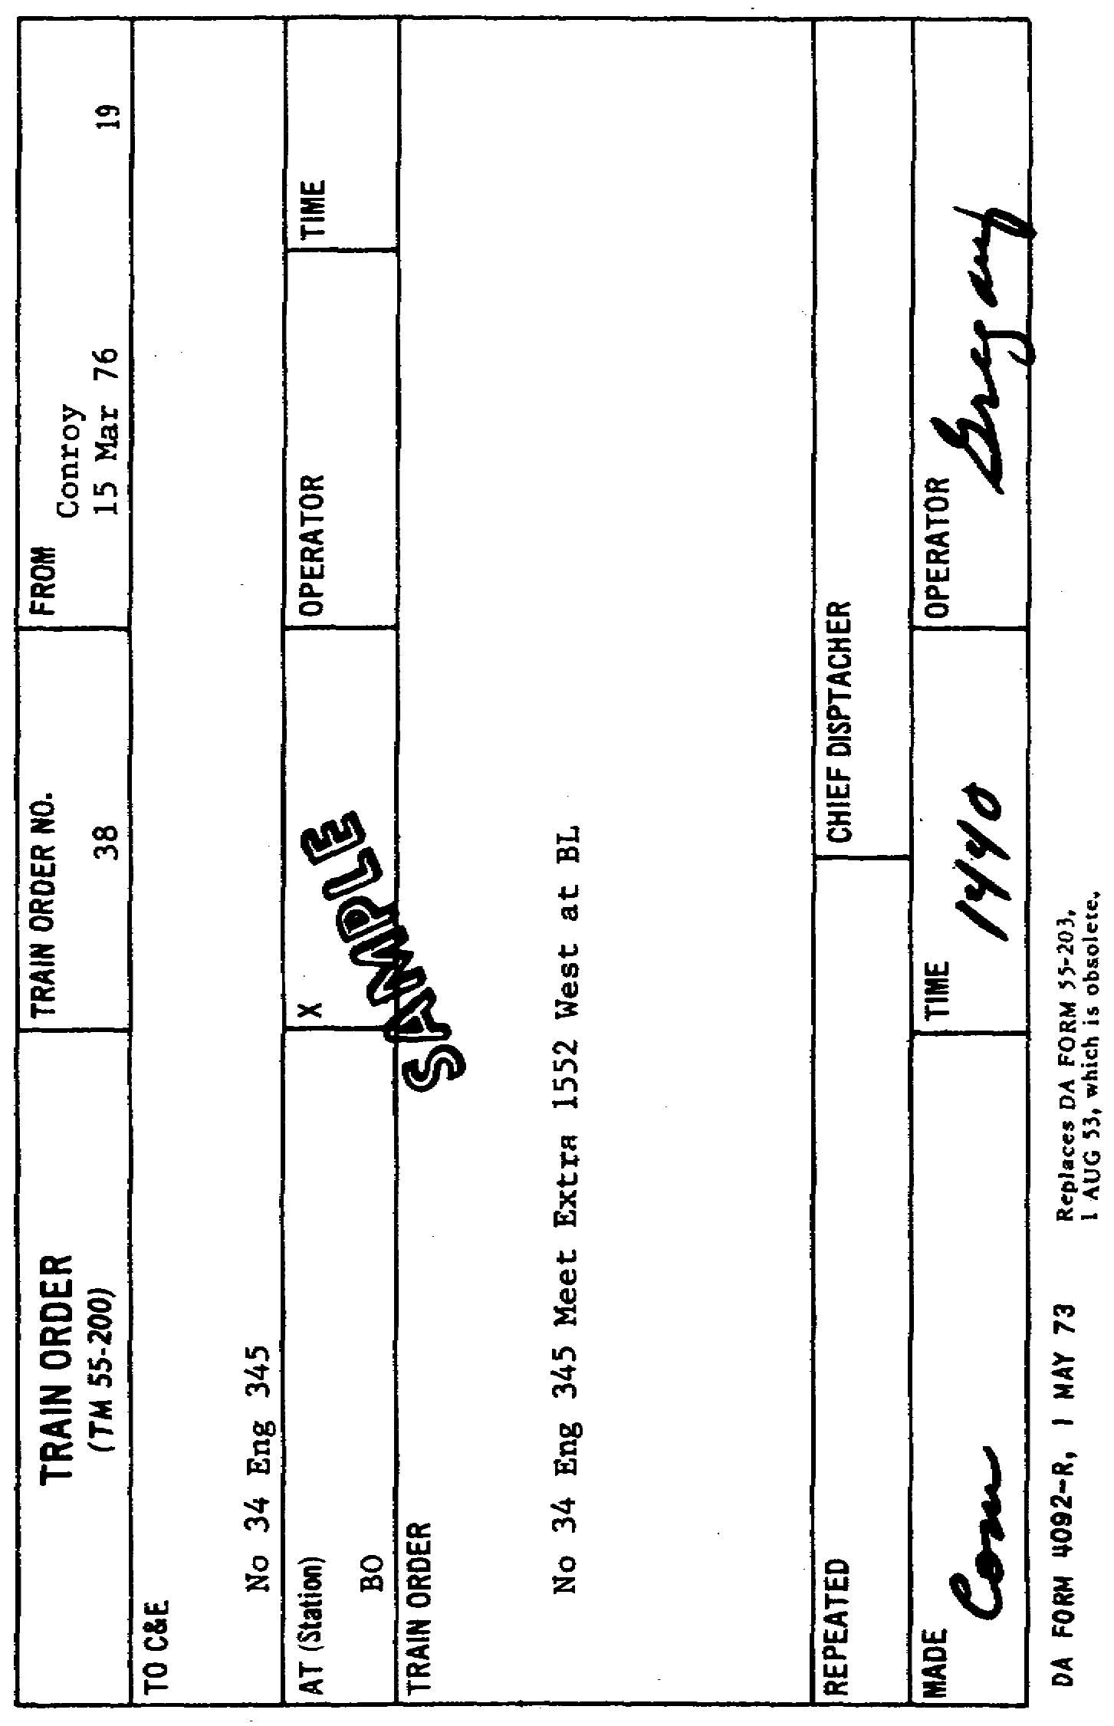

Slide 211
5.3. COPYING
When a dispatcher writes a train order in his trainorder
book, he
dictates the order over his wire to one or more operators along the
division. The handwriting in the trainorder
book should be clear and
legible, but it does not require the extreme writing care required of
operators. Frequently, written orders must be read by poor light on
lurching engines and cabooses without the writer being present to interpret
any unreadable words or phrases.

Slide 212
5.4. NUMBERING AND WRITING
Train orders are numbered consecutively each day beginning at 0001
hours. When subdivisions of a railroad are under the jurisdiction of more
than one dispatching office, a different series of numbers is used by each.
This prevents duplicating numbers for crews operating in more than one
dispatcher's territory. One might use the numbers from 1 through 200; the
other, the numbers from 201 to 400.
"Slow orders" are train orders that restrict speed to suit the track, a
certain bridge, or a particular work area. They are often recorded in a
special book. Slow orders are relatively few and are often in effect for a
stated periodoften
several days. Some railroads post these speed
restrictions on a bulletin board that road crews must read and sign before
going out on a road affected by slow orders. Other roads give every road
crew a slow order written on a regular trainorder
form.

Slide 213
In writing orders, such even hours as 1000 or 1500 should not be used in
stating time. Specifying it in even hours is peculiarly conducive to
misunderstandingsomething
that can be disastrous in singletrack
operations. When time normally would be 1300, it is necessary to move it a
little ahead or a little behind to, for example, 1301 or to 1259.

Slide 214
5.5. TRANSMITTAL
The way the dispatcher transmits train orders and the way operators
receive and deliver them are illustrated in the example detailed in the
remainder of this paragraph. It conforms to previous instructions and to
rules cited in appendix III and illustrates the planning that must be done
by the dispatcher. It shows how he must occasionally exercise his right to
restrict a superior train to assist an inferior one.
Refer to figure 1.1, which illustrates the singletrack
division, and to
columns 5, 6, and 8 of the singletrack
train sheet given in annex B. The
columns represent trains intended to illustrate a specific example. From a
standpoint of time and continuity, they do not dovetail with the remainder
of the train sheet. Neither will No. 34 be found in the timetable in
appendix II. The particular trains are used merely to present as many
situations as possible in the same illustration. The delays are cited in
the text but not itemized on the train sheet.

Slide 215
a. Superior train restriction. When the dispatcher created Extra 4550
West at Conroy and authorized it to go out on the main track and proceed to
Maxey, he provided, by train order, for it to take siding at RK to clear No.
34. The latter's crew was given a copy of the order, and they knew, despite
the train's schedule shown in the timetable, that their train's superiority
would be restricted unless Extra 4550 West was at RK upon their arrival.
b. Dispatcher planning. Assume, however, that No. 34 is delayed at BO
for 25 minutes awaiting a mail truck connection, and a minor gradecrossing
accident at FV delays it another 30 minutes. To permit the RK meet order to
remain in effect would now mean that Extra 4550 West would probably be
delayed at RK for 40 to 50 minutes while waiting for No. 34. This delay
would not be particularly serious to an extra train, but now something else
enters into the dispatcher's planning. He has Extra 9510 West called at
Conroy at 1715 hours, as column 8 on the train sheet in annex B shows. It
is a heavy train and this particular engine is overdue in the back shop for
major repairs. Consequently, the dispatcher would like to keep the 4550
well ahead of the 9510 to prevent the danger of the latter's engine stalling
on Windham Hill, shown on the map in figure 1.1. Previously, the dispatcher
had fixed a meet at MD for Extra 9510 West and No. 34.

Slide 216
c. Superseding an order. Because of the 55minute
delay to No. 34, the
dispatcher decides to put Extra 4550 West over
74
Windham Hill before it meets No. 34. This means that the new meeting point
has to be at OG. Such a move gets the advance extra over the hill and out
of an area where it could delay the extra behind it. This move might, of
course, delay No. 34 even more. However, assume that No. 34 carries mostly
express and mail and only a few revenue passengers. The dispatcher would
probably decide that a few minutes more delay would be secondary to the
possibility of Extra 9510 West's stalling and having to "double" over
Windham Hilltake
the train over in two sections. Paragraph 2.6d describes
how meet orders are superseded. The MD meet between No. 34 and Extra 9510
West can now be advanced to RK. Once the railroad is clear between RK and
OG, Extra 9510 West should have no trouble in getting over Windham Hill.

Slide 217
Since the dispatcher can reach No. 34 at WD and get new train orders
delivered to Extra 4550 West at RK tower, he calls the operator at WD and
advises him to "copy a train order, East." He rings RK tower and tells the
operator to "copy a train order, West." Then he advises each operator how
many copies of the orders are to be made. Because the operator at MD has to
copy and deliver the new meet order for Extra 9510 West, the dispatcher gets
MD station on the wire also. Because No. 34 is superior, even though the
orders are to be transmitted and copied simultaneously, the dispatcher must
address No. 34 first. When all operators are ready, the dispatcher dictates
the following orders:
No. 34 Eng 222 Meet Extra 4550 West at OG Instead of RK
FMB
No. 34 Eng 222 Meet Extra 9510 West at RK Instead of MD
FMB

Slide 218
When dictating the orders, the dispatcher writes in the trainorder
book as he reads. He records, in this book, all stations and trains to
which the order is addressed. Each operator copies in longhand the text of
the order and inserts his particular call letters in the heading: RK, MD, or
WD. The text must be copied in its entirety. In the same sequence in which
the operators were addressed, they repeat the order from their copy.
Figures, engine numbers, and dates are given thus: Eng 345three
hundred
fortyfive,
345;
14 Novemberfourteen,
14.
This form is used in
dictation and in the repeating. Read rule 206 in appendix III.

Slide 219
d. Completing the order. After the order is copied, the first operator
addressed by the dispatcher, the one copying the order for the superior
train, reads the order back. As the operator repeats the order, the
dispatcher underscores each word. If the repetition is correct in all
respects, the dispatcher completes the order by saying "complete" and giving
the exact time, such as 0931 hours. This, in effect, is saying, 'Okay,
you've got it correct at 0931 hours. You are free to deliver the order to
the train when it arrives.” The word "complete" is generally abbreviated
"com," and it is written along with the time in the appropriate spaces at
the bottom of the train order (fig. 5.1). Then in turn each of the other
operators repeats the order from his written copy, as the dispatcher
underscores each word in his trainorder
book and completes the order as he
did for the first operator. Now, they, too, are authorized to deliver the
orders to their respective trains along with a Clearance Form "A" (par.
5.8).
In short, train orders have no validity until they have been
completed, and the completing is done according to the superiority of the
particular trains. This means that the order for the superior train, which
is being restricted, must be completed before the one for the inferior train
which the order helps. The only exception to this procedure is known as the
"X" response, discussed in the next paragraph.

Slide 220
5.6. THE "X" RESPONSE
Trainorder
rules require that, when an order has been transmitted to
several offices, the receiving operators are to repeat it at once from their
copy and in the succession in which the several offices have been addressed.
Therefore, the last operator addressed is the last one to repeat it. The
dispatcher and all operators on the wire listen for any flaws or omissions
in the repetitions.

Slide 221
Occasionally, however, the last operator must necessarily repeat the
order first. This is permitted when it can be completed and delivered to an
inferior train which would otherwise be delayed while several other
operators are repeating the order to the dispatcher. When this occurs, he
directs that the operator receiving the order for the superior train give
the "X" response, as rule 212 in appendix III explains. Then he permits the
operator copying the order for the inferior train to repeat his first and,
when he's finished, to deliver it. Once the "X" response is given, the
order may be repeated and made complete to the inferior train before the
operator copying for the superior train repeats his order. When this
response has been given, the order to the superior train becomes a holding
order and cannot be delivered until it has been repeated and completed

Slide 222
Suppose, for example, that the power failed after the order had been
copied but before it had been completed. The "X" response has already been
given and a copy of the completed order to the inferior train has already
been delivered. The inferior train would execute its part of the order.
However, the superior train could not pass the office holding an order for
it which lacked the dispatcher's final approval. The operator would set a
trainorder
signal against the superior train and cause it to stop. Even
then, when the operator and the crew knew the contents of the order, the
crew could not act on it. Flagmen would have to be sent both forward and to
the rear of the waiting train until power was restored or until the
dispatcher could get additional instructions to the operator holding the
superior train.

Slide 223
5.7. TRAIN REGISTERS
When a train prepares to leave its starting point, the crew has no way
of knowing whether all superior trains have arrived and departed. Neither
has the crew any way of knowing whether any superior trains that have passed
were displaying signals for following sections (par. 4.7). In some
localities, the dispatcher advises a crew by a form R order of the superior
trains for which they must wait before going out on the main track. At
other locations, train registers are maintained to furnish this information
for all concerned. When a train arrives at a station where it has work or
when it reaches a junction point, the conductor signs the register. He
writes in the number, class, and arrival time of his train, and the type of
signals it is displaying, if any. Just before the train leaves, the
conductor checks the register for other arrivals or departures that may be
superior and then enters his departure time. Generally, extra trains having
no stops where the register is located are not stopped simply to register,
and timetables of most railroads provide that they may register without
stopping. Instead, the crew throws off a message containing the necessary
information and the operator enters it.

Slide 224
Information from the register is conveyed to a passing crew in the form
of a train order which might read as follows:
Extra 198 West
All Superior Trains Due at RK Before 2130 Hours
Have Arrived and Left

Slide 225
The train receiving this order would continue with respect only to any
superior trains due after 2130 hours. The timetable would be the governing
authority for superior trains due after that, and the moving train would
prepare to take siding only when a superior train to the rear came within 20
minutes of it. Actually, the rules specify that an inferior train must
clear by 10 minutes the time of a superior train as shown at the next
station to the rear. However, stopping a train, opening a siding switch,
restarting the train, and then closing the maintrack
switch when the train
is in the clear takes some time. Therefore, ordinarily 20 minutes is a
safer allowance.
Registering without stopping often saves considerable time and, when it
can be done safely, produces more economical operations. Should a train
start its run from a nonregister station, the dispatcher often advises the
conductor over the telephone what trains are overdue before he lets the
train move out on the main track.

Slide 226
5.8. DELIVERING ORDERS AND MESSAGES
The timetable designates which telegraphoffice
stations are trainorder
offices, that is, those equipped with trainorder
signals. When approaching
these offices, trains are not stopped unless they are to receive orders
requiring the crew's signatures. The normal position of the trainorder
signal is "stop" when an operator is on duty. When a train for which the
operator holds no orders approaches within sighting distance of the signal,
he changes it for the train to proceed. This is called “clearing the
block.” After the train passes the station, the signal is restored to its
normal "stop" position. On the other hand, when a train arrives at a
station and orders requiring the crew's signatures are held for it, the
trainorder
signal is kept in "stop" position. After halting the train, the
crew reports for its orders. In addition, a Clearance Form "A", DA Form
4091R,
shown in figure 5.2, which lists by number all orders that are being
delivered, is given to the crew. If none of the orders for the train
restrict it at that particular station, it is not stopped. The operator
attaches the clearance form and train orders to a message loop, or hoop, as
shown in the sketch, and hands them to someone on both the engine and
caboose as they pass the station. If, however, the orders restrict the
train at that point, the engine must stop clear of the fouling point of the
switch at which an opposing train may enter the siding.

Slide 227
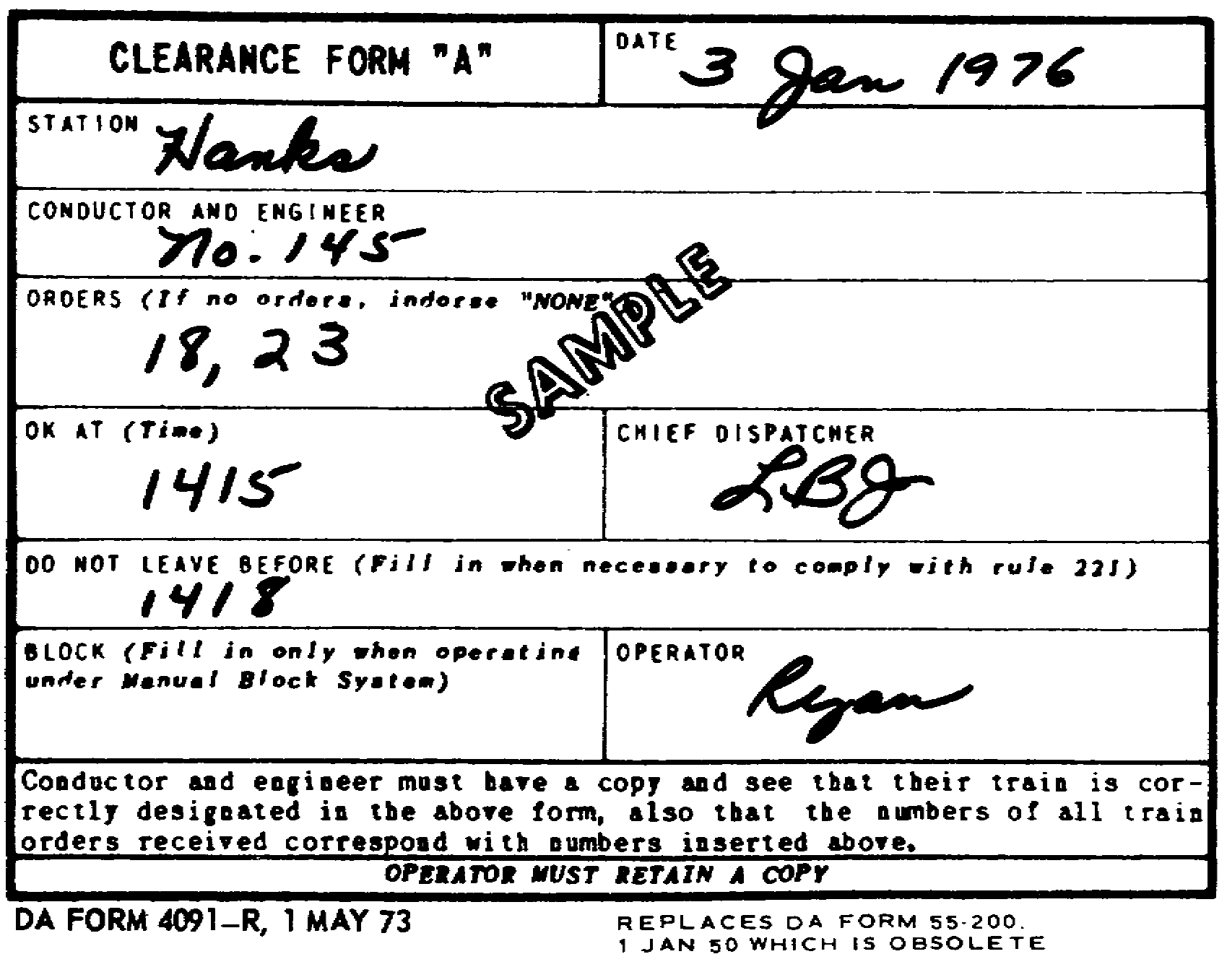

Slide 228
Even though signals are clear, crews are always on the lookout when
passing any telegraph office. Messages affecting their work along the way
are frequently delivered to the crew "on the fly" by the operator who
attaches communications to message loops. Messages are often informal and
never involve other trains. They might be used to amend, supplement, or
annul previous instructionsbut
not train ordersfrom
the dispatcher or
even from yardmasters and station agents along the line where the train is
scheduled to stop. Often a message can save a crew from stopping at a
station to pick up cars when it develops, after the crew has been instructed
to stop, that the cars will not be ready. Dispatchers often use messages to
ask crews about delays between stations and to warn engineers about
exceeding speed limits. Messages may often be used to advise crew members
about defective cars in their train.

Slide 229
Occasionally, a running conversation between the dispatcher and the crew
is carried on without stopping the train. The dispatcher's query is
delivered to the crew at the first station, and the
79
crew replies at the next. The dispatcher may seek additional information or
clarification which he requests at the third station; then the crew replies
at the fourth telegraph office. A humorous although farfetched story, which
illustrates the point, is told about an engineer who had difficulty
negotiating a hill. At the station beyond it, he received this message from
the dispatcher: "What was the delay on Fulton hill?" At the next telegraph
office, the engineer threw off a reply reading, "Out of sand." At the third
station, a dispatcher message asking for additional details was waiting for
the engineer. “What were you doing on Fulton hill without sand?" At a
fourth station, the engineer threw off this terse but perfectly logical
reply: "Slipping."

Slide 230
5.9. FORMS 19 AND 31
Two distinct kinds of train orders in use on commercial railroads are
known and numbered form 19 and form 31. The form 19 is green and form 31 is
canary yellow. Both forms are printed on a fine grade of transparent tissue
paper and are popularly known as "flimsies" because of their texture. They
are so thin that numerous carbon copies can be made easily. Their
transparency makes it possible to read them at night by holding them in
front of a lantern or other light that would ordinarily be inadequate for
reading.

Slide 231
These train orders are always referred to as "a 19 order" or "a 31
order," and the principal distinction, aside from their color, is the way in
which each is delivered. When delivering a 31 order, the train must be
stopped and the crew must acknowledge receipt by signing for it. Generally,
the delivering operator first reads the order to the crew members who then
read it back to the operator and sign a receipt. Both the engineer and the
conductor read the order and familiarize the other crew members with its
contents. Everything is done to insure that, first, the operator has copied
it correctly by his reading it to the dispatcher, and second, that it has
been read by the operator to the conductor and engineer who have read it
back and acknowledged their understanding of it. The engineer sees that the
fireman, if one is aboard, understands it, and the conductor does the same
with the head brakeman and flagman. A 19 order, however, is delivered to
moving trains with a message loop and no signatures are required.
Nevertheless, it is vital that the crew's interpretation of the order be
correct

Slide 232
After train orders are received, all members of the train and engine
crew should have easy access to them at all times. This is often done by
having, on both the engine and the caboose, a clipboard to hold the orders,
located where anyone can examine an order quickly.

Slide 233
Some railroads, including military railroads, do not use the 19 and 31
orders. The single green form shown in figure 5.1 is used instead. It is
known simply as a train order. Using it eliminates stopping a train for the
crew's signatures when the train is going to be restricted at a point in
advance of the station issuing the order. If it were being restricted at
the station where the order was issued, using the single form would be just
as effective as a 31 order. Regardless of whether the single or dual system
is used, the importance of properly issuing, repeating, interpreting, and
executing orders remains the same.

Slide 234
5.10. MESSAGE CATEGORIES
When a train order is written, the kind of message it contains places it
in one of a number of definite categories, each identified by letter
designators. These show that the order conforms to rules having a similar
designator. All twoletter
ones begin either with the letter "S" for single
track or "D" for double track. All singleletter
ones apply to both single
and double track

Slide 235
To illustrate how every train order falls into a definite category, the
following explanation is given. A DA form 55203
is a trainorder
form, and
whenever a message is written on it, it becomes a train order. If the
message should advise one train to meet another, it becomes, in
classification terminology, a meet order. Technically, the order is now
designated a form SA
order because it fixes a meeting pointsomething
that
can occur only on a singletrack
line. The "S" denotes the single track and
the "A" identifies the order as being a meet order. These initials,
however, are neither printed nor written on the train order. They are used
merely as a quick reference to describe the type of instructions contained
in the order. Form SH
describes a train order applying to a work extra
operating on single track. Similarly, form DM
indicates a train order
annulling part of another train order on double track, the letter 'D"
applying to the track and the letter "M" denoting the partial annulment. A
train order with a singleletter
designator, such as form F, applies to
single or double track. The numerous other designators for train orders,
with specific examples, are discussed in detail in the following paragraphs.

Slide 236
5.11. FORM SA
The form SA
train order fixes meeting points for opposing trains on
single track. Typical examples are:
81
No 61 Eng 201 Meet No 62 Eng 310 at RK
No 7 Eng 3220 Meet No 12 Eng 210 at BO
Note that no direction is specified because the train number denotes
this. Odd train numbers indicate movements in the inferior direction, and
even numbers designate movements in the superior direction

Slide 237
5.12. FORM B
The form B train order directs a train to pass or run ahead of another,
as the following examples show.
Extra 550 West Pass No 3 Eng 112 at MD
Extra 9564 West Run Ahead of No 61 Eng 345 DN Tower to RK

Slide 238
5.13. FORM SC
The form SC
train order gives right over an opposing train. It has the
effect of making an inferior train superior to the other named train between
the points specified in the order. Examples are:
No 61 Eng 1245 has Right Over No 62 RK to FV
Extra 199 East has Right Over No 3 BO to OG

Slide 239
5.14. FORM E
Form E train orders are time orders and are discussed in paragraph 4.10.
They are also called '"unlate"
or "wait" orders. Three typical ones, each
slightly different in scope, follow.
No 11 Eng 2245 Run 50 Minutes Late DN Tower to AY Tower
No 11 Eng 2245 Run 50 Minutes Late DN Tower to RK and 30 Minutes Late RK
to AY Tower
No 11 Eng 2245 Wait at RK Until 1959 Hours FV Until 2035 Hours and BO
Until 2115 Hours

Slide 240
5.15. FORM SE
A form SE
train order is a conditional wait order. The firstnamed
train will wait at the point designated until the lastnamed
train arrives,
or the specified time is passed, whichever occurs first. Examples follow.
No 5 Eng 2520 Wait at MD Until 0930 Hours for No 2 Eng 4570
No 33 Eng 3840 Wait at FV Until 2155 Hours for No 34 Eng 3006
In the first example, if No. 5 arrives at MD at 0925 hours and finds No.
2 already there, then it has fulfilled its order and may proceed. If,
however, No. 2 has not arrived, No. 5 is required to wait until 0930 hours
before it may proceed. This form is used to assist the lastnamed
train
without delaying the first beyond the time specified in the order.

Slide 241
5.16. FORM F
The form F train order is used when trains are run in sections and when
signals are displayed that indicate one or more sections of the same train
will be operating on the schedule of the train carrying the signals. The
examples following show the wide application of this order.
Eng 195 Run as Second 17 DN Tower to AY Tower
Eng 195 Display Signals and Run as Second 87 RK to BO
Engs 198, 199, and 200 Run as First, Second, and Third 17 DN Tower to AY
Tower
Eng 210 Instead of Eng 195 Display Signals and Run as Second 87 RK to BO
Second 17 Eng 2530 Take Down Signals at LY
Engs 199 and 200 Reverse Positions and Run as Second and Third 17 RK to
AY Tower

Slide 242
5.17. FORM G
The form G order is used for extra trains. On some railroads, extras
may represent the classification of the majority of the daily trains.
Examples of the form G order follow.
Eng 3240 Run Extra BL to AY Tower
Eng 205 Run Extra WD to FV This Order Annulled at 1550 Hours
After Extra 9550 Arrives at FV Eng 9002 Runs Extra FV to AY Tower
Eng 9005 Run Extra MD to RK and Return to DN Tower

Slide 243
5.18. FORM SH
The form SH
train order pertains to an extra work train on single
track. It authorizes the train to occupy the main track and do rightofway
work in the area designated and between the hours specified. The working
limits or time limits of a work extra cannot be extended by superseding the
original order to the work train. If an extension of either or both time
and work limits of the work extra is necessary, the original order must be
annulled and a new order issued. Copies of this order inform all other
crews traveling in the area of the presence of the work extra and the
flagging instructions it holds, if any. An example follows: "Eng 5440 Works
Extra 0930 Hours Until 1701 Hours Between MD and RK."

Slide 244
In this order, no flagging instructions are specified. Basically, all
work extras are required to protect, that is, flag, against all other extras
and, of course, against all other trains of superior class. Because this
order specifies nothing to the contrary, everybody reading it knows that the
work extra is to protect itself against all movements in both directions.
This order, however, may be amended to read: "Eng 5440 Works Extra 0930
Hours Until 1701 Hours Between MD and RK Not Protecting Against Westward
Extra Trains." Or, "...Not Protecting Against Extra Trains." The
designated area can be stated as between kilometer posts instead of between
stations. Paragraph 5.19 explains this more fully.

Slide 245
Work extras must, unless otherwise instructed, protect against extra
trains in both directions. Therefore, it is improper to tell a work extra
to protect against an extra until after it has been told not to protect.
Occasionally, it might be necessary to make a work extra superior to all
trains. This might occur when a wreck train is called to an accident scene.
If so, the following order might be typical: "Work Extra 9510 Has Right Over
All Trains Between DN Tower And BL From 1330 Until 1830 Hours."

Slide 246
5.19. FORM DH
The form DH
train order is used for work extras on double track or on
two or more tracks, as well as specifying the track or tracks the work train
is to occupy. The rules provide that the working limits should be as short
as possible. In the few books published on dispatching, examples show the
working limits as the areas between two or more adjoining stations, as the
examples in subparagraphs a through c specify. In actual rail operations,
however, the working limits may frequently be only 2 or 3 kilometers long.
Where the working area is comparatively short, kilometer posts instead of

Slide 247
stations may be specified. Kilometer posts are wooden or concrete signs
posted along the track and numbered consecutively from one end of the
division to the other. Inserted in the orders instead of the station
designators would be "....From Kilometer Post 27 to Kilometer Post 29...."
or "...From Kilometer Post 32 to Kilometer 33.5...." The approximation used
is necessary because the posts are spaced only in whole kilometers. Another
form of area designation might be '....From Kilometer Post 13 to Bridge
127...." This method pinpoints the work train's area and eliminates an
approaching train's expecting to see worktrain
flagmen anywhere in the 10
or 15 kilometers between two stations, if they had been specified instead of
kilometer posts.

Slide 248
When the time specified in orders expires, the work extra is in the same
position as a regular train that has lost its schedule; it is dead with
respect to any train standing. It must clear the main and seek new orders
or authorization to return to its home terminal. If the worktrain
crew
finishes its work an hour before the time expires, the crew cannot start
back to its home terminal without contacting the dispatcher. Why? Because
the train's original right is confined to the area specified by the working
limits in the original orders. Three examples of form DH
orders are given
in the subparagraphs following.

Slide 249
a. First example. “Eng 3031 Works Extra on Eastward Track 0801 Hours
Until 1701 Hours Between AY Tower and LY."
b. Second example. “Eng 3031 Works Extra on Eastward and Westward
Tracks 0801 Hours Until 1701 Hours Between AY Tower and LY.” Such orders
may be supplemented with the following: "...Not Protecting Against Extra
Trains." or "...Not Protecting Against Eastward (or Westward) Trains.” Once
a work train has received orders not to protect against extra trains, and it
is later desired to have it protected against a designated extra, the
following additional order may be used: "Work Extra 3031 Protects Against
Extra 210 West Between FV and BO After 1330 Hours.” This order tells the
crew of Extra 210 West that it must not enter the area specified before the
time shown in the order. After 1330 hours, however, the crew can expect the
work extra to be in the clear or protecting itself according to the terms of
the order. Should the order specify that the "Work Extra Will Clear" and
for some reason it cannot do so, the flagman of the work train would be far
enough to the rear to stop Extra 210 West.

Slide 250
c. Third Example. The widest range of right that could be conferred
upon a work train in a designated area would be as follows:
85
"Work Extra 3031 Has Right Over All Trains on Eastward and Westward Tracks
Between DN Tower and RK From 0930 to 1130 Hours." It permits the work train
to occupy one track and foul the other or to use both tracks alternately.
However, regardless of the type of orders held, work trains must yield the
rightofway
to other trains as promptly as possible.

Slide 251
5.20. FORM J
The form J train order is a holding order and is addressed only to the
station operators It is transmitted and completed in the same way as other
train orders and is delivered to a train or to each train the operator is
holding. The order may pertain to an individual train, to all westbound
trains, or to all trains. Examples follow.
Hold No 2
Hold All Westward Trains
Hold All Trains
When trains are held by a form J order, they may be released by
annulling the holding order or by a new order superseding the form J.
Examples follow.
No 2 May Go
Order No __________ (the holding order) Is Annulled
This form is generally used in emergencies when the duration of the
holding order is not known. Washouts, snow or rock slides, and derailments
are examples of emergencies which might require its use.

Slide 252
5.21. FORM K
The form K train order is used for annulling a schedule or a section.
Typical examples follow.
No 61 Due to Leave DN Tower 15 March is Annulled
Second 5 Due to Leave RK 15 March Is Annulled RK to AY Tower
In these examples, both the schedule and the section are annulled for
the trip on the date shown. A schedule annulled by this form of order
cannot be restored by revoking the order that canceled the schedule.

Slide 253
5.22. FORM L
The form L train order is used for annulling an order and is the most
simply stated one of all. For example, it might read"
Order No 15 is
Annulled." The order number must always be specified, and all crews holding
that particular one are to disregard its contents. An annulling order
should not be delivered to a train not yet having the order which is
annulled by the form L. For example, suppose a crew receives an order that
annuls order 15, but order 15 has not yet been delivered to them. Confusion
results. The crew would rightfully want to see a copy of order 15 which
might supersede some instructions held in other orders.

Slide 254
5.23. FORMS SM
AND DM
Both forms SM
and DM
train orders are used to annul part of an order:
form SM
for single track and DM
for double. The forms should be used only
when the part of the order not annulled is perfectly clear in its wording
after the annulled part is deleted. Two typical examples read:
That Part of Order No 14 Reading No 2 Meet No 1 at RK is Annulled
That Part of Order No 21 Reading No 17 Pass No 9 at FV Is Annulled

Slide 255
5.24. FORM SP
The form SP
train order is used to supersede an order or part of an
order simply by inserting the words "instead of." An order cannot be
construed as superseding an order with which form SP
conflicts unless these
two words are added. Once an order has been superseded, it cannot be
reissued under its original number. Typical examples of the SP
order
follow.
No 1 Eng 9520 Meet No 18 Eng 9002 at FV Instead of RK
No 5 Eng 520 has Right Over No 6 Eng 313 WD to AY Instead of WD to LY

Slide 256
5.25. FORM P
The form P train order serves the same purpose as form SP:
a part of an
order may be superseded without interfering with the remainder. Just as in
an SP
order, the keywords "instead of” must be used. The form P order is a
convenient type, because a dispatcher may use it to change even an engine
number by saying
87
"...Eng 9002 Instead of Eng 4006...." Without this order, the dispatcher
might have to annul an order and issue a new one merely to change an
incorrectly reported engine number. However, the form P should never be
used where it is not appropriate. For instance, it should never be used to
supersede any form E order, the socalled
runlate
or wait order discussed
in paragraph 5.14. When times must be changed, the form E must be annulled
and a new order issued.

Slide 257
5.26. FORM R
The form R train order is used for a check of trains in place of
checking the train register, as described in paragraph 5.7. This form of
order is similar to the following examples.
All Superior (FirstClass)
Trains Due at RK Before 1720 Hours Have
Arrived and Left
All Superior (FirstClass)
Trains Due at RK Before 1720 Hours Have
Arrived (Have Left) Except No 15

Slide 258
5.27. FORM DR
The form DR
train order authorizes a movement against the current of
traffic. Its usual form as well as a modified one is shown below.
No 1 Has Right Over Opposing Trains on Eastward (or No 2) Track DN Tower
to BL
After No 4 Eng 9090 Arrives at OG No 3 Has Right Over Opposing Trains on
Eastward (or No 2) Track OG to WD

Slide 259
5.28. FORM X
The form X train order is a reduced speed order and is commonly referred
to as a slow order. Train orders reducing speed should show the kilometer
post, bridge number, and other recognized locations. When practicable, the
number of meters to or from the nearest kilometer post may be used. In the
examples below, the abbreviation KMP stands for kilometer post.
Reduce Speed to 10 Kilometers Per Hour Over West Siding Switch at WD
Reduce speed to 15 Kilometers Per Hour From KMP 37 to KMP 39 From 0730
Until 1630 Hours

Slide 260
5.29. SUMMARY
The various train order forms are the dispatcher's tools. They give him
the flexibility and latitude necessary to handle efficiently a busy singletrack
division with its everchanging
operations. They permit the
dispatcher to cope with unexpected events and with emergencies. Both must
always be expected in railroading. As dispatcher tools, the train orders
represent the dispatcher's right to supersede the timetable. This right
probably best illustrates the old railroad saying: "The timetable giveth,
but the dispatcher taketh away.”
The examples of orders shown are standard on commercial railroads and
are approved for military use. However, train orders used in any theater
are necessarily governed by local operations, and rail operations may change
radically from theater to theater or even from division to division. What
will remain constant will be the objective of the train orders: to enable
the dispatcher to operate as many trains in each direction as safely and
expeditiously as possible to help accomplish the overall military objective

