Slide 2
INTRODUCTION
This subcourse is designed to train a 76W50 soldier on how to conduct
scheduling and dispatching operations on a petroleum pipeline. We will
cover each part of the task and what your responsibilities are when
scheduling and dispatching petroleum products through a petroleum pipeline.
Two credit hours will be awarded for successful completion of this
subcourse.

Slide 3
LESSON
TASK: 101-519-5110. Schedule and Dispatch Petroleum Pipeline
Operations. As a result of successful completion of this
subcourse, you will be able to perform the following
performance measures:
1. Prepare a consumption graph.
a. Plot the storage capacity for the product in thousands
of barrels (vertical axis) against the time in monthly
intervals (horizontal axis).
b. Figure from 0001 of one day to 0001 of the next.
c. Plot a 5-percent vapor space at the top of the graph.
d. Plot a four day safety level at the bottom of the
graph.

Slide 4
e. Draw a broken line for calculated issues and receipts.
f. Draw a solid line for actual issues and receipts.
g. When projecting tank cleaning, subtract the capacity of
the tank(s) from the total capacity and indicate this
on the graph.

Slide 5
2. Direct batching sequence. Schedule products to generate
usable interfaces by arranging aviation gasoline, motor
gasoline, aviation turbine fuel, kerosene, and diesel fuels
in the pipeline.

Slide 6
3. Prepare a monthly pipeline schedule.
a. Prepare the chart on a sloping table top, which can be
equipped with a parallel rule.
b. Determine the number of hours the line is to operate
each day. Show time from the beginning to the end of
one working day.
c. Draw one inch for each hour of a 24-hour period.
Represent the time period on the vertical axis.

Slide 7
d. Represent the line fill in distance in barrels on the
horizontal axis. One inch will represent 100 barrels.
e. Show terminals by their respective line fill distance
downstream from the base terminal. Plot them
vertically on the chart.
f. Provide each batch with a different batch number when
it is put into the pipeline.
g. Provide a new batch number for product taken from the
line at intermediate terminals and then put it back
into the line

Slide 8
h. Use different color codes for different types of
product. EXAMPLE: AVGAS, blue; MOGAS, red; JP-4,
green; kerosene, yellow; and diesel, brown.
i. Divide the pumping rate into the distance in barrels to
determine the numbers of hours it will take a batch to
reach a designated place.
j. Draw a solid sloping straight line to indicate no
intermediate terminal stripping.
k. Change the angle of sloping line to indicate
intermediate terminal stripping.
l. Draw a broken vertical line when stripping action is to
occur.

Slide 9
NOTE: The points at which the sloping lines intersect with
the vertical lines representing terminals and stations
indicate the scheduled arrival times. When you have drawn all
the throughput lines, you will have represented all the
scheduled pumping and delivery operations for the month.

Slide 10
4. Prepare a daily pumping schedule.
a. Transfer data from the monthly schedule in an
abbreviated, tabular form for the days concerned.
b. Show changes.
c. Show emergency requirements.
d. Prepare the schedule a week in advance so that the
dispatching section can be flexible in establishing its
operations.
5. Give the completed graphs and schedules to your operations
sergeant as each one is completed.

Slide 11
LESSON TEXT
1. GENERAL. In order to provide the vast quantities of bulk fuels
required by the military today, the use of pipelines is essential.
Pipelines are currently the fastest and most economical means of
transporting bulk petroleum products to using units. As a senior petroleum
NCO, you must be able to plan (schedule) the future movement of these
products through a pipeline. You mist also be able to direct the actual
movement of (dispatch) the fuel at the desired time, in the proper quantity
and also in the proper sequence. Scheduling is based on estimated
requirements and availability of products. These estimates are translated
into schedules that serve as the basis for daily pumping instructions. To
prepare a forecast for any given number of days, you must have some means of
determining when certain products will be required, where they will be
required, the amount of available storage space, and the length of time it
will take for the product to reach its destination after it has been started
through the pipeline. Past issue records are the best means of determining
the daily requirements throughout the pipeline system. Knowing the daily
requirements, available storage space along the line, and quantity of
product authorized to be on hand at the various terminals, you can then
prepare consumption graphs (para 2), which show projected consumption and
deliveries. You must prepare two schedules, a monthly pipeline schedule
(para 4) and a daily pumping schedule (para 5).

Slide 12
2. CONSUMPTION GRAPHS.
a. Purpose. A consumption graph (fig 1) provides you with required
data needed to prepare your monthly and daily schedules. It also provides
you with current quantities on hand and storage capacities. Consumption
graphs should be maintained in the main distribution office for each product
handled at each storage point, and each terminal should maintain similar
graphs for large volume users. These graphs are available for visualizing
present and future stocks and storage positions and for revealing trends in
consumption. Sudden increases or decreases in consumption are apparent
immediately and scheduling adjustments can be made.

Slide 13
b. Preparation of a Consumption Graph. A consumption graph must be set
up to show the total barrels of any given product for each terminal or
storage location. A separate graph should not be prepared for each tank.
Figure 1 is a consumption graph for motor gasoline during the month of
October.
(1) Storage capacity for the product in thousands of barrels
(vertical axis) is plotted against time in monthly intervals (horizontal
axis). Days are figured from 0001 of one day to 0001 of the next. Figure 1
reflects a total capacity of 60,000 barrels (60M bbls).

Slide 14
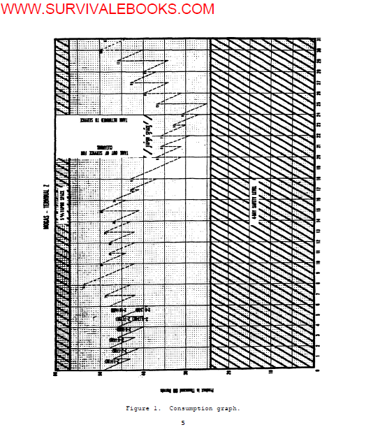

Slide 15
(2) Allowances for vapor space, 5 percent of total storage capacity,
is shown at the top of the graph. Vapor space allows room for the fuel to
expand and contract with temperature changes. For Terminal Z, with 60M bbls
capacity, vapor space is figured as follows:
60,000 bbls (capacity) x 5% (vapor space)
= 60,000 x .05
= 3,000 bbls for vapor space
The 3,000 (3M) bbl vapor space is plotted down from the top of the graph.
See figure 2 for a close-up.

Slide 16
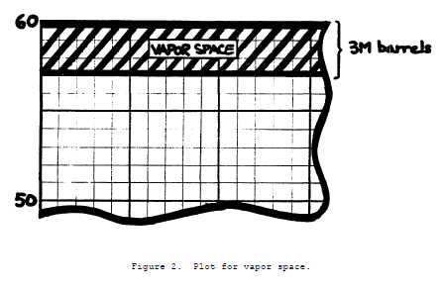

Slide 17
(3) Safety level, which is based on 4 days of normal (average) daily
consumption, is shown at the bottom of the graph. The 4-day safety level is
figured as follows:
4 (days supply) x 6,000 bbls
(Normal daily consumption from NOTE, figure 1)
= 4 x 6,000
= 24,000 (24M) bbls for 4-day safety level.
See figure 3 for a close-up.

Slide 18
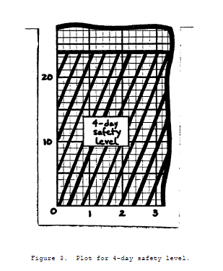

Slide 19
(4) Calculated (projected) issues and receipts are shown by a broken
line, and actual receipts and issues are shown by a solid line. In figure
4, the period began with 49M bbls in storage. The first day there was a
total issue of 7M bbls and a total receipt of 5M bbls. The line shows a
continuous drop in quantity from 49M bbls to 42M bbls (49M less the 7M
issued). The line then reflects the 5M bbl gain by showing a sudden rise
from 42M bbls to 47M bbls (42M on hand plus the 5M received). The second
day shows 8M in issues and 9M in receipts. The third day shows projected
issues of 6M bbls and projected receipts of 7M bbls. Projections for the
next two days are also shown in figure 4.

Slide 20
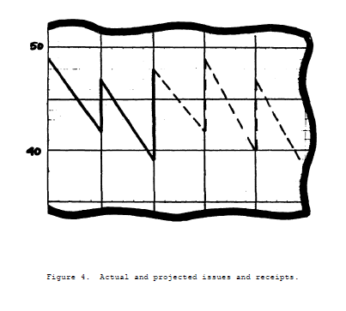

Slide 21
(5) Projected tank cleaning and repairs (reduced storage capacity)
must be provided for; the reduced storage capacity is subtracted from the
total capacity. In figure 1, a 20,000 barrel tank is shown scheduled for
cleaning on 20 July. The total capacity of Terminal Z is reduced by 20M
bbls. Notice also that the vapor space has been refigured. It is now 5
percent of 40M bbls, or 2M bbls.
(6) Differences in stock on hand from day to day indicate the rate of
consumption. The average rate of consumption based on past experience must
be projected to plan for future issues. The system must be replenished via
pipeline, based on this projected consumption rate

Slide 22
c. Batch Number. Figure 1 shows entries by each receipt such as 2-1
(4M), 2-2 (7M) and 2-4 (4M). These represent a batch number and the
quantity of fuel in that batch. The batch number also identifies the type
of product. A batch number must be assigned at the time each batch is put
into the line. When product is put into a terminal, it loses its number;
when it is taken out and moved farther up the line, it is assigned a new
batch number. A batch number is made up of two parts, the product code
number, and the numerical value of that batch. An example of such a number
is 2-4.

Slide 23
(1) Product code. The first part of the number identifies the
product (fuel). The suggested codes for the most common products are:
PRODUCT CODE
AVGAS 1
MOGAS 2
JP-4 3
KEROSENE 4
DIESEL FUEL 5
In the example given (2-4), the number 2 identifies the product as
automotive gasoline (MOGAS).

Slide 24
(2) Batch numerical value. The second part of the batch number
identifies the number of batches of that particular product that have been
pumped during that fiscal year. The numbers are assigned in sequence.
Batch number 1 would be the first batch of that product pumped after 0001, 1
October. In the example given (2-4), this is the fourth batch of MOGAS
pumped through the pipeline in that fiscal year.
(3) Additional information is included to tell personnel involved the
quantity of product being pumped. The quantity is expressed in thousands of
barrels (M). A batch number would then have this additional number added -
for example 2-4 (4H). This would mean that the batch 2-4 was 4,000 barrels
of MOGAS.

Slide 25
3. BATCHING SEQUENCES. Pipelines should, whenever practical, be used for
one type and grade of product only; however, between bulk terminals,
pipelines are often used as multiproduct lines. Problems that arise in
pumping more than one product through a pipeline are (1) mixing of the
products; (2) following the progress of the different products and the mixed
portions (interfaces) so that the products can be taken off the line at the
proper place; and (3) disposition of the interfaces

Slide 26
a. Controlling the Size of Interfaces. All scheduling should be done
in a sequence which will generate small, usable interfaces. The volume of
the interface depends upon these factors: differences in gravity of adjacent
products; pressure and velocity of the stream; interior conditions of the
pipe; the number of pump stations; and the distance traveled by the
interface. The size of the interface can be minimized by maintaining
sufficient flow rate (velocity) in addition to introducing products into the
pipeline in proper sequence (batching); and during shutdown, by maintaining
a packed (pressurized) line. Sufficient positive pressure will tend to
equalize small differences in gravity; thus the interface volume is kept to
a minimum whether the interface stops on level ground or on a slope. A
pipeline should never be shut down while an interface is in the line if it
can be avoided because some increase in the volume of the interface will
take place. The longer the pipeline is shut down, the larger the interface
can become

Slide 27
b. Determining Batching Sequence.
(1) To determine which product should be batched (pumped) behind
another, you must consider not only the product demands, but also the API
gravity of each product. Products should be injected into the pipeline in a
sequence so that the new product has an API gravity as close as possible to
that of the previous product. By following this procedure you will generate
smaller, usable interfaces. Products likely to be batched in military
multi-product pipelines include aviation gasoline (AVGAS), automotive
gasoline (MOGAS), jet fuel (JP), kerosene (KERO), and diesel fuel (DF).
Figure 5 shows the common API gravity ranges for these products.

Slide 28
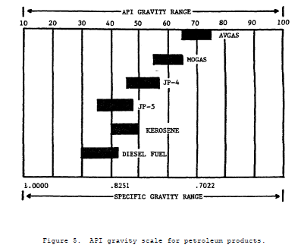

Slide 29
(2) Although products should be scheduled according to their API
gravity, product demands do not always allow this. Products can be batched
in any sequence but extreme care and extra precautions must be observed.
Figure 6 describes which tank the interfaces should be cut into and when.
The maximum percentage of interface product is also given. To insure that
this maximum percentage is not exceeded, a careful record must be kept of
interfaces to include the tank number and quantity of interface product
injected into each tank. As a general rule, only one interface should be
injected into any one tank of product prior to issue. The primary rule here
is to schedule your batches (and interfaces) so that the percentages in
figure 6 are never exceeded. After each receipt, your tanks should be
sampled and laboratory analysis performed. The laboratory analysis results
(and guidance from the petroleum laboratory NCO) should be checked before
making any final decision on scheduling of batches (and interfaces).

Slide 30
(3) The lab NCOIC should provide operations with (1) the tank to
accept the next interface and (2) the maximum amount of tail product in the
interface that can be cut into the recommended tank. For example, the lab
may recommend that a maximum of 75 barrels of tail product can be cut into
the recommended tank. If the interface is 100 barrels long it would contain
50 barrels of head and 50 barrels of tail product. So cutting of the entire
interface into the tank would be acceptable. The length (quantity) of the
interface is determined by multiplying the flow rate by the length of time
required for the interface to pass a given point. The flow rate can be
determined from our pipeline schedule and the length of the interface (in
minutes) is determined by having someone physically check the API gravity
changes and record the times. An example would be product flowing at 1000
BPH and the time for the interface to pass is 15 seconds (15 seconds ÷ 60
seconds =.25 minute). Flow rate of 1000 BPH divided by 60 minutes equals
16.66 barrels or 700 gallons per minute (GPM)(16.66 barrels x 42 gallons per
barrel). 700 GPM x .25 minutes equals 175 gallons in the interface.

Slide 31
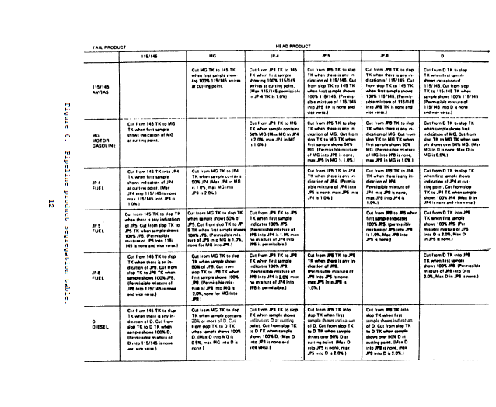

Slide 32
(4) Since the condition of no two tanks is exactly the same, the
schedule should normally have the interface going into a tank of high
quality fuel. Figure 6 shows that a slop tank is used in many cases for
receipt of the interface. In these cases if slop tanks are available, they
should be used. If no slop tank is available, the principles outlined in
3b(2) and (3) above should be followed very closely. If the percentage of
allowable interface is NONE, and no slop tank is available, you must either
schedule a small quantity of another acceptable product between these two
products or simply schedule the entire interface to be disposed of into a
tank that can accept it. All scheduling must be done in such a way as to
protect the quality of all products.

Slide 33
4. MONTHLY PIPELINE SCHEDULES.
a. General. The monthly pipeline schedule (fig 7) is based on
requirements to maintain stock levels and shows programmed movements through
the pipeline. When it is known what products are required for the 30-day
period, a schedule can be prepared to determine the time it will take for
the product to reach its destination after it has been started into the
pipeline. This schedule is merely a graph which shows line capacity in
barrels (distance) plotted against time in hours.

Slide 34
b. Preparation. The schedule is prepared on a sloping table top, which
can be equipped with a full length parallel rule. It is desirable to use an
adjustable protractor with the parallel rule to make sure that the flow rate
scale is plotted correctly.

Slide 35
(1) The number of hours a line is to be pumped each day must be
determined before the schedule is made. Time is shown from the beginning to
the end of a given working day. The chart is drawn with the vertical axis
representing the time period. Normally 1 inch on the vertical time axis
represents 1 hour, and 24 major units represent a pipeline day (fig 7).

Slide 36
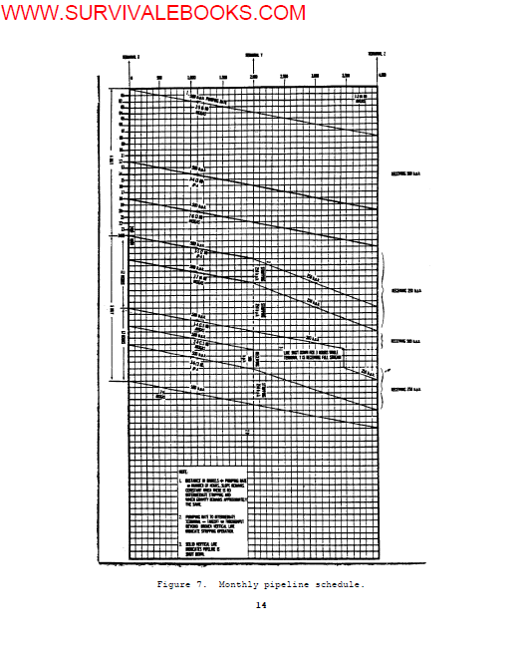

Slide 37
(2) The horizontal axix is drawn to show linefill in distance in
barrels. Normally, 1 inch on the horizontal axis represents 100 barrels
(fig 7).
(3) Terminals are located by their respective linefill distance
downstream from the base terminal and are plotted vertically.
(4) Each batch is labeled as to product and is identified by batch
number. Each type of product is marked on the graph with a distinctive
color. Suggested colors are as follows: AVGAS, blue; MOGAS, red; JP-4,
green; kerosene, yellow; diesel, brown.

Slide 38
(5) The distance in barrels divided by the pumping rate equals the
number of hours it will take for a given batch to reach a designated place
(see NOTE 1, fig 7).
(6) The slope of the throughput lines remains constant when there is
no intermediate stripping and when gravity remains approximately the same.
An example of this is shown in figure 7. The batch designated 2-5 (6M) is
shown being pumped from Terminal X to Terminal Z at a constant rate of 500
barrels per hour (BPH).

Slide 39
(7) Stripping of product at any intermediate terminal is indicated by
changing the rate of flow. This is shown on the graph as a change in the
angle of the throughput lines. Pumping rate to an intermediate terminal
minus takeoff equals the throughput beyond.
(8) A broken vertical line indicates a stripping action (see NOTE 2,
fig 7). In figure 7, batch 3-5 (2M) is being pumped from Terminal X at 500
BPH. At Terminal Y, 250 BPH is being stripped off. The remaining 250 BPH
is being pumped on to Terminal Z.

Slide 40
(9) A broken horizontal line indicates that the pipeline is shut
down.
(10) The points at which the sloping lines intersect the vertical
lines representing terminals and stations indicate scheduled arrival times.
(11) When all of the throughput lines have been drawn, the graph
represents all scheduled pumping and delivery operations for the month.

Slide 41
c. Example. Figure 7 shows an example of a 2-day portion of a monthly
pipeline schedule. Although the monthly pipeline schedule is the master
plan on which the daily pumping schedule, graphic progress chart, and daily
pumping order are based, figure 7 may be explained by reading the daily
pumping order for 5 July given in figure 8 and paragraph 5.

Slide 42
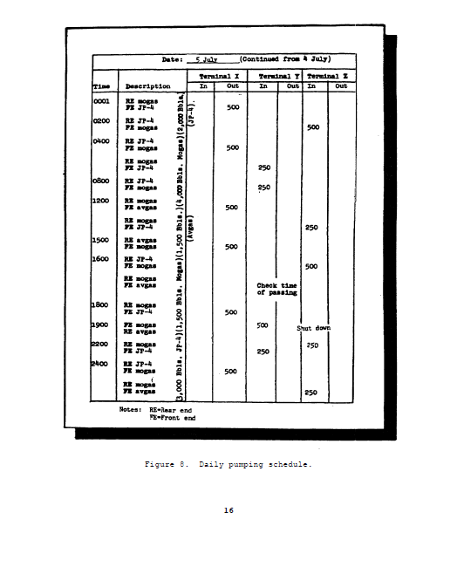

Slide 43
5. DAILY PUMPING SCHEDULE. Daily pumping schedules (fig 8) are prepared
as a basis for dispatching the pipeline. They are a translation of the
monthly schedule in abbreviated, tabular form for the days concerned and
show changes and emergency requirements. They usually are prepared a week
in advance so that the dispatching section can be equipped with a week's
supply. They serve as a basis for the graphic progress chart, and, in turn,
the daily pumping order.

Slide 44
6. COMPLETED GRAPHS AND SCHEDULES. When all the graphs and schedules are
completed, they are forwarded to the operations sergeant for distribution
and any additional required actions. Copies are kept on file to help with
the estimated requirements as covered in paragraph 1.

