Slide 1
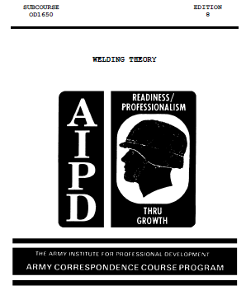

Slide 2
1. Introduction
Welding is one of the most important functions performed within a metalworking shop. Many broken parts may be welded and put back into service, saving the expense of fabricating or purchasing a new piece of equipment, and downtime is reduced. This task will describe the welding process, to include the interpretation and identification of welding symbols used in shop
drawings.

Slide 3
2. Welding Process
a. General. A master chart indicating the great variety of welding processes is shown in
figure 1 on the following page. The term "welding process" means heating metal parts to a temperature high enough to join the metal parts by coalescence. Welding is done with or without the use of pressure, by the pressure alone, and with or without the use of filler metal. Coalescence means the growing together, or growth into one body, of the base metal parts. There are two basic requirements for coalescence: heat and intimacy of contact.

Slide 4
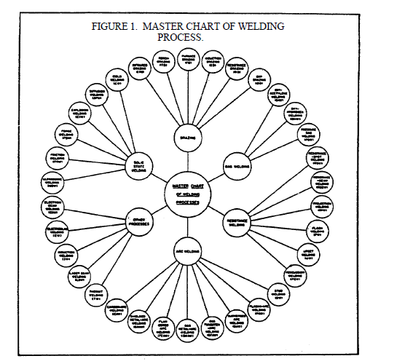

Slide 5
b. Heat. The welding processes differ depending on the source of heat, the manner in which the heat is applied or generated, and the intensity of the heat. The source of heat may be the combustion of a fuel gas such as acetylene or hydrogen, in air or in oxygen; an electric arc; an electric, gas, or oil furnace; the resistance of metal to the flow of electric current; or a chemical reaction between a metal oxide and finely divided aluminum. The intensity of heat applied or generated at the joint varies according to the welding process used. All welding, processes except brazing use temperatures high enough to melt the base
metals.
Brazing, the only welding process in which the melting of the base metal is not necessary for
coalescence, is similar to soldering, except that higher temperatures are used. The term soldering
is used to describe a joining process using nonferrous filler alloys melting below 800°F (427°C).
Soldering is not considered a welding process. Brazing is a welding process using nonferrous
filler alloys that have a melting point above 800°F (427°C) but below that of the base metal.

Slide 6
c. Intimacy of Contact. The second basic requirement for coalescence, intimacy of contact,
may be divided into two groups: pressure processes and non pressure processes. In pressure
processes, intimacy of contact is achieved by applying pressure while the contact surfaces are at a
high enough temperature to allow plastic flow of the metal. In non pressure processes, a space
remains between the surfaces to be joined. This space is then filled, either progressively or all at
once, with molten metal. The molten metal may be obtained from a filler metal (welding rod or
electrode) by melting the surfaces to be joined, or by combining a filler metal and melted base
metal.
All non pressure processes involve fusion, and they are often referred to as fusion processes.
However, this term is somewhat misleading since some pressure processes also involve fusion.

Slide 7
The various welding processes differ not only in the way coalescence is achieved, but also in
their ability to produce a satisfactory joint in a given kind of metal under the conditions in which the weld must be made. Many factors influence the selection of a welding process for a particular application. These factors include the relative cost, the amount of welding required, the location and position of welds, the service conditions the welded structure must withstand, and the qualifications of the person who does the welding. Probably the most important single factor, however, is the weldability of the metal.

Slide 8
d. Weldability. The term weldability means the capacity of a metal to be fabricated by a
welding process into a structure that will perform its purpose satisfactorily. Weldability also means the degree of simplicity or complexity of the procedures and techniques necessary to Produce welds with properties that are equal to or better than the properties of the base material. For example, mild steel can be welded by most welding processes, but the welds produced are not equally satisfactory, and one method may be more complicated or more expensive than another.

Slide 9
While it is possible to weld mild steel through the use of a variety of welding processes, some
metals such as aluminum and its alloys can be welded satisfactorily through only a few welding processes. Mild steel does not require elaborate preparations, fluxes, and special techniques because its characteristics are such that the welding operation can be easily performed. Other metals require special preparatory steps, complex welding sequences, skillful use of a specific
welding technique, and extensive heat treatments after welding.Many factors influence the weldability of a metal. Some important ones that must be taken into
account and, so far as possible, controlled are:

Slide 10
Many factors influence the weldability of a metal. Some important ones that must be taken intoaccount and, so far as possible, controlled are:
(1) the chemical composition of the metals involved (that is, the kind and percentage of
elements present) and the effect of radical temperature changes on the various elements;
(2) the expansion and contraction characteristics of the base metals;
(3) the filler metal (welding rod or electrode);
(4) the joint design; and
(5) the welding procedure

Slide 11
In steel, carbon is probably the most important element that limits weldability. Carbon gives
steel hardenability; that is, when certain carbon steels are heated above a critical temperature and then cooled rapidly, they become much harder. At the same time, they lose ductility. In fact, the metal may become extremely brittle. With few exceptions, the temperatures used in welding exceed the critical temperature of carbon steels. Further, more hardening may occur when the mass of relatively cold metal surrounding the weld area conducts heat away so fast that rapid cooling occurs. Thus, certain steels may become hardened by many of the welding processes.

Slide 12
When the percentage of carbon is less than 0.25 percent, its effect in producing hardness is slight. But when the carbon content exceeds 0.25 percent, or when such elements as manganese, vanadium, chromium, molybdenum, or titanium are present, together with a carbon percentage of less than 0.25 percent, the weldability of the steel is decreased. Special steps should be taken to control preheat, interpass temperature, postheat, and welding sequence. Otherwise a satisfactory weld is likely to crack and to have reduced toughness and less strength than is required. For this reason, tool steels and certain alloys like carbon-molybdenum steel are less weldable than many other steels.
Steels contain certain impurities such as sulfur, phosphorus, hydrogen, nitrogen, and oxygen. If
present in large enough quantities, these impurities may decrease weldability. For example, a
steel to which about 0.10 percent sulfur has been added to improve machineability is difficult to
weld because the weld has a tendency to carack. An excessive amount of phosphorus decreases
the ductility of the steel and thus decreases the weldability of the metal. The presence of
hydrogen in a steel, filler material, or flux may lead to cracks in the welds.

Slide 13
Stainless steels, high-chromium steels, and other special steels are less weldable than plain lowcarbon steels. The elements that give these special steels their desirable properties for specific
applications also have the effect of decreasing the weldability of the metals. To make these special steels weldable, the welding procedures, the filler metal, the fluxes, the preheat and
postheat temperatures, and the welding sequence must be carefully selected. This is also true for many nickel, copper, and aluminum alloys.
In some metals, the heat of the welding process may cause certain elements with low-melting points to vaporize, thus reducing the amounts of those elements present in the weld zone.
Nonferrous alloys containing lead, zinc, and tin are particularly subject to such looses from vaporization. These losses may seriously affect the properties of the joint by causing porosity or
oxide inclusions that weaken the weld

Slide 14
The weldability of a metal is also affected by its thermal conductivity. In general, metals with
high thermal conductivity are difficult to weld because they transfer the heat away from the weld so rapidly that the required temperature cannot be maintained at the joint.
Changes in temperature cause a metal to expand or contract and this also affects weldability. When metals expand and contract at different rates, the internal stresses set up by these changes can cause the joint to crack immediately, or to crack later under load.

Slide 15
Even when the weld joins identical metals, or metals having approximately the same coefficient of expansion, the expansion and contraction may not be uniform throughout all parts of the metal. These differences lead to internal stresses, distortion, and warping. Metal parts must be free to move or a special weld sequence must be used. When heat is applied or withdrawn, expansion and contraction set up high stresses, which may cause trouble in the weld itself or in
the adjacent base metal. In thin materials, uneven expansion and contraction may cause the metal to warp. In heavy material, the stresses set up may exceed the ultimate strength of the metal and cause cracking to occur in the weld, or in the metal next to the weld which is called the heat-affected zone.

Slide 16
Even if the ultimate strength of the material is not exceeded by the stresses developed during
welding, the combination of welding stresses plus the stresses developed when the material is placed in service may-be enough to cause failure of-the weld. It is for this reason that many materials are stress-relieved after welding.
Another factor that influences weldability is the filler material used. The wrong electrode or an incorrect welding process will make welding difficult or impossible, and it may lead to failure of the part under service conditions. It is not always essential that the welding rod or electrode be of the same chemical composition as the base metal; the important requirement is that the combination of the filler metal and the base metal will make a satisfactory welded joint.

Slide 17
In some processes, the flux selected for use with a welding rod has important effects on weldability. Also, the electrode covering influences the weld obtained in certain steels. Molten
steels have a tendency to absorb hydrogen from the surrounding atmosphere and to expel it when they solidify. Some types of electrode coverings send a lot of hydrogen into the atmosphere
surrounding the arc and the molten puddle. This hydrogen is enough to cause microscopic cracks in the heat-affected zone of some steels. To eliminate this problem, low-hydrogen electrodes
have been developed to weld the newer high-tensile steels.
Joint design also influences the weldability of a metal. Several factors must be considered when selecting a joint design. They include the welding process, the thickness of the material to be
welded, and the purpose the joint is to serve.

Slide 18
Thin sheets of metal can be butted together without special preparation other than cleaning; but
heavy plates must be beveled or grooved to make a satisfactory joint. Again, the design used is
related to the purpose; that is, the way the load or stress is applied, the erosive or corrosive
conditions it must resist, and the joint efficiency. The term "joint efficiency" is used to indicate
the strength of a welded joint as compared with the strength of the unwelded base metal.
Each of the welding processes has a technique or procedure peculiar to that process. Often the
technique varies with the kind or size of the filler metal used, or the kind of weld being made.
The incorrect use of a technique, or the use of the wrong technique, may lead to defects that
make the joint unsatisfactory

Slide 19
e. Conclusion. This information on welding processes is provided to give a brief
introduction to welding. A shop drawing is the universal language used to convey all the
necessary information that an individual would need to perform these welding processes. Special symbols are furnished on shop drawings to show the kinds of welds to be used. The following subparagraphs will contain data on the use and function of welding symbols

Slide 20
3. Weld and Welding Symbols
a. General. Welding symbols provide the means for placing complete and concise welding information on drawings. The reference line of the welding symbol (figure 2) is used to designate the type of weld to be made, its location, dimensions, extent, contour, and other supplementary information. When necessary, a tail is attached to the reference line which
provides specific notations. When such notations are not required the tail is omitted.

Slide 21
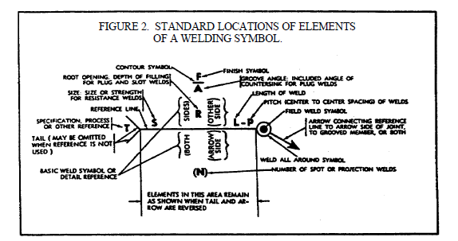

Slide 22
b. Elements of a Welding Symbol. A distinction is made between the term "weld symbol"
and "welding symbol." The "weld symbol" is the ideograph (figure 3, views A and B, on the
following page) that is used to indicate the desired type of weld. The assembled "welding
symbol" consists of the following eight elements, or any of these elements as are necessary: reference line; arrow; basic weld symbols; dimensions and other data; supplementary symbols; finish symbols; tail; and the specification, process, or other reference. The location of the elements of a welding symbol with respect to each other is shown in figure 2.

Slide 23
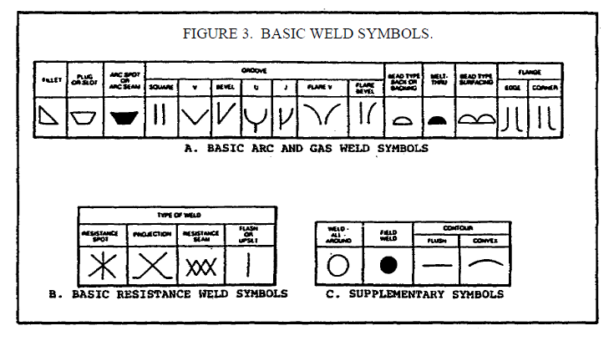

Slide 24
c. Basic Weld Symbols.
(1) General. Weld symbols are used to indicate the following welding processes used in
metal joining operations; whether the weld is localized or "all around"; shop or field welds; and
the contour of welds. These basic weld symbols are summarized in paragraphs (2) through (5)
below and are illustrated in figure 4 on the following page.
(2) Arc and Gas Weld Symbols. These symbols are used as shown in figure 3, view A.
(3) Resistance Weld Symbols. These symbols are used as shown in figure 3, view B.
(4) Brazing, Forge, Thermit, Induction, and Flow Weld Symbols. These welds are
indicated by using a process or specification reference in the tail of the welding symbols as
shown in figure 4, view A. When the use of a definite process is required (figure 4, view B), the
process may be indicated by one or more of the letter designations shown in Tables I and II on
the following pages. When no specification, process or other reference is used with a welding
symbol, the tail may be omitted, as shown in figure 4, view C.
(5) Supplementary Symbols. These symbols are used in many welding processes and will
be used as shown in figure 3, view C, on page 9.

Slide 25
The other member of the joint will be considered the other side member (figure 6, views A and
B, on the following page).
(3) When a joint is depicted by a single line on the drawing and the arrow of a welding
symbol is directed to this line, the arrow side of the joint will be considered as the near side of
the joint, in accordance with the usual conventions of drafting (figure 5, views C and D).
(4) When a joint is depicted as an area parallel to the plane of projection in a drawing and
the arrow of a welding symbol is directed to that area, the arrow side member of the joint will be
considered as the near member of the joint, in accordance with the usual conventions of drafting
(figure 6, views A and B).

Slide 26
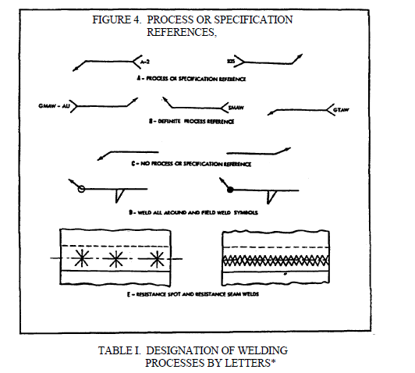

Slide 27
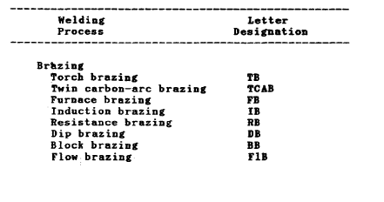

Slide 28
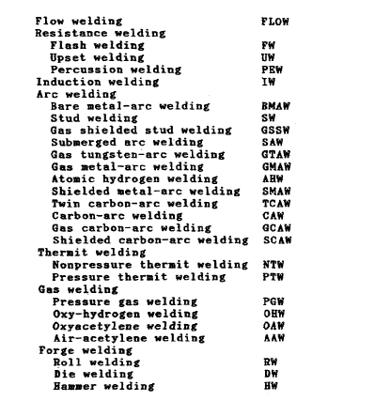

Slide 29
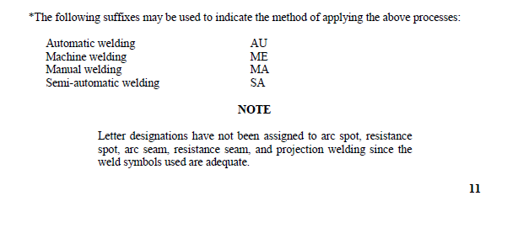

Slide 30
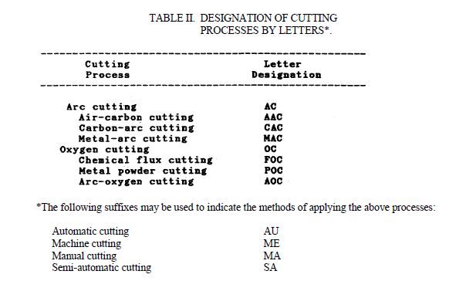

Slide 31
d. Location Significance of Arrow.
(1) In fillet, groove, flange, and flash or upset welding symbols, the arrow will connect
the welding symbol reference line to one side of the joint, and this side will be considered the
arrow side of the joint (figure 5, view A, on the following page). The side opposite the arrow
side of the joint is considered the other side of the joint (figure 5, view B).
(2) In plug, slot, arc spot, arc seam, resistance spot, resistance seam and projection
welding symbols, the arrow will connect the welding symbol reference line to the outer surface
of one of the members of the joint at the center line of the desired weld. The member to which
the arrow points will be considered the arrow side member

Slide 32
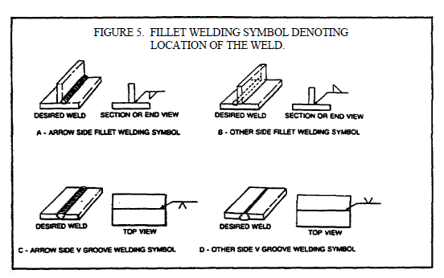

Slide 33
e. Location of the Weld With Respect to the Joint.
(1) Welds on the arrow side of the joint will be shown by placing the weld symbol on the
side of the reference line toward the viewer (figure 7, view A, on page 15).
(2) Welds on the other side of the joint will be shown by placing the weld symbol on the
side of the reference line away from the viewer (figure 7, view B).
15
WELDING THEORY - OD1650 - LESSON 1/TASK 1
(3) Welds on both sides of the joint will be shown by placing weld symbols on both sides
of the reference line, toward and away from the viewer (figure 7, view C, on the previous page).
(4) Resistance spot, resistance seam, flash .and upset weld symbols have no arrow side or
other side significance in themselves, although supplementary symbols used in conjunction with
these symbols may have such significance. For example: the flush contour symbol (refer to
figure 3, view C, on page 9) is used in conjunction with the spot and seam symbols (figure 7,
view D) to show that the exposed surface of one member of the joint is to be flush. Resistance
spot, resistance seam, flash and upset weld symbols will be centered on the reference line (figure
7, view D).

Slide 34
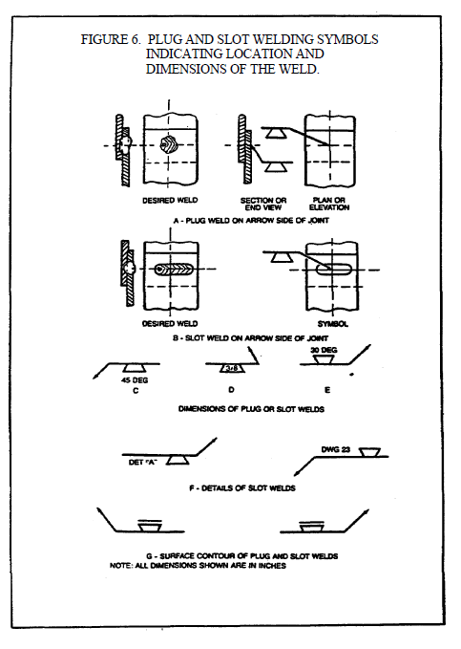

Slide 35
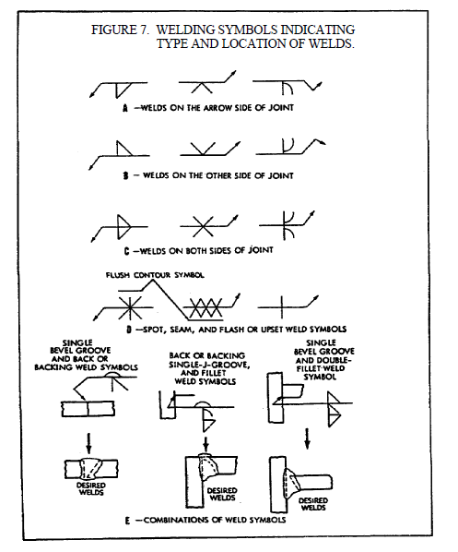

Slide 36
f. References and General Notes.
(1) Symbols may be used without specification, process or other references in the
following circumstances:
(a) A note such as the following appears on the drawing: "Unless otherwise
designated, all welds are to be made in accordance with Specification No ....."
(b) The welding procedure to be used is prescribed elsewhere.
(2) General notes, such as the following, may be placed on a drawing to provide detailed
information pertaining to the predominating welds, and this information need not be repeated on
the symbols:
(a) "Unless otherwise indicated, all fillet welds are 5/16 inch size."
(b) "Unless otherwise indicated, root openings for all groove welds are 3/16 inch."

Slide 37
g. Weld-All-Around and Field Weld Symbols.
(1) Welds extending completely around a joint will be indicated by means of the weldall-
around symbol (refer to figure 4, view D, on page 10).
16
WELDING THEORY - OD1650 - LESSON 1/TASK 1
(2) Field welds are welds not made in a shop or at the place of initial construction and
will be indicated by means of the field weld symbol (figure 4, view D, on page 10).

Slide 38
h. Extent of Welding Denoted by Symbols.
(1) Symbols apply between abrupt changes in the direction of the welding, or to the
extent of hatching or dimension lines, except when the weld-all-around symbol is used.
(2) The welding on hidden joints may be covered when the welding is the same as that of
the visible joint. The drawing will indicate the presence of hidden members. If the welding on
the hidden joint is different from that of the visible joint, specific information for the welding of
both will be given.

Slide 39
i. Location of Weld Symbols.
(1) Weld symbols, except resistance spot and resistance seam, will be shown only on the
welding symbol reference line and not on the lines of the drawing.
(2) Resistance spot and resistance seam weld symbols may be placed directly at the
locations of the desired welds (refer to figure 4, view E).
j. Use of Inch, Degree and Pound Marks. Inch, degree, and pound marks may or may not
be used on welding symbols, as desired, except that inch marks will be used for indicating the
diameter of arc spot, resistance spot and circular projection welds, and the width of arc seam and
resistance seam welds, when such welds are specified by decimal dimensions

Slide 40
k. Construction of Symbols.
(1) Fillet, bevel and J groove, flare bevel groove, and corner flange symbols will be
shown with the perpendicular leg always to the left (figure 8, view A, on the following page).
(2) In a bevel or J groove weld symbol, the arrow will point with a definite break toward
the member which is to be chamfered (figure 8, view B). In cases where the member to be
chamfered is obvious, the break in the arrow may be omitted.
(3) Information on welding symbols will be placed to read from left to right along the
reference line, in accordance with the usual conventions of drafting (figure 8, view C).

Slide 41
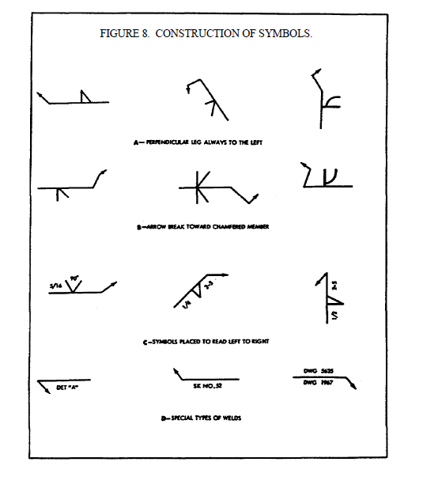

Slide 42
(4) For joints having more than one weld, a symbol will be shown for each weld (refer to
figure 7, view E, on page 15).
(5) When the basic weld symbols are inadequate to indicate the desired weld, the weld
will be shown by a cross section, detail or other data, with a reference on the welding symbol,
observing the usual location significance (figure 8, view D, on the previous page).

Slide 43
l. Fillet Welds.
(1) Dimensions of fillet welds will be shown on the same side of the reference line as the
weld symbol (figure 9, view A, on the following page).
(2) When fillet welds are indicated on both sides of a joint and no general note governing
the dimensions of the welds appears on the drawing, the dimensions will be indicated as follows:
(a) When both welds have the same dimensions, one or both may be dimensioned
(figure 8, views B and C).
(b) When the welds differ in dimensions, both will be dimensioned (figure 9, view
D).
(3) When fillet welds are indicated on both sides of a joint and a general note governing
the dimensions of the welds appears on the drawing, neither weld need be dimensioned. But if
the dimensions of one or both welds differ from the dimensions given in the general note, both
welds shall be dimensioned (figure 9, views C or D).

Slide 44
m. Size of Fillet Welds.
(1) The size of a fillet weld will be shown to the left of the weld symbol (figure 9, view
A).
(2) The size of a fillet weld with unequal legs will be shown in parentheses to the left of
the weld symbol. Weld orientation is not shown by the symbol and will be shown on the
drawing when necessary (figure 9, view E).

Slide 45
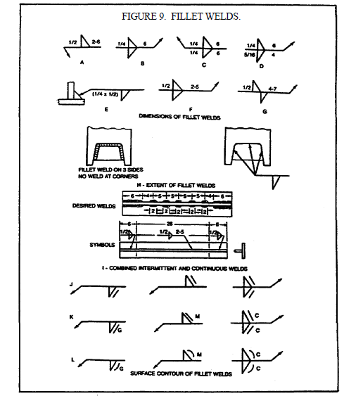

Slide 46
n. Length of Fillet Welds.
(1) The length of a fillet weld, when indicated on the welding symbol, will be shown to
the right of the weld symbol (figure 9, views A through D).
(2) When fillet welding extends for the full distance between abrupt changes in the
direction of the welding, no length dimension need be shown on the welding symbol.
(3) Specific lengths of fillet welding may be indicated by symbols in conjunction with
dimension lines (figure 9, view I, on the previous page).
o. Extent

Slide 47
o. Extent of Fillet Welding.
(1) When it is desired to show the extent of fillet welding graphically, one type of
hatching, with or without definite lines, shall be used.
(2) Fillet welding extending beyond abrupt changes in direction of the welding will be
indicated by means of additional arrows pointing to each section of the joint to be welded (figure
9, view H), except when the weld-all-around symbol is used

Slide 48
p. Dimensioning of Intermittent Fillet Welding.
(1) The pitch (center-to-center spacing) of intermittent fillet welding will be shown as the
distance between centers of increments on one side of the joint.
(2) The pitch of intermittent fillet welding will be shown to the right of the length
dimension (figure 9, view A).
(3) Chain intermittent fillet welding will be shown in figure 9, view F.
(4) Staggered intermittent fillet welding will be shown in figure 9, view G.

Slide 49
q. Termination of Intermittent Fillet Welding.
(1) When intermittent fillet welding is used by itself, the symbol indicates that increments
will be located at the ends of the dimensional length.
(2) When intermittent fillet welding is used between continuous fillet welding the symbol
indicates that spaces equal to the pitch minus the length of one increment shall be left at the ends
of the dimensioned length. Separate symbols will be used for intermittent and continuous fillet welding when the two are used in combination
(figure 9, view I, on page 20)

Slide 50
r. Surface Contour of Fillet Welds.
(1) Fillet welds that are to be welded approximately flat faced, without recourse to any
method of finishing, will be shown by adding the flush contour symbol to the weld symbol,
observing the usual location significance (figure 9, view J).
(2) Fillet welds that are to be made flat faced by mechanical means will be shown by
adding both the flush contour symbol and the user's standard finish symbol, observing the usual
location significance (figure 9, view K).
(3) Fillet welds that are to be mechanically finished to a convex contour will be shown by
adding both the convex contour symbol and the user's standard finish symbol to the weld symbol,
observing the usual location significance (figure 9, view D).
NOTE
The finish symbols referred to in (2) and (3) above indicate the
method of finishing ("C" = chipping; "G" = grinding; "H" =
hammering; "M" = machining) and not the degree of finish.

Slide 51
s. Plug and Slot Welding Symbols.
(1) General. Neither the plug weld symbol nor the slot weld symbol will be used to
designate fillet welds in holes.
(2) Arrow and Other Side Indication of Plug and Slot Welds. Holes or slots in the arrow
side member of a joint for plug or slot welding will be indicated by placing the weld symbol on
the side of the reference line toward the viewer (refer to figure 6, view A, on page 14). Holes or
slots in the other side member of a joint are indicated by placing the weld symbol on the side of
the reference line away from the viewer (refer to figure 6, view B).

Slide 52
(3) Plug Weld Dimensions. Dimensions of plug welds will be shown on the same side of
the reference line as the weld symbol. The size of a weld will be shown to the left of the weld
symbol. Included angle of countersink of plug welds shall be the user's standard, unless
otherwise indicated. Included angle of countersink, when not the user's standard, will be shown
either above or below the weld symbol (refer to figure 6, views C and E, on page 14). The pitch
(center-to-center spacing) of plug welds will be shown to the right of the weld symbol.
(4) Depth of Filling of Plug and Slot Welds. Depth of filling of plug and slot welds will
be complete unless otherwise indicated. When the depth is less than complete the depth of the
filling will be shown in inches inside the weld symbol (refer to figure 6, view D).

Slide 53
(5) Details of Slot Welds. Length, width, spacing, included angle of countersink,
orientation and location of slot welds cannot be shown on the welding symbols. These data will
be shown on the drawing, or by a detail with a reference to it on the welding symbol, observing
the usual location significance (refer to figure 6, view F).
(6) Surface Contour of Plug and Slot Welds. The surface contour (figure 6, view G) shall
be indicated in the same manner as that for fillet welds

Slide 54
t. Arc Spot and Arc Seam Welds.
(1) General. Dimensions for arc spot and arc seam welds will be shown on the same side
of the reference line is the weld symbol.
(2) Size of Arc Spot and Arc Seam Welds.
(a) These welds may be dimensioned by either size or strength.
(b) The size of arc spot welds will be designated as the diameter of the weld. Arc
seam weld size will be designated as the width of the weld. Dimensions will be expressed in
fractions or decimally in hundredths of an inch, and will be shown, with or without inch marks,
to the left of the weld symbol (figure 10, view A, on the following page).

Slide 55
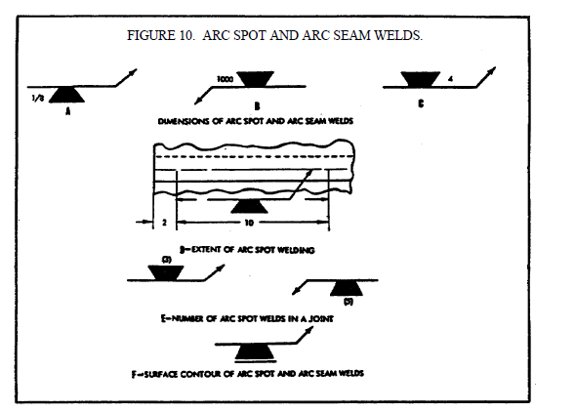

Slide 56
(c) The strength of arc spot welds will be designated as the minimum acceptable shear strength in pounds per spot. In arc seam welds strength is designated in pounds per linear
inch. Strength is shown to the left of the weld symbol (figure 10, view B). (3) Spacing Arc Spot and Arc Seam Welds.
(a) The pitch of arc spot welds and, when indicated, the length of arc seam welds wil be shown to the right of the weld symbol (figure 10, view C). (b) When arc seam welding extends for the full distance between abrupt changes in the direction of welding, no length dimension need be shown on the welding symbol.
(4) Extent and Number of Arc Spot Welds. (a) When arc spot welding extends less than the distance between abrupt changes in
the direction of the welding, or less than the full length of the joint, the extent will be dimensioned (figure 10, view D, on the previous page). (b) When a definite number of arc spot welds is desired in a certain joint, the number will be shown in parentheses either above or below the weld symbol (figure 10, view E).(5) Details of Arc Seam Welds. Spacing, extent, orientation, and location of arc seam
welds cannot be shown on the welding symbols. These data will be shown on the drawing. (6) Flush Arc Spot and Arc Seam Welded Joints. When the exposed surface of one member of an arc spot or arc seam welded joint is to be flush, that surface will be indicated by
adding the flush contour symbol (figure 10, view F), in the same manner as that for fillet welds.

Slide 57
u. Groove Welds.
(1) General.
(a) Dimensions of groove welds will be shown on the same side of the reference line
as the weld symbol.
(b) When no general note governing the dimensions of groove welds appears on the
drawing, the dimensions for double groove welds will be shown as follows:
1 When both welds have the same dimensions, one or both may be dimensioned
(figure 11, view A, on the following page).
2 When the welds differ in dimensions, both welds will be dimensioned (figure
11, view B).
(c) When a general note governing the dimensions of groove welds appears on the
drawing, the dimensions of double groove welds will be indicated as follows:

Slide 58
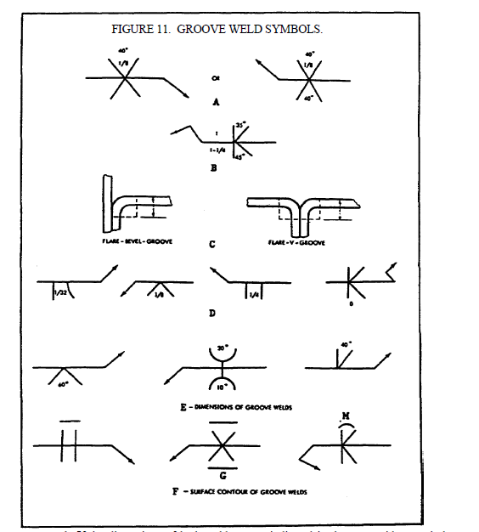

Slide 59
1 If the dimensions of both welds are as indicated in the note neither symbol
need be dimensioned.
2 When the dimensions of one or both welds differ from the dimensions given
in the general note both welds will be dimensioned (figure 11, view B, on the previous page).
(2) Size of Groove Welds.
(a) The size of groove welds will be shown to the left of the weld symbol (figure 11,
view B).
(b) The size of groove welds with no specified root penetration will be shown as
follows:
1 The size of single groove and symmetrical double groove welds which extend
completely through the member or members being joined need not be shown on the welding
symbol (figure 12, views A and B).

Slide 60
2 The size of groove welds which extend only partly through the member or
members being joined will be shown on the welding symbol (figure 12, views C and D).
(c) The size of groove welds with specified root penetration, except square groove
welds, will be indicated by showing both the depth of chamfering and the root penetration,
separated by a plus mark and placed to the left of the weld symbol. The depth of chamfering and the root penetration will read in that order from left to right along the reference line (figure 12, views E and F, on the previous page). The size of square groove welds will be indicated by showing only the root penetration. (d) The size of flare groove welds is considered as extending only to the tangent
points as indicated by dimension lines (refer to figure 11, view C, on page 26).

Slide 61
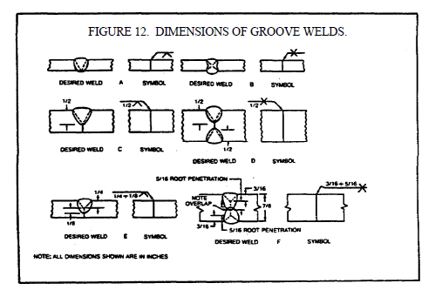

Slide 62
(3) Groove Dimensions.
(a) Root opening, groove angle, groove radii, and root faces of the U and J groove
welds will be the user's standard, unless otherwise indicated.
(b) When the user's standard is not used the weld symbols are as follows:
1 Root opening will he shown inside the weld symbol (refer to figure 11, view
D).
2 Groove angle of groove welds will be shown in figure 11, view E.
3 Groove radii and root faces of U and J groove welds will be shown by a cross
section, detail or other data, with a reference to it on the welding symbol, observing the usual
location significance (refer to figure 8, view D, on page 18).

Slide 63
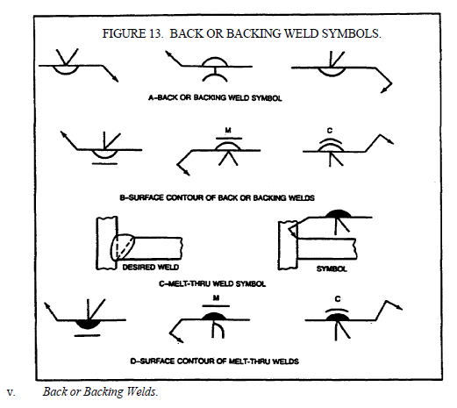

Slide 64
(4) Back and Backing Welds. Bead type back and backing welds of single groove
welds will be shown by means of the back or backing weld symbol (figure 13, view A, on the
following page).
(5) Surface Contour of Groove Welds. The contour symbols for groove welds (figure
11, view F) are indicated in the same manner as that for fillet welds.

Slide 65
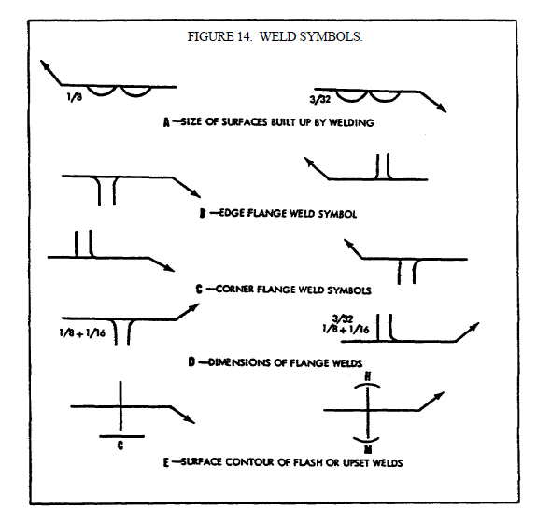

Slide 66
v. Back or Backing Welds.
(1) General.
(a) The back or backing weld symbol on page 9 will be used to indicate bead type
back or backing welds of single groove welds.
(b) Back or backing welds of single groove welds will be shown by placing a back or
backing weld symbol on the side of the reference line opposite the groove weld symbol (figure
13, view A).
(c) Dimensions of back or hacking welds will not be shown on the welding symbol.
If it is desired to specify these dimensions, they will be shown on the drawing
(2) Surface Contour of Back or Backing Welds. The contour symbols (figure 13, view C,
on the previous page) for back or backing welds (figure 12, view B, on page 27) are indicated in
the same manner as that for fillet welds.

Slide 67
w. Melt-Thru Welds.
(1) General.
(a) The melt-thru symbol will be used where at least 100 percent joint penetration of
the weld through the material is required in welds made from one side only (figure 13, view C).
(b) Melt-thru welds will be shown by placing the melt-thru weld symbol (figure 13,
view A) on the side of the reference line opposite the groove weld, flange, tee, or corner weld
symbol (figure 13, view C).
(c) Dimensions of melt-thru welds will not be shown on the welding symbol. If it is
desired to specify these dimensions they will be shown on the drawing.
(2) Surface Contour of Melt-Thru Welds. The contour symbols (refer to figure 3, view C,
on page 9) for melt-thru welds are indicated (figure 13, view D) in the same manner as that for
fillet welds.

Slide 68
x. Surfacing Welds.
(1) General.
(a) The surfacing weld symbol (refer to figure 3, view A, on page 9) will be used to
indicate surfaces built up by welding (figure 14, view A, on the following page), whether built up
by single or multiple pass surfacing welds.
(b) The surfacing weld symbol does not indicate the welding of a joint, and hence has
no arrow or other side significance. This symbol will be drawn on the side of the reference line
toward the viewer and the arrow will point clearly to the surface on which the weld is to be
deposited.

Slide 69
(2) Size of Built-Up Surfaces. The size (height) of a surface built up by welding will be
indicated by showing the minimum height of the weld deposit to the left of the weld symbol.
The dimensions will always be on the same side of the reference line as the weld symbol (figure
14, view A). When no specific height of weld deposit is desired, no size dimension need be
shown on the welding symbol.
(3) Extent, Location, and Orientation of Surfaces Built Up by Welding. When the entire
area of a plane or curved surface is to be built up by welding, no dimension other than size need
be shown on the welding symbol. If only a portion of the area of a plane or curved surface is to
be built up by welding, the extent, location, and orientation of the area to be built up will be
indicated on the drawing.

Slide 70
y. Flange Welds.
(1) General.
(a) The following welding symbols are intended to be used for light gage metal joints
involving the flaring or flanging of the edges to be joined. These symbols have no arrow or other
side significance.
(b) Edge flange welds will be shown by the edge flange weld symbol (figure 14, view
B, on the previous page).
(c) Corner flange welds will be shown by the corner flange weld symbol (figure 14,
view C).

Slide 71
(2) Dimensions of Flange Welds.
(a) Dimensions of flange welds will be shown on the same side of the reference line
as the weld symbol.
(b) The radius and the height above the point of tangency will be indicated by
showing both the radius and the height separated by a plus mark and placed to the left of the weld
symbol. The radius and the height shall read in that order from left to right along the reference
line (figure 14, view D).
(c) The size of flange welds will be shown by a dimension placed outward of the
flange dimensions (figure 14, view D).
(d) Root opening of flange welds will not be shown on the welding symbol. If it is
desired to specify this dimension, it will be shown on the drawing.

Slide 72
(3) Multiple Joint Flange Welds. For flange welds in which one or more pieces are
inserted between the two outer pieces, the same symbol as for the two outer pieces will be used
regardless of the number of pieces inserted

Slide 73
z. Resistance Spot Welds.
(1) General. Resistance spot weld symbols (refer to figure 3, view B, on page 9) have no
arrow or other side significance in themselves, although supplementary symbols used in
conjunction with them may have such significance. Resistance spot weld symbols will be
centered on the reference line. Dimensions may be shown on either side of the reference line.
(2) Size of Resistance Spot Welds. Resistance spot welds will be dimensioned, by either
size or strength, as follows:
(a) The size of resistance spot welds will be designated as the diameter of the weld
expressed in fractions or decimally in hundredths of an inch, and will be shown, with or without
inch marks, to the left of the weld symbol (figure 15, view A, on the following page).
(b) The strength of resistance spot welds will be designated as the minimum
acceptable shear strength in pounds per spot, and will be shown to the left of the weld symbol
(figure 15, view B).

Slide 74
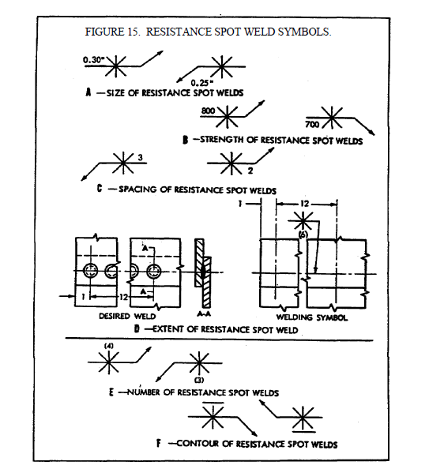

Slide 75
(3) Spacing of Resistance Spot Welds.
(a) The pitch of resistance spot welds will be shown to the right of the weld symbol
(figure 15, view C).
(b) When the symbols are shown directly on the drawing, the spacing will be shown
by using dimension lines.
(c) When resistance spot welding extends less than the distance between abrupt
changes in the direction of the welding, or less than the full length of the joint, the extent will be
dimensioned (figure 15, view D).

Slide 76
(4) Number of Resistance Spot Welds. When a definite number of welds is desired in a
certain joint, the number will be shown in parentheses either above or below the weld symbol
(figure 15, view E).
(5) Flush Resistance Spot Welding Joints. When the exposed surface of one member of a
resistance spot welded joint is to be flush, that surface will be indicated by adding the flush
contour symbol (refer to figure 3, view C, on page 9) to the weld symbol, observing the usual
location significance (figure 15, view F, on the previous page).

Slide 77
aa. Projection Welds.
(1) General.
(a) Embossments on the arrow side member of a joint for projection welding will be
indicated by placing the weld symbol on the side of the reference line toward the viewer (figure
16, view A, on the following page).
(b) Embossments on the other side member of a joint for projection welding will be
indicated by placing the weld symbol on the side of the reference line away from the viewer
(figure 16, view B).
(c) Proportions of projections will be shown by a detail or other suitable means.
(d) Dimensions of projection welds will be shown on the same side of the reference
line as the weld symbol.

Slide 78
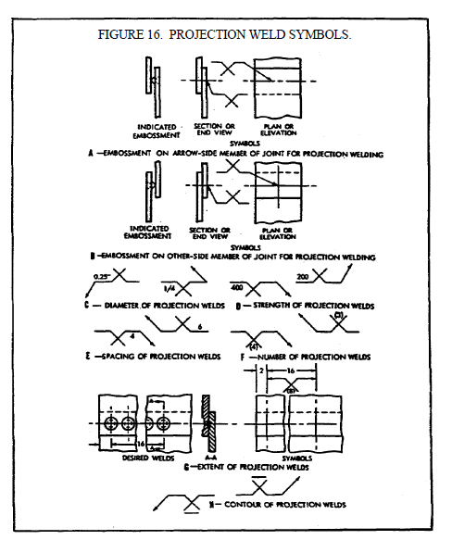

Slide 79
(2) Size of Projection Welds.
(a) Projection welds will be dimensioned by strength. Circular projection welds may
be dimensioned by size.
(b) The size of circular projection welds will be designated as the diameter of the
weld, expressed in fractions or decimally in hundredths of an inch, and will be shown with or
without inch marks to the left of the weld symbol (figure 16, view C).
(c) The strength of projection welds will be designated as the minimum acceptable
shear strength in pounds per weld, and will be shown to the left of the weld symbol (figure 16,
view D).

Slide 80
(3) Spacing of Projection Welds. The pitch of projection welds will be shown to the right
of the weld symbol (figure 16, view E).
(4) Number of Projection Welds. When a definite number of projection welds is desired
in a certain joint, the number will be shown in parentheses (figure 16, view F, on the previous
page).
(5) Extent of Projection Welding. When the projection welding extends less than the
distance between abrupt changes in the direction of the welding, or less than the full length of the
joint, the extent will be dimensioned (figure 16, view G).
(6) Flush Projection Welded Joints. When the exposed surface of one member of a
projection welded joint is to be made flush, that surface will be indicated by adding the flush
contour symbol (refer to figure 3, view C, on page 9) to the weld symbol, observing the usual
location significance (figure 16, view H).

Slide 81
bb. Resistance Seam Welds.
(1) General.
(a) Resistance seam weld symbols have no arrow or other side significance in
themselves, although supplementary symbols used in conjunction with them may have such
significance. Resistance seam weld symbols will be centered on the reference line.
(b) Dimensions of resistance seam welds may be shown on either side of the
reference line.

Slide 82
(2) Size of Resistance Seam Welds. Resistance seam welds will be dimensioned by either
size or strength as follows:
(a) The size of the resistance seam welds will be designated as the width of the weld,
expressed in fraction, or decimally in hundredths of an inch, and shall be shown with or without
inch marks to the left of the weld symbol (figure 17, view A, on the following page).
(b) The strength of resistance seam welds will be designated as the minimum
acceptable shear strength in pounds per linear inch, and will be shown to the left of the weld
symbol (figure 17, view B).

Slide 83
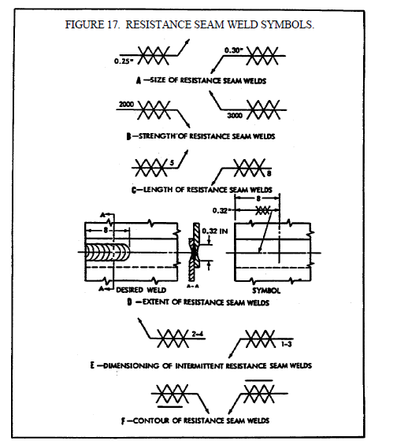

Slide 84
(3) Length of Resistance Seam Welds.
(a) The length of a resistance seam weld, when indicated on the welding symbol, will
be shown to the right of the weld symbol (figure 17, view C).
38
WELDING THEORY - OD1650 - LESSON 1/TASK 1
(b) When resistance seam welding extends for the full distance between abrupt
changes in the direction of the welding, no length dimension need by shown on the welding
symbol.
(c) When resistance seam welding extends less than the distance between abrupt
changes in the direction of the welding, or less than the full length of the joint, the extent will be
dimensioned (figure 17, view D, on the previous page).
(4) Pitch of Resistance Seam Welds. The pitch of intermittent resistance seam welding
will be shown as the distance between centers of the weld increments. It will be shown to the
right of the length dimension (figure 17, view E).

Slide 85
(5) Termination of Intermittent Resistance Seam Welding. When intermittent resistance
seam welding is used by itself, the symbol indicates that increments will be located at the ends of
the dimensioned length. When used between continuous resistance seam welding the symbol
indicates that spaces equal to the pitch minus the length of one increment will be left at the ends
of the dimensional length. Separate symbols will be used for intermittent and continuous
resistance seam welding when the two are used in combination.
(6) Flush Resistance Seem Welded Joints. When the exposed surface of one member of a
resistance seam welded joint is to be flush, that surface will be indicated by adding the flush
contour symbol (figure 17, view F).

Slide 86
cc. Flash or Upset Welds.
(1) General. Flash or upset weld symbols have no arrow side or other side significance
in themselves, although supplementary symbols used in conjunction with them may have such
significance. The weld symbols for flash or upset welding will be centered on the reference line.
Dimensions will not be shown on welding symbol.
(2) Surface Contour of Flash or Upset Welds. The contour symbols (refer to figure 13,
view C, on page 29) for flash or upset welds are indicated (refer to figure 14, view E, on page 31)
in the same manner as that for fillet welds.

