Slide 2
INTRODUCTION
This subcourse is designed to train a 92C20 soldier to review petroleum analysis
test results. We will cover each part of the task and your responsibilities.
Supplementary Training Material Provided: None.
Four credit hours will be awarded for successful completion of this subcourse

Slide 3
LESSON TEXT
1. GENERAL. As an NCO in the petroleum field, you must be able to review
petroleum analysis test results. When reporting errors in results using test
method, you must be able to identify repeatability and reproducibility precision
standards. Also, you must be able to identify possible erroneous test results by
comparing all test results for the sample, using the significance of tests and
product characteristic norms.

Slide 4
2. IDENTIFY ERRORS. To identify errors in reported test results, you must go to
each test method standard. In each test method you will find how to report the
results in the REPORT paragraph. If the test method does not have a REPORT
paragraph, you would use the PRECISION paragraph for accuracy in reporting results.
There are two basic ways that the results of test methods are reported, (1) to the
nearest... or (2) a certain number of significant figures.

Slide 5
a. An example of reporting the results to the nearest ... is shown in ASTM
Method D445 Kinematic Viscosity (by multiplying the seconds x the constant) which
reads "Report test results for both the kinematic and dynamic viscosity rounded to
the nearest one part per thousand of the value measured or calculated,
respectively." The result of this test is found on line 38 of the modified
Petroleum Products Laboratory Analysis Report (DA Form 2077)(figure 1).

Slide 6
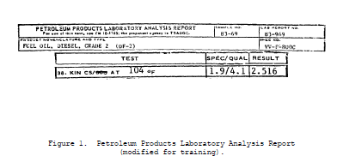

Slide 7
As shown in figure 1, the result is reported after it is rounded to the nearest one
part per thousand. To determine the correct number of digits, divide the highest
digit position by 1000, as for figure 1, ones position divided by 1000 equal 0.000
digits, as tens position equal 00.00 digits.

Slide 8
b. An example of reporting the results to a certain number of significant
digits is shown in ASTM method D 482 (Ash From Petroleum Products). "Report the
result to two significant figures as the ash, ASTM D 482 stating the weight of the
sample taken." The result of this test is found on line 33 of the modified
petroleum products laboratory analysis report (figure 2).

Slide 9
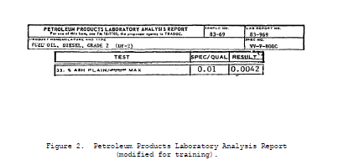

Slide 10
As shown in the figure, the results are reported after rounding off the number to
two significant digits.
(1) The rounding rule for all test methods is as follows: Numbers ending in
1, 2, 3, and 4 will be rounded down (12.34 would be rounded to nearest one-tenth or
12.3). Numbers ending in 6, 7, 8, and 9 would be rounded up (678.9 would be
rounded to the nearest whole number (679)). The number 5 would be rounded up to
the next even number if the preceding digit is odd (65.75 would be rounded off to
the nearest one-tenth (65.8)) or if the preceding digit is even, the 5 would just
be dropped (68.5 would be rounded off to the nearest whole number (68)).

Slide 11
(2) The number of significant figures is not influenced in any way by the
position of the decimal point. For numbers less than one expressed in decimal
form, the zeros after the decimal point and preceding other digits are not
significant, therefore 0.0042 as shown in figure 2 has only two significant
figures. The rules for significant figures are as follows: When carrying out any
sequence of multiplication or division, the answer should have no more significant
digits than the smallest number of significant figures present in any of the
numbers involved. In addition and subtraction, the significant digits of the sum
or difference are determined by the number of digits in the number with the least
amount of significant digits of the number involved.

Slide 12
3. INCONSISTENT RESULTS FOR REPEATABILITY. As the senior laboratory specialist,
you will have to identify inconsistencies in test results submitted by a technician
by reviewing several of his test reports for the same product. When doing this you
are checking the repeatability of test results which is defined as: "The
quantitative expression of the random error associated with a single operator in a
given laboratory obtaining replicate results with the same apparatus under constant
operation conditions on identical test material within a short period of time." The
repeatability information can be found in the precision paragraph in the test
methods. There are many different ways the repeatability for test methods can be
found. It may vary from a certain value not to exceed..., to a certain percentage
of the mean (the average of two or more quantities). The repeatability may also be
expressed by a graph in certain test methods.

Slide 13
a. The first example of repeatability is shown in ASTM test method D 482
which reads "The difference between successive test results, obtained by the same
operator with the same apparatus under constant operating conditions on identical
test material would, in the long run, in the normal and correct operation of the
test method, exceed the following values only in one case in twenty:
Ash, % Repeatability
0.001 to 0.079 0.003
0.080 to 0.180 0.007"
The results of the test to be checked for repeatability are found on line 33 of DA
Form 2077, figures 3 and 4.

Slide 14
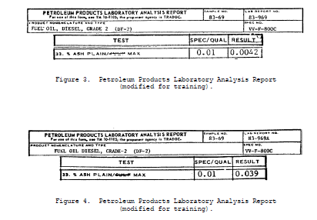

Slide 16
As shown in figures 3 and 4, the ash level is between 0.001 and 0.079 and therefore
the repeatability value is 0.003 and the results in figures 3 and 4 are within
repeatability.
b. The second example of repeatability is shown in ASTM test method D 445
which reads, "The difference between successive test results, obtained by the same
apparatus under constant operating conditions on identical test material, would in
the long run, in the normal and correct operation of this test method, exceed 0.35%
of their mean only in one case in twenty. Differences greater than this should be
considered suspect." The results of the test to be checked for repeatability are
found on line 38 of DA Form 2077, figures 5 and 6.

Slide 17
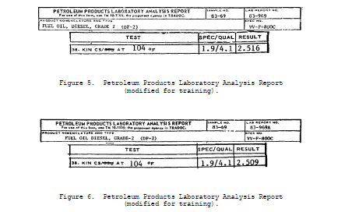

Slide 19
Take the results shown in figures 5 and 6, and then find the mean of the results as
shown in the following:
2.516 (figure 5)
+ 2.509 (figure 6) 5.025 = 2.5125 (mean)
5.025 2

Slide 20
The mean is then multiplied by 0.35% to find the repeatability value as shown in
the following:
2.5125 (mean)
x 0.35 (%)
0.00879375
At this point, you should determine the number of significant digits required by
the test method, in this case 4 significant digits are in the figure. So, the
figure would be rounded to 0.0088 (repeatability value for figures 5 and 6). To
determine if the results of figures 5 and 6 met the repeatability value of 0.0088
you would determine if the results are within 0.0088 of each other.

Slide 21
2.516 (figure 5 results)
- 2.509 (figure 6 results)
0.007 is less than 0.0088 or within repeatability
c. The third example of repeatability is shown in ASTM test method D 86
(Distillation of Petroleum Products) which reads, "Duplicate results obtained by
the same operator and apparatus should not be considered suspect unless they differ
by more than the repeatability which, according to the repeatability graph, is
appropriate to the test result obtained and to the rate of change in thermometer
reading which prevailed at the stage at which the result was obtained." The results
of the test to be checked for repeatability are found on the modified copies of DA
Form 2077, lines 5a-g, figures 7, 8, and 9.
(1) Figure 7 shows the official test results for laboratory report 83-969
to be used in this example.

Slide 22
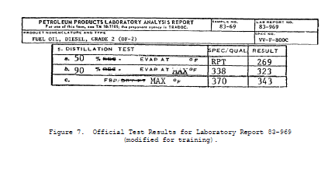

Slide 23
To determine the repeatability of the results for ASTM D 86 shown in figure 7, we
must have a laboratory worksheet with the results for 10% above and below the
points to be checked, except for the initial boiling point (IBP) and the final
boiling point (FBP) which requires 5% above and below the point to be checked
respectively, as shown in figure 8 laboratory worksheet (w/s).

Slide 24
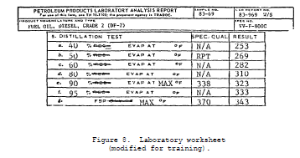

Slide 25
To determine the repeatability of the result 269° F at 50%, you would subtract the
40% results 253° F from the 60% results 282° F;
282° F 60%
- 253° F 40%
29
The answer 29 is then divided by the total distances to either side of the point to
be checked, of official test result, which is 20. This will give the rate of
change of thermometer reading.
29 ÷ 20 = 1.45 Rounded to 1.4

Slide 26
The rate of change of thermometer reading 1.4 is then charted on the ASTM D 86
repeatability and reproducibility to 1.4 on the right scale graph by drawing a
horizontal line from 1.4 on the left scale across (figure 9). Then you would use
notes A thru D on the bottom of figure 9 to determine which column will show
repeatability, in this case, column c. The 1.4 line intersects column c at 2° F
which is the plus or minus repeatability of 269° F at 50% for laboratory report
number 83-969. The repeatability of 323° F at 90% is shown below and with figure
10.

Slide 27
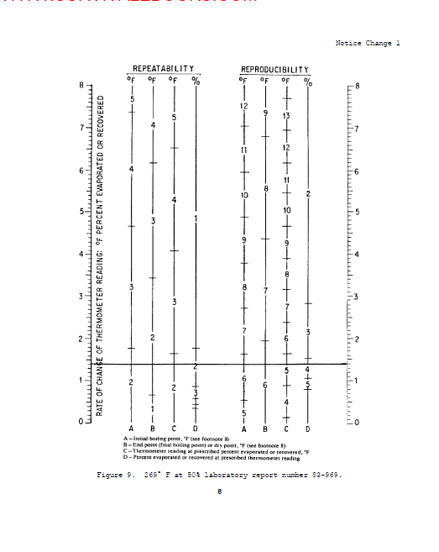

Slide 28
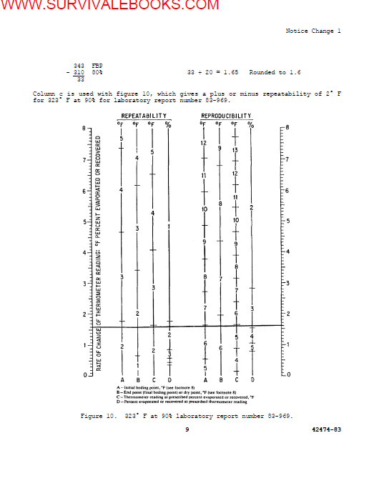

Slide 29
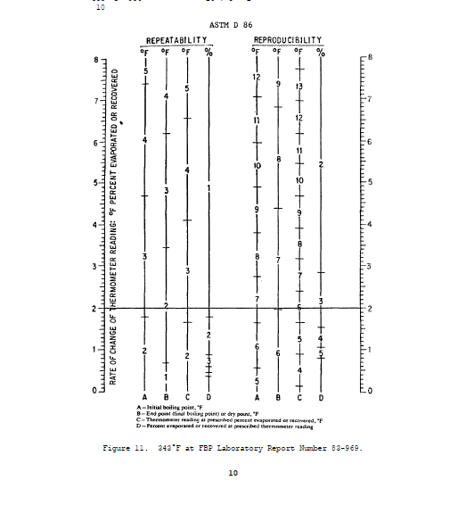

Slide 30
Column b is used with figure 11, which gives a plus or minus repeatability of 2° F
for 343° F at FBP laboratory report number 83-969.
(2) After finding the repeatability of the official results (figure 7) you
will check to see if the repeatability test results (figure 12) meet repeatability
limits of the official test results.

Slide 31
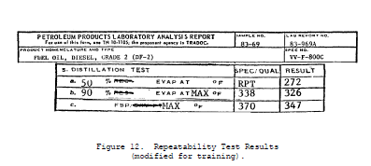

Slide 32
The official results and repeatability limits for laboratory report number 83-969
(figure 7) gives the limits in which the repeatability results must fall, at each
reported point of the test results (figure 12).
Repeatability
Figure 7 Limit for Figure 12 Results Within
% Evap 83-969 83-969 83-969A Repeatability
50 269° F ± 2° F 272° F NO
90 323° F ± 2° F 326° F NO
FBP 343° F ± 2° F 347° F NO
As shown above, the laboratory report number 83-969A is not within repeatability
limits of laboratory report number 83-969.

Slide 33
4. REPRODUCIBILITY PRECISION STANDARDS. As the senior laboratory specialist,
you will need to know if your test equipment and laboratory specialist are
performing the test within reproducibility precision standards. To achieve this
there is a correlation program that is set up by the USAGMPA that your laboratory
falls under. The addresses for the offices are:
US AGMPA US AGMPA
Petroleum Field Office West Petroleum Field Office East
ATTN: STSGP-PW Bldg 85-3, STSGP-PE
Defense Depot-Tracy New Cumberland Army Depot
Tracy, CA 95376 New Cumberland, PA 17070

Slide 34
As your laboratory is involved in the correlation program, you will provide a check
for reproducibility of test which is defined as: "The quantitative expression of
the random error associated with operators working in different laboratories, each
obtaining single results on identical test material when applying the same method."
The reproducibility information can be found in the precision paragraph in the test
methods. There are many different ways the reproducibility for test methods are
found. The different ways are similar to the ones already explained for
repeatability. The test methods used for repeatability will also be used for
reproducibility. The limits for reproducibility are found the same way that the
limits for repeatability are found.

Slide 35
a. The first example of reproducibility is ASTM test method D 482 which
reads: "The difference between two single and independent results obtained by
different operators in different laboratories on identical test material would, in
the long run, in the normal and correct operation of the test method, exceed the
following values only in one case in twenty:
Ash % Reproducibility
0.001 to 0.079 0.005
0.080 to 0.180 0.024"
The results of the test to be checked for reproducibility are found on line 33 of
DA Form 2077 (figures 13 and 14).

Slide 36
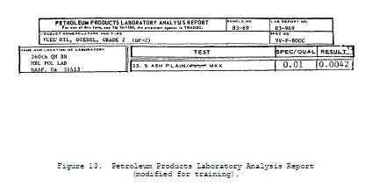

Slide 37
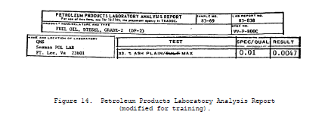

Slide 38
As shown in figures 13 and 14, the ash level is between 0.001 and 0.079 and
therefore the reproducibility is 0.005 and the results in figures 13 and 14 are
within reproducibility.
b. The second example is shown in ASTM test method D 445 which reads, "The
difference between two single and independent test results obtained by different
operators working in different laboratories on identical test material, would in
the long run, in normal and correct operation of this test method, exceed 0.70% of
their mean only in one case in twenty. Differences greater than this should be
considered suspect." The results of the test to be checked for reproducibility are
found on line 38 of DA Form 2077, figures 15 and 16.

Slide 39
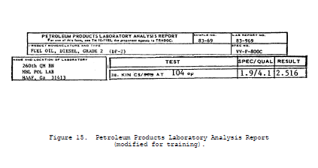

Slide 40
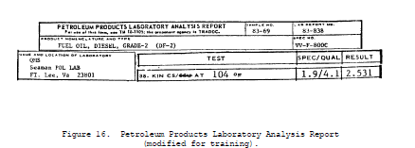

Slide 41
Take results shown in figures 15 and 16 and find the mean of the results as shown
in the following:
2.516 (figure 15)
+ 2.531 (figure 16)
5.047
5.047 = 2.5235 (mean)
2
The mean 2.5235 is multiplied by 0.70% to arrive at the reproducibility value as
shown in the following:
2.5235 (mean)
x 0.007
0.0176645

Slide 42
Now determine the number of significant digits required by the test method, in this
case, 4 significant digits. So the figure would be 0.0176 (reproducibility limit
for figures 15 and 16). To determine if the results of figures 15 and 16 met the
reproducibility limit of 0.0176 you would determine if the results are within
0.0176 of each other.
2.531 (figure 15)
- 2.516 (figure 16)
0.015 is less than 0.0176 or within reproducibility.

Slide 43
c. The third example of reproducibility is shown in ASTM test method D 86
which reads "The results obtained by each of two laboratories should not be
considered suspect unless the two results differ by more than the reproducibility
which, according to the reproducibility graph is appropriate to the test results
obtained and to the rate of change in thermometer reading which prevailed at the
stage at which the results were obtained."

Slide 44
(1) The results of the test to be checked for reproducibility are found on
the modified copies of DA Form 2077, lines 5a-g, figures 17, 18, and 19.
Reproducibility is found the same way repeatability is found, except the
reproducibility graph is used. Figure 17 shows the official test results for
report 83-969 that will be used in this example

Slide 45
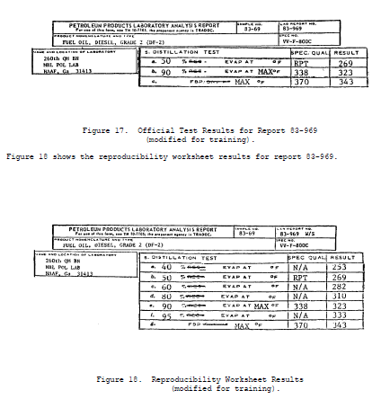

Slide 47
To determine the reproducibility of the result at 50%, 90%, and the FBP you would
perform the same steps as already explained in the repeatability of test results
for ASTM test method D 86, except that your reproducibility limits would be derived
from the reproducibility portion of the graph.
(a) To determine the reproducibility of 269° F at 50%, refer back to
figure 9. Read column c on the reproducibility side of the graph, at the point
which the vertical line intersects. In this case, the reproducibility of 269° F at
50% is 5° F.
(b) To determine the reproducibility of 323° F at 90% refer back to
figure 10. Read column c on the reproducibility side of the graph, at the point
which the vertical line intersects. In this case, the reproducibility of 323° F at
90% is 5° F.

Slide 48
(c) To determine the reproducibility of 343° F at the FBP, refer back to
figure 11. Read column b on the reproducibility side of the graph, at the point
which the vertical line intersects. In this case, the reproducibility of 343° F at
the FBP is 7° F.
(2) After finding the reproducibility of the official results (figure 17),
you will check to see if the reproducibility test results (figure 19) meet
repeatability test limit of the official test results. The official results and
reproducibility limits for laboratory report number 83-969 (figure 17) gives the
area in which the reproducibility results must fall, at each reported point of the
test results (see figure 19).

Slide 49
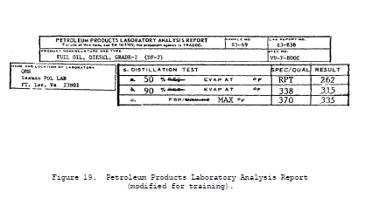

Slide 50
Reproducibility Results within
Figure 17 Limit for Figure 19 Reproducibility
% Evap 83-969 83-969 83-838 Limits
50 269° F + 5° F 262 NO
90 323° F + 5° F 315 NO
FBP 343° F + 7° F 335 NO
As shown above, the laboratory report number 83-838 is not within repeatability
limits of laboratory report number 83-969.
5. POSSIBLE ERRONEOUS TEST RESULTS. As the senior laboratory specialist in a
petroleum laboratory, you must be able to identify possible erroneous test results
by comparing all test results for the sample, using the significance of test and
product characteristic norms.

Slide 51
a. The product characteristic (physical and chemical) trends are established
by reviewing a minimum of three test results over a period of time.
(1) The characteristic norms of a stored product will change slowly by
deterioration (see figure 20). The abnormal rate of change of a characteristic
norm may indicate accelerated deterioration, contamination, or incorrect sampling
procedures. An example of an accelerated rate change is shown by West Side Burbank
tank farm, which has established the product characteristic normal trend for the
JP-4 in tank 42, after reviewing three B-2 test results. The fourth B-2 test
results shows an accelerated deterioration rate above the normal trend. After the
product characteristic normal trend has been broken, no matter by what, it must be
reestablished if the product is not consumed or contaminated by another outside
source before the trend can be established. In this case, the rate of change was
greater than the normal trend, but the same attention must be given to the product,
if the rate is less than the normal trend. In either case, an investigation of the
handling history of the product is warranted, as is a probable increase of quality
surveillance testing.

Slide 52
b. The performance characteristics of the tests will indicate specific
physical and chemical traits of the products performance during storage and
consumption, as well as the indication of deterioration and contamination.

Slide 53
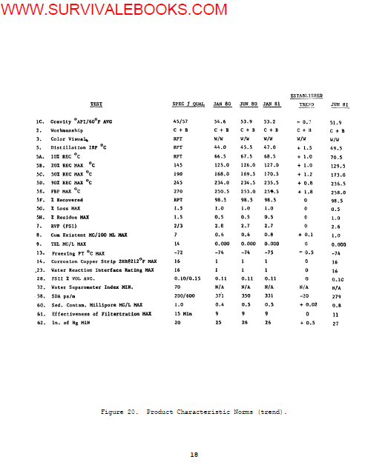

Slide 54
(1) All test results must be considered together since generally no one
result will, by itself, be out of trend. For example, when the flash point (FIP)
drops, the initial boiling point (IBP) will also drop. Many results are directly
related. If a product is contaminated with a lighter, more volatile product the
API gravity, Reid vapor pressure, and freezing point readings will be higher and
the initial boiling point and the flash point readings will be lower. If the
product is contaminated with a heavier, less volatile product, the final boiling
point, flash point, and the gum (if oily) readings will be higher and the API
gravity, initial boiling point, and Reid vapor pressure readings will be lower.
All the above reading changes are based on the percentage of contaminates. If a
product is deteriorating the API gravity, Reid vapor pressure, and freezing point,
readings will be lower and the initial boiling point, flash point, and gum (dry)
readings will be higher. Figures 21 through 25 are flowcharts designed to show you
how to systematically analyze a laboratory report to determine what is causing the
change in trend.

Slide 55
(2) When possible, take steps to prevent or correct problems with the
products, to save money as well as the products. The problems may be caused by
different forms of contamination or deterioration

Slide 56
6. SUMMARY. As an NCO in the petroleum field, you should now be able to review
petroleum analysis test results and determine any erroneous test results and
establish and review characteristic norms/trends. If you are not sure about any of
the material covered, reread and review the text and references listed on page 2.

Slide 57
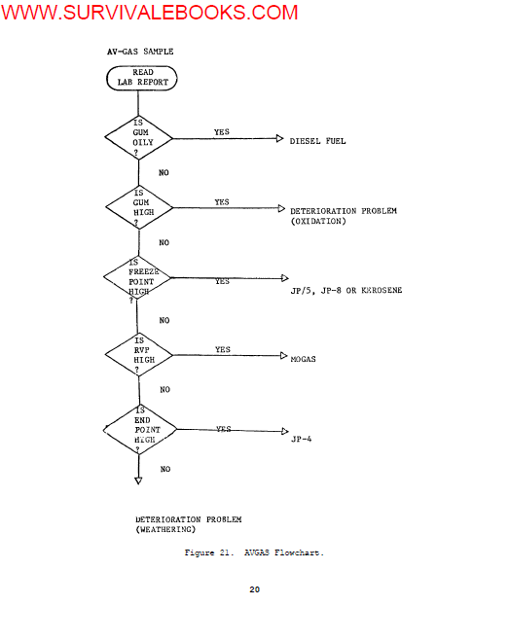

Slide 58
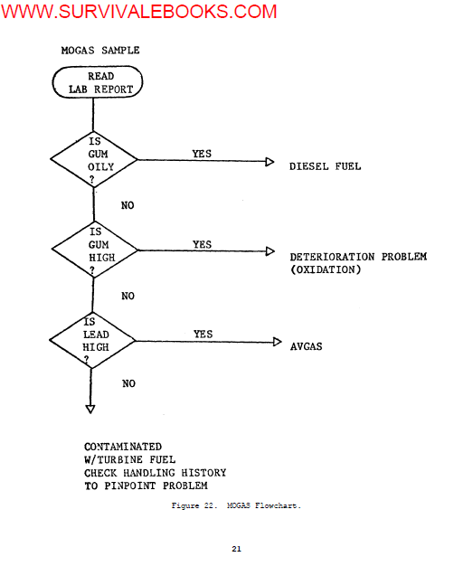

Slide 59
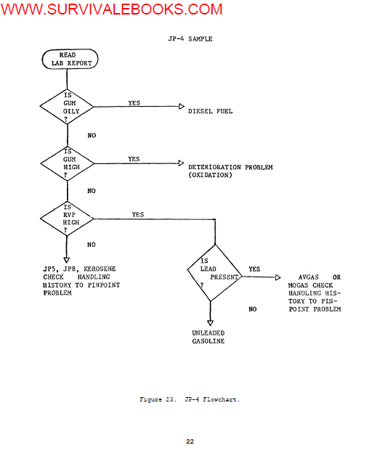

Slide 60
