Slide 2
INTRODUCTION
This subcourse is designed to train a 76W50 soldier on how to
prepare CONUS and overseas bulk petroleum slates. We will cover
each part of the task and your responsibilities.
Supplementary Training Material Provided: None.
Material to be Provided by the Unit or Supervisor: None.
Three credit hours will be awarded for successful completion of this
subcourse.

Slide 3
LESSON TEXT
1. INTRODUCTION. This lesson covers the procedures to follow to prepare
bulk petroleum slates. A slate is a monthly report of planned requirements for
tanker delivery of bulk petroleum to an ocean terminal. There are two types of
petroleum slates -- the CONUS slate and the overseas slate. CONUS slates are
submitted to the Defense Fuel Supply Center (DFSC) by DFSC CONUS fuel regions
in accordance with established fuel region operating procedures. Because the
CONUS slate is handled within DFSC, this lesson concentrates on the overseas
slate.

Slide 4
2. OVERSEAS SLATES.
a. General. Each military service in an overseas theater
determines its requirements for all bulk products for the entire theater of
operations. Each service then submits the requirements to the Subarea
Petroleum Office (SAPO) or directly to the unified command's Joint Petroleum
Office (JPO) if no SAPO exists. Each SAPO consolidates the requirements
submitted by the services into a single requirement for the SAPO area of
operation. The requirements from all SAPOs are then received and consolidated
by the JPO. This theater requirement is then sent to DFSC, which awards
contracts and arranges for shipment of the products to the overseas
destinations. The overseas slate is the planned delivery requirement for the
current month and the following four months. The slate is transmitted by
automatic digital network (AUTODIN) facilities in time to arrive at DFSC on or
before the 10th calendar day of each month.

Slide 5
b. Delivery Requirements. The delivery requirements for each ocean
terminal are determined, by product, for each of the five months reported. If
delivery is required for a specific time within a month, the requirements can
be identified by requesting delivery using the following codes:

Slide 6
PERIOD CODE DELIVERY PERIOD
1 1st - 10th of the month
2 11th - 20th of the month
3 21st - end of the month

Slide 7
These delivery periods should not be requested unless the product is actually
required at a specific time. If there is a requirement that has a priority for
delivery of quantity or for a date, it must be included in the footnotes to the
slate.

Slide 8
c. Delivery Methods. The method of delivery of the required
products is indicated through use of the following codes:
DELIVERY METHOD CODE EXPLANATION
1 MISC controlled tanker/barge
2 Other than MSC tanker/barge (for
example, contractor-owned)
3 Other than 1 or 2

Slide 9
d. Requirements Balances. The requirements balance of a product
for a terminal is figured as the difference between the quantity slated for
delivery during a calendar month and the actual amount received from tankers
(with DFSC cargo umber designations) during that month. DFSC will keep track
of requirements balances. Because there will be differences between quantities
slated and actually delivered, requirements balances are also important to the
JPOs. For example, if a negative requirements balance exists at the end of a
month (less was delivered than was slated), then the slating activity will
consider that negative amount to be a requirements that DFSC will schedule and
no further action is required (by the JPO). On the other hand, if a plus
requirements balance is shown, then DFSC will count the plus quantity as
already delivered against the next slated requirement for that product. The
JPO has to maintain the requirements balance figures to be sure ullage is
available to accept negative requirements balances. If ullage is not
available, the negative balance has to be adjusted to the quantity that can be
accepted and this adjustment must be explained by a footnote.

Slide 10
e. Footnotes to Slates. Footnotes will be used for information
that cannot be sent in the slate format:
(1) Changes in storage capacities resulting from such factors
as removal of tankage for tank cleaning, maintenance, repair, new construction,
or abandonment.
(2) Significant changes in requirements. Footnote should fully
explain reason for revised estimate.
(3) Special requirements, restrictions, or limitations relative
to ullage, storage facilities, pipeline distribution schedules, draft, safety
regulations, periods of possible port facilities congestion which could affect
tanker operations, and so on.
(4) Additional footnotes providing information, explanations,
or data may be included at the discretion of the submitting authorities.
(5) Product shuttled by tankers/barges controlled by MSC
organizations outside of Washington should be identified by footnotes

Slide 11
f. Unforeseen Changes. Unforeseen changes in storage capacity,
estimates of withdrawals, or any other factors affecting delivery requirements
during the first two months of the current slate should be reported through the
JPO to DFSC by the fastest means available. This type of change should then be
followed by a slate change with footnotes, as described in paragraph 2e above.

Slide 12
g. Response to Slated Requirements. DFSC will try to meet all
slated requirements -both in times and quantity requested. To give tanker
arrival information to each JPO, DFSC will send a Weekly Arrival Schedule (WAS)
to the JPO and other addresses on the first Tuesday after all message slates
have been processed. The WAS lists all cargoes scheduled to arrive at each
terminal from the date of the WAS message to the last day of the 5-month
slating period. On all other Tuesdays, DFSC will send a WAS which reflects all
cargoes scheduled for arrival through the next 60 days. As daily changes
occur, DFSC will update the preceding WAS by message. The WAS and all changes
will be reviewed by the JPOs to be certain the schedule is satisfactory. The
JPOs will advise DFSC if the schedule does not meet requirements adequately.

Slide 13
3. PREPARATION OF THE OVERSEAS SLATE. The remainder of this lesson will
cover the preparation of an overseas slate. The slate is sent by AUTODIN using
the Overseas Message Slate Transmission Card format (figure 1). Note that
there are three sections: HEADER, BULK, and FOOTNOTE. Each of these sections
is referred to as a "card."

Slide 14
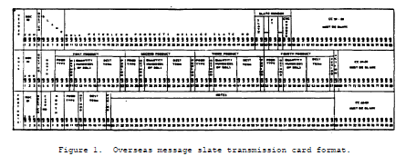

Slide 15
4. HEADER CARD.
a. The header card contains information that will never change,
with two exceptions. The entries in card columns (cc) 51-55 will be different
because they identify the month and fiscal year. When submitting changes,
additions, or deletions, there will be entries in cc 57-58, representing the
sequential changes to the basic slate. Look at figure 2 with the explanation
of the column entries to become familiar with the header card.

Slide 16
b. Refer to figure 2 and complete the blank slate header card below
(figure 3). Here is the information you will need:
Destination area code: L
Month slated for: August
Fiscal year: 84
Change number: 2
(NOTE: The entries are made below the columns.

Slide 17
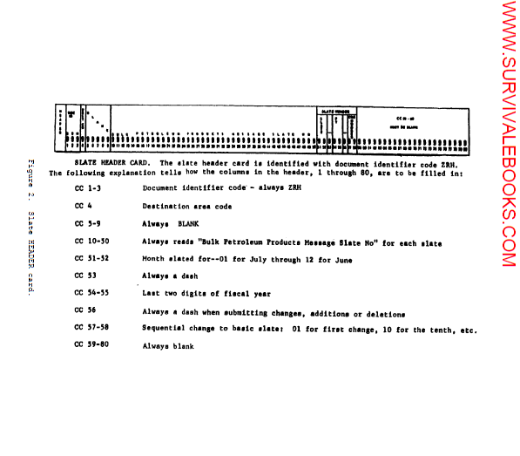

Slide 18
Your entries should look like the ones in figure 4. Don't forget that the
Document Identifier Code (DIC) is always ZRH for the header card.

Slide 20
5. BULK REQUIREMENTS CARD.
a. Card Entries. The bulk requirements card indicates the delivery
requirements for each month of the five months covered by the slate. Each card
has room to indicate requirements for one to four different products or
discharge points. The entries specify the product type, method of delivery,
quantity, destination terminal, and period required during the month. Figure 5
shows a bulk requirements card and gives an explanation of the entries and
their appropriate card columns. Take some time and become familiar with the
bulk requirements card.

Slide 22
b. Columns 1-7. The first seven columns of a bulk requirements
card are shown below (figure 6). Note that the document identifier code is
always ZRQ and is entered in columns 1 through 3. The destination area code is
entered in column 4. In columns 5 through 7, the month is designated by the
first three letters of the name of the month. This is a slate prepared in
destination area G for the month of April.

Slide 23
c. Columns 8-67. The bulk requirements card is broken down into
four parts between columns 8 and 67. The parts are--
Columns
First Product 8-22
Second Product 23-37
Third Product 38-52
Fourth Product 53-67
The four parts enable the slatemaker to order as many as four different
products for delivery to four different terminals.

Slide 24
d. First Product (cc 8-22). To explain how the columns in each
part are filled in, we will use columns 8 through 22 labeled -First Product .
Columns 8 through 10 show the product being ordered: column 11 shows the
delivery method; columns 12 through 16 give the quantity required in hundreds
of barrels: columns 17 through 21 show the destination terminal; and column 22
shows the period of the month in which delivery is preferred. In the example
below (figure 7), Whittier, Alaska, requires 50,000 barrels of JP4 to be
shipped by MSC tanker in time period 2.
NOTE: Don't worry about the codes for the destination terminal right now. They
come from DFSC Handbook 4705.1, Data Element Codes for Tanker Distribution.
Any codes needed for this subcourse will be given to you.

Slide 25
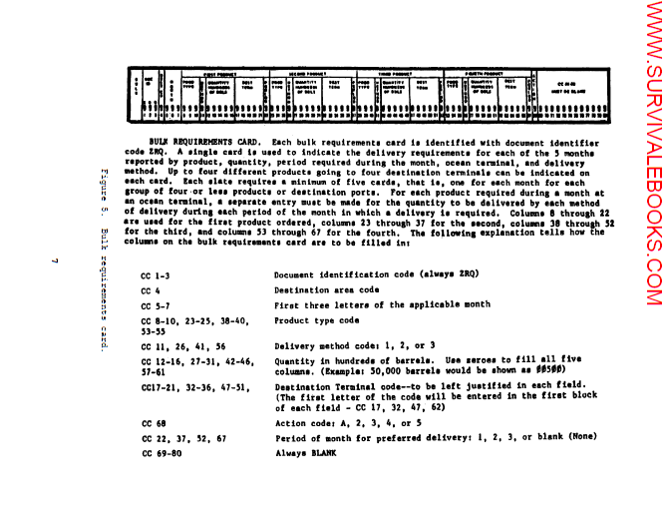

Slide 26
e. Second Product (cc 23-37). Make the proper entries under second
product in the segment of a requirements card printed below (figure 8), for a
100,000-barrel shipment of DF1 to go to Haines, Alaska, by a vessel that is not
operated by MSC; the shipment is to arrive after the 21st of the month. The
code for Baines, Alaska is RAIN. Refer back in the lesson to check for the
method and period codes.

Slide 28
Your entries should look like those in figure 9 below

Slide 30
f. Third and Fourth Product. The entries for third product and
fourth product would be filled in the same way, if they were needed.
g. Action Code. The last entry required for the bulk requirements
card is the action code in column 68. The following codes may be used:
- Enter action code A for the original submission of a slate.
- Enter action code 2 to add a new terminal, new product, or both
that did not appear on the original slate.
- Enter action code 3 to change a quantity previously slated for a
particular method or period or to add another delivery period for a product in
the original slate.
- Enter action code 4 to delete a specific requirement, such as a
product, quantity, period, or method, submitted for a terminal.
- Enter action code 5 to eliminate all data pertaining to a
terminal for a specific product and a given month.

Slide 31
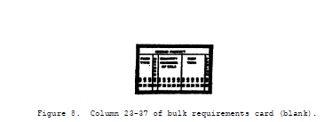

Slide 32
(1) Action Code A. Use this code when you are submitting an
original slate. Figure 10 shows a bulk requirement card as part of an original
slate for delivery to Anchorage, Alaska in May.
Figure 10. Bulk requirements card with action code A.
(2) Action Code 2. Example: 50,000 barrels of DF2 for Hawaii,
not previously slated, is required to be delivered by method 1 during the month
of April, period 1. The bulk requirements card entries would look like this
(figure 11):

Slide 33
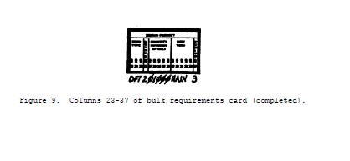

Slide 35
(3) Action Code 3. This is the most complicated code and it
requires using one or more of 20 possible entries. The following table gives
all possible codes and explains them.

Slide 36
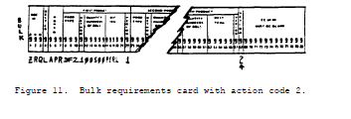

Slide 37
Example 1: The original submission for JP-4 to Chimu Wan in January had
indicated a requirement for 100,000 barrels each for periods 1, 2, and 3.
There is a need to reduce the requirement for period 1 by 30,500 barrels and
increase the requirement for period. 3 by 40,000 barrels without changing the
requirement for period 2. A bulk requirements card, action code 3, should be
prepared. The entries should look like those in figure 12.

Slide 38
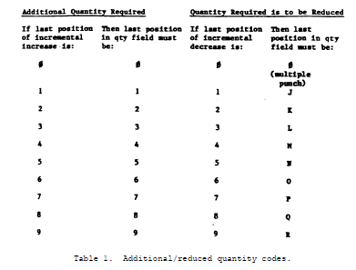

Slide 39
Notice that under FIRST PRODUCT, the letter "N" appears in cc 19. The
reduction for period 1 was 30,500 barrels of JP-4. Because it is a reduction,
the "5" is changed to an "N" and entered in the quantity field as 0030N.
Example 2: The original slate for Rota, Spain had requested 300,000 barrels of
JP-4 during period 1, April, using method 1. An additional 200,000 barrels of
JP-4 is now needed during period 3, April, by method 1. To make this change,
the bulk requirements card should be prepared like figure 13:

Slide 40
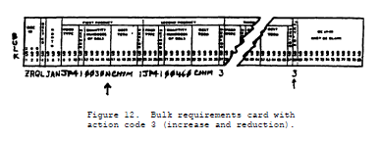

Slide 41
(4) Action Code 4.
Example: The slate has been submitted for Hawaii indicating 50,000 barrels of
JP-5 were required during each of periods 1 through 3, via method 1 in May. It
is now desired to delete the requirement for JP-5 during period 3. Figure 14
shows a completed bulk requirement card.

Slide 43
(5) Action Code 5.
Example: The slate has been submitted for Kunsan, Korea indicating MG1
requirements for the month of May as:
Method Period 1 Period 2 Period 3
1 50,000 bbl 100,000 bbl
2 50,000 bbl
3 50,000 bbl
Now all slated requirements for MG1 for Kunsan for May need to be deleted.
Using action code 5, the bulk requirements card would look like figure 15:

Slide 45
6. FOOTNOTE CARD.
a. General. Footnotes to slates contain information that cannot be
transmitted in the slate format. Included are the requirements balances by
product; changes in storage capacities; significant changes in requirements:
and special requirements, restrictions, or limitations relative to ullage,
storage facilities, and other factors affecting tanker delivery at the
destination. (Ullage is the mount that a container lacks of being full.)

Slide 46
b. Column Entries. A footnote card, with a DIC of ZRF, is written
in clear text starting with cc 20 and continuing through cc 67. If there is
not enough space for the complete footnote in cc 20-67 on the first card, the
text starts in cc 20 of the second card. Each card used for footnotes is
numbered consecutively (01, 02, and so on). However, cc 7-19, which are filled
in on the first card, are left blank on any continuation cards. Figure 16
shows a footnote card and gives a good explanation of the uses and column
entries.

Slide 47
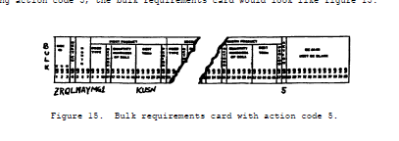

Slide 48
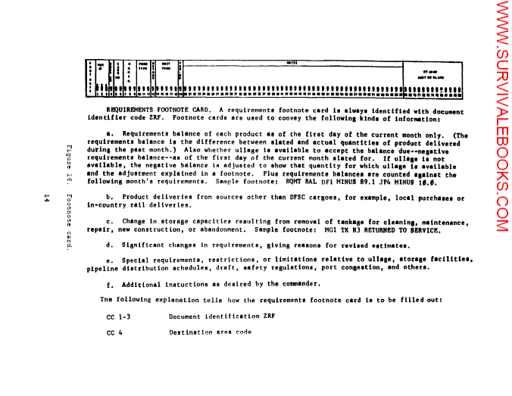

Slide 49
7. TRANSMITTING THE OVERSEAS SLATE VIA AUTODIN. After the slatemaker
completes all the slate cards, he fills out a Data Message Form (DD Form 1392).
A partially completed Data Message Form is shown at figure 17. An explanation
of the entries is also given. Remember that the slates must reach DFSC on or
before the tenth calendar day of each month.

Slide 50
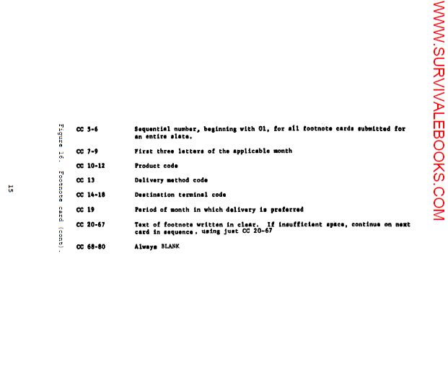

Slide 51
BLOCK ENTRY
Precedence ROUTINE
LMF (Language Media Format) CC
Classification UNCLASSIFIED
Addresses DLA Administrative Support Center
DASC-D
Cameron Station
Alexandria, Virginia 22314
Card Count Actual count of total number of all
slate cards: header, bulk requirement,
and footnote.
Content Indicator This is a four-position indicator. The
first letter identifies the category of
the sending activity (A, Army; N, Navy:
F, Air Force; I, Interdepartmental).
The other three positions are always
HAA.
Remarks Enter any remarks that are addressed to
the communications personnel.
All other entries are self-explanatory.

Slide 52
8. COMPLETED PETROLEUM SLATE. Figure 18 shows a sample of how an
AUTODIN requirement card listing looks. The entries for each of the five
months the slate covers are shown in the same order that they appear on the
bulk requirements cards. Only a sample for each month is shown. A full slate
could easily have 90 or more line entries, depending on the total requirements
Identified to the JPO.

Slide 53
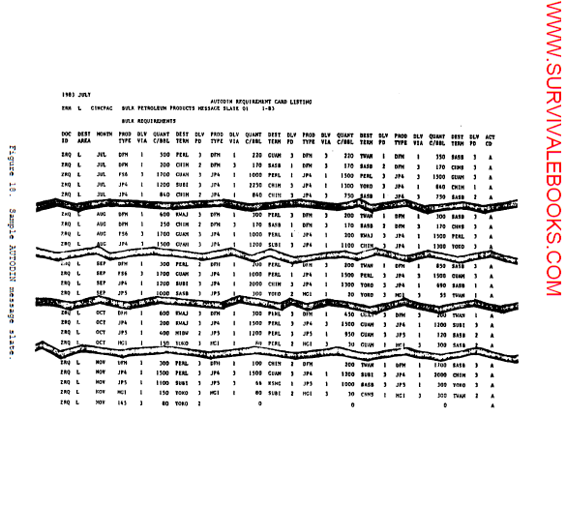

Slide 54
