Slide 2
INTRODUCTION
As a future petroleum officer, you may find yourself planning and managing
petroleum pipelines and pump stations. To get the most efficient
performance from the system, you must be familiar with the operating
characteristics of the pump stations. An easy way to

Slide 3
determine these characteristics is through the use of pump graphs. By using
the pump graphs you will be able to obtain maximum efficiency of the
available pumps.
Pumping unit operation graphs (performance curves) graphically display the
interrelationship between pressure (in feet of head and/or PSI), pump speed,
and throughput. From these graphs, you can estimate the pumping unit's
operating speeds, the volume of fuel throughput, or the operating head as
long as you know two of the three factors. Pump graphs are an integral part
of pump stations, pipeline, and terminal operations

Slide 4
Pump stations are combinations of two or more pump units with connecting
manifolds installed where needed along a pipeline to move products through
the line to storage or to dispensing facilities. Pump stations are engineer
facilities constructed of standard line pipe or IPDS-coupled pipeline with
couplings, nipples, valves, fittings, strainers, scraper-receiver assembly,
sandtraps, and the required number of pumps. Pipeline pump stations are
installed on the main line to keep the product moving at the desired flow
rate.

Slide 5
Petroleum pipeline systems vary in complexity depending on the size of the
theater of operations. The systems can range from a single product line
with one terminal to a series of multiproduct lines with several terminals.
Pipelines are used as far forward as tactically feasible. To operate any
pipeline successfully, all personnel must understand their responsibilities
in controlling the operations. Control of the pipeline operations begins at
the operating headquarters with the chief dispatcher and ends with the
terminal operating platoon.

Slide 6
1. Hydraulic System Terms. The following terms are presented to aid in
the understanding of petroleum terminology. Definitions of these terms will
add to the understanding of the terminology used in this lesson.
a. Brake horsepower: The amount of measurable horsepower after
deduction for friction loss.
b. Efficiency (%): The efficiency expressed in the percent at which a
pump operates at a specific RPM.
c. Emergency head capacity: Pressure in FTH which a pumping unit
produces at the maximum rate of discharge.
d. Feeder (flood) pumps: Pumps generally installed to supply the
required suction pressure between tank farm installations and main line
(trunk) pump stations or to feed fuel through short branch lines to
dispensing tankage installations

Slide 7
e. Head: An expression of pressure, usually stated in terms of inches
or feet.
f. Dynamic head: A measure of pressure in liquids in motion.
g. Feet of head: The measure of pressure in terms of the height in
feet of a column of liquid of a given fuel.
h. Static head: A measure of pressure in liquids at rest; pressure
produced with a column of liquid because of weight alone.
i. Impeller: A device, which impels or pushes forward, such as the
rotor of a centrifugal pump or air compressor.
j. Incremental pressure: The difference between the suction and
discharge pressure of a pump or of a multipump pumping station.

Slide 8
k. Parallel connection: The arrangement of two or more pumps to
discharge their cumulative output at the discharge pressure of one pump.
l. Series connection: The arrangement of two or more pumps to
discharge the output of one pump at the cumulative discharge pressure of all
pumps.
m. Stage: Grade, level, or step, as in the case of liquid passing
through an impeller of a pumping unit with more than one impeller.
n. Throughput: Capacity, quantity transported per unit of time, BPD,
GPM/GPH.

Slide 9
2. Operating Characteristics of Pumps. Pumping mechanisms can be broken
into two major categories: positive displacement pumps and kinetic pumps.
The positive displacement of fluids is the principle behind positive
displacement pumps. The most common types of positive displacement pumps
are reciprocating and rotary pumps.
a. Reciprocating pumps are similar in theory to reciprocating engines.
A piston is used to move fluid into a cylinder on the downstroke then move
the fluid out of the cylinder on the upstroke. Reciprocating pumps provide
high suction lift and high pressure for small quantities of flow as the
pistons move up and down.

Slide 10
b. Rotary pumps use a screw-type device to trap fluids in the cylinder
and force it out of the chamber. This type of pump is used with gasoline or
other low viscosity fuels when high suction lift is required. The rotary
pump provides a smooth, even flow.
c. The most common type of kinetic pump is the centrifugal pump.
Centrifugal pumps depend on centrifugal force for their operation.
Centrifugal force acts on the body moving in a circular path, tending to
force it farther away from the axis or center point of the circle described
by the path of the rotating body.

Slide 11
(1) In a centrifugal pump, the power plant turns an impeller which
creates centrifugal force in the pump housing and forces fuel out of the
pump. Major advantages to centrifugal pumps are fewer moving parts; smooth,
non pulsating flow; and a much higher capacity than positive displacement
pumps. One of the disadvantages of centrifugal pumps is that it has a
relatively lower head capacity than positive displacement pumps and the head
capacity is based on the design of the impeller.

Slide 12
(2) Centrifugal pumps are often classified by their stages. A stage
simply refers to the number of impellers on the pump. A one-stage pump has
one impeller and a two-stage pump has two impellers. To increase the
pressure of the pump, another impeller or stage must be added. Most Army
pumps are single stage. Such as the 6-inch, single-stage, 600-and 1,250-GPM
self-priming pump (IPDS). The Army's multistage pumps are: the 1,400-GPM
pump is a six-inch two-stage pump used as a booster pump and 800-GPM
mainline pump for IPDS, which is a three stage pump

Slide 13
3. Conversion of PSI to FTH. FTH is defined as the measure of pressure
in terms of the height in feet of a column of a given fuel. To measure this
pressure, we need a standard. This standard has been developed using the
one PSI gauge. The measure used as our standard was determined by using a
square inch column of water at a constant 60°F. As depicted, 1 PSI is equal
to 2.31 feet. We use this measurement as our constant. The gages on pumps
are rated in PSI. To determine certain information, we may need to convert
PSI into FTH. The formula for converting PSI to FTH is:

Slide 14
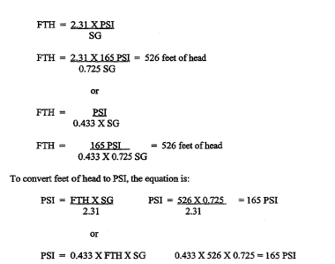

Slide 15
4. Characteristics of Pump Graphs: A pump graph is constructed to show
feet of head. It also shows the flow rate in gallons per minute, and
barrels per hour. Pumps are equipped with gauges that register the suction
and discharge pressure in PSI. Therefore, the operator must be able to
convert PSI to feet of head to determine the flow rate and efficiency of the
pump.

Slide 16
a. Data on pumping capacity, operating characteristics, operation, and
maintenance procedures are in the manufacturer's manual which is packaged
with each pump. Presently petroleum pipeline operations consist of the
IPDS. In this system, there are three different sizes of pumps, the 6-inch
single-stage, 600-GPM self-priming pump; the 6-inch, single-stage, 1,250-GPM
self-priming pump; and the 6-inch, three-stage, 800-GPM mainline pump
(IPDS).

Slide 17
b. See Figure 1. It is a uniform scale; that is, there is an equal
space between all units on the graph in both directions. Rate of flow is
plotted along the horizontal axis, increasing from left to right in GPM
(cubic meters per hour) on the bottom. The remaining variables are plotted
along vertical axis, increasing from bottom to top. Each of the RPM curves
represents the other variables at a specific engine operating speed. Engine
speed is shown in 100 RPM increments from 2,000 RPM to 2,400 RPM (maximum
governed speed). Along the left side of the scale, discharge pressures are
shown in PSI and FTH for 1.00, 0.72, and 0.85 specific gravity liquids.

Slide 18
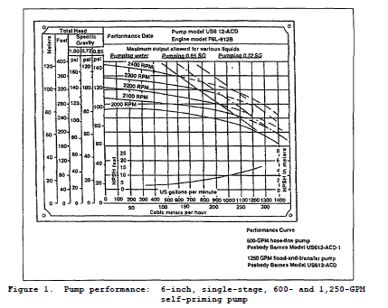

Slide 19
5. Application of the Pump Graph. A common application of a pump graph
is its use in determining the rate of flow, efficiency, and brake
horsepower, given the total dynamic head in feet and the operating speed of
the engine in RPM. Rate of flow is the most commonly desired quantity on
the graph, and it can be expressed in GPM or BPH.

Slide 20
a. Figure 1. Shows the Pump performance for a 6-inch, single-stage,
600-and 1,250-GPM self-priming pump. The 600-GPM pump is designed to pump
petroleum or potable water at a maximum operational output of 600-GPM at 150
PSI. The 1,250-GPM pump is designed to pump petroleum or potable water at a
maximum operational output of 1,250-GPM at 180 FTH or 66.2 PSI. The
difference between the two pumps is the 600-GPM pump is designed for use
with the tactical hoseline; it operates at higher pressure but lower volume.
The 1,250-GPM pump is a flood and transfer pump designed to provide high
volume with low pressure to your 800-GPM mainline pump (IPDS). Using the
pump graph in Figure 1. Given a 6-inch, single-stage, 600-GPM self-priming
pump with a head capacity of 2,100 RPM; 35°F API gravity; and a operating
pressure of 103 PSI, determine all other factors. See Figure 1. to
determine the rate of flow and feet of head.

Slide 21
(1) First determine type of fuel. Use the following formula: Note
both SG and API is at 60F.
SG = 0.8498 = 0.85 on pump performance graph (diesel)
(2) Enter the graph on the vertical line at 103 PSI for diesel.
Follow this line horizontally to the right until it intersects the head
capacity cure for 2,100 RPM. At this point, all the answers are determined
vertically up or down, and horizontally right or left.

Slide 22
(3) To read the rate of flow in GPM, move down to the horizontal line
for GPM and read the answer: 500-GPM.
(4) To determine the FTH read to the left of PSI. To be more
accurate or to confirm your reading, go through the formula that was given
earlier as follows:

Slide 24
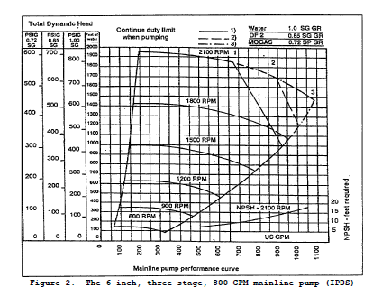

Slide 25
b. Figure 2 shows the pump performance of a 6-inch, three-stage, 800-
GPM mainline pump (IPDS), operational output of 800-GPM at 1,800 FTH, at
2,100 RPM, when pumping liquids with specific gravity of 0.85 (diesel).
Using the pump graph in Figure 2. Given a 6-inch, three-stage, 800-GPM
mainline pump (IPDS) with a head capacity of 1,800 RPM, product diesel, and
a operating pressure of 450 PSI, determine all other factors. See Figure 2
to determine the rate of flow and FTH.

Slide 26
(1) Enter the graph on the vertical line at 450 PSI for diesel.
Follow this line horizontally to the right until it intersects the head
capacity curve for 1,800 RPM. At this point, all the answers are determined
vertically, and horizontally.
(2) To read the rate of flow in GPM, move down to the horizontal line
for GM and read the answer 780 GPM.
(3) To determine the FTH, read to the left of PSI. To be more
accurate or to confirm your reading, go through the formula that was given
earlier as follows:

Slide 28
6. Series and Parallel Installation of Pumps. Pumps are normally hooked
up either in series or in parallel. A pump hydraulic system is very similar
to an electrical system. Electrical storage batteries are described in
terms of series or parallel hookups. To get 12 volts of electricity, two 6-
volt batteries must be connected in series. The same two 6-volt batteries
connected in parallel yield 6 volts of electricity, but the current doubles.
In other words, head capacity resembles voltage, and flow rate resembles
current. Both types of hookups (manifold) have certain advantages. Two
pumps connected in series double the head capacity of a single pump, while
the flow rate remains the same as for a single pump. Two pumps connected in
parallel double the flow rate capability of a single pump, while the head
capacity remains the same as for a single pump.

Slide 29
a. Pump station operation in series. Pumps in a mainline pump station
are invariably hooked up in series, since the primary consideration is head
capacity. Pumps hooked up in series actually pump the fuel more than once.
This repeated pumping builds up high pressure, which pushes the fuel through
the pipeline for a long distance to the next pump station. The 6-inch,
single-stage and the 4-inch, four-stage pumps can be hooked up in series by
use of a crossover pipe (Figure 3). The 4-inch, four-stage pump unit is
preset to always operate in series.

Slide 30
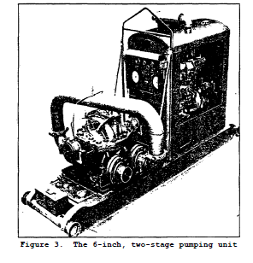

Slide 31
b. Pump station operation in parallel. Parallel operation is not
normally used on petroleum pipelines but can be found in terminal operations
due to the capability to move high volumes of fuel. Parallel installation
increases flow rate capability without increasing head capacity. The lower
the head capacity, the closer together pump stations must be located;
therefore, the more pump stations required for a given length of pipeline.
Only the 6-inch, two-stage pump can be placed in parallel operation.
Paralleling means that fuel flows through both stages at the same time.
This increases the volume and output of the pump. The pump is put into
parallel by using Y flanges (Figure 4), which are attached the suction and
discharge side of the pump.

Slide 32
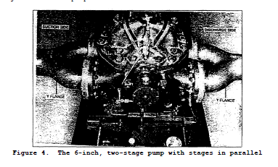

Slide 33
7. Effect of Pump Station Operations on Head Capacity and Flow Rate. The
normal head capacity of a pump station is the total head against which it
will pump at the most efficient operating point. In other words, the design
speed (RPM) of the pumping units must be considered together with the
required head and desired throughput (GPM or BPH) to establish maximum
efficiency in design. Optimum standard military pipeline head capacities of
pipeline pump units are shown in Figure 5. It also shows these emergency
capacities. Maximum head capacities are for emergency operations only and
are never used as the basis for design. Pump stations should not be
operated at maximum head capacity except during emergencies, and then for no
longer than 24 hours. Normal capacities are used for pipeline designing.

Slide 34
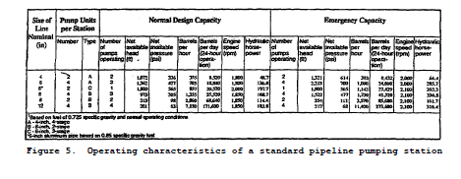

Slide 35
8. Determining of Pump Speed.
There should be only enough pumps on line (operating) at any station to
produce the required pressure (FTH) and throughput (GPM or BPH). Further
regulate pressure by adjusting pump speeds between minimum and maximum
speeds permitted. Determining pump speeds is largely based on experience.
Pump speeds are highly variable, influenced by line diameter, number of
pumps on line, specific gravity and viscosity of products, and other
hydraulic characteristics of the particular pipeline and pump station in
operation. Pump station pump speeds may also be determined using Figure 6.
These graphs are for three or four pumps in series.

Slide 36
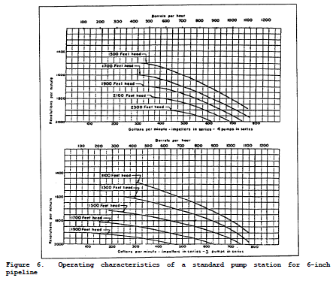

Slide 37
a. Figures 6 and 7 shows the operating characteristics of pipeline pump
station facilities. From these graphs, any one of three factors--the
pumping unit operating speeds, the volume of fuel throughput and the
operating head--may be estimated provided the other two factors are known.
For example, determine the operating speed required for three--pump
operation of a station on 6-inch pipeline to deliver 785 BPH (550 GPM)
against a head loss to the next station of 1,395 feet.
(1) Enter the bottom chart in Figure 6 at 550 GPM. Follow the
vertical line at this point to about midway between the curves labeled
"1,300 FTH" and "1,500 FTH."

Slide 38
(2) Follow the intersecting horizontal line to the left side of the
chart and read 1,800 RPM. Therefore, the three-pump operation calls for
speed for each pump of 1,800 RPM. Similarly, assume that a single 6-inch
booster pump is to be used to pump fuel from a marine terminal to a tank
farm. Data includes that the pump must overcome 300 FTH loss between the
dockside and tank farm.

Slide 39
c. See Figure 7. Assume that a single 6-inch booster pump is to be
used to pump fuel from a marine terminal to a tank farm. Data includes that
pump must overcome 300 FTH loss between the dockside and the tank farm.
Determine the volume of fuel delivered by the pump at 1,800 RPM, assuming
the pump stages are connected in series (single discharge). Find the point
at which the 1,800-RPM line intersects the curve labeled "300 FTH." This
point coincides approximately with the line representing 1,000 GPM.
Therefore, the pump throughput is about 1,000 GPM or about 1,429 BPH.

Slide 40
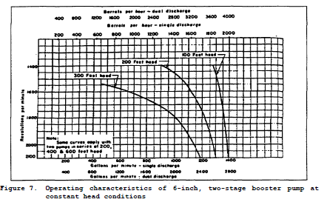

Slide 41
d. Individual pump stations must regulate pump speed (pressure) to keep
suction pressures above the minimum at the next pump station downstream. It
is desirable that pump station suction pressure be 20 PSI for elevations
less than 5,000 feet and for temperatures below 100F (20 PSI is equivalent
to 64 feet of military gasoline (MOGAS) head). If the temperature exceeds
100°F or 5,000 feet elevation, then the minimum suction pressure will be 30
PSI. The minimum suction pressure at a pump station must be 5 PSI because
of pump-entrance friction losses and the possibility of vapor lock in the
pump (5 PSI is equivalent to 16 feet of MOGAS head). The net discharge
pressure of the pump is determined by using the pump graph for the specific
rate or an operating pressure is given to you. The total discharge pressure
is determined by simply adding the suction pressure and the net discharge
pressure.

Slide 42
Parallel Problem:
Given: Suction at each pump = 20 PSI
Total discharge = 150PSI
Flow at each pump = 160 GPM
Fuel = DF2
Find: Net PSI for each pump
Net FTH each pump
Total discharge in FTH
Flow after pump station

Slide 43
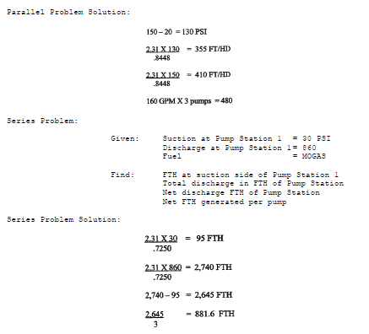

Slide 44
e. Discharge pressures are kept within safe working limits of pump,
pipes, and fittings to produce the desired rate of flow. Products handled
in a multiproduct line vary greatly in gravity and viscosity. To maintain
an even rate of flow, stations pumping a heavier or more viscous product
must develop higher pressure than other stations simultaneously pumping
lighter or less viscous product. Therefore, the heaviest product sets the
rate of flow.

Slide 45
f. Because gravity and viscosity affect flow, suction and discharge
pressure at one station are seldom identical to pressures at an adjacent
station. Hydraulic characteristics
15 QM5201
of sections of pipeline between stations vary; making identical pressures
improbable, even when all stations are pumping the same product.

Slide 46
g. Increasing or decreasing pump speed raises or lowers both head
capacity and flow rate as shown in Figure 8. When the pumps in the station
are in series, all the pumps should be operated at about the same speed,
because each pump handles the full stream. None of the pumps should be
operated at speeds lower than 1,200 RPM except when idling.

Slide 47
