Slide 1
CONTROL CLASS III AND PIPELINE OPERATIONS
Subcourse Number QM5099
EDITION A
United States Combined Arms Support Command
Fort Lee, VA 23801-1809
2 Credit Hours
Edition Date: March 1999

Slide 2
LESSON 1
THEORY OF FLOW
Critical Task:
101-519-4260

Slide 3
INTRODUCTION
Fuel supply personnel are responsible for all aspects of fuel supply
operations. One of the most complex, challenging and interesting aspects of
petroleum operations is the study of hydraulics. Pipeline design offers an
excellent opportunity to use those theories and principles in the classroom.
A broad base understanding of pipeline distribution system will enhance your
professional career because the possibility of conventional or limited
nuclear warfare at any location in the world will result in demands for
large quantities of fuel. Currently there is no better state of the art
bulk delivery than by pipeline.

Slide 4
PART A - STATIC FLUID (FLOW OF FUEL IN PIPELINES)
Specific weight. The specific (or unit) weight of water is 62.3 pounds per
cubic foot.
Specific gravity. The ratio of the weight of a volume of liquid to an equal
volume of water. The specific gravity of water is 1.
API gravity. API gravity is an arbitrary scale accepted for general use by
the petroleum industry. It is based on reciprocals of specific gravities
and produces a range of numbers between 10º and 90º API between the heaviest
and the lightest petroleum products. The standard (water) is established at
60° F. All other observations must be converted to this standard to make
meaningful comparisons.

Slide 5
Conversion formulas. The following formulas are used for conversion between
API gravity and specific gravity.
API = 141.5 - 131.5
SPGR
SPGR = 141.5
API + 131.5

Slide 6
PART B - PRESSURE
Pressure. All forces which produce pipeline flow velocity and all those
that oppose it can be described or measured in terms of pressure or feet of
head.
Static pressure. Static pressure is a measure of liquids at rest. It is the
vertical height from a given point in a column or body of still liquid to
its surface and is usually expressed in feet

Slide 7
Example: A column of water (at 60° F) 1 inch by 1 inch, 2.31 feet in
height will exert one pound per square inch at its base. Then we can
express this as: 2.31 feet of head is equal to one pound of pressure.
If 2.31 feet of head is one PSI then one feet of head is .433 PSI (1 ÷
2.31 = .433).
Dynamic Pressure: Dynamic pressure is a measure of potential energy or
liquids in motion.

Slide 8
Example: The distance from the liquid level in a tank to ground level is
the static pressure. As the liquid starts to flow down a pipe then it is
expressed as dynamic pressure

Slide 9
Conversions. The equation for converting feet of head to pounds per
square inch is:
P = H x SPGR or H = 2.31 x P
2.31 SPGR
Where:
P = pressure in PSI
H = Head (in feet of fluid)
SPGR = Specific gravity
2.31 = Conversion constant

Slide 10
We found out in the first part of this class that all products produce a
different pressure at different heights. In the equation, the specific
gravity compensates for the different products and the constant 2.31 takes
care of the feet of head (hd)or the PSI.
Example: SPGR =.8448
Head = 250 ft
P = 250 x .8448 =91 PSI
2.31
H = 2.31 X 91 =249 ft/hd
844

Slide 11
PART C – DESIGN FUEL
Design fuel: Fuels most likely to be transported by military pipeline are
motor gasoline, JP-4, and diesel fuel. Properties of these fuels will be
found in MIL-HDBK-200 (Federal specifications) and gravity range in Table 6-
1. With such a wide variation, specific gravity becomes an important factor
in the design of military pipelines. The heaviest fuel making up 24 percent
or more of the total requirement will be taken as the design fuel.

Slide 12
Viscosity: Viscosity is a measure of the relative ease or difficulty with
which a liquid can be made to flow. It is the internal force (resistance)
or opposition to flow. Viscosity can be expressed as kinematic viscosity or
dynamic viscosity. For our purposes in the U.S. Army we will use kinematic
viscosity. The units of kinematic viscosity are centistokes and feet
squared per second. The viscosity, in units of centistokes (cs), is found
by using Figure 1-1. If the units of feet squared per second are desired,
then the conversion factor of 92,900 cs equals one foot squared per second
is used.

Slide 13
Example: To convert 20 cs to cubic ft/sec use, the following formula:
y = Kinetic = 20 = 0.000215285
92,900 92,900

Slide 14
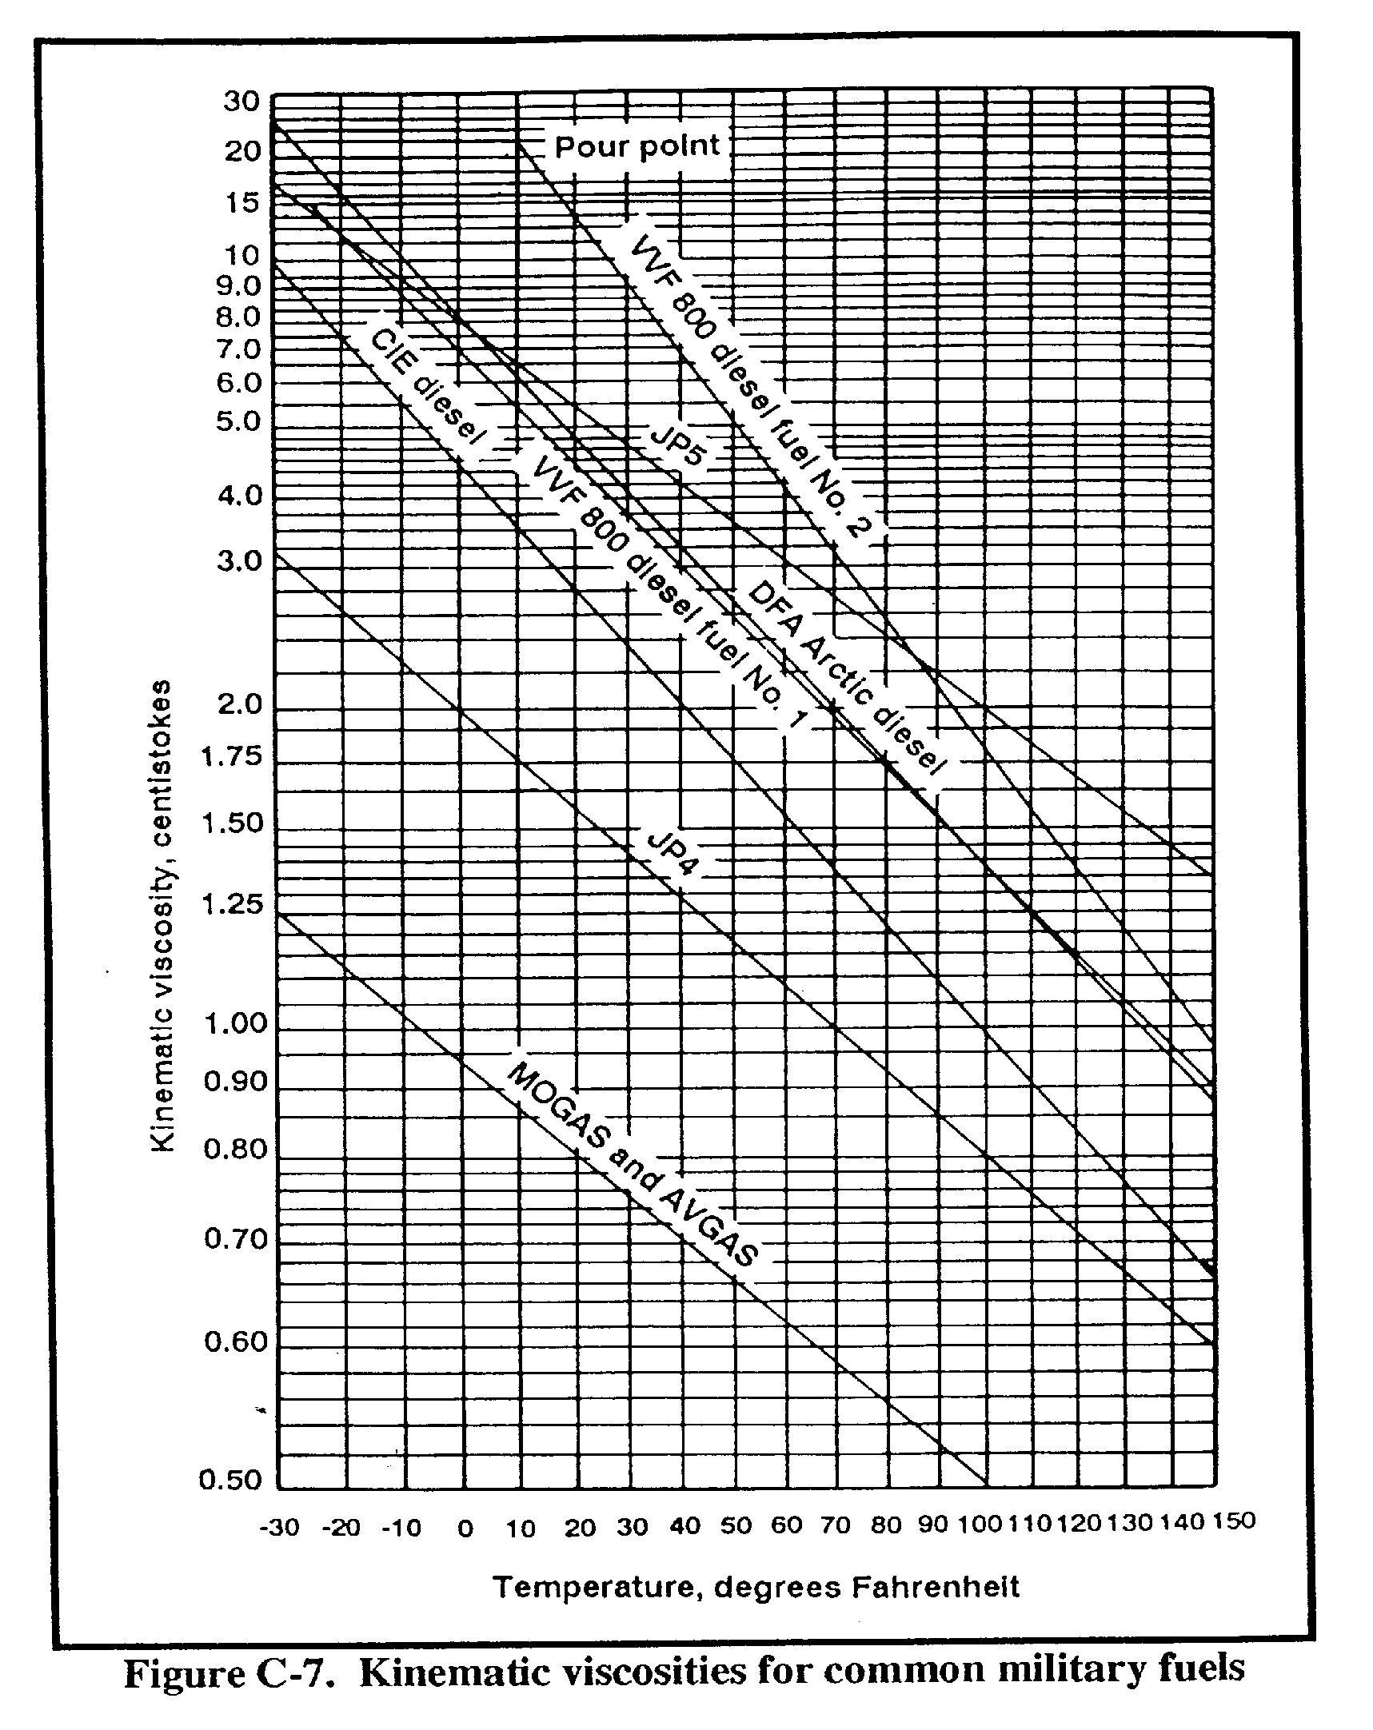

Slide 15
PART D - DYNAMIC FLUID FLOW
Reynolds number. The Reynolds number is a dimensionless quantity that does
not represent any particular unit.
Example: 4 inches divided by 4 inches = 1; in this case 1 does not
represent inches but a number that represents the ratio of 4 inches to 4
inches. The Reynolds number is a dimensionless quantity which can be
calculated using the following equation:
R = Reynolds number
Q = Flow rate in GPM
d = Inside diameter of pipe, in inches
K = Kinematic viscosity in centistokes (see Figure 1-1).
R = 3160 x Q (where 3160 is a constant)
d x K

Slide 16
In this equation we use field data and we will concentrate on it in the
classroom. It is also the one used by the Army.
Reynolds number using design data.
V = Velocity in feet per sec
d = Inside diameter of pipe in ft
Y = Kinematic viscosity in feet squared (ft²) per sec
R = V x d
Y

Slide 17
Scientific Notation. Once you have obtained the Reynolds number you must be
able to use it. We know that the Reynolds number can tell you whether the
flow is laminar or turbulent. We can also determine a friction factor using
the Reynolds number. The friction factor relates to the resistance to flow
in pipeline operations. In our example using field data, we obtained a
Reynolds number of 144881. Because of the large number we will express it
in scientific notation. This is simply a way of expressing a number as a
decimal with one integer to the left of the decimal point times the
appropriate power of ten. For example: The number 144881 is expressed as
1.44x10 to the 5th power. In this case the decimal is moved 5 places to the
left 1.4x10 to the 5th power. The reverse is true for numbers less than
one, example: 0.00000064 becomes 6.4x10 to the (-) eighth. We just count 8
places to the right of the decimal

Slide 18
Example: Determine the Reynolds number using field data, given the
following information:
Q = 350 gpm
D = 6.415 inches
Fuel = JP-4 at 50ºF
Figure 1-1 is a chart that gives you Kinematic viscosity for common military
fuels. Across the bottom of the chart from left to right is the temperature
in degrees Fahrenheit. On the left hand vertical side of the chart you will
find Kinematic viscosity in centistokes. First, locate 50º F on the bottom
12-11
QM 5099
horizontal line. Move up until the solid line intersects JP-4. Now move to
the left and read 1.19 centistokes. Look at the graduations between 1.00
and 1.25, there are five graduations, each one is equal to .05 cs so you
must visually interpolate.

Slide 19
R = 3160 x 350 = 1106000 = 144881 or 1.44 x 10 to the 5th
6.415 x 1.19 7.63385

Slide 20
Example: using design data
Given: Rn = V = 3.48 ft per/sec
D = .53 ft
Y = .0000128 ft/sec
V = Q = 3.48 x .53 = 1.8444 = 144093.75
A .0000128 .0000128
= 144094 or 1.44 x 10 to the 5th

Slide 21
PART E – TYPES OF FLOW
Types of flow. How do you interpret the Reynolds number once you
have calculated it?
Laminar flow. Laminar flow is undesirable in multi-product pipeline
operations because it has a telescoping effect on the product and
causes an increase in the spread of the interface.
Turbulent flow. Turbulent flow on the other hand will hold the spread of
the interface to a minimum.
In laminar flow the Reynolds number is 2,000 or below, in turbulent flow the
Reynolds number is 4,000 and above. The numbers between 2,000 and 4,000 are
considered transition flow.

Slide 22
Friction Factor (resistance to flow in pipeline operations). After
calculating the Reynolds number and changing to scientific notation, we can
obtain a friction factor using Figure 1-2. Horizontally across the bottom
are numbers in scientific notation, to the right and vertically is pipe
diameters, to the left of the graph and vertically are the friction factors
starting at .010 and ending with .032. Using our calculation 1.44 X 10 to
the 5th, locate this on the bottom horizontal line. The pipe diameter is
6.415 inches; move up the chart until the line intersects the pipe diameter
curve and move to the left and read .0188 for the friction factor

Slide 23
Darcy Weisbach Equation
The Darcy Weisbach equation provides an accurate method of calculating
friction head loss in a pipeline. This equation should be used when a high
degree of accuracy is required. An example would be the construction of a
permanent pipeline system. The Darcy Weisbach equation states that:

Slide 24
Where:
Hf = friction head loss, in ft
f = dimensionless friction factor
V = velocity, in ft/sec
g = acceleration due to gravity (32.2 ft/sec)
d = inside diameter of the pipe, in ft
L = length of pipe, in ft
Hf = fxLxV
2g x d

Slide 25
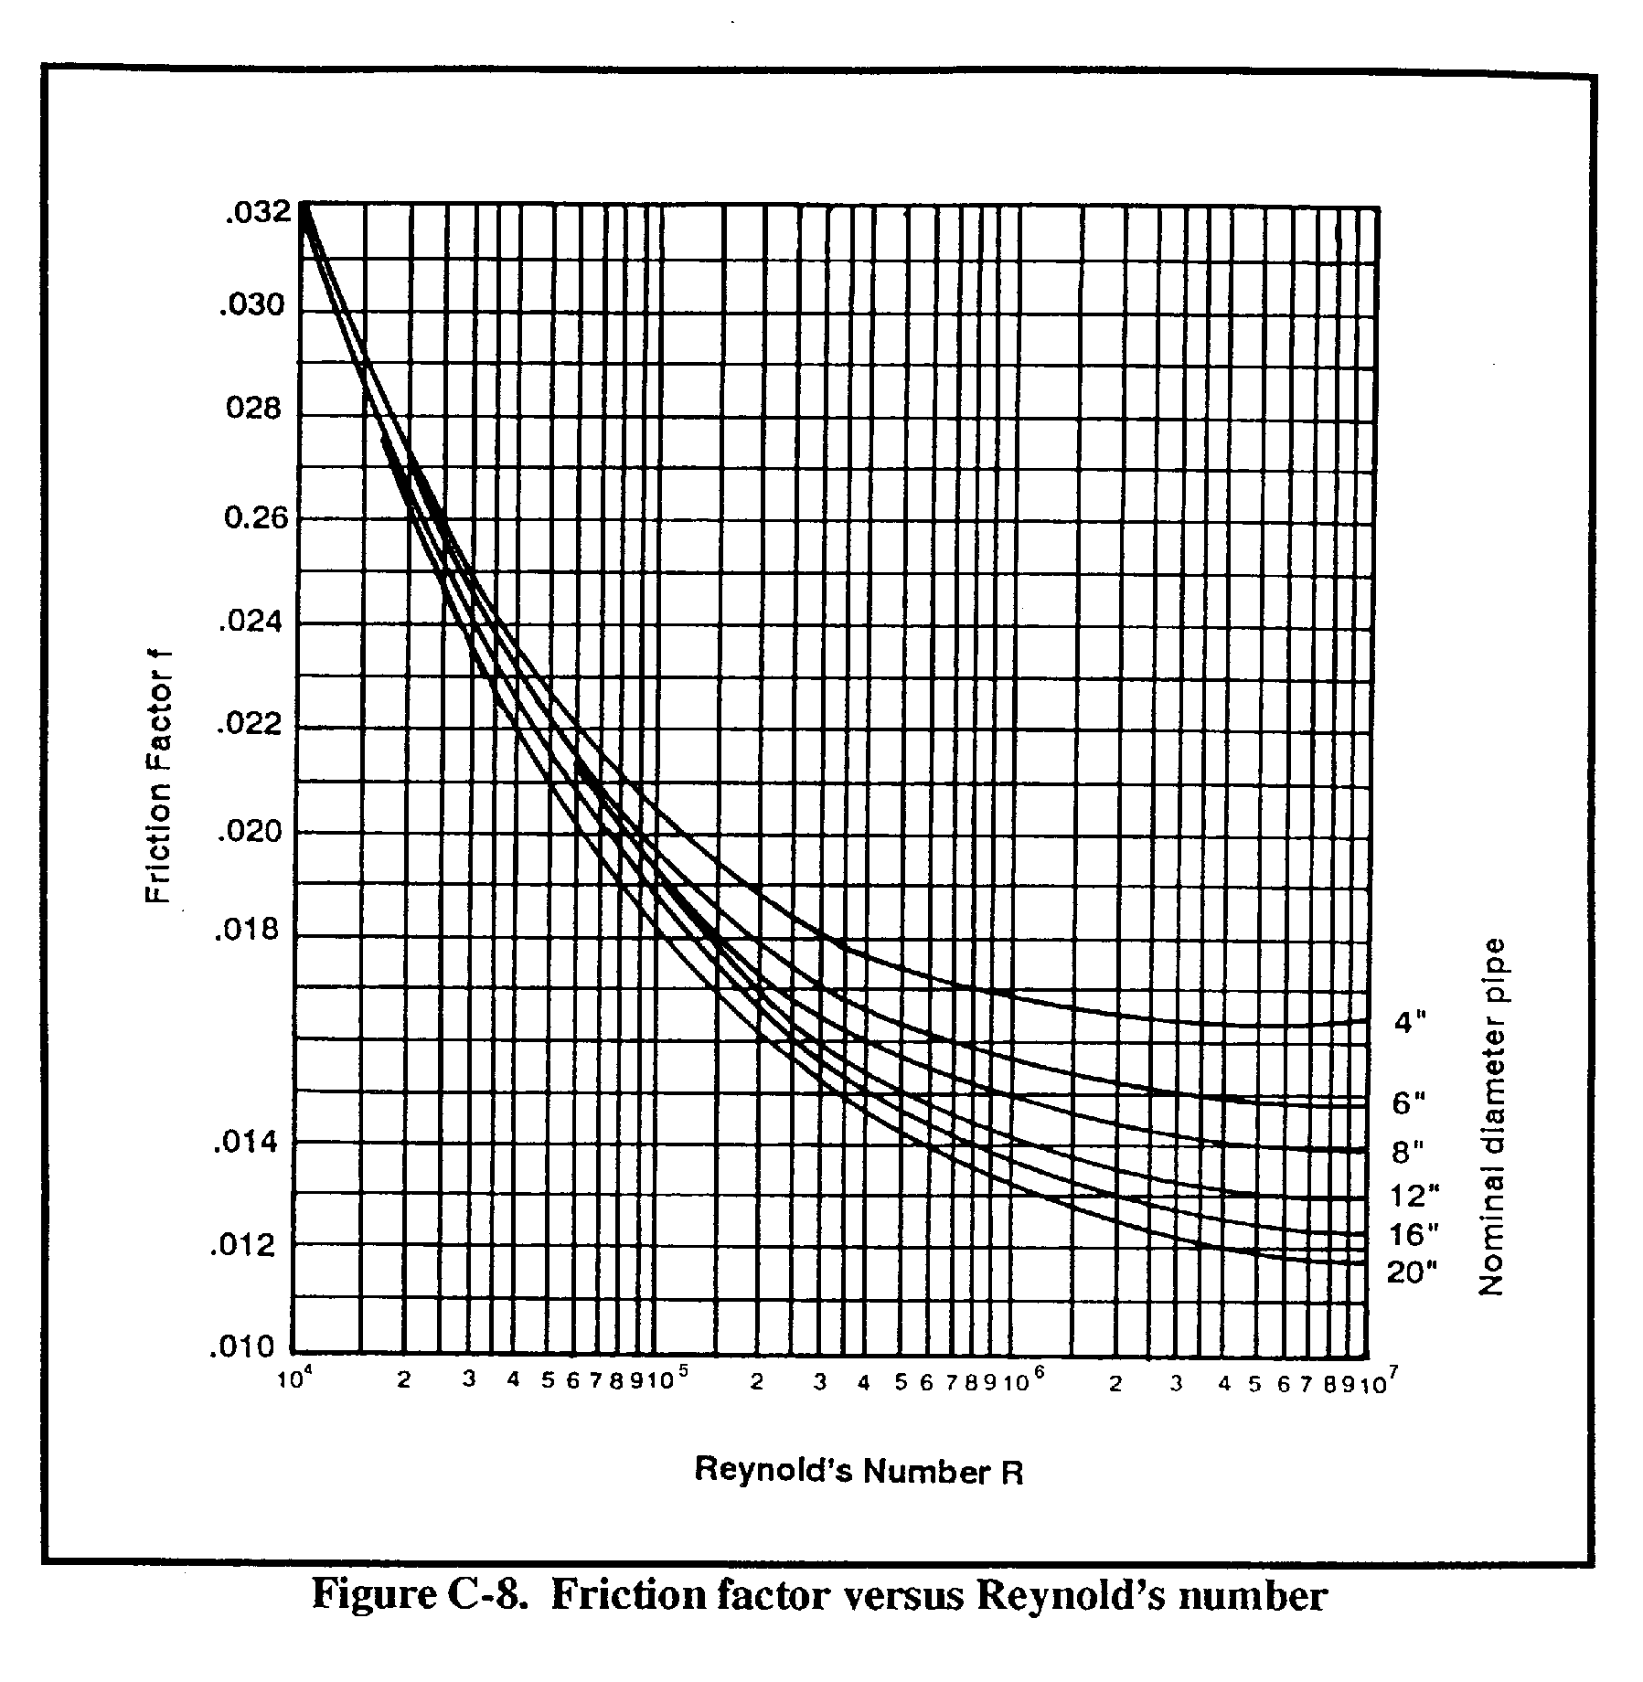

Slide 26
Since flow data is usually given in gallons per minute and pipe
diameters in inches, it is more convenient to express the Darcy
Weisbach equation as:
Where:
Hf = friction head loss, in ft
f = dimensionless friction factor based on the Rn and the inside
roughness of pipe
L = length of pipe, in ft
Q = flow, in GPM
d = inside diameter of the pipe, in inches
0.031 = Constant
Hf = 0.031xfLxQ²
d5

Slide 27
Example: Calculate frictional head loss, given the following information
and using the following equation.
Pipe size = 8.415 inches.
Fuel = DF-2 at 50ºF.
V = 4 ft/sec
Length of pipe = 4000 ft.
Hf = fxLxV²
2gxD

Slide 28
Step 1: Calculate Reynolds number
K = 4.9 = 0.0000527
Y = 92900
R = VD = 4 x .701 = 53206.8317(52307) or 5.3 x 10
.0000527
R = 3.160 xQ
dxK
To obtain Kinematic viscosity in centistokes, use Figure 1-1; move up the
scale to DF-2, move to the left and read 4.9.
Step 2: find the friction factor using the Reynolds number. Figure 1-2.
Locate 5.36 x 10, move up the chart to 8 inch pipe, move to the left and
read .0216 or .022.

Slide 29
Step 3: Hf = fxLxV²
2gxD
Step 4: 2g = 2x32.2 = 64.4
Step 5: Diameter of pipe in ft. = .701
Step 6: Hf = .0216x4000x16 = 1382.4
64.4 x .701 45.1
= 30.6 or 31 ft

Slide 30
Using the same information and the modified Darcy- Weisbach equation:
Hf = .031xfxLxQ²
d5
Step 1: Frictional factor is the same - .0216
Step 2: Length is the same - 4000 ft
Step 3: Q² = 700 x 700 = 490,000
Step 4: Figure 1-2 = 42,196
Step 5: .031x.0216x4,000x490,000 = 1312416 = 31.102853
42,196 42,196
= 31 ft
You can see that the frictional head loss is the same using either of the
two equations.

Slide 31
LESSON 2
LINE FILL AND FRICTION LOSS
Critical Task:
101-519-4260

Slide 32
INTRODUCTION
During previous instruction you were given an understanding of the flow of
fluids in pipelines. We discussed equations that can be used to determine
how fast the fluids flow and what effects the flow has on pressure. The
purpose of this instruction is to teach you how to obtain information from
other methods that are much easier. Although the information obtained may
not be as accurate, it is suitable for Army pipelines

Slide 33
PART A - FRICTION LOSS
Friction Loss Graph: The friction loss graph is an expedient method of
obtaining friction loss per mile of pipe in military pipelines. Although the
results are not exact, it is close enough and is a much faster way than
using the Darcy Weisbach equation. The basic graph (Figure 2-1) contains
the following information. Barrels per hour top horizontal line. Gallons
per minute bottom horizontal line. Friction loss per mile of pipe left
vertical line. The other lines on the graph represent pipe diameter in
inches and velocity of the fuel in feet per second. The graph has been
constructed using MOGAS at 60° F as the design fuel, Kinematic viscosity of
8 x 10 minus 6 ft per sec and absolute roughness of 0.00015. For this
reason you must use a correction factor for fuels other than MOGAS and at
temperatures other than 60° F.

Slide 34
Using Figure 2-1, given a flow rate of 700 gallons per minute and a pipe
diameter of 8.415 inches: enter the graph at the lower right hand corner
and move to the left to 700 gallons per minute. Move up the graph until you
locate the pipe diameter (8.415). Read to the left and read 33 feet. This
means that for every mile of pipe you will lose 33 feet of head. If the
pipeline was 10 miles long you would lose 330 feet of head.

Slide 35
PART B – CORRECTION FACTOR
Correction Factor. To determine the friction head loss for fuels other than
MOGAS at 60° F, it becomes necessary to correct the value obtained from
Figure 2-1. Table 2-1 contains correction factors for all military fuels at
temperatures ranging from -20º F to 80° F.
At temperatures other than these, interpolation must be used. These
factors can be used for any flow rate and for API pipe or light weight steel
tubing having the same nominal diameter as that shown in the tables.
If we use the same flow rate and the same pipe diameter (700 GPM and
8.415), we know that our head loss is 33 feet per mile. If we were pumping
DF2 at a temperature of 80° F, we must use the correction factor.

Slide 36
Using Table 2-1, locate DF2 at 80° F and read the correction factor 1.17.
Multiply 33 feet by 1.17 which equals 38.61 feet or 39 feet. You now have
the friction loss per mile of pipe for DF2 flowing at 700 GPM through an
8.415 diameter pipeline.
Once computed, the head loss due to friction for one mile of pipe has a
special name; hydraulic gradient (hg). Since hg is a constant ratio of two
linear dimensions: head loss in feet over pipe distance in miles; it can be
expressed graphically as the slope of a straight line.

Slide 37
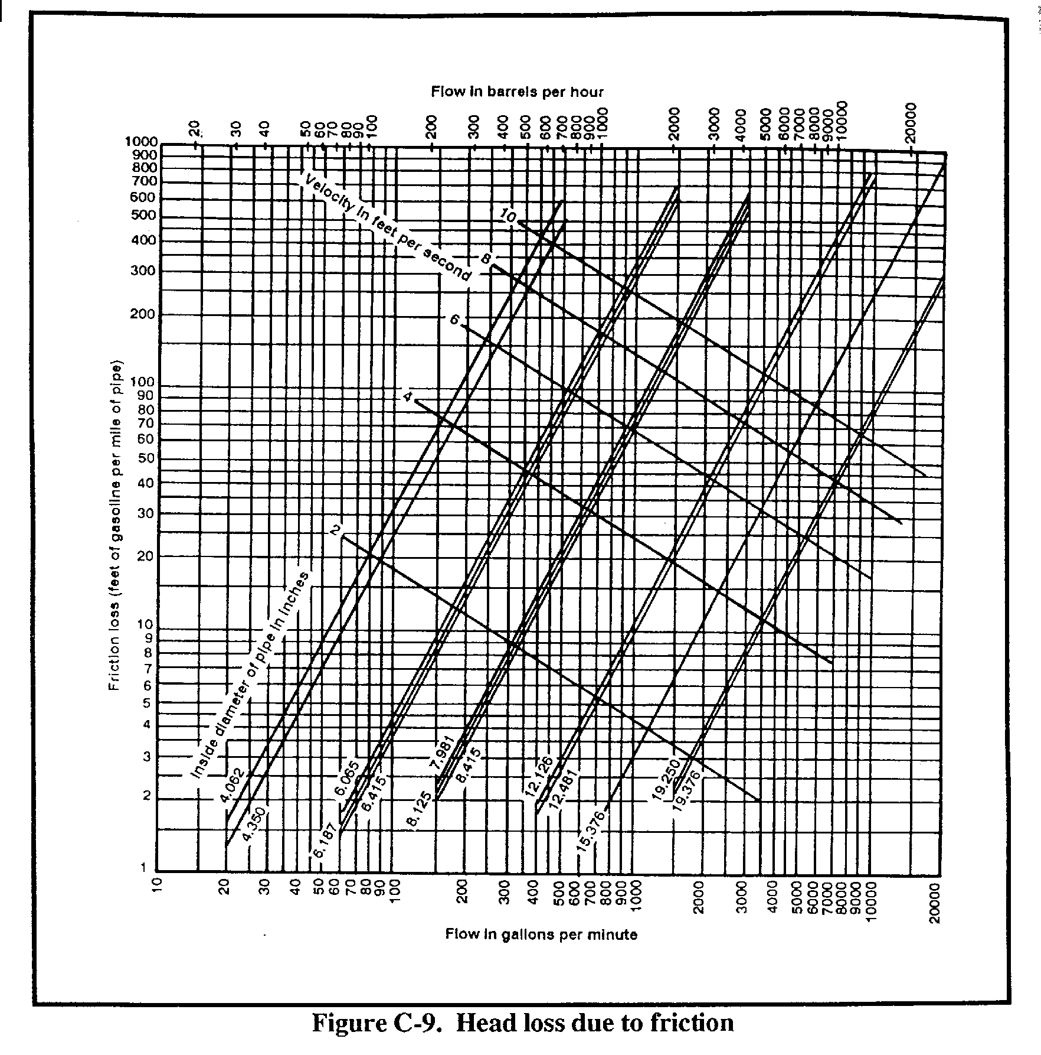

Slide 38
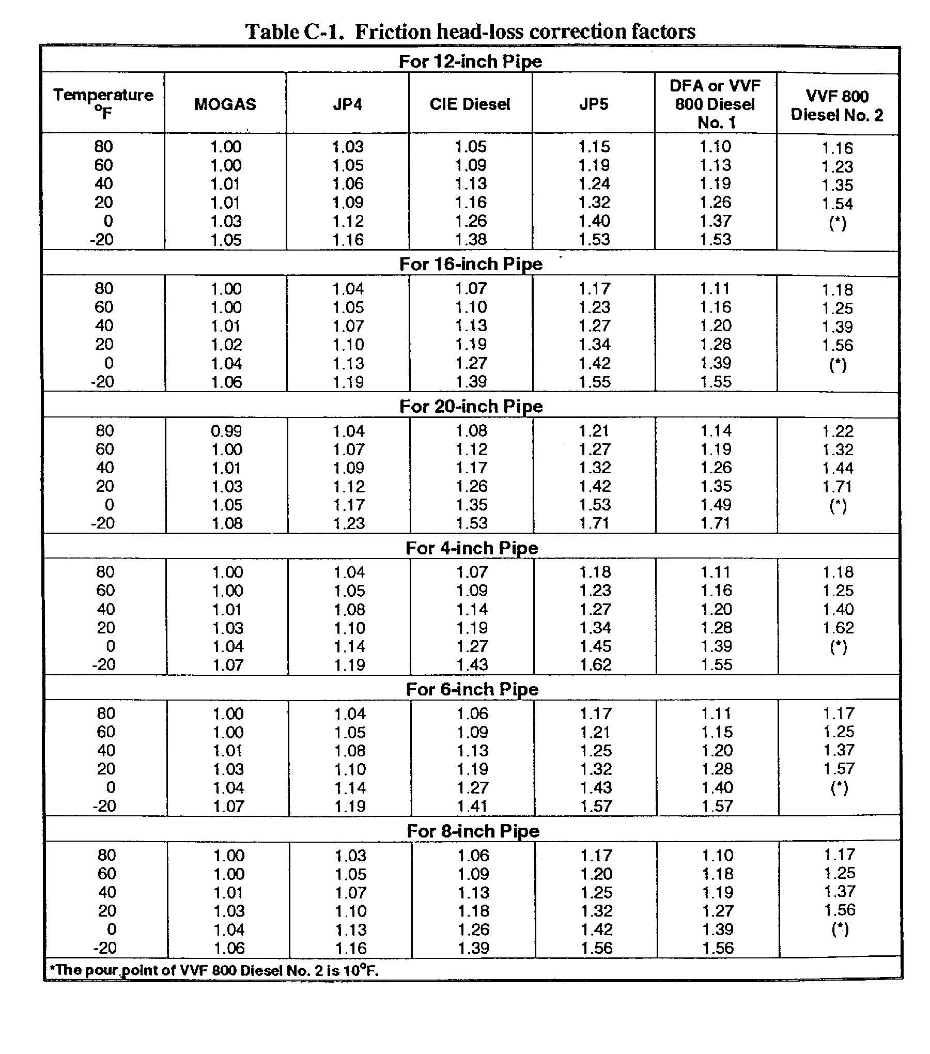

Slide 39
Being able to measure the head at a point downstream or head loss between
points downstream becomes academic. For example:
Head available = 390 feet
Pipeline distance = 10 mile (52,800 feet)
H = 38.61 feet per mile (or 39)
Head available after one mile = 351
Head loss after three miles = 117
390
351
312
273
234
195
156
117
78
39
1 2 3 4 5 6 7 8 9 10
MILES

Slide 40
In order to determine how much head is used and how much head is available,
draw a line from the lower left hand corner; as if the gradient was a
rectangle. Locate 4 miles on the X axis and move up the graph until you
intersect the sloping line. Move to the left and read 156 feet of head;
this gives you the head used and the head remaining which is 134 feet.
390
351
312
273
234
195
156
117
78
33
1 2 3 4 5 6 7 8 9 10
MILES

Slide 41
PART C – FEET OF HEAD AVAILABLE
Feet of Head available. Given a storage tank containing DF1 at an elevation
of 225 feet above the feeder pump, the feeder line is 6 inch LWST, 9000 feet
long, with a flow rate of 400 BPH. Determine how many feet of head are
available at the suction side of the pump.
STEP 1: Determine the true gradient (400 BPH and 6.415 inch pipe) using
Figure 2-1. Hg = 24 ft/mi
DF1 at 40º F Correction Factor = 1.20
True Gradient 24 ft/mi x 1.20 = 28.8 ft/mi

Slide 42
STEP 2: Determine the miles of pipe
9000 ft = 1.70 mi
5,280 ft/mi
STEP 3: Determine head loss
Hf = 28.8 ft/mi x 1.70 mi = 49 ft
STEP 4: Determine head remaining
225 ft - 49 ft = 176 ft

Slide 43
PART D – FRICTION LOSS
Friction Loss in Valves and Fittings: Friction losses in valves and
fittings result from the same surface friction losses in straight pipe. So
far we have only considered the losses in pipe. Now we are going to find
out how to compute the losses through valves and fittings. Valves and
fittings have been mathematically evaluated to determine the friction loss
and the information has been put in graph form. Special consideration must
be given to terminals and tank farms because of the numbers of valves and
fitting used. This friction loss must be carefully evaluated to ensure that
feeder pumps can meet the required pressure to feed the mainline pumps and
to transfer fuel from tank to tank within the terminal

Slide 44
Now we can calculate the equivalent length for a pipeline that has a
certain number of valves and fittings. This number would then be added to
the pipeline length. For example:
3 rising stem gate valves
2 swing check valves
1 90 degree welding elbow
All valves and fittings are 8.415 inch diameter
Gate valve - 6.2 x 3 = 18.6
Swing check valve - 70.0 x 2 = 140
90 degree welding elbow 95.0 x 1 = 9.5
Total = 168 f

Slide 45
Given: JP-5 at 80° F
Q = 700 GPM
d = 8.415 inches
Valves and fitting equivalent length = 188 Feet
Pipe length = 2.5 mi
Find: Total head loss due to friction (Hf)

Slide 46
STEP 1: Determine Hg
NOTE: Using Figure 2-1, at 700 GPM and 8.415 inch pipe Hg = 34 ft/mi
STEP 2: Determine correction factor using Table 2-1.
Correction factor = 1.17
STEP 3: Determine True Gradient
34 ft/mi x 1.17 = 39.78 ft/mi

Slide 47
STEP 4: Determine length of pipe and fittings
168 ft
5280 = .03 mi 2.5 mi + .03 mi = 2.53 mi
STEP 5: Determine Hf
Hf = 2.53 mi x 39.78 ft/mi
Hf = 101 ft

Slide 48
PART E – LINE FILL
Line Fill. The amount of fuel in pipelines and manifolds must be taken into
account for several reasons. In the initial planning stages of the
pipeline, this becomes a requirement above that required for the units
supported. Taking into account the fact that the pipeline is always full
but must be accounted for on the books is very important. The length of the
line and the size of the pipe can be obtained from blue prints or drawings.
The volume of fuel in the line can be obtained by use of the following
equation

Slide 49
V= 5.13 constant
V = d2 x 5.13
V = Bbls per mile
d2 = Inside diameter of pipe in inches squared
5.13 constant
Example: d2 = 8.415
Pipeline length 3 miles
8.415 x 8.415 x 5.13 = 363 Bbls/per mi
363 x 3 = 1089.8 or 1090 BBLS in 3 miles of pipe.

Slide 50
LESSON 3
DESIGN
Critical Tasks:
101-519-4260
101-519-4310

Slide 51
INTRODUCTION
It is very important to fully understand the layout and design of a
petroleum pipeline for effective and safe movement of fuel. As a result of
this instruction you should be able to apply the basic principles to plan
and design a petroleum pipeline.

Slide 52
PART A – HYDRAULIC GRADIENT
Placing Pump Stations Using the Hydraulic Gradient: Although you will not
be required to place pump stations while you are here in the school, it is
very important that you understand the principles of how it is done. Given
a flow rate (Q) of 600 gpm, Mogas at 60° F and a pipe diameter of 6.415
inches, we can determine Hf = 97 ft/mi (Figure 3-1). This chart is
constructed to show miles on the horizontal axis starting at zero on the
left and ending at 80 miles on the right hand side of the chart. The left
vertical column shows elevation in feet of head starting at zero and ending
at 4000 feet of head. The pipeline trace is represented by the ground

Slide 54
Determin+e the Hydraulic Gradient: To determine the hydraulic gradient for
the chart, multiply 97 ft/mi by 10 miles = 970 ft. Locate 10 miles on the
bottom horizontal axis and 970 ft on the left vertical axis. Draw a
straight line between the two; this establishes the slope of the Hg. Find
the total head for a 6 inch pipeline 1362 ft/hd (Figure 3-2). Using the
hydraulic gradient as a guide, draw a parallel line from 1662 ft/hd down to
the pipeline trace at 950 ft/hd at 7.5 miles. This is your True Gradient.
From the True Gradient back up 64 ft of head to meet the minimum requirement
of 20 psi at each pump station. Using the hydraulic gradient as a guide,
draw a parallel line from 1598 ft/hd down to the pipeline trace at 900 ft/hd
at mile 7. This is your Design Gradient. We will locate pump station 2 at
this point. At pump station 2, draw a vertical line up 1362 ft/hd, now draw
a parallel line down to the pipeline trace at mile 22.75 and 810 ft
elevation. This is the location of pump station number 3. Simply continue
this procedure to place the remaining pump stations. The end of the profile
is the Head Terminal (HT). From pump station 4, you can see that the line
does not come in contact with the pipeline trace, at this point there is a
terminal and the fuel will enter the terminal at 1190 ft/hd or 373 psi. Use
the formula shown below.

Slide 55
Where:
P = pressure, in psi
H = head, in feet
SG = specific gravity
P = (h) (SG) or P = (0.433)
(h) (SG)
2.31
and
h = (2.31) P or h
=
P
SG 0.433
(SG)

Slide 56
Design Gradient/True Gradient: The difference between design gradient and
true gradient is important for you to understand because of the suction
pressures required. The normal suction pressure required is 20 psi or 64
ft/hd and the minimum is 5 psi or 16 ft/hd. Knowing this when we placed the
pump stations using the true gradient our suction pressure is zero at pump
stations 2, 3, and 4. The true gradient is represented by a solid line.
The design gradient we will show as a dotted line 64 ft/hd below the solid
line, insuring that each station will receive 20 pounds of suction pressure

Slide 57
NOTE: For temperatures over 100 ºF suction pressure required is 30 psi.
Atmospheric pressure is comparable to static pressure in liquids. So,
elevations above 3,000 ft design loads are decreased by 4 percent for each
1,000 ft of elevation. Hydraulic gradient is the rate of head loss due to
friction. Pressure reducing stations are installed on long downhill slopes
or grades

Slide 58
PART B – PUMP STATION SUCTION AND DISCHARGE PRESSURE
Determining Pump Station Suction and Discharge Pressure:
Since the design gradient was used to place the pump stations we can now use
the operating gradient to determine suction and discharge pressures. Our
flow rate is 600 GPM, MOGAS 60° F. Our gradient is based on a loss of 97
ft/mi times 10 miles or 970 ft/hd loss over 10 miles. Starting at pump
station number 1 (using our gradient) it will take 1398 ft/hd (439 PSI)
discharge pressure to reach pump station 2 at 20 PSI (64 ft/hd).

Slide 59
If the fuel is DF with a gravity of .8448 this changes the head from 64
ft to 55 ft in order to maintain 20 PSI suction. At pump station 2 the
parallel line will give you the suction and discharge head required. At
pump station 4 we have a little different situation, assuming we must enter
the terminal at 20 PSI or 55 ft/hd, using the hydraulic gradient and
parallel lines our discharge head must be 100 ft/hd (37 PSI). This
procedure can be accomplished by starting at the end of the pipeline on the
right hand side of the graph or at pump station 1 on the left hand side of
the graph. If we start at the end of the pipeline and work backwards the
procedure is called back chaining; either way the system will work and
becomes a matter of preference.

Slide 60
Using graph number 3 the procedures are the same except we will consider
whether we can bypass any of the pump stations in case of an emergency or
for efficiency. To accomplish this lets look at pump station 3. We must
create enough head to get over the peak at mile 35. If we create 960 ft/hd
(351 PSI) we can bypass pump station number 4 and enter the terminal at 510
ft/hd (187 PSI). Caution should be used in doing this as you run the risk
of creating an over pressure on the pipeline on the long down hill slope at
mile 28. Counting down from the gradient at this point we have 1,060 ft/hd
(388 PSI). The pipe will withstand 740 PSI (2,390 ft/hd) so we are well
within our working pressure (Figure 3-3).

Slide 61
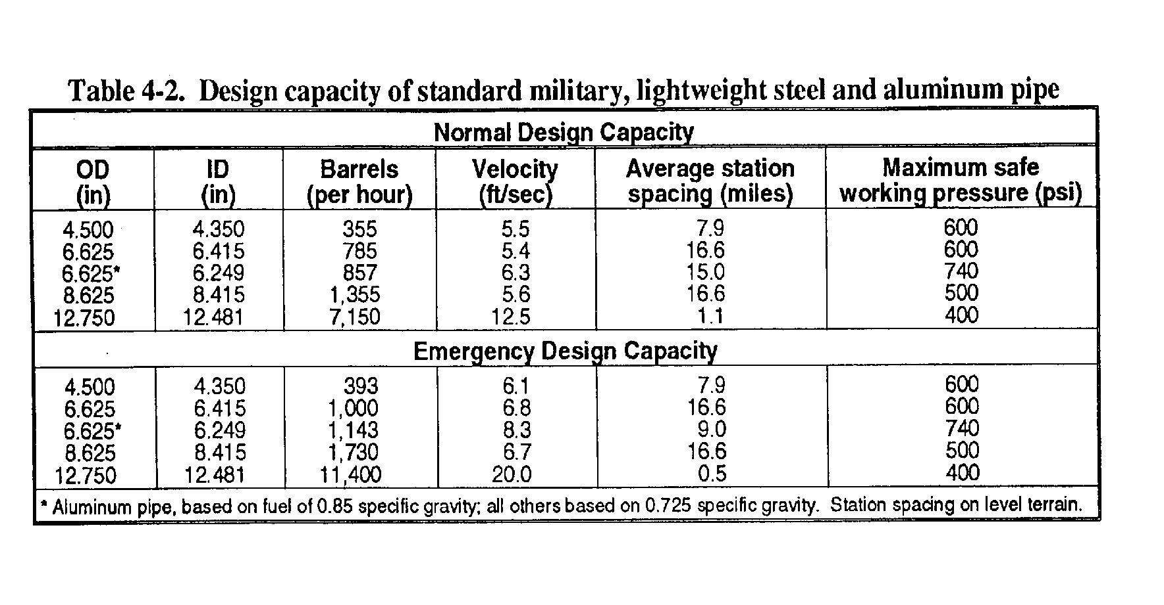

Slide 62
LESSON 4
SUPERVISE THE SELECTION AND PREPARE A CLASS III SUPPLY POINT
Critical Tasks:
101-519-3304
101-519-4316

Slide 63
PART A - PREPARATION FOR MOVEMENT
Tactical Operations. As the petroleum platoon sergeant, you can expect
to be either in the advance party or main body during a movement
operation. Since it is the advance party that does that actual on-theground
site selection, the majority of this block of instruction will be
based on your role as a member of the advance party.
As a platoon sergeant, the first notice you would receive of an
impending move would be a warning order from your company commander. The
warning order will probably be an oral order with general information on
the time and date of the move, information on the destination, and the
probable route

Slide 64
After you get the warning order, the commander will probably leave the
area and begin a route and site reconnaissance of the area assigned to
him by the battalion operations S-3. While that is occurring, you should
be preparing to move. Information needs to be passed out to your
platoon, equipment needs to be checked, PMCS needs to be performed on
your equipment, and if you have the time, all of your equipment needs to
be laid out and checked for serviceability before it is loaded into the
vehicles.

Slide 65
When the commander returns, he should have a sketch map of the route
and the site. The map/diagram should show the route to the site and the
general locations where each platoon will set up. If at all possible,
the site should be as close to supported units as the tactical situation
permits. The site should also be large enough to provide for two
balanced storage sites because you don't want to put all of your product
in one location. By splitting your storage assets, you reduce the
possibility of losing all of your product to one accident or attack. The
site should also have easy access to road nets with at least one road
running through the supply point, but never near populated areas. These
conditions should be discussed with the commander prior to you leaving
with the advance party because you will be the one making the final site
selection from the area allocated to you by the commander

Slide 66
Advance Party. The commander will make the personnel selection for the
advance party. The advance party should consist of at least one member
from each section of the company. The executive office (XO) or senior
lieutenant will usually be the advance party leader. Your local SOP
should detail what equipment should go with the advance party, but at the
very least, you will want to bring some engineer tape and marking devices
to mark off the areas where you want the equipment to go.

Slide 67
Designated Area. Once you have identified exactly where you want each
operation to go, designate the areas with engineer tape and signs. When
the main body arrives, you or your representative should personally
escort each truck to its designated area.

Slide 68
PART B - PLANNING AND ENGINEER SUPPORT
Planning. Before you begin to move the Class III and FSSP supply point,
you must develop a plan. You will need to make sure you have all your
personnel and equipment on hand when you begin to move the supply point.
Find out how much time you have in which to prepare your crew and
12-37
QM 5099
equipment for the move. There are some tasks that should be taken care
of before you move. These include surveying the area to which you will
be moving, coordinated with an engineer unit, and developing a flow plan.

Slide 69
Area Survey. Go over the area where the supply point will be located.
Decide where to place the entire supply point. Choose an arrangement for
the FSSP that fits the situation and the terrain. Also, decide where you
want the truck parking, bulk storage (50,000-gallon collapsible tanks),
and bulk reduction storage areas and other bulk reduction equipment.

Slide 70
Coordinate Engineer Support. When you go to look over an area for the
first time, take a member of an engineer unit with you. After you choose
a site for each part of the supply point, you can give this information
to the engineers. With this information, the engineer unit can prepare
individual tank sites, remove underbrush from bulk reduction areas, clear
truck parking areas, and build an improved road through the site (if one
is needed). If you do not have engineer support, your unit needs to
prepare the site before you start setting up the equipment at the new
site.

Slide 71
Develop a Flow plan. After you select the specific sites for the parts
of the Class III supply point, develop a flow plan so that you do not
handle products and containers more than is needed. The flow plan
identifies steps which can be eliminated, combined, or changed to make
the operation more efficient. It can also show unnecessary delays in
handling and transporting. When developing the plan, consider the
location of bulk storage, packaged product storage, bulk reduction, and
can and drum cleaning areas. Also consider the flow of traffic through
the supply point. Only one-way traffic should be permitted in the supply
point. Study the area, and make a flow plan before the supply point
moves to the new location.

Slide 72
PART C - SELECTION OF CLASS III SUPPLY POINT
Layout Design. Once the area has been declared safe for use by the
advance party and communication has been established with the main body,
actual site selection begins. In determining the layout of the system,
you should use some of the factors the commander used in making his site
selection such as:
•  Adequate space to provide storage space and truck parking requirements
for both your vehicles and your customer vehicles.
•  A good road net with at least one road running through your
operations. A good road is not a trail. A good road will hold up
under heavy traffic and will not turn into a mud trap when it rains.
•  Location is away from populated areas

Slide 73
In addition to the above, you need to consider the following when you are
making your selection:
•  Use vacated forward sites or existing facilities if possible. Many
times you will be able to inherit a site that was previously occupied
by some other units. Usually they will leave behind improvements such
as foxholes to the existing road network that you will be able to use
for your operations.
•  Avoid low areas so vapors do not get the chance to collect.
•  Use reasonably level ground with no more than a 3-degree incline on
any surface. If you set up on a larger incline, your storage tanks
could roll when you start to fill them.

Slide 74
•  Do not set up upstream of troop concentrations. Spills and accidents
could pollute their water supply.
•  Maximize the use of cover and concealment. Often, many of the
components of a class III supply point can be concealed inside a
wooded area or along a tree line. Other components can be hardened
with sandbags.
•  Distance between each storage tank. Forty feet is recommended for
safe operations; however, the physical terrain features of the final
site will dictate the actual distance between the tanks

Slide 75
•  Distance between each storage tank. Forty feet is recommended for
safe operations; however, the physical terrain features of the final
site will dictate the actual distance between the tanks.
•  One-way traffic flow with checkpoints at the entry and exit points.
•  Different space requirements for bulk, retail, and packaged
operations. The operating space to service retail customers may not
be the same as for bulk customers. Usually, you will need a
much-larger operating space for your bulk customers than your retail
customers,
•  Availability of other transportation modes. You should always try to
take advantage of any rail loading facilities or barge loading points
whenever possible.

Slide 76
Site Selection. Select a reasonably level site that can hold container
stacks. Choose a site with good drainage so that water does not damage
the containers. Avoid low areas because dangerous vapors collect in
them. Do not use an area with a cinder base or marshland and wasteland
overlaid with peat; they are usually damp. Use such areas only if no
other site is available. Be sure the site has natural cover and
concealment and is large enough for future expansion. Do not locate near
other areas of operation (Figure 4-1). Stay at least 500 feet away for
low-flash products and 200 feet for high-flash products. Your site must
be away from overhead electric lines so a broken wire cannot fall on the
drums. Clear the site of all underbrush that may get in the way or
present a fire hazard. Spread sand, gravel, or similar material over
areas where you store containers. They help drain the area and provide a
more stable base for the stocks. Do not use ashes or cinders because
they are corrosive. Build a dike at least 18 inches high around each
major storage division in which low-flash products are stored. This dike
must be able to hold all the liquid in the drums stored in the area and
have a freeboard of at least 6 inches. Choose a site for at least two
clearing (incoming and outgoing) areas. These will be used to segregate
incoming and outgoing mixed loads (railroad cars or truckloads). Each
area should have its own site. The sites should be located next to each
other so that the same personnel can operate both areas

Slide 77
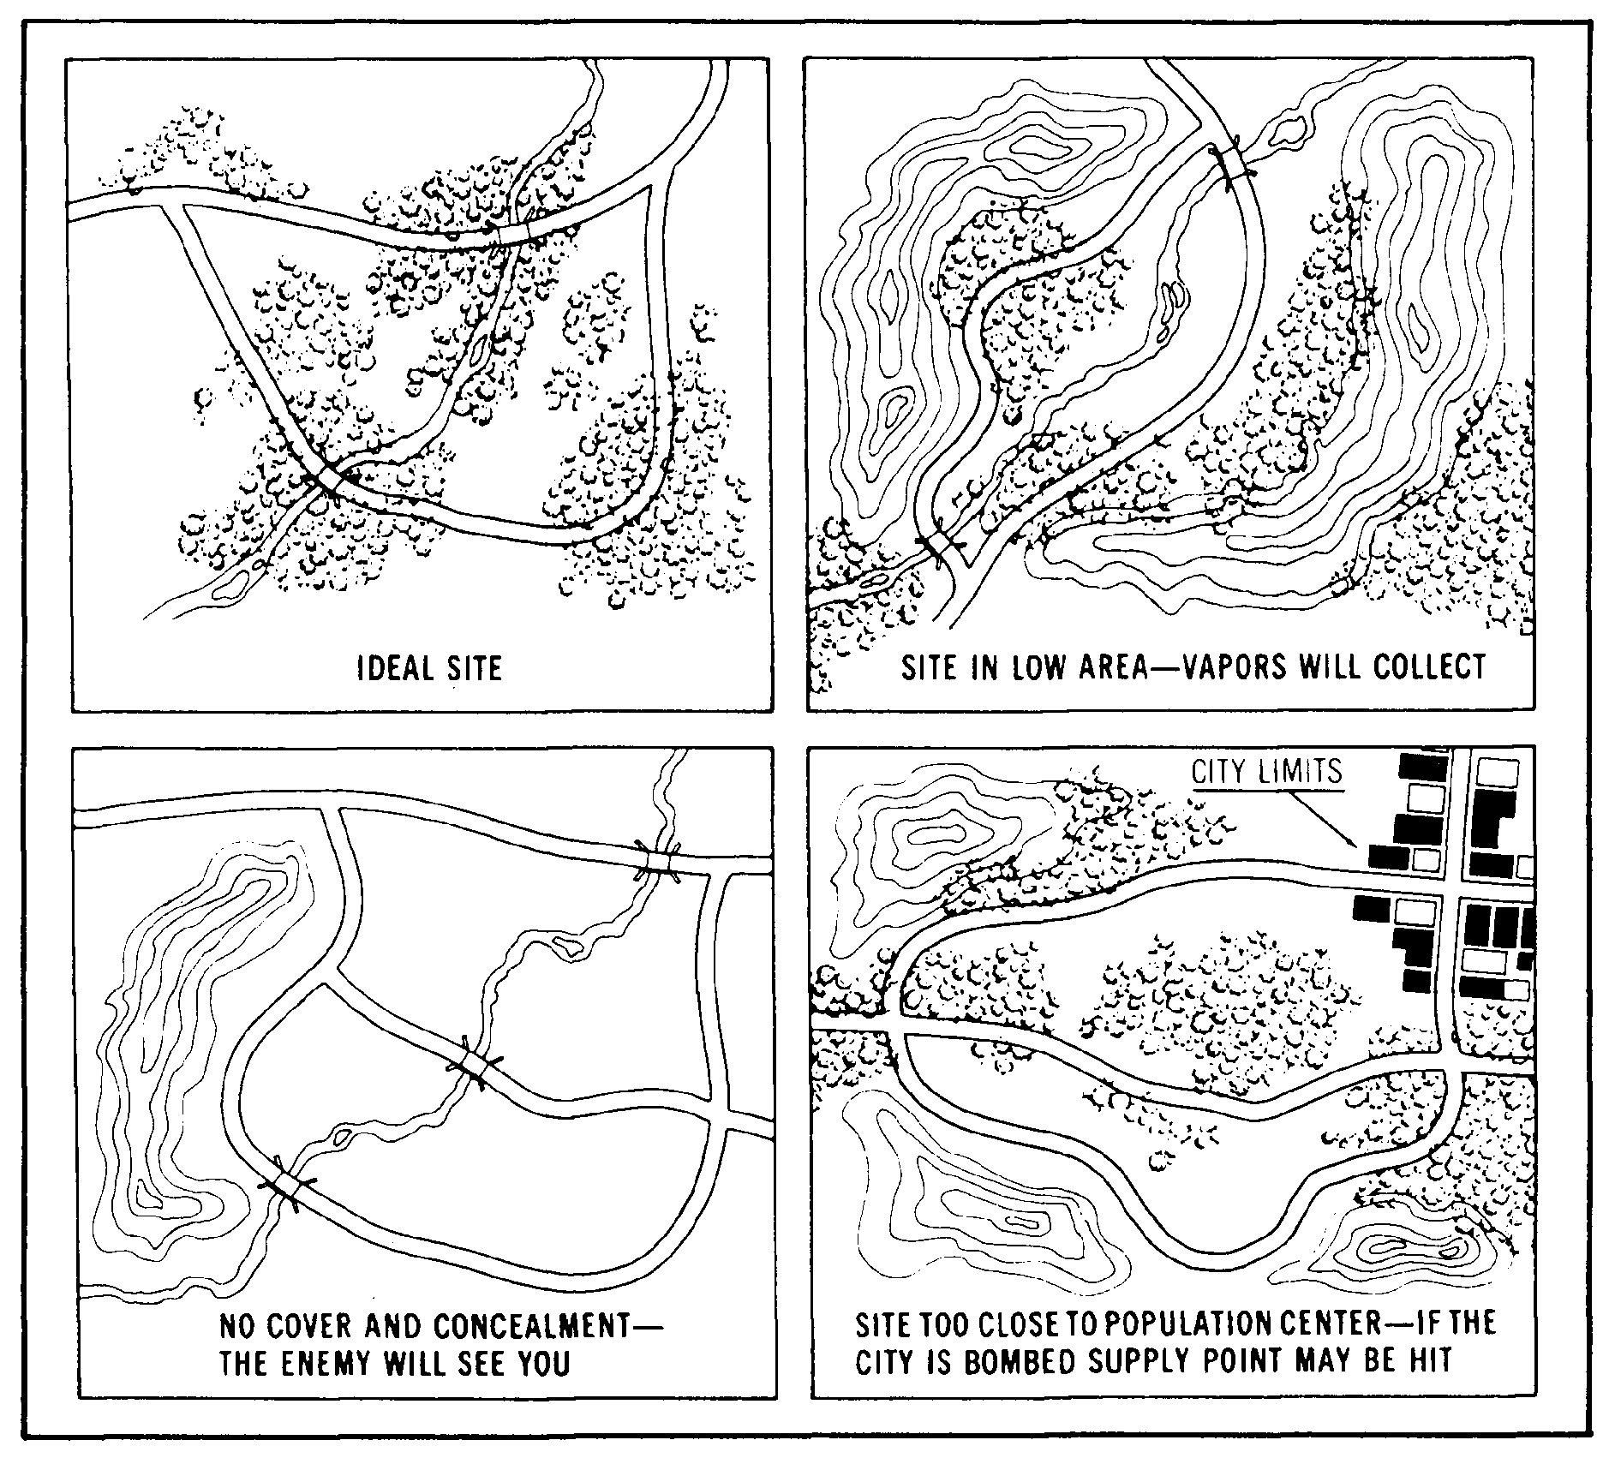

Slide 78
Selection Criteria for Equipment. You must also select a site for other
equipment in the Class III supply point. This equipment includes 20,000-
gallon collapsible tanks, 50,000-gallon collapsible tanks, and 500-gallon
collapsible drums.

Slide 79
The site you choose for the 20,000-gallon collapsible tanks should be
similar to that for the 10,000-gallon collapsible tanks. Choose a site
that is nearly level with a gentle slope toward the manifold end of the
tank. Space the tanks about 150 feet apart. Build a fire wall around
each tank. Make it large enough to hold the contents of the tank and 1
foot of freeboard. To do this, build the fire wall 4 feet high and 18
inches wide at the top, and make the inside dimensions of the fire wall
35 feet long and 31 feet wide. Maintain a distance of 4 feet from the
edge of the tank to the base of the fire wall. If an engineer unit
prepares the site, you must ensure they follow these design factors.
Place the discharge pumps at a level lower than the tanks to aid pump
suction.

Slide 80
Choose a site for the 50,000-gallon collapsible tanks that is similar
to that for the 10,000- and 20,000-gallon collapsible tanks. Build the
12-40
QM 5099
fire wall 4 feet high and 18 inches wide at the top, and make the inside
dimensions of the fire wall 73 feet long and 33 feet wide. Place the
discharge pumps at a level lower than the tanks to aid pump suction.
For the 500-gallon collapsible drums, select a firm, level site near
the source of supply. Select a site that allows drums to be easily lined
up for filling and rolled away after filling

Slide 81
PART D - PLANNING THE MOVEMENT OF THE FSSP
The FSSP is used at distribution points to provide storage facilities for
transferring bulk fuel from one means of transport to another and at
dispensing facilities for bulk reduction or delivery of fuel to using
vehicles. The FSSP can receive product from tank trucks, railway cars,
pipelines, hoselines, and aircraft. Since it can also receive fuel from
ocean tankers, it is capable of supporting beach operations. It can
store 60,000 gallons of bulk petroleum. It can store even more if
additional or larger collapsible tanks are added. However, this
expansion requires additional hoses, fittings, and valves. The FSSP can
be easily moved from one location to another, and it can be divided in
half to handle two different types of fuels at two different locations.
It can also be changed to a 10-point, rapid-refueling system for rotary
aircraft.

Slide 82
The first step in moving an FSSP is to receive the mission. Normally,
as a section chief you receive the mission from the platoon sergeant or
even the platoon leader. The mission can come in one of three different
ways. A warning order, an operation order, or a fragmentary order. Once
received, there are some questions you need to ask yourself:
•  What is the mission?
•  What is known about the enemy?
•  How will the terrain affect the operation?
•  What troops are available?
•  How much time is available?
•  What supplies and equipment are needed?
•  What special tasks need to be assigned?

Slide 83
Personnel. Make sure that all personnel are on hand for the move to the
new site. The usual strength level of a supply section in a petroleum
supply company consists of a section chief E7, petroleum heavy vehicle
operator E5, petroleum inventory control E5, two petroleum heavy vehicle
operators E4, five petroleum supply specialists E4, and ten petroleum
supply specialists E3. In some situations, you will have to augment
personnel.

Slide 84
Equipment. Make sure your Class III supply point equipment is on hand
and ready for use. If any items are not working properly, try to have
them repaired or replaced before you move. The equipment may vary
according to the situation.
•  One Fuel System supply point.
•  One collapsible fabric tank repair kit.
•  Three 500-gallon collapsible drums.
•  Three Pressure controls for filling nonvented drums.
•  One 500-gallon collapsible drum tie-down kit.
•  One 500-gallon collapsible drum towing and lifting yoke.
•  Six 50,000-gallon collapsible tanks.
•  Four 20,000-gallon collapsible tanks.
•  Four 10,000-gallon collapsible tanks.
•  Ten 350-GPM pumping assemblies.

Slide 85
•  One fuel handling hose line outfit (assault hose line).
•  One electric floodlight.
•  One gas engine generator (3 kW).
•  Eight filter/separators.
•  One FARE system.
Make sure you have the necessary vehicles needed to transport the
equipment to the new site.
•  Four semitrailers, stake, 12-ton, with equipment.
•  Four tractor trucks and 5-ton, 6x6, long wheelbase, with equipment.
•  Two cargo trucks and 5-ton, 6x6, long wheelbase, with equipment.
•  Two cargo trailers, 1-1/2 ton, 2-wheel, with equipment.

Slide 86
Loading Plan. Next you must develop a loading plan, a tentative plan,
and issue a warning order to give soldiers time to prepare for the
mission. Determine the total number and types of fuel transporters
needed to move the product on hand. Determine the type and number of
transporters needed to move the system. Determine the type and number of
transporters needed to move personnel

Slide 87
Your plans for loading personnel and equipment should apply to every
type of transport that may be used in a movement. Make the plan before
the move to allow time for packing. Base your plan on the type of
transport to be used; the number of persons involved; and the type, size,
weight, and quantity of supplies and equipment to be moved. When
preparing the plan, consider the priority of loading and the safety of
equipment and supplies in transit. Design the plan to permit quick and
orderly unloading and regrouping of personnel and equipment. Once the
equipment is loaded, make sure it is properly secured and make sure the
pumps are braced, blocked, and tied.

Slide 88
Before you complete your plan, you need to have an idea where you will
operate and what the terrain looks like. Consult the latest intelligence
map or, if possible, conduct a reconnaissance and walk around the area.
This will give you an idea about the type of terrain in which you will be
working. Information from the reconnaissance can either change or delay
the mission.

Slide 89
Once you complete your plan, issue an operation order. Once you
complete the operation order, issue your order orally. Whenever
possible, issue the order from a location where your soldiers can see
their objective. If this cannot be done, use a terrain model or a
sketch. When you issue the complete order, make sure your soldiers
understand it. Be sure they know how you expect to accomplish the
mission and how they fit into the overall plan. Explain to them what to
do if you lose communication, and make sure you give the order in
language they understand. The final step in troop-leading procedures is
supervision. After you issue the warning order, you must diligently and
constantly check details, conduct back briefs, rehearsals, and before the
operation begins, inspect. Troop-leading procedures help you prepare
your soldiers for any type of operation using logical step-by-step
procedures. Use it as a mental checklist to make sure you do not
overlook anything important. Keep in mind that no single individual can
do everything by himself or herself, not even you. Use your subordinates
and get the job done right

Slide 90
Communications and Status Reports. The unit status report produces
information to help the Army manage its resources. The payoff is
military readiness. The Army wants the company to have it is authorized
personnel on board, the authorized equipment available in working order,
and the required supplies on hand. Additionally, the Army wants the
company to do what it is supposed to do--turn out soldiers who assist the
unit mission.

Slide 91
The Petroleum Supply Sergeant assists the platoon sergeant by
supervising two shift operations and maintains close coordination with
the petroleum operations sergeant. Every 24 hours the status report data
from the supply sections will be consolidated, and a report will be sent
to the supply control section. The format for the status report should
be detailed in both the company and battalion SOPs.

Slide 92
PART E - SELECTING THE SITE FOR CLASS III SUPPLY POINT AND FSSP OPERATION
Selection Criteria for FSSP. When you select the FSSP site, consider
cover and concealment, road nets, dispersion factors, terrain, and site
preparation requirements. Make sure the site is suitable for the fuel
system layout (Figure 4-2).

Slide 93
Select a site for the collapsible tanks, pumps, and filter/separators
that is in the woods or in a tree line where the natural shadows disguise
the telltale shapes. Use camouflage nets if you have them. When you lay
hoseline, make use of natural terrain contours and vegetation to break up
straight lines. One way to do this is to cut branches, stick them in the
earth under the hose, and then weigh them down with the hoseline. Where
you have deep grass or other vegetation, bend it over the hoseline to
hide the hose so that it is not seen from the air.

Slide 94
Choose a site for the receiving, truck bottom loading, and vehicle
refueling points that is next to a road in the Class III supply point.
You can then load or unload trucks and refuel vehicles without leaving
the road nets in the supply point.
You must consider the distance between items when you select the sites
for the equipment in the FSSP. The distances can vary with the terrain,
natural cover, concealment, hose available, and road nets. However, you
must put the 10,000-gallon collapsible tanks at least 40 feet apart.

Slide 95
Select level terrain for the FSSP. Look for a tank site without
slopes. A large slope may cause filled tanks to roll sideways,
backwards, or forward. Put the pumps and filter/separators on level
ground. Try to place the discharge pump at a lower level than the
collapsible tanks so that there will be good suction to the pump

Slide 96
Deal with these three major items of equipment in the FSSP--the
collapsible tanks, the pumps, and the filter/separators. Slope the tank
sites gently toward the manifold end to help drain the tanks when they
are removed. Slope the site for each tank no more than 3 to 6 inches in
the direction of the tank’s fill port. Build a fire wall around each
tank. Make it large enough to hold the contents of the tank and 1 foot
of freeboard. To do this, build the fire wall 3 feet high and 18 inches
wide at the top. Make the inside dimensions of the fire wall 26 feet by
26 feet and maintain a distance of 3 feet from the edge of the tank to
the base of the fire wall. If an engineer unit prepares the site, you
must ensure they follow these dimensional and procedural specifications.
The pump and filter/separator sites must be cleared of any dry grass,
leaves, and trash.

Slide 97
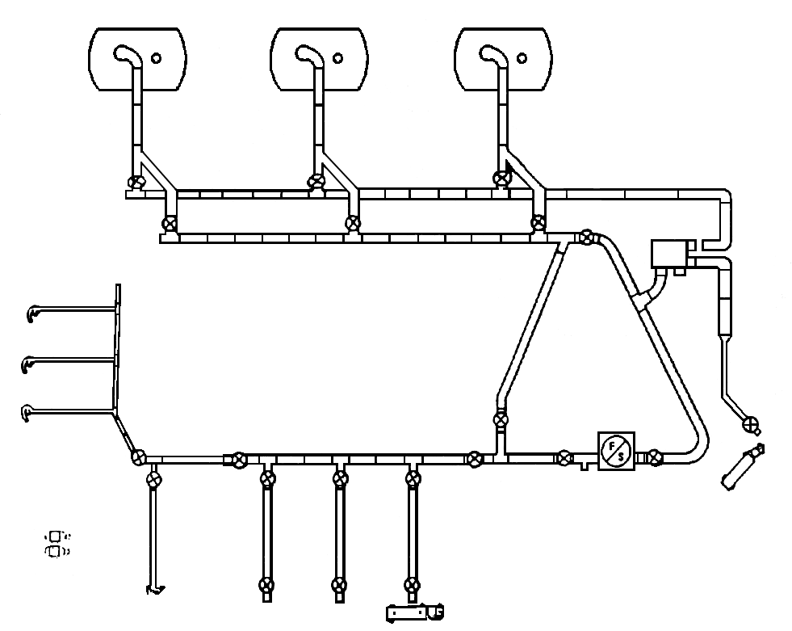

Slide 98
GPS Navigation. Each satellite transmits a unique signal that contains
data needed by the SLGR to determine your location. The signal cannot
penetrate objects such as buildings, metal, mountains; or very thick
vegetation and your body tend to block it. Clouds, rain, snow and even
severe weather have little effect on it. Canvas and kevlar covers do not
effect it either. If you are not receiving signals from enough
satellites, the SLGR will tell you this.
Move to a more open position, away from buildings and steep slopes so
the antenna can receive the signals. Since the satellites are always
moving, sometimes a short wait is needed until three or four satellites
have moved into the view of the receiver.

Slide 99
Operation.
•  Inspect the GPS and ensure that all required accessories are
available.
•  Turn the unit on and go to the SETUP Screen.
•  Set SV Type to “MIXED” or “ALL-Y” in war time.
•  Go to the SETUP UNITS page and set Elevation, MSL, DEG, MAG.
•  Go to the SETUP MAGVAR page and set CALC and DEG.
•  Set the time

Slide 100
•  Perform the SETUP I/O if required.
•  Set the AUTOMARK Mode to OFF.
•  Set the BULLSEYE screen as required.
•  Set the OPERATOR ID if required.
•  Set the APPROACH if required.
•  Set the REHEARSAL if required.
•  Initialize the unit.
•  Obtain a position, record the Estimated Position Error, time, time
error, date/day, speed, satellites being tracked, datum, magnetic
variation, and if required, the azimuth and range to the bullseye.
•  Enter and store the waypoints.
•  Set the Navigation mode to 2D FAST and DIRECT.
•  Select a waypoint.
•  Record the distance, tracking azimuth, and azimuth to the waypoint.
•  Navigate to a waypoint.

Slide 101
PART F - SUPERVISING THE MOVEMENT OF THE FSSP
Your next task is to direct the preparation of the FSSP equipment for
transport. Make sure the system is drained of all product. Ensure that
all spills are cleaned up and reported as required by unit policies and
procedures and applicable environmental laws. Dispose of contaminated
fuel and materials in an environmentally safe way in accordance with unit
policies and procedures and applicable environmental laws. Direct
personnel to roll or fold all collapsible tanks and put them in their
storage containers, attach all caps and plugs to the hose assemblies as
they are dismantled and place hose assemblies in canvas bags. Make sure
equipment is properly loaded and that components are correctly placed,
blocked, or braced as needed to prevent damage during transport.

Slide 102
Movement Methods. Moving (or displacing) the supply point consists of
taking it down at one place, loading it on transporters, and moving it to
the new site. There are two ways you can do this, and the one you use
depends on your situation. One way is to move the entire supply point to
the new site and the other way is to move by leapfrogging. This means
you move one-half of the FSSP to the new site and leave the other half at
the old site to give limited service. In this way, support to the user
is not interrupted during the move. Divide the system in half. The
first thing you do when moving is to transfer product at the supply point
to fuel transporters. Tell the drivers of these vehicles how to get to
the new site or to meeting points where they can exchange trailers or
transfer the load to other tank vehicles. You can also use these
transporters to store and issue product on a temporary basis at the old
and new supply points. You can start to take down the supply point just
as soon as you move the fuel. The sequence in which you take down the
equipment should be based on the requirements at the old and new sites.
Usually, you dismantle the FSSP first unless you are using the
leapfrogging method. In any case, it is important that you work quickly
once the order is given. Your main concern is to get to the new site as
soon as possible and get set up.

Slide 103
Bulk Reduction Storage Area. Ensure that personnel set up, in the bulk
reduction storage area, a separate stocking area for each product and
type of package. If you have an area for each, you can inventory and
control the stock more easily, and you are not as likely to identify the
product incorrectly. Use a block system to separate large amounts of
stored supplies so that the entire stock of one product is not lost if
there is an enemy attach or a fire. Plan the exact layout and size of
the stacking area according to local conditions and safety requirements.
Aisles between double rows of drums (units) are usually 9 to 10 feet
wide. You can reduce the width to 4 feet if this leaves you enough room
to handle the product. Allow 15 to 30 feet for aisles between sections
of containers and 50 to 150 feet between blocks. A specific layout of a
stacking area for 5-gallon cans is suggested.

Slide 104
PART G - ENVIRONMENTAL CONSIDERATIONS
Supply and storage facilities often contain HM. Ensure that personnel
take precautions when storing and transporting these materials. Keep a
copy of the applicable MSDS for each HM on hand in a binder in the
storage area. You can support your installation’s environmental goals in
supply areas by doing the following:
•  Compliance. Ensure that personnel store materials according to the
manufacturer’s guidelines, as stated on the MSDS

Slide 105
•  Prevention. Ensure that personnel reduce the amount of solid wastes
and HW in the supply room by avoiding stockpiling or keeping items
around “just in case they are needed.” Reuse containers whenever
possible. Recycle materials as required by your installation’s
recycling program.
•  Conservation. Ensure that personnel dispose of all solid wastes and HW
according to local policy.

Slide 106
LESSON 5
SUPERVISE THE OPERATION OF THE FSSP
Critical Tasks:
101-519-4305
101-519-4313

Slide 107
PART A - SUPERVISING THE OPERATION OF THE FSSP
Flow Through the FSSP. Inspect the fuel when it arrives. The product
then enters the system through the receiving manifold. It usually moves
under suction from one of the 350-GPM pumps used as a receiving pump.
The product may also move under positive pressure from a transporter,
pipeline, or hoseline. When you have both filter/separators installed on
the delivery side of the system, the receiving pump distributes the
product directly to the tanks through the hoseline manifold. The other
350-GPM pump is used to draw fuel from the tanks and discharge it through
the two filter/separators into the hose header system. When you leave
one filter/separator installed on the receiving side of the system, the
receiving pump distributes the product to the receiving filter/separator
and then to the collapsible tanks. After than, the flow of product is
the same, except the fuel is drawn through only one filter/separator on
the discharge side of the system instead of two. You can also draw from
the supply source directly to the discharge side of the system. This
procedure bypasses the storage tanks. You need only one pump and one
filter/separator for this operation.

Slide 108
Flow Through the 50,000-Gallon Collapsible Tank. The first step is the
inspection of the product. The fuel then enters from the transporter
through a receiving manifold made up of a suction hose and gate valve.
The product usually moves under suction from a 350-GPM pumping assembly
that distributes it into the 50,000-gallon collapsible tank. Another
350-GPM pumping assembly acts as a discharge pump and distributes the
fuel from the tank to the discharge hose assembly. The discharge hose
assembly consists of a gate valve and discharge hose. From the discharge
hose assembly, the product moves into a transporter (Figure 5-1)

Slide 109
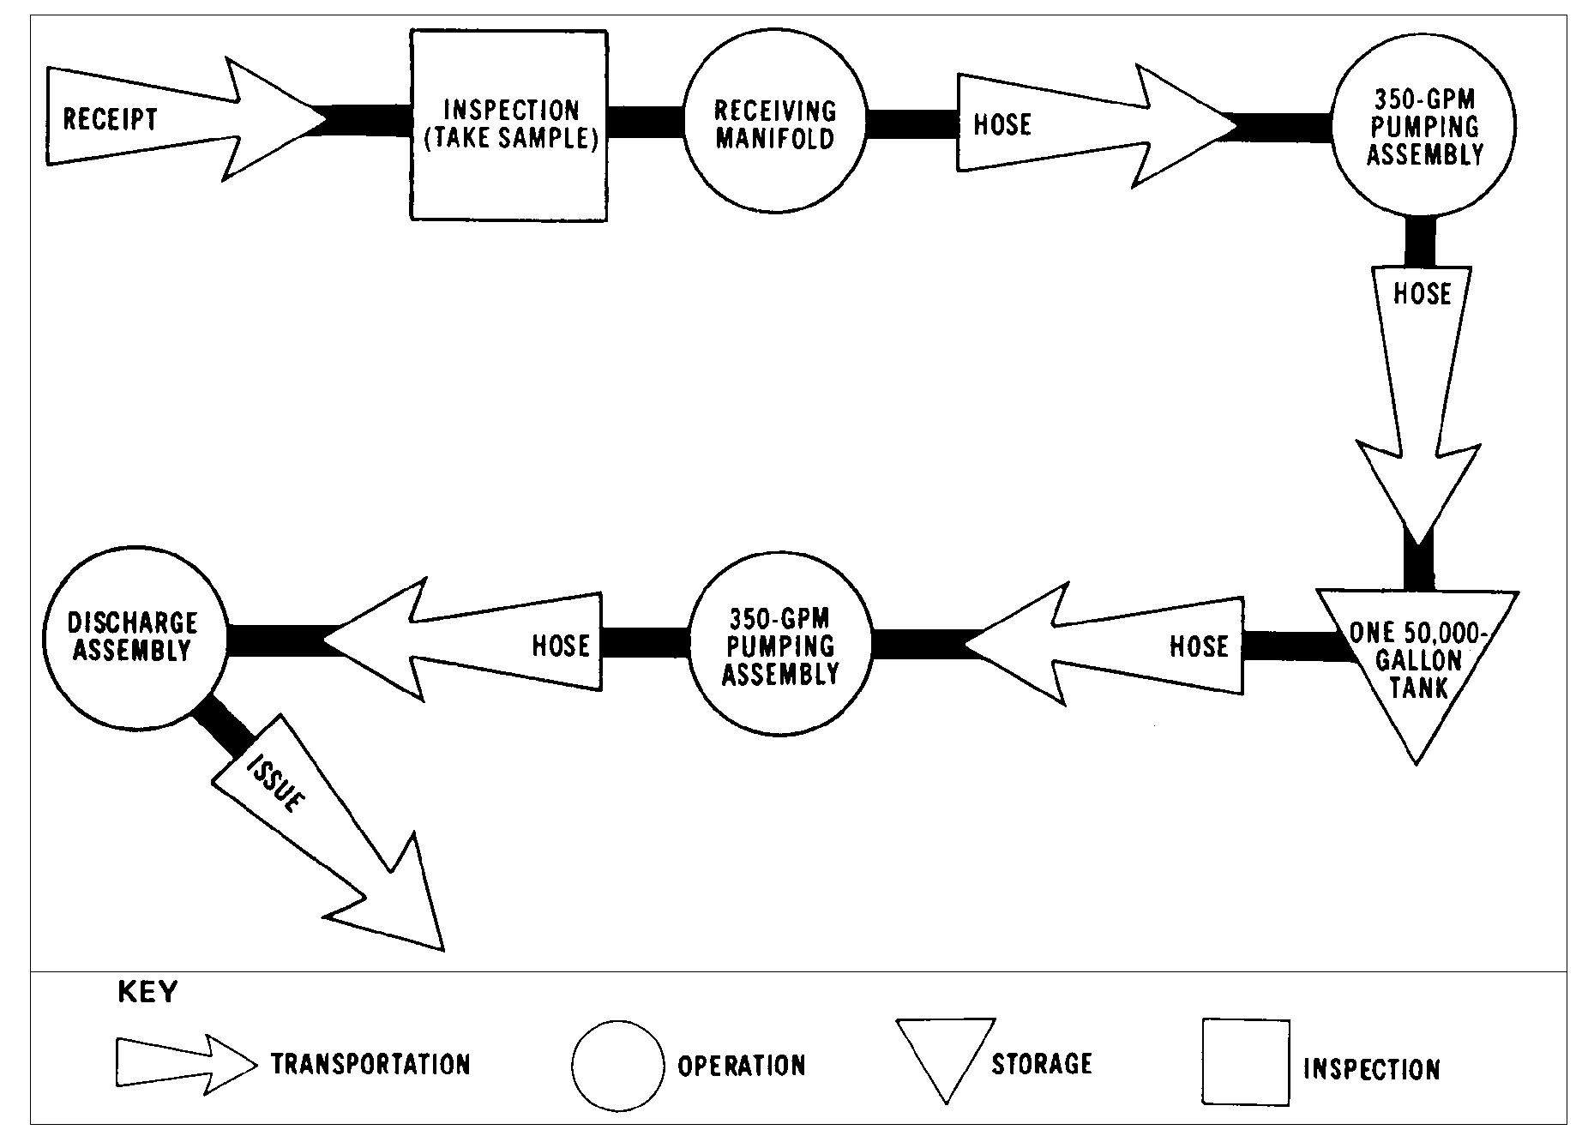

Slide 110
Personnel. How you use your personnel is one of the most important parts
of managing a Class III supply point. In other words, how many do you
need for a specific operation? Where should you place them in relation
to the equipment? What tasks should you give them to do? It is
important that you assign specific tasks to your personnel at the Class
III supply point, but you should also try to be flexible. The best way
to use all of your personnel wisely is to let the job determine the
assignment. For example, if you have no issues scheduled for the FSSP,
you can use the workers assigned there to improve the fire walls around
the collapsible tanks. On the other hand, there may be a time when the
supply point, or a section of it, is not busy. You may then use your
workers to improve the camouflage and concealment of the area, improve
drainage ditches and roadways, make sure the safety equipment is
serviceable, and do operator and organizations maintenance on the
equipment in the supply point. Although the number of persons you assign
to a specific task may vary greatly with your mission, it is still
possible to obtain an average number for each operation.

Slide 111
For a single shift, you need eight workers to operate the FSSP
efficiently. Place them at certain strategic points in the operation.
Assign two workers to the receiving manifold. They operate all valves at
the receiving point and make all necessary hose connections. Assign
three workers to the pumps and control valves. Have one worker operate
each pump, and the third worker operate the discharge and receiving
manifold of the collapsible tanks. Assign three workers to the delivery
side of the system. Make them responsible for dispensing petroleum and
12-53
QM 5099
controlling the fuel flow. When tank vehicles are filled, have the truck
driver help dispense the fuel.

Slide 112
Receipt. Before a product arrives, you should be notified of the type
and amount of product and the approximate date and time it will arrive.
This will give you time to prepare a delivery schedule to avoid delays
and interruptions at a Class III supply point.

Slide 113
Storage. At the tactical Class III supply point, you should always store
bulk petroleum in collapsible tanks. If you are in a supply section of a
petroleum supply company, you can store up to 420,000 gallons of bulk
petroleum (120,000 gallons in the FSSP and 300,000 gallons in the six
50,000 gallon collapsible tanks.) But storage is much more than putting
product in a tank. It involves such things as inspections, product
circulation, tank repair, and even the disposal of excess product. The
storage of bulk petroleum can be as dangerous as its receipt and issue,
so always follow applicable procedures

Slide 114
Inspection. Inspections are the key to finding out how well your Class
III supply point is performing. They give you first hand information on
how the equipment and products are maintained from day to day.
Inspections let you make on-the-spot corrections. They also give you
information on the availability of required publications, accuracy of
supply records and procedures, supply economy practices, care of tools
and equipment, and status of authorized stock levels of equipment and
repair parts

Slide 115
Product Consolidation and Circulation. When you consolidate or circulate
product, you simply move it from one storage tank in the supply point to
another. You should consolidate your stock so that several storage tanks
are filled with product and several are empty. This way you can be ready
to receive and issue large quantities of bulk petroleum on short notice.
You also cut down on the number of tank switches you have to make during
receipt and issue. Circulate the stock in your supply point so that the
heavier portions of the product do not settle to the bottom of the tank
and the light ends do not come to the top. Also, circulation ensures a
good mixture of all the additives in the fuel.

Slide 116
Disposal of Excess. If you are in CONUS or an overseas activity and you
have an excess in bulk or packaged fuels of 500 gallons or more per
product grade, report the excess by sending a message to the Commander,
USAPC. Include in your message the quantity, type of product, NSN, and
the latest laboratory, test results. If you are in an overseas command,
also report the excess to the appropriate DESC field office or the JPO.

Slide 117
Issue Considerations. Issuing bulk petroleum is perhaps the most
important responsibility you have at the Class III supply point. The
reason you are in the field is to get large quantities of petroleum to
the units you support. In the theater of operations, you issue liquid
petroleum in bulk as far forward as the tactical situation permits.
Usually the units you support pick up the bulk petroleum from the supply
point in their own vehicles. When you use the FSSP, make your bulk
issues from the bottom loading points. Before issuing bulk petroleum

Slide 118
from your Class III supply point, preferably before any transporters
arrive, you must prepare an issue schedule. Start by telling your
customer how much and what type of product you have on hand and when he
can pick it up. If your transporters are delivering the product, tell
the customer when it will arrive at this supply point. Try to avoid
delays and interruptions when you are scheduling issues, that is, do not
schedule more transporters to arrive at your supply point than you can
handle at one time. Also, ensure that you have enough product on hand to
fill all scheduled issues.

Slide 119
Safety and Security Items. Once your supply point is set up, you must
take steps to make sure it is safe and secure. Ensure that personnel set
up a checkpoint at the entrance and one at the exit of the operating
area. Give personnel coming to the area a safety briefing at entrance
checkpoint. Use the checkpoints not only to control the vehicles going
in and out, but also to account for the receipt and issue of petroleum in
the supply point. Develop a fire plan. You must set up many different
types of signs in the area of operation. Place stock locator signs at
petroleum storage areas, including bulk reduction storage sites. Place
signs identifying NO SMOKING areas and dangerous areas throughout the
supply point. You must also set up speed control and traffic direction
signs.

Slide 120
PART B - DEFENSE PLAN
Rear Area Protection (RAP). Rear area protection operations may be
defined as all actions taken to prevent or neutralize localized enemy
threats to units, activities, and installations in the rear area. It
includes area damage control (ADC) prevention and control measures which
are taken before, during, and after an attack or natural disaster to
minimize its effects. Together, these actions represent an added
dimension to the responsibilities of theater army area command (TAACOM),
corps support command (COSCOM), and division support command (DISCOM)
commanders. Thus, combat service support units may have to be diverted
temporarily from their primary missions to rear area protection tasks
such as local security, base defense, firefighting, decontamination,
emergency medical treatment, and traffic control. The commander
responsible for rear area protection operations determines the manner and
extent to which these units will be diverted

Slide 121
The theater army commander has overall responsibility for RAP
operations within the COMMZ. In the corps, the deputy corps commander is
the RAP officer who directs the rear area battle. To assist these
individuals in defining and assigning RAP responsibilities, a rear area
operations center (RAOC) is assigned to each TAACOM, area support group,
and corps. The RAOC’s mission is to plan, coordinate, advise, monitor,
and assist in directing the execution of the rear area battle. Petroleum
units interface with the RAOC

Slide 122
Phases. Rear area protection may be divided into two phases -- the
preparation phase and the operational phase.
The preparation phase includes preventative readiness measures taken
before an enemy attack. These operations range from the initial planning
to the actual reconnaissance, surveillance, and counterintelligence
operations. Measures taken during this phase include establishing local
12-55
QM 5099
security elements; organizing, equipping, and training units specifically
designed for these missions; assigning area responsibilities; and
establishing communications and warning systems. SOPs are written and
rehearsed, and route patrolling and convoy escorting are carried out.

Slide 123
The operational phase includes measures taken during or after an
attack or a natural disaster. These actions begin when an incident
occurs and include units sending reports to the commander concerned on
the nature and extent of the damage. These reports allow for necessary
estimates and orders for establishing route clearances and redirecting
supply flow. Thus, interruption of support to combat forces is reduced.
Combat forces receive data in time to change priorities and tactical
plans if needed. Fire prevention and firefighting actions are conducted.
Salvage and search and recovery operations begin on order. Traffic and
personnel movement controls are established. If necessary, nuclear,
biological, chemical (NBC) decontamination is begun. Emergency supplies
are distributed, and communications are reestablish

Slide 124
Petroleum Group. The extent to which the petroleum group becomes
involved in rear area protection is prescribed by higher authority. The
group and its units stand ready to participate in these operations as
directed. Consequently, the group security officer stays in close
contact with the RAOC. The group security officer also supervises
development of petroleum group rear area protection plans and procedures.
He directs implementation of plans and procedures by subordinate
elements

Slide 125
Protection of Petroleum Supplies. Protective measures for petroleum
supplies include special packaging, proper storage, and dispersion of
supplies and installations. Protection against chemical contamination
and nuclear fallout, and maximum use of natural and artificial protective
shelters or other shielding devices. Every advantage is taken of natural
cover and camouflage for pipelines located above ground. Underground
pipelines are use whenever possible. Embankments and underground storage
facilities can be effectively used to reduce blast damage. Dispersion of
packaged supplies limits and keeps under control fires that start as a
result of a nuclear explosions. Care is taken to keep combustible
materials to a minimum in and around petroleum supply installations

Slide 126
Demolition. Demolition is a command responsibility. It is performed
only as a last resort and only to prevent supplies and equipment from
falling into enemy hands. Except in emergencies, demolition is performed
only on orders from higher headquarters. Unless otherwise specified,
petroleum stocks are destroyed by burning

Slide 127
PART C - ENVIRONMENTAL CONSIDERATIONS
Supply and storage facilities often contain HM. You must ensure that
personnel take precautions when storing and transporting these materials.
Keep a copy of the applicable MSDS for each HM on hand in a binder in the
storage area. You can support your installation’s environmental goals in
supply areas by doing the following:
•  Compliance. Store materials according to the manufacturer’s
guidelines, as stated on the MSDS.

Slide 128
•  Prevention. Reduce the amount of solid wastes and HW in the supply
room by avoiding stockpiling or keeping items around “just in case
they are needed.” Reuse containers whenever possible. Recycle
materials as required by your installation’s recycling program.
•  Conservation. Dispose of all solid wastes and HW according to local
polic

Slide 129
PART D - PREVENTIVE MAINTENANCE CHECKS AND SERVICES (PMCS)
Emergency Tank Repair. If any of the collapsible tanks develop a leak,
repair them at once with emergency repair items. There are two methods
of repair: one uses sealing plugs and one uses sealing clamps. The one
you use depends on the size of the rupture. Use a sealing plug if the
hole in the tank is 3/8 of an inch or smaller. Use a sealing clamp if
the hole is larger than 3/8 of an inch. Whatever method you use, ensure
you put on rubber gloves and the protective hood before starting the
repair operation.

Slide 130
Forms. During operation of the FSSP, operator maintenance is performed
on pumps, filter/separators, and related equipment. Forms are prepared
to schedule inspections and preventive maintenance and to record the
results of inspections and the need for repairs. They are also used to
report preventative maintenance performed, to note repairs made, and to
request services of support maintenance. In addition, forms are used to
keep track of the time equipment is in use or out of service, and to
provide data for reports on the condition and status of equipment.

Slide 131
•  DD Form 314 (Preventive Maintenance Schedule and Record) is used to
show when equipment is scheduled for periodic preventive maintenance
and when maintenance has been performed.
•  DA Form 2404 (Equipment Maintenance Schedule and Report) is used to
report faults or malfunctions discovered by an equipment operator.
•  DA Form 2407 (Maintenance Request) is used by organizational
maintenance personnel mainly to request support maintenance.
•  DA Form 2409 (Equipment Maintenance Log (consolidated)) is used to
keep a complete maintenance history on a piece of equipment.
•  DA Form 4177 (Utilities Inspection and Service Record) is used to
schedule inspections and preventive maintenance on a fixed utility or
structure such as a storage tank

Slide 133
LESSON 6
DIRECT ASSAULT HOSELINE OPERATIONS
Critical Task:
101-519-3315

Slide 134
INTRODUCTION
The assault hoseline system is intended to be used as a temporary
pipeline and can transport fuel at a maximum rate of 500 to 550 barrels
per hour across 10 miles of flat terrain. The use of the assault
hoseline for transportation of bulk petroleum has become increasingly
important as an expedient means of providing adequate quantities of bulk
petroleum in the shortest time possible.

Slide 135
PART A - THE ASSAULT HOSELINE SYSTEM
Six soldiers and the following equipment are needed to lay out and
assemble the hose line:
•  Thirteen flaking boxes.
•  One 350-gallon-per-minute (GPM) pumping assembly.
•  A flow control kit.
•  Ten steel roadway crossing guards.
•  A hose suspension kit.
•  A hoseline displacement and evacuation kit.
•  A hoseline packing kit.
•  A hose repair kit.

Slide 136
PART B - SAFETY AND ENVIRONMENTAL CONSIDERATIONS
Prior to the start of the mission, the troops must be briefed on any
safety or environmental hazards they may encounter. The briefing should
include the proper response to such hazards and other information which
will enable them to correctly address less serious infractions
independently. Each mission encompasses different situations and unit
interactions so you need to develop a mission-specific briefing for each;
therefore no one solution can or will be presented in this lesson. If
your experience does not afford you a basis for preparing a briefing,
contact a supervisor for additional information

Slide 137
PART C - SUPERVISING THE LAYOUT, ASSEMBLY, AND TESTING OF
THE ASSAULT HOSELINE
Choosing a Route. Select a direct route which is free of obstacles. If possible, try to parallel an existing
road to aid construction, operation, and security. A route parallel to a secondary all-weather road is better
than a heavily traveled main supply route. Take advantage of natural cover such as fencelines, woods, and
hedgerows. However, do not disturb the natural cover by grading or leveling. Try to avoid rocky areas which
might damage the hose

Slide 138
It is possible to distribute the hose at speeds up to 35 MPH. However, the recommended maximum
speed is 20 MPH. As the hose is distributed, men spread out along the route (at least two each 1/4 mile),
walk the line to straighten out undesirable kinks or bends, and remove small obstructions which might cause
damage when the hose is pressurized. When distributed on a road, the hose must be picked up from the
roadway itself and moved to a position in the road ditch (Figure 6-1).

Slide 139
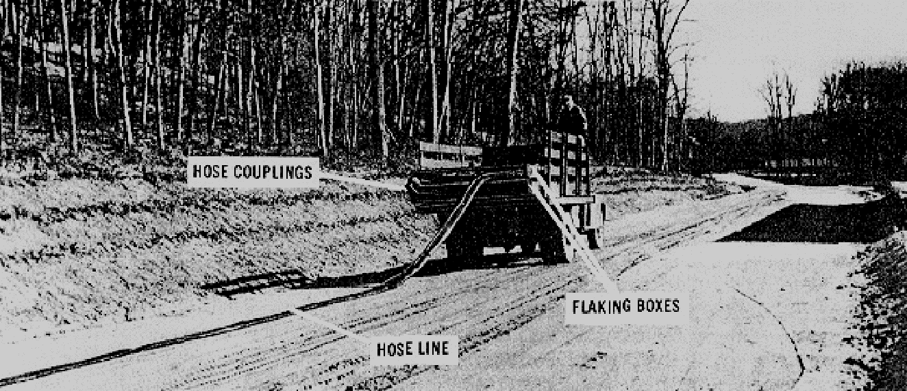

Slide 140
Crossing Streams. There are several ways you can ensure that personnel lay the hoseline across a
stream or water course. If there is a bridge, suspend the hoseline on improvised brackets outside the bridge
railing. If there is no bridge, personnel may lay the hoseline directly in the streambed if it is narrow and not
apt to flood. Use the hoseline suspension kit to cross a wide stream. Fabric saddles, with eyes for easy wire
attachment, come with the kit.
Crossing Gaps. Personnel should also use the hoseline suspension kit to span small gaps with steep
sides. For a wide crossing, ensure that personnel build a suspension bridge with a flat deck or floor to hold
the hose. This eliminates the sags that occur when the suspension kit is used.

Slide 141
Crossing Roads. To cross a highway or railroad, run the hoseline under a bridge or through a culvert, if
possible. Personnel can pull the hoseline through the culvert with a rope or push it through with a piece of
lumber or a small-diameter pipe. If there is no bridge, ensure that personnel install the roadway crossing
guard to protect the hoseline. Never bury unprotected hoseline in a railbed. When crossing a railbed,
personnel can either install a piece of heavy wall pipe in a shallow ditch under the rails or suspend the hose
over the railbed at a suitable height. As soon as possible, replace the hoseline at a railway crossing with
welded pipeline because of the fire hazards caused by trains.

Slide 142
Pumping Stations. Assault hoseline pumping stations have one 350-GPM pumping assembly. If you
are using only one hoseline outfit, ensure that personnel place the pumping assembly at the beginning of the
hoseline system. Because this pump does not have a pressure-regulating device, you must monitor it at all
times for changes in hoseline pressure. Personnel must set up pumping stations when they connect hoseline
outfits together. There is a formula you can use to locate pumping stations on level ground using motor
gasoline in the hoseline. If you use a product other than motor gasoline, the distance between pumping
stations (given by this formula) changes. For example, if you use a product heavier than motor gasoline, the
pumping stations should be closer together. If the product you use is lighter than motor gasoline, the
pumping stations should be further apart. The distance between pumping stations (given by this formula) also
changes with the height of the terrain. For example, if you place the hoseline on an uphill slope, the pumping
stations should be closer together. If you place the hoseline on a downhill slope, the pumping stations should
be farther apart.

Slide 143
Hoseline Testing. Once personnel have set up the assault hoseline, they should fill it, pressurize it, and
check the hoseline for leaks. Ensure that personnel start the pumps slowly and raise the fluid pressure in the
system gradually in increments of 50 PSI. Ensure that personnel hold the pressure each time they raise it,
and inspect the hoseline for leaks. Keep doing this up to and including 150 PSI. Even though the design
12-61
QM 5099
burst pressure of the hose is higher, your test should not exceed the rated safe-working pressure of 150 PSI.
If the line pressure doesn’t build up, personnel should stop and check the hoseline for a leak. Personnel can
usually fix leaks at couplings, fittings, or valves by tightening, adjusting, or replacing gaskets.
Observe operations for safety and environmental infractions. Immediately shut down operations and
correct any problems detected

Slide 144
PART D - SUPERVISING THE EVACUATION AND DISPLACEMENT OF
THE ASSAULT HOSELINE
Removing fuel, vapor, and air from the hoseline causes the hoseline to collapse into a flat ribbon-like form.
This allows for the most compact storage of the hose for transportation to the next site. The hoseline is
evacuated by personnel as follows:
•  Remove the ball from the ball receiver; replace with an airtight cap (use a blank cap with grooved
coupling).
•  On the inlet end, disconnect the compressor hose from the ball injector.
•  Attach the suction connection of the air eductor.
•  Attach the air compressor hose to the inlet side of the eductor, and set the pressure at 20 to 25 PSI.
•  Operate the eductor approximately 10 minutes for each 1,000 feet of hoseline.
•  When the hose has flattened as much as possible, fold it back and tie a knot.
•  Remove the ball injector and eductor

Slide 145
When displacing the assault hoseline, ensure that personnel pack the hose
into the flaking box making successive folds from left to right until you
reach the front. Ensure that personnel bend the hose so that it fills
the entire width of the box. Also, make sure the folds are packed
tightly together so that you can get 1,000 feet of hose in the box. If
the temperature is below 40 degrees Fahrenheit, personnel may have to use
the hoseline packing kit to get the hose in the flaking box.

Slide 146
PART E - MAINTAINING COMMUNICATIONS
Communication breakdown is the single non-equipment-related item which
can start a domino effect capable of bringing an entire mission literally
to a halt. A missed communication regarding the emergency shutdown of
the assault hoseline could leave a FSSP or FARE system without a source
of fuel and strand dozens of aircraft and vehicles miles from a secondary
source of fuel. The vulnerability of such vehicles and the loss of them
to the enemy cannot be overstated. Accurate and timely communications
with all levels of the supply team and command headquarters is imperative
for the success of any mission requiring the use of the FSSP, FARE, and
assault hoseline.

Slide 147
An efficient communication system is a must for the operation and
maintenance of military pipelines. The system must be separate,
continuous, and dependable. The communications system must have highquality
transmission to keep errors to a minimum, enough channels or
circuits to carry the traffic load efficiently, prompt connections to
avoid delays, and immediate alternate systems so there will be no
interruptions in pipeline operations.

Slide 148
LESSON 7
DIRECT THE ASSEMBLY, OPERATION, PMCS, AND DISASSEMBLY OF THE FORWARD AREA
REFUELING EQUIPMENT (FARE)
Critical Tasks:
101-519-3215
101-519-3317

Slide 149
INTRODUCTION
Unit-level refueling operations in theaters of operation are usually
carried out by individual aviation units. A lightweight, airtransportable,
refueling system is used at the unit level. At present,
the system authorized to most units that have the mission to refuel
aircraft in forward areas is the Forward Area Refueling Equipment (FARE)
system. This system can be set up by skilled personnel with 15 minutes
of delivery to a site.

Slide 150
The FARE system is designed for refueling helicopters in forward
areas. It is lightweight and can be flown to the refueling point by
helicopter or fixed wing aircraft. The fuel for the system is usually
flown to the site in 500-gallon collapsible drums. The FARE system can
also use various size collapsible tanks, tank vehicles, or semitrailers
as fuel sources.

Slide 151
PART A - FARE COMPONENTS
Components. The FARE system consists of a pumping assembly,
filter/separator, and valves and fittings.
Pumping Assembly. The pumping assembly is made up of a 100 GPM
centrifugal pump and a two-cylinder, four-cycle, 3-horsepower gasoline
engine that powers the pump. The inlet and outlet connections are 2
inches in diameter. The pump has a priming port on the top of the pump
casing. The pumping assembly and the engine’s fuel tank are all housed
in a tubular aluminum frame.

Slide 152
Filter/Separator. The 100 GPM filter/separator is an aluminum tank
with a removable cover. Five filter elements, each in a canister, are
set in mounting plate near the bottom of the tank. The filter/separator
has an air vent valve, a pressure differential indicator, a water sight
glass, and a water drain valve that is turned by hand. The flow rate of
the filter/separator is 100 GPM, and its top working pressure is 75 PSI.
The filter/separator is mounted in a frame of tubular aluminum.

Slide 153
Discharge hose, suction hose and fittings. The FARE system has two
sets of discharge hose, fittings, and nozzles. Each set is mounted in a
tubular frame. Two canvas carrying cases hold the suction hose and their
fittings.
Fire extinguishers are not components of the FARE system. Providing
the extinguishers is a command responsibility. Three fire extinguishers
are required for each FARE system used in aircraft refueling--one to be
within reach of the pump operator and one for use at each nozzle. The
recommended fire extinguisher is the 20-pound Halon 1211

Slide 154
No fuel source is provided as a component of the FARE system.
Generally, 500-gallon collapsible drums are used because they can be
airlifted, full, to the FARE point. But the FARE system can also be
adapted to use larger fuel reservoirs. The number of drums and tanks, as
well as the type of fuel to be used, is determined by the number and type
of aircraft the FARE point is to support

Slide 155
PART B- FARE LAYOUT
Planning. The S3 of the aviation battalion or the operations officer of an aviation company plans the unit
operations. As part of these plans, he chooses the general area for a refueling point and specifies the
12-65
QM 5099
amount and type of refueling support needed. He or a pathfinder team must choose a site that has enough
open ground for the aircraft to land and lift off safely. The site must be flat or have only a slight grade. When
planning the layout of a FARE system, five factors must be considered

Slide 156
•  Spacing Between Aircraft: There must be at least 100 feet of space between these aircraft (center rotor
to center rotor).
•  Wind Direction: Ensure that personnel lay out the FARE system so that the helicopter can land, refuel,
and take off into direct head wind or a left or right quartering head wind.
•  Vapor Collection: By laying out the system at right angles to the wind for helicopter landing and takeoff,
the wind will carry the fuel vapors away from the site.
•  Drainage: Ensure that personnel do not put the equipment in a place where a spill will drain into a stream
or river. Choose a part of the site that is firm enough to support the weight of the aircraft and the fuel
drums.
•  Camouflage: Camouflage is the only protection at a FARE point in a combat zone. Site features are
depended upon because airlifting in camouflage materials is not practical

Slide 157
Site Preparation. All sticks, stones, and debris should be cleared from the area. To prevent fires, ensure
that personnel clear dry grass, leaves, and brush away from the pumping assembly. In some cases, engineer
personnel prepare the site.

Slide 158
Layout. Once all equipment is on-site, ensure that personnel layout the FARE system in the way that is best
for the specific situation. Tailor the layout to avoid obstacles, take advantage of terrain features, achieve
maximum dispersion, and operate with a restricted amount of space. The only mandatory feature of the
FARE system is the spacing between the aircraft (Figure 7-1).
•  Position pump and filter/separator.
•  Ground pump and filter/separator.
•  Assemble discharge hose.
•  Assemble discharge hose.
•  Assemble dispensing points.
•  Connect to two 500-gallon collapsible drums.
•  Position fire extinguishers.

Slide 159
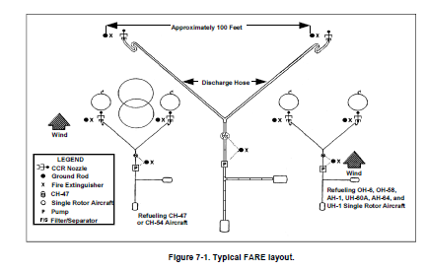

Slide 160
PART C - QUALITY SURVEILLANCE
The quality and cleanliness of turbine fuel are vital to the safety of turbine-engine-powered aircraft. Turbine
engines have more stringent cleanliness requirements than do reciprocating engines. Because turbine
engines have high fuel consumption rates, contaminants accumulate in them rapidly. Turbine engine filters
cannot remove fine sediment, excess amounts of sediment, or water from the fuel. Separating the
contaminants from JP-5 and JP-8 is time-consuming and further complicated by their high viscosity and
specific gravity. Any unit or organization that has military-owned aviation fuel in its physical possession is
responsible for establishing and maintaining an adequate quality surveillance program. Each person involved
in aircraft refueling is responsible for ensuring that the fuel pumped into an aircraft is clean, bright, on
specification, and does not contain any free water or sediment.

Slide 161
Quality surveillance testing and sampling are used to find common contamination hazards. The hazards
that may affect aircraft are sediment, water, microbiological growth, and commingled fuel. Since each aircraft
engine is designed to burn one particular type and grade of fuel, the consequences of using a mixture of
different fuels can range from small variations in engine performance to total loss of power and engine failure.
The consequences of commingling depend on the physical properties of the fuel.

Slide 162
Sampling and Testing. How often aviation fuels are sampled and tested depends on several factors. It
depends upon whether the fuel is taken from a fuel source, a system or refueler, or an aircraft tank. Fuel
supplies must be tested to confirm their identities (API gravity test) and detect water (Aqua-Glo test) and
particulate contaminant by color comparator ratings. Samples of fuel to be dispensed to aircraft should
contain no more than 10 fibers when a 1-quart sample is visually examined. The aviation fuel contamination
test kit is designed to provide a final check on aviation fuel just before the fueling of an aircraft. It includes the
API gravity test, the Aqua-Glo test, and the Millipore test (a test for particulate contaminants). Fuel in aircraft
tanks must be checked by the aircraft crew before flight operations begin. Taking a preflight sample is the
only way of ensuring that the fuel on board does not contain water or other visible contaminants. Any fuel that
fails a visual check should be segregated and held until laboratory test results are received. To check a fuel,
choose a clean sample bottle, draw a fresh sample, visually inspect it, and test it for debris, foreign matter, or
water. Laboratory testing ensures that the fuel’s quality meets specifications, unknown products and existing
12-67
QM 5099
or potential contaminating causes are identified, unfavorable field test results are corroborated, and offspecification
fuels are not used.

Slide 163
PART D - MAINTAINING COMMUNICATIONS
Communication is the single non-equipment-related item which can enable the FARE site to be a major factor
in the successful mission. This communication is multi-level. Unless otherwise directed, you are responsible
for informing the chain of command of the following:
•  When the site becomes operational.
•  When the site is shut down for any reason before the scheduled shutdown time.
•  Report status of operations and any problems encountered as required by unit policy and procedures.
•  When the site is shut down as indicated in the operations orders

Slide 164
PART E - SUPERVISING THE OPERATION OF THE FARE
The FARE system should be primed and ready for operation as soon as it is
laid out and the fuel has been sampled. There should be at least three
people in addition to the ATC or pathfinder present during refueling
operations. At least two of these people should hold MOS 77F. The
proper procedure for refueling an aircraft are as follows:
•  Land aircraft. Check to see that the armaments aboard the aircraft
have been set to SAFE.
•  Deplane crew and passengers. Only the pilot may remain in the
aircraft during refueling. If required, a crew member may assist with
the refueling by manning the fire extinguisher.

Slide 165
•  Position fire extinguisher on the side of the aircraft by the fill
port.
•  Turn off radios. The pilot may monitor the radio used for air traffic
control but must not transmit while actual refueling is taking place.
The pilot and crew chief may talk by intercom during refueling.
•  Ground and bound the nozzle to the aircraft. It should never be
attached to the radio antenna or to a propeller.
•  Remove dust cap from the nozzle and remove the plug from the aircraft
fill port.

Slide 166
•  Begin refueling. Be certain to observe the safety precautions
associated with closed-circuit or open-port refueling, as the case may
be.
•  Replace aircraft fill port plug, and replace nozzle caps/plugs.
•  Remove nozzle bond. Carry the nozzle back to its hanger.
•  Remove fire extinguisher.
•  Board crew and passengers.
•  Direct aircraft to lift-o

Slide 167
procedures and render status reports as required by unit policy. If any
leaks or hazardous conditions are found the system must be shut down and
the problem corrected before resuming operations. All spills must be
cleaned up and reported as required by unit policies and procedures and
applicable environmental laws. Dispose of contaminated fuel and
materials in an environmentally safe way in accordance with unit policies
and procedures and applicable environmental laws. You must also ensure
that during and after PMCS are done and that DA Form 2404 or DA Form
5988-E is annotated with any faults or deficiencies found. The completed
DA Form 2404 or DA Form 5988-E is returned to the motor pool with the
equipment.

Slide 168
PART F - SAFETY
Switch Fueling. Switch fueling means supplying an aircraft with fuel
that has flammability characteristics different from that which is
already in the tank. The flammability characteristics of the mixed fuel
will be different from the two fuels involved. The danger is that if a
spark should occur in the tank, the vapor-air mixture above the fuel may
be in the flammable range and an explosion could result. If an aircraft
is to be switch fueled, the rate of flow at the nozzle should not exceed
50 percent of the rated flow. Changing to JP-4 after using a kerosenegrade
fuel also constitutes switch fueling

Slide 169
Heat. Aircraft, vehicles, and engine powered equipment generate heat by
burning fuel. They also generate static electricity because of friction
between moving parts. The engine heat of an idling aircraft turbine
engine is in the auto-ignition range of JP-4. Poorly maintained vehicle
engines may backfire or discharge sparks. Do not allow any work to be
done on an aircraft’s batteries while the aircraft is being refueled.
Aircraft radios may operate to receive messages during refueling, but
radio transmissions from the aircraft are not allowed because of the
danger from arcing. Do not use flashlights within 50 feet of the
refueling operation unless they are approved explosion-proof type. Do
not allow electric handtools to be used in the refueling area. The
electric circuits of tools used in refueling operations must be
maintained in top condition to prevent short circuits around defects.
And in addition, the beam of high-frequency radar equipment can ignite a
flammable vapor-air mixture

Slide 170
Open Flame. The danger of an open flame is that it will ignite fuel or
a flammable vapor-air mixture. Do not allow any type of open flame, or
any flame-producing device within 50 feet of an aircraft refueling
operation.

Slide 171
Static Electricity. There are two ways to prevent static electricity from
sparking. The charges on different materials can be equalized by
connecting them with a conductor (bonding). Also, a way can be provided
for the charges to dissipate harmlessly (grounding). The Army uses both
of these methods to control static electricity.
Bonding is the process through which two conductive objects are connected
to lessen their potential differences. Bonding does not dissipate the
static electricity. It equalizes the charges on two unlike objects (an
aircraft and a refueling nozzle) in order to preclude arcing as the two
objects are joined. A nozzle-to-aircraft bond is required. This bond is
made before the nozzle dust cap or fuel tank cap is removed. Likewise,
do not disconnect the bond until refueling is complete and the fuel tank
cap and nozzle dust cap are replaced.

Slide 172
Grounding is the process that provides a conductive path into the
ground so that a static charge is not trapped on the surface of the
equipment where it can discharge as a spark. This conductive path is
made by connecting a conductive cable from the piece of equipment to a
conductive metal rod that is driven into the earth to reach the level of
permanent moisture. Common sources of static electricity are identified
as follows:
•  Vehicles
•  Human body
•  Lightning

Slide 173
Air Traffic Control. Air traffic control (ATC) is required for safe
refueling operations. An air traffic controller or some other adequately
trained person is required at each refueling point that serves more than
one aircraft. This person controls and directs refueling traffic and
resupply aircraft. He provides flight personnel with information such as
wind direction and velocity, remaining fuel supply, enemy activity in the
immediate area, hazards or obstructions to landing, and emergency
situations. At a fixed airfield, full radio communication equipment is
provided for controlling air traffic. At a large semipermanent or
temporary refueling point a radio control tower should be used whenever
aircraft are being refueled. In forward areas, personnel controlling air
traffic should have FM radio suitable for ground-to-air or ground-toground
communication. Aircraft marshaling signals and landing aids are
necessary at semi-permanent and forward refueling points. In marking
landing and refueling areas in the field, procedural principles should
be followed closely especially in forward tactical areas

Slide 174
PART G - ENVIRONMENTAL CONSIDERATIONS
You must pay close attention during refueling operations because of the
potential for spills and fires. If you take simple precautions you will
prevent large pollution problems. During refueling you can protect the
environment by doing the following:
•  Compliance. Follow your unit SOP concerning the types and quantities
of items you can store at a fuel point.
•  Prevention. Reduce the amount of soil contaminated during refueling
by being careful not to spill fuel. Reuse rags and absorbent
materials. Recycle used or contaminated petroleum, oil, and lubricant
(POL) products.
•  Conservation. Dispose of contaminated soil and absorbents according
to the installation’s policy and the unit’s SOP.

Slide 175
LESSON 8
INLAND PETROLEUM DISTRIBUTION SYSTEM
Critical Task:
101-519-4310

Slide 176
INTRODUCTION
Since the days of World War II, petroleum NCOs have grappled with the
challenges of moving fuel to the front lines of battle quickly and
efficiently. Today’s NCOs now have an advantage over their predecessors
because they accomplish the task with the Army’s inland petroleum
distribution system (IPDS). The IPDS is the Army’s primary method of
receiving, storing, and distributing bulk fuel to support military forces
deployed in worldwide contingency operations. The system consists of both
commercial and military petroleum equipment made up of three primary
subsystems: the tactical petroleum terminal (TPT), pipeline components,
and pump stations. By successfully integrating these elements, troops can
move fuel from any source forward into the theater of operations

Slide 177
PART A - COMPONENTS
Inland Petroleum Distribution System (IPDS) is designed as a lightweight,
rapidly deployable pipeline and terminal system that can be used in
undeveloped and developed theaters of operation. It can interface with an
existing host nation fuel source, such as a refinery, or with the Navy’s
Offshore Petroleum Discharge System (OPDS). The Navy is responsible for
delivery of petroleum from offshore tankers to the high water mark. The
system is modular in design and can be tailored for any locality or
operation.

Slide 178
Pipeline. The pipeline is configured in 5-mile pipeline sets. There are
1,404 sections of 19-foot long IPDS single grooved, aluminum pipe with
coupling clamps and gaskets. Pipes are packed in nine 20-foot ISO
containers with 156 sections of pipe per container. An allotment of
elbows and coupling clamps for directional changes, expansion/contraction
devices, and a supply of gate valves, check valves, vent assemblies,
pipeline anchors, culverts, overcouplings, and repair clamps are packed
in four additional containers.

Slide 179
•  19-foot aluminum pipe sections (Figure 8-1). Used in the main run of
the pipeline. The pipes vary in thickness from 0.404 inches to 0.188
inches and are used over long distances. They cannot be cut to
different lengths due to the varying wall thickness, but each end may
be regrooved once if damaged.
•  9.5-foot aluminum pipe nipples (Figure 8-1). There are 44 pipe
sections in each 5-mile set and 10 sections with each pump station. As
they are of a constant wall thickness (0.404``), they can be cut to
any length required and regrooved using the cutting and grooving tool
furnished. They are used to close short gaps in the pipeline. Each
section has a black line down the length for easy identification of
nipple material

Slide 180
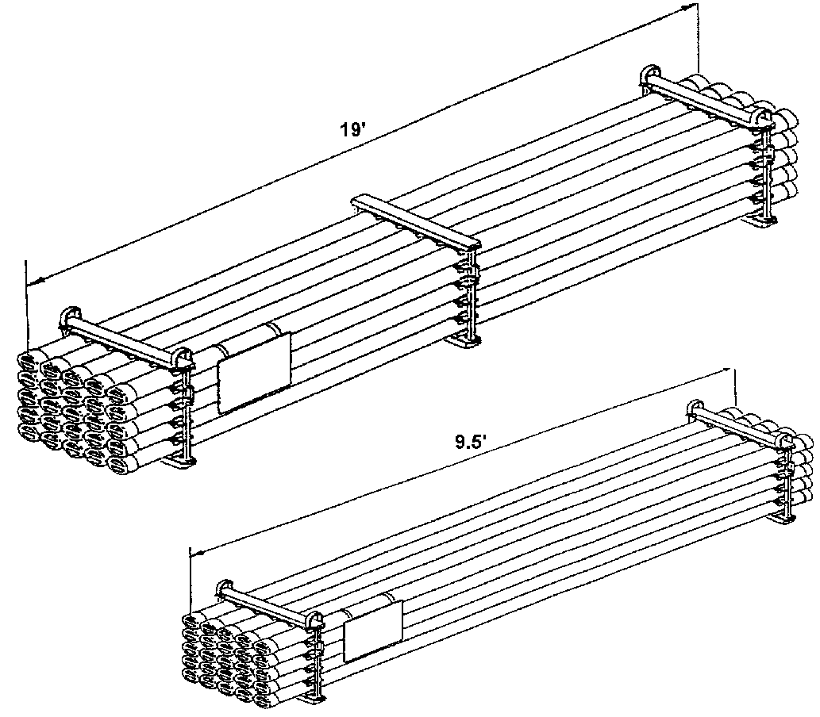

Slide 181
Pump stations. Each pump station has two skid-mounted, diesel engine
driven (three stage centrifugal) mainline pumps, with an operational
output of 800 GPM at 1,800 feet of head, at 2,100 rpm (Figure 8-2). Only
one is operated at a time. Launcher and receiver assemblies, a dual inline
strainer assembly located on the incoming side of the station, and a
flood light set are also components of pump stations. Except for the
mainline pumps, all pump station equipment will be stored in four 20-foot
ISO containers.

Slide 182
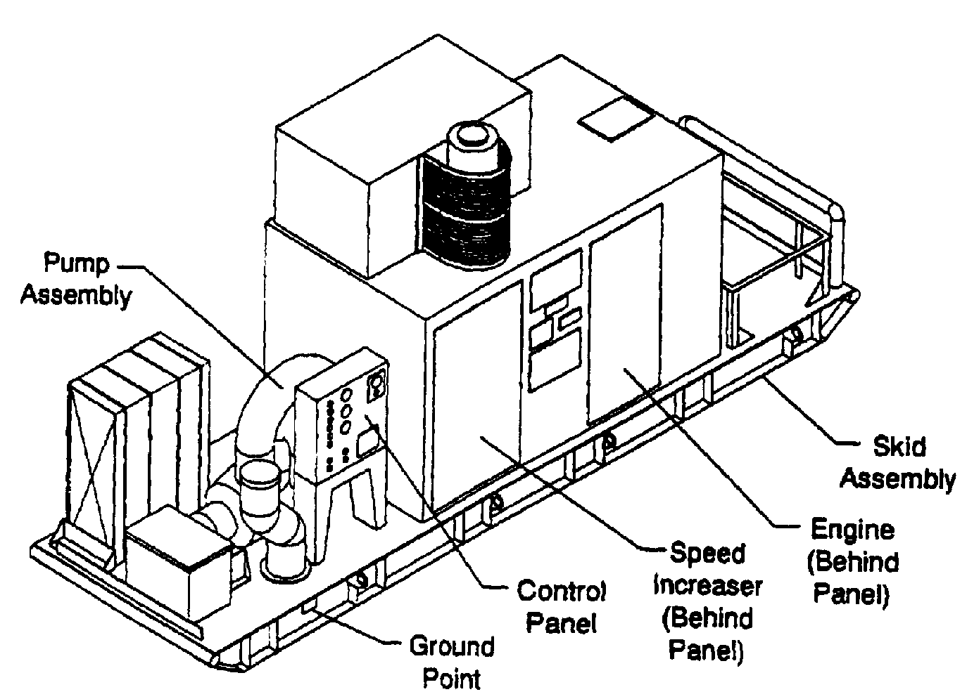

Slide 183
Tactical Petroleum Terminal (TPT). The mission of the TPT is to
receive, store, and dispense liquid fuel, specifically diesel, motor
gasoline, and aviation jet fuel (Figure 8-3). It serves as a base
terminal in an undeveloped theater and can be used in the developed
theater to supplement existing facilities that are inadequate or damaged.
The TPT was designed to operate at a maximum allowable operating pressure
of 150 psi. The standard TPT has a storage capacity of 3,700,000 gallons
in eighteen 5,000-barrel (210,000 gallons) collapsible fabric tanks. The
TPT is modular with three identical fuel units. Each TPT also has one
pipeline connection assembly. The total TPT is stored in 77 ISO
containers.

Slide 184
The fuel unit consists of three tank farm assemblies, with two 5,000-
barrel fabric tanks each, a tanker-truck receipt manifold, a fuel
dispensing assembly, a transfer hoseline assembly, six fire suppression
assemblies, a 50,000-gallon optional tank configuration, and a fuel unit
support assembly. A total of 24 ISO containers are used to store one fuel
unit (min 600’ between units).
•  Tank farm assembly. Consists of two 5,000-bbl fabric tanks, a
hoseline pump, and associated hose, valves and fittings; a total of
three containers for each assembly (at least 400 feet between
assemblies).

Slide 185
•  Tanker-truck receipt manifold. Consists of a hoseline pump and
associated equipment to provide four defueling stations. It is used to
receive fuel from fuel tanker-trucks (two containers).
•  Fuel dispensing assembly. Dispenses fuel directly to user’s bulk fuel
transporters and to 500-gallon collapsible drums. There are six
stations for trucks and two for drums (one container).
•  Transfer hoseline assembly. Is used to connect the tank f

Slide 186
•  Transfer hoseline assembly. Is used to connect the tank farm
assemblies, switching manifold, fuel dispensing assembly, and tankertruck
receipt manifold into an operational TPT. There are four
transfer hoseline assemblies in a TPT, one in each fuel unit and one
in the pipeline connection assembly. Each assembly has fifteen 500-
foot by 6-inch hoselines packed in three Tricons (5 hoses per Tricon)
to tie the major components into a total system (one ISO container
equivalency).
•  Fire suppression assembly. The main component is the wheel mounted
fire extinguisher. Skid mounted on a two wheeled trailer, the system
is designed to apply the dry chemical (Purple K) until fire is under
control and then apply the aqueous film forming foam (AFFF) creating a
blanketing effect. The chemical should continue to be applied with the
AFFF until the solution is exhausted or until there are no existing
smoldering pockets remaining that could cause reignition (one
container for each of the six assemblies)

Slide 187
•  50,000-gallon tank option. Consists of two 50,000-gallon collapsible
fabric tanks, one transfer pump (350 GPM) and one 350 GPM filter
separator. This option gives the commander an additional 100,000
gallons of storage space to use as the situation dictates (total
option is stored in one container).
12-75
QM 5099
The fuel unit support assembly consists of the fuel unit’s interim
support item list (ISIL), two floodlight sets, one displacement and
evacuation kit, one hoseline suspension kit, two hoseline installation
and repair kits, and a spare hoseline pump (600 GPM) (four containers to
store the assembly).

Slide 188
•  50,000-gallon tank option. Consists of two 50,000-gallon collapsible
fabric tanks, one transfer pump (350 GPM) and one 350 GPM filter
separator. This option gives the commander an additional 100,000
gallons of storage space to use as the situation dictates (total
option is stored in one container).
12-75
QM 5099
The fuel unit support assembly consists of the fuel unit’s interim
support item list (ISIL), two floodlight sets, one displacement and
evacuation kit, one hoseline suspension kit, two hoseline installation
and repair kits, and a spare hoseline pump (600 GPM) (four containers to
store the assembly).

Slide 189
The displacement and evacuation kit is used to remove fuel and
evacuate the small residual quantity of fuel, vapor, and any air within
the hose. The kit consists of a displacement ball, an injector for
displacing fluid with the ball, a ball receiver, end caps to seal off the
hoseline, and an air ejector, used to evacuate residual fuel and vapor
from the hoseline.
The suspension bridge is prefabricated and packed in kits in 100-,
200-, and 400-foot sizes. They are provided for crossing rivers, chasms,
or ravines identified in potential areas of operation. The major
components are: towers, guy wires, deadpan anchors, main cable suspenders
and cross bearers, staging boards, tension cables, wind guys, and hand
rope.

Slide 190
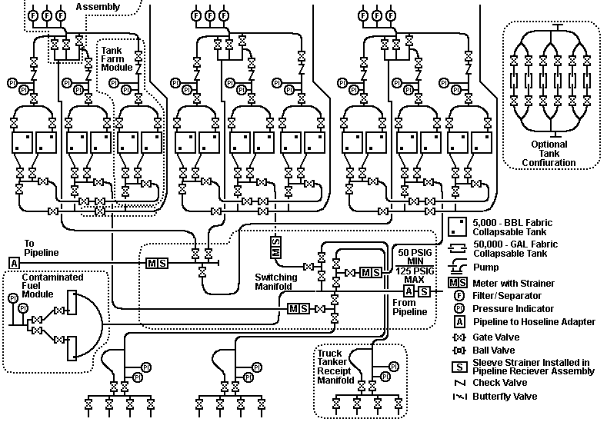

Slide 191
Pipeline connection assembly (PSE). The pipeline connection assembly
is required if fuel is to be received from or issued to pipeline. The
total assembly is stored in four containers and three Tricons.
+
•  Switching manifold. Allows the TPT to be connected to the pipeline
and controls the fuel flow in, out, and within the TPT (one
container).
•  Contaminated fuel module. Consists of two 50,000-gallon collapsible
fabric tanks used to hold contaminated fuel for blending or disposal
and a transfer pump to load tanker-trucks (one container).

Slide 192
•  Fire suppression assembly. Main component (one container).
•  Pipeline connection support assembly. Contains additional ISIL items,
one aviation petroleum test kit, one hoseline suspension kit, one
displacement and evacuation kit, and two hoseline installation and
repair kits (one container).
Special assemblies are available to aid in the total system construction
and interface.
Beach interface. The beach interface is an assembly of adapters to
connect IPDS to OPDS. It also allows access to the pipeline for shorebased
forces; i.e., U.S. Marines

Slide 193
Pipeline support equipment. The basis of allocation is one set of
pipeline support equipment per 100 miles of pipeline to be installed. The
assembly contains those items required to assist in the construction and
operation of a pipeline. PSE will accompany each deployed pipeline
segment (five containers). Equipment includes:
•  Two-wheel mounted hoseline pumps (600 GPM), used as source pumps if
the pipeline receives fuel from commercial storage.
•  Two cutting and grooving machines for cutting of pipeline and pump
station nipples.
•  Four hydraulic drive heads for anchor installation.
•  Two tapping machines for tapping into a pipeline in order to drain a
portion of the line. Usually needed when required to repair a leak.
•  A dead weight tester used to calibrate gages.
•  Five additional elbow sets.
•  Tool kits with pump alignment tools.
•  Additional 9.5-foot pipe sections.

Slide 194
PART B - QUALITY SURVEILLANCE
Quality Surveillance includes all procedures used by operators of the TPT
to ensure petroleum products received, stored, and dispensed by the IPDS
meet the minimum specifications when delivered to the user.
Quality Control (QC) is the inspection performed by refinery personnel
to monitor the production of a particular petroleum product. Quality
Assurance (QA) is the Army’s program to determine if a refinery or other
source has fulfilled its contract concerning the quantity and quality of
petroleum products. QA is complete when the product is accepted by the
Army and becomes Army-owned. Quality Surveillance (QS) consists of the
measures taken to ensure that petroleum products, which have been
12-77
QM 5099
accepted by the Army, are still of the required quality when delivered to
the user. QS is the responsibility of the organization having physical
possession of the Army owned products.

Slide 195
Sample points. The high-pressure fuel sampling assembly is installed in
the pipeline one-half to one mile upstream from the TPT. This assembly is
used to spot the interface as it approaches the TPT and to give advance
warning of its arrival.
The low-pressure fuel sampling assembly is installed in the header,
feeding the TPT switching manifold from the pipeline. The primary use of
this fuel sampling assembly is to check incoming fuel and establish the
end or last of the interface between batches of different specification
fuel. It can also be used to spot sample and check the quality of
incoming fuel and to draw samples for laboratory testing

Slide 196
The water detector kit adapter is in the discharge line of each filter
separator. The primary purpose is to check the quality and make sure no
water is carried over the dispensing assembly. Samples from the adapter
using the aviation fuel contamination test kit are taken downstream of
each filter separator to ensure that the filter separators are performing
properly and customers are provided quality fuel that meets
specification.
•  Test once every 4 hours of operation of dispensing assembly.
•  Perform three checks at 15-minute intervals after filter separator is
first put into operation or whenever the elements are changed

Slide 197
PART C - PIPELINE CONSTRUCTION
Pipeline installation. The aluminum pipe used in the IPDS is highly
susceptible to heat. Changes in temperature cause the pipe to expand and
to contract. This tendency requires pipeline installation to follow
certain rules exactly. The pipeline must be installed as straight and
level as possible. Any desired turns or changes in direction must be
made using elbows, vertical as well as horizontal directions. Anchors
are used to direct expansion and contraction of the pipeline into
expansion and contraction devices. Aluminum pipe is subject to thermal
expansion that can overstress couplings and cause breaks in the pipeline.
Since the pipeline will be installed above ground, the pipe will move as
it expands and contracts with temperature variation. In some geographical
locations where the pipeline may be used, the temperature can vary by as
much as 100 degrees Fahrenheit in 24 hours, which can cause an expansion
of up to 20 inches for 50 sections of pipe. Expansion can cause the
pipeline to fail at a coupling if side pressure deflects the joint more
than 4 degrees. This expansion must be controlled and directed to spots
specifically designed to move with pipeline expansion and contraction

Slide 198
Controlling expansion and contraction. To control this expected
expansion/contraction movement, the pipeline must be equipped with
anchors and expansion devices. The anchor fixes the pipeline to the
ground and directs any expansion towards the expansion device. The flex
in the couplings at the elbows allow these devices to move without
breaking the integrity of the pipeline. In a desert environment, where
the temperature change can be anywhere from 50 to 100 degrees Fahrenheit,
there must be a maximum of 50 sections of pipe between
expansion/contraction devices, with an anchor in between. In a more
temperate environment with an expected temperature change of less than 50
degrees Fahrenheit, the distance between expansion/contraction devices
can be extended up to 100 sections of pipe. There still must be an anchor
between devices. The pipeline must be laid in an anchor - expansion
device - anchor sequence with the anchor just outside of each pump
station starting the sequence. Expansion loops on hills should be no more
than 15 sections of pipe hanging downhill from an anchor.

Slide 199
There are two types of expansion devices used with the IPDS. The “U”
shaped loop and the “Z” shaped offset. Both devices provide required
pipeline flexibility and are considered equal from that standpoint. The
“Z” shaped offset should be used if sufficient cleared trace (width 30
ft.) is available. If the trace is not available, the “U” shaped loop
should be installed. A cleared area of about 30 ft. by 30 ft. is required
for each “U” loop.
•  “U” shaped loop, will normally be constructed with one pipeline length
(19 ft.) on a side and may use 45 or 90 degree elbows or a combination
thereof. As elbows are limited, 90 degree elbows should be used
whenever possible. The deflection at the loop can be as much as 20
inches from the cold to the hot position.
•  “Z” shaped offset will normally be offset one 19-foot pipe length. To
allow for proper expansion, the “Z” should be constructed only with 45
degree elbows unless two 19-foot lengths of pipe are used in the
offset

Slide 200
Mandatory anchor points are located:
•  Always between expansion loops to direct expansion into the loops.
•  On the first or second section of pipe outside pump stations at the
launcher and receiver assemblies.
•  On the first section of pipe downstream of gate and/or check valves in
the pipeline.
•  On the first or second section of pipe on both sides of elbows that
change the direction of the pipeline (both horizontal and vertical).
Anchors must be located at the bottom of a hill with the expansion loop
up the hill. There must be no more than 15 sections of pipe hanging
downhill from an anchor.

Slide 201
Pipe support and guides. Must be installed where required to ensure
that joint alignment is maintained. Pipe supports and guides may be
constructed to pickets, sandbags, or other available materials. Sandbags,
if used, should always be stacked in a pyramid to provide support during
pipe movement; never stack one on top of the other. Pickets are used to
keep the pipeline from slipping downhill when laid along a slope. There
are 225 pickets and 2,000 sandbags in each 5-mile set. Obstacle
crossings include:

Slide 202
•  Road crossing. Ensure that personnel use existing culverts whenever
possible. Make sure that the cross sectional area of the culvert is
not significantly reduced as this may prevent or restrict the run-off
of water. Eighty linear feet (eight 2-foot halves) of 24-inch
diameter, nestable, corrugated steel culvert are included in each 5-
mile pipeline set.
•  Critical gap crossing kit. To aid in crossing gaps along the trace in
difficult terrain, a special critical gap crossing kit has been
developed and added to the IPDS operational stocks. The kit consists
of 4-inch steel pipe, cross beams, braces, and roller assemblies. The
steel pipe can be cut/welded to any length required. A kit has enough
material to cross up to a 250-foot of gap.

Slide 203
PART D - PUMP STATION OPERATION
Pump stations are located along the pipeline to boost the pressure of the
fuels flow. Maintaining adequate pressure is a must. Without adequate
pressure, the flow of fuel would decrease to a point that little or no
fuel would reach the head terminal.

Slide 204
Information source for pumping order. All users of military fuel in
the theater are required to forecast their fuel requirements. These are
consolidated at all levels, giving the theater fuel activity estimated
fuel requirements at each terminal. The pipeline dispatcher uses this
information to schedule fuel flow into each terminal, ensuring that
enough fuel is on hand to meet expected demand. The dispatcher sets up a
schedule which includes the type and quantity of fuel, flow rate, and the
batch number assigned to that fuel shipment. The batch number is a
designation given to each fuel shipment. One of the most common ways of
assigning batch numbers to fuel shipments is to assign a number to a ty

Slide 205
of fuel, i.e., 1 = MOGAS, 2 = DF2, 3 = JP4. The second number would be
the number of shipments of that type of fuel that have been shipped this
fiscal year; i.e., 1st shipment = 1; 2d shipment = 2. Batch 1-14 would be
the 14th shipment of MOGAS. Once the dispatcher has set up the schedule,
a pumping order is made each day and sent to all pipeline areas.

Slide 206
Daily pumping orders. The dispatcher issues daily pumping orders to
pump station and terminal operators. Pumping orders include:
•  Type of fuel.
•  Batch number.
•  Destination of each batch.
•  Amount of fuel in batch.
•  Estimated size of interface.
•  Estimated times of arrival of interface at terminals.
•  Starting and stopping times of all pumping operations.
•  Type of interface to cut.
•  Pipeline pump station pressures and pipeline flow rates.

Slide 207
PART E - SITE SELECTION AND PLANNING
When conducting a site and route reconnaissance, you must have two known
points; where the fuel source is or will be located and where the forces
will be located requiring support.

Slide 208
Site and route selection. A survey using a topographic map must first
be conducted and a profile of the best trace made. Using the profile and
the hydraulic limitations of the pumps, mark the pipeline trace and the
required locations for pump stations. When conducting the physical
reconnaissance on foot or by vehicle, stakes or other marking devices
must be used to indicate the actual path of the pipeline. Location of
valves, anchors, expansion/contraction devices and any obstacles must be
marked on the trace. Actual pump station locations can be adjusted
somewhat from the ideal locations selected from the profile and hydraulic
analysis. But every effort should be made to locate pump stations within
2,000 feet of their ideal locations.

Slide 209
Plot Plan. After the site has been selected, a preliminary plot plan
should be made that shows all the major equipment and system locations,
after review and corrections made to the plot plan, roadways and berm
construction can begin according to the plan.
•  Pump station. A space of 140 feet by 85 feet is ideal, especially if
it’s flat. Pumps must be positioned for access in case one needs to be
replaced during operation. This requires at least 50 feet to the rear
of pumps and should be 10 feet off the road. Stake anticipated
location of the inlet and outlet piping about 95 feet from the edge of
the road with 140 feet between stakes to align the incoming and the
outgoing pipeline.

Slide 210
•  Tank farm assembly. Should be located to provide wide spacing between
fuel units and to provide fire protection and suppression. Tank farm
assemblies within a fuel unit should be at least 400 feet apart. There
should be a minimum of 600 feet between fuel units.
12-81
QM 5099
•  Fuel dispensing assembly (FDA). The FDA should be located on a road
capable of supporting heavy vehicle traffic during weather changes and
at least 100 feet from the nearest fabric tank. The plot plan
requirements for the FDA are approximately 750 feet long by 50 feet
wide. An area alongside, 120 feet by 850 feet long should be graded
for vehicle traffic and parking while load

Slide 211
•  Tanker-truck receipt manifold. The most important factor in choosing
the exact site is road excess, since heavy traffic will occur in this
area of the TPT. A graded area of 120 feet wide by 250 feet long is
required per receipt manifold.

Slide 212
PART F - EXTERNAL IDENTIFICATION
•  Each ISO container is marked with a large black bordered symbol.
•  The pipeline components are represented by a circle.
•  The TPT is a triangle. Each container has identification information
stenciled on it and is marked as part of a series, i.e., box 1 of 5.
•  The pump station is marked by a diamond. Note that a packing list is
secured to the outside of each box or crate.

Slide 213
PART G - COMMUNICATIONS
An efficient communication system is a must for the construction,
operation, and maintenance of a military pipeline. The system must be
separate, continuous, and dependable. Ideally, the chief dispatcher will
have direct communication to each pump station operator and to each TPT.
Each unit will set up their own communication system along the pipeline
with their capability; i.e., teletypewriters, field phone, or radios. No
operation will start until there is communication between the issuing and
receiving stations. Pipeline patrol will carry radios at all times.
Establishing hand signals can be an effective form of communications
within small sections such as pump stations and tank farms. All
personnel within the communication network must be familiar with all
requirements that could be placed on them and what action must be taken
in each situation

Slide 214
LESSON 9
COMPUTE BERM REQUIREMENTS
Critical Task:
101-519-4316

Slide 215
INTRODUCTION
Firewalls are designed to contain 100 percent of the volume of a storage
tank plus one foot of freeboard. These walls are intended to contain
fuel spilled when tanks leak, overflow, or burst and to help prevent the
spread of fuel or fire to neighboring tanks and other installations.
This block of instruction is designed to further your training so that
you can better supervise your personnel in terminal operations

Slide 216
PART A - FIREWALLS
Firewalls should contain 100 percent of the capacity of the storage tank
plus one foot freeboard, and in the case of earth firewalls (Figure 9-1),
they should be at least 18 inches wide at the top. The exact height of
the firewall will depend on the amount of “real estate” or space
available in the area in which you are operating. In theaters of
operation, it is not uncommon to have “splinter walls” of brick or
concrete, 8 or 10 feet high around the tank. These serve as firewalls
and protection against low trajectory fire, blast, etc. A sump will be
provided at the lowest point inside the firewall, and the rest of the
area will be graded or drained to the sump. The sump will connect to the
outside of the firewall by a drain line with an elbow (swing point) leg
on the outside to drain water from the sump. The crane is closed by
elevating the swing joint.

Slide 217
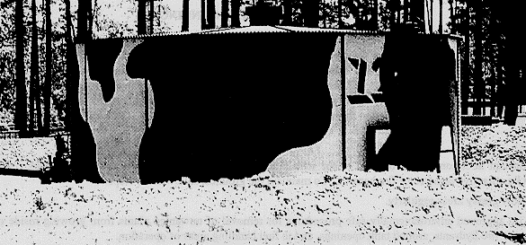

Slide 218
PART B - FORMULA
Tank Capacity
(Gallons)
Fire Wall
Dimensions (Feet)
Inner Dimensions
(Feet)
10,000 3 high, 1.5 wide 26 by 26
20,000 4 high, 1.5 wide 31 by 35
50,000 4 high, 1.5 wide 73 by 33
210,000 5.5 high, 1 wide
6.5 wide at bottom
73 by 73
The formula for determining the inside diameter of the firewall is:
d = 2.68 X
c
h 1
c = Tank capacity [known, (in barrels)]
h = Height of firewall [known, (in feet)]
d = Diameter of firewall (unknown)

Slide 219
Example: We must construct a six foot berm around a 3000 bbl tank.
d = 2.68 x
3000
6  1
d  2 68x
3000
5
.
d x x
d ft
  

2 68 600 2 68 24 5 67 5
67 5
. . . .
.

Slide 220
The formula for determining the height of a firewall based on the
diameter is:
 
h
c
D
 
2 68
2
1
.
Example: Capacity of the storage tank is 3000 bbl, the diameter is 67.5:
 
h
h
h or feet

Slide 221
LESSON 10
RECOMMEND PLACEMENT OF TERMINAL EQUIPMENT AND MANIFOLDS
Critical Task:
101-519-4310

Slide 222
INTRODUCTION
As a petroleum manager, you will be required to oversee the minor repair
of terminal equipment. It is in your best interest to know the proper
procedures and reference material available to you. You will also be
responsible for managing the on the job training (OJT) of newly assigned
personnel. The more knowledgeable you are in the area of equipment
repair, the more effective your training program will be. You will also
be responsible for knowing the manifold system within the petroleum
terminal. Until bulk petroleum products are issued for consumption from
the terminal they must first be received and stored in storage facilities
of varying capacities. All facilities have a common feature that allows
control of the products entering, leaving and transferring within the
system: This control feature is the manifold

Slide 223
PART A - TYPES OF PIPE AND COUPLINGS
•  Lightweight Steel Tubing - Lightweight Steel Tubing is made of light
gage steel with API STD (standard) 5L pipe nipples welded to each end.
This tubing is furnished in 20-foot sections in 4-, 6-, 8-, and 12-
inch nominal sizes. Lightweight steel tubing is normally used in long
stretches of cross-country pipeline due to greater ease of handling,
and because under this condition it will experience only normal
operating pressures. Due to its thin wall, the pipe is not to be
buried nor is it to be used for submerged stream crossi

Slide 224
•  API S&D 5L Pipe - API S&D 5L Pipe has a thicker wall than the
lightweight steel tubing pipe and is furnished in 4-, 6-, 8-, 12-, 16-
, and 20-inch nominal sizes. It is furnished in 20-foot sections
grooved for coupling and is beveled for welding in random lengths. It
is used at critical points and high pressure areas such as downhill
slopes, manifold areas, and pup joints.

Slide 225
•  “Victaulic” Couplings - “Victaulic” couplings are used to join the
lightweight steel tubing and API S&D 5L pipe sections together.
“Victaulic” is a trade name associated with the couplings which
consist of two housing segments, two bolts and nuts, and a syntheticrubber,
oil-resistant, self-sealing gasket. The coupling and gasket
are designed so that the pipe joint seals under pressure and vacuum.
The coupling also provides a sufficient amount of angular deflection
and slack adjustment for expansion and contraction of the line between
adjacent joints. The gasket used with the coupling should be greased
to prevent pinching or sticking of the gasket.

Slide 226
•  Aluminum Pipe - Aluminum pipe is a new type of pipe being evaluated
for future use by the Army. It is lightweight, yet meets static and
dynamic pressure requirements of the fuel systems. This pipe has
fewer corrosion problems and is available in 19-foot sections. It is
used in locations similar to the lightweight steel tubing and API STD
5L pipe. High-pressure situations are corrected by the use of
pressure reduction stations. Maximum deflection (4°) is determined
using the device shown in the slide

Slide 227
•  “Labarge” Snap Lock Couplings - “Labarge” snap lock couplings are one
of two types of couplings being evaluated for use with aluminum pipe.
“Labarge” is a trade name associated with the couplings. The Labarge
12-89
QM 5099
coupling is hinged on one side, clamped around the pipe, and then
pinned on the other side. The clamp is pulled tightly shut with the
assistance of the tightening handle

Slide 228
•  Stab Lock Couplings - Stab lock couplings are the second type of
coupling being evaluated for use with aluminum pipe. The pipe
sections are stabbed into the coupling where a series of gaskets
inside the collar result in a seal being formed. Special pliers are
utilized to break apart these sections of pipe in the event that a
section needs to be replaced.

Slide 229
Cutting and Grooving Procedures for Steel Pipe. Grooved pipe is used
for coupling pipe sections together with the split-ring, groove-type
coupling. Due to layout or damage, a section of pipeline must be cut to
a nonstandard length and regrooved to allow for proper assembly. A
portable cutting, grooving, and beveling machine is used to perform this
task. These machines are packaged in a kit and are included in the welded
pipeline construction tool set. The kit includes two large suitcases and
two pipe stands. The machine is powered by a 250 cubic-foot-per-minute
(CFM) air compressor or by a generator. It is used primarily during
mainline pump station construction. It takes about 30 minutes to cut and
groove each end of the pipe

Slide 230
Welding of Pipeline. Pipe to be welded will have a beveled edge on it
to facilitate making a good weld. Rebeveling, because of damage to the
edge, or cutting and beveling are accomplished with the machine described
above. The bevel is cleaned of slag with a bevel grinding machine

Slide 231
PART B - VALVES
•  Gate Valves - Gate valves have a gate in the form of a disk or wedge,
which is raised to permit the flow of fuel and lowered to stop the
flow of fuel.
•  Rising-Stem Gate Valves - Rising-stem gate valves are threaded on the
upper end of the stem. The lower end is attached to a disk. When the
hand wheel is turned both the stem and disk are raised and lowered.
When the valve is fully opened it will allow pipeline scrapers, poly
pigs, etc., to pass through. By looking at the valve from a distance
you can tell whether or not the valve is open or closed. The stem of
the valve is easy to sabotage. The exposed surface of the upper stem
on the rising stem gate valve should be protected by placing a split,
one-inch hose or some similar device around the stem in the yoke area.
A fine film of motor oil can be used to lubricate the thread on the
stem. This valve is used in the pipeline at intervals at the bottom
of long slopes, on both sides of a stream crossing, and at storage
tanks.

Slide 232
•  Nonrising-Stem Gate Valves - The threaded lower end of the stem on a
nonrising-stem gate valve screws into the disk, thereby raising or
lowering the disk while the stem is retained in place by a thrust
collar. The packing gland must be monitored and replaced as
necessary.
12-90
QM 5099
•  Globe Valves - Globe valves are used to throttle the flow of product
inside a pipeline. This is the same type of valve used at home on
kitchen or bathroom sinks. Packing, disks, and seats will become
worn and will need replacing depending on usage. These valves are
used in areas where the throttling of product flow is desired.

Slide 233
•  Swing Check Valves - Swing check valves permit fuel to flow one way
only by means of a hinged disk or clapper which is pushed aside by the
fuel when it flows in the desired direction. When flow stops and back
pressure develops, the clapper is pushed against its seat, stopping
back flow. These valves are self-operating and need little
maintenance other than tightening the cover nuts regularly. Typically
they are used on the discharge sides of pumps and at pump stations
between the suction and discharge lines of each pump at the pump
station. They are also used at the foot of upgrade slopes in lieu of
gate valves, but they must be removed if the line is ever pumped in
reverse.

Slide 234
•  Flow Control Valves (Pressure Reducing Valves) - Flow control valves
are activated by pressure. If pressure in the pilot is great enough
to overcome the force of the spring, the excess pressure activates the
diaphragm to throttle the flow in dynamic situations, and in static
conditions it will decrease the head acting against a particular point
in the pipeline. These valves require little maintenance beyond
checking the pilot strainer at least every 3 months and inspecting the
diaphragm once a year. They are used on downhill slopes.

Slide 235
•  Pressure Relief Valves - Pressure relief valves are set to open at
certain pressures and are triggered by a spring. The pipeline is
tapped at points which may experience excess pressures under static
conditions. If pressures reach the upper limit set on the valve by
the operators, the valve activates by opening and bleeding fuel off
until safe pressures are again reached and the valve resets itself to
the closed position. Typically these valves are used at locations
where the pipe is going to a storage tank to bleed-off excess
pressures built up in the line because of heating by the sun under
shut down conditions. These valves should be tested once a year using
a reliable pressure gage

Slide 236
•  Plug Valves - Plug valves are small, compact valves activated by
turning the head of the valve 1/4-turn. This valve may or may not
open to the full diameter of the pipe depending on the type of plug
valve used. As a result, plug valves which do not open to the full
diameter of the pipe cannot be used in portions of the pipeline
through which a scraper is designed to pass. This valve can be
lubricated in the open or closed position. Lubrication is done
through the lubrication screw at the top by the use of a high pressure
grease gun, or the screw can be screwed down. This valve also has
rope-type packing which must be periodically replaced. Plug valves
are commonly used at tank farm manifolds or in places requiring quick,
positive shut-off such as at a scraper launching station.

Slide 237
Additional pipeline components.
Figure Eight Blinds - Figure eight blinds provide a positive shutoff in
pipelines and manifold areas. A line blind is comprised of a flanged
holder, hand wheel, and figure eight blind. Turning the hand wheel one
way causes the holder to spread open wide enough to insert or remove one
12-91
QM 5099
end of the figure eight blind. Turning it the other way causes the
holder to grip the blind tightly. Maintenance involves coating the
exposed half of the figure eight blind with a thin film of motor oil
every 3 months and inspecting the packing rings in the grooves of the
figure eight blind every 6 months for wear. If the packing rings are
worn they must be replaced. Grease fittings on the hand wheel must be
regularly lubricated

Slide 238
Spool Pieces - Spool pieces are short sections of pipe into which figure
eight blinds are inserted.
Line Strainers - Line strainers catch debris in fuel as it comes down
through a basket or strainer and then passes through the discharge side.
The basket has a wire-mesh or screen which catches the debris and
prevents it from continuing to flow downstream and damaging things like
pump impeller blades and meters. The baskets or screens need to be
pulled from the devices in which they are installed on a periodic
schedule (once a week) to remove the debris. Line strainers are found
on the suction side of pumps and meters and on the discharge side of
filter separators.

Slide 239
PART C - FITTINGS AND PIPE REPAIR ACCESSORIES
Fittings. Standard, groove-type fittings include elbows, tees, and
reducers such as the following:
•  Standard Tee Fittings - Standard tee fittings provide a splitting of
the fuel stream. These fittings have a characteristic “T” shape.
•  Reducing Tee Fittings - Reducing tee fittings allow reduction in one
leg of the branch, either through the tee portion or through the
branch portion of the tee.
•  Elbow Fittings - Provide for the change in the pipeline direction by
45 or 90 degrees.
•  Reducers - Provide a connection from one diameter of pipe to some
smaller diameter of pipe

Slide 240
Repair clamps. Listed below are some of the more common types of clamps
used to repair leaking pipelines.
•  Pit Leak Clamps - Pit leak clamps are designed to temporarily repair a
leak caused by a small hole such as a pit.
•  Split Leak Clamps - Split leak clamps are designed to temporarily
repair a leak caused by a split pipe. This clamp is limited in the
size of the split which can be repaired due to its limited length.
•  Over-Coupling Leak Clamps - Over-coupling leak clamps are designed for
placement over the regular split-ring, groove-type coupling when a
leak develops from the initial coupling.
•  A pipeline leakage report will be completed for all leaks occurring in
a pipeline.

Slide 241
PART D - PUMPS
Pipeline pumps consist of one or more impellers mounted on a rapidly
rotating shaft. Liquid enters the impeller at its center and is impelled
12-92
QM 5099
outward by centrifugal force into the volute of the pump casing. The
volute catches the discharge and converts peripheral velocity into head
pressure while conducting the liquid at a reduced flow rate to the
discharge nozzle of the pump casing. Different pumps are used on
aluminum and steel pipeline systems

Slide 242
•  6-inch, Single-Stage Pump - The 6-inch, single-stage pump is a selfpriming,
centrifugal pump equipped with a mechanical shaft seal.
Suction and discharge connections are grooved pipe. Maximum safe
working pressure is 207 PSI or 660 feet of head for fuel with a SG of
0.725.
•  6-inch, Two-Stage Pump - The 6-inch, two-stage pump is a multi-stage
pump fitted for external connection to operate either in series or in
parallel. Maximum safe working pressure is 700 PSI or 2,390 feet of
head for a fuel with a SG of 0.725.
•  800 GPM Mainline Pump - The 800 GPM mainline pump is a new pump used
for operation in an aluminum pipeline system. It is a skid-mounted,
three-stage centrifugal pump.

Slide 243
PART E - PIPELINE SCRAPER OPERATIONS
Scrapers are devices inserted into the pipeline to remove internal scale,
rust, or other foreign material. In the petroleum industry, scrapers are
often called “pigs” or “go-devils.” Two types of scrapers are used:
•  Steel Brush Scraper - The steel brush scraper is constructed of a
tubular shaft on which are mounted two sets of four spring-loaded
steel brushes and two synthetic rubber cups. The spring-loaded steel
brushes clean the walls of the pipe. The front and rear brush groups
are staggered to cover the entire pipe surface. The tubular shaft of
the scraper is open at the rear, which permits a fraction of the
stream to flow into the scraper and escape through small ports near
the front end, thereby agitating and propelling the loosened scale
forward. This prevents the scale from accumulating ahead of the
scraper, causing the line to become clogged. This type of scraper
comes in 6-, 8-, 10-, and 14-inch sizes. The 10- and 14-inch scrapers
have three synthetic rubber cups

Slide 244
•  Poly Pig Scraper Device - The poly pig scraper device is constructed
of foam-type material and wrapped with abrasives to clean the
pipeline. They are able to make 90-degree turns in the pipeline and
are inexpensive, though they do not clean as thoroughly as steel brush
scrapers nor are they as durable.
Military pump station manifolds have two scraper stations; one for
launching and another for receiving. Before launching a scraper, lines
should be free from sharp bends and valves that do not open the full
diameter of the pipe. To provide free passage for scrapers, changes in
pipeline direction are made by bending pipe rather than using elbow or
tee fittings

Slide 245
Sandtraps are, in effect, sediment or settling chambers which collect
dirt, scale, sludge and floating debris pumped through the pipeline or
accumulated during pipeline cleaning. They are installed on the suction
side of each pump station. Sandtraps split the flow into two 14-inch
barrels, thus reducing the velocity of the flow. This allows sediment to
settle out. They must be cleaned periodically and after each scraper
run.

Slide 246
PART F - MANIFOLD DESIGN FACTORS
The following factors are affected by the theater support requirements:
•  Number and quantity of products - The number of and quantity of
products depends on theater needs (i.e., troops, equipment, etc.).
•  Number of tanks - The number of tanks depends on the quantity and type
of product stored and the facility size (a minimum of two tanks per
product is preferred).
•  Number of incoming lines - The number of incoming lines entering the
facility is determined by the supporting locations.
•  Number of outgoing lines - The number of lines leaving the facility is
determined by the locations supported.

Slide 247
•  Future expansion - Future expansion is based on the expansion of the
theater and an increase in corresponding support requirements.
•  Location - The location of a facility is given with the manifold
centrally located within it.
•  Layout - The layout requires that the manifold is located at the low
point near the center of the tank farm piping network. The minimum
distance to any tank should be 250 feet.
•  Construction - The manifold consists of API standard pipe sections and
plug valves. The API pipe will accommodate higher pressures
associated with the sharp angles and close proximity to the fuel
source. Plug valves provide control in switching products as they
require only a 1/4-turn to open or close the valve

Slide 248
•  Manifold design - A manifold is designed to support the facility in
which it is located. The basic manifold used in a facility is called
a switching manifold which is an assembly of pipe, fittings, and
valves used for controlling the flow of petroleum products into, out
of, and within, a tank farm complex. The manifold is located at the
lowest point within the facility to assure positive suction to the
transfer/feeder pumps. The manifold connects a number of tanks with
incoming and outgoing lines as well as pumps used in transferring
products. A single tank connected to a pipeline does not
provide the flexibility to accomplish more than a single function.
Multiple tanks connected to a pipeline, even while providing increased
capacity, can only perform a single function. The manifold system
permits simultaneous receipt and delivery of petroleum products by the
facility. By adding pipe, fittings, and valves, control of the
product to complete multiple tasks can be accomplished. Products can
be received into one tank while issues can continue simultaneously.

Slide 249
•  Manifold Identification Markings - An identification system is
essential for control within a facility. The facility commander will
establish the identification system where one is not established or if
a current system needs changing. Identification systems should be
kept simple. The system should identify each tank, pump, line, and
valve. A schematic of the facility tanks, pumps, lines, and valves
identifying each needs to be available with the facility for
reference. Schematic and facility markings are suggested as a method
for identification of the system. Whatever method is utilized, the

Slide 250
actual facility schematic must match what is actually in place. The
following identification method is suggested:
Valves - Valves located along the main pipeline (ML) are identified by
the office of the chief dispatcher, starting at the beginning of the
pipeline and ending outside the last facility of the head terminal.
These valves are identified by the letter ML, followed by a dash (-
), and a number. For example: ML-1, denotes a valve as being the
first in the pipeline system.

Slide 251
Tanks - Tanks are identified by numbers. When numbering the tank
valves, start with the first valve at the tank and number across the
manifold in sequence. Write the tank number down first, followed by
a dash, and then the valve number. For example, if identifying Tank
10, all valves starting from the tank would be numbered sequentially
beginning with 10-1, then 10-2, then 10-3, etc., to the last valve
in the manifold for that particular line.
Pumps - Pumps are identified by numbers. Pump valves may be
identified with a letter or numbering system. For example, Pump 1
can have its suction and discharge valves identified individually or
in sequence. For example, P-1 or Pump Suction Valve (PSV)-1, and P-
2 or Pump Discharge Valve (PDV)-2. An alternative that would
identify valves to a specific pump is P-1-1 or PSV-1-1 and P-1-2 or
PDV-1-2 for Pump 1, suction and discharge valves.

Slide 252
NOTE: When there is more than one pump, the valve can be numbered
in sequence (i.e., P-1 through P-4, two pumps, or in relation to the
specific pump).
Pipelines - Pipelines, both incoming from and outgoing to the
manifold, are identified by a letter. The incoming lines of a
pipeline begin where they enter the facility and end where they
connect to the manifold. For example, a line entering the facility
is identified with a letter (starting with A). Valves located in
the line are identified with the line letter followed by a dash (-),
and then in numerical sequence starting with 1. The highest number
identifies the valve in the line just prior to its connection to the
manifold. If line A has five valves in it, then they would be
numbered starting with A-1 (the valve nearest the entry to the
facility) and ending with A-5 (the valve closest to the manifold).
The outgoing lines begin at the furthest point inside the manifold
and are identified with the line letter, a dash, and a number. The
last valve in an outgoing line is the one at the point where the
line ends in, or exits, the facility

Slide 253
Additional markings used in a system for identification include the
following:
Direction of Flow - The direction of flow in a line is indicated with an
arrow physically placed/painted on the line. The direction can be in
one direction only or in both directions.
Product Identification for Products - The product identification for
products should relate to the product in the line (i.e., tank lines
immediately outside the manifold should show the product).
Product Identification for Facilities - The product identification for a
facility will be applied where practical depending on the tactical
situation and the commander’s guidance

Slide 254
LESSON 11
DIRECT USE OF PUMPS
Critical Task:
101-519-4260

Slide 255
INTRODUCTION
Pumps can be operated at a wide range of speeds in order to compensate
for variations in the pumped product’s specific gravity, temperature, and
the pipeline topology. The speed at which the pump is operated also
determines the efficiency and therefore the cost of operation. To
effectively direct a pumping operation you must be able to balance all
the operating parameters of the pumps which is accomplished by the use of
pump graphs.

Slide 256
PART A - FEET OF HEAD AND POUNDS PER SQUARE INCH
A pump graph is constructed to show feet of head, flow rate in gallons
per minute (GPM), and barrels per hour. Pumps are equipped with gauges
that register the suction and discharge pressure in pounds per square
inch (PSI). Therefore the operator must be able to convert PSI to feet
of head to determine the flow rate and efficiency of the pump.
The equation for converting PSI to feet of head is H
xPSI
SPGR

Slide 257
2.31 is a constant based on a column of water at 60 degrees Fahrenheit, 2.31 feet high and measuring 1
inch by 1 inch. 2.31 feet of head of water at 60 degrees Fahrenheit equals 1 PSI. One foot of head is equal
to 0.433 PSI (1 divided by 2.31). By using the specific gravity of different fuels in the equation the operator
can determine the difference in PSI.
EXAMPLE: The fuel being pumped (DF) has a specific gravity of 0.8254.
The pressure at which it is being pumped is 325 PSI. Using the
following equation, it is calculated that the feet of head is 909:
H
x

2 31 325
08254
.
.
.
The operator knows the pump can overcome 909 feet of head.
The equation for changing feet of head to pressure is P
HxSPGR 
2.31

Slide 258
EXAMPLE: A pump operator must overcome 909 feet of head while pumping DF
with a specific gravity of 0.8254 and needs to know the pressure which
must be maintained. Using the equation:
P = pump
H = Head
2.31 = constant
SPUR = specific gravity
P
x
  PSI

Slide 259
PART B - EFFECT OF PUMP STATION OPERATION ON HEAD CAPACITY
AND FLOW RATE
The normal head capacity of a pump station is the total head against
which it will pump at the most efficient operating point for example, the
design speed of the pumping units. Revolutions per minute (RPM) must be
considered, together with the required head and desired throughput (GPM
or BPH), to establish maximum efficiency in design. The maximum head
capacity of a pump station is the total head against which it will pump
to provide maximum pipeline capacity. Maximum head capacities are only
for use in emergency operations and are never used in normal operations.
Pump stations should not be operated at maximum capacity except for
emergencies. Operation under emergency conditions should not exceed 24
consecutive hours

Slide 260
PART C - PARALLEL AND SERIES INSTALLATION OF PUMPS
Electrical storage batteries are described in terms of series or parallel
hook-up. In order to get 12 volts of electricity, two 6-volt batteries
may be connected in series. The two 6-volt batteries connected in
parallel provide 6-volts of electricity, but the current is doubled. A
hydraulic system is very similar to an electrical system because the head
capacity resembles voltage and the flow rate resembles the current.

Slide 261
Two pumps connected in series double the head capacity of a single
pump while the flow rate in GPM or brake horse power (BHP) remains the
same as for one pump. Two pumps connected in parallel double the flow
rate, while the head capacity remains the same as for one pump.
Parallel operation is not normally used on petroleum pipelines. Pump stations are costly to operate and
require man power. The objective in pipeline design is to use as few pump stations as possible. The size of
the pipeline maintains the required volume. Pump stations are designed to push fuel products as far as
possible down the line. As a result, pump stations are connected in series.

Slide 262
PART D - PUMP GRAPHS
Observe how the pump graph is constructed (Figure 11-1). The graph
consists of a coordinate system. It is a uniform scale which means there
is an equal space between all units on the graph in both directions.
Rate of flow is plotted along the X or horizontal axis increasing from
left to right in GPM on the bottom and BPH on top. The remaining
variables are plotted along the Y or vertical axis. The RPM curve
defines what is referred to as the operating speed of the pump

Slide 263
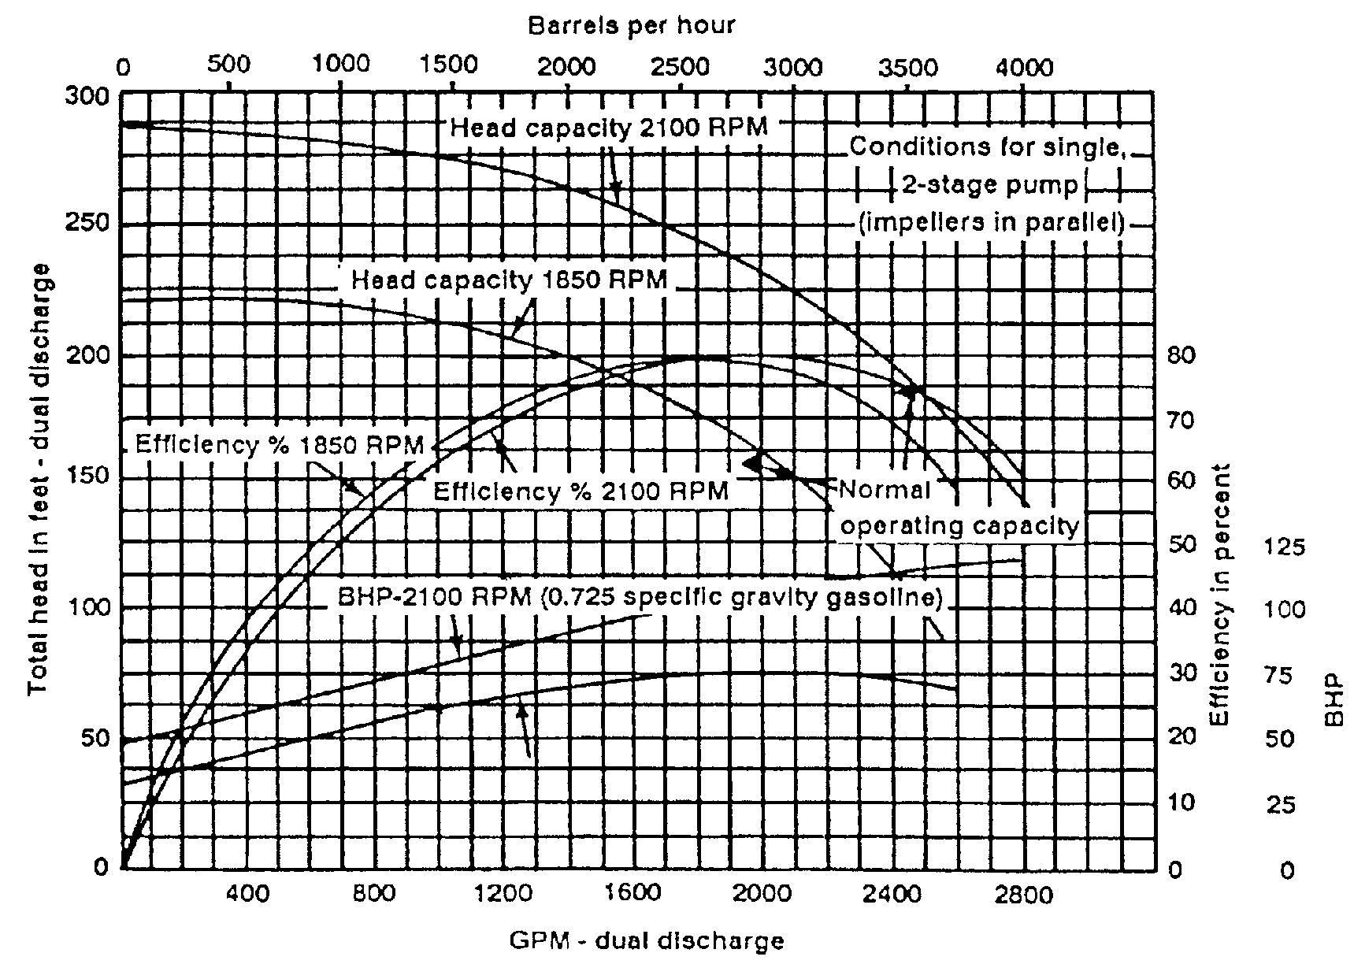

Slide 264
Pump graph application. A common application of a pump graph (Figure
11-1) is its use in determining the rate of flow, efficiency, and BHP,
given the total dynamic head in feet and operating speed of the engine in
RPM. Recall the definition of dynamic head--the height to which a pump
can push a column of liquid. Rate of flow is the most commonly desired
variable on the graph, and can be expressed in either GPM or barrels per
hour. At an engine speed of 1,800 RPM and total dynamic head of 160
feet, determine the following:
•  Rate of flow (GPM).
•  Efficiency (percent).
•  Brake horsepower (BHP).

Slide 265
To solve this problem, enter the graph on the Y axis at 160 feet of head.
Follow this line to the right until it intersects the head capacity curve
for 1,800 GPM. At this point, all answers are determined vertically up
and down.
•  To read rate of flow in GPM, drop down to the X axis and read the
answer 850 GPM.
•  To determine the efficiency, drop down to the efficiency curve
and read the percent efficiency in the right-hand margin (70 percent).
•  The BHP is similarly read. Drop down to the BHP curve for gasoline
and read the answer (35 BHP).
NOTE: BHP is expressed with a given specific gravity fuel. For design
purposes, we use 0.8524 specific gravity diesel fuel.

Slide 266
PART E - DETERMINATION OF PUMP SPEED
12-101
QM 5099
Individual pump stations must regulate pump speed to keep suction
pressures at the next pump station downstream above the minimum. The
normal suction pressure at a pump station is 20 PSI for elevations less
than 5,000 feet and where temperatures are below 100 degrees F (20 PSI is
equivalent to 64 feet of head of Mogas). The minimum suction pressure at
a pump station must be 5 PSI because of pump entrance friction losses and
the possibility of vapor lock in the pump. 5 PSI is equivalent to 16
feet of head of Mogas. To determine flow rate, efficiency, and BHP in
pump station operations the total pressure produced on the discharge side
of the pump station must be determined firs

Slide 267
of the pump station must be determined first.
EXAMPLE: There are three pumps on line connected in series
operating at 1800 RPM with a discharge pressure of 480 PSI and a
suction pressure of 20 PSI. They are pumping a product which
has a SP/GR 0.8254.
480 PSI minus 20 PSI = 460 PSI.
H
x
 
2 31 460
0 8254

Slide 268
In order to use the pump graph, divide 1,287 ft/hd by three because there
are three pumps on line (429 ft/hd). Locate 429 feet of head on the
graph, read to the right of the head curve (1,800 RPM). Read down to 600
GPM. At that flow rate, read up the graph until the line intersects the
brake horsepower curve at 1,800 and read 68 BHP. This represents one
pump and there are three on line. Multiply by three, 204 BHP for the
station. In the same manner, read up to the efficiency curve and read 74
percent. As shown, the graphs can be used for pump stations as well as
individual pumps

Slide 269
800 GPM main line pump graph. This pump graph (Figure 11-2) looks
different but is constructed and interpreted the same as the other pump
graphs used. It shows total dynamic heads in PSI, feet of head, and flow
rate for water (1.0 sp/gr), DF-2 (0.8254 sp/gr), and Mogas (0.7254 sp/gr)
from 770 RPM to 2,100 RPM.
For example, at a flow rate of 500 GPM and 1,800 RPM pumping DF-2, the
pressure and feet of head can be determined. Locate 500 GPM and read up
to the 1,800 RPM curve. Read to the left 1,359 ft/hd 500 PSI.

Slide 270
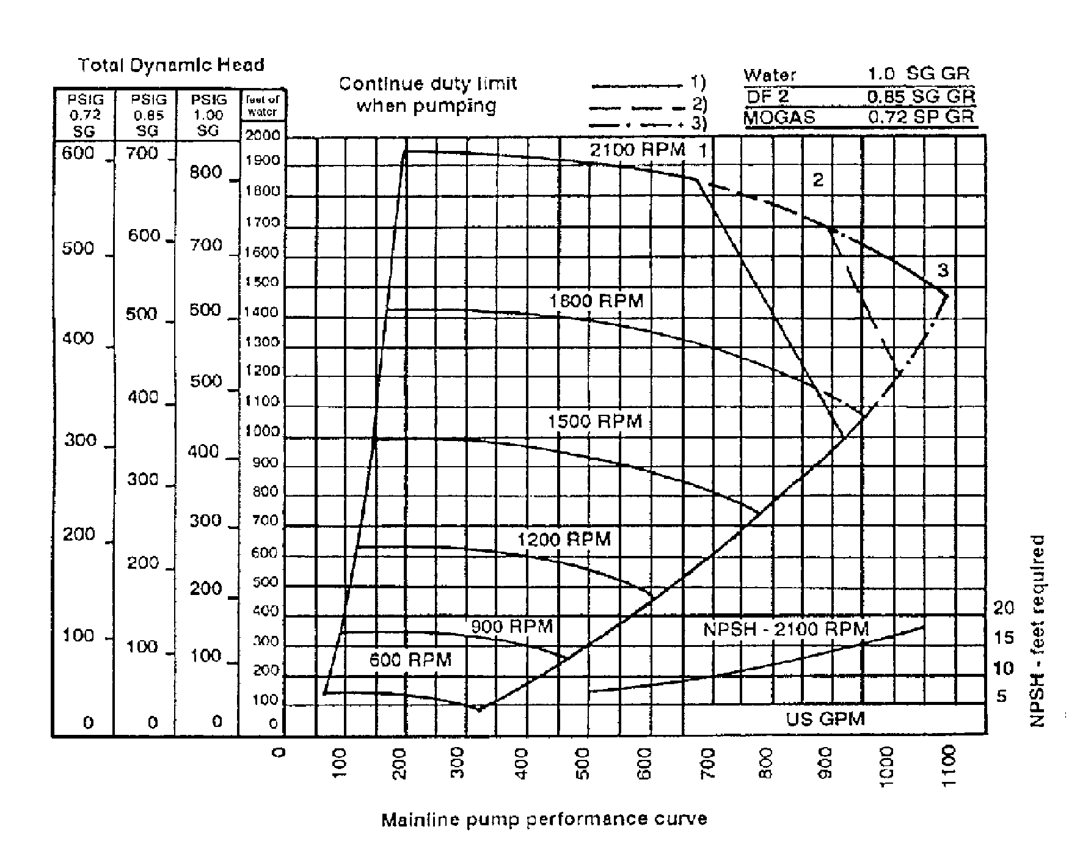

Slide 271
LESSON 12
Pressure Testing Hose and Pipeline
Critical Task:
101-519-4310

Slide 272
INTRODUCTION
Periodically, due to corrosion and/or erosion leaks and cracks occur
which must be corrected immediately

Slide 273
PART A - CORROSION
Corrosion is the process of any refined metal returning to its natural
form. What happens during corrosion is similar to the chemical actions
that takes place in a battery. Negatively charged atomic particles
called electrons are given up by a metal called an anode. These
particles form an electrical current which passes through an electrical
conductor called an electrolyte. The electrons are attracted to another
metal called a cathode. The circuit is completed when current returns to
the anode by way of a metal connection. During this process the metal
acting as the anode breaks down and deteriorates. The metal acting as a
cathode is protected and suffers no damage

Slide 274
Different and Same Metals. Corrosion can involve two different metals.
Also, it can occur when the anode and cathode are the same metal. For
example, a newly cast metal will act as an anode to an older similar
metal. A metal in acidic surroundings will act as an anode to the same
metal in less acidic surroundings. A metal in an area lacking in oxygen
will act as an anode to the same metal in an oxygen rich atmosphere

Slide 275
Causes of Pipeline Corrosion. For corrosion to take place, there must
be an anode, a cathode, an electrolyte, and some metallic connection
between the anode and the cathode. Corrosion can occur in a pipeline
under the following conditions:
•  Different metals come in contact. This occurs where sections of pipe
are joined by couplings and where fittings and valves are used.
Moisture and chemicals in the surrounding ground and air act as the
electrolyte. The pipeline provides the necessary metallic connection
between the anode and cathode.
•  A new section of pipe is put in the place of an old one. The new pipe
acts as an anode to the neighboring old pipe.

Slide 276
•  The pipeline passes through different kinds of soil. Electrons will
move from pipe sections laid in high acidic soil to sections in low
acidic soil and from pipe sections in high alkaline areas to sections
in low alkaline areas. (A swamp is an example of an acidic area.
Ground made up of moist clay is alkaline.)
•  The pipeline moves from under ground to above ground, and it moves
from under water to above water.
•  The pipeline passes through fine soil. Fine soil holds more water and
dissolved minerals and acts as a better electrolyte than coarse sand
and earth.
•  Stray electrical currents from outside power sources flow into the
pipeline. They are carried along and then leave the pipeline to
reenter the soil. The area of the pipe where the stray current enters
will act as a cathode, and the area where it leaves will act as an
anode. An example of a possible source of stray currents is the

Slide 277
ground wire of an electrical device such as an electrically powered
pump.
Prevention of External Corrosion. Several techniques are used to
prevent external corrosion. None is perfect, so a combination of several
methods is usually used to cut down on corrosion as much as possible.
•  Design. Corrosion control is considered before the pipeline is built.
Soil studies are made and the planners try to avoid high acidic areas
such as swamps and high alkaline areas such as clay deposits.
•  Protective coverings. Pipe sections are coated at the factory or at
the construction site with coal tar enamel. Protective wrappings are
put around the pipeline before it is buried. The enamel and wrappings
are waterproof. They act as a barrier between the pipeline and
surrounding ground and atmosphere, and they prevent current from
leaving the pipeline. When a pipeline is repaired it is important
that these protective coverings be restored to their original
condition.

Slide 278
•  Sacrificial anodes. Another way to protect the pipeline is to use
sacrificial anodes. One type of sacrificial anode is magnesium. Bars
of magnesium are buried in ground beds that are located away from the
pipeline. The anodes are connected to the pipeline with insulated
copper wires. In this way, the pipeline becomes the cathode and the
magnesium anode is sacrificed to protect the pipeline. Corrosion is
not stopped; it is only directed to a less important surface.
•  Mitigation bonds. Mitigation bonds are used to protect the pipeline
from stray electrical current. These bonds are insulated grounding
cables that serve as paths of least resistance to stray electrical
currents. Stray current will tend to flow through these cables
instead of the pipeline.

Slide 279
PART B - PIPELINE TESTING
A new coupled or welded pipeline should be tested before it is accepted
for service by the using organization. Testing is done to locate leaks,
blockages in the line, and flaws in construction. Testing may be done
with water, fuel, or compressed air.

Slide 280
Water. Although testing with water is safer than testing with fuel,
there are disadvantages to using water. Water may be scarce in some
area. It may not be practical or possible to pack the line with water.
Water expands as it freezes. It should not be used to test a line if
there is any chance of the temperature falling low enough to freeze the
line. All water should be removed or displaced entirely form the line
before it is packed with fuel. In a combat situation this process could
use valuable time.

Slide 281
Fuel. Since there are problems testing with water testing is usually
done with fuel. Several conditions should be met when fuel is used.
•  The test section should be outside of a city or heavily populated
area.
12-108
QM 5099
•  Each building within 300 feet of the test section should be empty of
people.
•  The test section should be watched by a patrol during the test.
•  The people running the test should be in constant contact with the
patrol.
•  The fuel used should be a low grade, noncritical fuel that does not
vaporize quickly.

Slide 282
Compressed Air. If the test section is in an area with many people, the
line should be tested with compressed air. Compressed air should also be
used to test a section of line that crosses a river. Compressed air can
only be used on clean, vapor free lines. To test coupled and welded
pipelines with compressed air, ensure that personnel:
•  Divide the pipeline into smaller sections than those used in testing
with fuel or water. Consider the size of the pipe and air compressor
before deciding how long of a section should be tested. Do not try to
test more than 5 miles at a time. Use the gate valves placed 1 mile
apart in the pipeline to break the test section into 1 mile pieces.
If the pipeline must be tested quickly test the line mile by mile
instead of by 5 mile sections. Break the line at each gate valve.
Uncouple and move the air compressor forward for each test. This
method cuts down on the time it takes to empty a line of air.
•  Uncouple the beginning of the test section from the rest of the
pipeline.

Slide 283
•  Cap off this section with a coupling made from a blank end. (To make
this coupling, cut a hole in a blank end and weld an air hose coupling
to the blank end over the hole.)
•  Attach the air line from the air compressor to the blank end.
•  Close the gate valve at the end of the first mile of test section.
•  Pressurize the line at 90 pounds per square inch to the closed gate
valve.
•  Patrol the line and swab the couplings with soapy water. Look for
bubbles caused by air escaping at a leak. Listen for the hissing
sound of air escaping.
•  If a leak must be repaired: close the gate valve at the end of the
next mile of the test section, open the gate valve at the end of the
first mile to relieve pressure, repair the leak, close the gate valve
at the end of the first mile, pressurize the first mile of pipeline,
and patrol again to look and listen for leaks.
•  If the first mile checks out all right, close the gate valve at the
end of the second mile of the test section and open the gate valve at
the end of the first mile.

Slide 284
•  Pressurize the first 2 miles of pipeline.
•  Patrol for leaks in the second mile.
•  If there are leaks: close the gate valve at the end of the first mile
of pipeline to prevent loss of air pressure, open the gate valve at
the end of the second mile to relieve pressure in the section to be
repaired, repair leaks, close the gate valve at the end of the second
mile, open the gate valve at the end of the first mile, pressurize the
first 2 miles of the pipeline, and patrol again to look and listen for
leaks.
12-109
QM 5099
•  Repeat the above steps until the 5-mile section of pipeline has be
tested and all leaks repaired.
•  Pressurize the whole 5-mile section for a 24-hour test if there is
enough time.
•  Anchor the end of the pipeline after the test is over or hold it down
with heavy equipment so that it cannot whip around. Warn everyone in
the area to stand clear of the line. Then empty the air from the line
by opening the gate valve at the end of the test section. Open the
gate valve as quickly as possible

Slide 285
Preparations for Testing. Before the test begins several actions
should be taken. To ensure that the test runs smoothly, personnel
should:
•  Test all radios and telephones.
•  Check the accuracy of all gages.
•  Make sure enough repair clamps are on hand.
•  Move in fire fighting equipment.
•  Make sure a tank vehicle and drums are nearby in case a section of
line has to be drained.
•  See that shovels and material to dig and line a pipe are at the test
site in case there is a spill.
The pipeline should be divided into test sections. The usual test
length is the distance between pump stations (about 15 miles). Shorter
distances can be tested by using gate valves to divide the pipeline into
smaller segments

Slide 286
During testing, line pressure in welded pipelines is measured by gages
at pump stations and at line taps between pump stations. Before the test
begins, over coupling leak clamps with pressure gages are mounted on
coupled pipelines to measure line pressure. The clamps are mounted every
one third mile, if practical. If not, they are used at least every mile.
To mount an over coupling leak clamp for a pressure test, personnel
should:
•  Remove the vent plug and put a pressure gage in the vent plug hole.
•  Loosen the split ring coupling on the pipeline.
•  Remove the gasket or push a nail under the gasket to make a small
leak. (The nail should not damage the gasket and should not get in
the way of the over-coupling leak clamp.)
•  Remove nuts and bolts from the over coupling leak clamp.
•  Fit the two halves of the leak clamp and the two part gaskets over and
around the split ring coupling.
•  Put the large side bolts back in on each side of the clamp and tighten
them.
•  Tighten smaller packing bolts around the housing on the leak clamp to
form seal between the gaskets and the pipe.

Slide 287
PART C - PIPELINE PATROLLING
When put into service, pipelines are patrolled by at least two people.
The patrols look for leaks and signs of a leak such as an oil slick on a
stream and/or dead or wilted plant life nearby. They report all leaks on
12-110
QM 5099
a DA Form 5456-R. Patrols also prevent or hinder sabotage or theft.
They are sent out often and at different times each day so that no one
can predict when a patrol may be in a specific area. Usually, patrols
are not sent out during the night because leaks are hard to spot when
flashlights must be used. Patrols can be made on foot, by using a jeep
or truck, or by using a small airplane or helicopter.

Slide 288
Foot and Motor Patrols. Foot and motor patrols are equipped with
radios or telephones, coupling wrenches, grease, gaskets, and repair
clamps to make minor on the spot repairs. Motor patrols can carry more
equipment and cover more territory than foot patrols, but they are
limited to areas where the pipelines runs alongside a road. Foot and
motor patrols report major leaks to the pump operator as soon as
possible.

Slide 289
Air Patrols. Air patrols are used only when there is a need to check
out the pipeline quickly. They are also used in areas where foot and
motor patrols are difficult or impossible to use because of the rough
terrain. This is especially true in mountainous areas. Air patrols
require fewer persons to patrol more pipeline than do foot and motor
patrols. However, air patrols may be limited because of bad weather.
Air patrols report all problems by radio so that repair crews can be sent
to work on the pipeline

Slide 290
LESSON 13
Slating

Slide 291
PART A. INTRODUCTION
A slate is a request for a quantity of fuel, by product type, to be
delivered by a specified means (MSC-tanker, commercial tanker), at a
specified period. A slate also projects future requirements. From the
slate, a Weekly Arrival Schedule (WAS) is developed to meet the
requirements. This schedule projects what tankers will arrive at what ocean
terminal on what date. A slate projects requirements for four months
(current plus three months). The first and second month requirements must be
firm, subject to minimal change, since shipping arrangements are made 30 to
60 days in advance:

Slide 292
•  The requirements for later months are future projections and these
requirements become refined/perfected as their time period gets
closer. Therefore the slate establishes requirements for products and
tankers.
•  The early months are accurate requirements and the later months are a
“heads up” notice.
•  Efficient Tanker Distribution - As mentioned earlier, the early months
of the slate are accurate requirements. Shipping arrangements are
made 30 to 60 days in advance of the delivery date, thereby dedicating
vessels to meet the requirements. The later months are used to
schedule tankers the 30 to 60 days in advance for the requi

Slide 293
PART B. TYPES OF SLATES
CONUS Slate.
Use - CONUS slates are used to schedule the movement of bulk products to
ocean terminals within CONUS.
Four Month Requirement - The CONUS slate establishes requirements for the
current plus three (3) subsequent months.
DESC Fuel Regions - There are five (5) fuel regions in CONUS. They are:
DFR’s Northeast, Southwest, Central Southwest, and West (Alaska and Hawaii
are considered overseas DFR’s).
Tanker Movements of Product to CONUS Terminals - DESC consolidates
requirements from all CONUS DFR’s. Tanker movements to all water terminals
are developed from these slates.
Format - CONUS slates have no universal format. The slates are prepared IAW
established fuel region operating procedures

Slide 294
Overseas Slate.
Use - Overseas slates are used to schedule the movement of bulk petroleum
products to ocean terminals outside of CONUS.
Five Month Requirement - The overseas slate establishes requirements for the
current plus four (4) subsequent months.
JPO - The JPO is normally located at the theater J-4 office. The JPO
consolidates requirements from each of the theater services. The
requirements of the terminals are used to prepare the slate.
Receive at DESC - the slate must be received at DESC NLT the tenth (10th)
calendar day of each month. In order for this to be accomplished, JPO’s
transmit the slate via AUTODIN. AUTODIN is Automatic Data Information

Slide 295
Network, a punch card system for communication centers to transmit
information.
Format - The format for the overseas slate is explained in DOD Manual
4140.25M. There are three types of punch cards that are required to be
filled out. The three types are:
• The Header Card
• The Bulk Requirements Card
• The Requirements Footnote Card

Slide 296
PART C. SLATE PREPARATION
Preparation of the Overseas Slate.
Header Card - The header should never change except for the slate number
(card column [cc] 51 thru 55) and any change number (cc 56 thru 58).
cc 1-3 ZRH (Document Identifier Code)
cc 4 Destination Area Code
cc 5-
50
Blank
cc 51-
52
Month - two characters, i.e. 01 will represent the month of OCT, 02
- NOV, thru 12 - SEP.
cc 53 (a dash)
cc 54-
55
Last two digits of the fiscal year.
cc 56 (a dash) if change submitted, otherwise blank.
cc 57-
58
Change Number - (01 - first change etc., otherwise leave blank)
cc 59-
80
blank

Slide 297
Bulk Requirements Card - Reflects the type of product required, by quantity,
during a specific period, at a specific location, and by a specific delivery
method. At least one card for each month is prepared. Up to four types of
product or four locations can be put on each card. There will always be at
least five bulk requirements cards prepared with each slate.
cc 1-3 ZRQ (Document Identifier Code)
cc 4 Destination Area Code (DESC 4705.1, PG. 72)
cc 5-7 Month - three letters (i.e. JAN-January, OCT-October, etc.).
cc 8-
22
First Product, Delivery, Quantity, Destination and Period,
for up to four products.
cc 8-
10
Product Type - three characters (MG2, DFM, etc.(DESCH 4705.1,
pg. 32))
cc 11 Method of delivery.
-Code: 1 - MSC controlled tankers/barge.
-Code: 2 - Commercially controlled tankers making FOB
destination shipments.
-Code: 3 - Pipeline, tank-car, tank-truck, barge deliveries
arranged by other than MSC.
cc 12-16 Quantity - expressed in hundreds of barrels, zeros will precede the numerical quantity (i.e.,
50,000 bbl are shown as 00500).
cc 17-
21
Destination Terminal Code. (DESCH 4705.1)

Slide 298
cc 22 Period - delivery desired.
-Code: 1 - 1st thru 10th day of month.
-Code: 2 - 11th thru 20th day of month.
-Code: 3 - 21st thru end of month.
-Blank - No preference.
cc 23-
37
Second Product - same as (d) above.
cc 38-
52
Third Product - same as (d) above.
cc 52-
67
Fourth Product - same as (d) above.
a. Code: A - The initial submission each month will contain
code “A”.
b. To add a new requirement where no previous entry appeared
on the original slate.
c. To change a quantity and or particular period and method.
NOTE: Action code 3, report only quantities increase or
decrease coded IAW DOD 4140.25m.
d. To delete a specific requirement (product, quantity,
terminal).
e. To delete all data for a product an given month
pertaining to a terminal.
cc 69-
80
blank

Slide 299
Requirements Footnote Card - Footnotes will be used to convey information
not included in the slate format:
- Changes in storage capacities resulting from such factors as removal of tankage for tank cleaning, maintenance,
repair, or abandonment.
- Significant changes in requirements. Footnote should fully explain for revised estimate.
- Special requirements, restrictions, or limitations relative to ullage, storage facilities, pipeline distribution
schedules, draft, safety regulations, port congestion which affect tanker operations.

Slide 300
cc 1-3 ZRF
cc 4 Destination Code
cc 5-6 Footnote Card Number (i.e.; 01 - 1st footnote; 02 -
2nd footnote; etc.)
cc 7-9 Month - first three letters
cc 10-12 Product type
cc 13 Methods of Delivery
cc 14-18 Destination
cc 19 Period
cc 20-67 Written Footnotes
cc 68-80 Blank
NOTE: cc 7-19 are filled out on the first (1st) footnote card referring to all the areas mentioned.
Where footnote comments exceed card column 67 they are continued on additional cards
starting in cc 20. Card column 1-6 will be filled in with required data.

Slide 301
Reporting. Slates will be reported on a monthly basis calculated to ensure its arrival at DESC on or before the
10th calendar day of each month, IAW the Bulk Petroleum Slate RCS DLA(M) 1881-(DESC). Detailed procedures
for reporting slates are contained in DOD 4140, Volume V, Appendix A27.
Bulk Requirements Report - Reflects the type of product required, by
quantity, during a specific period, at a specific location, and by a
specific delivery method. At least one card for each month is prepared. Up
to four types of product or four locations can be put on each card. There
will always be at least five bulk requirements cards prepared with each
slate.

Slide 302
PART D. DELIVERY REQUIREMENTS
The delivery requirements for each ocean terminal will be by product code for each of the months reported. Each
months requirement may be further refined by requesting delivery during: (1) the first through the tenth of the
month; (2) the 11th thru the 20th of the month; (3) the 21st thru the end of the month. These refinements should
only be used if delivery is required in a specific period of the month. Due to the many variables involved in
resupply of bulk fuel by ocean tankers, the quantities and times of deliveries may not always match the slate. Any
requirement that that has priority for firm delivery of quantity or date, must be highlighted by footnotes to the slate
card

Slide 303
PART E. REQUIREMENT BALANCES
Requirements Balance. Some variations can be expected between the
quantity slated and the quantity actually delivered during a calendar month
by tankers with DESC cargo number designations.
The quantity on the tanker may not equal the quantity requested on the
slate. The difference between ordered and received is reported as a
“PLUS, MINUS, or ZERO”, in cc 20-67.
If the quantity delivered is less then the quantity slated, the requirements
balance would be a MINUS.
• If the quantity delivered is greater than the quantity slated, the
requirements balance would be a PLUS.
• If the quantity delivered is the same as slated, the requirements
balance would be a ZERO.

Slide 304
• The requirements balance must be considered when preparing the slate.
• If a MINUS quantity is reflected then the slating activity considers
that negative quantity to be a requirement. DESC will schedule and no
further action needs to be taken.
• Storage must be available to accept the product.
• (7) If storage is not available, the requirements balance on the
slate must be adjusted to meet the storage and an explanation in the
footnotes is required.
• If a PLUS quantity is reflected then DESC will count that plus quantity
as already having been delivered against the next slated requirement for
that product.
• (9)If the quantity delivered equals the quantity slated, the
requirements balance would be ZERO.
The following is an example of the requirements bal

Slide 305
AUG The slated quantity was 90 Mbbl, but 120 mbbl were delivered. This
difference, 30 Mbbl brings the requirements balance to (plus) 10
Mbbl. The slate for September will reflect a requirements balance of
(plus) 10 Mbbl. Note: The slate for September did not reflect a
requirements balance of 30 Mbbl because July’s requirements balance
of (minus) 20 Mbbl was considered in determining August requirements
balance (i.e.: 20 + 30 = +10).
SEP The slated quantity was 12 Mbbl, and 115 Mbbl were actually
delivered. The delivery is 10 Mbbl short, but this evens out the
requirements balance. The August requirements balance was (plus) 10
Mbbl, the September slated and delivered quantity was (minus) 10 Mbbl
which leaves the requirements balance in September as ZERO for JP4 at
terminal X

Slide 306
PART F. UNFORESEEN CHANGES
Changes can have an impact on delivery requirements. These unforeseen
changes in the storage capacity, consumption, and receipt capability etc.
will require a change in the delivery requirements. If the changes affect
the third and latter months the following months slate can reflect
corrections. If a change affects delivery requirements during the first two
(2) months of the current slate, a follow-up submission of a slate change,
and explanation of the change will be in the footnotes section to DESC using
the quickest means possible.

Slide 307
PART G. WEEKLY ARRIVAL SCHEDULE (WAS)
The WAS provides the JPO and SAPO with tanker arrival information. The WAS
is sent out the first Tuesday after the monthly slates have been processed.
The WAS will reflect all cargoes destined to fill slated requirements at all
terminals from the date the WAS is sent out through the last day of the five
month slating period. On all other Tuesdays a WAS is sent out listing all
deliveries scheduled for the next 60 days. Changes other than previously
mentioned will be updated by message traffic. The JPO’s will review all WAS
and update message traffic.

Slide 308
LESSON 14
Preparing Terminal Operating Reports

Slide 309
PART A. INTRODUCTION
The bulk petroleum facilities report provides data on all bulk petroleum
storage facilities of 500 barrel capacity or more, either alone or in
manifold configurations. Defense Energy Supply Center (DESC) sends current
storage data on record to each of the military services; for the Army this
agency is US Army General Material & Petroleum Activity (USAGMPA). DESC
established a three year update schedule for this report. The report is
provided to the military services by 1 June, for review and updating with
appropriate additions, changes, or deletions. The report is due to DESC via
USAGMPA by 15 August.

Slide 310
PART B. FORMAT AND CONTENT
The report consists of six (6) sections which includes the following data:
Section I
-
Activity Information. Includes command, location, operating
hours etc.
Section II
-
Tankage Information. Includes product, number of tanks by
product, shell capacity in barrels, tank characteristics (type
of construction and type of protection), tanks in/out of
service and product/tank owner etc.

Slide 311
Section
III -
Manifold Information. Includes product code (a three digit
code identifying a specific product, for multi-product
manifolds "MLT" is used), capacity (in barrels) etc.
Section IV
-
Vessel Berth Information. Includes type, draft, size, channel,
tonnage, status (for ship, pier size and design) etc.
Section V
-
Receipt and Issue Capability Information. Includes data on
products, pumping hourly rate in barrels (for issuing and
receiving) and accommodations. Note: This section is divided
into five (5) parts:
Part 1 - Barge
Part 2 - Tanker
Part 3 - Tank Truck
Part 4 - Rail
Part 5 - Pipeline

Slide 312
Section VI
-
Bulk Petroleum Storage Review Planning Data. Includes data on
all changes i.e. construction, repair, additions, deletions and
use etc.
All changes in bulk petroleum storage facilities which take place other than
at the time of the scheduled review and update will be reported to DESC via
USAGMPA when the change takes place. Changes will include:
• Storage capacities, including product allocation which exceed 10,000 bbl
at any location.
• Berthing capacities that affect the size of a tanker or barge that can be
accommodated.
• Shipping or receiving facilities, increases or decreases

Slide 313
Report Transmission. Transmission of data through USAGMPA after updating
the report is by the mail system. Optional data submission is by the
AUTODIN system or punch card format. The AUTODIN use through the Defense
Automatic Addressing System (DAAS) is contained in DOD 4140.29M. The
keypunch format is obtained through the local data service element and
transmitted via mail.

Slide 314
PART C. BULK PETROLEUM STORAGE FACILITIES REPORT (DA FORM
5411-R)
This report form is submitted by CONUS Army commanders to USAGMPA upon
request. The report provides data on fixed petroleum storage facilities
with individual or manifold configured tankage ranging in capacity from 200
to 21,000 gallons. This report, coupled with the 506 report (which reflects
quantities of 21,000 gallons [500 bbl) and up]), allows GMPA the capability
of determining the total CONUS petroleum storage capacity

Slide 315
PART D. BULK PETROLEUM TERMINAL MESSAGE REPORT-RCS 1884
This report is a weekly operational report submitted by each DLA terminal or
terminal complex. This report is prepared by locations that in the past
also submitted the DD Form 1788 monthly report. The DD Form 1788 has been
discontinued per DESC and has been replaced by the Defense Fuel Automated
Management System (DFAMS). The report is prepared as of 0800 hours local
time each Friday. The message is to arrive at DESC-OD/FM no later than 0800
hours the following Monday, Washington D.C. time, with an information copy
to the appropriate JPO and Defense Fuel Regi

Slide 316
Bulk petroleum message report format:
Heading - Name of activity, Julian date, phone number, name of person who
prepared the report, terminal name and DODAAC.
Section I - (Submitted by all terminals) Grade of product (code),
receipts, sales, inventory, capacity, totals (all quantities
are to the nearest thousand barrels).
Section II - (Reported by ocean terminals only) Product, cargo number,
vessel name, quantity (quantities will be to the nearest
thousand barrels).
Section III - (Remarks) To be reported by all activities as applicable

Slide 317
PART E. MISCELLANEOUS REPORTS
The following reports are only reviewed/updated and maintained by a limited
number of locations/duty positions:
Prepositioned War Reserve Requirements for Terminal Storage (RCS 1887) (DD
Form 1887). For the Army; USAGMPA will compute bulk petroleum
(Prepositioned War Reserve Requirements (PWRR)), by grade of product based
on approved force structure, and prescribed combat days of supply. The Army
will store Prepositioned War Reserve Stock (PWRS)/(Propositioned War Reserve
Material Stock (PWRMS), at or near the location of ultimate use to the
maximum extent possible. USAGMPA will provide to the Theater Army commands
partially completed DD Form 1887. The Theater Army Staff agencies
responsible (i.e. 200th TAMMC) will complete the form identifying
requirements that are equal to or exceed 150 barrels (nominal tank truck
cargo) for terminal prepositioning. The following categories of petroleum
supplies will not be counted as PWRM

Slide 318
• Peacetime operating stocks.
• Military Stocks intransit i.e. Seagoing tankers, pipelines etc.
• Non-dedicated commercial stocks.
• Refinery production capacity.
12-122
QM 5099
• Fuel dispensed to using organizations or field activities.
Upon completing the form, the theater staff agencies will coordinate with
the appropriate joint or unified commands JPO, and return the form to
USAGMPA. GMPA will consolidate all information and forward the terminal
storage requirements to DESC for inclusion in the Inventory Management Plan
(IMP). The Inventory Management Plan (IMP) is a two-volume publication that
provides data on storage availability and product inventory which is to be
positioned geographically in support of peacetime operations and prepositioned
war reserve materiel requirements. As requirements and military
force structure change, inventory is pre-positioned to support those
changes.

Slide 319
PART F. SOURCE IDENTIFICATION AND ORDERING AUTHORIZATION
(SIOATH)
Activities that receive authorization Source Identification & Ordering
Authorization (SIOATH) to order fuels from an industry source are required
to submit an on-order, but not delivered report, DD Form 1886, each month.
The activities authorized to order petroleum products from DESC contracts
will maintain a DD Form 1886 for each contract line item for which a SIOATH
authorization has been received. Ordering activities must place orders under
SIOATH in advance of required deliveries IAW limits established by the
contracts. The SIOATH will provide details when ordering limits are other
than the following standards:
• Tanker - 20 days
• Pipeline - 15 days
• Barge - 15 days
• Tank car/tank truck - 2 days (48 ho

Slide 320
PART G. DEFENSE ENERGY INFORMATION SYSTEM (DEIS)
The DEIS currently consists of the DEIS-I (Bulk Petroleum Products Report),
and the DEIS-II (Utility Energy Report). The Defense Energy Information
System (DEIS) - DEIS-I provides information on inventory, consumption,
resupply, and sale of bulk petroleum throughout the Department of Defense.
The DEIS-II identifies inventory for coal, propane, wood, and LPG only, and
the consumption of purchased utility energy. The DEIS reports are as of the
last day of each month and provided to Defense Logistic Agency.

Slide 321
LESSON 15
Schedule And Evaluate Meter Verification

Slide 322
INTRODUCTION
Accounting for fuel is one of the most important aspects of operations in
the field. If you are using meters for accountability, then you must
understand how they work in order to properly protect the meter and
ensure that they are properly calibrated

Slide 323
PART A - TYPES OF METERS
Positive Displacement (PD) Meters. As the name implies, a positive
displacement meter measures the flow by separating the flowing stream
into volumetric segments and counting them. There are typically three
basic subassemblies in a PD meter.
•  External housing. This is the pressure vessel with inlet and outlet
connections. Meters may be of single or double case construction.
The single case acts as a pressure vessel and as the outer wall of the
measuring element. Small meters (less than 6 inches) are normally
single case. Double case construction is used on meters over 6
inches. The advantage of double case construction is that the piping
stress or pressure is not transmitted to the measuring element

Slide 324
•  Internal measuring element. Measures the volumetric flow by
continuously separating a flow stream into discrete volumetric
segments and counting them. It is also used to drive the counter.
•  Counter drive train (counter or totalizer). The gear ratio of the
drive train is designed to convert the fixed volume per revolution to
the number of gallons or barrels and transmit it to the counter. The
calibrator (adjuster) is used to adjust the counter for slippage
through the meter. It may be used if the meter is outside the
authorized tolerance.

Slide 325
Because of the design of the PD meter it must be protected from dirt and
trash. Any solid material passing through the meter will cause it to
malfunction. The meter will also register any air passing through the
housing. The clearance between the housing and the van is usually .004
inches to .005 inches. Because of their simplicity, positive
displacement meters are the most commonly used in petroleum operations
and are used as master meters in the place of provers.
Turbine Meters. Turbine meters are precise measuring devices, even
though they are classified as inferred rate meters. They go from simple
measuring devices to very complex instruments, and they are much smaller
than PD meters. There are three basic subassemblies in a conventional
turbine meter.

Slide 326
•  Meter housing. The meter housing assembly is constructed of a flanged
pipe spool and houses the internal parts.
•  Internal parts. The heart of the internal parts subassembly is the
rotor blade suspended in the flowing stream on the platform bearing
and rotor shaft.
•  Detector subassembly. In the more complicated meters you have the
viscosity compensator and the magnetic reed switch. In this kind of
meter the flow is corrected to 60 degrees Fahrenheit

Slide 327
When the meter is installed it must have straightening vanes upstream and
downstream of the meter. The pipes are usually 5 pipe diameters long
downstream and 10 pipe diameters upstream. This prevents fluid swirl and
cavitation due to back pressure, which will cause the thermometer to lose
accuracy. The meter is accurate up to 1/10th of 1 percent and is used for
custody transfer. However, the meter requires a lot of maintenance and
expertise. (They are generally not used by the military.)
Turbine meters, like the PD meters, will register air and any
obstructions from trash which can effect the flow (the meter must be
protected while in operation). Protective devices consist of air
eliminators and basket type strainers

Slide 328
Inferential Rate Meters. The inferential rate meter is an instrument
whose primary element (orifice plate), when placed in a flowing stream,
infers the flow rate by known physical laws (pressure drop based on the
viscosity of the fuels). The orifice plate is machined to exact
tolerances.
The secondary element is used to record the quantity of fuel passing
through the meter. It consists of piping, high- and low-pressure sealing
pots, and a 24-hour recording chart. The 24-hour chart registers the
viscosity of the fuel (based on pressure drop) and the flow rate in
barrels over a 24-hour period.

Slide 329
When the meter is installed it must have straightening vanes upstream
and downstream. The length of the pipe depends on the size and type of
valves used. The meter also requires protection from trash in the
flowing stream (line strainers). The meter itself requires a great deal
of maintenance and expertise to keep it in proper operating condition.
Orifice meters are used in pipelines where the interface passage needs to
be monitored.

Slide 330
PART B - METER INSTALLATION AND PROTECTIVE DEVICES
Meter Installation. A typical meter installation would be set up as
follows:
DIRECTION OF FLOWFilter separator Strainer Air eliminator
Meter.
The strainer is downstream of the filter separator in case you have a
ruptured element. The strainer will catch any fiberglass or filter paper
that might get into the meter and cause it to hang up. There is also a
strainer in the system on the suction side of the pump. This would
prevent any trash from entering the filter separator.

Slide 331
Line Strainers. Line strainers consist of a metal housing which holds a
canister-shaped wire mesh strainer. The mesh is usually 25 mesh or more.
•  Uses. Line strainers are used in the suction side of pumps and on the
inlet side of meters preventing debris from entering the pump and
damaging the impeller or meter.
•  Maintenance. Line strainers should be inspected and cleaned on a
periodic basis (recommended at once a week). The gaskets are checked
for damage, cleaned, and returned to use.

Slide 332
Air Eliminators. Air eliminators are placed in the line on the intake
side of the meters. It consists of a cylinder usually 14 inches to 20
inches in diameter, containing baffles that are designed to force the
flow of fuel to the bottom of the cylinder and to force air to the top.
On the top of the cylinder is a diaphragm float-activated valve. The
float holds the valve open, allowing air and vapors to escape to the
atmosphere; when all air is removed, the float rises in the product and
closes the valve.
The flange gaskets should be checked daily for leaks. The diaphragm
valve should be checked daily to ensure it is working properly or to be
replaced if needed. Remove any rust and paint.

Slide 333
PART C - PROVING DEVICES
•  Prover tanks. There are several types of provers available for
proving meters. They are primarily tanks or piping of a known volume.
When they are filled, the known volume is compared to the metered
volume (unknown). Prover tanks normally range in size up to 600
gallon capacity.
•  Five gallon prover. The 5-gallon prover is used for proving small
meters on tank trucks and at service station type installations.
•  Mechanical displacement provers. These provers have a calibrated

Slide 334
•  Mechanical displacement provers. These provers have a calibrated
continuous loop and a spheroid. The sphere displaces a known volume
from the number one sensor to the number two sensor, and the amount
displaced is compared to the meter reading. You will find this kind
of meter in fixed installations, or they may be trailer-mounted.
•  Open volumetric prover. Open provers can be trailer-mounted or in a
fixed installation. They consist of the tank, the neck of the prover,
a splash dome, overlapping site gage glasses, and a gage glass scale
in the neck of the prover. Thermometers are at the top and bottom.
Provers are used in any installation where you have to calibrate
meters in pipelines, loading docks, and dispensing areas. The
maintenance of meters is very limited. Check for dents or
distortions, and make sure the sight gages are in good working order.
Make sure the thermometers are certified.

Slide 335
PART D - VERIFICATION REQUIREMENTS
Meters must be verified based on the following factors:
Size of Meters (GPM) Total Gallons Measured
10-99 200,000
100-299 800,000
300-599 1,200,000
600 and over 2,000,000

Slide 336
Meters will be calibrated at least every 12 months or whenever the meter
is suspect, whichever comes first. The meter must be within .0025 (1/4
gallon) for every 100 gallons registered by the master meter. If the
12-128
QM 5099
meter is out of tolerance by more than .0025, then it must be adjusted or
taken out of service. If this cannot be done, then you may use the meter
factor or meter percent error to adjust the meters registered reading on
the gallons pumped. The instructions for adjusting the meter are
normally placed inside the top cover or in the manufacturer’s manual

Slide 337
Preparation.
•  Meters must be checked under normal operating pressure and flow rate.
•  The prover must have the capacity for no less than the volume
delivered through the meter in one minute.
•  Fill the prover and then empty to the zero mark (dry run). This
removes air pockets in the line and warms up the meter.
•  During the dry run, the time and flow rate can be determined.
•  All gages and thermometers will be checked for accuracy.
•  All fittings and valves must be checked for le

Slide 338
Verification Records and Reports.
Meter test results. The following information will need to be
included on all meter verification reports and records in order to obtain
reliable meter performance rating:
•  Closing meter reading, after the prover is full.
•  Opening meter reading; this is for meters that cannot be set to zero.
•  Registration; quantity recorded by the meter.
Example: * Closing meter reading = 2,762
* Opening meter reading = 1,920
* Quantity Recorded = 2,762 - 1,920 = 842 gallons
•  Temperature of metered stream.
•  Temperature correction factor

Slide 339
•  Registration corrected to 60 degrees Fahrenheit equals amount pumped
times the correction factor.
•  Elapsed time. Elapsed time for test in seconds. (It will usually
take less than a minute to fill the prover.) Elapsed time for test in
minutes. (The flow rate is in GPM, so seconds must be corrected to
minutes.)
•  Rate of flow. The total register reading corrected to 60 degrees
Fahrenheit divided by the elapsed time for the test equals the rate of
flow. (This tells you whether the meter is running at its prescribed
flow rate in one minute.)
•  Closing prover tank reading (percent). The prover is allowed to be in
excess of the rated capacity by +1percent or -1percent. (The
graduations are in 10ths.) If the prover is rated at 840 gallons and
the closing percent is +2, then change the percent to a decimal (for
example 2percent is changed to .002); multiply the prover capacity
(840) by .002 = 1.68 gallons. (Note: You pumped 841.68 gallons).
•  Closing prover tank readings (gallons). 841.68 gallons

Slide 340
•  Opening prover tank reading is always 0.
•  Delivery. The closing prover tank reading minus the opening reading
equals the delivered amount.
•  Prover temperature. If the prover has an upper and lower thermometer
this would be the average of the two.
12-129
QM 5099
•  Temperature correction factor.
•  Delivery correction to 60 degrees Fahrenheit.
•  Meter factor. The meter factor equals the prover quantity at 60
degrees Fahrenheit divided by the meter quantity at 60 degrees
Fahrenheit divided by the meter quantity at 60 degrees Fahrenheit. The
factor is carried out to four (4) decimal places.

Slide 341
Meter certification record. The meter certification record in
conjunction with the meter test results is your proof that the meter has
been properly calibrated. The following items will be included in the
meter certification and recorded to ensure that the meter has been
properly tested and calibrated when required:
•  Date meter was verified.
•  Meter factor.
•  Was meter factor within .0025.
•  Verification adjustment

Slide 342
Not
Required___________
Performed Date__________
Required but Not
Performed
______________________
•  If adjustment is required but not performed, the meter factor should
be used to adjust all issues or receipts through the meter.
•  Use of the meter verification record.
•  Remarks: Any repairs or adjustments to the meter should be recorded.

