Slide 1
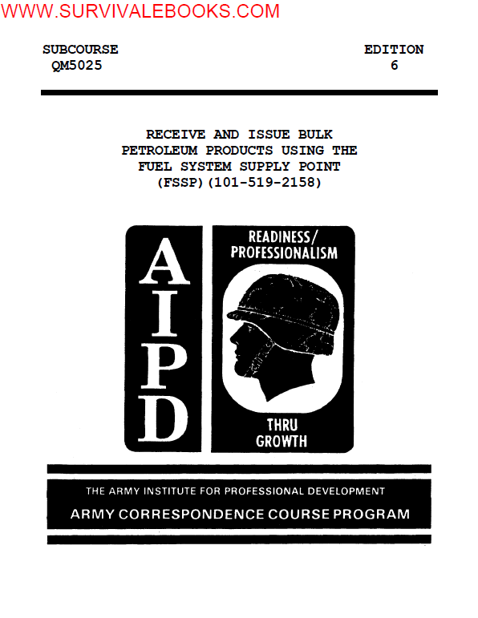

Slide 2
INTRODUCTION TO RECEIVE AND ISSUE BULK PETROLEUM PRODUCTS
USING THE FUEL SYSTEM SUPPLY POINT (FSSP)
The FSSP is the Army's primary means of receiving, storing, and issuing bulk
petroleum products to combat forces in the field.
RECEIVE AND ISSUE BULK PETROLEUM PRODUCTS USING THE FUEL SYSTEM SUPPLY POINT
(FSSP)
In Lesson 1, you will learn how to receive and issue bulk petroleum products
using the FSSP.
To understand the procedures for receiving and issuing bulk petroleum
products using the FSSP, you must be able to:
1. Follow correct safety precautions and layout procedures of the FSSP.
2. Receive bulk petroleum products using the FSSP.
3. Issue bulk petroleum products using the FSSP.

Slide 3
Learning Event 1:
FOLLOW CORRECT SAFETY PRECAUTIONS AND LAYOUT PROCEDURES
Safety Precautions
Whenever you are working with petroleum products, there is a risk of fire.
This danger can be reduced by following the proper safety precautions during
all phases of an operation. The primary precaution is to prohibit smoking
near the FSSP. Post "NO SMOKING" signs so that anyone entering or working
in the supply point can see the signs immediately. Do not let anyone carry
matches or other smoking materials into the supply point. Collect smoking
materials at the entrance checkpoint. Ensure that personnel smoke only in
designated smoking areas.

Slide 4
Place fire extinguishers at all receipt, storage, and issue points. All
fire extinguishers must be operational and inspected daily.
Ensure that all equipment is grounded. Follow proper grounding and bonding
procedures during fuel transfer operations.
If there is an enemy attack, electrical storm, or fire in the immediate
area, stop all operations immediately. Disconnect all pump hoses and move
all vehicles out of the area, if possible. If fire breaks out at the
manhole cover of a tank vehicle or the hinged dome cover of a rail tank car,
stop the transfer operation and close the manhole or dome cover. This will
extinguish the flames

Slide 5
Do not permit welding, open flames, or lights (other than approved
explosion-proof flashlights) within 100 feet of any receipt, storage, or
issue operation.
When operating a pump and you can see sparks, stop the pump and inspect all
grounding and bonding connections. Make sure the connections are bare
metal-to-metal contact. If you cannot find any faulty connections, look at
the power equipment in the area to find possible cause of stray current.

Slide 6
Maintain a distance of at least 25 feet between tank vehicles during receipt
or issue operations. Also, keep all tractors coupled to the semitrailers
while product is being transferred. This allows the semitrailers to be
moved quickly in an emergency.
The canvas top and rear curtain of the tractor must cover the driver
compartment when the vehicle is carrying, loading, or unloading product.
This keeps the inside of the tractor from being splashed with fuel.

Slide 7
Do not use nozzles that are equipped with locking devices. If you have a
nozzle that is equipped with a locking device, disable the locking device
before use. Ensure that nozzles are attended constantly when refueling.
Take all precautions possible to prevent spills. Use drip pans whenever
hoses are being connected or disconnected. Repair all leaks immediately.
If needed, replace defective hoses, gaskets, and valves.
All personnel must be properly trained and follow all safety precautions.
They must know how to properly administer first aid for fuel-related
injuries.

Slide 8
Layout Procedures
The FSSP consists of two 350 gallons per minute (GPM) pumping assemblies,
two 350-GPM filter/separators, six 10,000-gallon collapsible tanks, six
bottom-loading points for tank vehicles, two 500-gallon collapsible drumfilling
points, six refueling points for filling 5 gallon cans, 55 gallon
drums, and retail issues to vehicle fuel tanks. The system's components are
connected with approximately 2,400 feet of hose with 11 types of fittings.

Slide 9
The FSSP is designed to be flexible in its layout. The system's layout
depends upon the needs of the mission and the variables of the terrain. You
must lay out the system and identify the components needed. For example, if
your mission does not include filling 500-gallon collapsible drums, then you
do not include the filling points in your layout. The FSSP can be used for
receiving, storing, and issuing two types of fuel without using any
additional equipment. This is done by dividing the system into two smaller
components. By splitting your FSSP in half, you can also operate from two
different locations simultaneously. This method makes it easier to move and
keep up with advancing forces. By moving half of a system at a time, the
other half can stay in operation and be moved when the first half is
operational. This process is called "leapfrogging."

Slide 10
No matter how the system is laid out, certain requirements must be met.
Figure 1 lists the minimum distances that must be maintained between items
of equipment. Whether one pump or two are used as part of the same system,
there must be both a receiving point and an issue point. The receiving and
issue points are separated as much as possible to avoid congestion and
possible confusion.

Slide 11
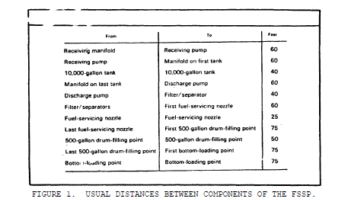

Slide 12
The basic setup for the tank manifold remains the same regardless of the
number of tanks used or the layout design. The manifold on each tank must
be assembled so that fuel can be received or issued, because the 10,000-
gallon collapsible tank has only one filler-discharge port. The basic
manifold for each tank is shown in Figure 2.

Slide 13
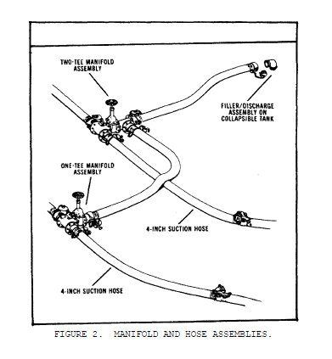

Slide 14
Various ways of laying out a complete FSSP are shown in Figure 3. Lay out
the system the best way possible for your specific situation.

Slide 15
After you decide how to lay out the system, you must prepare the areas where
the tanks will be positioned. Pick up all loose debris. Each collapsible
tank must be surrounded by a firewall (also called a berm). This firewall
must be large enough to contain the entire contents of the tank plus one
foot of freeboard (empty space). To meet this requirement, the firewall
must have an inside diameter of 26 by 26 feet. The firewall must be 3 feet
high and 18 inches wide at the top of the berm. Figure 4 displays a berm
construction.

Slide 16
When constructing the firewall, a water drain must be installed. This is
done by burying a section of hose at lowest point in the base of the
firewall. The drain is closed at all times except when draining the water
that has collected in the berm.

Slide 17
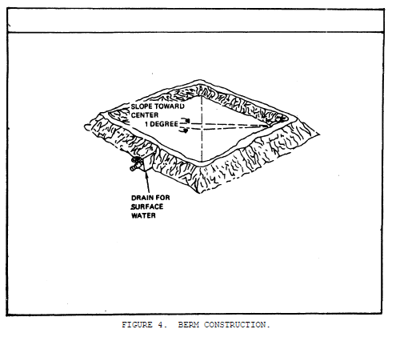

Slide 18
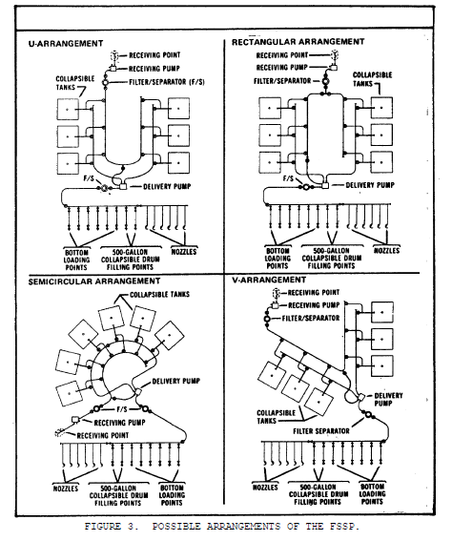

Slide 19
The area inside the berm are as level as possible with a slight slope of one
or two degrees toward the discharge assembly. The slope helps in emptying
the tanks. A hole, one foot deep, is dug under the discharge assembly for
use as a sump.
Use ground cloths to protect the bottom of the tank. These may be canvas
tarpaulins or unserviceable tanks. In some areas, ground cloths are
required to prevent possible ground contamination in case of leaks or tank
ruptures.

Slide 20
The filter/separators are placed in the system so that they can be bypassed
for maintenance. If you are using the complete system, place one separator
at the receiving side of the system and the other at the issue side.
Another alternative is to place both separators at the issue side and
connect the manifold so that if one is taken out of service the other can be
used. Filter/separators must be placed in the system to permit filtering of
fuel during tank to tank transfers.

Slide 21
When your personnel are laying out the hoses for the system, ensure that
they only remove dust caps and plugs when they are ready to make the
connection. After the connection is made, the dust plugs are placed inside
the dust caps to prevent contamination of the hoses. Place the connected
caps and plugs under the connection to raise the hose connection off the
ground and make it easier to spot leaks. Before the connection is made, be
sure the gasket in the female coupling is present and cam locks are
serviceable.

Slide 22
Learning Event 2:
RECEIVE BULK PETROLEUM PRODUCTS
Preliminary Procedures
To avoid interruptions and delays, prepare a receiving schedule. Before the
product arrives, you are notified of the type and amount of product as well
as the date and time of arrival.
Before receiving product, inspect pumps, filter/separators, hoses, valves,
and fittings for cleanliness and good working condition. Check your
collapsible tanks for cleanliness, damage, and available product space for
the receipt. Do this before any product arrives at your location.

Slide 23
When the transporter arrives, position it so there is no strain on the hose
connections. This is called "spotting." If unloading more than one
transporter at the same time, make sure they are at least 25 feet apart.
Bond and ground the transporter.
Compare the seal numbers on the transporters to the numbers on the shipping
documents to detect any tampering. If there is a broken seal or the seals
do not match the shipping documents, notify the proper authorities. Do not
unload or use the product until it has been gaged, sampled, and tested. If
seals are not used on a load, verify the quantity and quality before
loading.

Slide 24
Inspect the transporter for leaks. If the transporter is leaking, place a
drip pan to catch the leak and unload the fuel at once. Be sure to clean up
any spilled fuel immediately.

Slide 25
Unload Tank Vehicles
Before starting the unloading operation, make sure the vehicle and the major
components in the supply point are bonded and grounded. Place a drip pan
under the manifold of the vehicle before making any connections. Make sure
you have a fire extinguisher near the receiving point and you follow all
safety precautions.
Connect the suction hose to the discharge port of the vehicle. Assign
someone to watch the level of the fuel as the product is discharged from the
vehicle. Make sure the manhole stays open during the operation. Keeping
the manhole open prevents the tank shell from collapsing, if the vent valve
on the tanker does not work.

Slide 26
Open the discharge valves on the tank vehicle and the suction valve on the
350 GPM pumping assembly in the FSSP. Start the pump, and idle at the
appropriate speed for three to five minutes.
Lesson 1/Learning Event 2
Make sure the tanks have enough ullage (empty space) to receive the product.
While the pump is idling, open the manifold valves of the collapsible tank
to be filled. Make sure all the valves between the collapsible tank and the
vehicle tank are open except for the pump discharge valve.
When the pump warms up, slowly open the pump discharge valve. When the
discharge valve is fully open and the product is flowing, slowly increase
the pump speed to achieve the desired flow rate.

Slide 27
While the tank vehicle is being unloaded, check the hoses, valves, pump, and
receiving tank for leaks. Place a drip pan under any leak and stop the
operation immediately. Make any necessary repairs before continuing the
operation.
When the transporter is empty, idle the pump engine then close the discharge
valve. Allow the engine to idle for three to five minutes before turning it
off. Close the pump suction valve.
Close the manhole and all open valves and disconnect the suction hoses from
the transporter and the grounding wire from the vehicle. Have the vehicle
moved out of the area and prepare for the next operation

Slide 28
Unloading Tank Cars
You may be able to set up your FSSP close enough to a railroad track to
receive product by rail tank cars. This will allow larger shipments of fuel
and will allow other materials to be moved by vehicle on the main supply
route.

Slide 29
When receiving product from a rail car, use a standard car mover to spot the
rail car. After spotting, set the brakes and chock the wheels. Place the
signs reading "STOP-TANK CAR CONNECTED" between the rails at a distance of
at least 25 feet (50 feet is preferred) ahead and behind the rail car.
Ensure that the rails are grounded by connecting a wire to both tracks and
to a grounding rod. Position fire extinguishers at all unloading points and
have drip pans available. A cone shaped wooden plug is also required for
use in case the bottom outlet valve is open when the cap is removed.

Slide 30
When the rail tank car is in position and grounded, make a quick inspection
for leaks. If you receive a rail car that is leaking, place a drip pan
under the leak and unload the car as soon as possible. Perform the
preliminary steps to ensure that the product is suitable for use and has not
been tampered with.
Unload the rail tank car through the bottom outlet valve unless the valve is
broken or unless the proper adapter for the rail tank car is unavailable.
In these cases, unload the car through the dome with a suction hose.

Slide 31
When opening the manhole cover on the rail car, stand on the upwind side and
avoid breathing fumes. If possible, release internal pressure before
opening.
Check the size of the bottom outlet pipe and get the correct size adapter.
If you are using the adjustable (Gossler) coupling, the size is not
important. Outlet pipes vary in size from four to six inches so it is
important to use the correct size adapter.
Connect the suction hose to the adapter and open all valves to the pump
suction (Figure 5).

Slide 32
Open the pump suction valve and start the pump. Idle the pump for three to
five minutes. While the pump is idling, open the valves between the pump
discharge and the receiving tank. Have one person monitor the fuel level in
the tank car as it is unloaded.
When the pump engine warms up, slowly open the discharge valve. Increase
the pump speed to the desired flow rate. While transferring the product,
make sure the during-operation maintenance is performed by the pump
operator. Also ensure that all hoses, valves, and the tank receiving the
product are checked for leaks.

Slide 33
If a leak is found during unloading, place a drip pan under the leak and
stop the operation. Make the necessary repairs before resuming the transfer
operation.
When the rail tank car is empty, slow the pump engine to idle speed and
close the pump discharge and all other valves. Allow the pump to idle three
to five minutes before shutting it off and closing the suction valve.
Close the bottom outlet valve on the rail tank car. Disconnect the suction
hose from the rail car and remove the adapter. Replace the outlet cap, and
close the manhole cover.

Slide 34
On all sides of the rail car are diamond shaped cards that say "FLAMMABLE".
Remove these cards and replace them with "DANGEROUS EMPTY" cards. (NOTE:
Some cards are printed on both sides in which case you flip them over.)
Disconnect the grounding wire from the rail car, release the brakes, remove
the chock block, and move it from the transfer area, or notify the proper
authorities that the car is ready to be removed.

Slide 35
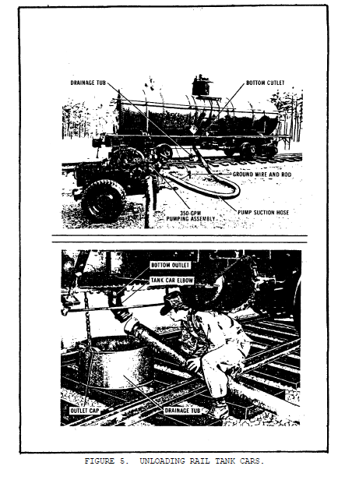

Slide 36
Receipt of Product Through the Assault Hoseline
In some cases, you may receive product into your FSSP by the assault
hoseline. As with the rail tank car, this has the advantage of freeing up
the main supply route for other types of supplies. An added advantage is
being able to receive more product into your system, assuming there is an
adequate source at the other end of the hoseline.

Slide 37
The assault hoseline usually connects directly into your manifold system on
the discharge side of your receiving pump. Figure 6 depicts the assault
hoseline attached to the FSSP. You can connect the assault hoseline to a
50,000-gallon collapsible tank with this setup.
You must have good communications with the pump stations on the hoseline.
You must maintain constant contact with the pump station upstream to prevent
overfilling and rupturing of your collapsible tanks.

Slide 38
You will receive pumping orders before the operation begins. Pumping orders
tell you when the operation begins, how much fuel you are to receive, and
how long the pumping operation will take. After receiving the pumping
order, ensure that you have enough ullage to receive the quantity
designated. You may want to transfer product from partially filled tanks to
consolidate the fuel on hand. Doing this can reduce the number of tank
switches required during the receipt.

Slide 39
Once you have decided which tanks are to receive the product, then you can
determine which valves need to be opened. Remember when you are switching
tanks to open the valves to the next tank before closing the valves of the
first tank. Failure to follow this procedure results in overfilling and
rupturing the tank.

Slide 40
When it is time for the operation to begin, open the valves necessary for
the receipt, except for the valve connecting the hoseline to the FSSP.
Notify the pump station upstream that you are ready to receive. The pump
station operator tells you when to open the final valve and begin receiving
product.

Slide 41
When the product starts arriving in the FSSP, check hoses and valves for
leaks. Observe the collapsible tank to be sure that you are receiving the
fuel, send out a patrol to inspect the hoseline for leaks, damage, and signs
of tampering or sabotage.
If you are receiving a large amount of fuel into the FSSP, more than one
tank is required. When a receiving tank is almost full, open the valve
necessary to start the flow of product into the next tank. With product
flowing into both tanks, wait until the first tank is completely filled
before closing the valve to allow flow into the new tank. Continue in this
manner until you have received the entire quantity.

Slide 42
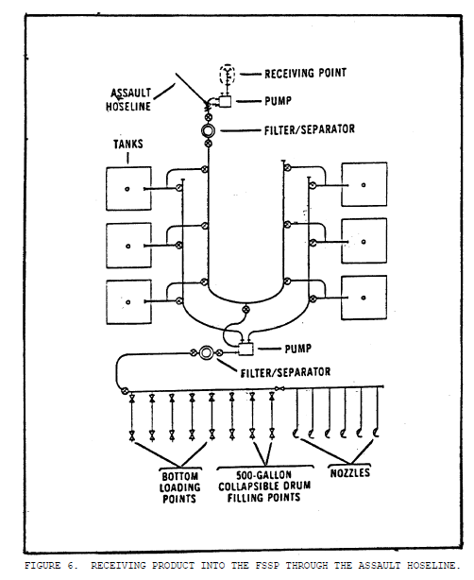

Slide 43
If you are receiving product until your tanks are full, it is your
responsibility to notify the pump station operator when to shut down the
operation. Remember that you must stop the flow gradually. If you are
receiving a specific amount, the pump station operators notifies you when
they begin shutting down.
If at any time during the receipt there is a fire, enemy attack, or other
emergency, notify the pump station operator and shut down the operation
immediately.
After the receipt is completed, close all valves, perform after-operation
maintenance, and prepare for the next operation.

Slide 44
Learning Event 3:
ISSUE BULK PETROLEUM PRODUCTS
Preliminary Procedures
Issuing bulk petroleum is perhaps the most important responsibility you have
at the FSSP. You are in the field to provide the consuming units with fuel
to perform their mission. In the theater of operations, you issue fuel in
bulk as far forward as possible. Usually, the units you support picks up
the bulk petroleum from you in their organic vehicles; however, you may
sometimes have vehicles assigned to your unit for delivery to the units.

Slide 45
Prepare an issue schedule before any transporters arrive at the FSSP. Start
by telling your customer what type and how much fuel you have on hand. Then
tell the customer when to pick up the product at your facility. If your
transporters are delivering the product, tell the customer when to expect
delivery so he can prepare for its arrival. Try to avoid delays and
interruptions when scheduling issues. In other words, do not have more
transporters at your supply point than you can handle at one time. Also,
make sure you have enough product on hand to fill all the requests.

Slide 46
Inspect your pumps, filter/separators, collapsible tanks, hoses, manifolds,
valves, and fittings to make sure that they are free of leaks and
contamination.

Slide 47
Loading Tank Vehicles
When the transporter arrives at the FSSP, position it at an issue point.
Attach a ground wire to the transporter. Open the manholes or dome cover
and inspect the transporter. (NOTE: The following inspection can be
performed at the entrance checkpoint.)
Check the inside and outside of the tank for holes, cracks, or loose plates.
Make sure there are no leaks in the tank. The tank must be properly mounted
to the frame and safe for the road.

Slide 48
Inspect the interior of the tank. If you see any residue such as rust,
sand, or dirt, reject the transporter and have it cleaned.
Check the interior of the tank for foreign objects such as tools, bolts, or
old seals. Have authorized personnel remove objects from the tank

Slide 49
Connect the discharge hose to the receiving port of the vehicle. Three
soldiers are needed to load a tank vehicle. Assign one to watch the product
as it enters the tank, so that you do not overfill the vehicle. In addition
to the person on the vehicle, there must be one person at the vehicle valves
and one person at the pump. Coordination between them is important to avoid
overfilling.

Slide 50
Open the receiving valves on the vehicle and the manifold valves on the
collapsible tank supplying the product. Make sure all other valves between
the collapsible tank and the tank vehicle are open. Open the suction valve
on the 350-GPM pump assembly and start the pump. Idle the pump three to
five minutes to allow the pump to warm up.

Slide 51
Open the discharge valve on the pump and slowly increase the engine speed
to obtain the desired pumping rate. Pump at this rate until the vehicle
tank is three-fourths full, then reduce the engine speed and continue to
pump until the vehicle is full. Idle the pump and close the discharge
valve. Be sure to allow the pump engine to idle for three to five minutes
before shutting it off. Close all valves that were opened for the transfer
operation and disconnect the discharge hose from the tank vehicle.

Slide 52
The product must stand for 15 minutes to allow suspended water and sediment
to settle and to dissipitate any static electricity in the product. The
vehicle must then be gaged and have a sample drawn.
Close the manhole covers, remove the drip pan, and disconnect the bonding
and grounding wires from the vehicle. Put a seal on the manhole cover and
the bottom outlet. Write the serial numbers on the transfer documents.
Have the transporter moved out of the area and prepare for your next
operation.

Slide 53
Loading Rail Tank Cars
There may be times when you issue products into rail tank cars from your
FSSP. This has the advantage of being able to move large quantities of fuel
to a forward location without adding to the traffic on the main supply
route.
Always load a tank car through the bottom outlet unless the bottom outlet is
broken or the correct adapter fittings are unavailable. When unable to use
the bottom outlet, load the tank car through the dome. Loading through the
bottom outlet is far better because it prevents vapor formation, reduces
static electricity, and protects the fuel against contamination from outside
sources. Follow the safety precautions outlined in Learning Event 2.

Slide 54
After you have inspected the tank car and you are sure it is in good
condition, ensure that the track rails are properly bonded and grounded.
Inspect the mechanical or cable connections to make sure they are secure and
make a bare metal-to-metal contact. The rail car and all the major
components in the supply point must be bonded and grounded.
Place a fire extinguisher near the tank car. Make sure it is easy to see
and reach. Put a drip pan under the bottom outlet of the tank car. Connect
the discharge hose to the bottom outlet with the tank car elbow and
necessary fitings from the FSSP. Station someone on the upwind side of the
dome to signal when the product reaches the full mark.

Slide 55
Open the bottom outlet valve on the tank car and the manifold valves on the
collapsible tank supplying the product. Make sure all the other valves
between the tank car and the collapsible tank are open. Open the suction
valve on the 350 GPM pumping assembly. Start the pump engine and allow it
to idle for three to five minutes.
Open the discharge valve on the pump and then increase the speed to the
desired flow rate. Have the person on the tank car check the product level
in the rail car often to avoid overfilling, but never allow him to put his
head inside the dome of the tank. When the tank car is three-fourths full,
reduce the pumping rate and continue pumping until the product reaches the
full mark. If the tank car has no full mark, fill it to the top of the tank
shell.

Slide 56
Idle the pump engine before quickly closing the discharge valve and the tank
car bottom outlet. Allow the pump engine to idle for three to five minutes
before turning it off. Next, close the manifold valves on the collapsible
tank and suction valve on the pump. Close all other valves that were opened
for the transfer, and disconnect the discharge hose and elbow adapter from
the tank car.

Slide 57
Replace the bottom outlet cap after inspecting the gasket. Replace the
gasket if necessary. The product must stand for 15 minutes to allow
suspended water and sediment to settle and to dissipitate any static
electricity in the product. The rail car is gaged and a sample drawn.
Close and lock the dome cover and place seal numbers on the shipping
documents. Release the brakes and remove the tank car from the issue point.
Change the cards on the sides of the rail car to read "FLAMMABLE."
The procedures for loading a tank car through the dome are almost the same
as those for bottom loading. You operate the pump the same way and perform
the same preliminary, safety, and follow-up procedures. The only difference
is that you place the discharge hose in the dome instead of attaching it to
the bottom outlet.

Slide 58
The discharge hose is placed through the dome until it almost touches the
bottom of the tank. If you do not put the hose far enough into the tank,
the product splashes and gives off excessive amounts of vapor. This creates
a potential fire hazard.
Make sure there is no strain on the hose, or it may move and come out of the
tank during the transfer operation.

Slide 59
Always station someone on the dome to monitor the hose and signal when the
tank car is full.
Start the filling at a reduced rate until the end of the hose is completely
submerged in the fuel. Wait at least five minutes after the filling stops
before removing the hose. This wait reduces the chance of static
electricity arcing when the hose is removed from the fuel.

